Slide 1
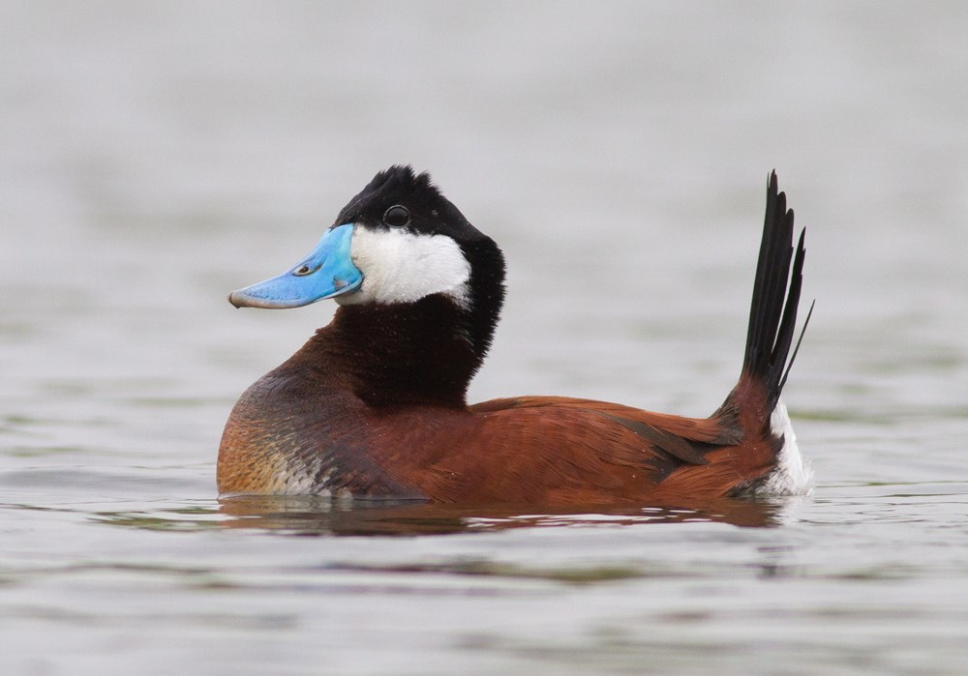
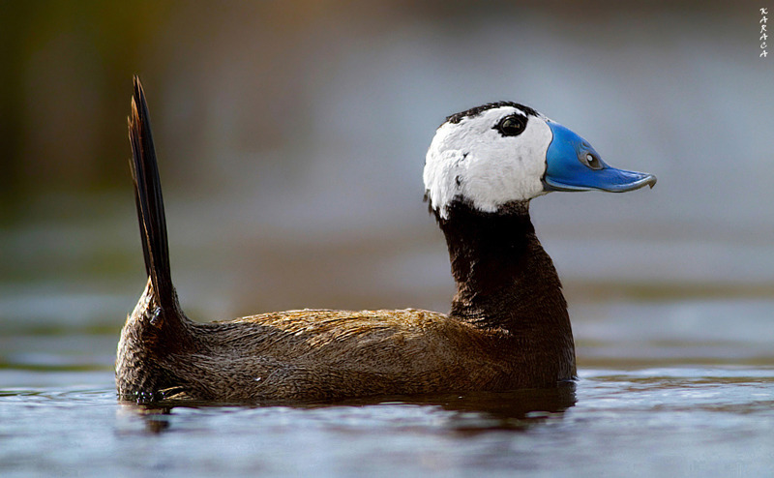
Eradicating Ruddy Ducks in the Western Palaearctic
Progress update 2021
Peter Cranswick & Colette Hall
Notes:
Ruddy Duck is an introduced species in Europe. A large population became established in the UK in the 1990s, and from there spread to many countries across Europe. It became the main threat, through hybridisation, to the native White-headed Duck.
The Bern Convention has long championed the eradication of the Ruddy Duck. An action plan was developed in the 1990s and has been updated every five years, most recently in 2020.

Slide 2
Recommendation No 209 (2020) of the Standing Committee
All Contracting Parties to implement without delay the actions specified in the ‘Action Plan for the Eradication of the Ruddy Duck, 2021–2025’
Goal – Ruddy Ducks stop being a threat to the White-headed Duck
Outcomes
Ruddy Duck is functionally extinct in the wild in the Western Palaearctic by 2025
Progress is regularly assessed and adaptively managed
Contracting Parties coordinate their activities to collectively achieve the plan’s outcomes and targets
Notes:
In the third decade of eradication, one of the aims of the plan – eradication in the wild – is within reach.
The outcomes of the latest plan reflect that eradication in the wild is achievable in the current plan period In this final stage, we will actively track progress – each year checking that the plan remains on course, identifying problems as soon they arise, so they can be solved quickly.
This is of paramount importance as we reach the closing stages – collective actions need to be coordinated and synchronous if the plan is to succeed.

Slide 3
Recent
means & estimates
 | winter | summer | breeding pairs
 | 14/15-18/19 | 2015-19 | 2015 | 2016 | 2017 | 2018 | 2019
FR | 159 | 116 | 40-60 | 40-60 | 30-40 | 30-40 | <30
NL | 70 | (34) | 13 | ? | ≥4 | ≥6 | ≥12
UK | 46 | 33 | 5 | 7 | 7 | 2 | 2
BE | 6 | 18 | 0 | 1 | 1 | 1 | 0
Notes:
At the end of last plan period (2 years ago) –
Roughly 250 birds in total, breeding in four countries
Primarily in FR, smaller numbers in NL, lower still in UK and BE
We now know there are also small numbers in Germany

Slide 4
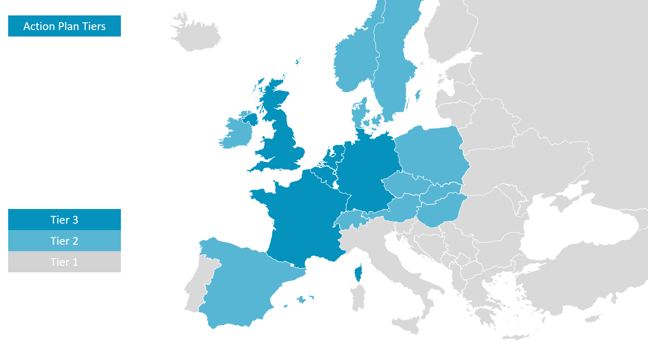
Notes:
For the current plan, CPs are placed in Tiers, requiring different actions relevant to their situation –
Tier 3 – are those with breeding and/or significant numbers of Ruddy Ducks – these countries need proactive control programmes
Tier 2 – are those at significant risk of birds arriving from Tier 3 countries – requiring reactive control
Tier 1 – all other CPs – who actively monitor
To assess progress this year, a questionnaire was sent to all CPs – responses were received from 19
A meeting was held of Tier 3 countries for adaptive management – technical experts from the five countries reviewed progress and identified any issues so these could be addressed immediately to ensure the plan meets its goal

Slide 5
Numbers of individuals
Tier 3 | winter 2019/20 | summer 2020 | winter 2020/21 | summer 2021
BE | 8 (6) | 8 (6) | 5 (2) | 6 (5)
FR | c60 (-) | ? | c15 (-) | ?
DE | 13 (11) | 9 (9) | 12 (10) | 5 (4)
NL | 100–120 (15+) | 80+ (30+) | 100–120 (15+) | 75+ (28+)
UK | 12 (12) | 12 (12) | 14 (8) | 14 (14)
Tier 2 – found in only four CPs
Tier 1 – found in only one CP
Notes:
Figures are the number of individuals, and the number of sites on which they were found is given in brackets
There are obvious positives to report: we have information from all key countries (now including Germany) and are genuinely closing in on the goal of eradication in the wild. In particular, efforts in France in recent years, as part of a Life Project, have brought about a very large reduction there.
Numbers in four of the five Tier 3 countries are now very low – fewer than 20 in each. The overall population is between 150 and 175 birds. At least two thirds of those are in the NL.
Very few are seen elsewhere – generally just single birds for short periods. These are assumed to be wanderers from Tier 3 countries.

Slide 6
Breeding pairs
Tier 3 | 2020 | 2021
BE | 0 (0) | 0 (0)
FR | 2–3 (-) | 2–3 (-)
DE | 1 (1) | 0 (0)
NL | 20+ (13+) | 22+ (15+)
UK | 2 (2) | 0 (0)
 | 2015 | 2016 | 2017 | 2018 | 2019
NL | 13 | ? | ≥4 | ≥6 | ≥12
Notes:
Figures are the number of breeding pairs, and the number of sites on which they were found is given in brackets
These figures are even more pertinent. Numbers are now very low. The number of individual birds in each county is much higher, but if those individuals are widely spread, they do not meet up to breed, which is reflected in these figures. Even without control, if they do not breed, naturally, the population will go extinct.
This is close to being the case in the UK – there are 15 birds, but so thinly scattered that in some years there is no breeding
The key concern is the significant numbers of birds still breeding in NL. In the last plan period, there were around 10 breeding pairs in NL – numbers are now at least double that.

Slide 7
Numbers controlled
Tier 3 | 2020 | 2021
BE | 2 (2) | 1 (1)
FR | 60 (-) | ?
DE | 1 (1) | 0 (0)
NL | 33 (7) | 19 (4)
UK | 1 (1) | 0 (0)
DK – 6 (2) and 9 (4)
Notes:
The largest numbers controlled were in FR and NL.
Control becomes harder as the population gets smaller – hence the small numbers shot in other countries.
It will be hard to control every last bird, particularly when lone birds are spread widely – an individual bird can easily be overlooked, and then controlling those individuals is even harder. But controlling every last bird may not be necessary to bring about functional extinction.
The only birds controlled elsewhere were in DK – those birds have come from other countries, probably from NL

Slide 8
Meeting of Experts (Tier 3) – conclusions
BE – control is effective, numbers are small; birds are likely from NL
FR – enormous progress, few birds remain, functional extinction is expected; control expected to continue after Life project ends
DE – monitoring is in place; numbers small, sporadic breeding; control is patchy
UK – control is effective; few birds, widely spread, on verge of functional extinction
Notes:
Tier 3 countries met to review progress in more detail
Four countries are in similar position – numbers are low, and measures are mainly in place
There is a need to maintain the programmes in these countries, but eradication is within reach

Slide 9
Meeting of Experts (Tier 3) – conclusions
The Netherlands –
Control measures and structures are in place
But numbers are >100 birds and >20 breeding pairs (an increase)
Numbers controlled are much smaller than required
The problem – delegation to Provinces and overcoming political issues locally
Functional eradication will not be achieved
Consequences
NL has two-thirds of European population, and great majority of breeding birds
NL is the likely source of birds elsewhere (BE, DK, DE, even CH?)
Notes:
Local issues are, in particular, access to sites and concerns over public safety
Note, this problem originally began with around six birds – a few pairs in the same location. That was sufficient to create a European population. It has cost many millions in both UK and FR to reach the point where we are today.
While significant numbers of pairs continue to breed in NL, Europe still has a viable population: numbers are increasing, and birds spread to surrounding countries.

Slide 10
Meeting the goal
Eradication is in reach, realistic and achievable
Local political issues are common and have been overcome elsewhere
Progress required
Reduction in numbers of c50% each year for 3–4 years
Numbers shot – c100 next year
This is achievable – UK and FR achieved this with much bigger populations
Notes:
The key remaining challenge is primarily in just one Contracting Party, and seems to be just one hurdle – this is now pivotal to the success of the whole plan
To bring about eradication requires a reduction of around 50% each year over 3-4 years
Based on experience from UK and FR, that requires the numbers shot to be similar to the peak winter count - so, in NL, around 100 birds should be controlled next year
This is achievable – this is what UK and FR did, with much bigger populations

Slide 11
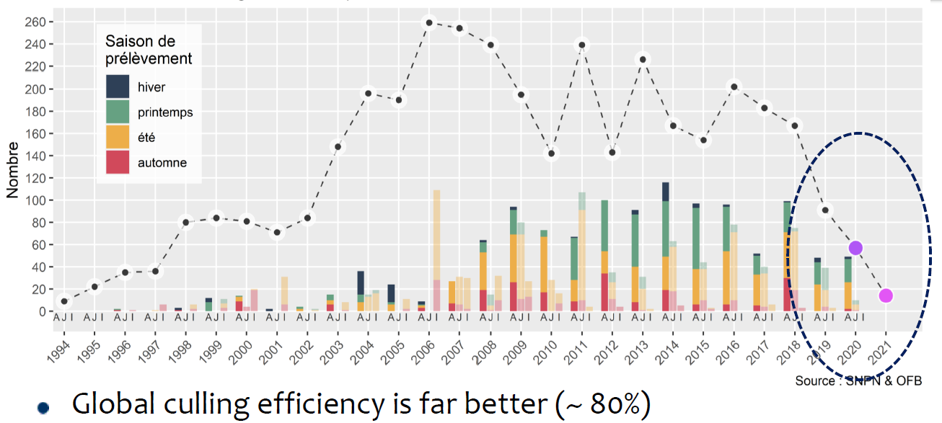
Notes:
To illustrate this control in France
A large reduction has been achieved in the last three years –
Three years ago, the wintering total was c170 – adding the numbers of adults and juveniles that were controlled, around 170 birds were shot. That brought about a 50% reduction in the population.
The next year, the population was around 90 birds, and 90 were shot. Then 60 birds were counted, and 60 birds were shot. Each time, reducing the population by around a half.
The remaining need is to control 120 birds in NL. This is achievable.
The success of the plan hinges on this.

