Slide 1



Council of Europe
Strategy & Standards on Children in Migration Context
@CoE_children
#CoE4Children
children@coe.int

Slide 2

Building a Europe for and with Children
Council of Europe Strategy for the Rights of the Child (2022-2027)
Freedom from violence for all children
Equal opportunities and social inclusion for all children
Access to and safe use of technologies for all children
Child-friendly justice for all children
Giving a voice to every child
Children’s rights in crisis and emergency situations

Slide 3

Building a Europe for and with Children
Council of Europe’s Standards on Children in Migration Context
ECHR and Lanzarote Convention
Three Recommendations of the Committee of Ministers of the Council of Europe addressing the situation of children in migration context

Slide 4

Building a Europe for and with Children
Recommendation on age assessment and Explanatory Memorandum
Human rights principles and guidelines on age assessment in migration context
Presumption of minority, evidence-based multidisciplinary approach, medical examination if reasonable doubt, reasoned decision and remedies
Case law of the ECtHR.

Slide 5
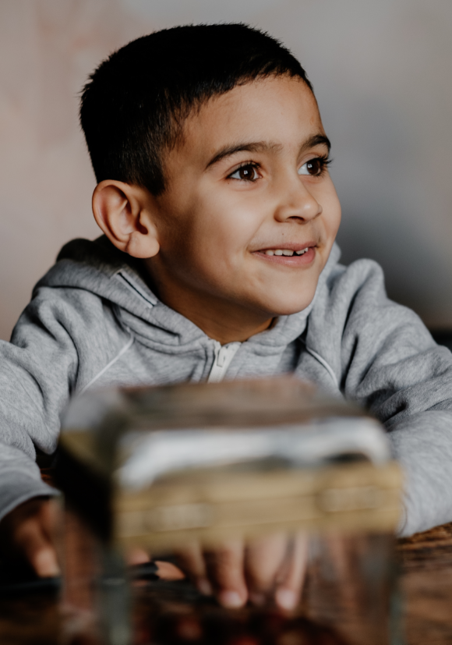
Building a Europe for and with Children
Recommendation on effective guardianship and Explanatory Memorandum
Promoting good practices
Appointment of guardians without delay, legal responsibilities and tasks of guardians, access to child-friendly information, justice and remedies, institutional measures, training
Good practice: project in Armenia.

Slide 6

Building a Europe for and with Children
Recommendation on life projects
Sustainable and durable solutions and effective integration of children
Individual tools defining minor’s future prospects, integrated policy tool, mutual agreement between children and authorities
Good practice: NGOs’ initiative.

Slide 7
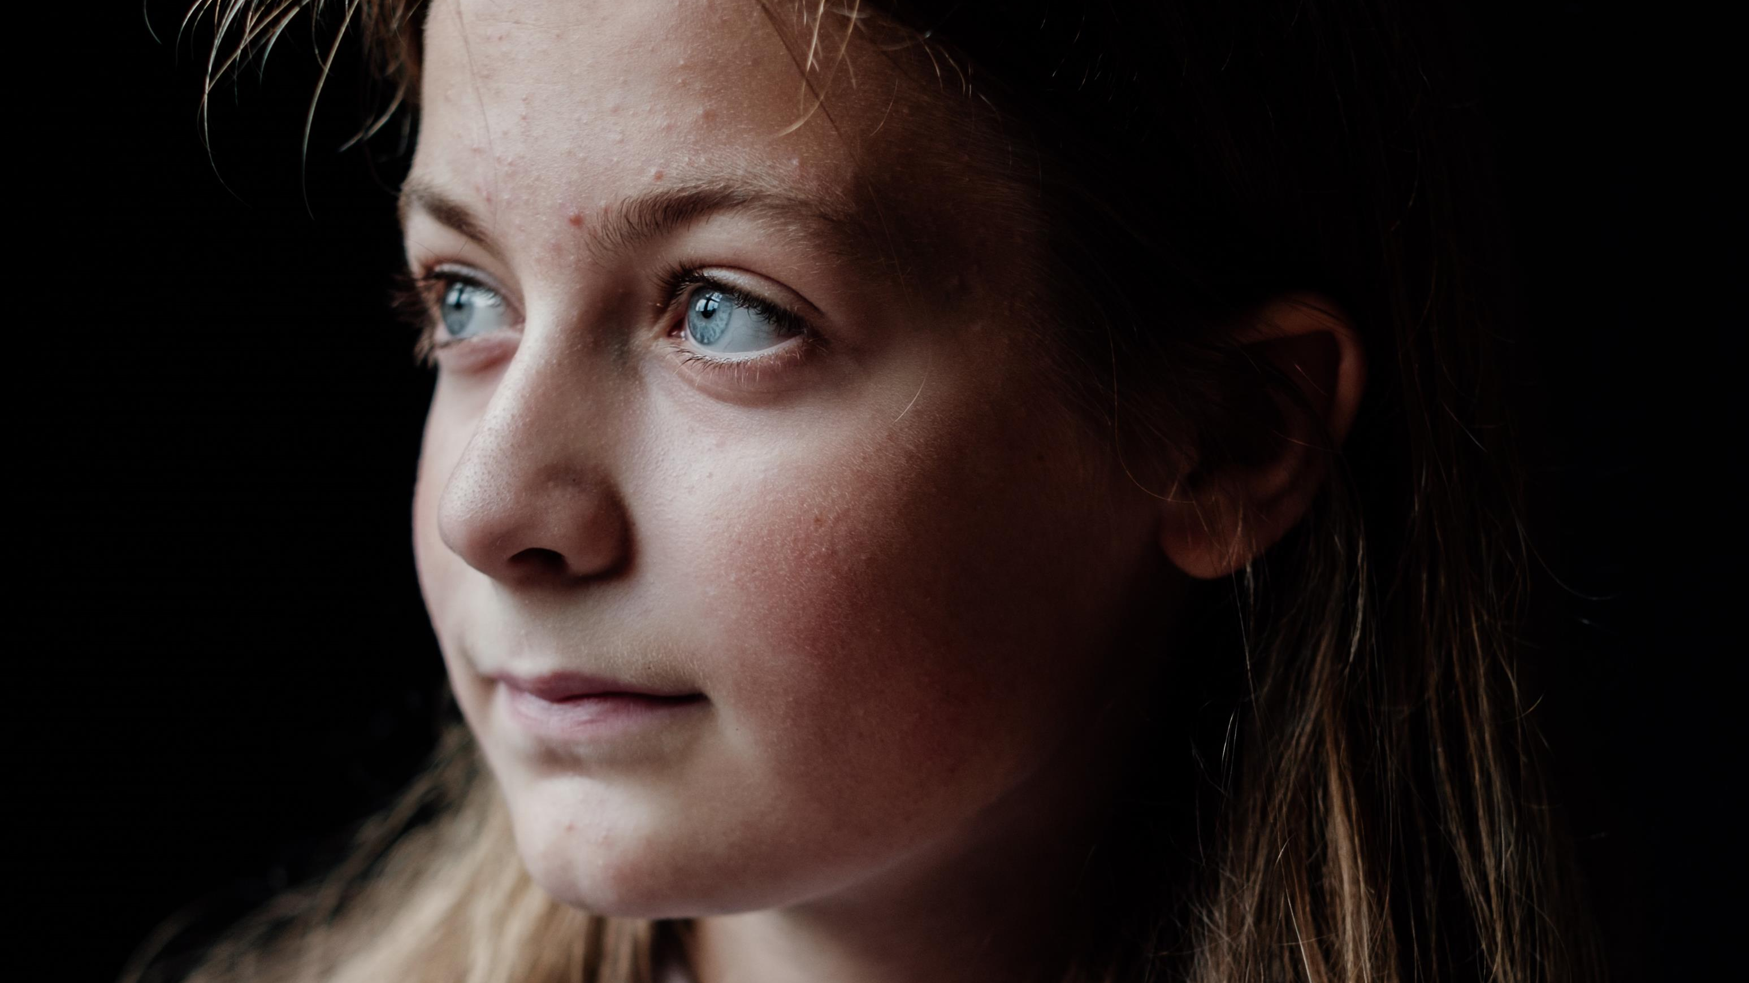

Thanks for your attention ☺
For more information :
https://www.coe.int/web/children
children@coe.int
@CoE_children #CoE4Children

