Slide 2
Assessing whether hate speech will spread Victoria Carasava ActiveWatch

Slide 3
Assessing whether hate speech will spread
The importance of pre-identifying hate storms
Methodology
Case study: Romania
Case study: Germany
Case study: Italy
General Conclusions and Recommendations

Slide 4
The importance of
pre-identifying hate storms
There are 3 main ways through which activists can tackle online hate-speech
Taking action against the speaker (administrative, civil or criminal proceedings)
Censoring expressions
(deleting content)
More communication
(counter or alternative narratives)

Slide 5
The importance of
pre-identifying hate storms
Out of these three, choosing to communitate more can be the most effective method:
It changes/influences the perspective of the audience
It does not turn the hater into a martyr
It has a longer-term impact

Slide 6
The importance of
pre-identifying hate storms
An “early warning” system for an upcoming hate storm could increase activists’ chances of deploying:
The right narrative
At the right time
To the right audiences
However, employing counter and alternative narratives successfully is dependent on:
The experience and skills of the activist
Timing and beliefs of the audience

Slide 7
Methodology
Data collection period
Spring—Summer 2020
Country-specific data for
Romania
Italy
Data analysed
Social media posts about events concerning social groups that are usually targeted by hate-speech
Social groups targeted by hate-speech
Germany
Roma people
Sexual and gender minorities
Jewish people
Muslim people
Hungarian minorities (for Romania)

Slide 8
Methodology
Each of the events was described based on:
Scope of the event (local / regional / national / European / other)
Materialized threat generated by the event
Description (what happened)
Perceived threat generated by the event
Number and characteristics of the direct victims of the event
Characteristics of the people pictured by the hateful narratives as the (potential) aggressors involved in the event
The context in which the event took place

Slide 9
Methodology
The public discourse on social media related to each of the identified events was coded based on the following characteristics:
The approximate number of the social media posts covering the event (the extent of the coverage)
The extent to which the social media posts that were identified contained hate speech
The most probable audience of the messages (only in those cases in which this was possible to infer)
The rate at which the comments to the social media posts contained hate speech
The extent to which counter and alternative narratives were deployed
The types of influencers involved in generating negative emotions towards the groups targeted by hate speech

Slide 10
Case Study
Romania
73 events identified and analysed
Mostly on Facebook
Generated houndreds of posts and thousands of comments
Findings are highly contextual

Slide 11
Case Study
Romania – Percieved Threat
Posts concerning the LGBT community more likely to get shared by larger number of people
likely to attract more hate in the comments but also more CAN messages
threats of cultural changes or changes to the way of life
Events relating to Roma ethnics
generated most hate when the perceived threat had to do with depictions of theft or acts of physical violence.
Posts about the Hungarian minority
concerns expressed were related to the possible discrimination of Romanian ethnics in the areas where Hungarians represent a local majority.

Slide 12
Case Study
Romania – Localization
Posts concerning the Roma community
Events taking place at the local level were more likely to generate comments containing hate speech
For the Hungarian minority
Events taking place at a local level generated the most hateful posts and comments
In the case of the LGBT community
Events taking place outside Romania (either in the EU or elsewhere) more likely to generate hate speech.
What this suggests is that the proximity of the events to the readers strongly influence their likelihood to be emotionally triggered and to engage in hate speech.

Slide 13
Case Study
Romania - A surprising finding
The levels of hate speech were not influenced by whether an event involved concrete antisocial acts or not.
This confirms once again that hate speech tends to be motivated not by facts but by subjective perceptions.

Slide 14
Case Study
Romania - Recommendations
Romanian activists should pay special attention to:
Events taking place at a local and national level; for the LGBT community, special attention should be paid to the international level;
Given that hate speech tends to be more prevalent in the user generated comments to posts on social networks, the managers of these accounts should allocate more resources for content moderation activities.

Slide 15
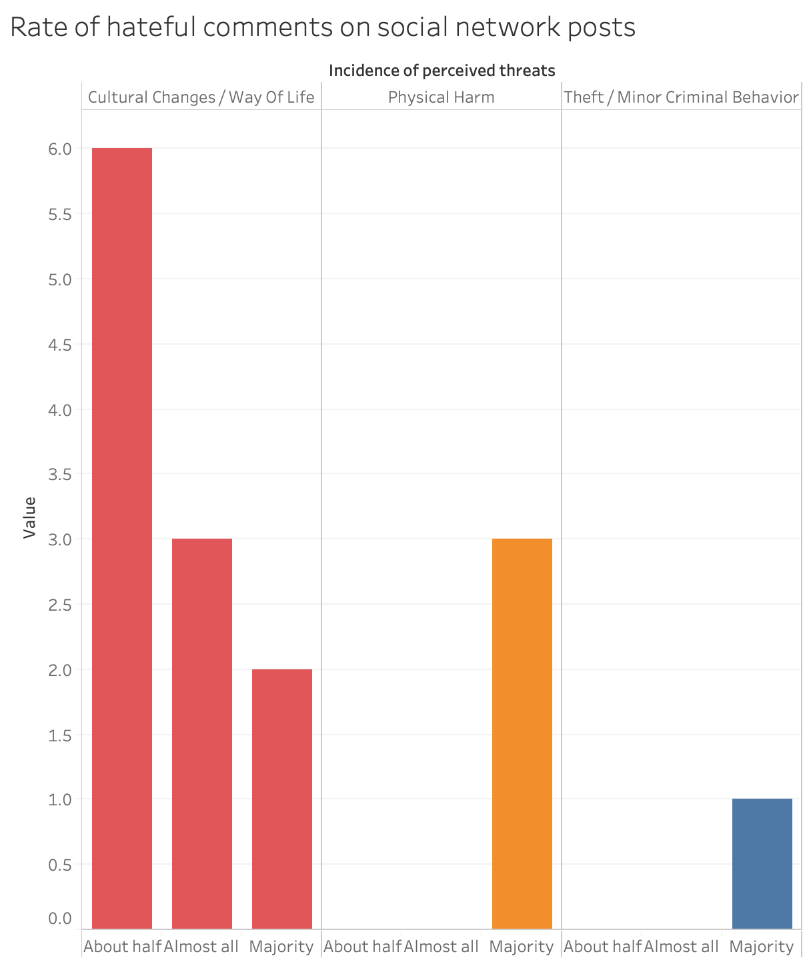
Case Study
Germany – Perceived Threat
15 events occuring mostly in spring 2020
These events generated multiple posts on social networks (mainly on Facebook and Twitter) and hundreds of comments.
Perceived threat
Most of the events were susceptible to primarily generate fear regarding cultural changes or changes to the way of life in Germany (11 out of 15 events).
Concrete antisocial acts or behaviors were observed in only one event out of the 15 we have analyzed.

Slide 16
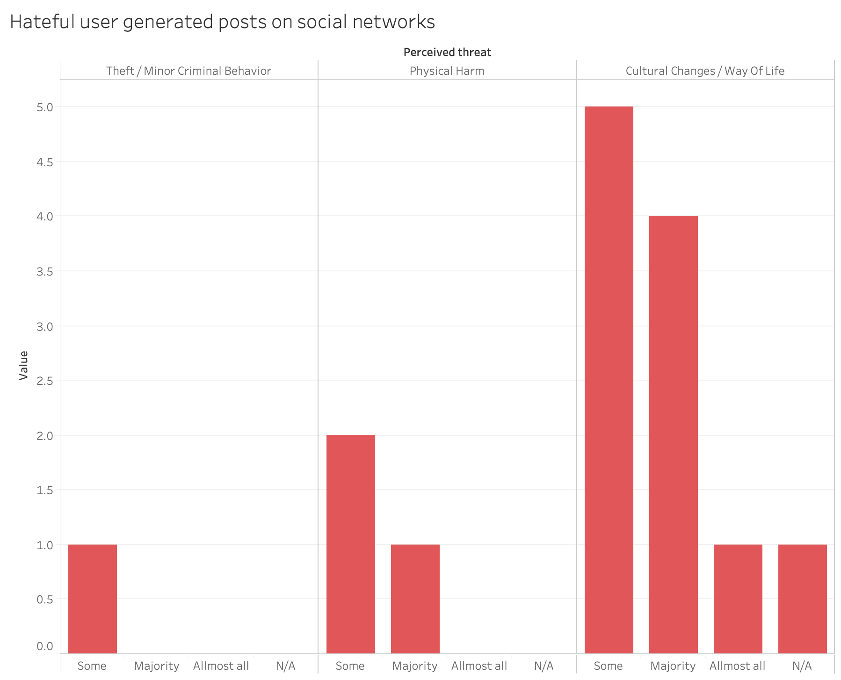
Case Study - Germany
Perceived Characteristic
1/3 of the events involved refugees
2/3 of the events involved minorities, either historical or more recent
Out of the 15 events, 9 had the potential to generate hate speech against people based on their ethnicity and 5 based on their religion.
Localization
Almost 2/3 of the events at a national level
Almost 1/3 of the events at the European level

Slide 17
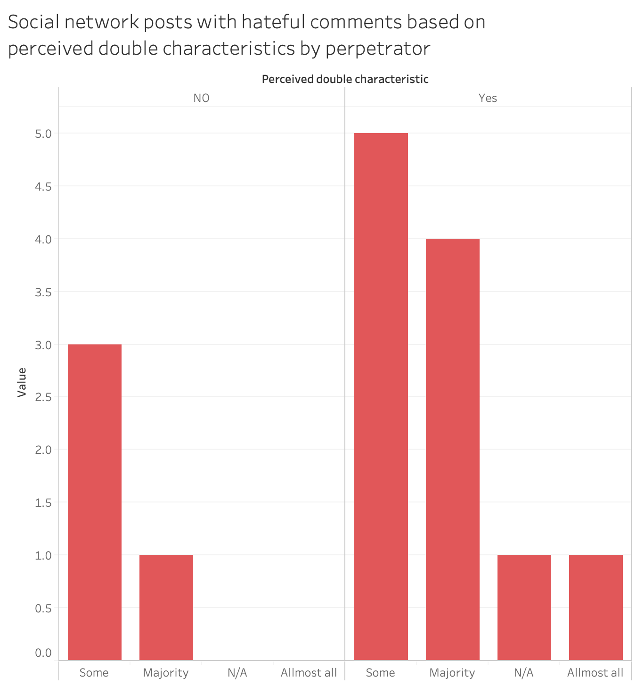
Case Study
Germany - Recommendations
German activists should expect higher volumes of hate speech:
From events taking place at a national level,
Involving refugees or asylum seekers,
Involving people belonging to more than one group vulnerable to hate speech.
Particular attention should be paid to events that can consolidate the fear of threats to the current way of life in Germany or of cultural changes.

Slide 18
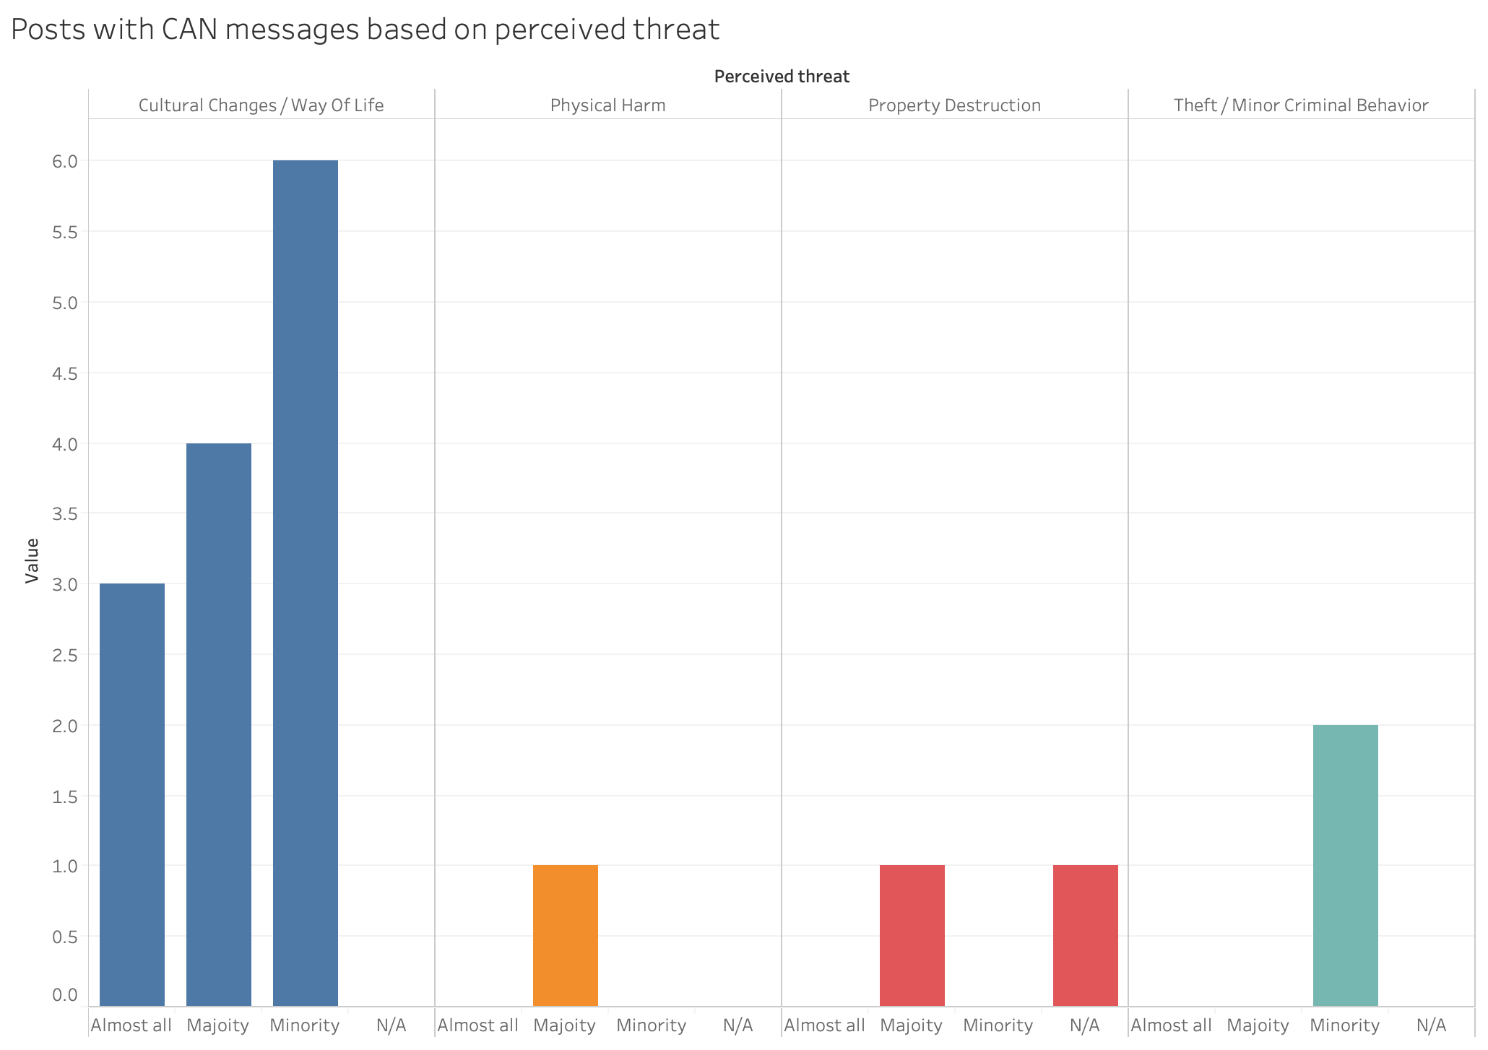
Case Study - Italy
21 events between March and September 2020
These events generated hundreds of posts on social networks (mainly on Facebook and Twitter), which generated thousands of comments.
Perceived Threat
the most common type of threat was fear about changes to the current way of life in Italy or fear of cultural changes (16 events)
fear of property destruction (2 events)
fear of theft/other minor criminal behavior (2 events)
fear of physical harm (1 event).

Slide 19
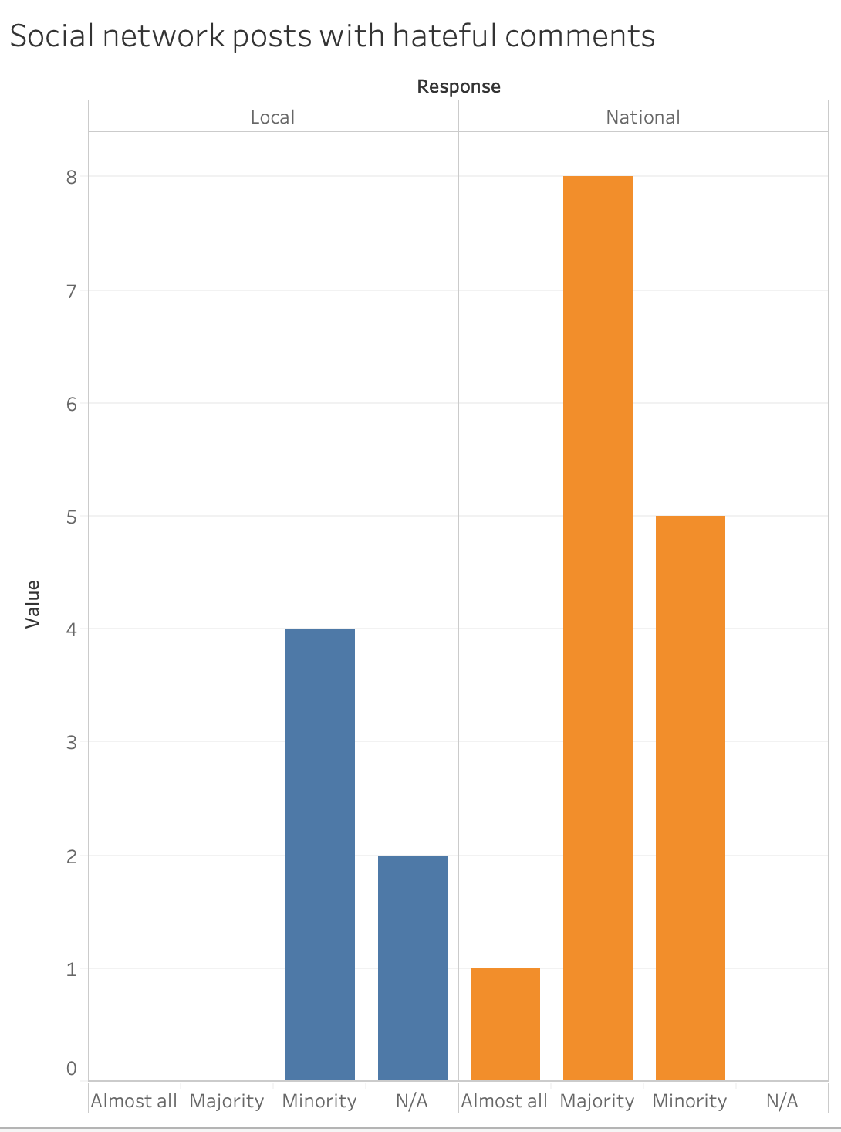
Case Study - Italy
Perceived Characteristic
race (8 events)
ethnicity (5 events)
gender (4 events)
sexual orientation (2 events)
age (1 event).
Localization
at a national level (14 events)
at a local level (4 events)
In strong contradiction to the findings in Romania and Germany, hate speech was frequently found in the posts discussing the events, as in the comments to these posts

Slide 20
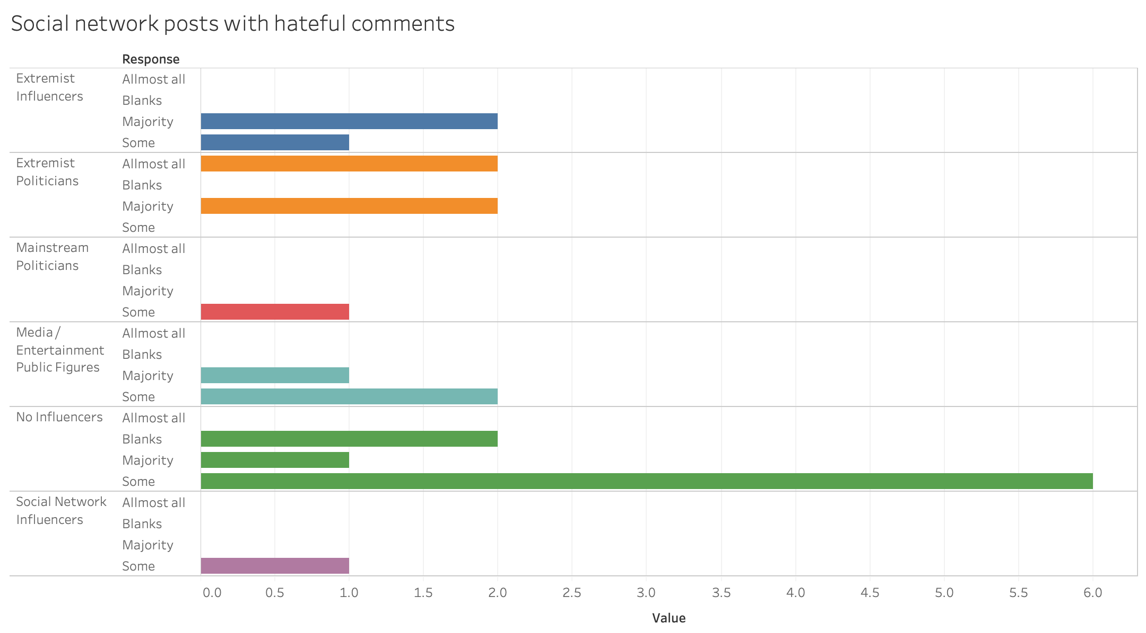
Case Study – Italy
Recommendations
Italian activists should pay particular attention to events that:
attract more types of public figures to express hateful comments
involve people belonging to more than one group vulnerable to hate speech
happen at a national level
generate fears of theft or minor criminal behavior
involve concrete antisocial actions.
CAN messages are less frequent in case of events that could generate fears of concrete, direct threats and become more frequent to combat threats of cultural changes or changes to the way of life.

Slide 21
General Conclusions and Recommendations
Extremely few common findings between the results in Romania, Germany and Italy
The research was not able to identify any “model” that would predict, at a European level, hate storms.
Findings and models are highly contextual.
We encourage activists to apply the methodology in this paper on their own national context

Slide 22
General Conclusions and Recommendations
One similarity: the most common types of perceived threat was that of cultural changes or changes to the current way of life.
hate speech does not require to be fueled by concrete violent or antisocial acts
The events with potential to instill fear of cultural changes or of changes to the existing way of life, generated lower levels of hate speech (apart from Germany)
attracted more CAN messages.
Another common finding was that events happening at a national or local level tend to attract more hate speech than international events.

Slide 23
Thank you for your time and interest!

