Slide 1


Slide 2
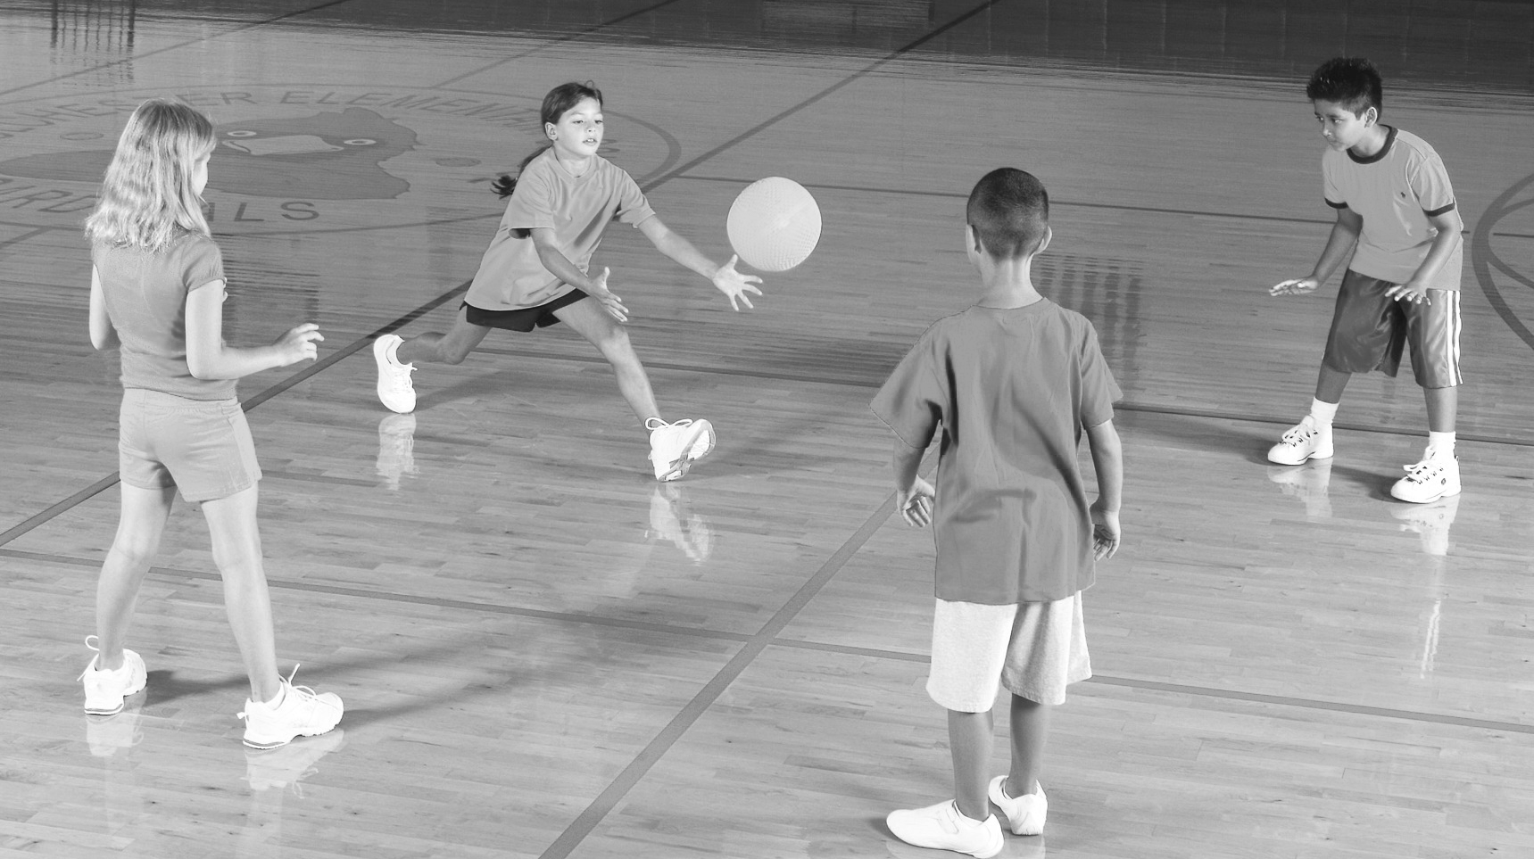
PA programs in schools administered through PE
Promote physical activity
Increase motor control
Increase academic performance
Decrease injury risk

Slide 3
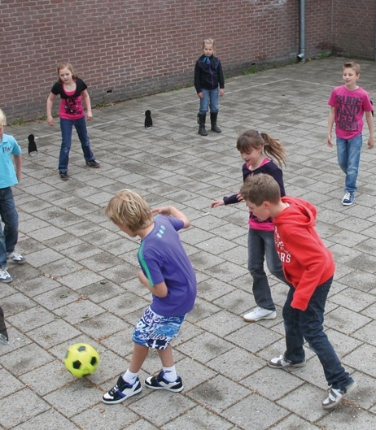
PLAYGROUNDS
INCREASING ACTIVITY LEVELS DURING SCHOOL RECESS
Janssen et al. @BJSM 2015

Slide 4
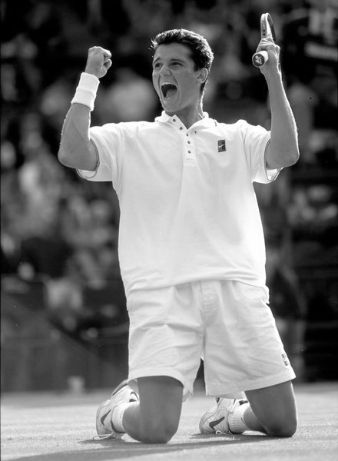
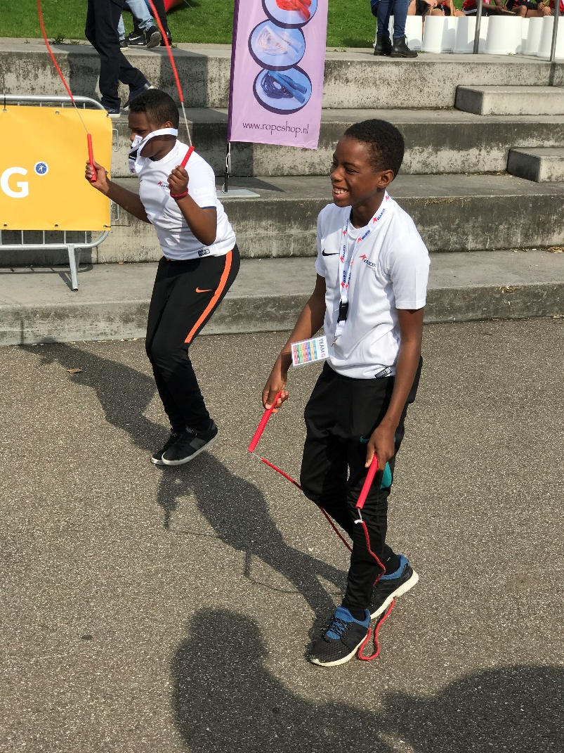
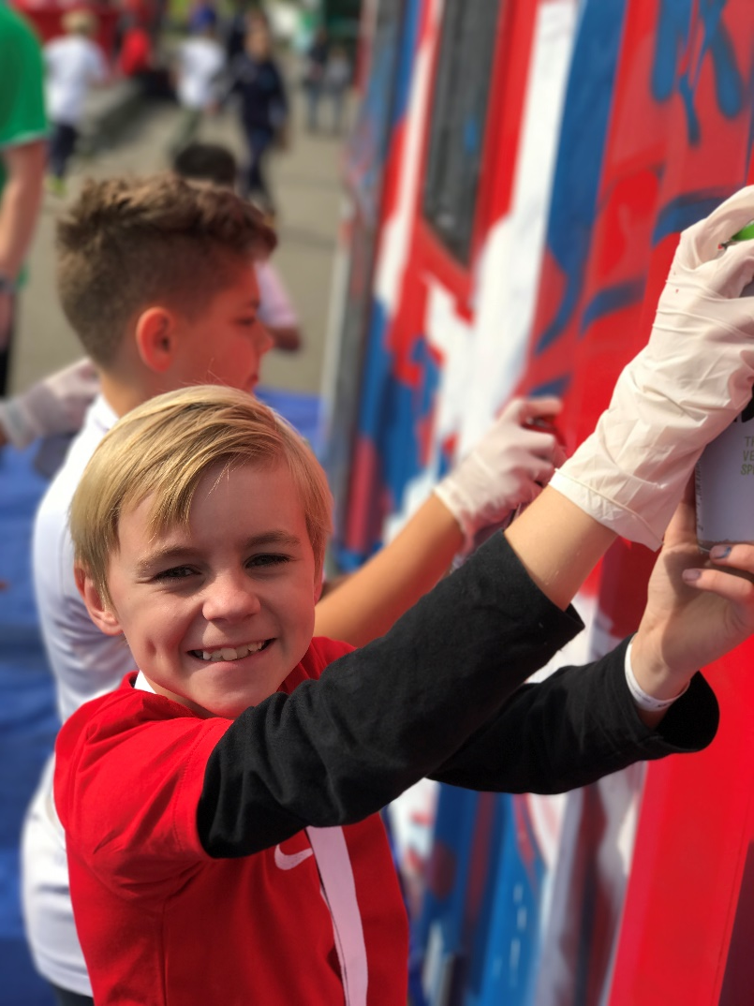
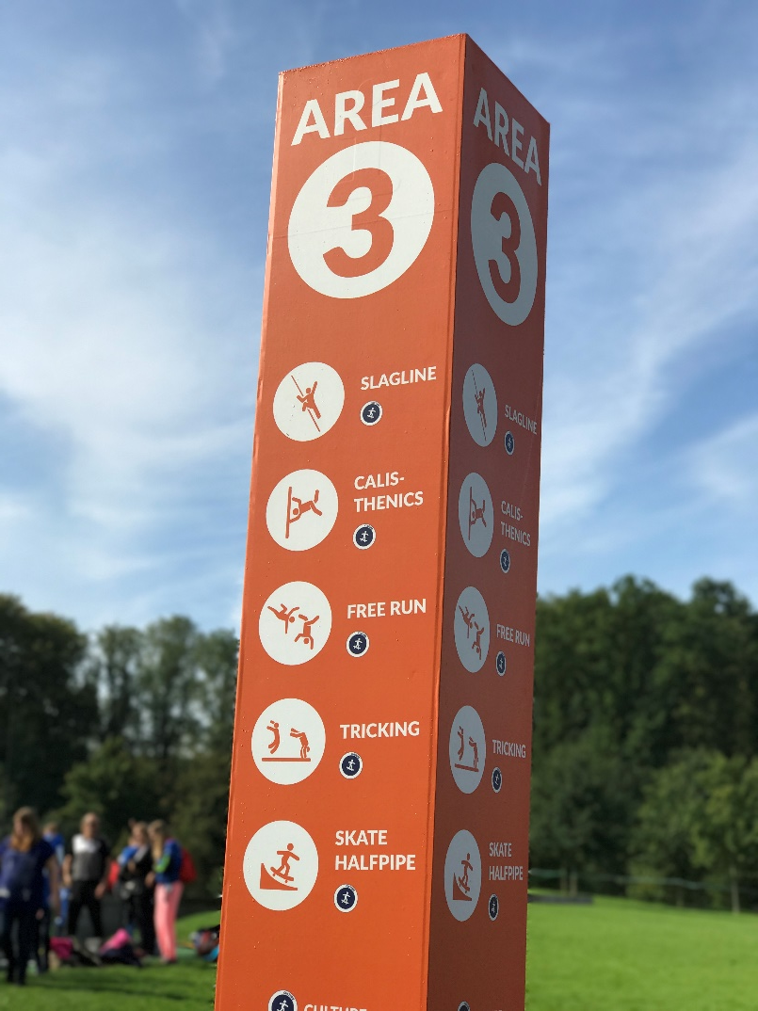
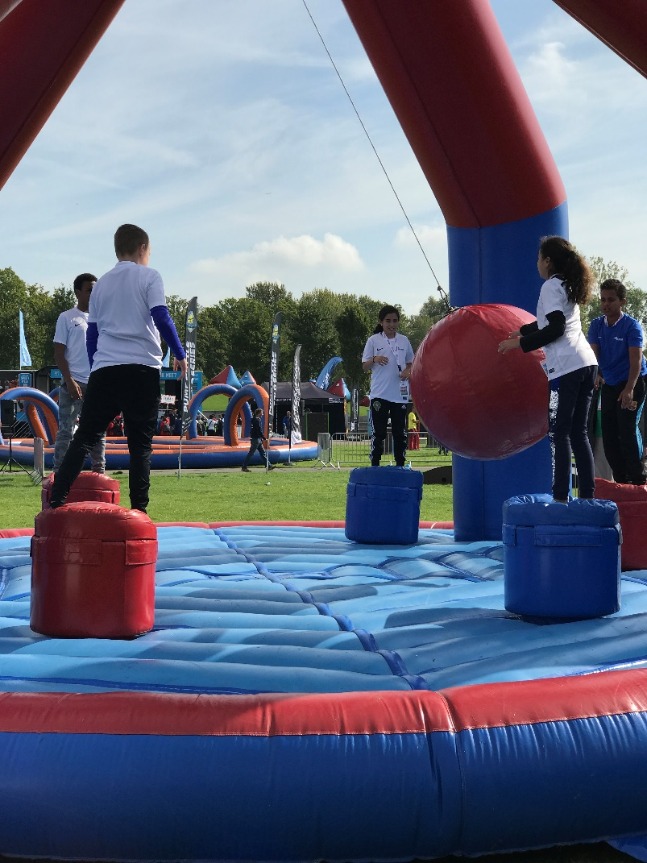
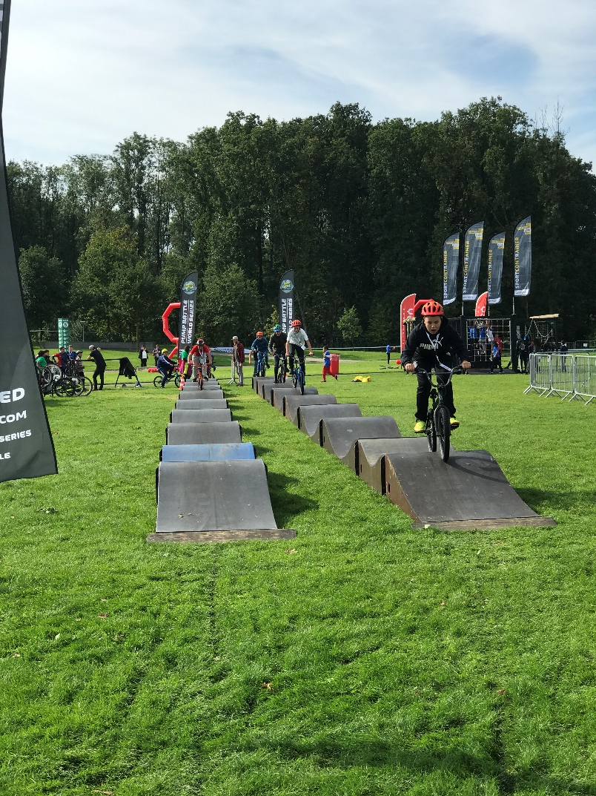
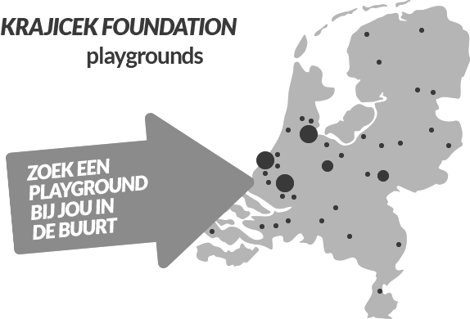
KRAJICEK FOUNDATION

Slide 5
KRAJICEK FOUNDATION
DOES IT WORK?
Boonzajer Flaes et al. @JSAMS 2016

