Slide 1
Approximation of EU legislation in the audiovisual sector in candidate countries
Regional Peer-Support Workshop
4-5 September 2024, Chisinau, Moldova
Sophie Valais
Deputy Head of Department for Legal Information
European Audiovisual Observatory

Slide 2
The Audiovisual Media Services Directive (AVMSD)

Slide 3
The regulatory frameworks of the audiovisual sector in the EU
- Before 2018 -
AVMS Directive of 2010/13/EU
E-Commerce Directive
VoD services
TV broadcasting
Audiovisual media services
Video-sharing platforms

Slide 4
The regulatory framework of the audiovisual sector in the EU
- 2018 update -
AVMS Directive (EU) 2018/1808
Need to match market realities
Audiovisual media services
Video-sharing platforms
VOD

Slide 5
AVMSD 2018
KEY CHANGES – Towards more level playing field
Establishment criteria / jurisdiction + freedom of reception and retransmission
Promotion of European works for VOD services
Audiovisual commercial communications
Video-sharing platforms
Protection of minors
Independence of National Regulatory Authorities (NRAs)
Transparency of media ownership and promotion of media pluralism

Slide 6
Relevant EAO online services and publications

Slide 7
AVMSDatabase
Database on the transposition of the AVMS Directive into national legislation.
https://avmsd.obs.int

Slide 8
AVMSDigest
The promotion of European works (2023)
The protection of minors on VSPs (Fall 2024)
https://rm.coe.int/avmsdigest-the-promotion-of-european-works

Slide 9
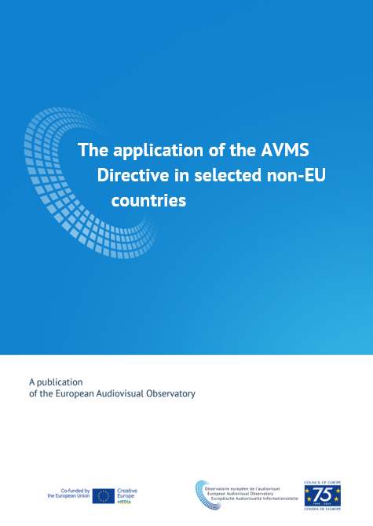
MAPPING ON THE APPLICATION OF THE AVMSD IN SELECTED NON-EU COUNTRIES
Study on legal developments in the media field in a range of non-EU countries conducted by the EAO in 2022 and 2023 and published in April 2024.
https://www.obs.coe.int/en/web/observatoire/mapping-reports

Slide 10
PROJECT SCOPE
11 countries covered – incl. candidate countries:
Albania, Armenia, Bosnia and Herzegovina, Georgia, Moldova, Montenegro, North Macedonia, Serbia, Tunisia, Ukraine, Kosovo

Slide 11
AVMSD IN SELECTED CANDIDATE COUNTRIES
Key findings and on-going challenges

Slide 12
KEY FINDINGS
In selected candidate countries
MOSTLY IN LINE WITH AVMSD 2010
The majority of the 11 countries covered broadly contained or reflected the provisions of the AVMSD 2010
PUSH TOWARDS LEGAL REFORMS IN LINE WITH AVMSD 2018
Updating and additions of definitions (e.g. VSPs, UGC…)
Level-playing field for linear/on-demand AVMS re. European works
Relaxation of rules on audiovisual commercial communications
Expansion of rules to include VSPs
Additional provisions regarding the independence of the NRA
Provisions on transparency of media ownership
Strengthening rules on accessibility to people with disabilities

Slide 13
KEY FINDINGS
General principles
RELEVANT GENERAL PRINCIPLES
Principle of non-discrimination addressed in a range of legislation (Constitution, Criminal law, Audiovisual law, specific laws)
Prohibition of incitement to hatred provided in a range of legislations (Constitution, Criminal law, Audiovisual law)
Prohibition of illegal content largely addressed in Criminal codes, except where new amendments to Audiovisual law, in line with AVMSD

Slide 14
KEY FINDINGS
Legislative approaches
COLLABORATIVE APPROACHES
A common approach in many of the countries covered is to engage stakeholders extensively in the development of draft laws
NEW AREAS COVERED
All laws and draft laws address the issue of Video Sharing Platforms (VSPs) and secondary legislation is likely to be developed in this area
National Regulatory Authorities (NRAs) frequently play a significant role in most countries in the development of legislative proposals.

Slide 15
ON-GOING CHALLENGES
In selected candidate countries
FREEDOM OF EXPRESSION / FREEDOM OF THE MEDIA
Safety of journalists and media workers
Financial situation of the media sector
Disinformation and online media hate speech
INDEPENDENCE OF NATIONAL REGULATORY AUTHORITIES
Funding
Powers of enforcement
Appointment and dismissal of members
Media ownership

Slide 16
The Digital Services Act (DSA)

Slide 17
Digital Services Act (DSA)
KEY CHANGES: VSPs and disinformation
New obligations for online platforms:
Regulation adopted on 19 Oct. 2022 / directly applicable since August 2023
Establish transparency reports on platforms’ internal complaint handling system and content moderation activities;
Suspend access to the platform (“for a reasonable period and after notice”) to users frequently disseminating manifestly unlawful content;
Take appropriate measures to ensure a high level of protection of minors and protect the private life of users
Applicable to all platforms since February 2024

Slide 18
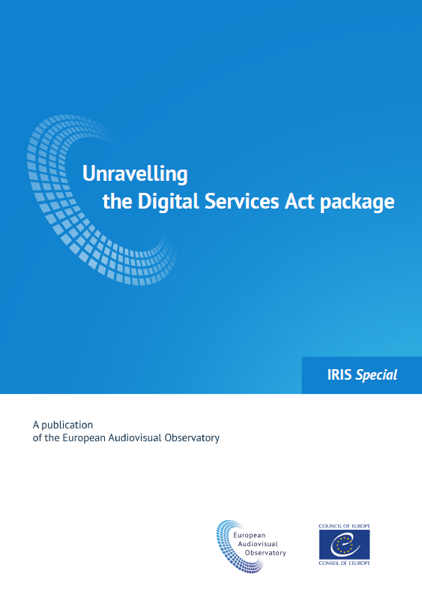
“UNRAVELLING THE DIGITAL SERVICES ACT PACKAGE
IRIS Special, early 2022
https://rm.coe.int/iris-special-2021-01en-dsa-package/1680a43e45

Slide 19
The European Media Freedom Act (EMFA)

Slide 20
European Media Freedom Act (EMFA)
MAIN GOAL:
Protects media independence and pluralism
Regulation adopted on 11 April 2024
Key words: Protection of journalists, public media service, media ownership, funding, media regulators..
Directly applicable 15 months later (i.e. 8 August 2025) (some provisions earlier)

Slide 21
IN PARTICULAR…
Citizens must have access to a plurality of editorially independent media content (Art. 3).
Protection of journalists against intrusive measures from authorities (Art. 4).
Measures for the governance and independence of public service media (key appointments through transparent and non-discriminatory procedures, safeguards against dismissals..(Art. 5).
Transparency of ownership: all news and current affairs outlets shall publish information about their owners in a national database (Art. 6).
State financial support and funds received from state advertising should be reported (Art. 6).
New measures to prevent major online platforms from restricting/deleting independent media content. (Art. 18).
Setting up of the European Board for Media Services (replacing ERGA).

Slide 22
Thank you for you attention!
For any queries: sophie.valais@coe.int

