Slide 1
Good practices and lessons for the future
Unaccompanied and Separated Children in Greece
Conference on Effective Alternatives to the Detention of Migrants
EC, EMN, CoE
Strasbourg, 04 April 2019
Laurent Chapuis, Migration Advisor, UNICEF ECARO

Slide 2
“The possibility of detaining children as a ‘measure of last resort’, which may apply in other contexts such as juvenile criminal justice, is not applicable in immigration proceedings as it would conflict with the principle of the best interests of the child and the right to development.”
Notes:
United Nations Committee on the Protection of the Rights of All Migrant Workers and Members of Their Families (CMW), Joint general comment No. 4 (2017) of the
Committee on the Protection of the Rights of All Migrant Workers and Members of Their Families and No. 23 (2017) of the Committee on the Rights of the Child on State
obligations regarding the human rights of children in the context of international migration in countries of origin, transit, destination and return, CMW, 16 November 2017,
paragraph 10.

Slide 3
* Includes separated children. As of 28 February 2019, among 3,773 referred children to EKKA, 242 were separated
Notes:
Steady increase of the number of unaccompanied children in Greece, although many decide to pursue their journey up North
As per government counterparts report, UAC in “protective custody” and in RICs are not there for migration control purposes. National authorities have been keen to engage with UN agencies, civil society and the EU to find solutions to a situation that does not satisfy anyone
While RICs are opened facilities on the Islands, UACs freedom of movement is de-facto limited until they are formally transferred to one of the reception facility on the mainland
The reasons are many and include the lack of suitable alternatives on the mainland and cumbersome procedures regarding the medical clearance required for transfers which have contributed to a backlog of children to be transferred
Reasons also include weak age assessment procedures possibly resulting in individuals wrongly identified as adults or as children

Slide 4
No magic bullet
Setting up safe zones, putting children in hotels, do not, in itself, put an end to the use of “protective custody” or to extended stay of children in Reception and Identification Centers (RICs)
Assumption is that, together with other comprehensive and systemic measures, safe zones, hotels have contributed to improving the availability and quality of care and protection refugee and migrant children access in Greece

Slide 5
Comprehensive and systemic measures
Strengthening the data
Aligning national policy and legal framework
Investing into national oversight capacity
Designing, domesticizing, scaling up alternatives to detention/institutions for unaccompanied children on the move

Slide 6
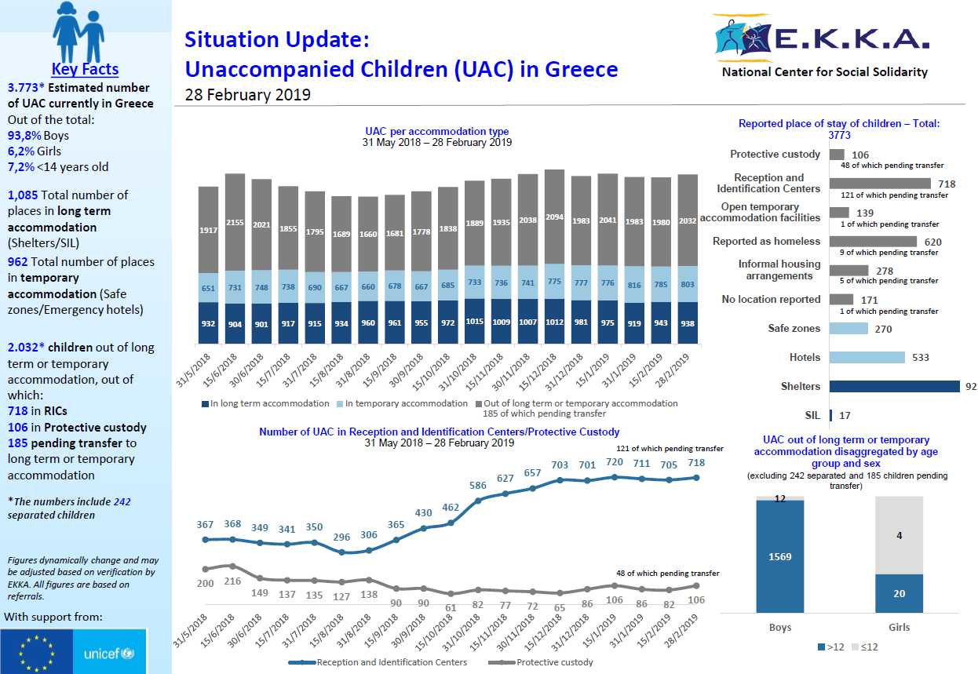

Slide 7
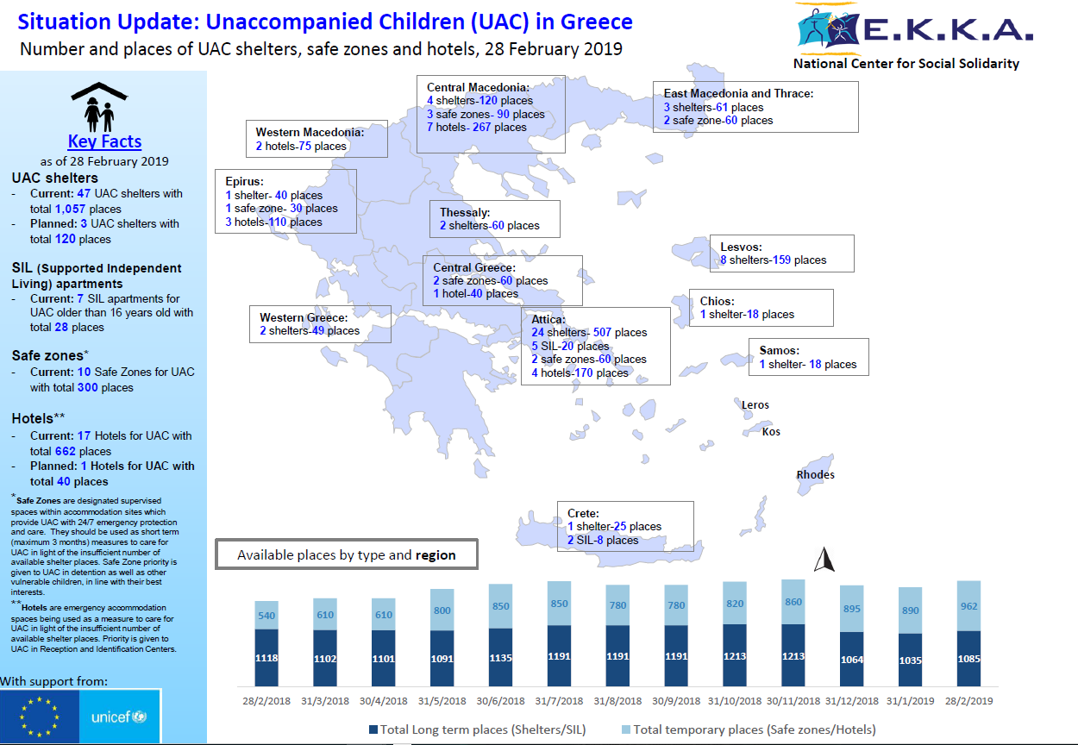

Slide 8
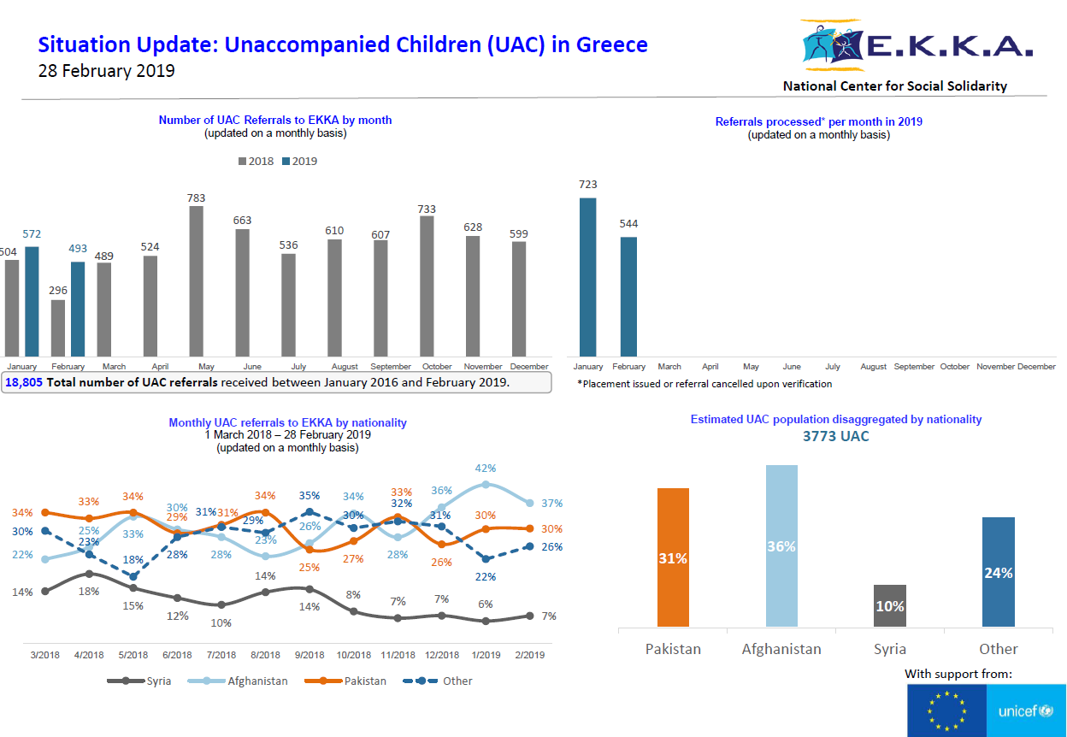

Slide 9
Legal framework
Transposition of the EU recast Directive on Reception Conditions (2018)
Law on guardianship. “Provisions on Social Security and Pension, tackling of undeclared work, strengthening of workers’ protection, guardianship of unaccompanied minors plus other provisions” (Law 4454/2018, Article 13)
Law on fostering and adoption and other provisions (L. 4538/2018.)
Notes:
Transposition of the EU recast Directive on Reception Conditions
Allows children over 16 to be placed elsewhere than in shelters, introduced Supported Independent Living (SIL), in safe zones
Clarifies of Ministry of Labour and Social Solidarity competency (vs. Ministry of Migration Policy) over UAC
Law on guardianship. Developed by the Ministry of Labour, Social Security and Social Solidarity, entitled “Provisions on Social Security and Pension, tackling of undeclared work, strengthening of workers’ protection, guardianship of unaccompanied minors plus other provisions” (Law 4454/2018, Article 13)
Key stakeholders, i.e. the Public Prosecutor, the Guardian and a Supervisory Council
New role for EKKA (under MoLSS oversight). Establishment of a Department for the Protection of Unaccompanied Minors, responsible for:
Coordination, support and assessment of professional guardians for unaccompanied children
Management of referrals for accommodation of unaccompanied children (already existing)
Assessment and monitoring of accommodation centres for unaccompanied children
Allows for Supported Independent Living
Law on fostering and adoption and other provisions (L. 4538/2018.)
Establishment of a council overseeing fostering and adoption
Definition of EKKA’s role, establishment of roster of families, registry of children to be placed, favor kinship care when relevant…
Supervisory role for foster care (Ministry of Labor and Social Solidarity vs. Ministry of Justice, involvement of the prefecture/municipal level level)

Slide 10
National oversight technical capacity
Bylaws/Ministerial Decisions, Standard Operating Procedures, rooster, registry for the operationalization of the Guardianship Law and the provision of care and accommodation through shelters and SIL schemes
Standard Operating Procedures, binding minimum standards for shelters, SIL schemes
Monitoring framework, actual monitoring of group home” like shelters, supported independent living schemes
Capacity building of guardians, personnel involved in the provision of care and accommodation to UAC
Maintain/extend existing database on UAC to support effective referrals, optimal management of available capacity and service provision
Notes:
Together with national authorities, in close coordination with IOM, UNHCR and supported by DG Home, UNICEF invested into the national oversight capacity through the secondment of 8 national experts to the Ministry itself and EKKA to accelerate the operationalization of the new legal framework and the transfers of UAC from “protective custody” and RICs into suitable accommodation.

Slide 11
Modeling, scaling up alternatives
“Group-home” type shelters
Safe zones (temporary)
Hotels (temporary)
Supported Independent Living (SIL) scheme
Foster families
Notes:
RIC
Not closed but freedom of movement de-facto limited on the Islands until UACs are formally referred to appropriate reception facilities on the mainland
Shelters
With very few exceptions, pre-existing facilities hosting Greek children were not ready to accept unaccompanied children on the move. 3,500 children placed in various type of residential institutions, with only 1,000 children cared for in state-run institutions, the rest of children being cared for in institutions run by the church or faith-based organisations.
UNHCR initiated work on minimum standards covering technical specifications, principles, service provision (food, medical, legal counseling, social support, interpretation), staffing…
GoG minimum requirements as part of a call for proposal for the establishment of UAC shelters through AMIF financial support
EKKA to develop revised standards under new law on guardianship. Expected impact on absconding
Ensure children aging out are supported to transition into appropriate accommodation. Close collaboration with IOM, UNHCR, MoMP for placement into apartment scheme and other adult accommodation options
Accelerate establishment of new places (IOM, MoD, NGOs with AMIF funding)
Safe zones
Not formally regulated, established as temporary measures, like hotels
Joint UNHCR UNICEF recommendations to MoMP: maximum number of children, staffing, services, security, building bridges with rest of reception facility’s population, host community, temporary placement prior longer-term placement in shelter…
Under MoMP oversight, Public Prosecutor and EKKA looped in
Only children over 14. Remain on EKKA priority list for placement in shelters
ATD
Hotels
ATD, as temporary measures,
Foster families
SIL
Aiming for 200 places by end 2019

Slide 13
Next steps
Accelerate operationalization of the new legal framework on the care and protection for refugee and migrant unaccompanied children
Highlight linkages with the need to promote a wider De-Institutionalization reform of the Greek child protection system
Develop a De-Institutionalization and Child Care Reform policy with a shift from institutional to community-based care
Support government access to structural funds and technical assistance

Slide 14
Thank you

