Slide 1
Understanding of volcano-tectonic seismic activity on the example of the Virunga Volcanic Province, DR Congo
ECGS
Meeting of Directors, EUR-OPA Major Hazards Agreement
6-7 November 2017

Slide 2
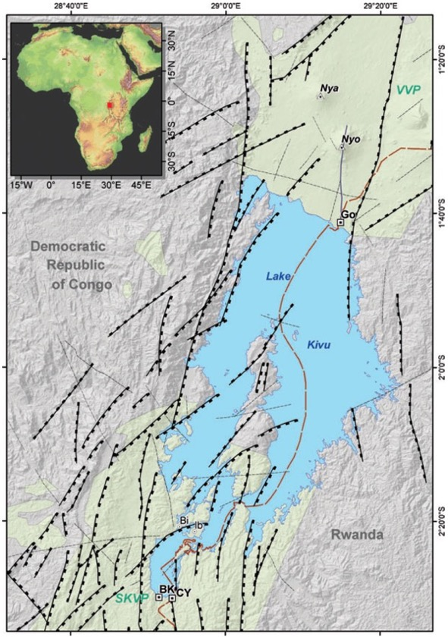
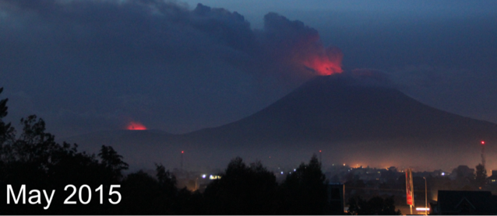
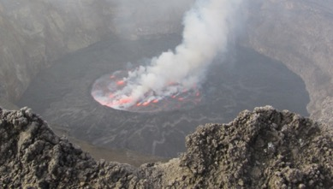
Context of the study region
Kivu Rift: home to two of most active volcanoes in Africa, Nyiragongo & Nyamulagira
Major threat to city of Goma with ∼1 million inhabitants
Nyamulagira
Nyiragongo
Nyiragongo
Nyamulagira
Goma: pop. ∼1 million
September 2011

Slide 3
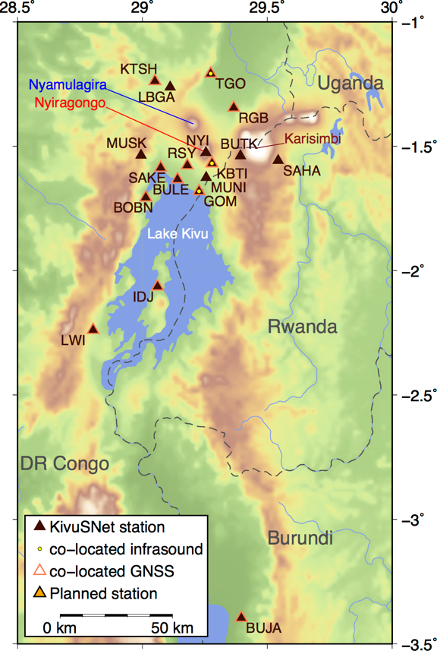
KivuSNet: a new monitoring tool
KivuSNet: broadband seismic network deployed gradually since 2013
At present 17 operational stations
Allows for unprecedented scientific insights into the volcano-tectonic characteristics of this region
Major contribution to volcanic risk management through improved monitoring capabilities

Slide 4
Results 2017

Slide 5
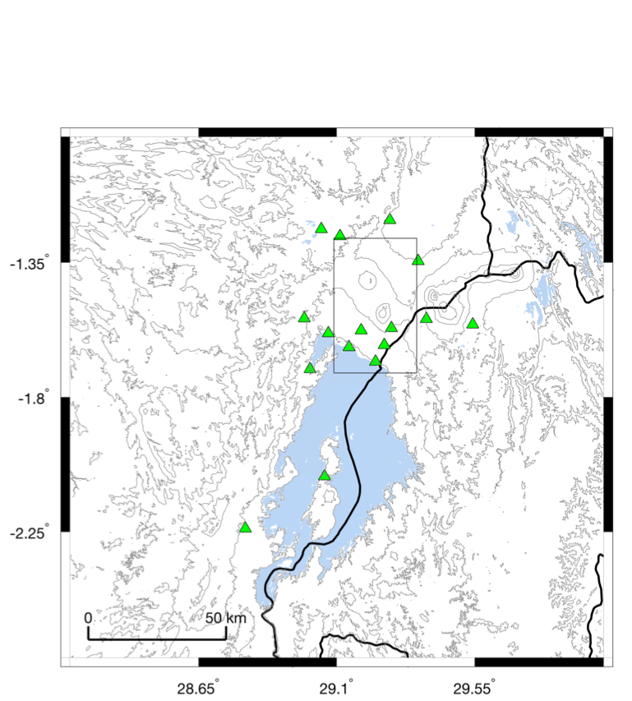
Seismicity of nearly 2 years (10/2015–07/2017)
Automatic source scanning for event detection and location
Modern, cross-correlation based approach (written report)

Slide 6
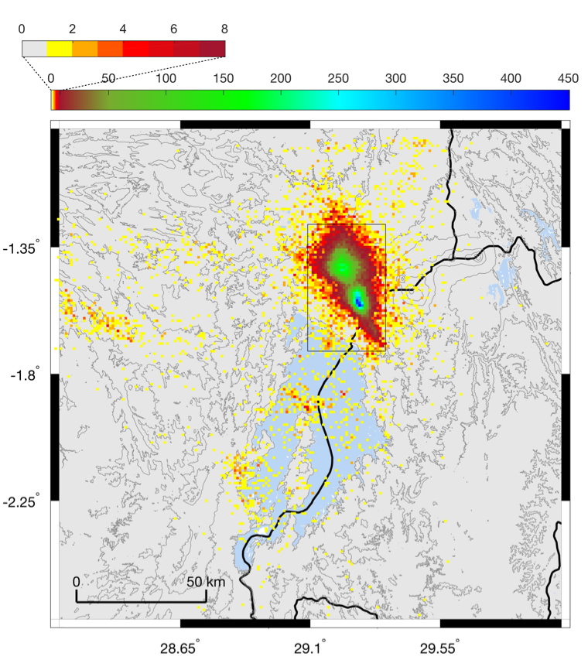
Seismicity of nearly 2 years (10/2015–07/2017)
Number of events
Automatic source scanning for event detection and location
Modern, cross-correlation based approach (written report)
33,023 events in total, 30,409 of which are located in volcanic field
Tectonic seismicity around Lake Kivu, source region of 2016 Walikale M 4.9 earthquake highlighted
Space-time distribution shows several volcanic swarm events
Walikale

Slide 7
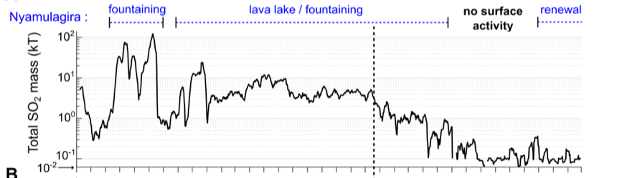
Tremor, Seismicity & Degassing
SO₂
Magma movements can be inferred through combined analysis of variations in long-period seismicity (tremor, LP events) and SO₂ degassing
Long-term time series of total daily SO₂ mass in the Virunga using the space instrument OMI (Theys et al., JGR Atmo., 2015)
Tremor
(Example: January 2015)

Slide 8
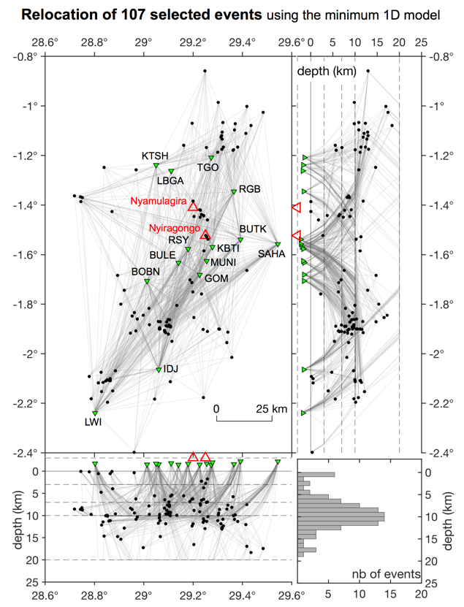
Seismic velocity model for better location
Seismic velocity model crucial for appropriate earthquake location and magnitude estimation
No dedicated model existed thus far for this region
We use 107 well-recorded events to derive a calibrated 1D velocity model
Relocation of all catalogue events with new model

Slide 9
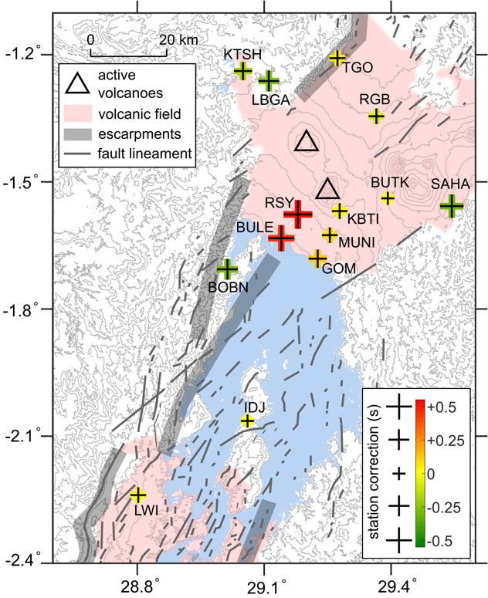
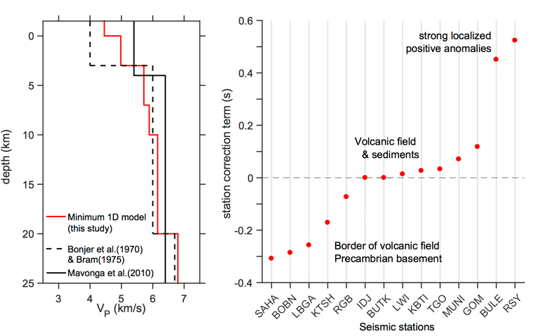
Seismic velocity model for better location
Find best 1D model with additional station corrections (stations slower or faster than average model)
Stations in volcanic field are slower (expected for volcanic rocks & presence of fluids)
Article planned for submission in Frontiers in Earth Sciences

Slide 10
Planned work for 2018

Slide 11
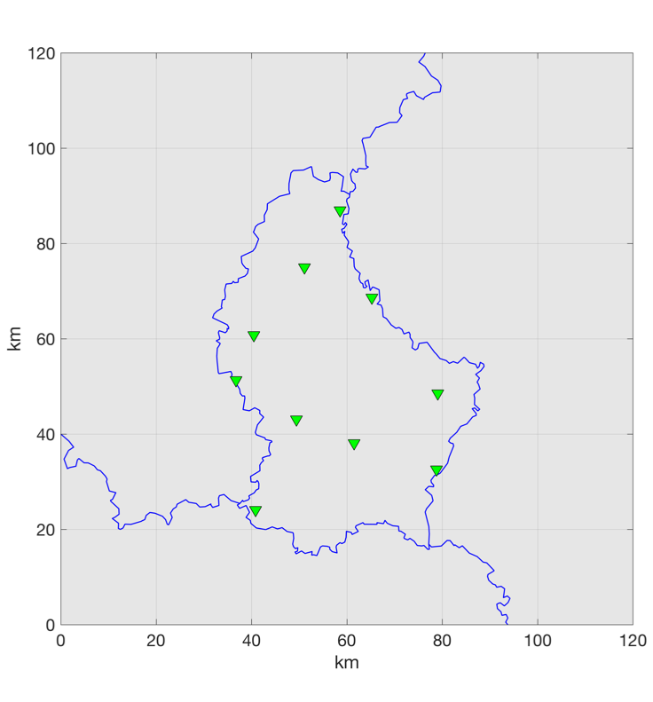
Focus on Luxembourg
Luxembourg: low seismicity region, but small-magnitude natural and anthropogenic activity not yet well studied due to lack of network until recently
Over the past few years, development of a broadband network of 10 stations (4 temporary, 6 permanent thus far)
Will apply expertise and techniques developed in strongly active Kivu region to characterize small-scale seismic activity
KLB
WILW
VIA
LBB04
PNBR
LBB02
LBB01
WLF
WMG
LBB08

Slide 12
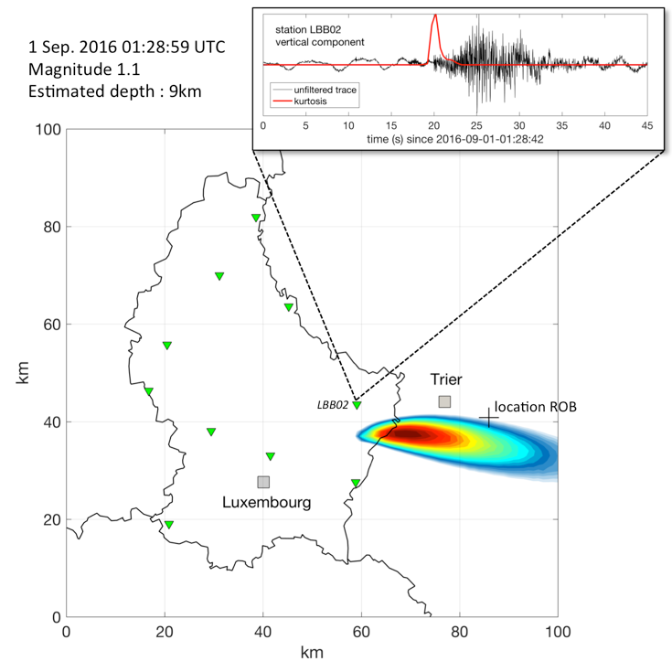
Focus on Luxembourg
Started implementing some routines already
Example: M1.1 event on Luxembourgish-German border
Will be made systematic and automatized in the 2018 work programme
Expected result: catalogue of small-magnitude natural & anthropogenic seismicity

