Slide 1
RFCDC Teacher Reflection Tool
Launch Webinar
17th February 2022
21/02/2022
1

Slide 2
Introduction:
Why a teacher reflection tool?

Slide 3

Why a teacher reflection tool?
•Teachers’ role as “significant others” and facilitators is crucial for building democratic culture through education
•Teachers need to develop CDC and a democratic professional ethos in order to create supportive and empowering learning environments and processes

Slide 4

Why a teacher reflection tool?
•In many countries, teachers’ democratic role and ethos are not addressed in teacher education
•Democratic practice as continuous development
•RFCDC as teachers’ companion for continuous personal and professional development

Slide 5

The prerequisite:
self-observation and self-reflection
As a teacher, do I
•establish respectful and trusting relations with students, colleagues and parents?
•facilitate a classroom culture in which students feel acknowledged and cared of?
•give learners space and opportunities to become independent thinkers?

Slide 6
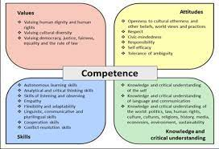
Developing teachers‘ CDC
Aiming to support teachers’ development of
•the ability to listen to learners, colleagues and parents
•openness for the cultural affiliations and practices students bring into the educational process;
•empathy and a sense of responsibility for the well-being and empowerment of all learners

Slide 7
What can the Teacher Reflection Tool do?
Familiarizing teachers with observation and self-reflection by
• offering scenarios to reflect on
• going back to former experiences
• applying CDC to everyday life and teaching practice
Guiding teachers through reflection loops related to their own educational practice

Slide 8
A tour through the TRT

Slide 9
Presenting module 1:
Making students’ voices heard

Slide 10
Structure of the modules
Introduction
Basic information, principles
Guiding questions
Scenarios
2 to 5 scenarios per module
Planning and evaluating an educational activity
Planning an activity
Choosing from a list of proposed activities

Slide 11
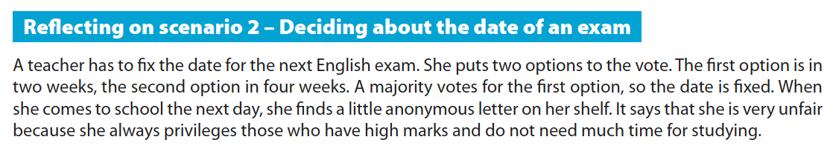
Reflecting on a scenario
Step 1: Reflect on the situation
Step 2: Select competences and descriptors
Step 3: Looking ahead

Slide 12
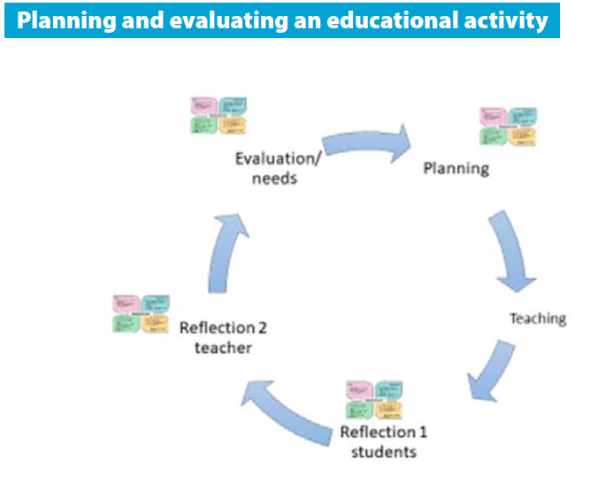
Planning and evaluating an educational activity
The reflective circle
Planning
Doing
Reflecting
Adapting

Slide 13
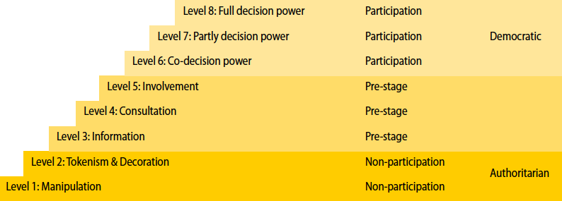
Working with the participation ladder

Slide 14
Doing an educational activity
Step 1: Select competences and descriptors
Step 2: Self-observation during the activity and reflection
Step 3: Debriefing/meta-reflection
Step 4: Repeat the reflective circle

Slide 15
Presenting module 2:
Addressing controversial issues

Slide 16

What do we mean by controversial ?
Definition by the Council of Europe:
„Issues which arouse strong feelings and divide opinions in communities and society“

Slide 17
The Council of Europe`s approach:
Teaching controversial, emotional and potentially polarising issues as key competence (2015)
    „Learning how to engage in dialogue with people whose values are different from one`s own and to respect them is central to the democratic process and essential for the protection and strengthening of democracy and fostering a culture of human rights.“

Slide 18
This kind of issues raises difficult pedagogical questions for teachers including:
How should I respond to conflicting truth-claims among students – so that I do not feel compromised or the students sense there is a ‘hidden agenda’?
Should I take sides? How? When?
How can I protect the sensitivities of students from different backgrounds and cultures and of those with a personal or family involvement in the topic?
How can I enable an open and free discussion?
How can I encourage students to listen to each other's opinions?
How can school administrators support this?
Do I have the confidence to do it?

Slide 19
Scenario 1: Teaching Style
Fortress Europe
A teacher teaches a course in European politics “The refugee crisis in Europe – Putting solidarity to the test”. Just before you start a well-prepared but as for the students challenging dilemma discussion/debate on the question “Should the EU improve its external border protection?” one of his/her students asks him/her about how HE/SHE actually feels about this topic.

Slide 20
Possible positions:
Always make your own views known
Adopt the role of a neutral chairperson – never let anyone know your own views
Make sure students are presented with a wide range of different views on every issue
Challenge students’ views by arguing the opposite view
Try to support particular students or groups of students by arguing on their behalf
Always promote the ‘official’ view on an issue - what the authorities expect you to say

Slide 21
Ask yourself/Shared exchange
Which positions were particularly familiar to you?
Which ones rather not?
Did you find certain positions controversial?
Did you experience more of a consensus on certain positions?

Slide 22
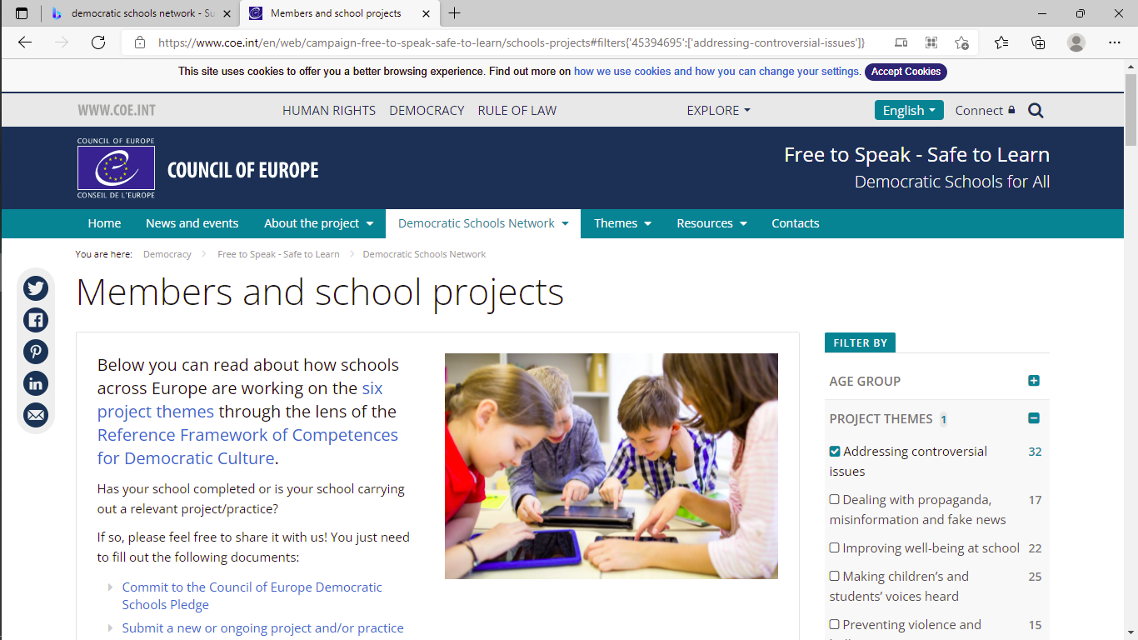

Slide 23
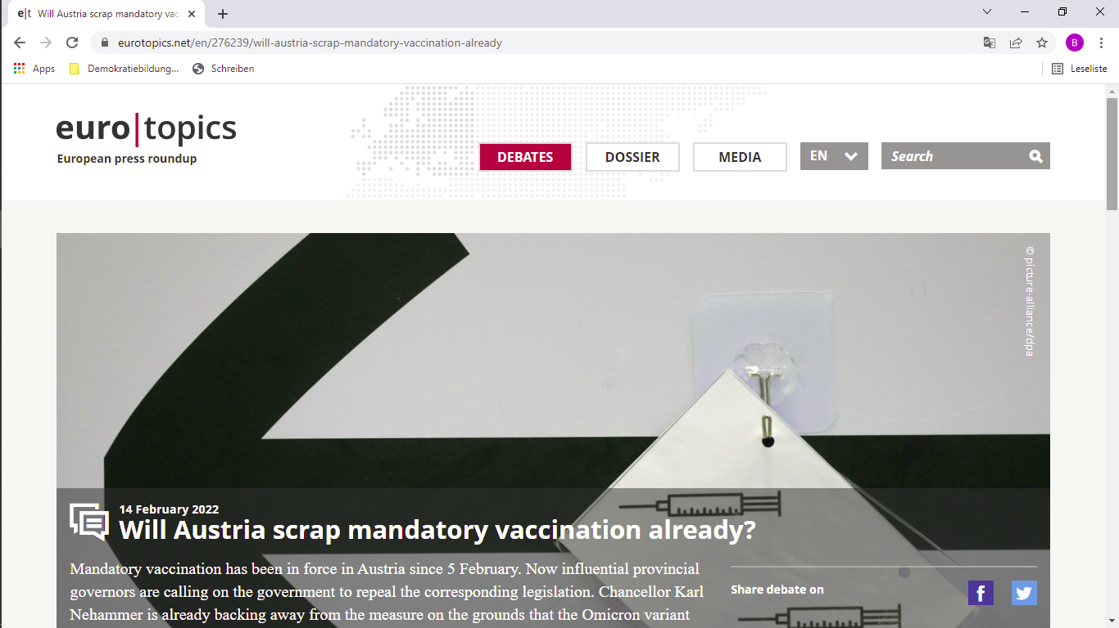

Slide 24


Slide 25

The RFCDC Teacher Reflection Tool
as companion

Slide 26
Presenting module 3:
Preventing violence and bullying

Slide 27




Preventing
Violence and Bullying

Slide 28
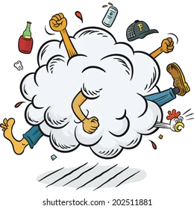
Violence
at school
Cases of violence happen at school.
Some are noisy, so we become aware of them,
Some are underground and we may understand their after-effects,
Some happen at homes or in society and students carry them to school.
Some happen in the online world, both outside and inside the school.

Slide 29

Violence
at school
Dealing with violence and bullying at school is not simply a matter of stopping fights, giving punishments and imposing order.
It poses a question about the wider culture of the school.
What teachers perceive is simply the tip of the iceberg.
In most cases, one has to decode facts and behaviours in order not to overlook them.
When facing such complex challenges, a teacher may feel incompetent or helpless.

Slide 30
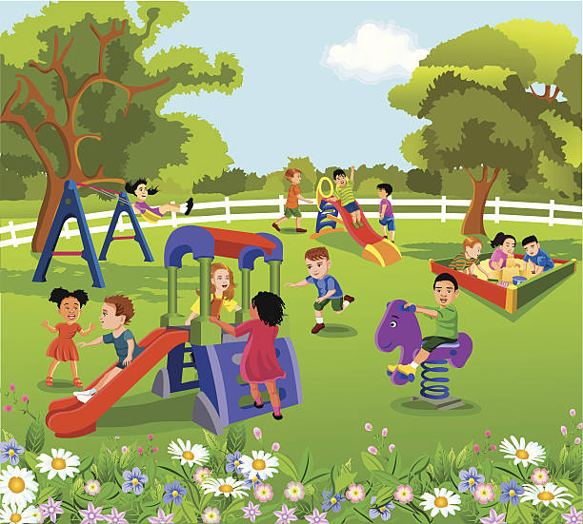
Mrs. X

Slide 32

Cyberbullying
at school

Slide 33

Cyberbullying
at school

Slide 34
Cyberbullying
at school

Slide 35

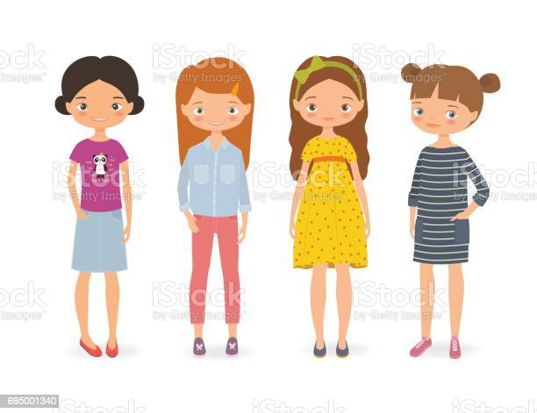
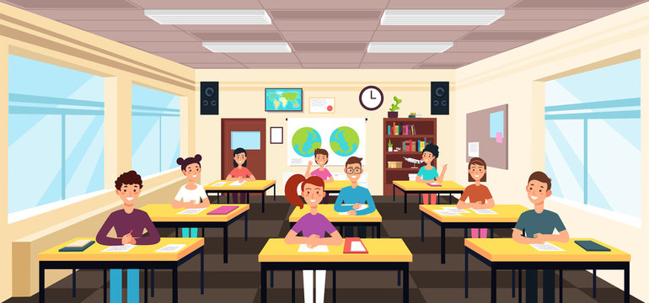

Step 1: Reflect on the situation
Step 2: Select competences and descriptors
Step 3: Look ahead
Mr. Z

Slide 36
Your impression and experiences?

Slide 37
In your view:
what are the strengths of TRT?
what might be challenging in using TRT?
Do you wish to share experiences with TRT?
Please, write into the chat!

Slide 38
Questions & Answers

