Slide 1
Training for the Syrians Living In The Temporary Protection Centers (TPCs’) On
Basıc Disaster Awareness and Fire Protection
Pilot Project: Şanlıurfa
European Natural Disasters Training Center (AFEM)

Slide 2
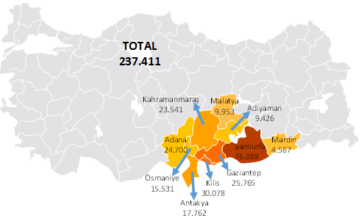
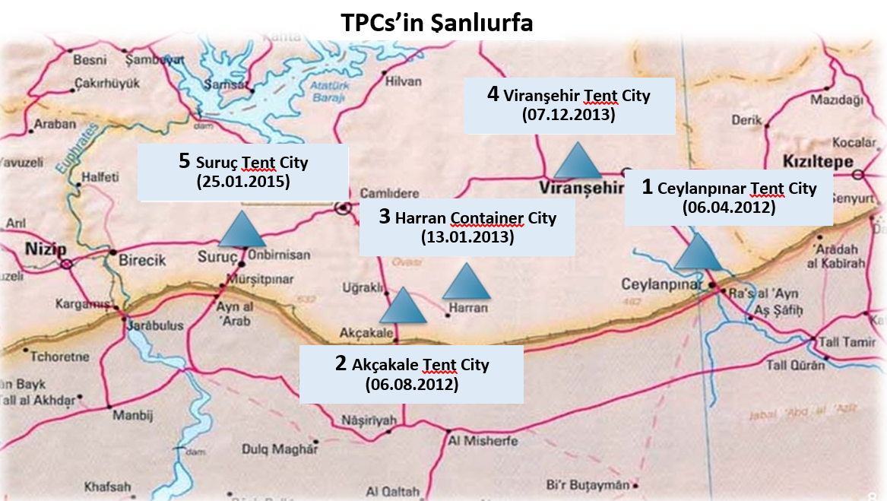
Temporary Protection Centres (TPCs) in Turkey
Turkey is currently hosting about 3.2 million Syrians and 237.411 are living in 23 TPCs that have been established and managed in 10 provinces.

Slide 3
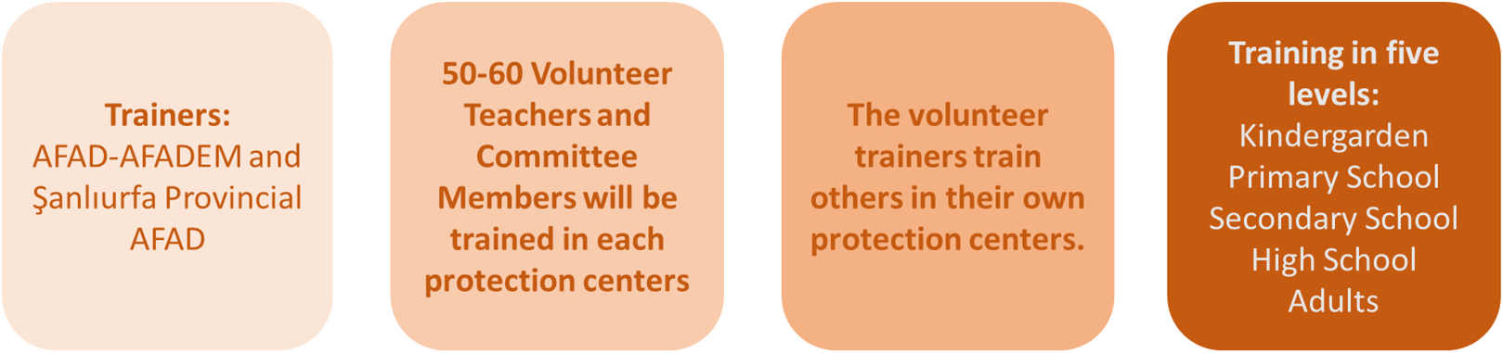
Training Model

Slide 4
Content of the Training / 1st Day
Pre-disaster
First 72 hours
Hazard and Risk
Disaster
Disaster Awareness
Risks in our living space
Disaster and emergency plan
  Disaster and emergency bag
  Importance of communication
  Emergency telephone numbers
  Disaster and emergency information cards
  Assembly points
  People with special needs
During-disaster
Proper Behaviors
DROP-COVER-HOLD ON !
Post-disaster
Fire protection
Evacuation

Slide 5
Content of the Training /2nd Day
Stages of a Presentation
"Basic Disaster Awareness and Fire Protection Training" presentations developed for 5 levels such as:
Pre-school Students
Primary school Students
Secondary school Students
High school Students
Adults
and distributed in order to provide a common language among the voluntary trainers to extend trainings at the protection centers.
Trainer’s Skills
Adult and child training
Expectations of audience
What is a presentation
Our fears?
Fire Extinguishing Exercise
Introducing the portable fire extinguisher
Teaching how to use it and how to respond in the beginning of the fire.

Slide 6
Training in Harran Container City, 3-4 May 2017
11.460 individuals are living in Harran container city.
In total there are 4907 students and 250 Syrian teachers working in the protection center.
52 voluntary trainers participated.
Table. Number and dissemination of voluntary trainers
 | Pre-School Teacher | Primary School Teacher | Secondary School Teacher | High School Teacher | Special Education Teacher | Member of Youth Council | Member of Wisemen Committee | Member of Vestry | Member of Women Committee
Men | 1 | 7 | 5 | 5 | 1 | 2 | 3 | 2 | -
Women | 6 | 5 | 5 | 5 | 2 | - | - | - | 3

Slide 7
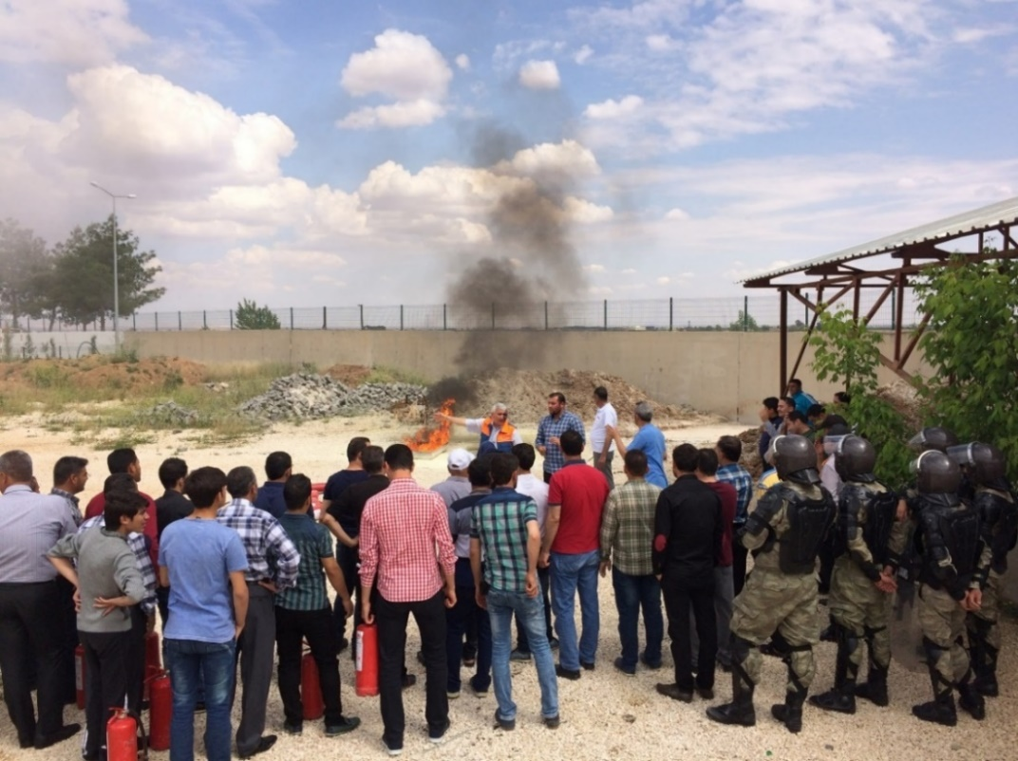
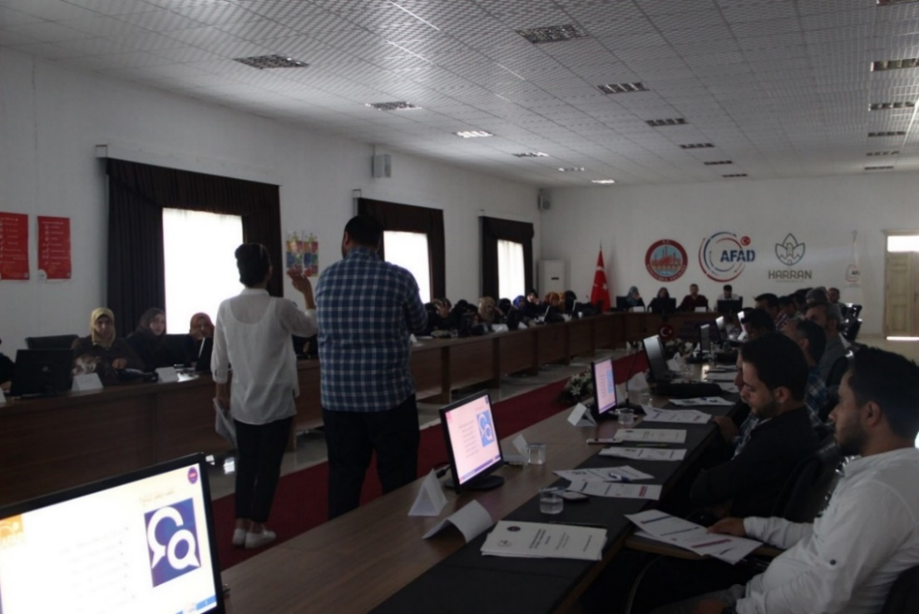
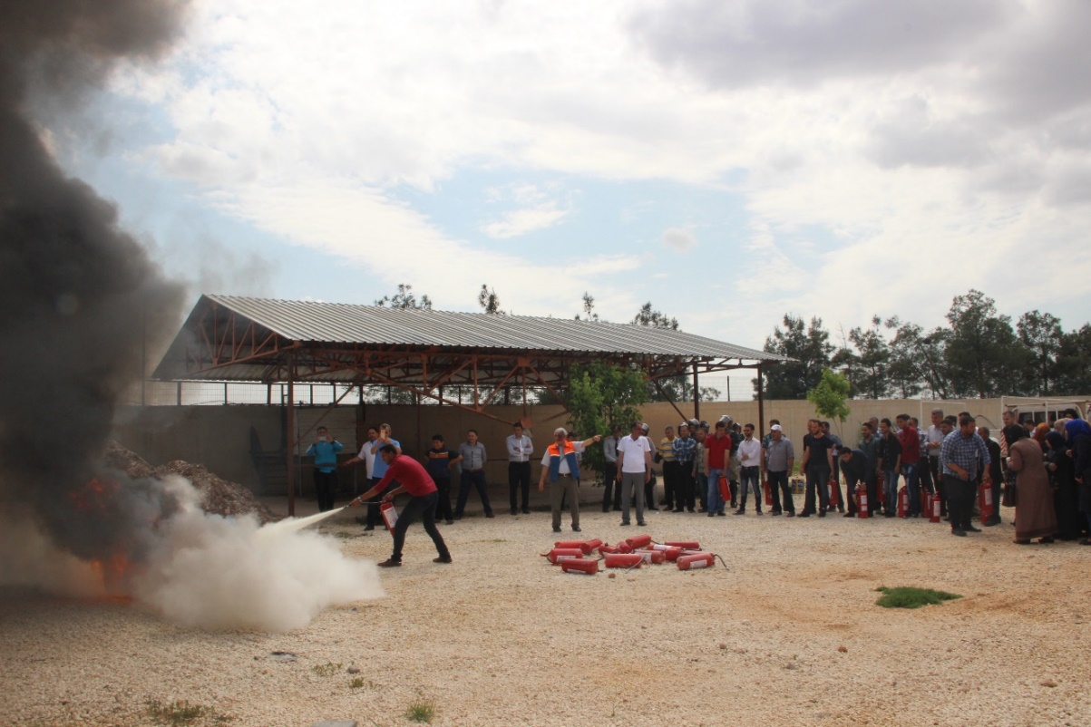
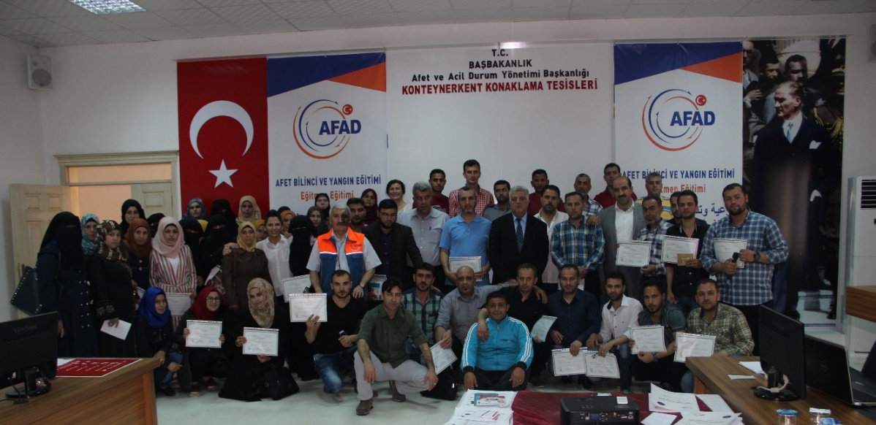
Picture. Fire extinguishing exercise
Picture. Overall picture from the training

Slide 8
Training in Ceylanpınar Tent City, 5-6 October 2017
There are 11 districts in Ceylanpınar tent city and totally 18.176 individuals are living.
In total there are 7476 students and 352 Syrian teachers working in the protection center.
45 voluntary trainers participated.
Table. Number and dissemination of voluntary trainers
 | Pre-School Teacher | Primary School Teacher | Secondary School Teacher | High School Teacher | Special Education Teacher | Member of Youth Council | Member of Wisemen Committee | Member of Vestry | Member of Women Committee
Men | - | 12 | 3 | 2 | - | - | - | 11 | -
Women | 2 | 5 | - | - | - | - | - | - | 10

Slide 9
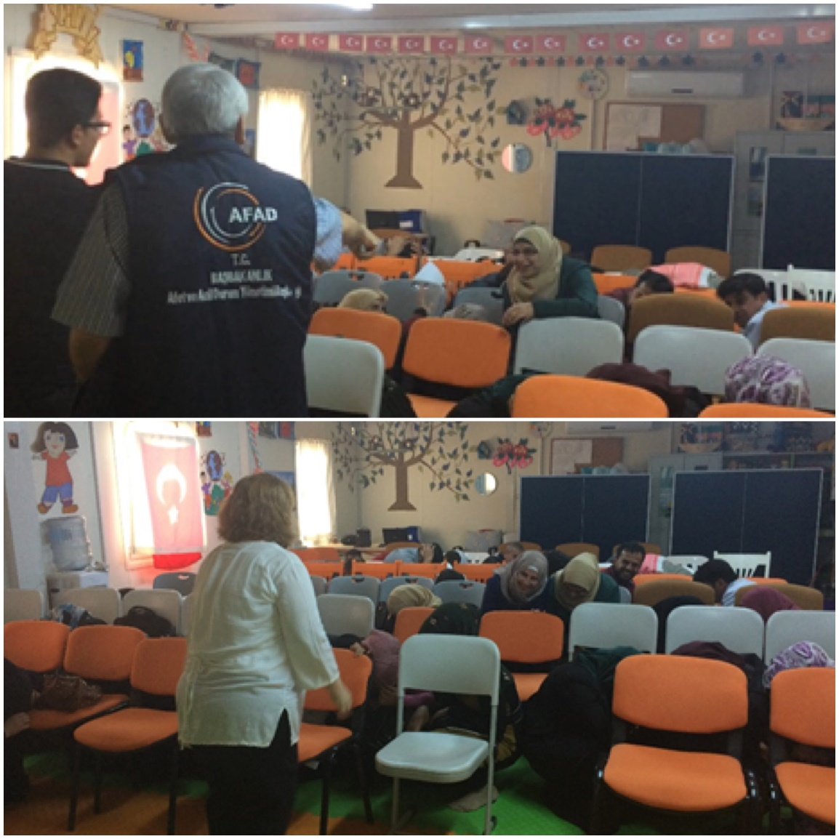
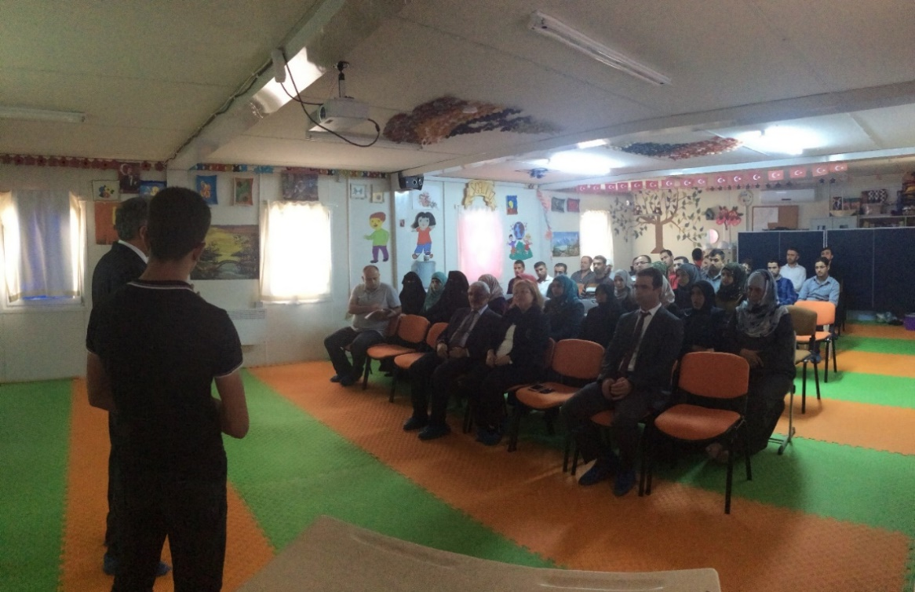
Picture. Overall picture from the training

Slide 10
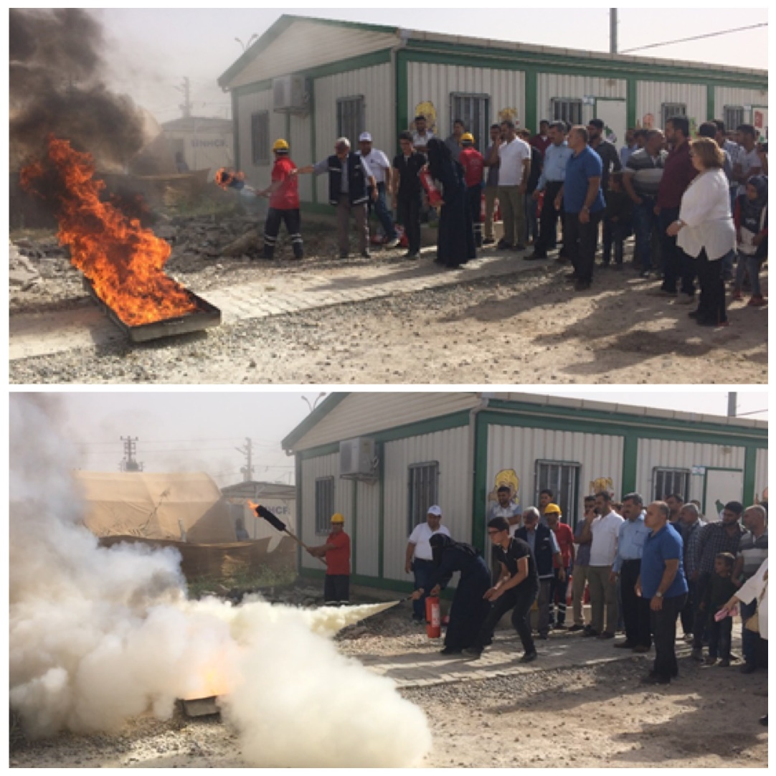
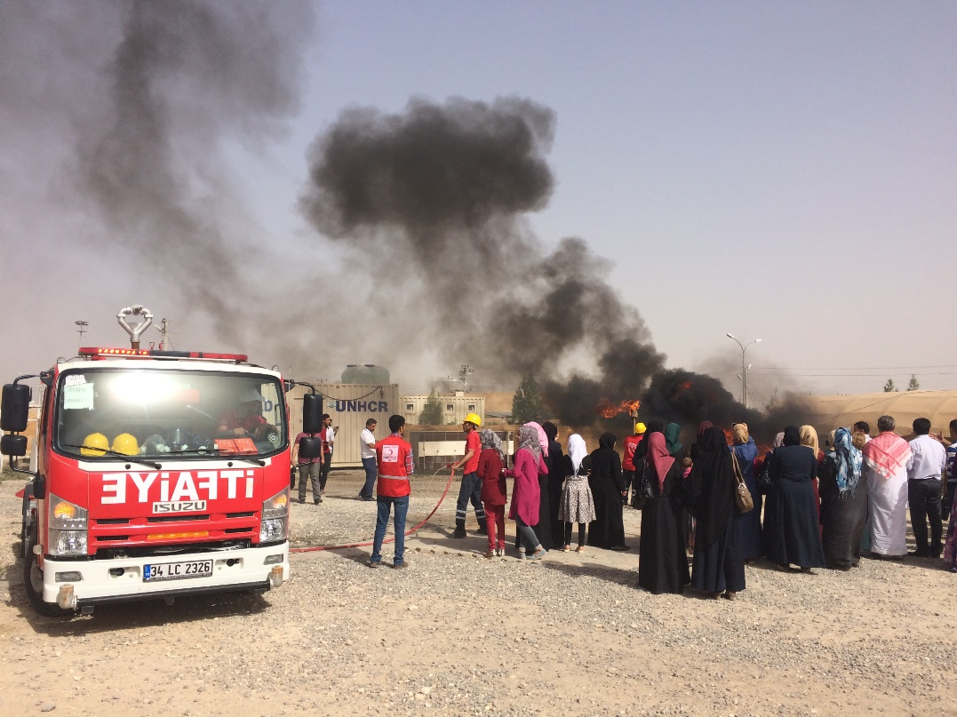
Picture. Fire extinguishing exercise

Slide 11
Training in Suruç Tent City, 9-10 October 2017
Totally 22.418 individuals are living in Suruç Tent City.
In total there are 6701 students and 221 Syrian teachers working in the protection center.
58 voluntary trainers participated.
Table. Number and dissemination of voluntary trainers
 | Pre-School Teacher | Primary School Teacher | Secondary School Teacher | High School Teacher | Special Education Teacher | Member of Youth Council | Member of Wisemen Committee | Member of Vestry | Member of Women Committee
Men | - | 15 | 5 | 14 | - | - | - | 2 | -
Women | 1 | 4 | 8 | 7 | - | - | - | - | 2

Slide 12
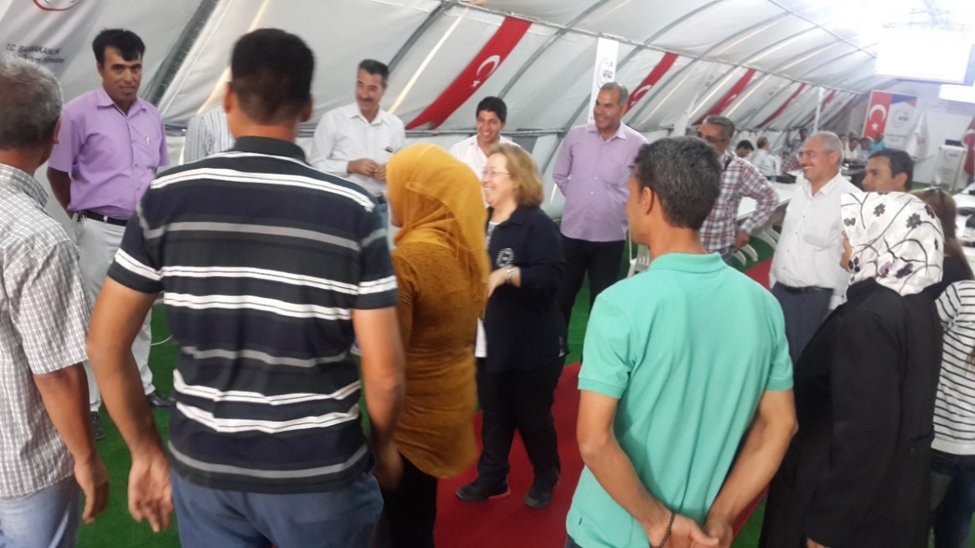
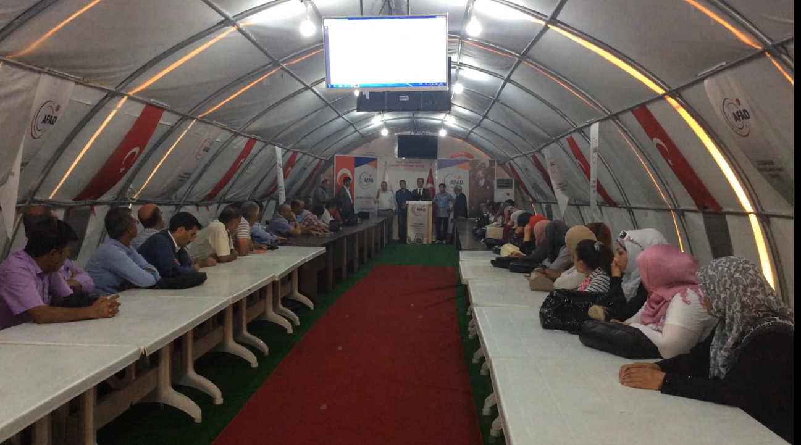
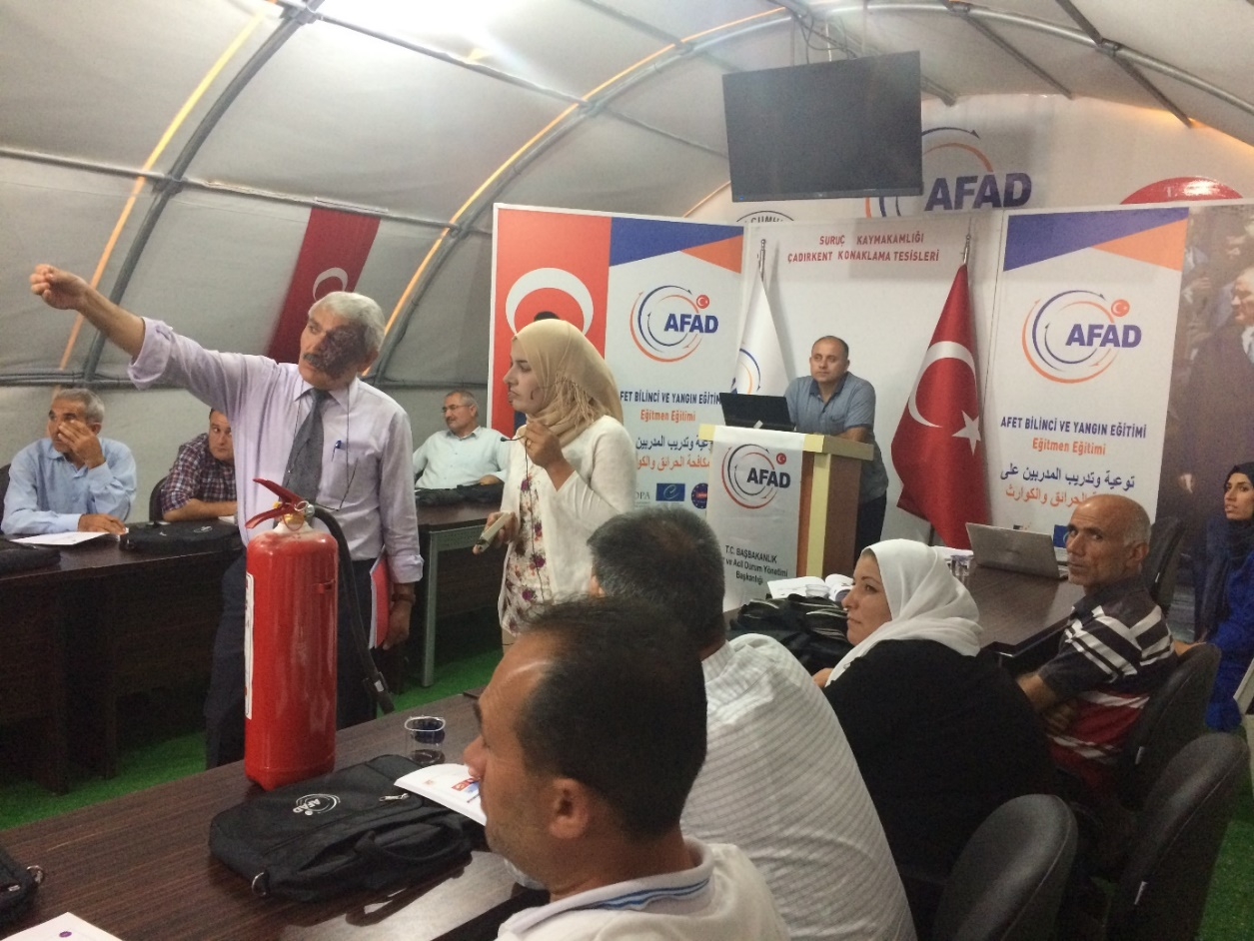
Picture. Overall picture from the training

Slide 13
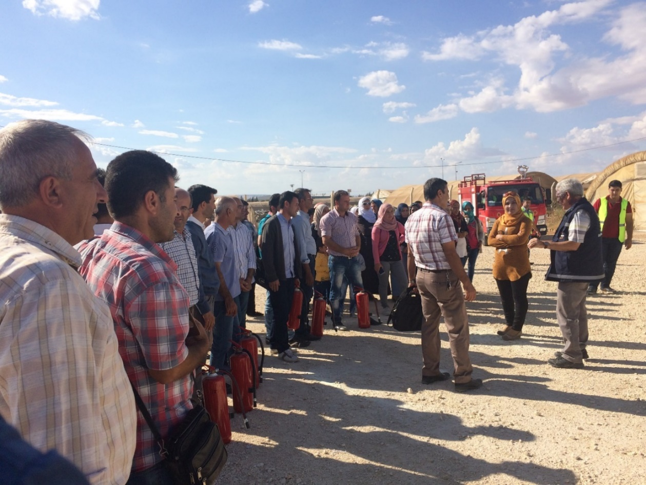
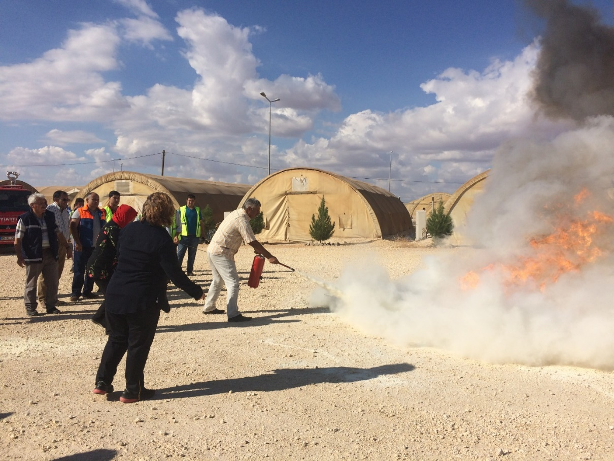
Picture. Fire extinguishing exercise

Slide 14
Training in Akçakale Tent City, 12-13 October 2017
24.034 individuals are living in Akçakale Tent City.
In total there are 9159 students and 277 Syrian teachers working in the protection center.
49 voluntary trainers participated.
Table. Number and dissemination of voluntary trainers
 | Pre-School Teacher | Primary School Teacher | Secondary School Teacher | High School Teacher | Special Education Teacher | Member of Youth Council | Member of Wisemen Committee | Member of Vestry | Member of Women Committee
Men | - | 22 | - | 14 | - | - | - | - | -
Women | 3 | 9 | - | 1 | - | - | - | - | -

Slide 15
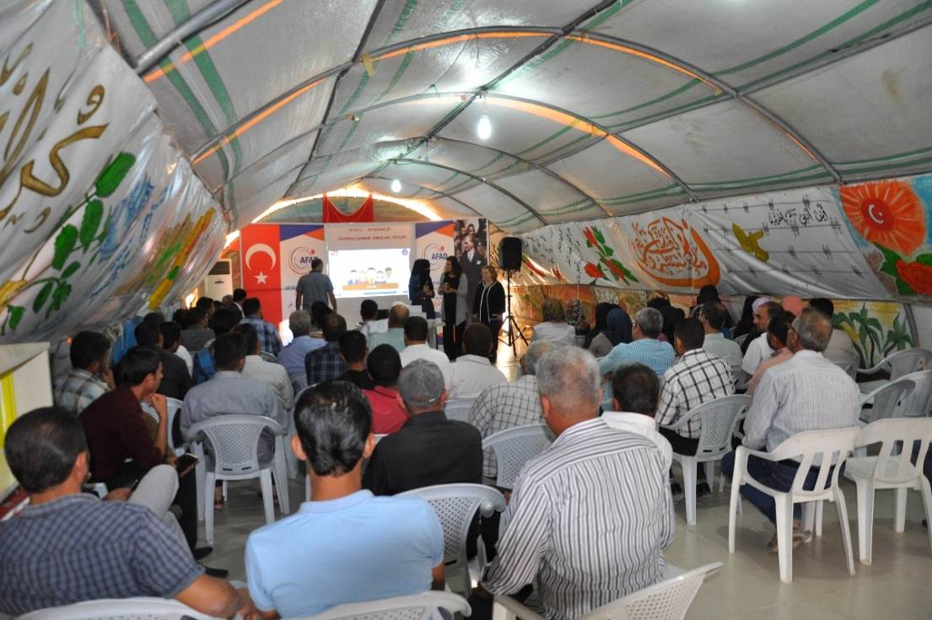
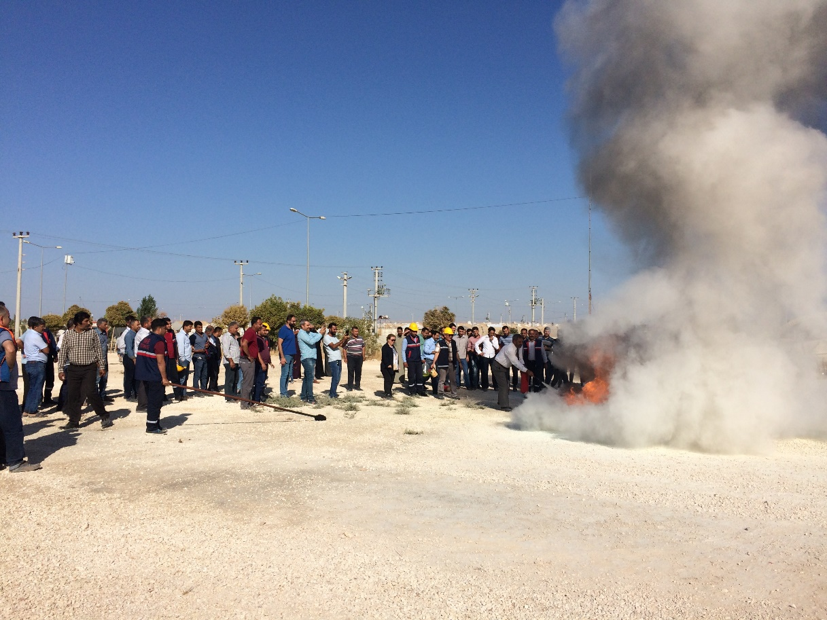
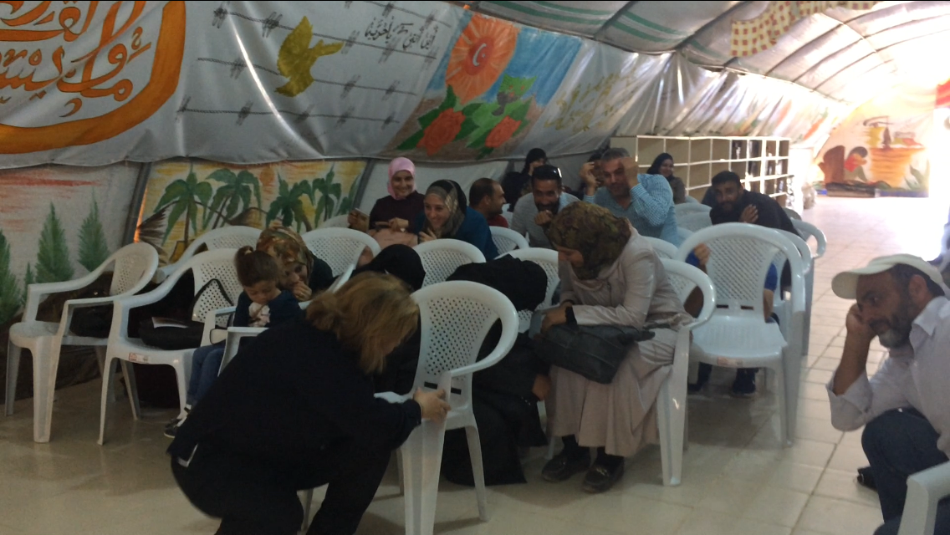
Picture. Overall picture from the training and fire extinguishing exercise

Slide 16
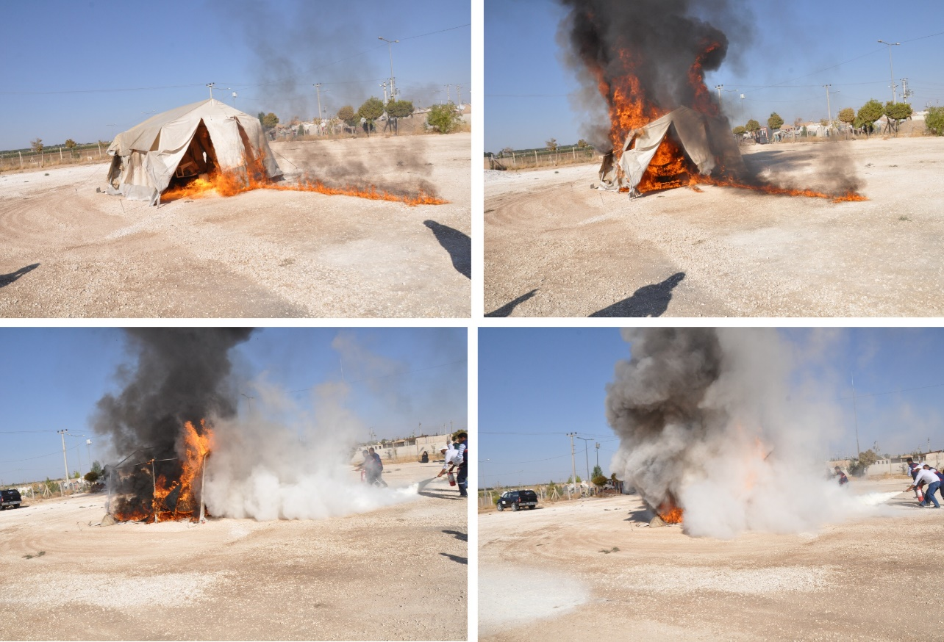
Picture. Simulation of a fire incident in a tent

Slide 17
2018 PROJECT PROPOSALS
European Natural Disasters Training Center
(AFEM)

Slide 18


PROJECT PROPOSALS
Proposal 1;
Workshop on Strengthening the Role of Local Authorities to Build Disaster Resilient Communities
Proposal 2;
Short Film/Spot Film Competition on Disasters and Disability

Slide 19

Proposal 1:
International Workshop on Strengthening the Role of Local Authorities to Build Disaster Resilient Communities
The purpose:
The impact of all disasters is local,
The role of the local authorities in dealing with DRR,
The Making Cities Resilient Campaign of UNISDR.
  Institutional and administrative framework,
  Financing and resources,
  Multi-hazard risk assessment,
  Infrastructure protection,
  Education and health,
  Land use planning,
  Training, education and public awareness,
  Environmental protection,
  Effective preperadness, early warning systems and response,
  Recovery and rebuilding communities
Ten Essentials

Slide 20
Methodology
İstanbul
2 days workshop
Kocaeli
Invitation to 5 cities
Yalova
Making Cities Resilient:
My City is Getting Ready
Participation of;
  Representatives of municipalities and provincial directorates of Ministries
  Representatives from UNISDR as well as from other countries
  Representative of Role Model City
  Academic expert
Gaziantep
Antalya

Slide 21

Themes of Workshop
Introducing the Making Cities Resilient Campaign
How to become a role model city?
Sharing best practies (DRR studies of Municapilities)
Discussion about urban risk, city planning and public awareness
Improving innovative projects

Slide 22
Objectives and Expected Results
Specific Objectives:
Effective interaction between local authorities.
Sharing best practices.
Improve the innovative projects to define and implement local actions related to disaster resilience.
Expected Results:
Evaluate the current situation and sharing the best practices.
Extend the implementation of the campaign in nationwide building disaster resilient communities.
Strengthen the coordination between local authorities.
Encourage the Municipalities to develop work related to DRR.

Slide 23

Proposal 2
Short Film/Spot Film Competition on “Disasters and Disability”
The purpose is;
to raise awareness on disasters among all the layers of the public.
to use visual arts such as cinema, an important mass media tool. Short film, is a popular field especially among the youth, particularly the university students, and it may be used to raise the awareness on disasters and disability.

Slide 24

Objectives and Expected Results
Specific Objectives:
To raise awareness on vulnerable groups, especially people with disabilities, at disasters among public and particularly the university students by using disaster and disability themed short films as a tool.
To create disaster awareness culture among the youth and to encourage them to think to the issues related to disasters.
Expected Results:
Through the short film/spot film competition, university students will be informed of disasters and their effects on the community, especially on people with disabilities.
If students are made aware of “disasters and disability”, they will be more sensitive to this social issue and raise awareness of the community in the future.

Slide 25
THANK YOU ..
Dr. Yeliz TEKER
yeliz.teker@afad.gov.tr

