Slide 1
The Aims of Language Teaching and Learning
Mike Fleming

Slide 2
AIMS

Slide 3
‘Traditional’ view of Language as Subject and foreign language teaching

Slide 4
Flaws in traditional view
Language as Subject not always first language
Reductive view of foreign language teaching
‘First language’ not homogeneous concept
Acquisition of first language not entirely natural
Limited conception of language and meaning

Slide 5
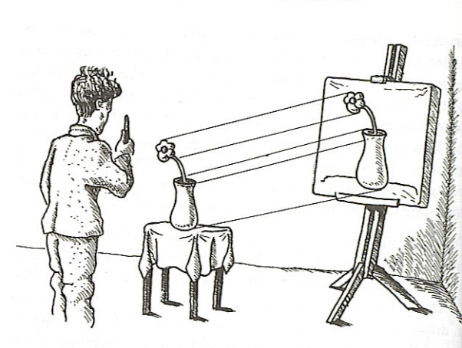
Picture theory of language
Meaning: a function of use in social contexts

Slide 6
ambiguity
texture
uncertainty
nuances of meaning
Notes:
A view of language that embraces ambiguity, uncertainty, texture and nuances of meaning as being central to language use and not just confined to creative and aesthetic uses of language in literature and poetry

Slide 7
However…
Importance of first language or ‘mother tongue’
Language is not just a disembodied tool

Slide 8
Balancing the need to promote national and international languages while preserving the teaching and learning of minority languages.
Regional, Minority and Migration Languages http://www.coe.int/T/DG4/Linguistic/Default_en.asp
Notes:
The paper Regional, Minority and Migration Languages recognizes the complexity facing policy developers when seeking to balance the need to promote national and international languages with a concern to preserve the teaching and learning of minority languages.

Slide 9
Language in Other Subjects
Traditional view sees Language as Subject as a service provider to other subjects
Not entirely wrong but not the whole story
Language cannot just be summoned to do a specific job without recognition of the importance of context and use

Slide 10
Summary of traditional view
discrete approach to describing aims
Language as Subject embraces personal growth
aims of foreign language learning conceived fairly straightforwardly
subject curriculum has responsibility for developing subject specific knowledge with language just seen as a tool

Slide 11
Summary of integrated view
recognises the overarching aims of plurilingualism and interculturalism as relevant to all aspects of the curriculum
and
associated with education for active, responsible, participatory citizenship, democratic participation and personal growth.

Slide 12
Practical Implications
Importance of dialogue and mutual understanding
Development of whole school policy on language
Examination of the shared goals of language learning and the particular responsibilities of aspects of the curriculum

