Slide 2
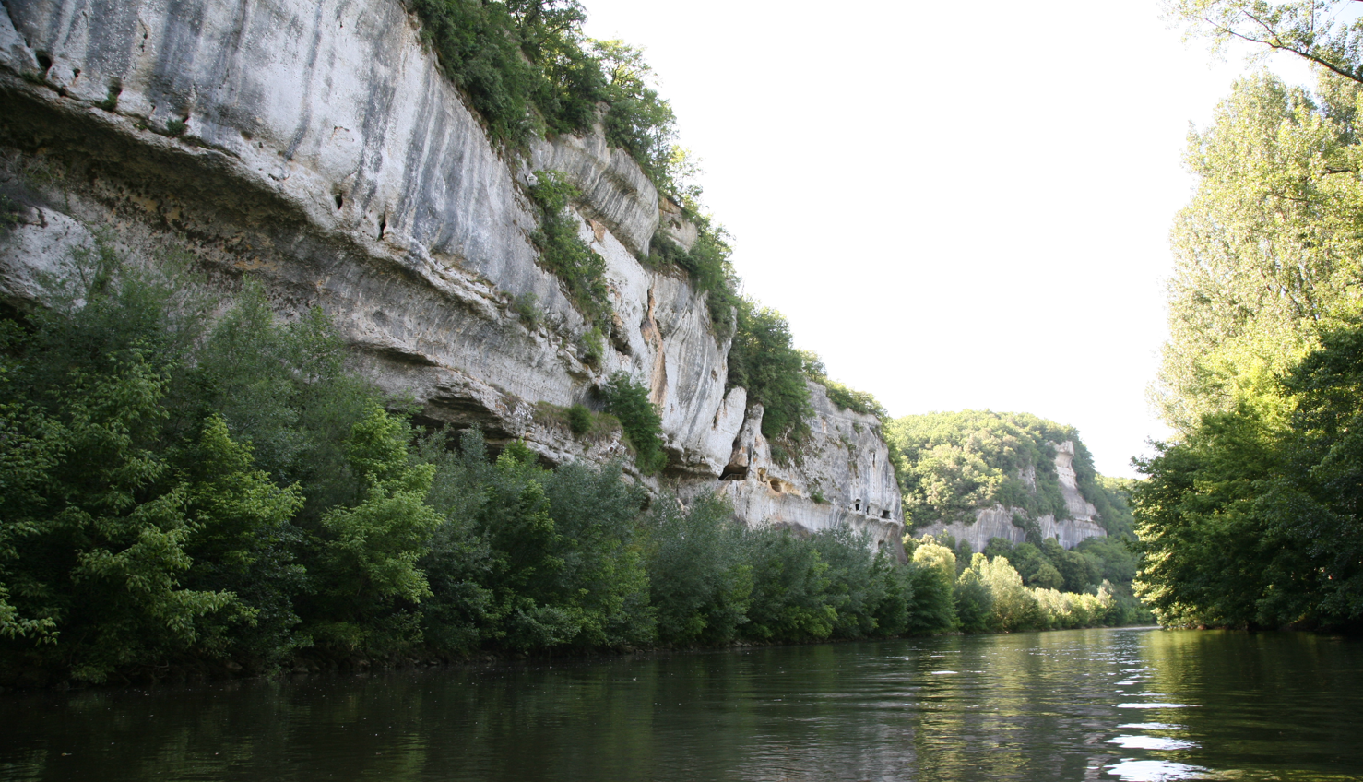
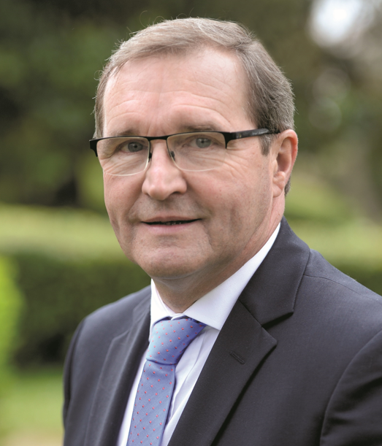
WELCOME TO DORDOGNE, THE EUROPEAN PALAEOLITHIC PARADISE
BIENVENUE EN DORDOGNE, LE PARADIS PALÉOLITHIQUE EUROPÉEN

Slide 3
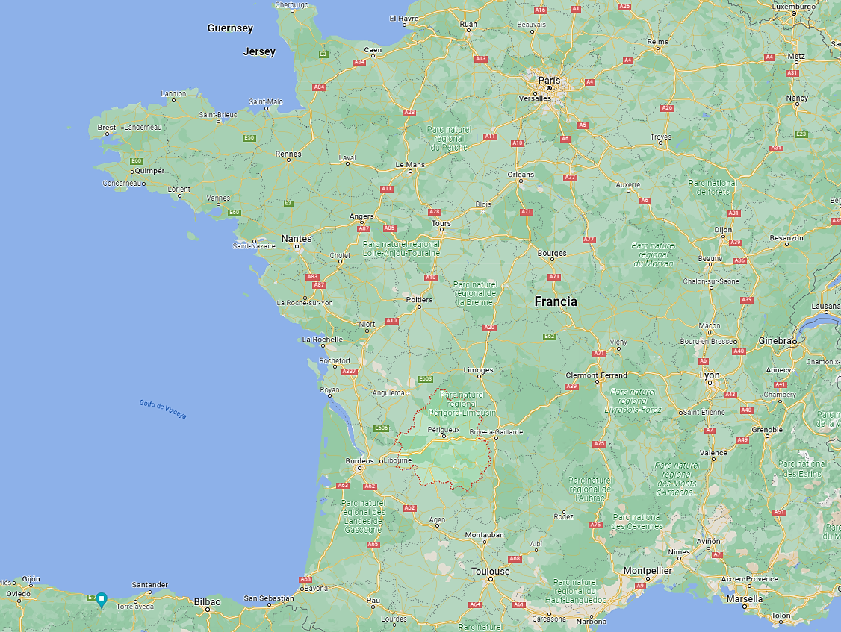
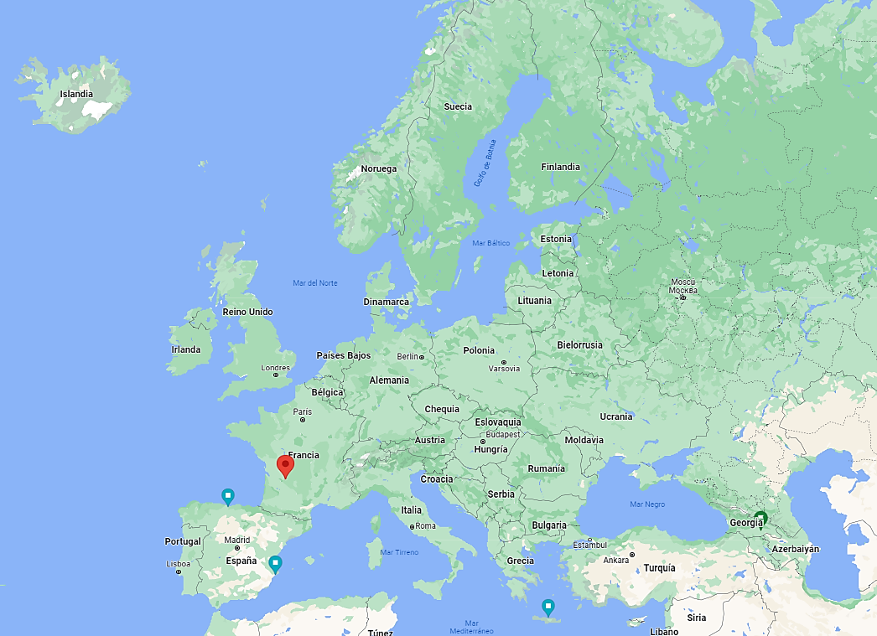
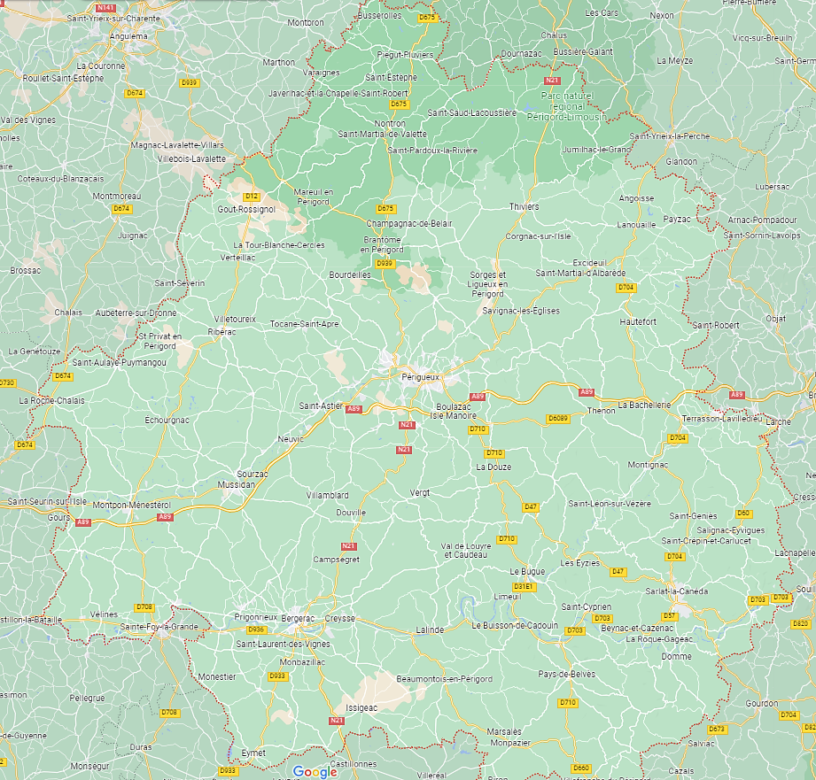

Slide 4
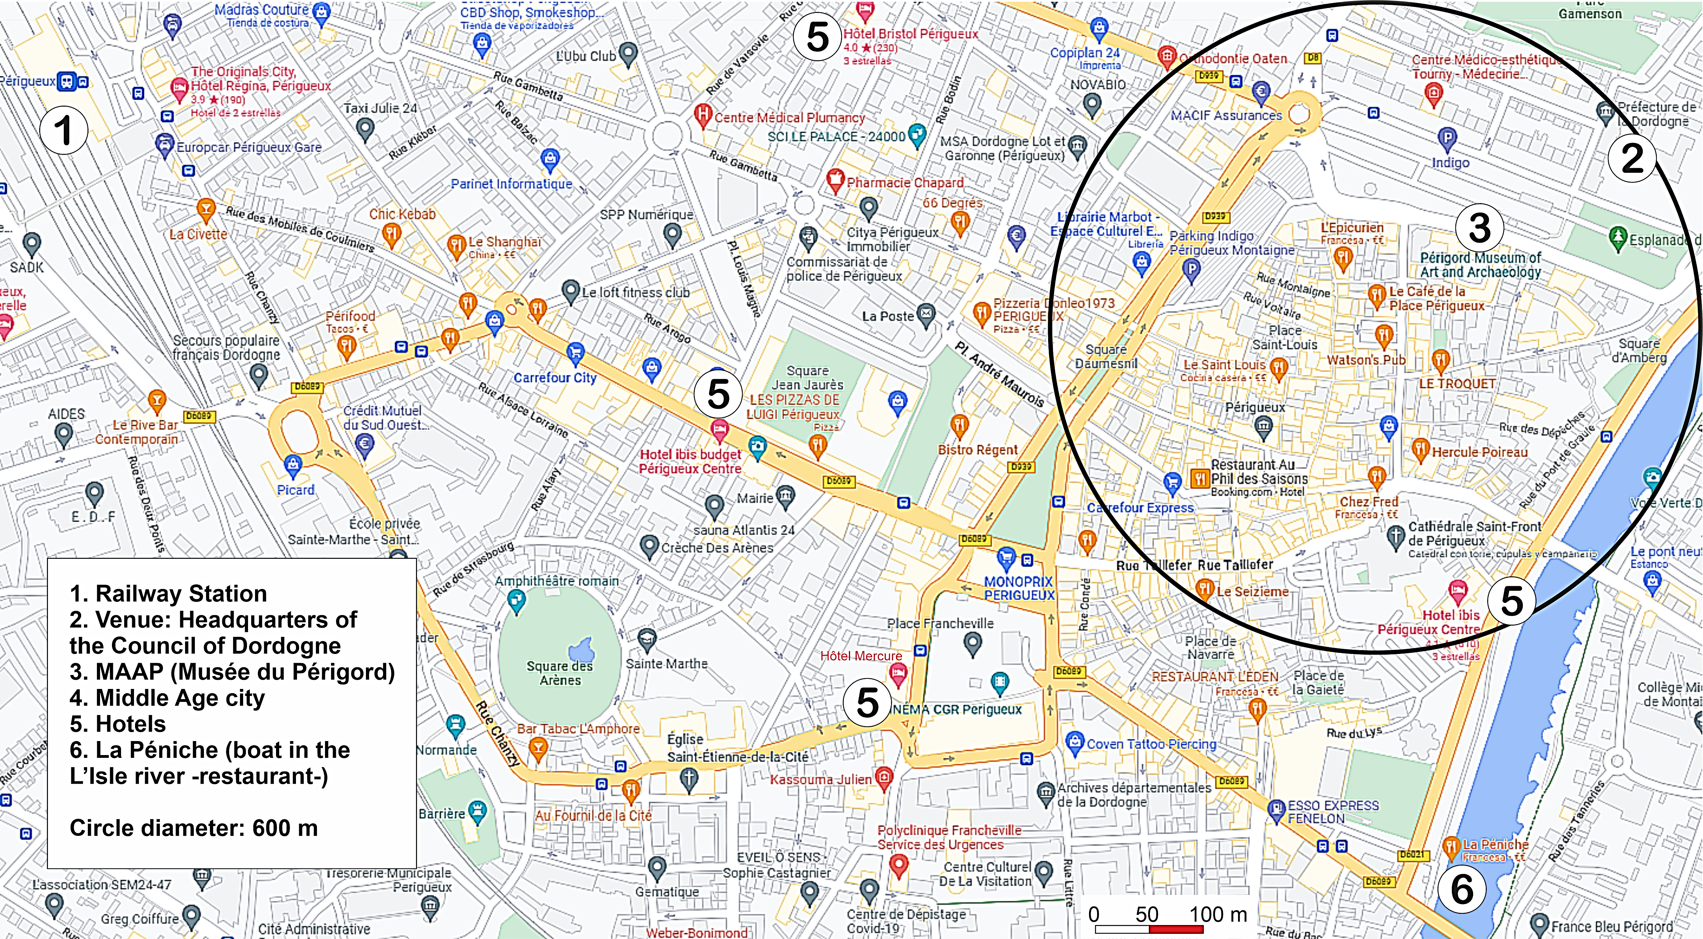

Slide 5
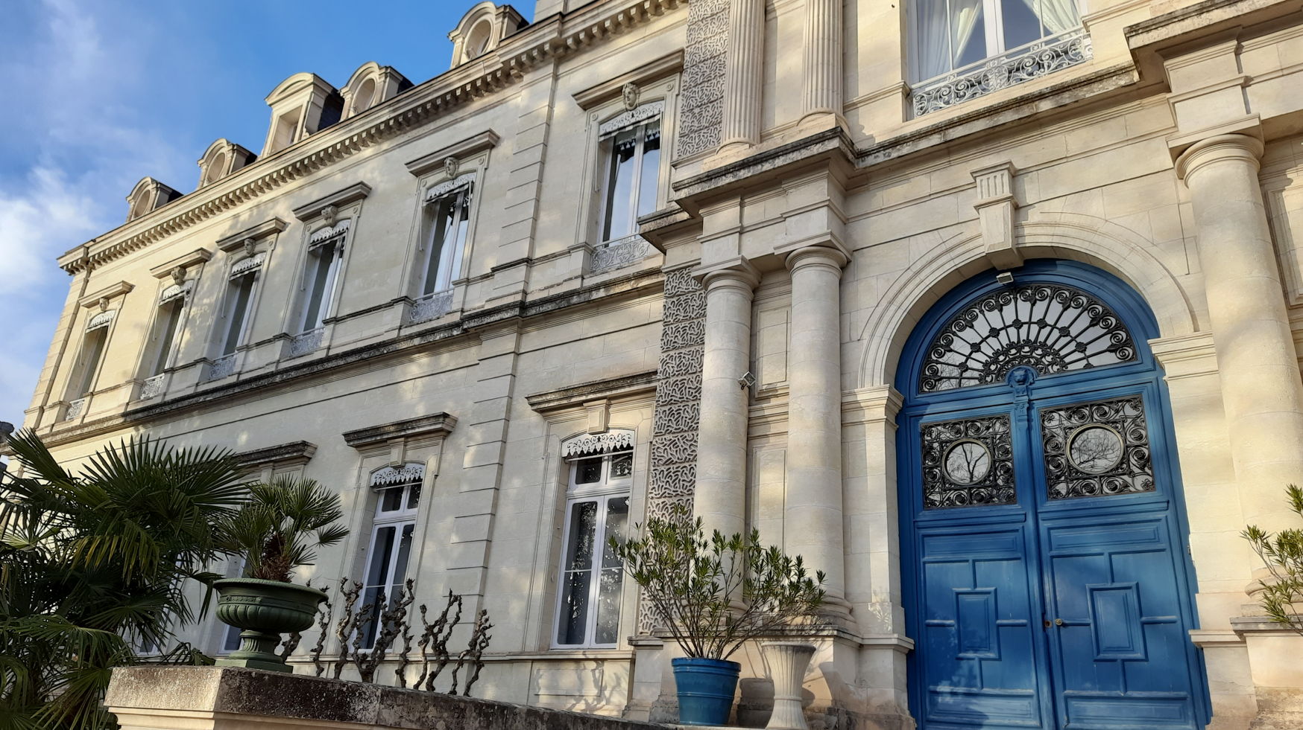
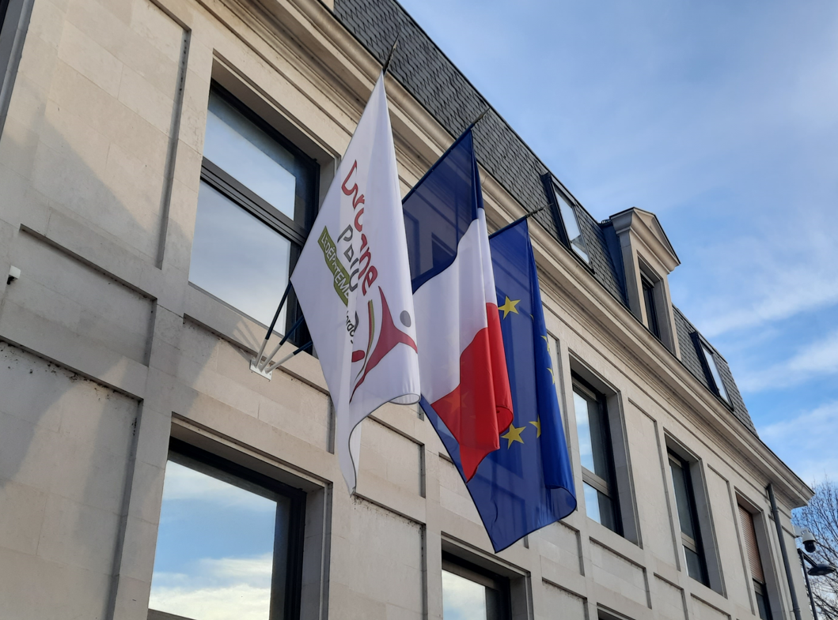
Venue 1: headquarter of Conseil Départemental de La Dordogne

Slide 6
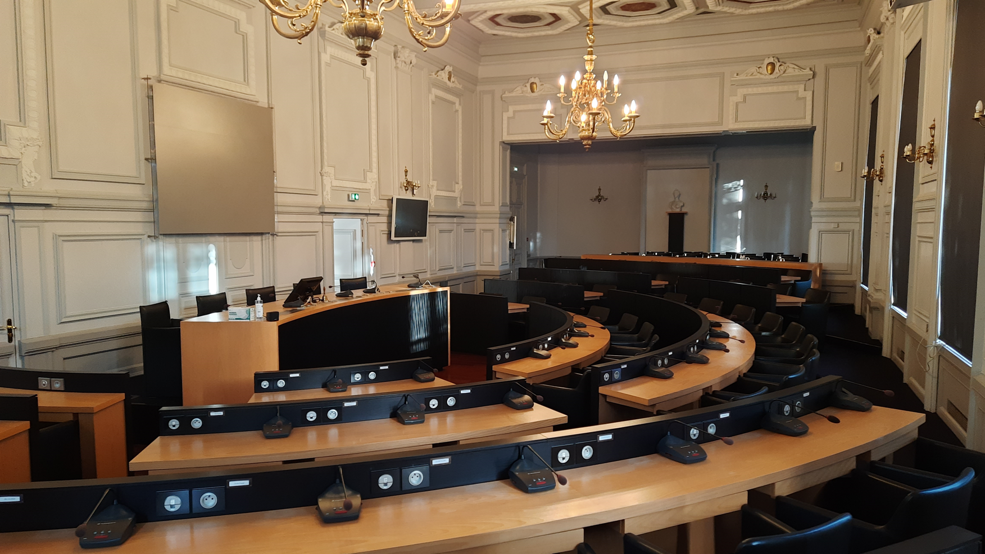
Venue 1: headquarters of Conseil Départemental de La Dordogne

Slide 7
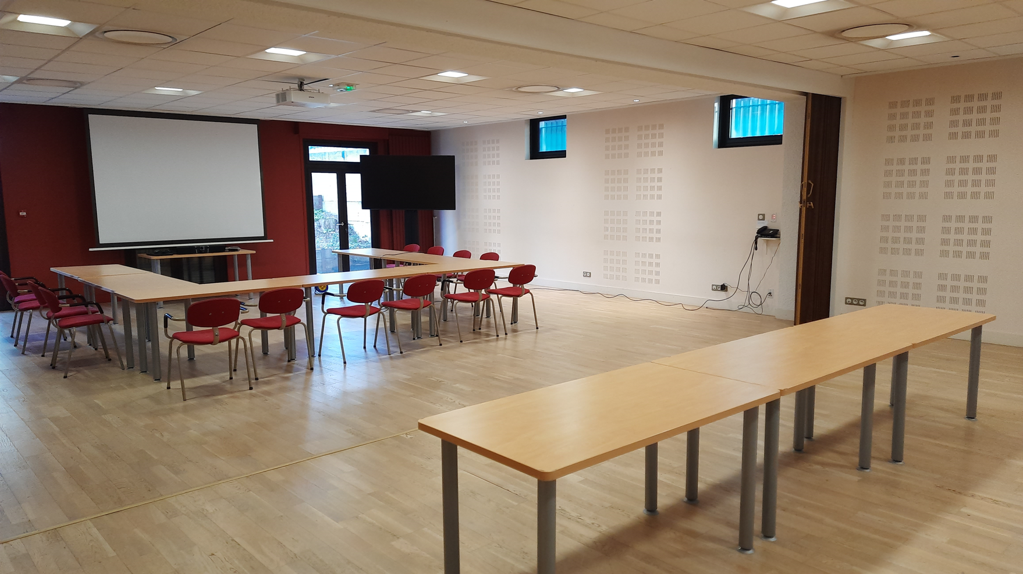
Venue 1: headquarters of Conseil Départemental de La Dordogne

Slide 8
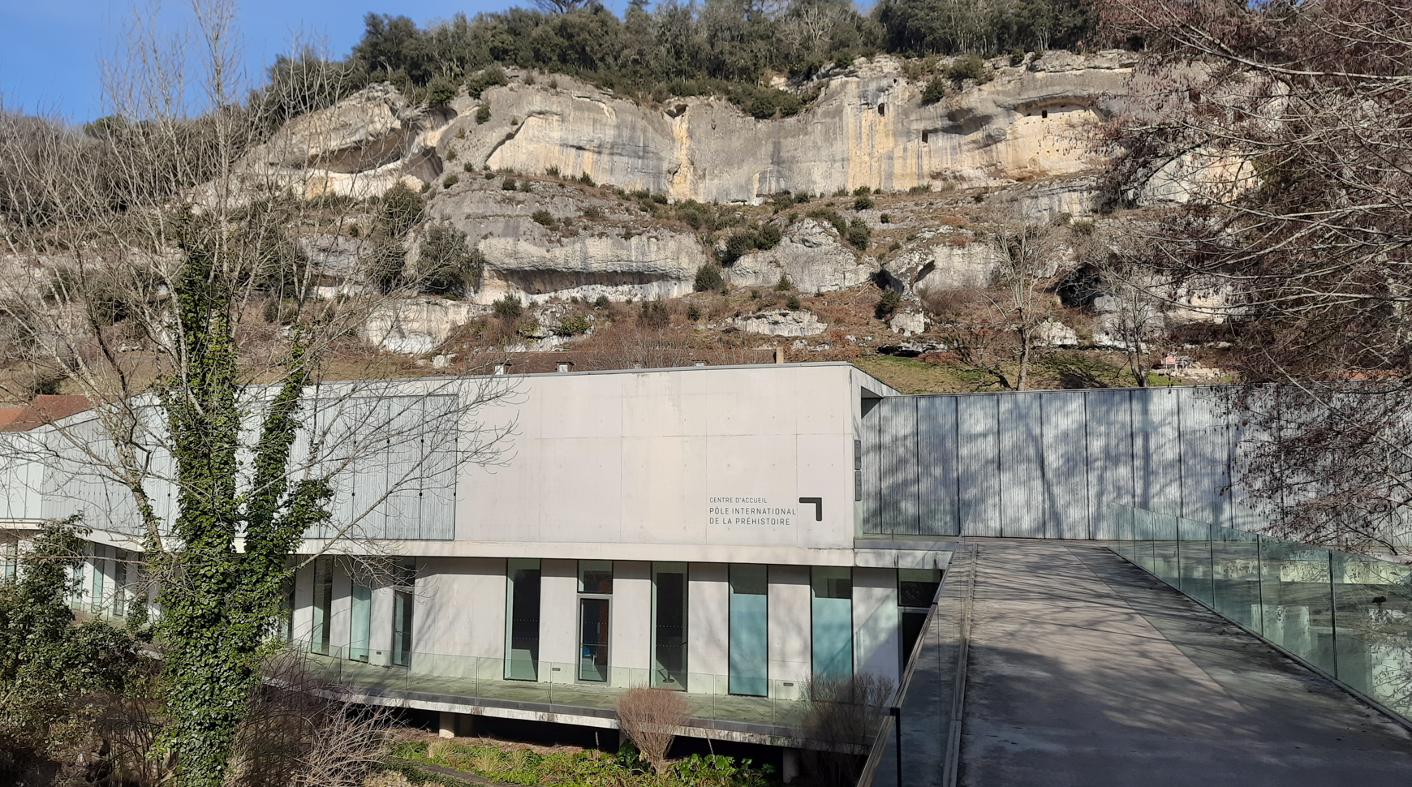
Venue 2: PÔLE INTERNATIONAL DE LA PRÉHISTOIRE –PIP-

Slide 9
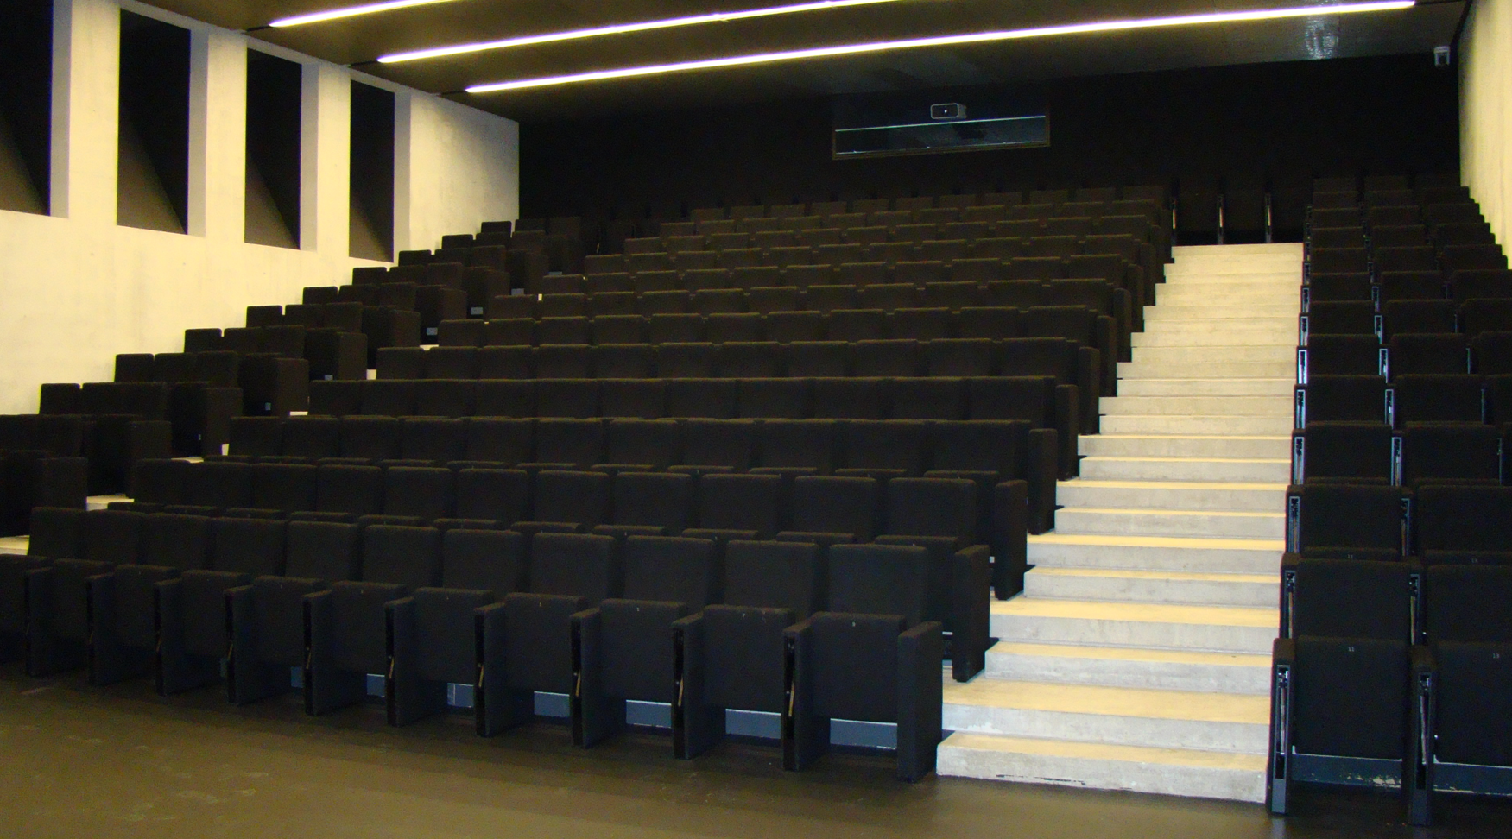
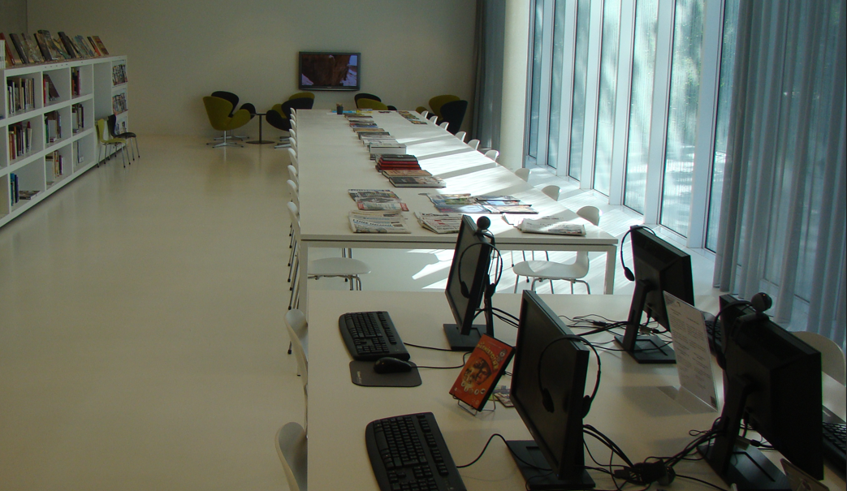
Venue 2: PÔLE INTERNATIONAL DE LA PRÉHISTOIRE
Les Eyzies de Tayac-Sireuil –PIP-

Slide 10
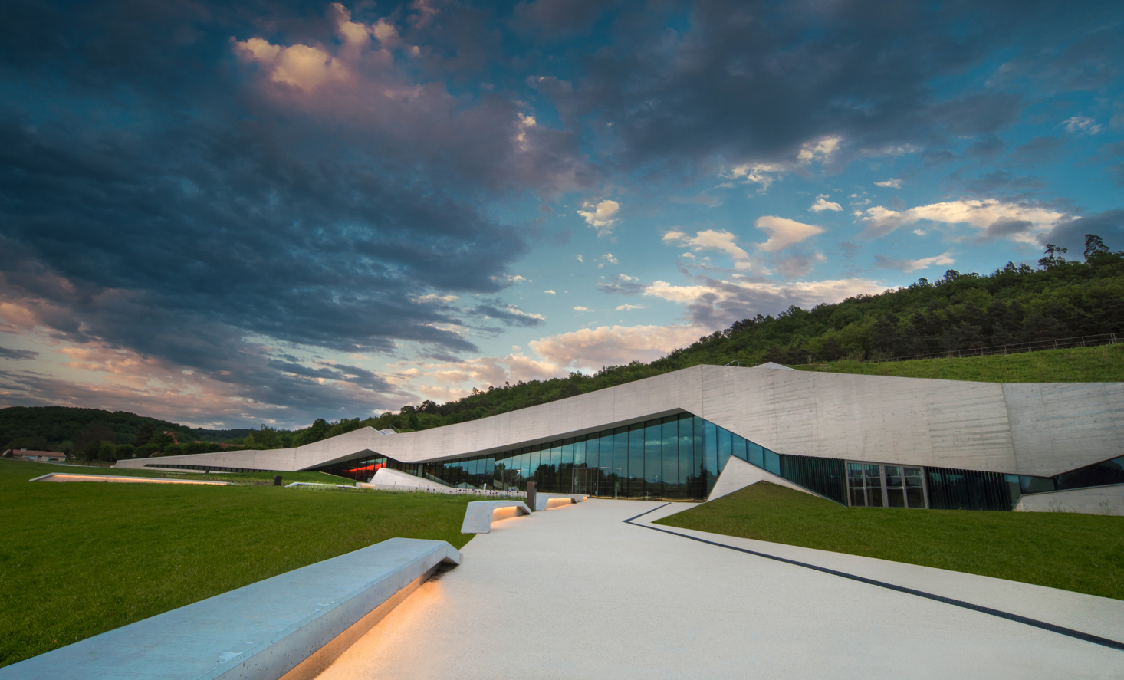
Special visit: Centre d’Interprétation du Art Pariétal
LASCAUX - MONTIGNAC

Slide 11
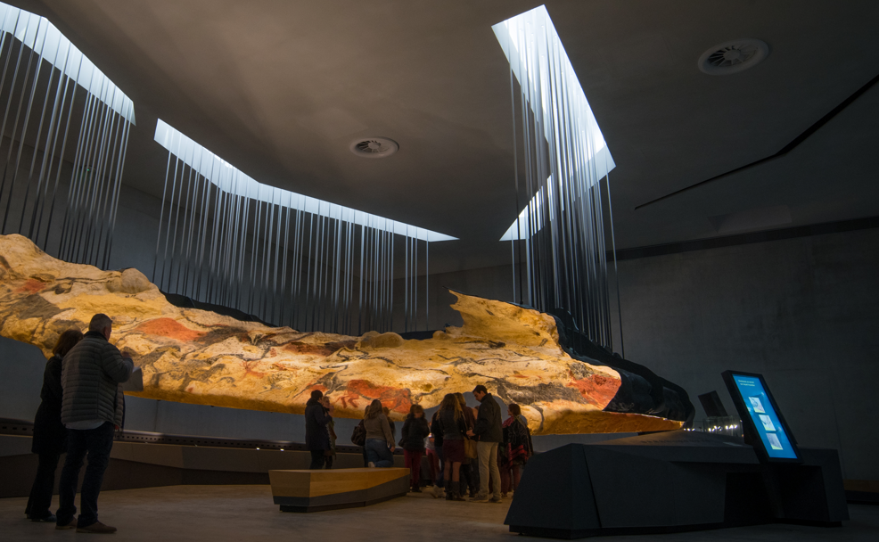
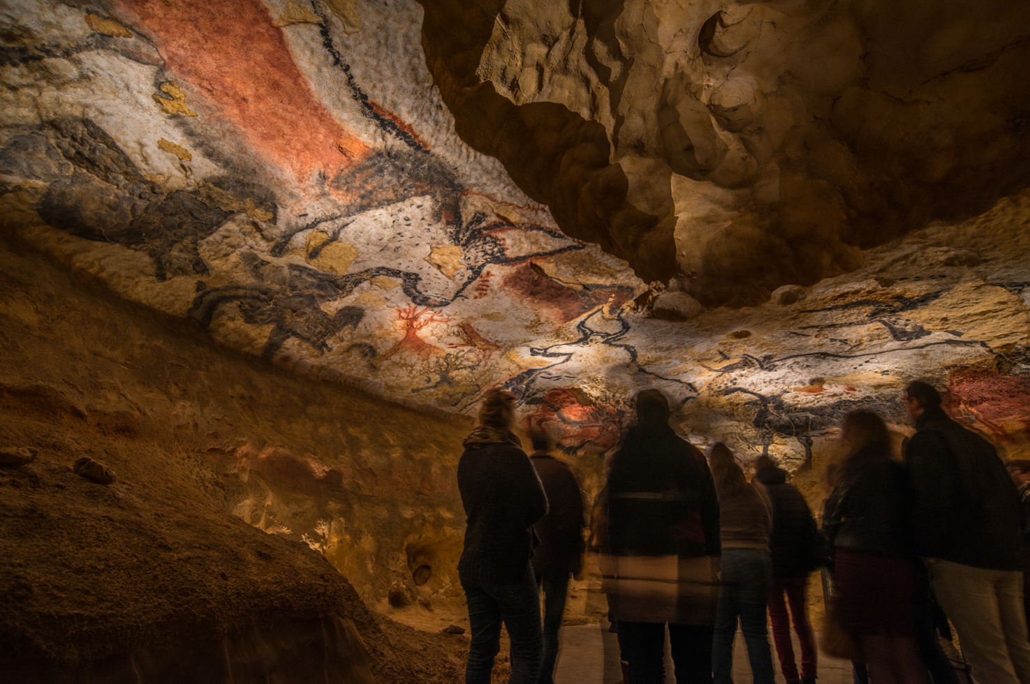
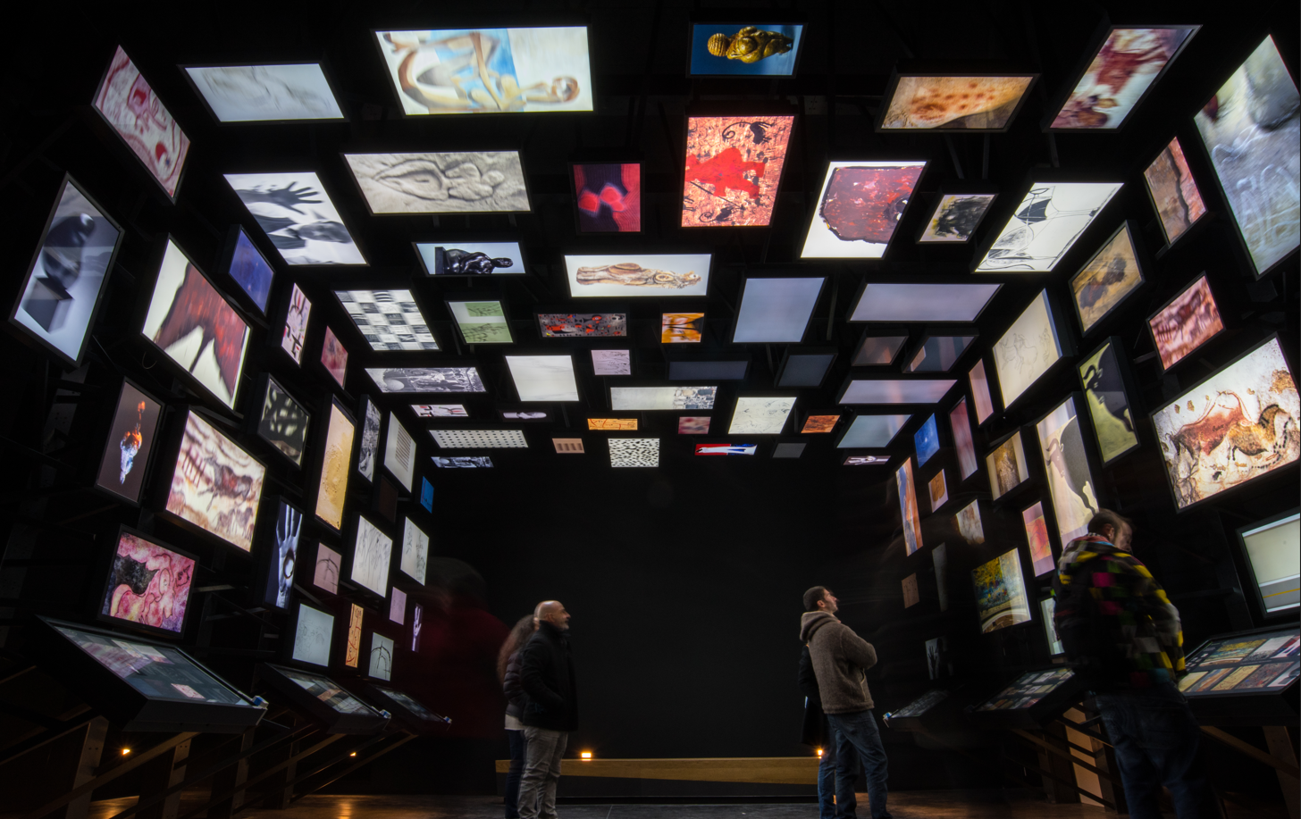
Special visit: Centre d’Interprétation du Art Pariétal
LASCAUX - MONTIGNAC

Slide 12
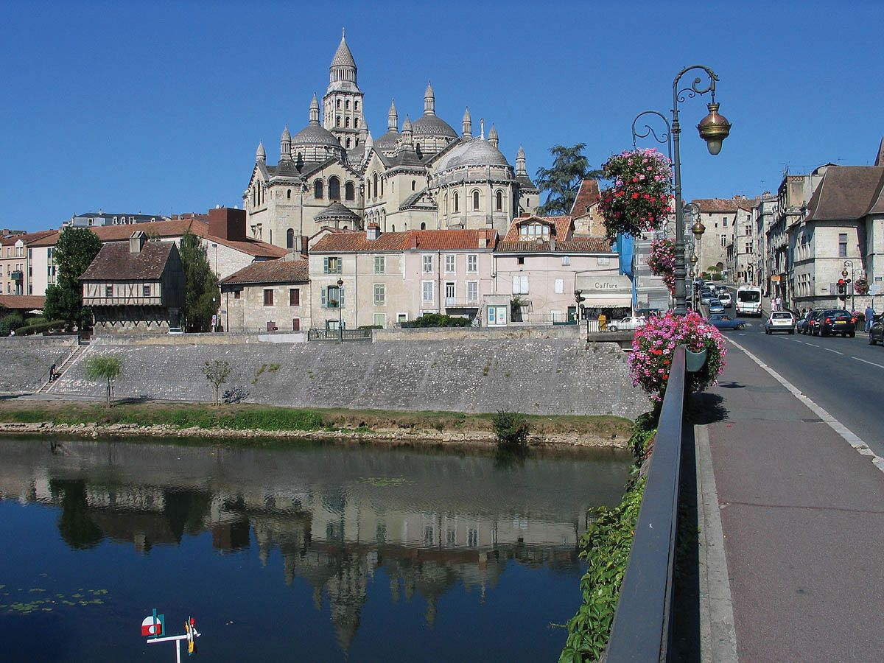
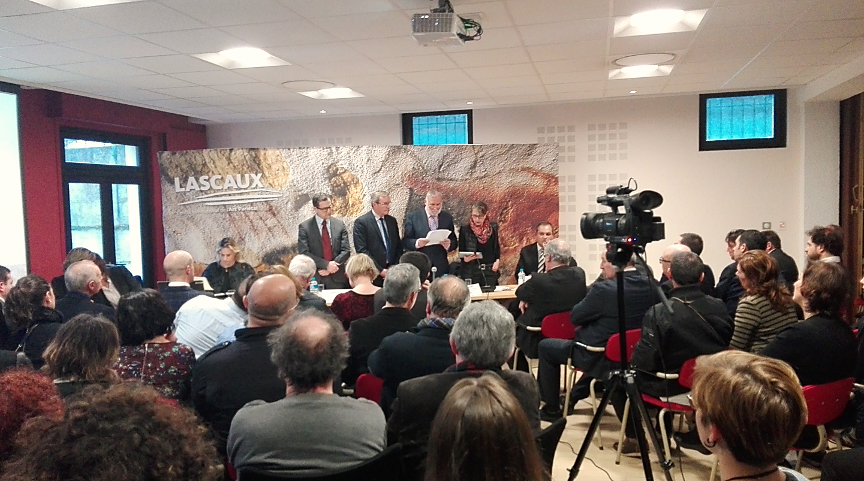
Programme Draft 22/02/2023
30 May. Périgueux (Capital of Dordogne Region)
18h00 – 20h30. Reception of participants and get-together session.
31 May. Périgueux (Venue: headquarters of Conseil Départemental de La Dordogne)
08h30-09h00. Registration of participants.
09h00-09h20. Institutional opening of the Training Academy.
09h20-09h40. Opening Speech (30’). Germinal Peiro (Chairperson of PRAT-CARP CR and President of Dordogne). Visibility, Cooperation and Sustainability in Cultural Tourism: The experience of Dordogne Region.
09h40-10h00. Framing the topics. Inger Harlevi -The Hansa Cultural Route-. Coordinator of Task Force of Cultural Routes.
10h00. Working session 1.
12h00. Lunch.
14h00. Working sesión 2.
17h30 – 19h00. Free time to visit the Historic centre.
19h00. Visit to Musée d’Art et d’Archéologie du Périgord (MAAP)
20h00. Diner at MAAP.

Slide 13
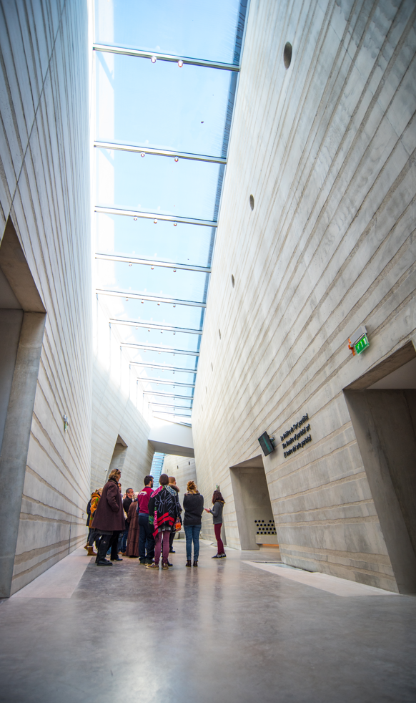
Programme Draft 22/02/2023
01 June. Montignac/Les Eyzies de Tayac (Venue: CIAP Lascaux and Pôle d’Interprétation de La Préhistoire)
08h30. Transfer by BUS to Montignac / Les Eyzies de Tayac – Sireul
10h00. Working session 3.
15h00. Visit to LASCAUX (World Heritage UNESCO)
18h45. Return to Périgueux
20h00. Dinner at La Peniche (boat on the L’Isle river)
02 June. Périgueux (Venue: headquarters of Conseil Départemental de La Dordogne)
08h30. Working session 4.
1h30. Closure of the Training Academy.

Slide 14
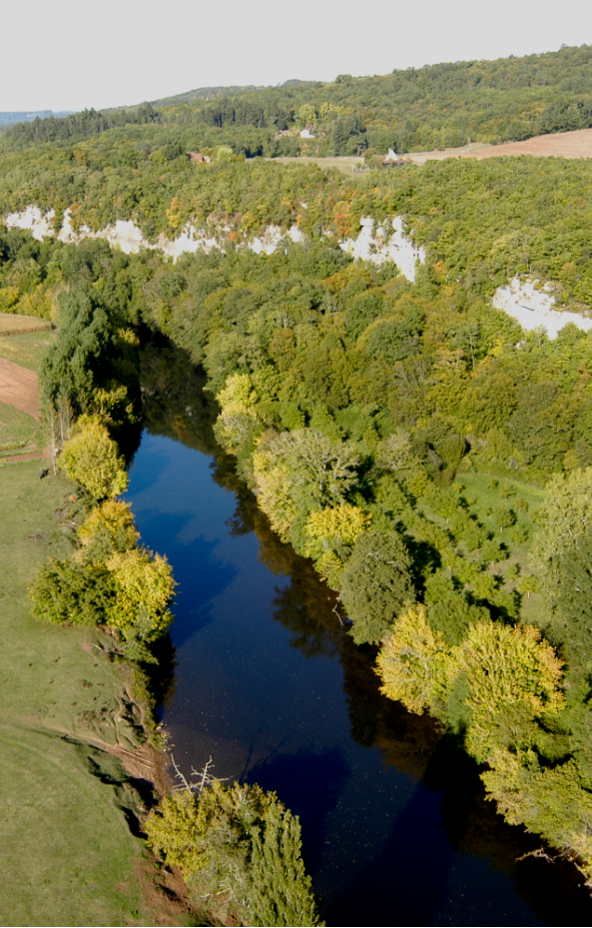
Working session 1. Wednesday, 31th May
Time Table | How to improve the VISIBILITY of the Cultural Routes of the Council of Europe. | Lecturer(s) from
10:00 | Keynote speaker on the topic (30’) | Academic speaker proposed by EICR
10:30- 11:00 | Framing the topic of Visibility on Cultural Routes
 | Presentation of report of the Working Group on Visibility of Cultural Route of the CoE (10’) | Benedetta Diamantini -European Route of Ceramics- & Eleonora Berti -Destination Napoleon CR- (Coordinators of WG on Visibility)
10:40 | 2 Good Practices Presentations followed by Q&A (I) (30’) – 10’ each good practice + 5’ for Q&A | Cultural Routes of the Council of Europe
11:10 | COFFEE-BREAK
11:30-12:00 | 2 Good Practices Presentations followed by Q&A (I) (30’) – 10’ each good practice + 5’ for Q&A | Cultural Routes of the Council of Europe
12:00 | Debate (30)’
12:30 | Lunch

Slide 15
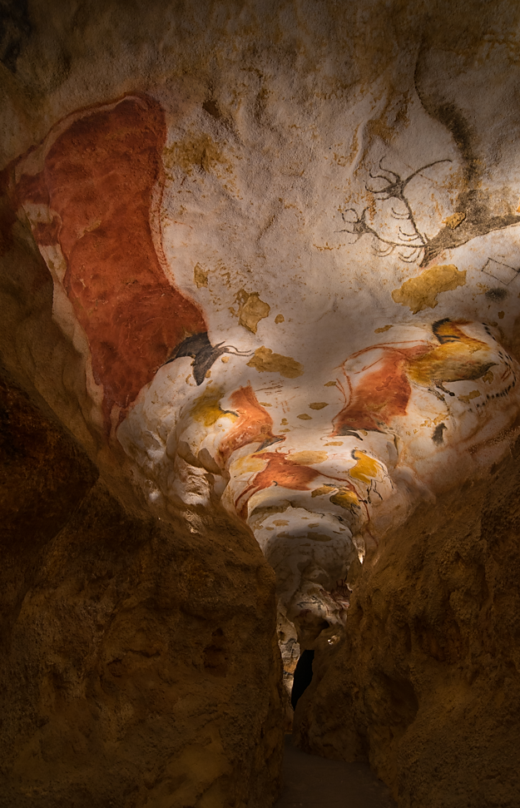
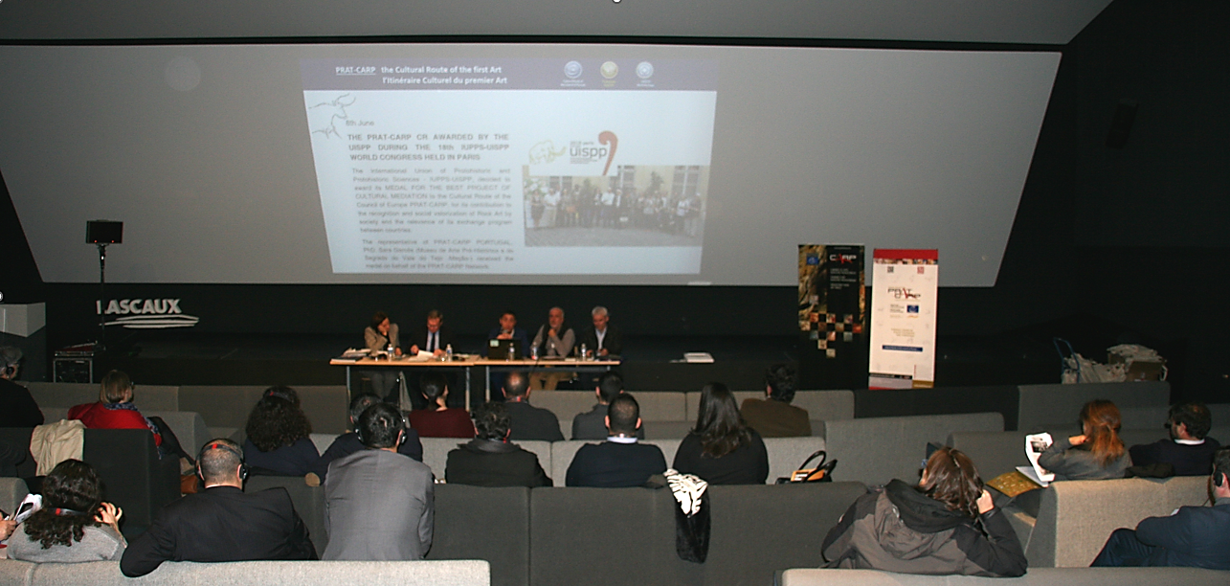
Working session 2. Wednesday, 31th May
Time Table | How to Improve the COOPERATION of the Cultural Routes of the Council of Europe. | Lecturer(s) from
14:00 | Cooperation between Cultural Routes | Bruno Favel -Ministère de la Culture et de la Communication, France-
14:30-15:00 | Framing the topic of Cooperation on Cultural Routes.
 | Presentation of report of the Working Group on Cooperation of Cultural Route of the CoE (10’) | Víctor Sorensen -European Route of Jewish Heritage- (Coordinator of WG on Cooperation)
14:40 | 3 Good Practices Presentations followed by Q&A (I) (30’) – 10’ each good practice + 5’ for Q&A | Cultural Routes of the Council of Europe
15:25 | COFFEE-BREAK
15:45 | INTERACTIVE SESION (4 groups) | Managers of Cultural Routes of the Council of Europe
17:00 | Common debate (30’)
17:30 | END OF SESSION

Slide 16
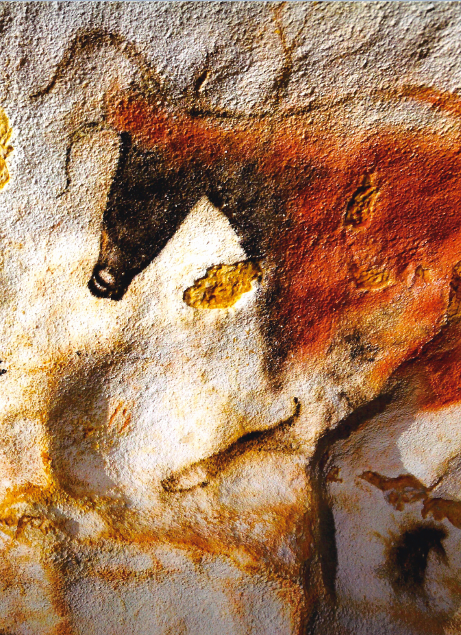
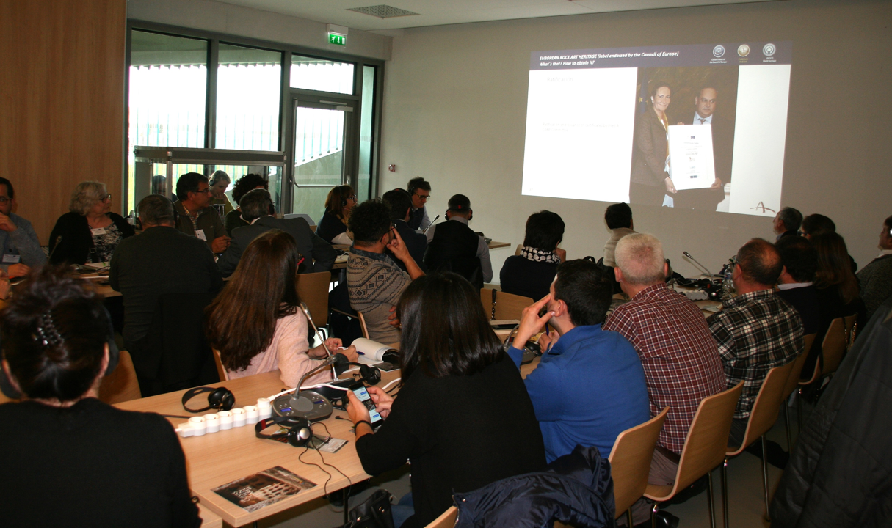
Working session 3. Thursday, 1st June
08h30. Transfer by BUS to Montignac (or Les Eyzies de Tayac – Sireul)
Time Table | How to Improve the SUSTAINABILITY of the Cultural Routes of the Council of Europe. | Lecturer(s) from
10:00 | Sustainable Tourism at the “Land of Cro Magnon people” | Christophe Vigne -Director of Pôle d’Interpretation of the Prehistory, Dordogne
10:30-10:40 | Framing the topic of Sustainability on Cultural Routes.
 | Presentation of report of the Working Group on Sustainability of Cultural Route of the CoE (10’) | Stefanie Bischof -The Hansa- Coordinator of WG on Sustainability.
10:40 | 2 Good Practices Presentations followed by Q&A (I) (30’) – 10’ each good practice + 5’ for Q&A | Cultural Routes of the Council of Europe
11:15 | COFFEE-BREAK
11:30-12:15 | INTERACTIVE SESION (4 groups) | Managers of Cultural Routes of the Council of Europe
12:15 | Common debate (30)’
12:45 | LUNCH

Slide 17
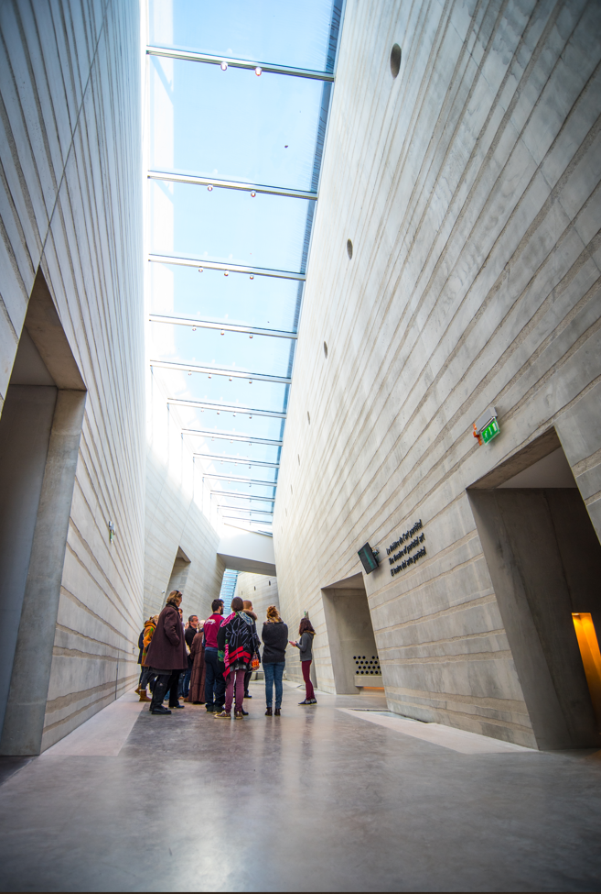
Working session 4. Friday, 2st June
Time Table | LOOKING TO THE FUTURE | Lecturer(s) from
8:30- 9:30 | MEETING OF OFFICIAL REPRESENTATIVES OF CULTURAL ROUTES
9:30-10:15 | Lecture on Cultural Tourism. Presentation of the UNWTO Report: Preliminary Conclusions from the World Experts Meeting on Cultural Tourism ? (30’) | Proposed by EICR
 | Q&A (15’)
10:15 | Wrap-up Session and main conclusions (I) (60’) -WG Visibility (20’) followed by Q&A (10’) -WG Cooperation (20’) followed by Q&A (10’) | Cultural Routes of the Council of Europe coordinated by the Task Force with the Participation of coordinators of WG
11:15 | COFEE BREAK
11:30 | Wrap-up Session and main conclusions (II) (30’) -WG Sustainability (20’) followed by Q&A (10’) | Cultural Routes of the Council of Europe coordinated by the Task Force with Participation of coordinators of WG
12:30 CLAUSURE OF THE TRAINING ACADEMY

Slide 18
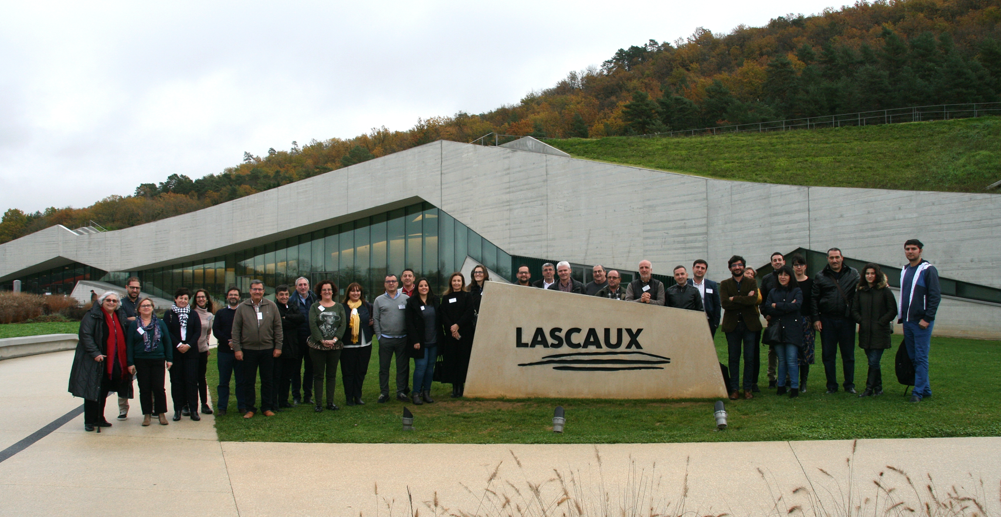
WE ARE ALREADY WAITING FOR ALL OF YOU !!!

