Slide 1
Training of judges at times of war: why and how?
Tetyana FULEY
HELP focal point
National School of Judges
UKRAINE

Slide 2
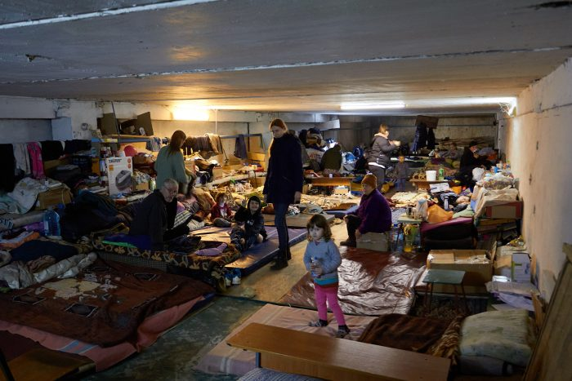
Courts in time of war: challenges
security of the courts functioning and court staff work – life-safety priority;
territorial jurisdiction of court cases might be changed in accordance with the law – in case it is impossible to administer the justice in certain territory where martial law has been imposed;
obstacles for access to justice;
new types of cases (collaboration, war crimes, compensation for damage due to loss of property, injuries, etc.);
number of violent crimes involving the use of weapons might increase;
application of recently adopted legislation (amendments to the Laws On the Principles of National Resistance and On the Martial Law; Law On Ensuring the Participation of Civilians in the Defense of Ukraine (No. 2114-IX); amendments to the Criminal Code re increasing criminal responsibility for looting, etc.).
Notes:
Amendments to the Law of Ukraine "On the Judiciary and the Status of Judges" re ensuring the sustainable functioning of the Judiciary (No. № 2128-IX) and determining the territorial jurisdiction of court cases (No. № 2112-IX)
It should be understood that there are still many circumstances and situations that do not allow to exercise the right of access to justice
the reason for non-appearance of the participant in the trial
person is hiding in the basement;
evacuation;is located outside Ukraine;
to be in territorial defense;
no connection due to network failure.

Slide 4
New courses for judges
“Administration of justice in time of war”
“Martial law: prohibitions and restrictions”
“Criminal proceedings under martial law”
Training of judges and court staff
47 events
“Access to justice for people with disabilities in time of war”
“Administration of justice by commercial courts in time of war: problems, challenges, solutions”
“Cybersecurity and current challenges in judicial activity”
“Russian military aggression against Ukraine: national and international judicial protection”
“Some rules of conduct and responsibility of civilians in conditions of military aggression”

Slide 5
“Overcoming the consequences of trauma: psychological help”
Psychological help
9 events
“Psychological adaptation of judges and court staff to work in wartime”
“Skills of psychological and pre-medical assistance in time of war”

Slide 6
European Judicial Training Network (EJTN) Steering Committee meeting (April 28, 2022)
“The Role of the ECHR and ECtHR case-law of the in the Justice system in Ukraine: 25 years of experience and New Challenges” (June 10, 2022)

Slide 7
responding to Judicial Training needs in the wartime
“International mechanisms for the investigation and prosecution of war crimes”
Changing priorities – case law related to armed conflict;
More attention to international law – International humanitarian law (IHL), International criminal law (ICL), International human right law (IHRL);
Re gender sensitive cases – focus on sexual and gender-based violence (SGBV) as international crime/war crime;
Psychological security of judges in wartime;
Adopting training methodology.
Notes:
On June 6 and 10, 2022, the National School of Judges of Ukraine together with the National Institute of Justice of Bulgaria and the Training Center of Prosecutors of Ukraine with the assistance of the PRAVO-Justice Project and the European Judicial Education Network (EJTN) held online webinars to improve the skills of judges and staff. local and appellate courts, prosecutors "International mechanisms for the investigation and trial of criminal proceedings for war crimes."
The crucial is to count victims, record their testimonies, and for Ukrainian state bodies authorized to collect, investigate and report cases, including SGBV, - to do so promptly and in accordance with standards of effective investigation and commits this cases to courts.
New courses for judges
"Crime of Genocide: International Experience";
"Some aspects of the consideration of cases on the establishment of facts of legal significance and related to the military aggression of the Russian Federation against Ukraine";
"Psychological security of judges in wartime";
“Strengthening Measures to Combat Money Laundering and Terrorist Financing in Ukraine”,
“Arrest and Confiscation of Assets”.

