Slide 1

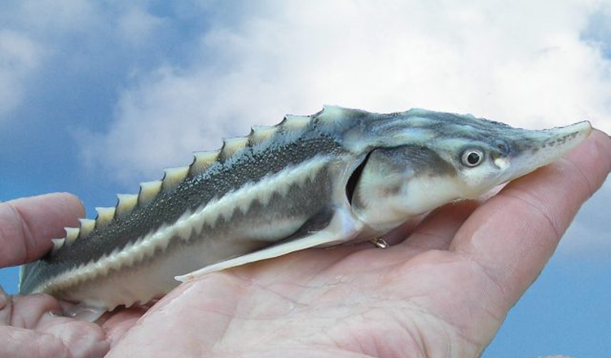
Welcome to the Pan European Sturgeon Action Plan
Side Event
Bern Convention
39th Standing Comittee Meeting
Strasbourg
3.12.19
Beate Striebel-Greiter, WWF and Jörn Gessner, WSCS

Slide 2
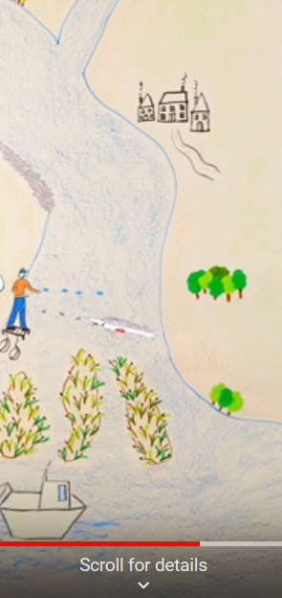
Notes:
https://www.youtube.com/watch?v=bwExvqto6t8&feature=emb_logo

Slide 3
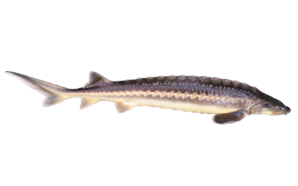
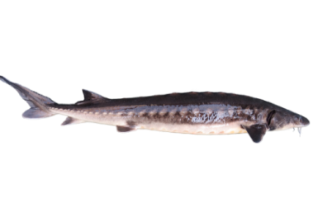
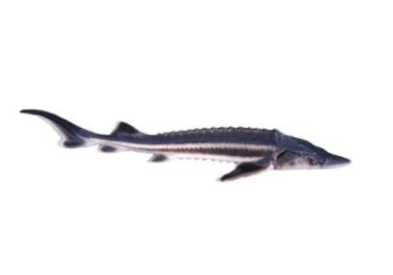
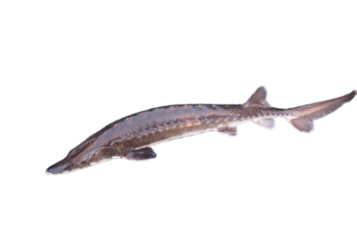
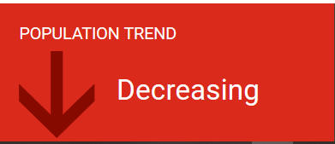




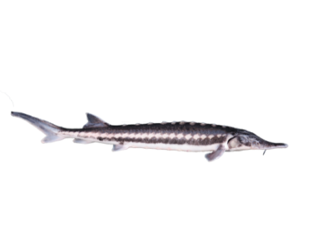
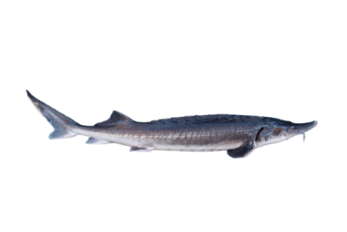
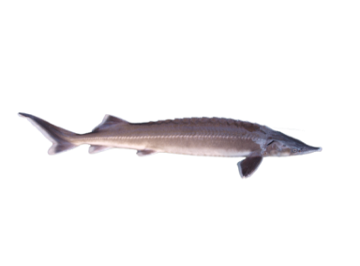


Alarming Status
Russian Sturgeon Complex
Adriatic Sturgeon
Ship Sturgeon
Baltic Sturgeon
Sterlet
Stellate Sturgeon
European/Common Sturgeon
Beluga
© M. Roggo f. A. sturio; © Thomas Friedrich
Notes:
Reminding the audience that seven of eight species in Europe are already critically endangered and all show negative popualtion trends. An IUCN assesment is ongoing for all sturgeon species and will not bring good news. Overall the situation has not improved in Europe, and the Ship sturgeon has most probably dissapeared from the European continent.

Slide 4
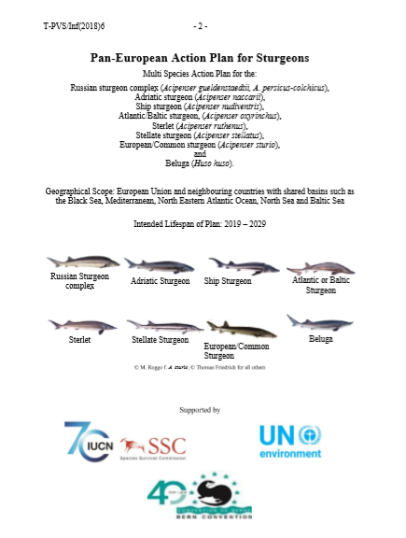


Pan European Action Plan for Sturgeons
Recommendation No. 199 (2018) of the Standing Committee, adopted on 30 November 2018 on the Pan-European Action Plan for the conservation of the sturgeon
Notes:
Remidner of the status:
Nov 2018 adopted during the last Standing Committee meeting and mandate provided to Secreteriat for coordination of implementation
May 2019 endorsed by the EU NADEG group and recommend for implementation as species action plan under the HD

Slide 5

But a plan is just a plan……………
Notes:
Now that we have a plan, there is the need to fill it with life!
Too many species action plans have been written and too many ended up in the drawers, never being implemented.

Slide 6
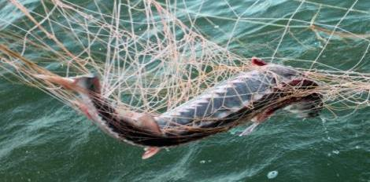
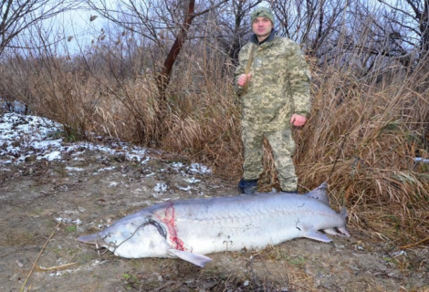
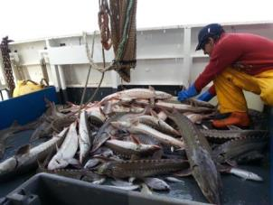
Objectives of the Plan
Stop the decline of existing populations
  Directed fishing prohibited and enforcement against poaching effective
  Bycatch assessed and eliminated
Current situation:
Targeted sturgeon fishing is forbidden in all European countries
Existing fishing bans in Romania and Bulgaria will expire soon and require prolongation.
IUU fishing and by-catch is ongoing in rivers and seas !
Notes:
Idea: Remind of all objectives and than have a few high level bullet points on the current situation. Ideally, those would be valuable for all of the Bern Convention signatory states

Slide 7
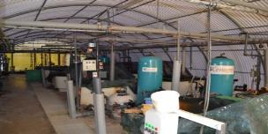
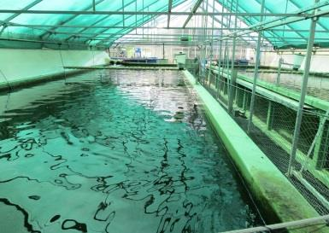
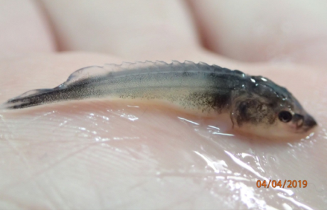
Objectives of the Plan
(2) Actively support populations through ex situ living gene banks
  Ex situ stocks established to secure genetic diversity of all sturgeon populations
  Reproduction and release programmes implemented
  Regional (basin wide) coherence is ensured
Current situation:
Good examples for ex situ programmes exist for A.sturio (France) and A.oxyrinchus (Germany)
Feasibility Study for Upper Danube ongoing
„Projects“ underway in Austria, Germany, Italy, ….
Notes:
Stress urgency again!!!
Urgent need for coordination!
Institutional funding for long-term maintenance of stocks essential

Slide 8
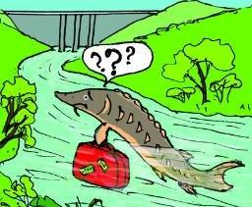
Objectives of the Plan
Sturgeon habitats protected and restored
  Existing habitats identified and protected
  Habitat restoration options identified & pilots implemented
Sturgeon migration secured or facilitated
  No further migration obstacles build in key rivers
  Existing obstacles identified and feasibility for passage solutions verified and prioritized
Current situation:
Danube: MEASURES project collects all available data on habitats for migrating fish
Germany: Elbe River fish passage for sturgeons established
Feasibility study for passage at Iron Gate ongoing: We-Pass
Notes:
https://www.youtube.com/watch?v=81i25THmBws

Slide 9
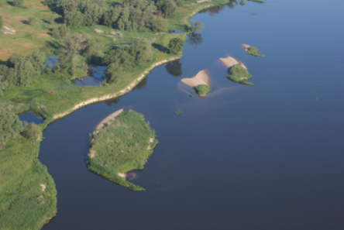
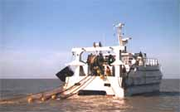
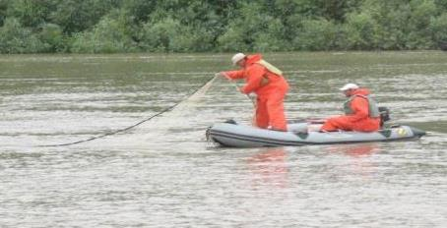
Objectives of the Plan
(5) Ensure monitoring of sturgeon populations
For EU MS also an obligation under Art 17 of the HD
Current situation:
The only sound population monitoring program is in place in France
Lack of funding for directed monitoring in most other European countries
Lack of consistency and cooperation between range countries

Slide 10

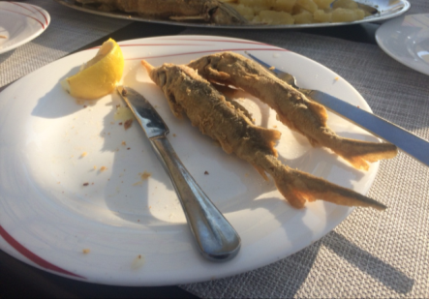
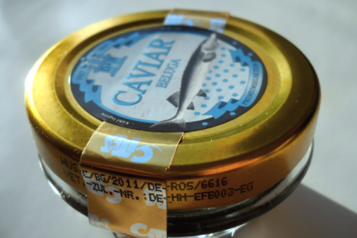
Objectives of the Plan
(6) Eliminate illegal trade of all sturgeon products
Current situation:
Combating illegal caviar trade is not a priority for the national agencies
Attempts to improve the labelling process under CITES were unsuccessful in 2018
A market survey is part of a LIFE project in the Lower Danube Region http://danube-sturgeon.org
Study on forensic methods to identify sturgeon in trade is planned for 2020 under the CITES Animals Committee
Notes:
Other than the market survey under the LIFE project not much is being done to identify illegal trade.
TORs for study on forensic methods are currently agreed by the AC of CITES. The need for this study has been expressed for several years in CITES meetings and it is now planned for 2020.

Slide 11

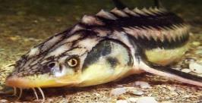
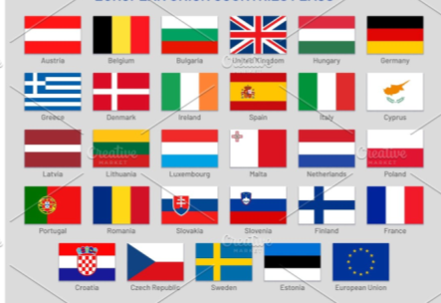
Objectives of the Plan
(7) Secure adequate funding and regulations to enable implementation of AP
Current Situation
DG ENV has compiled information on EU funding instruments for sturgeon conservation measures
National Priorities for the next EU funding phase must reflect sturgeon conservation measures (e.g. PAF)
National funding sources needed for national obligations (i.e. Art 17 Reporting)

Slide 12
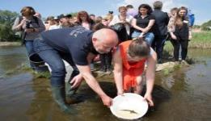
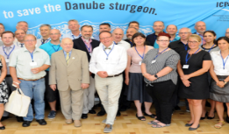
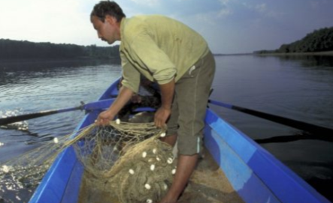
Objectives of the Plan
(8) Secure support from actors and stakeholders
Raise awareness
Stregthen the inter-agency and inter-sectoral exchange
Current situation:
Various awareness raising measures implemented mostly as project based activities
Diversity of stakeholders (fisheries, river and marine administrations, navigation, energy, enforcement authorities, science, CSOs) makes involvement of governmental actors essential

Slide 13



Example for range-wide collaboration and involvement: Galati conference Oct 2019
Discussion of implementation strategies among representatives and stakeholders from all Danube Basin and all Black Sea countries
120 participants from fisheries, water and environmental administrations, the scientific community and civil society
Resulting in joint Galati Declaration (see flyer)
http://sturgeon.ugal.ro
Notes:
Conference participants confirmed the urgent need for regional collaboration on a long-term fishing ban, effective measures against poaching, limiting bycatch in commercial fisheries and, to ensure that we do not lose the species while trying to save them from extinction, rearing these fish in scientifically controlled facilities in several countries to release them into rivers where populations have crashed or vanished altogether. Other measures highlighted at the meeting are the need of engaging fishing communities in sturgeon conservation and protection of remaining sturgeon habitats for spawning, breeding or overwintering. Only if all relevant stakeholders work together within countries and across borders can these amazing fish be saved from extinction". - Peter Gammeltoft, Chair of the Danube Sturgeon Task Force
The conference was jointly organised by “Dunarea de Jos” University of Galati (Research and Development Centre for Sturgeon, Aquatic Habitats and Biodiversity), the DSTF (Danube Sturgeon Task Force), the Romanian Ministry of Water and Forests, the Romanian Ministry of Environment, NAFA (Romanian National Agency for Fisheries and Aquaculture), WSCS (World Sturgeon Conservation Society) and WWF (World Wide Fund for Nature), and took place under the patronage of the Romanian Presidency of the EUSDR (EU Strategy for the Danube Region) and the Romanian Academy from October 28-30.

Slide 14
Objectives of the Plan
(9) Monitor and evaluate AP implementation
  International coordination and cooperation is a key factor of success
Current Situation:
Mandates for the Secretariat of the Bern Convention to:
1. Closely monitor the implementation of the Action Plan with all competent MEAs, actors and institutions, if possible through a dedicated working group;
2. Coordinate regular reporting on the progress of the Action Plan at national level, to support the implementation of recommended actions and of adaptive management;

Slide 15
Focal points
  Result 9.1 Responsibilities for AP implementation clarified and regular monitoring and evaluation conducted
  Action 9.1.1 States; river basin and sea commissions and EC authorities nominate a focal point/coordinator responsible for monitoring the implementation of the AP
National stocktaking and coordination shall be the responsibility of a national focal point in the respective state. The national focal point is responsible for collecting information on the progress of implementation of the Action Plan and transfer to the Bern Convention
So far Austria, Georgia, Italy, Poland, Serbia and the European Commission have nominated such a focal point.
All other signatory countries are invited to do so.

Slide 16
Questions or comments?
Examples

Slide 17
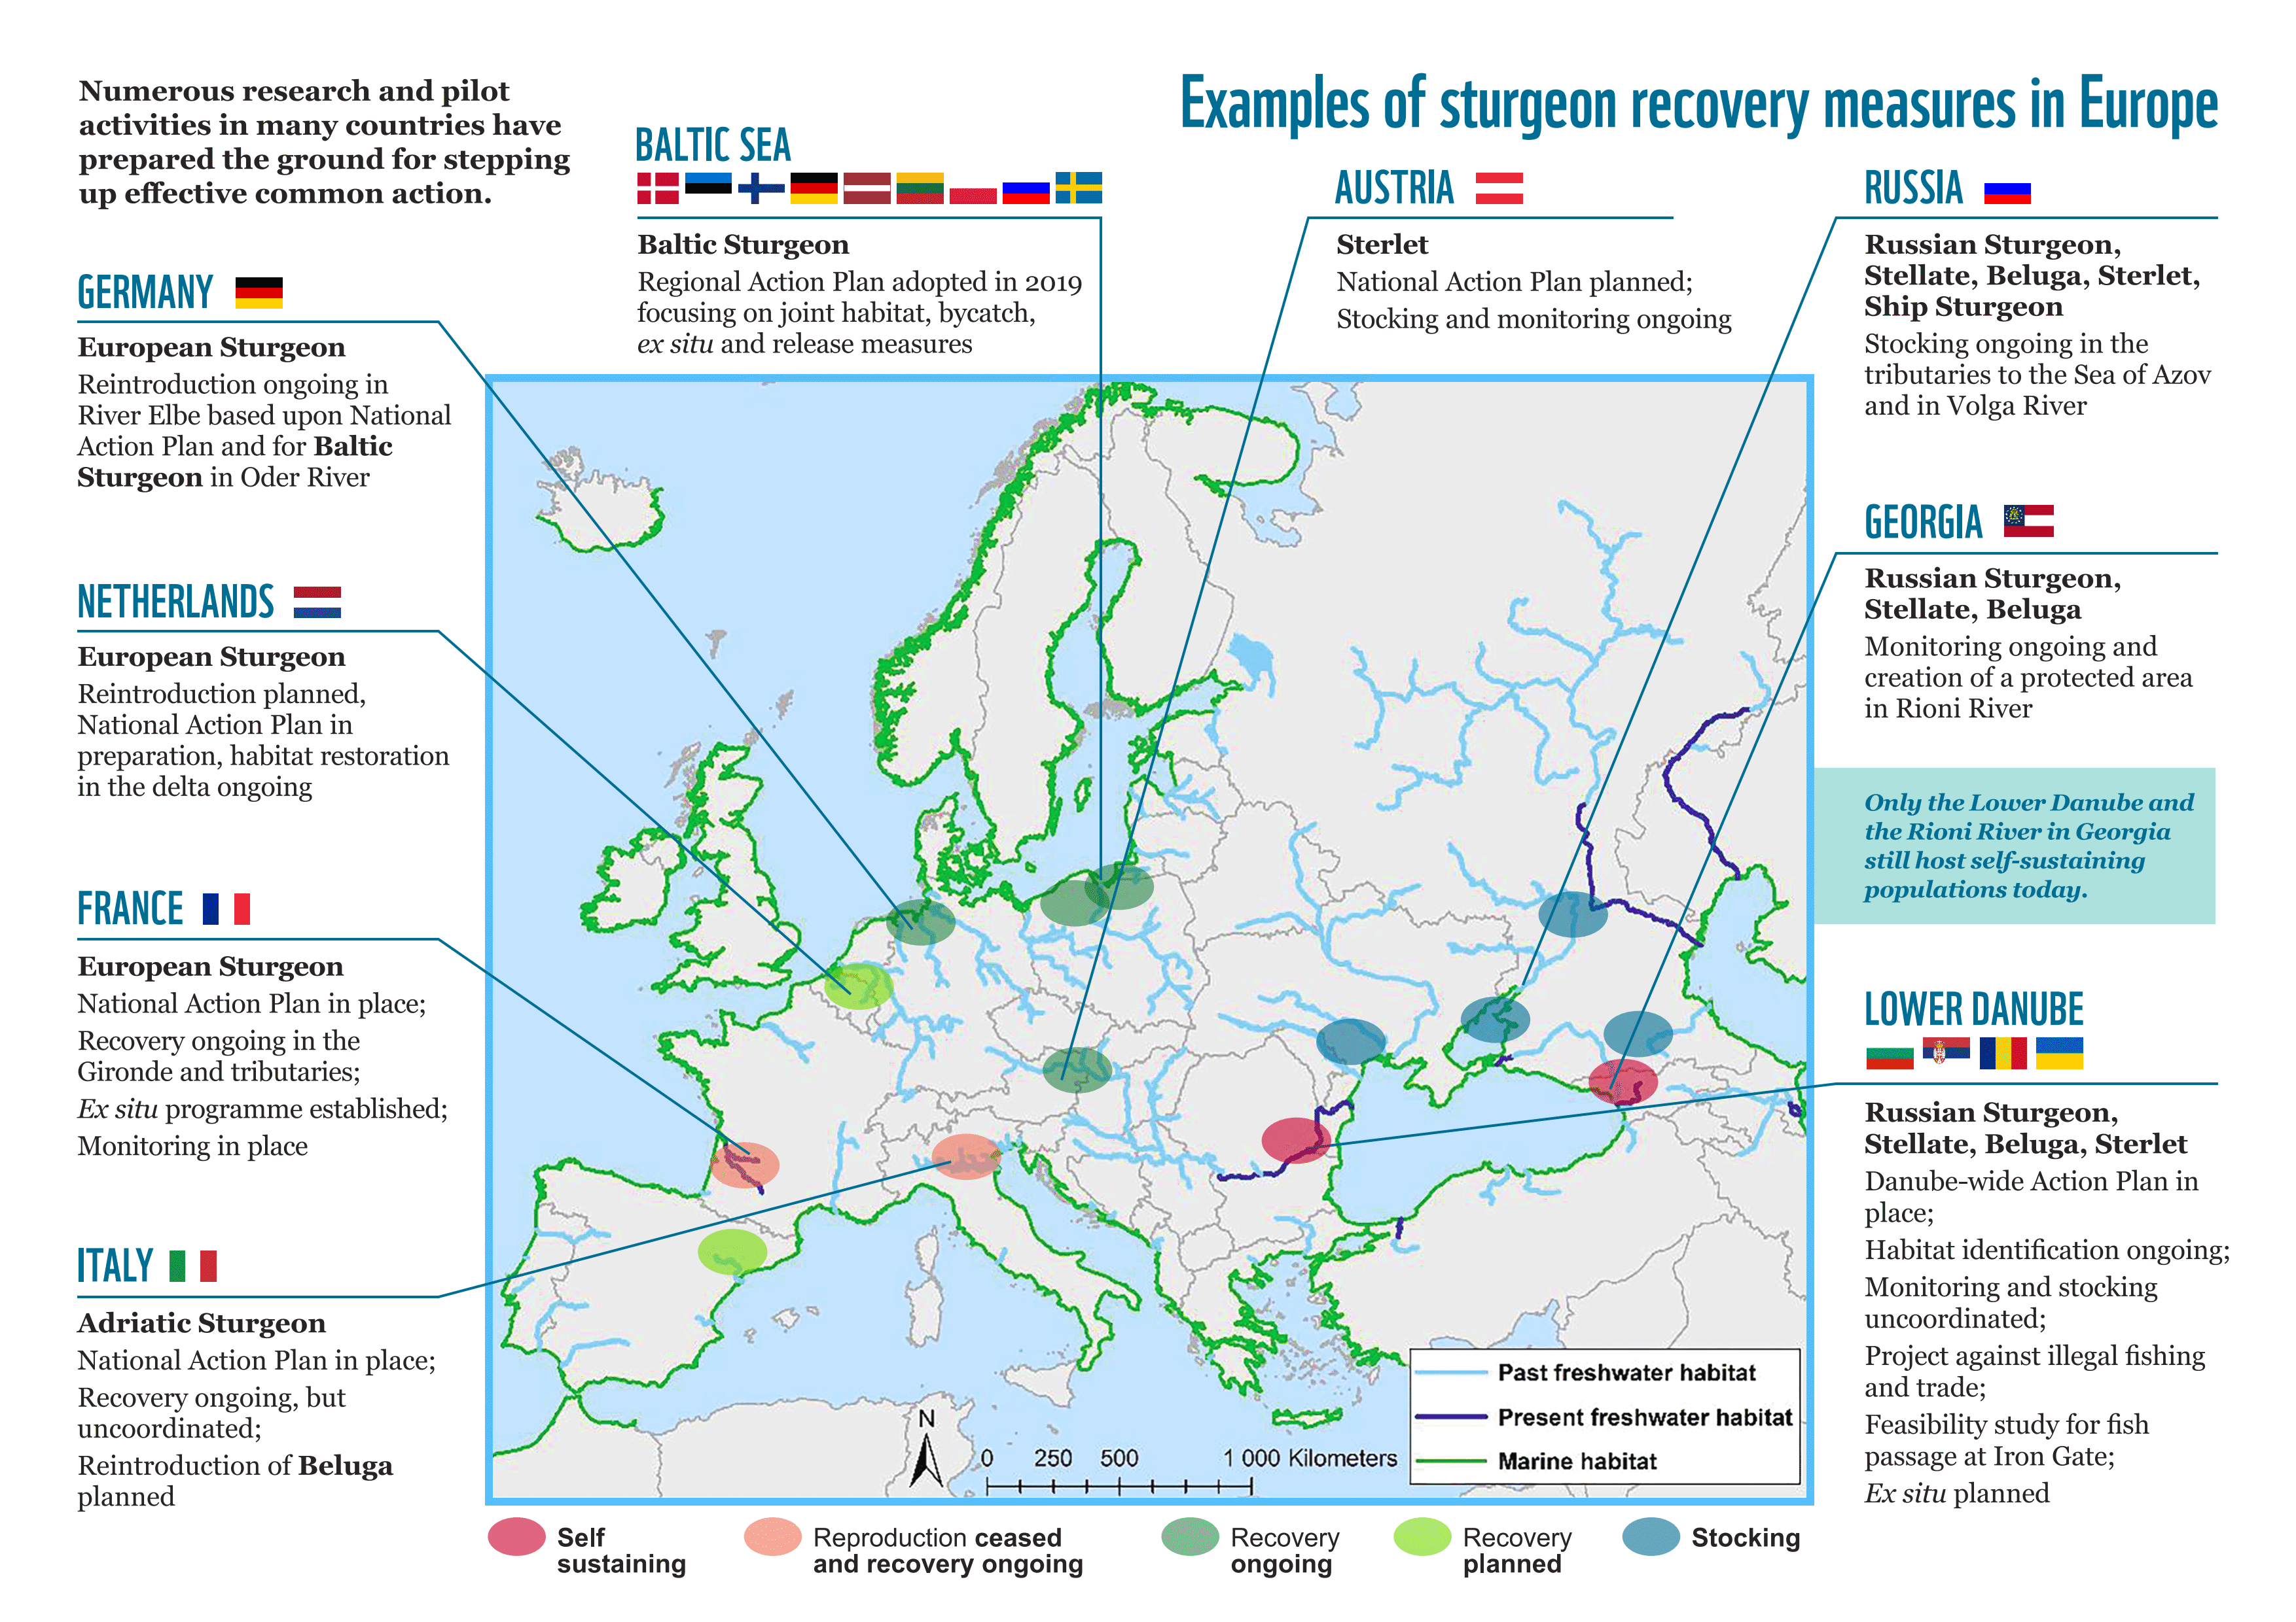
Notes:
Nevertheless measures are ongoing in several countries, lack of financing and coordination of actors within or across states are common issues observed almost everywhere.

Slide 18
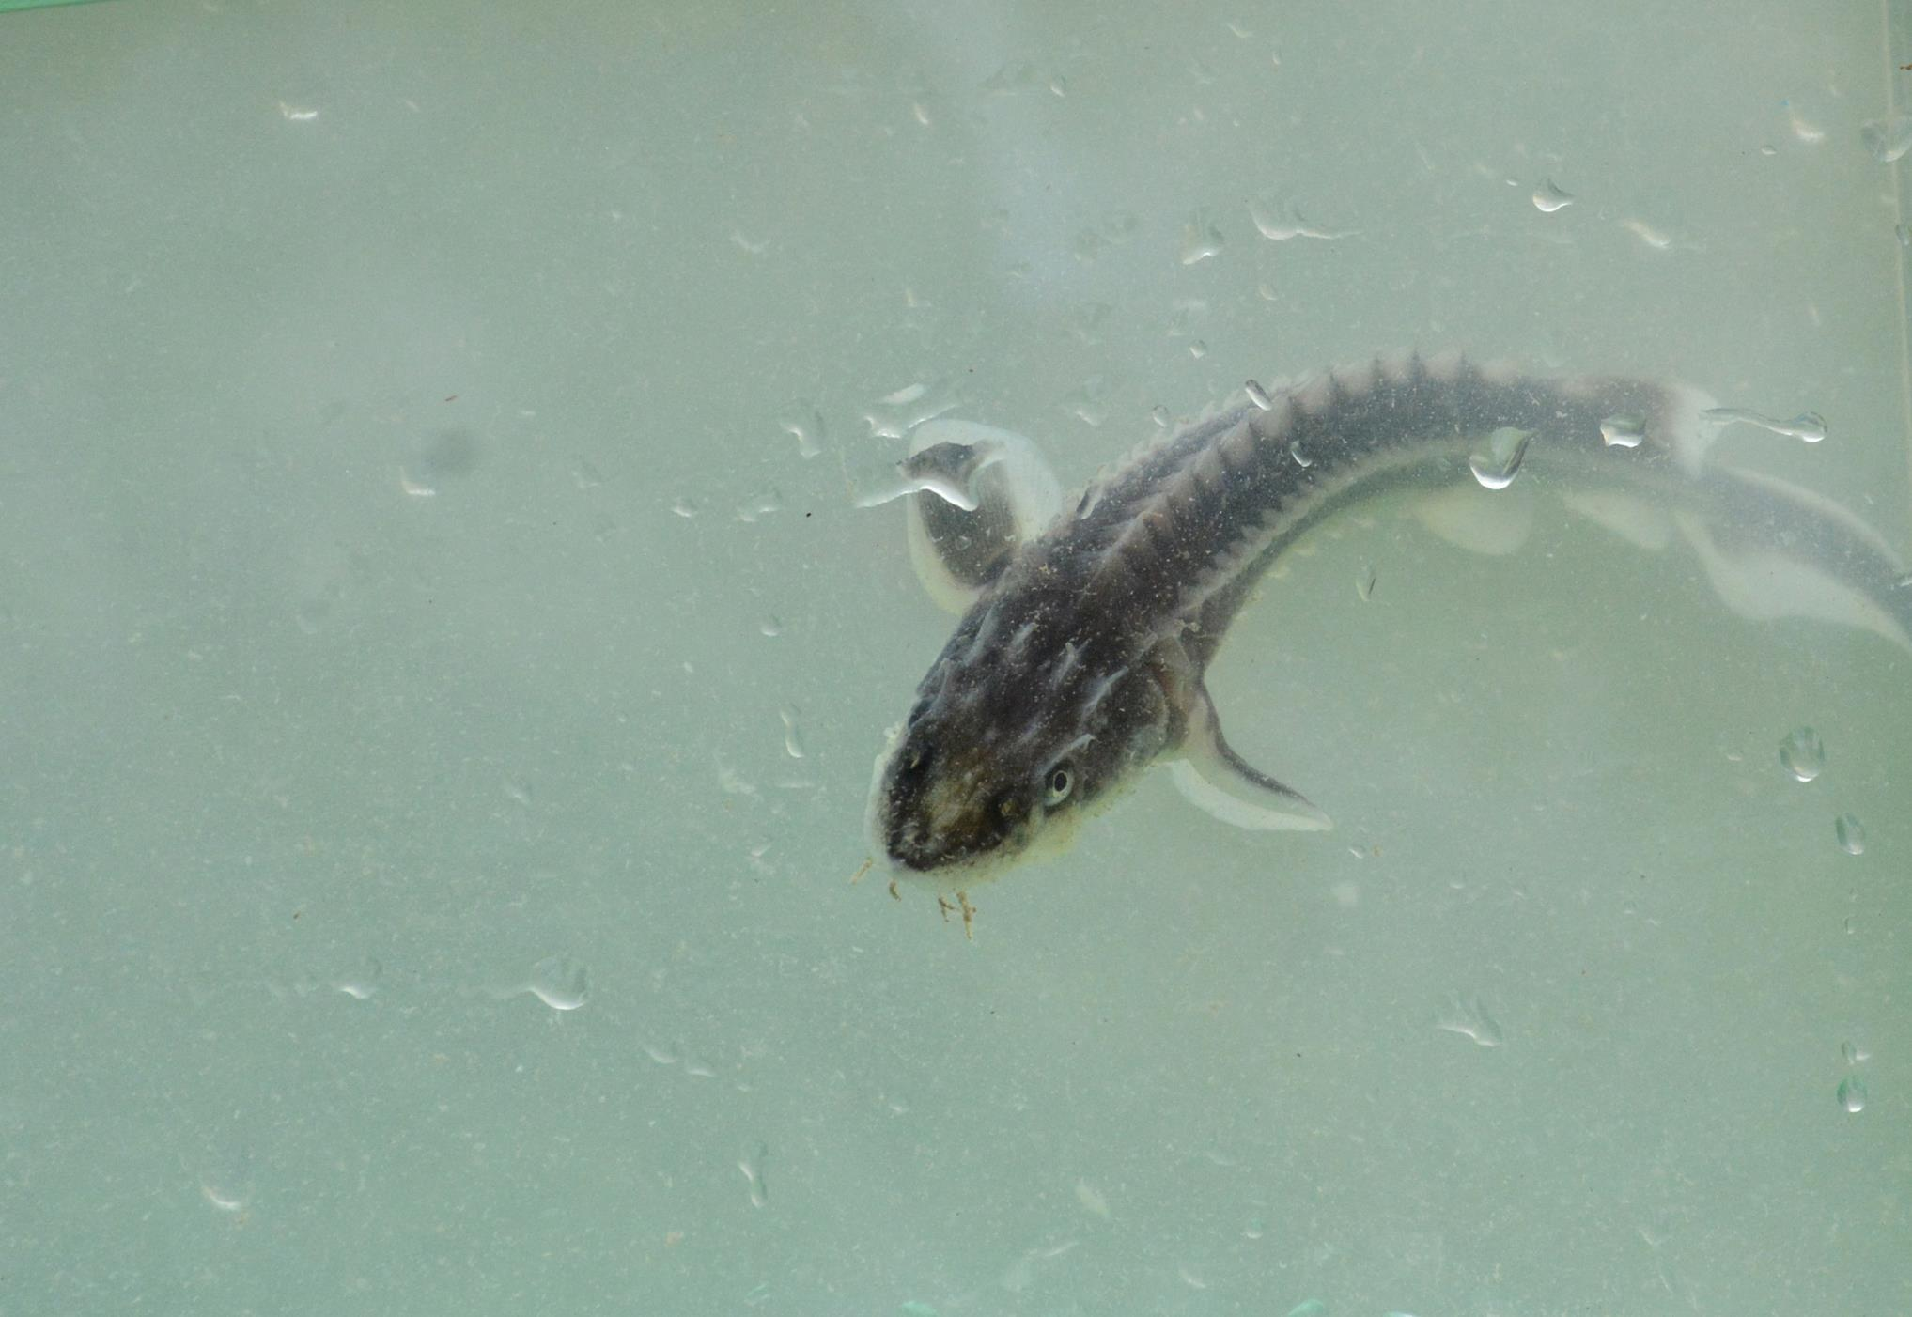
Examples from selected countries
Ex situ - Upper Danube
General approach - France
Regional approach - Helcom

Slide 19


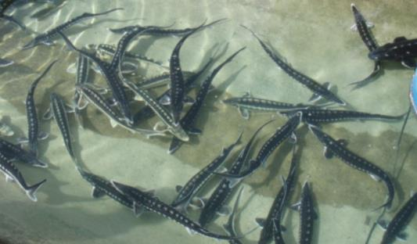
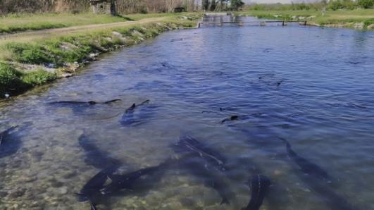


Feasibility study on the construction of an ex situ facility for Danube sturgeon species in the Upper Danube River Basin
Facility for:
Safeguarding & broodstock holding for Danube sturgeon species
Reproduction & rearing for release
Research in the fields of rearing technology & ecology
Public relations activities
Supported by:

Slide 20

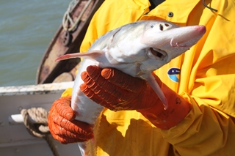
French National Action Plan
© S. Roques (Irstea)
European action plan (Rosenthal et al., 2007)

Slide 21











The first phase of the French Action Plan
(2011-2015)
French implementation of the European Action Plan
Governance, committees
Synthesis of knowledge
Identification of main threats
Long-term strategy
  Axis 1 In situ conservation of the population
  Axis 2 Protection of habitats and connectivity
  Axis 3 Ex situ conservation
  Axis 4 Research to support the conservation through international cooperation

Slide 22

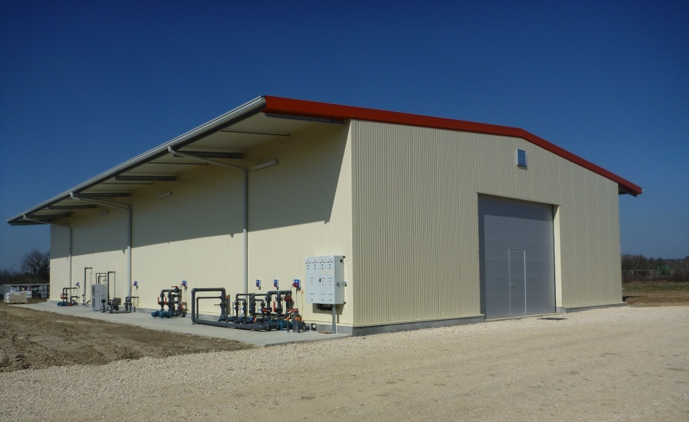
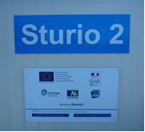
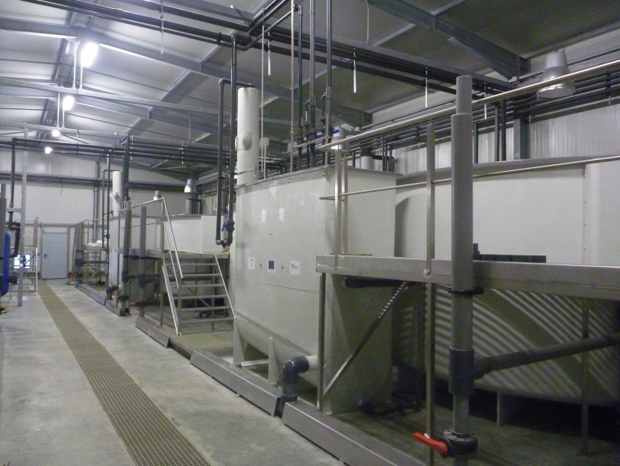
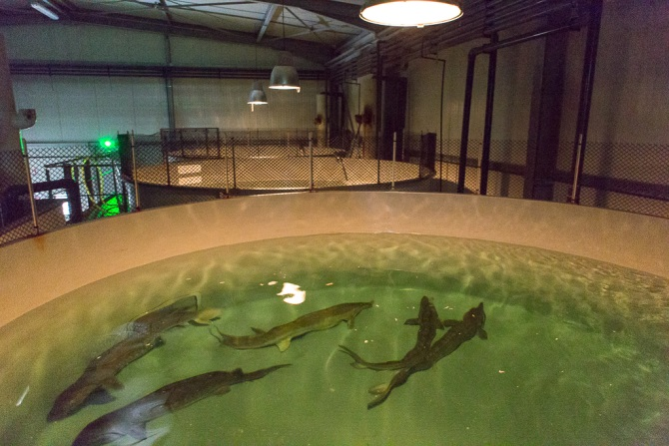
Ex situ stock development
© C. Roqueplo (Irstea)
© C. Roqueplo (Irstea)
© C. Roqueplo (Irstea)

Slide 23
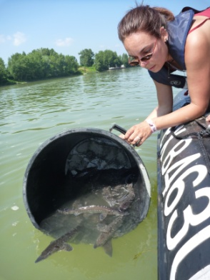
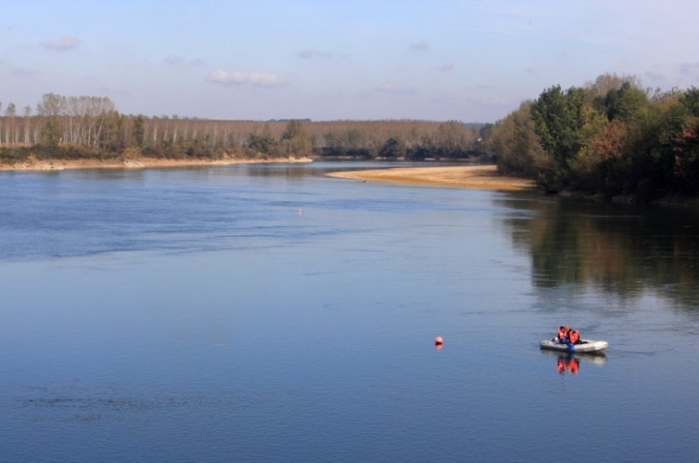
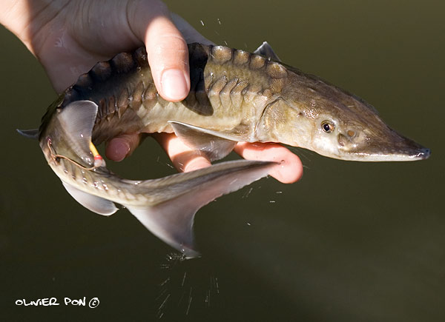
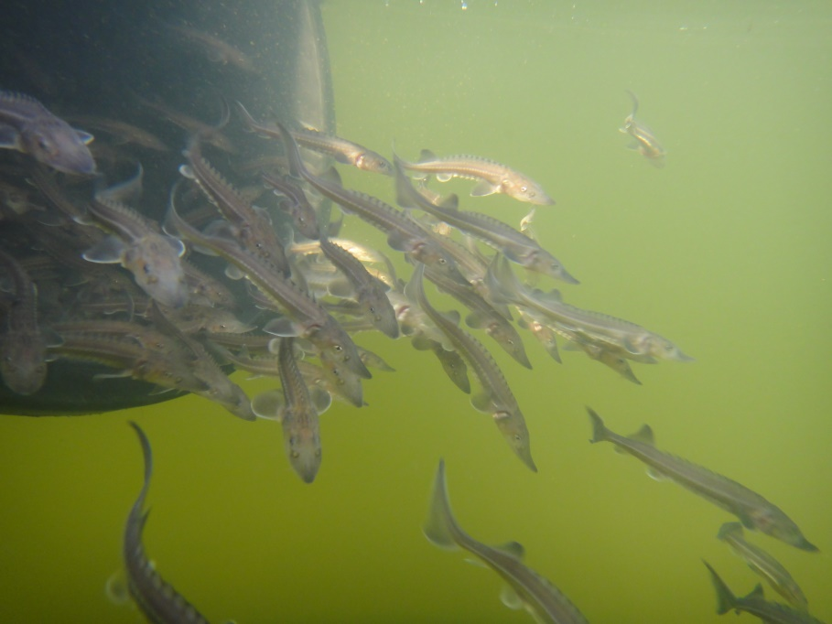
Releases
1.6M juveniles between 1996 and 2016
© D. Mercier Cemagref
© E. Balancia
© ML Acolas Irstea

Slide 24


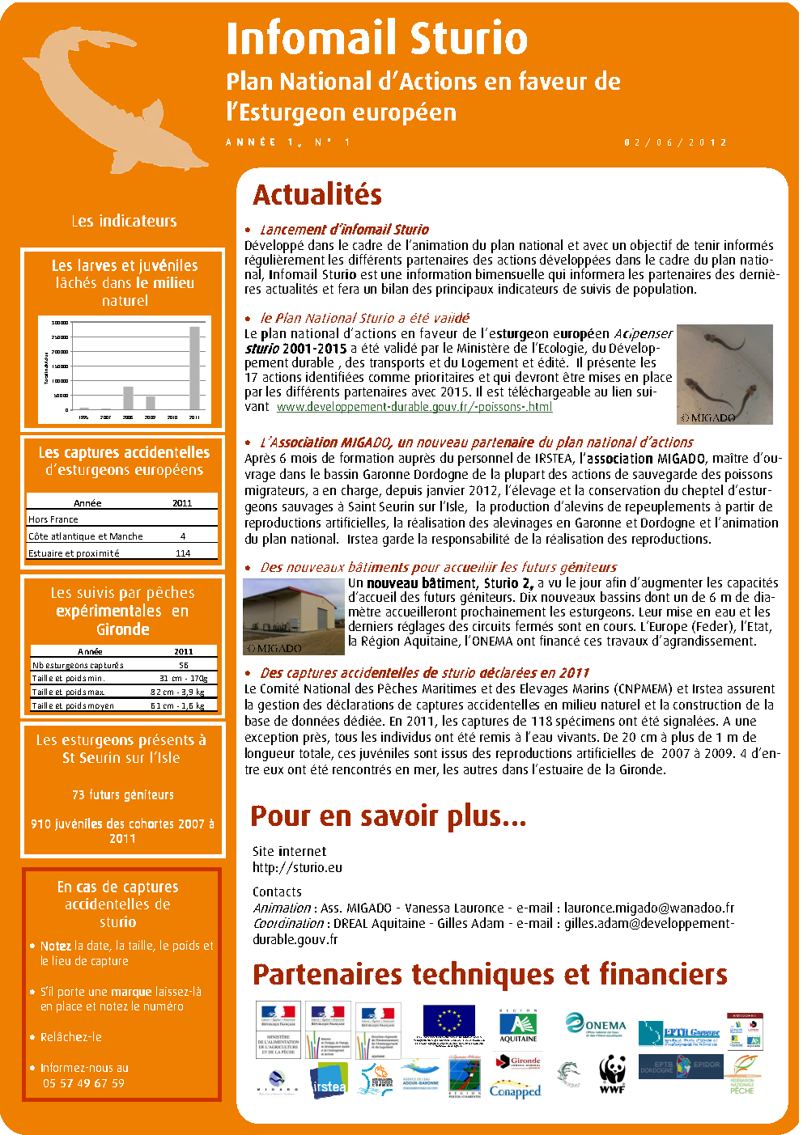

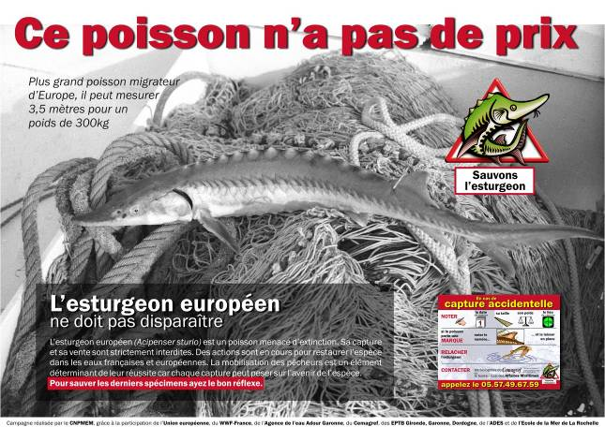
Fisheries oriented
campaigns
www.sturio.fr

Slide 25
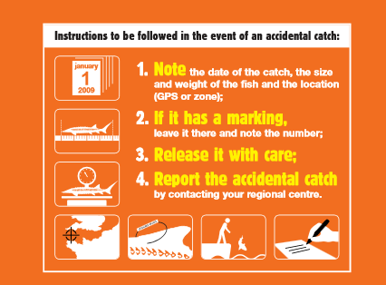
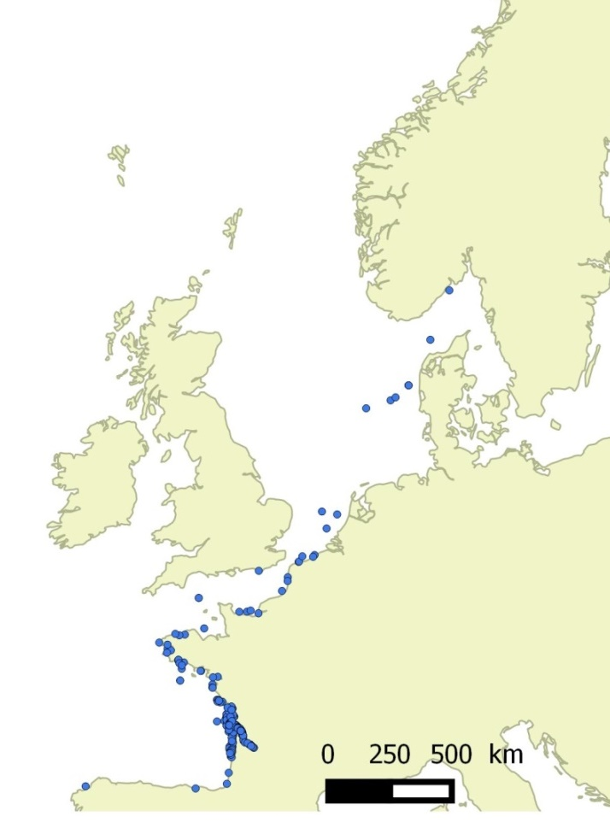

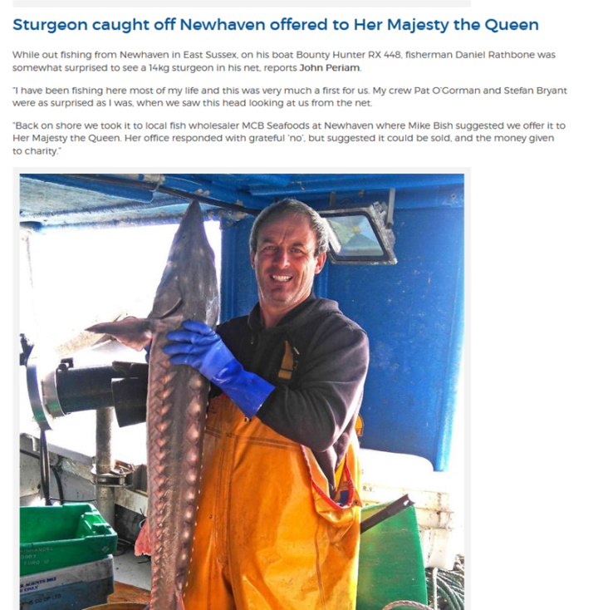
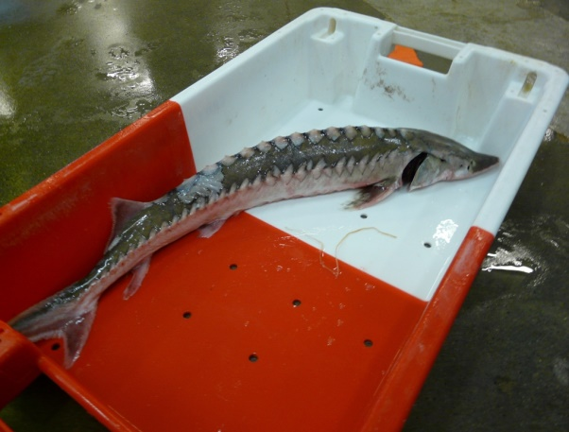
Accidental capture reports
2006-2017: 1329 declarations
Database
Web application STURWILD
© Parc marin d'Iroise, 2011

Slide 26
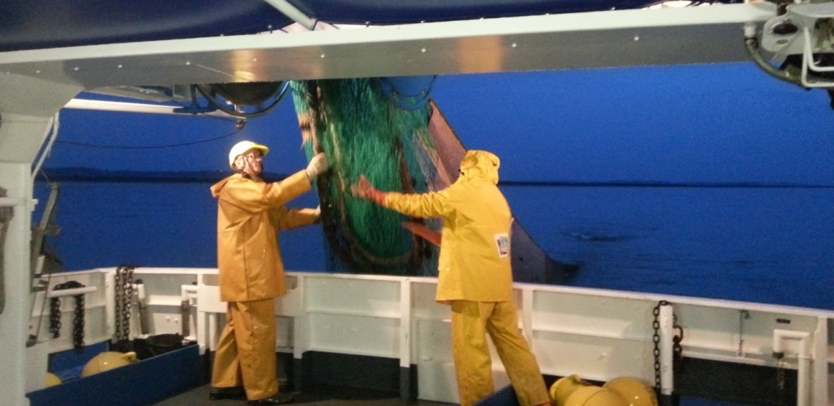
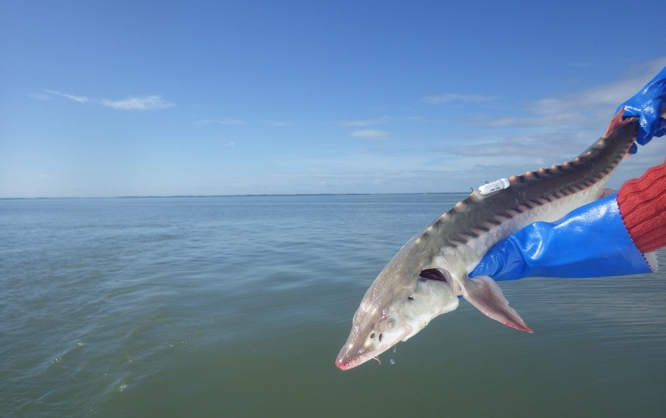

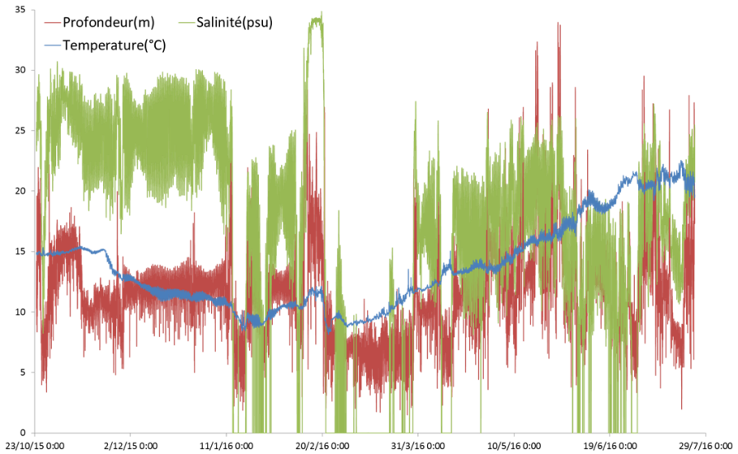
Population monitoring in the Gironde estuary
2009-2016 841 trawling tows  399 captures A . sturio
© Irstea
© Irstea
© Irstea

Slide 27








European cooperation
© Life MigratoEbre
© WWF The Netherlands
© E Rochard (Irstea)
© Life MigratoEbre

Slide 28


Next phase
National Action Plan 2020-2030?
Axis 1 Monitoring of the population in the wild
  Reduce the mortality at sea
  Check the efficiency of stocking
  Detect reproduction in the wild
Axis 2 Protection of habitats and connectivity
  Assess the carrying capacity

Slide 29



Next phase
Action plan 2020-2030?
Axis 3 Improving the state of the ex situ stock and stocking of juveniles in the wild
  Improving biotechnology of maintenance for a better fitness
  Assessing possibilities of reintroduction in other basins
Axis 4 Continuation of the efforts to support research and international cooperation in conservation
  Coordination with other Action Plans
  International cooperation
© Life MigratoEbre
© Irstea
© E Rochard (Irstea)

Slide 30
Funding for the Action Plan implementation was provided for….
IRSTEA:
  Agence de l’Eau Adour Garonne,
  Agence française de la Biodiversité,
  Agence nationale de la recherche, département de la Gironde,
  Ministère de l’écologie et du développement durable, Région nouvelle Aquitaine
  Irstea.
Migado (broodstock maintenance)
  FEDER Nouvelle Aquitaine
  Ark Nature
  IGB Berlin

Slide 31

HELCOM Action Plan for the protection and recovery of the Baltic Sturgeon Acipenser oxyrinchus
By the Baltic Sturgeon EN, Helcom S&C
Authors: Jörn Gessner^{1,2}, Gerd-Michael Arndt ^{2,3}, Andrzej Kapusta⁴, Sergey Shibayev ⁵, Alexey Gushin⁶, Andrej Pilinkovskij⁷, Justas Povliūnas⁷, Ruta Medne⁸, Santa Purvina⁸ , Meelis Tambets⁹, Peter Rask Möller¹⁰

Slide 32

The General Assembly in June 2019 endorseD the HELCOM-Action Plan for the period 2019 until 2028
…
Now Implementation is DUE!
Action requested

Slide 33


Main threats for the recovery of the species
Mortality caused by accidental catch (by-catch) and illegal fishing (poaching)
Changes of hydrology and hydromorphology in rivers and estuaries affect spawning and nursery habitats
Dams block migration to spawning sites
Anthropogenic environmental pollution affects reproductive success
The introduction of allochthonous (sturgeon) species causes competition, pathogen transfer, and hybridization
Climate change increases water temperature, alters discharge patterns, and fauna composition

Slide 34





Action Plan scope
Based upon the reasons for decline and potential threats
Provides a joint framework for restoration attempts and coordinated action!
Implementing the Objectives of the Pan European Action Plan
The AP identifies the means to implement the restoration target in 3 categories and 16 Actions
Supported by a S&C Expert Group
Implementation to take place on a national level

Slide 35








The long-term aim!
Eestii
Loodushoiu
Keskus
KSTU
Kaliningrad State
Technical University
VNIRO
Atlantic
Researach
Branch

Slide 36
Conclusion
In order to fullfill the targets of the Pan EU AP….
More active involvement of the governmental level is urgently required to bring the actors to the table regionally
Ex situ, in situ, and monitoring activities need a strong commitment including long-term national funding
Setting priorities will help to maintain the focus on the essential actions: National strategies under development
Need to implement the mandate for coordination between range states by Bern Convention Secretariat.

Slide 37



Freshwater Berlin Meeting – World Café/Deep Dive
Please use this pptx template to prepare your pitch for the World Café
If you do not have the WWF font installed on your computer, please contact Patricia for an alternative template.
When your slides are ready, please send to Patricia

