Slide 2
Youth engagement
The year 2017 marked the beginning of CO-MANAGEMENT in the youth sector, with the incorporation of the largest national youth platforms to Movijovem, the National Youth Council and the National Federation of Youth Associations
In 2019 the Youth Card participates in the Give a Vote Campaign, with two young ambassadors (Rui Teixeira and Marta Ramos)
In 2019, the final declaration of the Conference of Youth Ministers (Lisbon+21) reinforces the need for active participation of young people
The year 2019 registers the 1st edition of the EYCA Youth Panel
In 2021 there is a large participation of Portuguese candidates for the 2nd edition of the EYCA Youth Panel (Rui Teixeira and Rafaela Nunes)
In 2022 Plataforma J is launched, with 9 young portuguese people
In 2023 there is one candidate for the 3rd edition of the panel

Slide 3
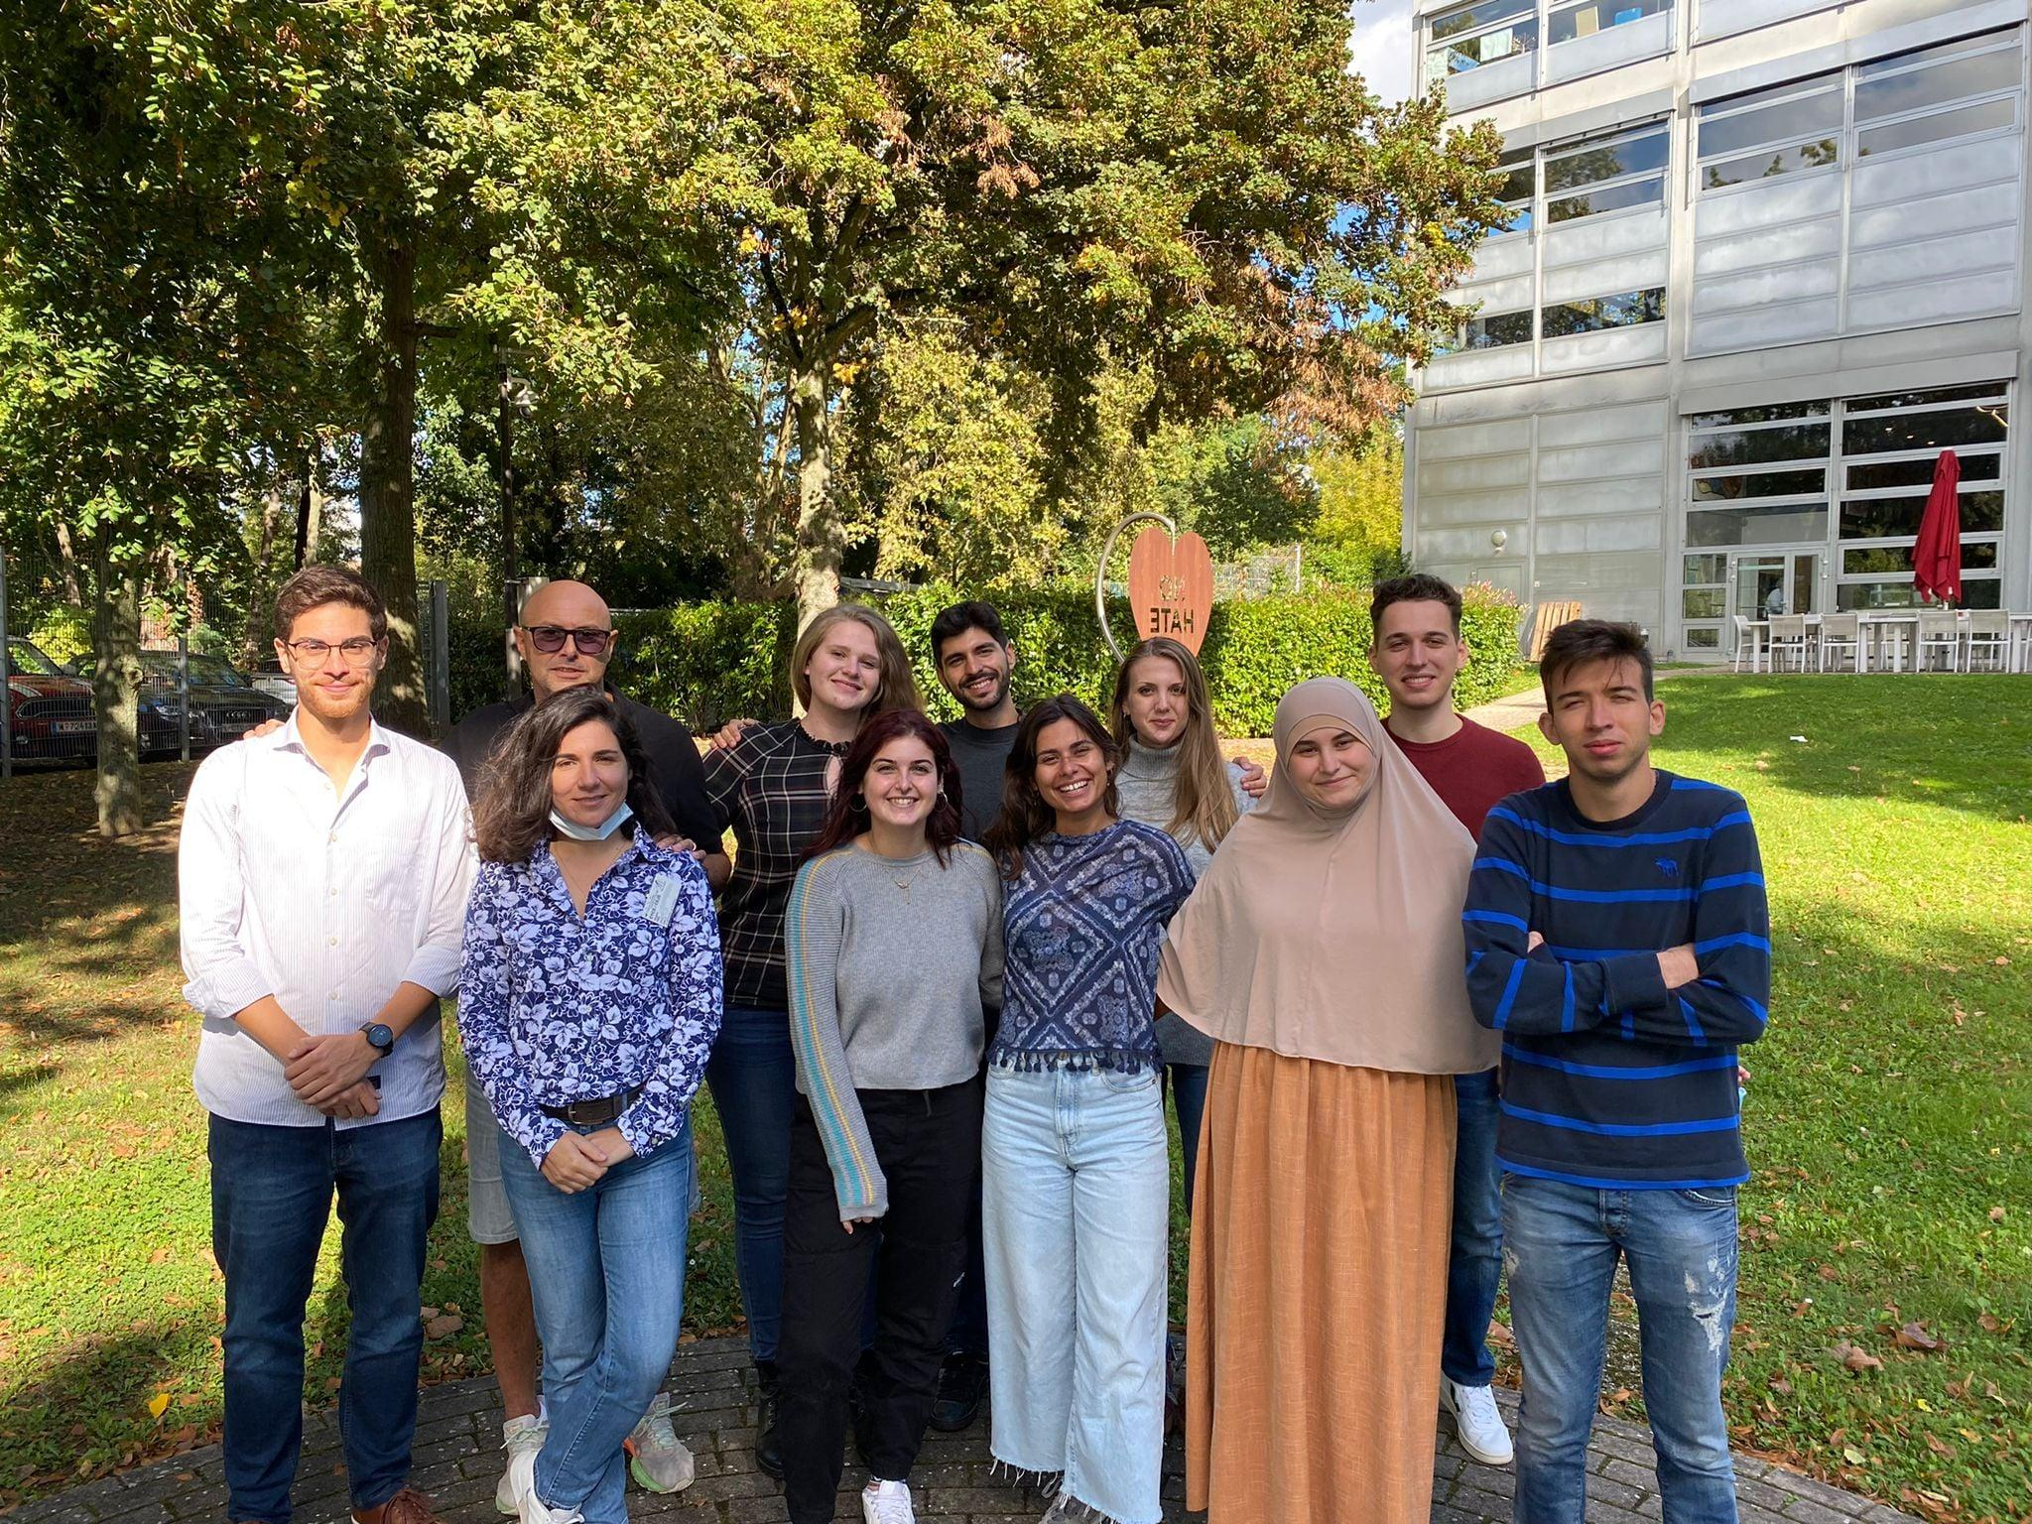
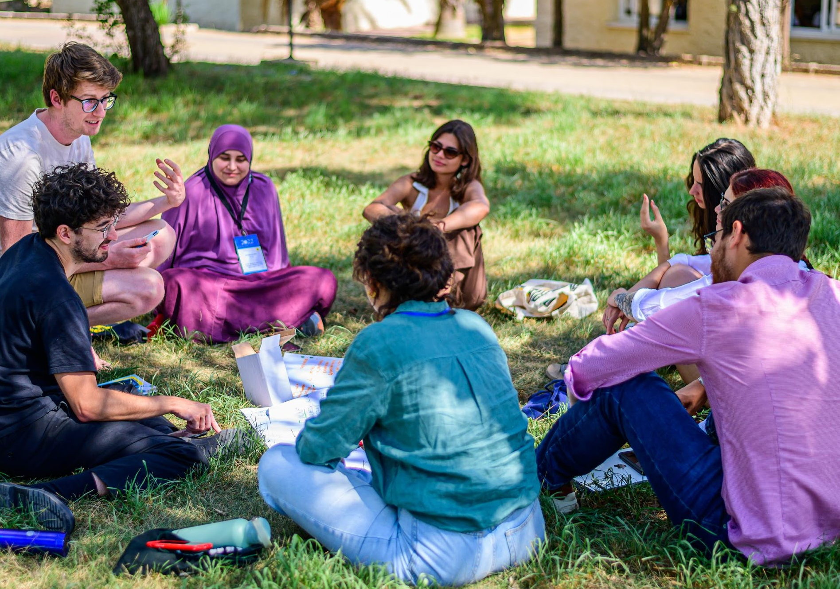
Youth Panel
Second Edition
Be the face of EYCA as representatives of young people around Europe.
Voice the concerns and ideas of our generation
Get hands-on experience with organizing Europe-wide initiatives and projects
Make sure ideas and policies have a direct impact on young people and their empowerment
Collect valuable information on young people's priorities

Slide 4
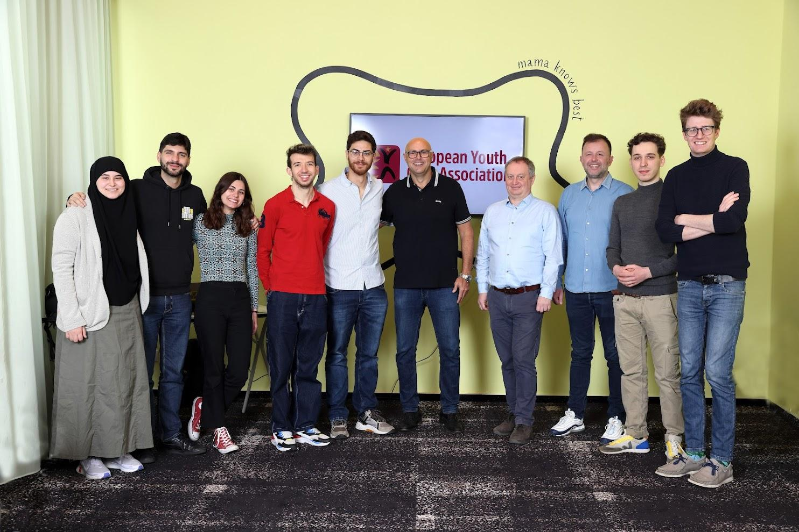
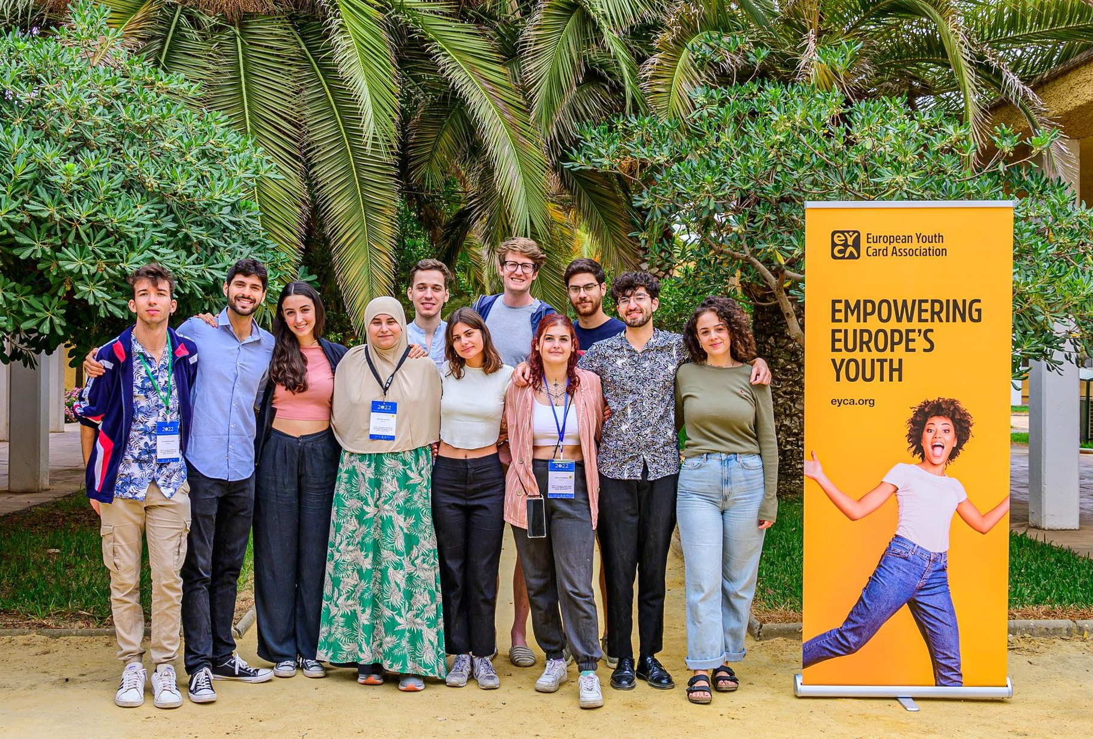
Youth Panel
Strategy:
Connecting EYCA and cardholders; communication between YP and EYCA
Environmental and Social impact
Empowering youth by sharing knowledge and skills
Space and participation for all
- Statutes

Slide 5
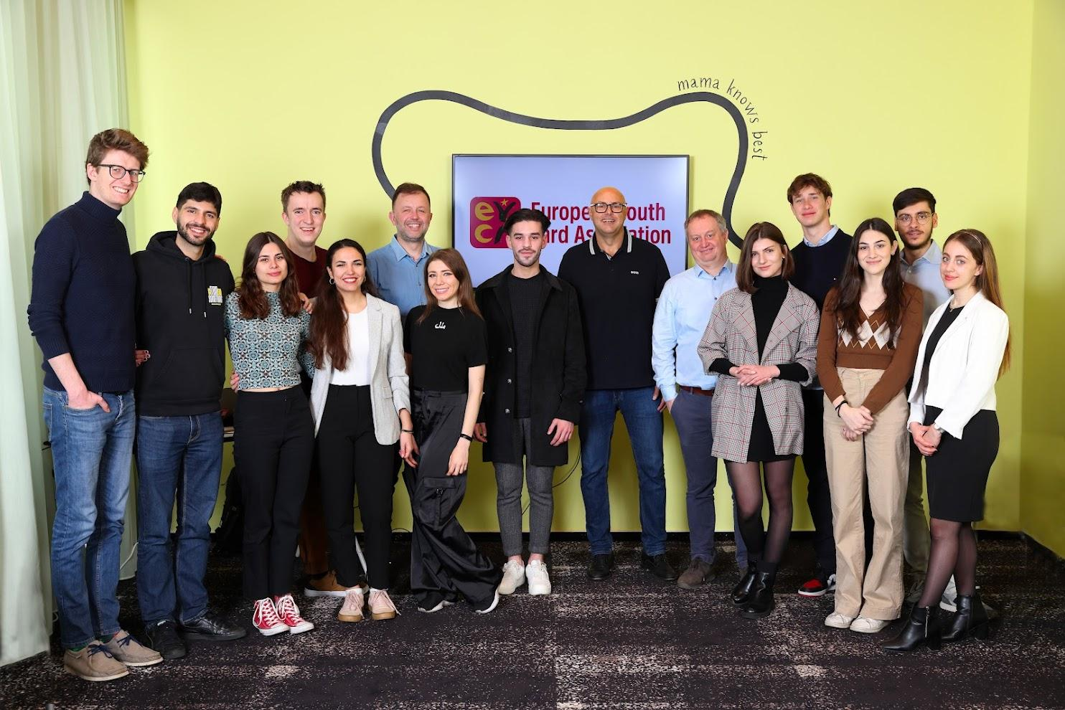
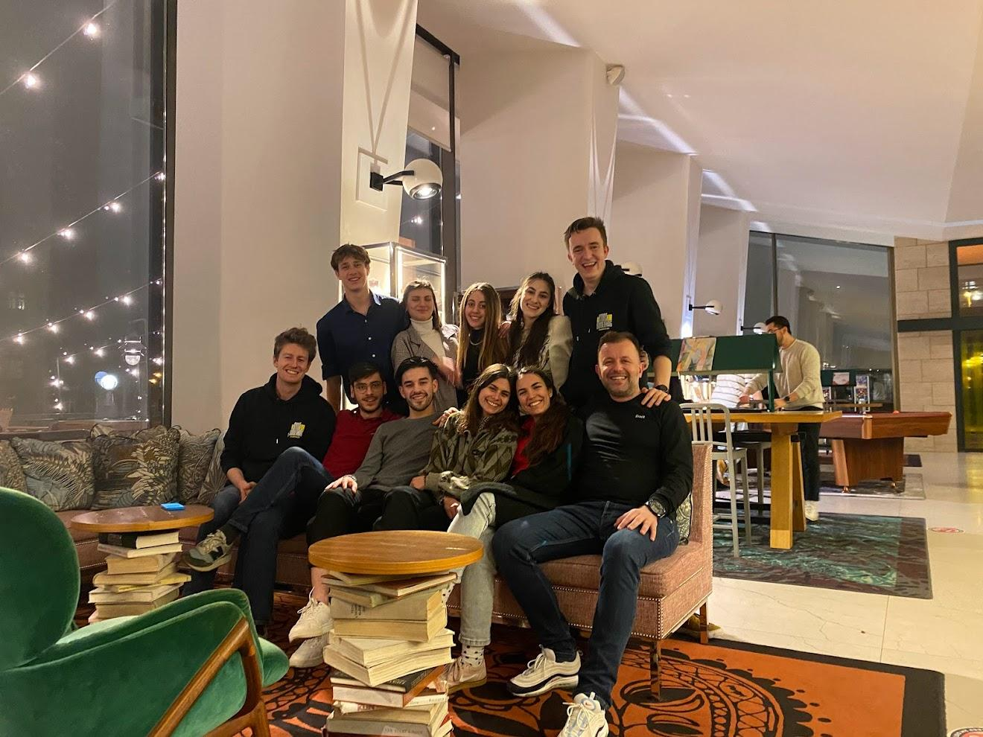
Youth Panel – 3rd edition
Continuing the great work (the stakes are high!)
Visibility, dissemination, youth-led projects
Empowering youth by sharing knowledge and skills

Slide 6
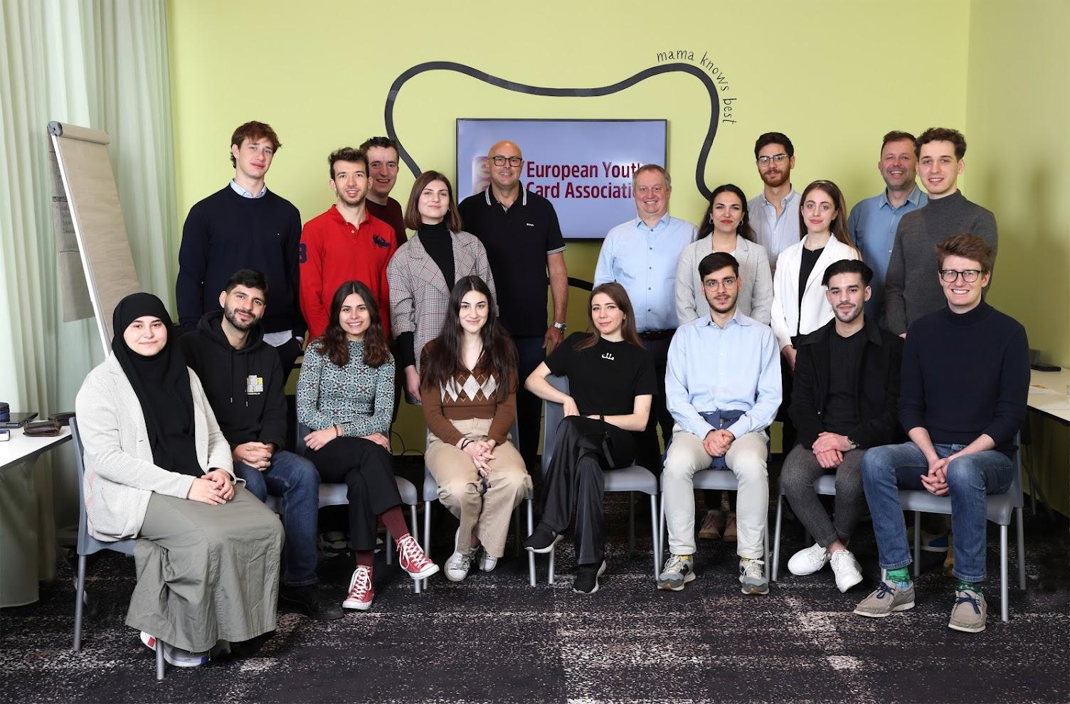
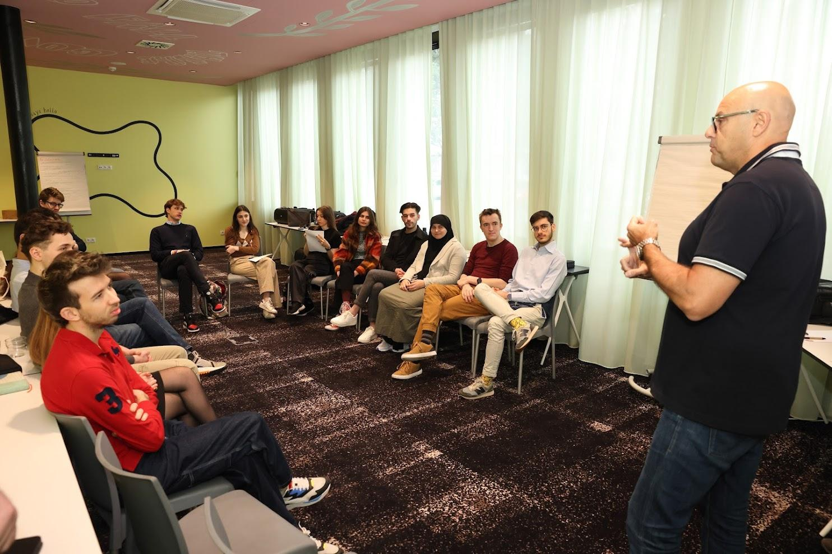
Youth Panel – 3rd edition
Sharing and developing together
Building trust and making a difference

Slide 7
Presentation of the project – march 2022

Slide 8
Definition
Advisory body, made up of young people, created by Movijovem in the field of development and promotion of the European Youth Card
Goals:
To be a youth space for meetings, debate, reflections and action;
Promote the participation of young people involved in the Platform and of young people in general;
Safeguard broad representation in terms of gender identity, ages, ethnic origins, and territory;
Influence the political decision with the objective of promoting better public policies in the areas of youth, sustainability, citizenship, education or others.

Slide 9
Direct Colaboration with the Youth Card
Active participation in the promotion, communication and dissemination of the Youth Card program (its members are ambassadors);
Plataforma J may institutionally represent the Youth Card in national and international events;
Plataforma J debates annually the Plan of Activities and Budget of the Youth Card, as well as the Movijovem´s in general;
Composition
9 young portuguese people, between 14 and 29 years old
Members of EYCA Youth Panel
2 years mandate

Slide 10
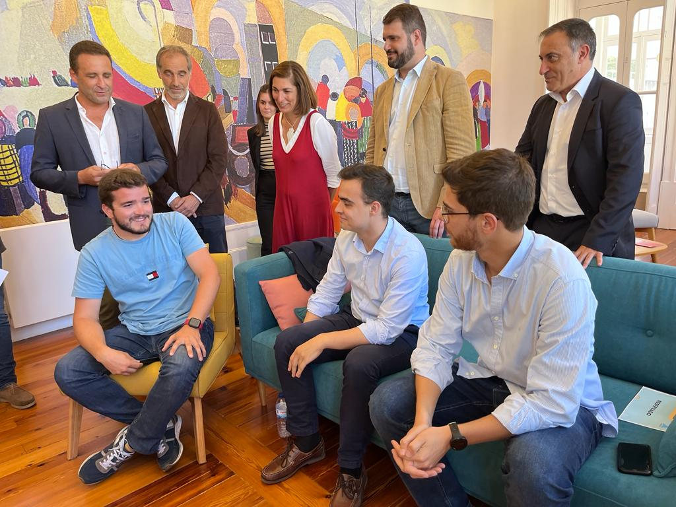
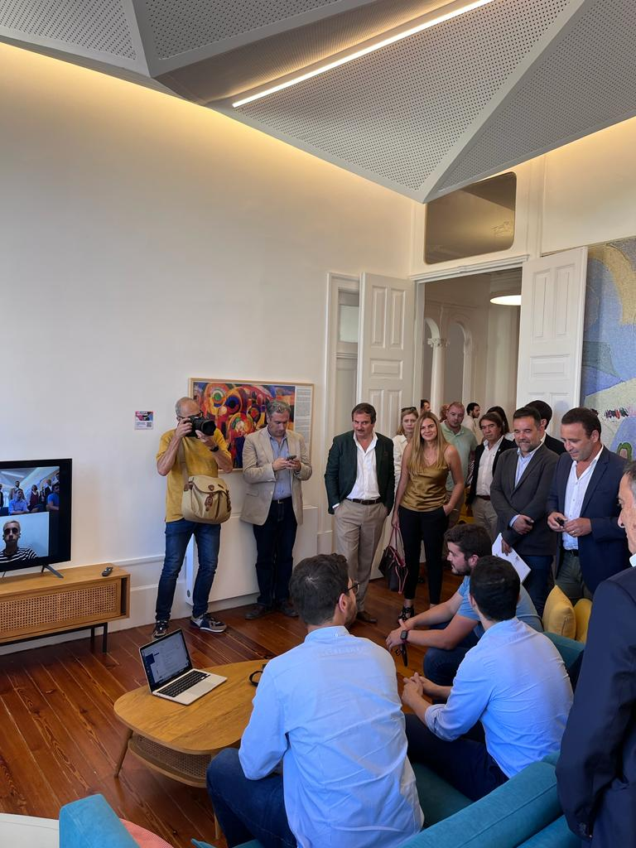
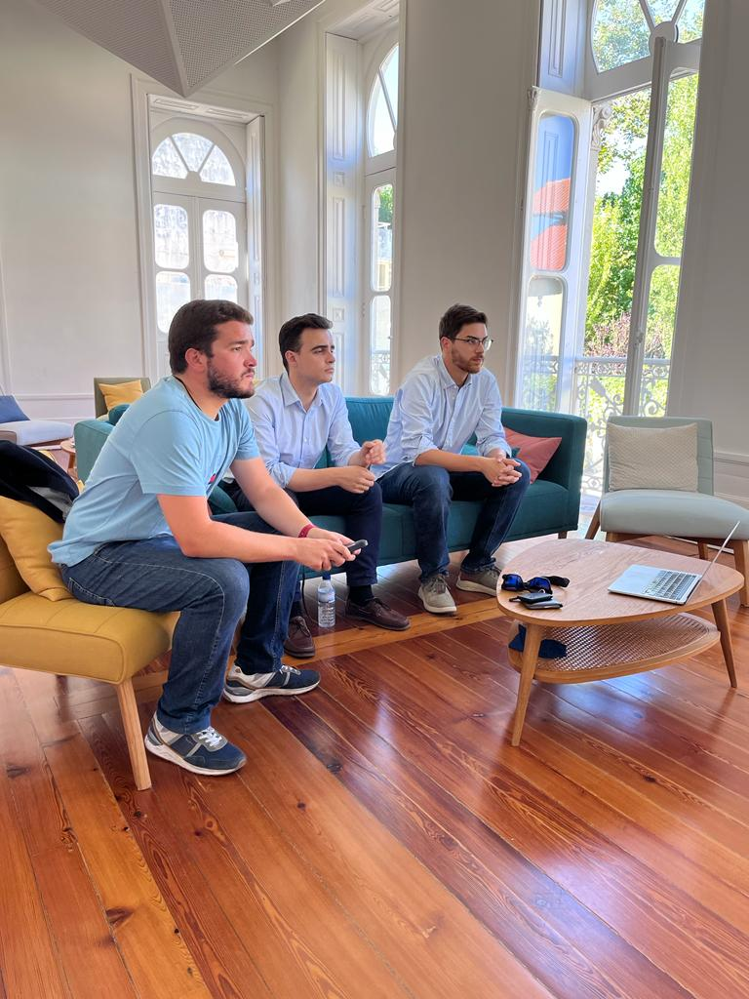
Official presentation– 12 de agosto 2022
With the presence of the highest political leaders of the government in youth matters

Slide 11
Thank you
Follow us:
www.movijovem.pt | www.pousadasjuventude.pt | www.cartaojovem.pt

