Slide 1
Strengthening capacities for governmental youth agendas using EYC as a tool: the case of Portugal
Instituto Português do Desporto e Juventude IPDJ, I.P.

Slide 2
Portuguese Institute for Sport and Youth
The mission of the Portuguese Institute for Sport and Youth (IPDJ) is to implement an integrated and decentralized policy in the areas of sport and youth in close collaboration with public and private bodies, namely sports organizations, youth and student associations and local authorities.

Slide 3
Secretary of State for Youth and Sport
Portuguese Institute of Sport and Youth
Sole Auditor
Executive Board
Advisory Council
Board Member
Carlos Alves Pereira
President
Vitor Pataco
Vice-President
Selene Martinho
Board Member
Sílvia Vermelho
Sports Foundation
Organizational
Structure
Youth National Council
Advisory Youth Council
National Agency Erasmus+ Youth/Sports and European Solidarity Corps
Movijovem, CRL
Youth Department
Training and Qualification Department
Sports Department
Regional Directorates
Programs Division
Federated Sports Division
Northern Region
Associativism Division
Sports For All Division
Information, Communication, and International Relations Department
Legal and Auditing Department
National Sports Center of Jamor
Central Region
Information and Communication Division
Facilities and Aquatic Activities Division
Lisbon and Tagus Valley Region
Documentation and Museulogy Division
Lisbon Youth Centre
Alentejo Region
Human Resources, Finance, and Patrimony Department
Infrastructure Department
Sports Medicine Department
Algarve Region
Financial Resources Division
Sports Infrastructure Division
Porto Delegation
Human Resources Division
Technological Infrastructure Division
Procurement and Patrimony Division
Jamor High Perfomance Centre
Administrative Modernization and Organizational Development Division
National Plan for Ethics in Sports

Slide 4
YOUTH DEPARTMENT

Slide 5
Youth Department
Division of Programs
Division of Associativism
Deliberação nº 995/2012
(DR 2ª série nº 137 de 17 de Julho 2012)
Portaria nº 11/2012 de 11 de Janeiro – Estatutos do IPDJ,IP
Instituto Português do Desporto e Juventude, IPDJ, I.P.

Slide 6
Division of Programs
Intervention Areas
Volunteering
Program "Now We"
Young Volunteering for Nature and Forests
International Fields of Work
Health
Program Cuida-Te+
Sexuality Line
Leisure Time
OTL - Leisure Occupation
Holidays on the Move
Entrepreneurship
Program "Empreende Já"
Culture
"Young Creators" Program
Citizenship and Participation
Youth Parliament
EUROSCOLA
Young Participatory Budget
Instituto Português do Desporto e Juventude, IPDJ, I.P.

Slide 7
YOUNG ASSOCIATIVISM
Legal Regime - Law 23/2006 of June 23 (amended and republished by Law No. 57/2019 of August 7) and
Instituto Português do Desporto e Juventude, IPDJ, I.P.

Slide 8
Typology of Youth Associations
Youth Associations
Student Associations
Indirect Youth Groups
Lei 23/2006 de 23 de Junho
Federations of Student Associations and Youth Associations

Slide 9
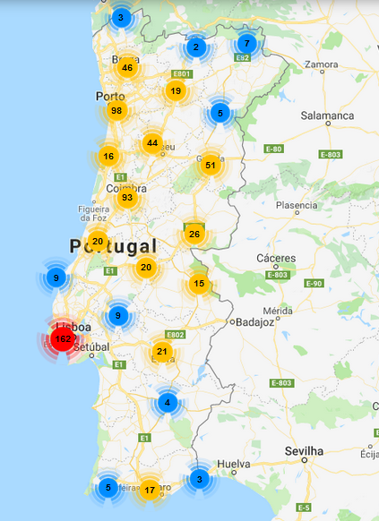
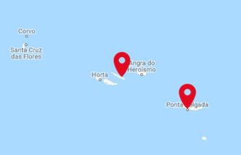
Around 1200 registered entities
Instituto Português do Desporto e Juventude, IPDJ, I.P.

Slide 10
A
Financial Support
Programs
B
Formative Support
Program Form+
C
Logistic Support
IPDJ,IP Installations
D
Technical Support
Ipdj,IP Deconcentrated Services
E
Support for Associative Development

Slide 11
Mobility
The attributions of the IPDJ in the scope of youth mobility it´s also exercised through the cooperative Movijovem, which aims to promote territorial cohesion, as well as to support and encourage youth mobility actions in the social, cultural, educational, sports and recreational fields.
Within the evolution of youth public policies in Portugal, Movijovem has become a central piece in mobility policies for young people, both through the Youth Hostels and through the Youth Card, which since 1986 has provided young people aged 12 to 30 with a set of advantages such as discounts, reductions, exemptions or exclusive services provided by public or private companies, municipalities and associations, and also the INTRA_RAIL program.

Slide 12
Youth Card and Youth Hostels
With the signature of the Partial Agreement on Youth Mobility through the Youth Card, governments and EYCA members, aimed at developing the Youth Card scheme at European level with a view to facilitating mobility for youth.

Slide 13
Youth Mobility Policies
IPDJ
CNJ
Youth Mobility Policies
FNAJ
Movijovem

Slide 15
NATIONAL YOUTH PLAN - 2022 - 2024
The National Youth Plan is the policy instrument for intersectoral coordination of youth policy in Portugal.
Its objectives are:
To increase and improve youth policies;
Improving inter-ministerial coordination;
Encourage monitoring and evaluation practices of public youth policies.
Notes:
Dinâmica de grupo: formar 4 grupos de trabalho para planificar sessões e workshops nos espaços e nas escolas de cada município.

Slide 16
Methodology
The consultation for the 2nd edition of the Plan started on 23 July 2021, integrating the following initiatives:
Seminars;
Youth panels at national level;
Online questionnaire to young people at national level; Involvement of all governmental areas;

Slide 17
The Youth Plan has 425 Measures and adopts the following structure in 5 axis:
Emancipation and Autonomy
Education and Science
Citizenship and Participation
Healthy Lifestyle
Culture and Free Creation

Slide 18
Emancipation and Autonomy
Axis I - Emancipation and Autonomy

Slide 19
Education and Science
Axis II - Education and Science

Slide 20
Citizenship and Participation
Axis III - Citizenship and Participation

Slide 21
Healthy Lifestyles
Axis IV - Healthy Lifestyles

Slide 22
Culture and Free Creation
Axis V - Culture and Free Creation

Slide 23
Evaluation
In terms of evaluation, the National Youth Plan has three moments:
Monitoring;
Interim report;
Final report.

Slide 24
THANK YOU FOR YOUR ATTENTION
miguel.martins@ipdj.pt

