Slide 1


Steering Systems, Strategic Steering and Performance Management in Finnish Context
Kari Kiesiläinen Heikki Liljeroos

Slide 2
Department of Judicial Administration
Head Mr. Kari Kiesiläinen
Courts
General,
Administrative
and
Special Courts
Legal
Aid
Enforcement
Legal Aid Offices
District Bailiffs
Economy – Human Resources
International affairs
Legal Training Unit
OFFICES AND INSTITUTIONS

Slide 3
The Department of Judicial Administration
Main duty is to ensure that the preconditions for a functioning judicial system exist
This requires that the courts and offices have:
  sufficient financial resources,
  sufficient staff,
  proper premises,
  facilities,
  communications, and
  sufficient training to maintain the professional skills of the staff at a high level.

Slide 4
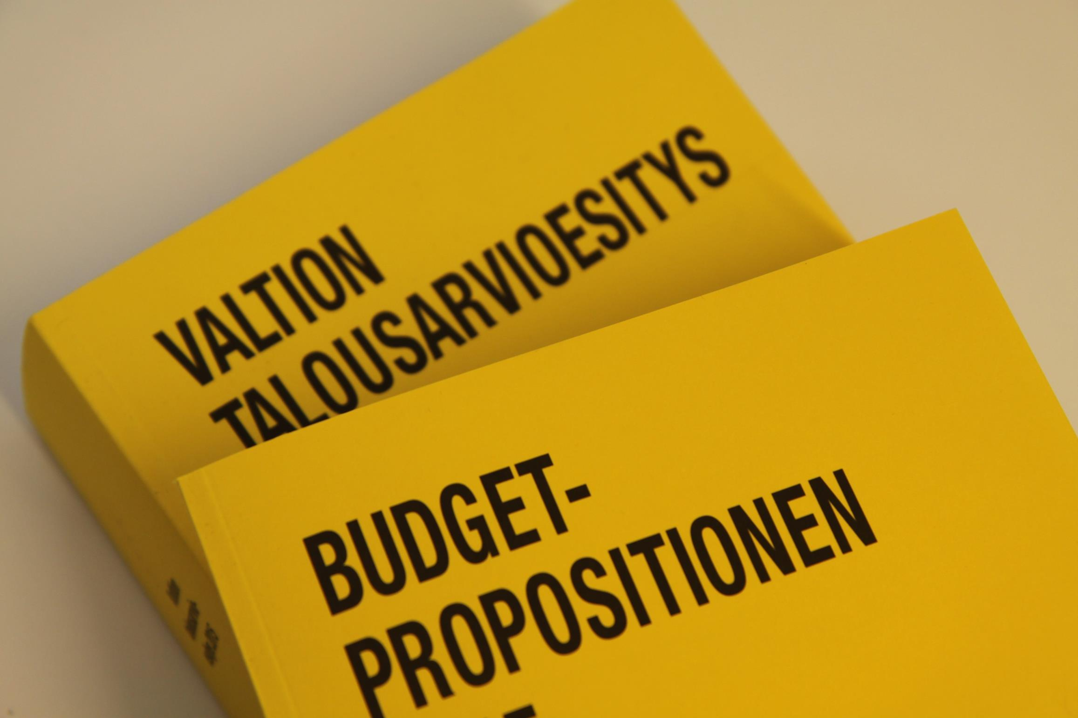

Slide 5
Finances
The budget of the administrative branch for 2017 is approximately EUR 917 million, which accounts for less than 2 per cent of the government expenditure.
Operating expenses
in 2016

Slide 6
STATE BUDGET 2017 / MoJ
whole administrative sector
appropriation 915 mil €
(incomes 145 mil €)
MOJ AND ADMINISTR.
126 mil €
COURTS AND LEGAL AID
423 mil € (incomes 69 mil)
A) Courts of law 279 mil €
1) Supreme Court 8,6 mil €
2) Supreme Administr. Court 13,1 mil €
3) Other Courts 257 mil €, from which
66 % the District Courts
20 % the Appeal Courts
10 % the Administrative Courts
4 % the Special Courts
B) Legal aid and trustees 66 mil €
Payments for private lawyers 78 mil €
ENFORCEMENT
106 mil €
(incomes 73 mil €)
PROSECUTION
46 mil €
PRISON ADMINISTR.
219 mil €
ELECTION
8,5 mil €

Slide 7
Courts of Law
Court
Of
Impeachement
Supreme
Court
Supreme
Administrative
Court
Labour
Court
Courts of
Appeal
(5)
Insurance
Court
Market
Court
Administrative
Courts
(6+1)
District
Courts
(27)

Slide 8
The course of courts performance negotiations
General about development
Resources (personnel/euros)
Targets;
  Incoming/ solved cases
  Time of hearing (lead times)
  economic efficiency/productivity

Slide 9
The most used indicators:
Number of incoming cases
Length of proceedings
Number of postponed cases
Number of pending cases
Number of decisions
Caseload of judges and courts
The budgetary means of a court and the spending of the budget
Quality indicators

Slide 10
Steering Policy and Steering Systems

Slide 11
Steering Policy and Steering Systems
Steering Policy
Defines a big picture of steering policies in time (privatisation, public service delivery through state agencies)
Political point of view: rules and principles set up in the Government Programme and its Implementation plan
  Currents issues: reform of social welfare and healthcare and regional administration reform
Actor: Government and all the ministries
Ministry of Finance has a role to steer state administration
  Interest of public finances, efficiency and quality of service production

Slide 12
Steering Policy and Steering Systems
Steering Instruments
Steering instruments refer to processes, documents and instruments seeking to obtain targets set up by the Government or the administration
  Measures of economic policy and measures of governance policy
  Management and leadership key areas in implementation
Objective is to seek balance between public finances and state operations, to develop efficient steering mechanisms and guarantee clear processies and logical system
Interest of Corporate steering becomes more and more important

Slide 13
Strategic Level Steering
- Government Programme and its Implementation Plan
- Steering Policies
Steering of Resources
- General Government Fiscal Plan
- Budget Process
- Performance Management
Normative Steering
- Acts and Decrees
- Regulations and directives of EU
- Other regulation
Corporate Steering
Other Steering instruments
- Leadership
- Organisational Structures
- Strategies
- Information Steering and Training
- Incentive Systems

Slide 14
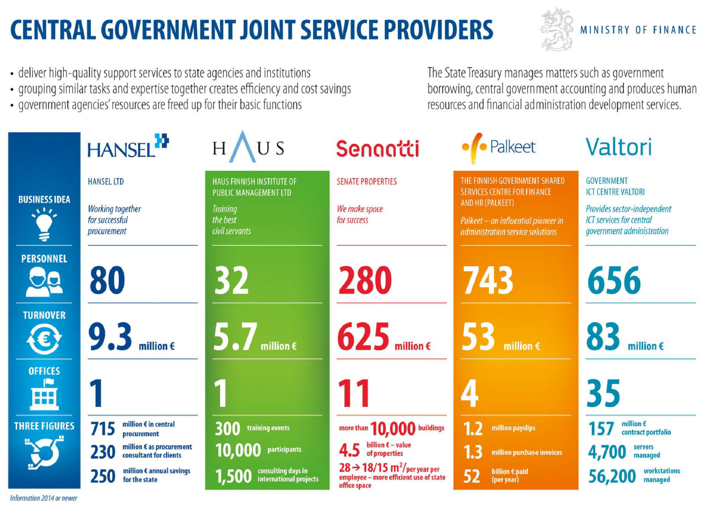
Corporate Steering: Joint Service Providers

Slide 15
Performance Management

Slide 16
Key ideas and principles
  Performance management (PM) is an agreement based steering model
    Parties negotiate and then agree. Reporting and follow up
  PM’s main purposes:
    To find balance between resources and targets
    To improve quality of public services
    To ensure cost- efficiency in service production
    Societal advantages must be also considered

Slide 17
Key ideas and principles
The principal instrument for performance management is the annual central government budget
  Includes:
    resources and the agreed targets
    indicators to analyse achievement of the targets

Slide 18
Key ideas and principles
Other main instruments of performance management:
  four year financial framework for Public Finances compiled by the Government (Fiscal Plan)
  performance agreements between sector Ministries and agencies on the respective administrative sector
  reports and statements upon results achieved
    The government and ministries report to the parliament in the Annual Central Government Report
Legal framework: no single enactment but legal provisions in a few acts
  Budget Act, Budget Decree, Government Rules of Procedure

Slide 19
Actors and roles
Ministry of Finance is responsible for the development of performance management as a steering system in state administration
  Performance management process
  Budget process and budget
State Treasury has supportive role under the MoF
  Provide support regarding the development of the whole steering system
  Responsible for State performance and reporting system Netra
  Provide practical consultation to certain extent (performance analysis, indicators, reporting)
Line ministries are responsible to execute performance management in their administrative branch
The Government financial controller's function is the Government's joint supervisor of performance and finances
State Audit Office: fulfils its external audit task by conducting financial audit, compliance audit, performance audit, fiscal policy audit
  role of administrational controller and independent supervisory authority
  ensuring financial accountability

Slide 20
New Performance Management
- more strategic, horizontal, integrated and less administrative burden

Slide 21
6. Travelling towards new performance management
More strategic
Less administrative burden
More horisontal
More integrated

Slide 22
- Support to Government's Strategic Objectives
- New Corporate Steering Package

Slide 23
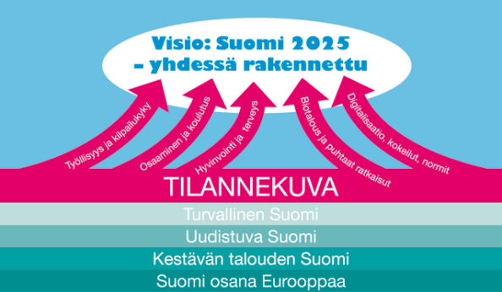
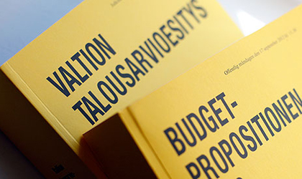

More strategic and clear target setting
Restricted amount of targets
Genuinely common targets
Shared process including strategic decisions and use of resources
Information based decision making
Indicators and follow up are key areas of interest

Slide 24
Support to Government’s Strategic Objectives
Common Targets Support
Common targets in performance management support implementation of common policies set up by the Government
Common Targets Consist
Common targets consist of 5 Strategic Priorities materialised in the form of 26 key projects in the Government Programme and its Implementation plan
Ministry (owner) and Agency (steered party) negotiate and select relevant targets under 5 strategic priorities to each agency. They may employ targets as such or derive more functional ones to each steering relationship.
Performance Management Database supports the presentation and reporting of targets
Negotiate and Agree
Database Available

