Slide 1
Technologies in biomedicine & health
Sophie van Baalen, Rathenau Instituut
European Council CDBIO
Horizon Scanning Event
Notes:
Welcome to my talk. I am going to present views from stakeholders, patients and citizens on the use of AI for health and care that we have derived from a blog series with different stakeholders and dialoges with citizens and patients.

Slide 2
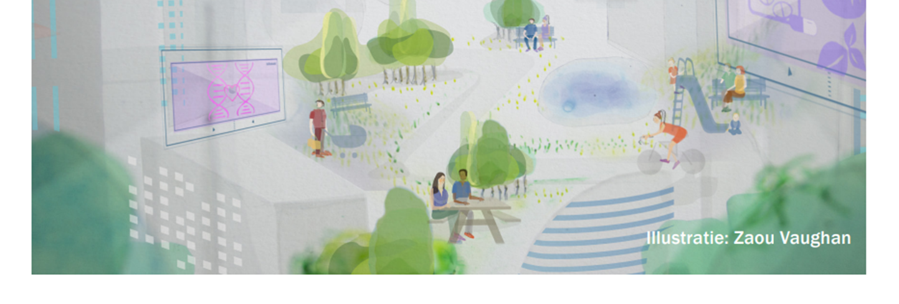
Technologies in biomedicine & health – future developments

Slide 3
Content
Digitalisation
Biotechnology
Global ecological, economic and social context
Concluding remarks

Slide 4
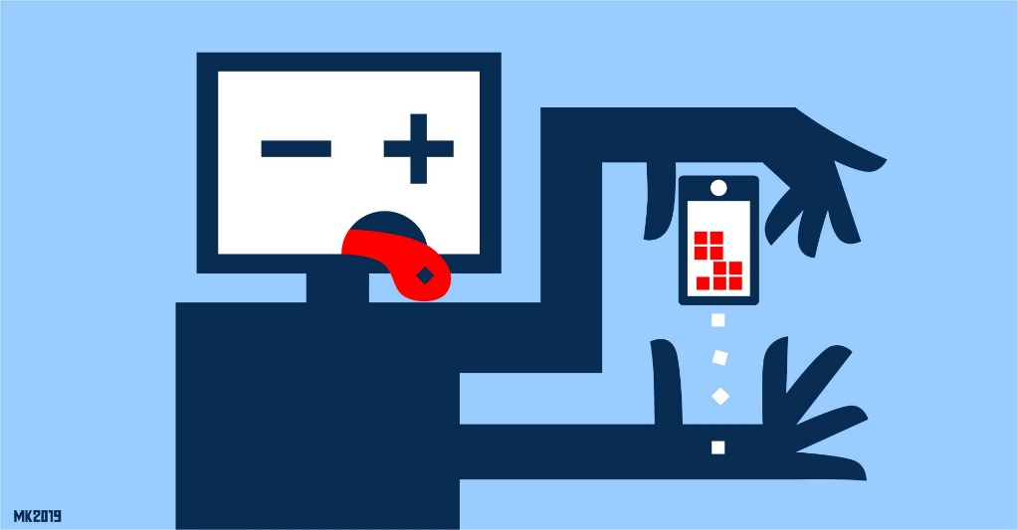
Digitalisation

Slide 5
Digitalisation is a driving force for several developments in health care and biomedical research
Examples:
In medical practice:
care-at-a-distance,
AI in medical practice,
data sharing and collaboration
In medical research:
Synthetic data,
multi-omics,
neurotechnology
Notes:
In medical practice:
Care-at-a-distance examples: video consulting, telemonitoring and activity tracking
The promise of these technologies is that it will make healthcare more efficient and cost-effective
Currently little prove of this effect
AI examples: decision-support tools, image interpretation, automatic generation, compiling or search of health record, and many more…
Promises increased efficiency, better quality and new ways of working
➔ AI tools are slowly finding their way into the clinic
Data sharing and collaboration examples: Increase use of data generated in a health(care) context– i.e. from digital devices (wearables), in health care records and in registries
Data sharing generates opportunities for collaborations between care providers, scientific research, innovation and technology development (enabled by the European Health Data Space - EHDS).
In medical research:
Using artificially generated data instead of real-world data while maintaining key statistical properties.
Useful when dealing with sensitive of confidential information (i.e. personal of proprietary data)
Protects privacy, while allowing researchers to perform analyses
Integration and analysis of data from multiple disciplines, made possible by AI technologies,
i.e. genomics, transcriptomics, proteomics, metabolomics and epigenomics.
➔ high throughput technologies that enable large-scale study of biological entities.
Contributes to the complex understanding and dynamics within biological systems and the development of personalized/ precision medicine.
AI significantly impacts brain research by improving data comprehension, data integration and automatic data processing.
New avenues to develop interventions
For example, brain implants and brain-computer interfaces.

Slide 6
Issues with digitalisation in medical research & practice
Changing relationship between health care professionals and their patients/ clients.
Affect accessibility of health care, i.e., for people with limited access to digital devices, literacy & digital skills ➔ increasing the health-gap
Data privacy, data solidarity & informed consent
Bias, discrimination & lack of transparency
Neurotechnology brings down our last bastion of privacy – privacy of thought ➔ several human rights might be under pressure

Slide 7
Biotechnology

Slide 8
Biotechnologies such as CRISPR-cas9, whole genome sequencing, etc. enable novel applications in biomedical research and practice.
Examples:
In medical practice:
Gene therapy,
Human genome editing,
Xenotransplantation
In medical research:
Embryo-like structures,
In vitro gametogenesis,
Epigenomics &
epigenome editing
Notes:
* First CRISPR-based gene therapies are on the market, targeting sickle cell disease.
Gene therapies targeting many different diseases are expected to follow in the coming years.
This would comprise a revolution in medical care for genetic disorders
* When gene therapy is deployed to ‘cure’ an embryo (and future child) from a genetic disease (or make other genetic alterations), the child will pass on the alteration to its offspring.
Techniques for HGGE is not yet considered safe and efficient, but experiments are being performed worldwide (i.e. CRISPR-babies)
* Embryo-like structures (ELS) made from stem cells can serve as an embryo-model for research without creating, using and discarding actual human embryos
* Generating germ cells (sperm and egg cells) in the lab from skin or other body cells might generate new avenues to research genetic diseases or fertility disorders.
In the future it may also comprise a new reproductive technology, when two synthetic germ cells are used to generate an embryo that grows into a child.
Ethical issues include informed consent of potential donors, a different appreciation of early human life and access to care and reproductive technologies.
More research and a broad society dialogue are crucial to responsible development of IVG
*Increasing knowledge of epigenetic mechanisms – the “operating system” that regulates gene expression, provides information on the complex interaction between the genome and the environment.
With epigenetic editing, researchers envision the ability to swich genes on or off, in order to improve dysregulated body processes.
Epigenetic editing might generate therapies that enable to cure genetic (or other) diseases without cutting the DNA
Ethical concerns might be similar to gene therapy, but further research and societal dialogue is required for responsible development of epigenetic editing

Slide 9
Issues with emerging biotechnology in medical research & practice
Wide range of ethical and societal concerns
Patients participating in clinical trials run specific risks, for example related to CRISPR-technology (off-target effects)
Moral & legal status of embryo & embryolike structures
Costs associated to advanced biotechnology therapies
Lack of global regulations and oversight
National and international societal dialogue is needed

Slide 10
Broader (global) ecological, economic and social context

Slide 11
Disparities in access to healthcare
Climate change and health care
Growing scarcity of resources in health care
Availability and accessibility of biotechnological innovations worldwide
Individualisation
Social media and health
Notes:
Disparities in access to Healthcare:
Disparities in access to healthcare services create challenges in applying ethical guidelines universally. The ethical dilemma of allocating limited healthcare resources fairly and addressing healthcare inequities remains a contentious issue.
Climate change and health (planetary health)
Human health is intricately linked to the health of the planet and the sustainable functioning of its ecosystems. There is a growing awareness of the impact of climate change on health, including the spread of diseases and the exacerbation of health inequalities. The multidisciplinary field of planetary health focuses on the interconnections between the health of human civilizations and the health of the Earth's natural systems, emphasizing the complex relationships between human well-being, ecosystems, and the global environment.
Simultaneously, measures against climate change can also affect our health. For example, cities in the Netherlands are developing measures to retain water in cities, as water will become scarce and water can cool cities, however, this will also allow mosquitoes to do well in the future. This is problematic because with higher temperatures, it is likely that mosquitoes will carry more viruses in the future.
Growing scarcity of resources in health care
Several factors contribute to scarcity of resources in healthcare, including a rising health care demand as populations grow, age, and face new health challenges, advancements in medical technology that increase costs, and a shortage of healthcare professionals and prescription drugs. The COVID-19 backlash of delayed health care, long covid and exhausted medical personnel compounds these issues further.
Availability and accessibility of biotechnological innovations worldwide
There’s a growing risk that personalized medicine will edge out public health measures that are beneficial to all. This leads to more expensive personalized care, and at the same time to less funding available. There is a risk that due to private lobbying, more resources will be allocated to these technologies than to healthcare or prevention, that are less represented by lobby organizations. This is a matter of health justice.
Individualisation
The increase in individual-oriented behaviors, values, and lifestyles, come at the expense of traditional collective or communal structures.
Social media and health
Besides the impact social media has on the mental and physical health of children as well as adults, social media platforms can also be sources of health-related misinformation. Individuals may encounter inaccurate information, potentially leading to self-diagnosis, unnecessary anxiety, or the adoption of unnecessary or harmful treatments.
Different sources also note an increase in psychological and self-help mainstreaming in everyday language. This could be contributed to increased awareness and acceptance of mental health issues in society, increased access to information on mental health through the internet and social media platforms, increase of the self-help industry and therapeutic language in marketing. Policymakers should be aware of who owns these therapy-platforms and what will be done with the data they create.

Slide 12
Concluding remarks
Public values: attention to collective values
National and international innovation policies focus on economic benefits rather than societal challenges
Collaboration needs to move beyond academic and professional experts. More democratic model of innovation, also involving citizens and societal stakeholders is desirable.
Notes:
Public values: attention to collective values
Current debates on bioethics often depart from individual values such as reproductive autonomy. Autonomy has become the most important ethical value in medicine, and it has gotten a narrow
One important aspect: in current national and international policies , countries focus on competing for economic benefits of development and production of biomedicine. This can have a negative impact on patients, research participants and society at large. Especially since large pharmaceutical companies have a lot of power and an enormous lobby that influences policymakers. Instead, innovation policy and funding should be directed at solving societal challenges.
Collaboration can be expanded beyond the above-mentioned academic and professional experts. In our experience, there is quite a lot of exchange in place between these actors (i.e. in the Netherlands, bioethicists and healthcare professionals take seats in the commissions that develop and evaluate (controversial) health care policy such as the embryo law). However, the engagement with the broader public on such issues is limited and there are few to no mechanisms in place to facilitate the inclusion of opinions, values or perspectives from the broader public in discussions about emerging challenges in the field of health & care. A more democratic model of innovation and transformation, in which citizens have a say in the wanted direction of change and whether and how new technologies will be developed is desirable.

Slide 13
Societal dialogue
Notes:
a process of collective opinion formation
Participants (experts & lay people) exchange perspectives, arguments, opinions, information, etc.
→ In that process, participants are enabled to formulate a well-informed and carefully considered opinion on the topic

Slide 14
Thank you!
Contact: s.vanbaalen@rathenau.nl
Links:
https://www.rathenau.nl/en/nauwkeurig-en-gericht-bewerken-van-het-epigenoom
https://www.rathenau.nl/en/gezondheid/discussing-modification-heritable-dna-embryos

Slide 15
Care-at-a-distance & telemedicine
Examples: video consulting, telemonitoring and activity tracking
The promise of these technologies is that it will make healthcare more efficient and cost-effective
➔ Currently little prove of this effect
Major concerns are
Relationship between healthcare professional & patient will change
The accessibility of health care for people with limited acces to digital devices, literacy and digital skills
Might enlarge the existing “health gap” between higher & lower educated people
Notes:
Also: privacy → see later slides

Slide 16
AI in health care
Examples: decision-support tools, image interpretation, automatic generation, compiling or search of health record, and many more…
Promises increased efficiency, better quality and new ways of working
➔ AI tools are slowly finding their way into the clinic
Major concerns are:
Bias, discrimination & lack of transparency
Professional responsibility and accountability
Loss of expertise & skills of health professionals, loss of jobs
Notes:
→ Privacy as well…

Slide 17
Data sharing, collaboration & data privacy
Increase use of data generated in a health(care) context– i.e. from digital devices (wearables), in health care records and in registries
Data sharing generates opportunities for collaborations between care providers, scientific research, innovation and technology development (enabled by the European Health Data Space - EHDS).
However, ethical concerns around data ownership emerge.
Individuals have the right to access, rectify and erase their health data.
Not all citizens are capable to carry this responsibility
These issues are in only partially addressed in the GDPR and EHDS

Slide 18
Synthetic data
Using artificially generated data instead of real-world data while maintaining key statistical properties.
Useful when dealing with sensitive of confidential information (i.e. personal of proprietary data)
Protects privacy, while allowing researchers to perform analyses
However, synthetic data may not capture the full complexity and diversity of real-world data, potentially introducing bias and error, and misleading results and compromising the performance of models based on the data.

Slide 19
Multi-omics
Integration and analysis of data from multiple disciplines, made possible by AI technologies,
i.e. genomics, transcriptomics, proteomics, metabolomics and epigenomics.
➔ high throughput technologies that enable large-scale study of biological entities.
Contributes to the complex understanding and dynamics within biological systems and the development of personalized/ precision medicine.
(Ethical) concerns include privacy and informed consent, and the integration of dissimilar data from different sources

Slide 20
Neuroscience
AI significantly impacts brain research by improving data comprehension, data integration and automatic data processing.
New avenues to develop interventions
For example, brain implants and brain-computer interfaces.
A major ethical concern is bringing down our last bastion of privacy – privacy of thought
Several human rights might be under pressure – human dignity, freedom of thought, a right to a private life

Slide 21
Gene therapy
First CRISPR-based gene therapies are on the market, targeting sickle cell disease.
Gene therapies targeting many different diseases are expected to follow in the coming years.
This would comprise a revolution in medical care for genetic disorders
However, these therapies are very expensive, might not be available to everyone or constitute a heavy burden on national healthcare budgets.
Moreover, patients participating in clinical trials might be vulnarable to specific risks that need to be considered when stimulating the development of gene therapy.

Slide 22
Human Germline Genome Editing
When gene therapy is deployed to ‘cure’ an embryo (and future child) from a genetic disease (or make other genetic alterations), the child will pass on the alteration to its offspring.
Techniques for HGGE is not yet considered safe and efficient, but experiments are being performed worldwide (i.e. CRISPR-babies)
HGGE generates a wide range of possible ethical and societal concerns
Broad, societal dialogue and consensus is crucial and often mentioned
However, no global oversight and no existing mechanisms to incorporate the outcomes of public dialogue into laws and regulations

Slide 23
Embryolike structures
Embryo-like structures (ELS) made from stem cells can serve as an embryo-model for research without creating, using and discarding actual human embryos
Ethical concerns includes the moral and legal status of ELS
The definition of embryo require reconsideration
Conceptual and normative (dis)similarities should be elucidated and publicly discussed.

Slide 24
In vitro gametogenesis
Generating germ cells (sperm and egg cells) in the lab from skin or other body cells might generate new avenues to research genetic diseases or fertility disorders.
In the future it may also comprise a new reproductive technology, when two synthetic germ cells are used to generate an embryo that grows into a child.
Ethical issues include informed consent of potential donors, a different appreciation of early human life and access to care and reproductive technologies.
More research and a broad society dialogue are crucial to responsible development of IVG

Slide 25
Epigenomics & epigenetic editing
Increasing knowledge of epigenetic mechanisms – the “operating system” that regulates gene expression, provides information on the complex interaction between the genome and the environment.
With epigenetic editing, researchers envision the ability to swich genes on or off, in order to improve dysregulated body processes.
Epigenetic editing might generate therapies that enable to cure genetic (or other) diseases without cutting the DNA
Ethical concerns might be similar to gene therapy, but further research and societal dialogue is required for responsible development of epigenetic editing

