Slide 1
National Information Centre
The geographical challenge
to tackle fake degrees and fraudulent credentials
Vera Skorobogatova
RUSSIA

Slide 2
Higher Education of Russia in numbers
 | 2000 | 2005 | 2010 | 2019
Number of Higher Educational Institutions (HEIs) | 965 | 1 068 | 1 115 | 741
State HEIs | 607 | 655 | 653 | 496
Private HEIs | 358 | 413 | 462 | 245
Enrolment of students (thsd) | 4 741 | 7 065 | 7 050 | 4 162
State HEIs | 4 271 | 5 985 | 5 849 | 3789,7
Private HEIs | 471 | 1 079 | 1 201 | 372,3
Notes:
I would like to present in vain the eloquent statistics of higher education. On the table you can see a significant reduction in the number of universities in Russia and this is due, first of all, to the processes of struggle for the quality assurance , deprivation of licenses and accreditation, and you see a reduction of state universities by a third and non-state universities almost 2 times. There is still a process of consolidation and the merging of regional universities into strong universities - drivers of regional development.

Slide 3
Dynamics of submitted applications (2014-2018)
Notes:
And which accepted more than 21 thousand applications for recognition of a foreign education in 2018 and provided 85 thousand consultations in various forms

Slide 4
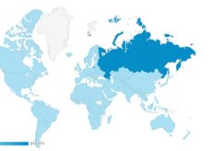
Web-portal of National Information Center – nic.gov.ru
The web-portal was visited by
401 257
users
from 167 countries
The number of provided
consultations
The number of submitted
applications
80%
from total
68 600
65%
from total
13 650
450
Notes:
Therefore on the Internet portal - www.nic.gov.ru - it is possible get information on the legislative acts of the Russian Federation in the field of education, information about the educational system in Russia and other countries, information on international treaties on mutual recognition, and a list of sample documents on foreign education and (or) foreign qualifications recognized in the Russian Federation, as well as other information prescribed by the new Law on education.

Slide 5
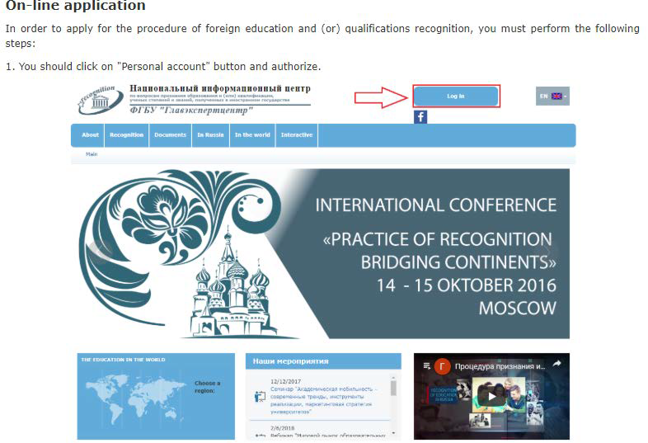
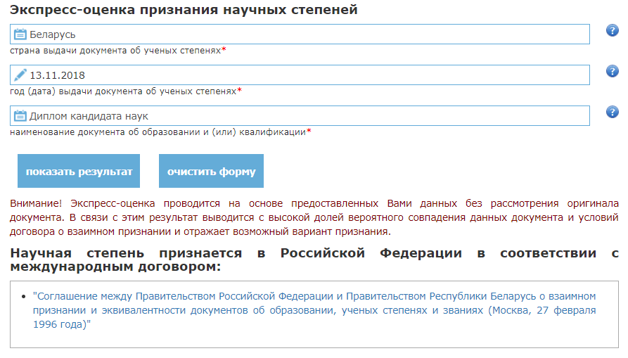
Portal NIC abilities
7 language versions
On-line consultation of applicants
Express assessment of a foreign diploma
Application in English
Application tracking and other
Notes:
The portal has a fairly wide range of features:
7 language versions work: Russian, English, German, French, Spanish, Chinese and Arabic, which are constantly being developed
Organized online counseling, implemented the possibility of a preliminary assessment of the diploma regarding the need for passing the recognition procedure (express assessment),
submission of documents in English and monitoring the progress of the application

Slide 6
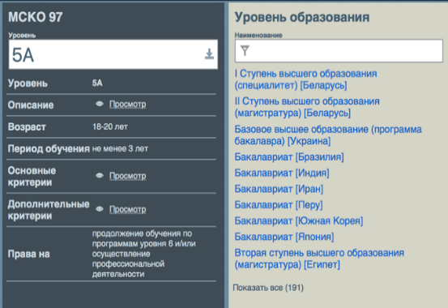
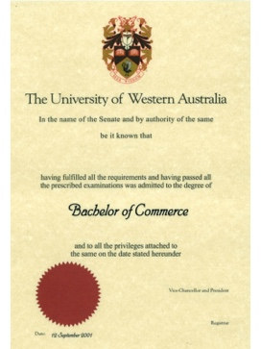
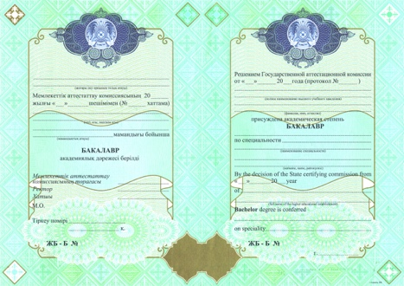
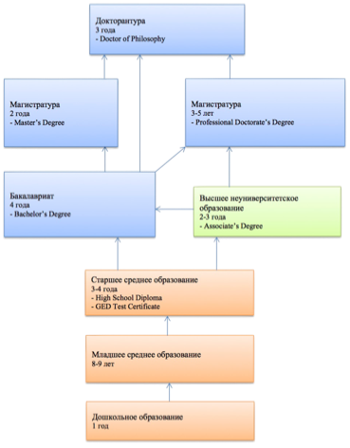
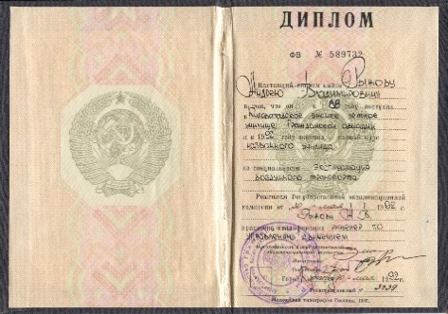
The Information system «Recognition database» of National Information Centre (Russian ENIC) as an instrument for expert evaluation
It provides:
The assistance in determining the appropriate level of foreign education to the level of education in Russia
The checking of the fact of issuing educational documents
The list of recognized educational institutions
The samples of the documents on education
The Descriptions of education systems in more than 100 countries
The section with the results of recognition in Russia is developed.
The Access to the database is available only under the contract.
Notes:
NIC also has an internal information system RD, it was created for credential evaluators for providing maximum information for each country

Slide 7
Recognition procedure is provided by
NIC | 47 Higher Education Institutions
2
Lomonosov Moscow State University
7
HEIs under the Government
10
Federal Universities
St. Petersburg State University
28
National Research Universities
provides the authority of Rosobrnadzor on recognition of education credentials on the basis of the State task.
Notes:
In addition to recognition in NICr as part of a public service, for 47 universities that have the right to work according to their own educational standards, the law establishes the right to independently recognize a foreign education.

Slide 8
General characteristics of our work on the prevention and detection of false documents
Internal digital database
Understanding of printing process of academic documents
Samples database
Training of evaluation personnel
Verification contacts

Slide 9
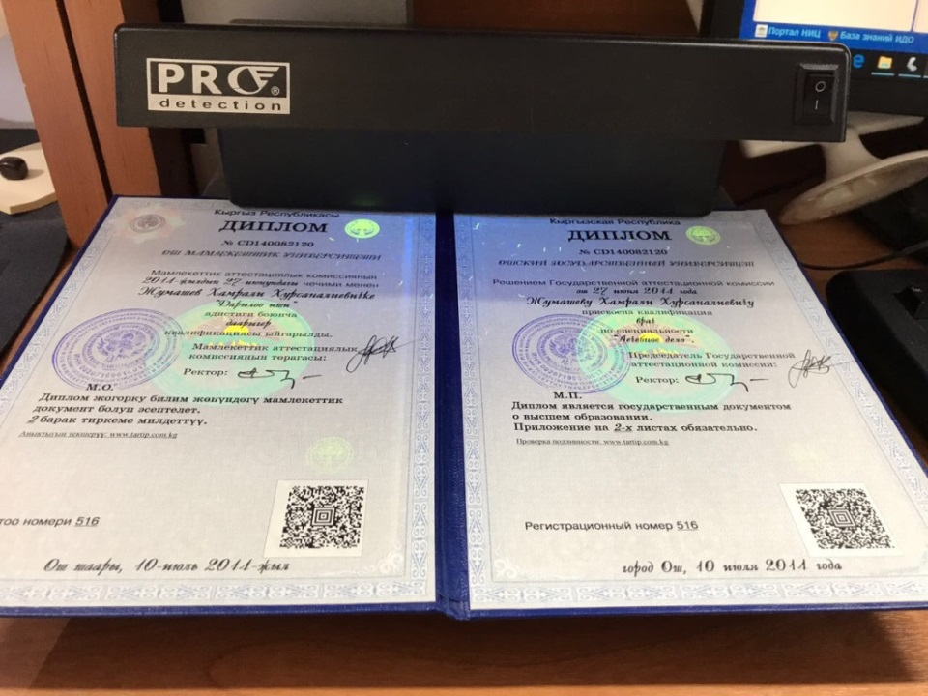
Verification of protective elements in ultraviolet light

Slide 10
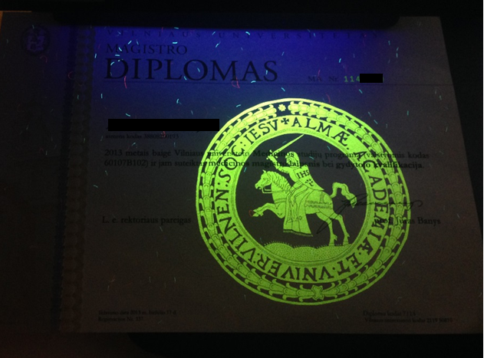
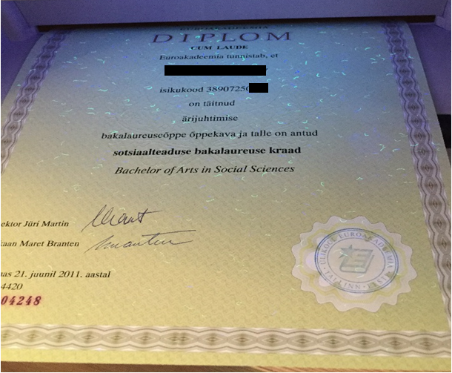
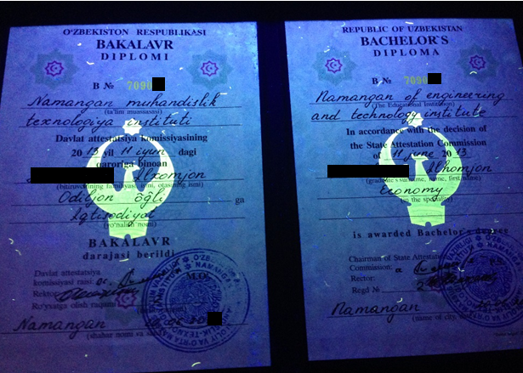
Foreign Diplomas verification

Slide 11
Typical tags which can identify fake documents
Traces of changes in personal data (name, date of birth, gender)
Faded or faded areas, damage, corrections
Interrupted or erased lines provided for printing data
Missing photos on education documents
Part of the print is present only on the photograph of the holder, and not on the document itself
Atypical and “floating” fonts
Additional or missing spaces in the text
Atypical turns of speech, spelling and grammatical errors
Poor quality paper and print
Color and ink quality
Notes:
Practical experience allows us to distinguish typical tags of false documents identified during the preliminary examination

Slide 12
Typical tags which can identify fake documents
Incorrect stamps, emblems, color and form of the document
Atypical names of qualifications and abbreviations
Corrected, blurry or pixel captions
Violation of the symmetry of the document
Inconsistency of dates (change of name of educational organization, institutional merger, closure of educational organization)
Deviations in the program (number of hours, atypical grading system, training period)
Unusual application format using terminology that does not correspond to the main document on education
Availability of ratings atypically high for a given country
Lack of security features for documents - chemically sensitive paper, holograms, glow of fibers and symbols in ultraviolet light, watermarks, micro font, embossed prints

Slide 13
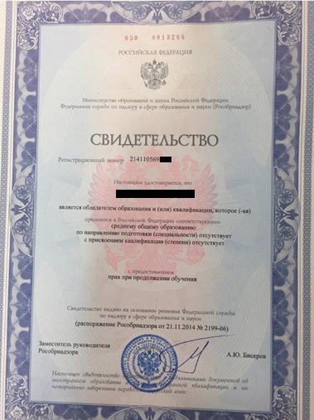
Final decision
Positive
Negative
Inaccurate information
Inappropriate form of study
No corresponding specialty
Non-recognized HEI/Diploma in the country of issue
No answer for the second request

Slide 14
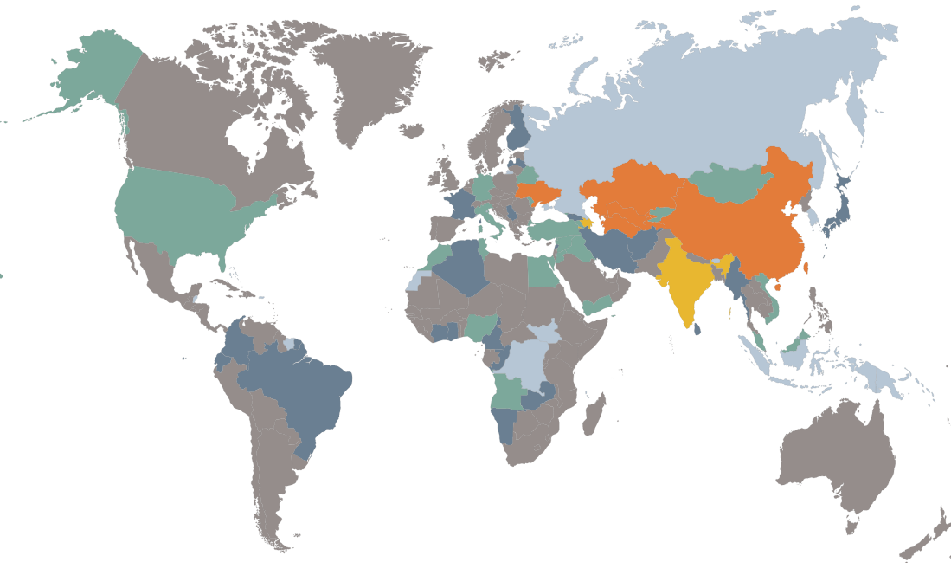
Interactive map
Display of existing mutual recognition agreements
Dynamics of foreign students by years
Information resources to verify the issuance of a document on education
Notes:
But today, in the age of information technology, the main way to verify the authenticity and quality of education should be information resources. Therefore, an interactive map was created on our portal, on which you can see:
1. Display of existing mutual recognition agreements
2. Dynamics of foreign students by years
3. Information resources to verify the issuance of a document on education

Slide 15
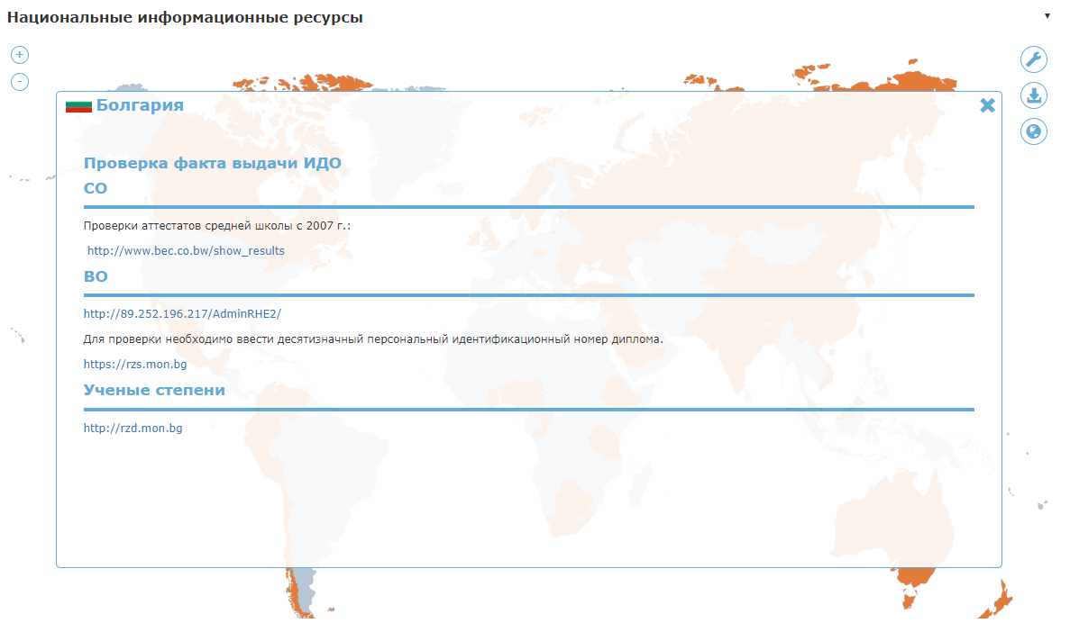
Interactive map
National Information Resources
(registers of educational certificates issued)
Notes:
For example, if you click on Bulgaria, you can see the following information

Slide 16
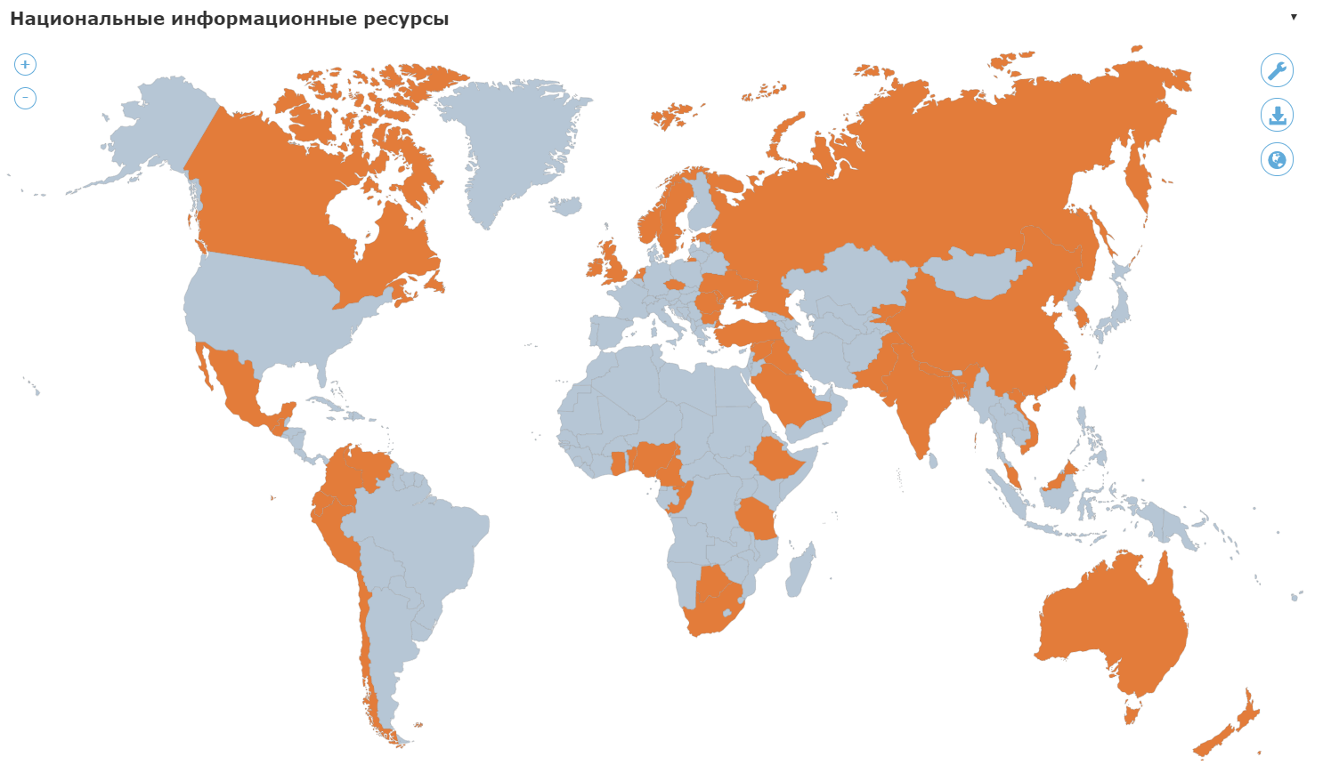
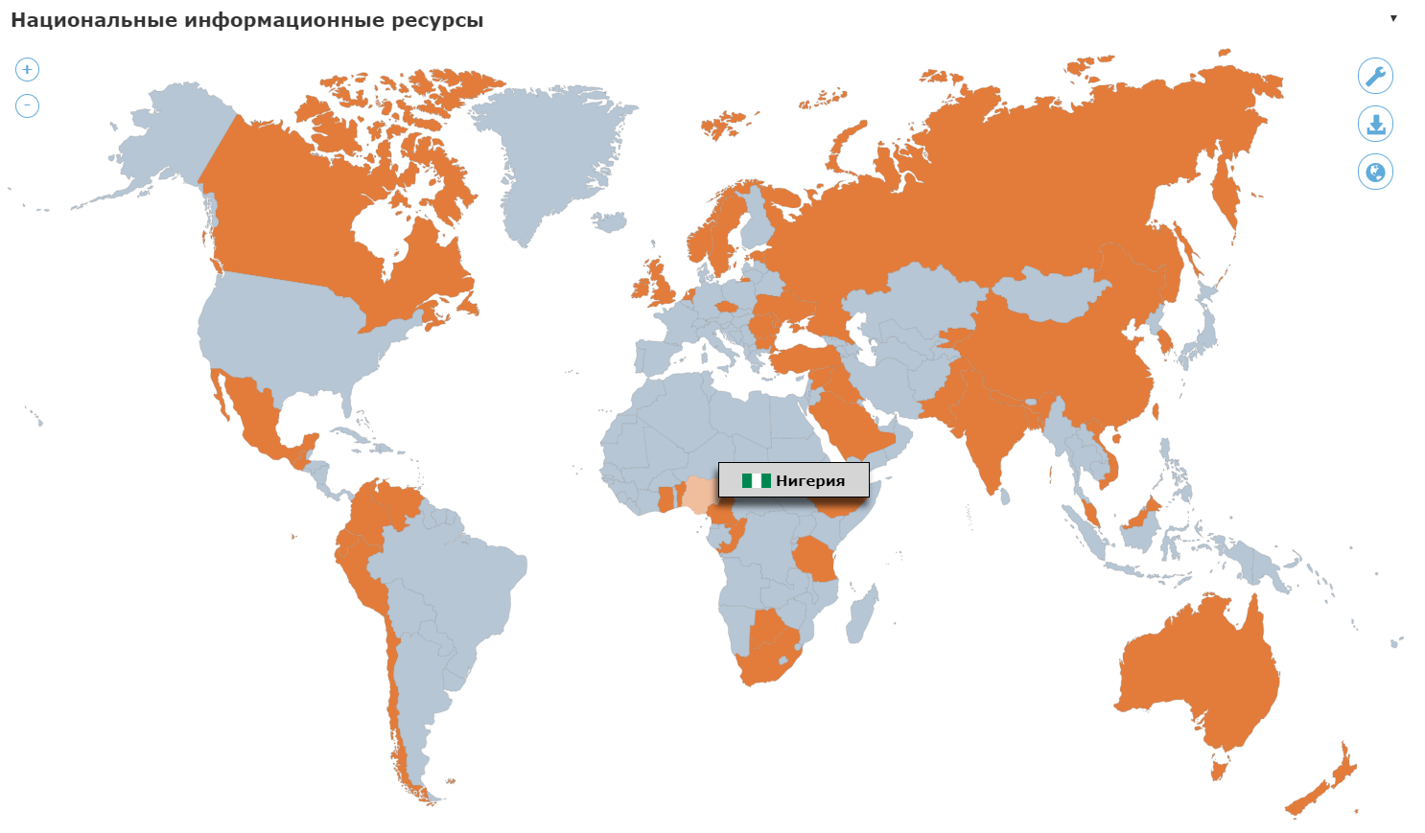
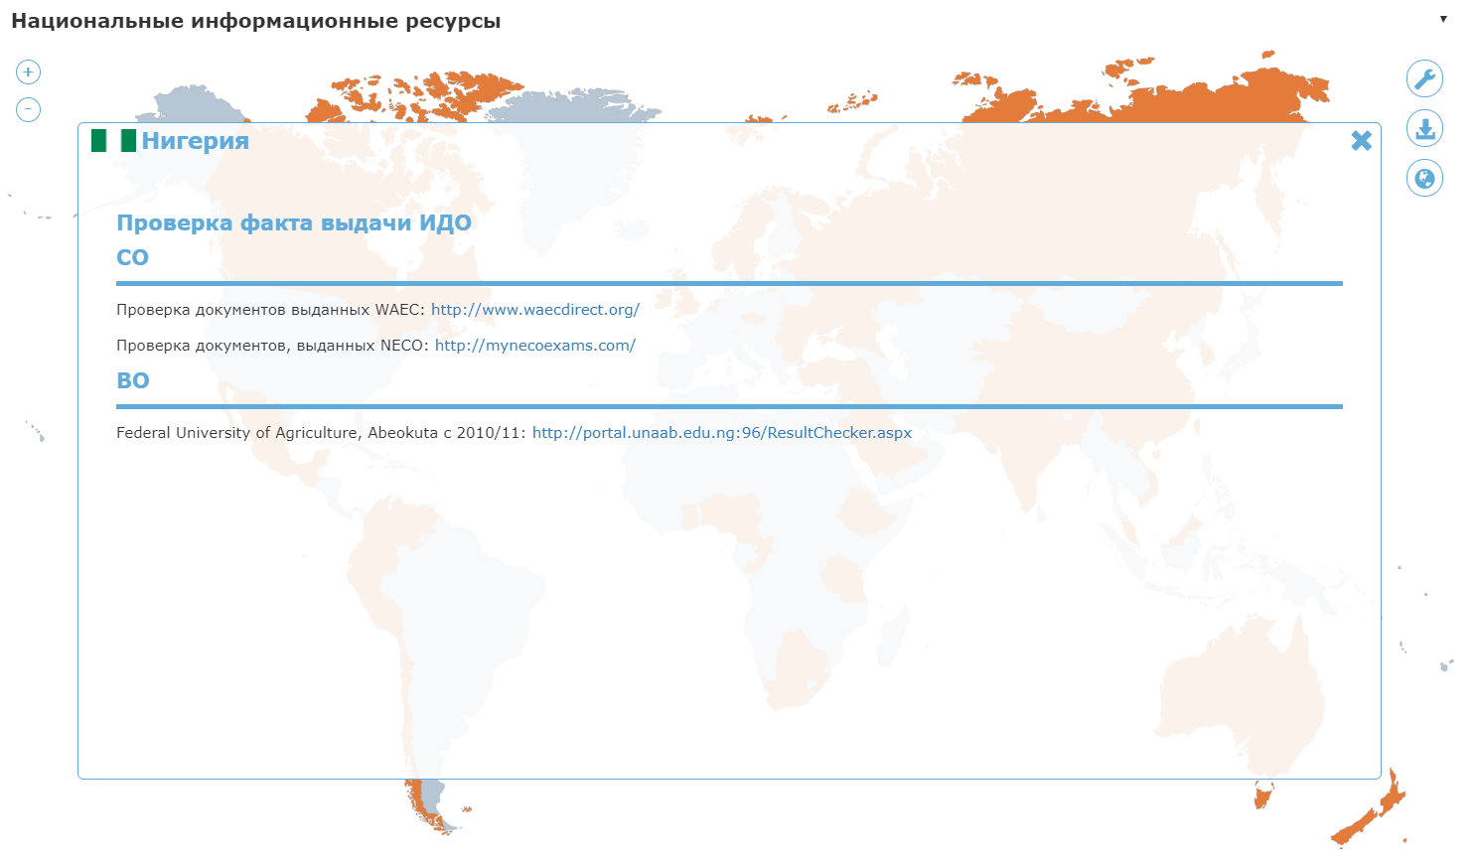
Interactive map
National Information Resources
(information resources to verify the issuance of a document on education )

Slide 17
What Action Can Be Taken?
In order to reduce the risks of accepting fake education documents when assessing qualifications, the following recommendations can be made:
the study of education systems of foreign countries in order to identify the features of the issuance and execution of documents on education
collection of samples of educational documents for use as precedents in assessment and recognition
work with the original document of education, as copies are more often modified
checking the document for typographical and grammatical errors, as well as atypical formulations
the use of technical capabilities to test protection elements (ultraviolet lamps, magnifiers, microscopes)
appeal to information resources (national registers) to quickly verify information about educational organizations and confirm the fact of issuing documents

Slide 18
Why Groningen Declaration
IN A NUTSHELL
The Groningen Declaration Network seeks common ground in best serving the academic and professional mobility needs of citizens world wide by bringing together key stakeholders in the Digital Student Data Ecosystem at its Annual Meeting.
The goal
We make Digital Student Data Portability happen. Citizens world wide should be able to consult and share their authentic educational data with whomever they want, whenever they want, wherever they are.
Notes:
I would like to note the important role in this work of the participants of the Groningen Declaration, which promotes best practices and new ideas in the digitalization of educational documents. Our center also signed this declaration

Slide 19
Federal information systems in the field of education
Information system of the Unified State Examination after secondary education (USE results)
Federal Register of Apostilles
Federal Register of education documents and (or) qualifications, documents of training
Federal Register of licensed institutions
Federal Register of accredited educational programs
Notes:
I want to introduce the state information systems of Russia in education

Slide 20
Federal Registers are created for
Liquidation of fraudulent state-form Diplomas traffic
Provision of authentic information regarding qualification for organizations and employers
Reducing the number of violation and corruption cases in educational organizations
Improvement of education quality by provision of authentic information for the general public

Slide 21
Federal Register of education documents and (or) qualifications
FR was created in 2012 as a part of a special project
It provides information on all state-form Diplomas issued from 2010
The information provision on issued credentials is mandatory for HEIs registered in the system otherwise administrative liability appears
The information on credentials should be lodged within 60 days after Diploma issue and becomes available in the system on the next day after uploading
The system is open for the general public
Data is provided at no charge on the basis of the following criteria: level of education, name of organization, holder’s last name, diploma number, date of issue

Slide 22
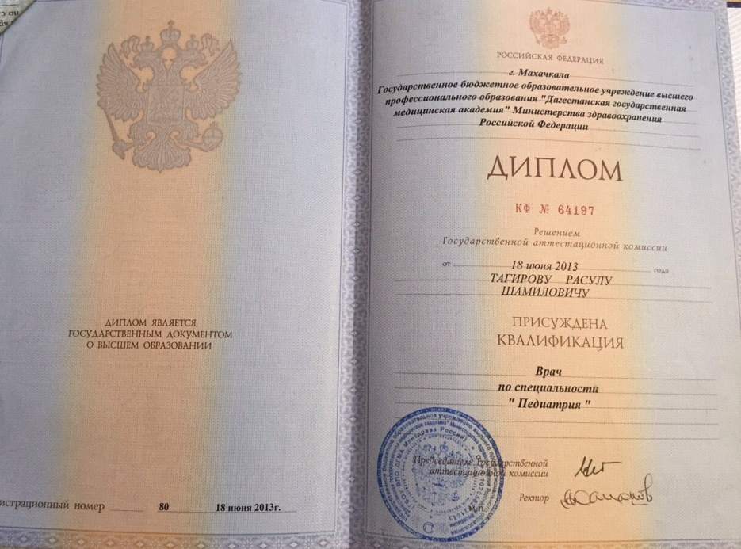
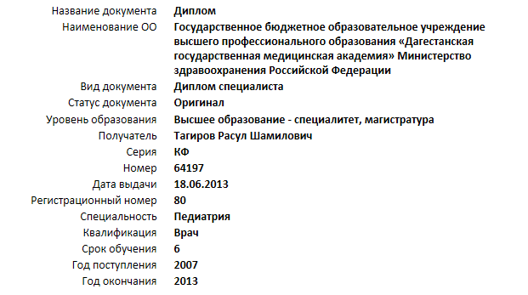
Effective tool for verification

Slide 23
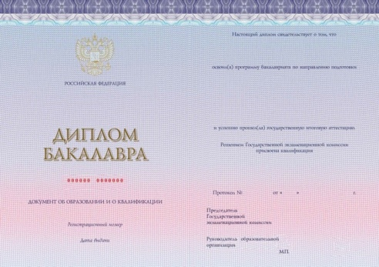
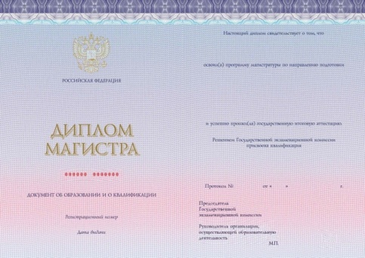
Register of licensed institutions and accredited programmes
The Federal Service for Supervision in education and Science (Rosobrnadzor) is responsible for issuing license for educational activity and accreditation for educational programmes.
In order to gain better quality and higher level of education all changes in HEI and programme status are reflected in the Federal Registers.
Diplomas of state form can be issued only on the basis of accredited programmes.

Slide 24
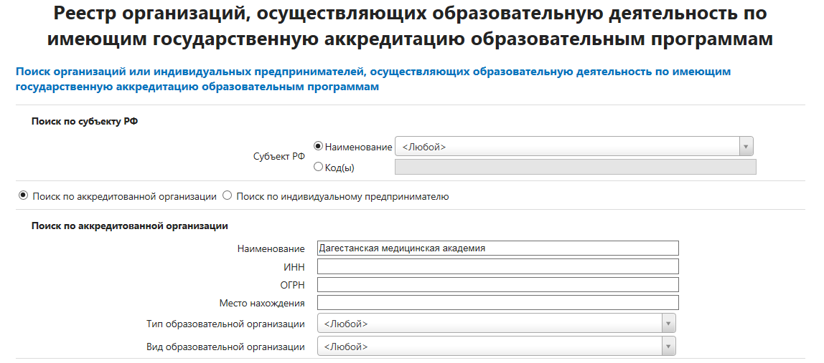
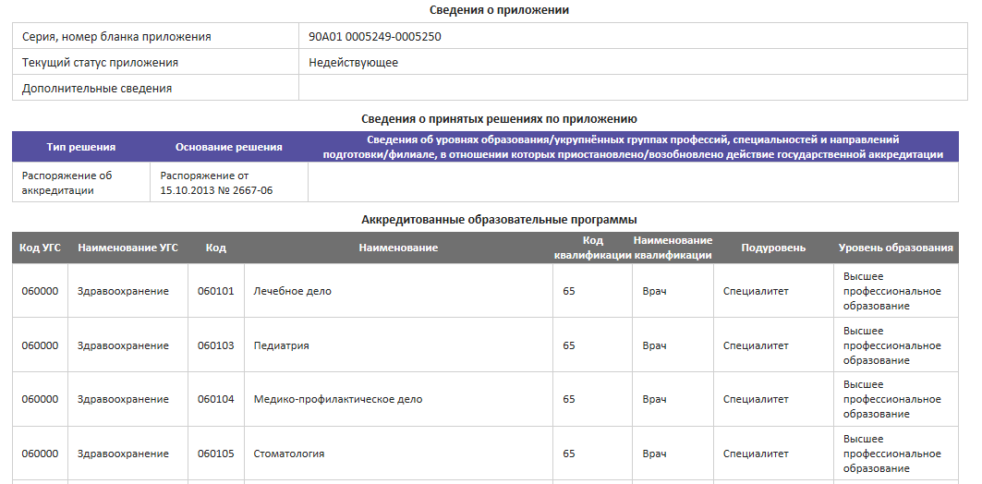
Register is open to the general public

Slide 25
Advantages
Time saving
Reliability
Openness
Relevance

Slide 26
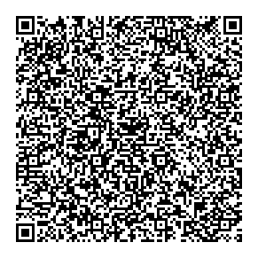
Innovations in educational digitalization
Ensuring the possibility of forming individual portfolios of students on the created information resource (platform) «Modern digital educational environment in the Russian Federation» («Современная цифровая образовательная среда в Российской Федерации»), including the use of a set of service and integration solutions
Usage of QR code
Initially, this know-how began to apply St. Petersburg state University for its graduates.

Slide 27
The influence of public control on government decisions
Civil society
Government response to plagiarism and falsification under pressure from public institutions and citizens
Mass-media
Attracting public attention to the problems of falsification in science
Free Network Community «Dissernet»
Decisions of Higher attestation commission

Slide 28
Free Network Community «Dissernet»
counteract illegal fraud and forgery in the field of scientific and educational activities, especially in the process of defending dissertations and assigning academic degrees in Russia.
A free network community of experts, researchers, and reporters dedicated to exposing fraudsters, forgers and liars

Slide 29
Results of the Dissernet activity
Consecuensis
In five years, the number of defended dissertations has halved.
The cheating dissertation ceased to be an element of prestige, but became, on the contrary, a vulnerability
Cheating dissertation rating
Number
1. Economics
2. Pedagogy
3. Law science

Slide 30
Changes in national legislation aimed at combating fraud theses
First, applicants will now be required to publish the full text of their dissertation on the Internet before defending it
Secondly, the responsibility for the unjustified conferment of scientific degrees is now vested in dissertation councils
Thirdly, one of the most important innovations is the change in the deadlines for considering applications for the deprivation of an academic degree. Now it is 10 years, not three years as before
Notes:
Particular attention in the state is paid to the quality of national research and the protection of academic degrees: Ph.D. and Doctor of Sciences

Slide 31
Graduation revocation
In accordance with the legislation of the Russian Federation, only the Ministry of Education and Science of the Russian Federation can deprive a scientific degree for violating the requirements for dissertations established by the Law. The main violations include:
falsification of documents submitted for defense
plagiarism in various forms: from borrowing text and research results to ignoring co-authorship in joint work
the presence of incorrect information about published works

Slide 32
Deprivation of academic degrees
The most famous was the case with the former rector of the Moscow State Polytechnic University, Andrei Nikolayenko, who lost his degree in 2017 and stopped being rector for an article published retroactively
The number of precedents for the deprivation of an academic degree for the period 2016-2019 (based on orders of the Ministry of Science and Higher Education of the Russian Federation)
Based on | 2016 | 2017 | 2018 | 2019
Expert Council Decision | 14 | 42 | 70 | 51 (40/11)
Personal statement | 5 | - | - | -
Notes:
One of the most important innovations is the change in the deadlines for considering applications for the deprivation of an academic degree. Now it is 10 years, not three years as before.
So in 2018, 70 people were deprived of academic degrees for plagiarism and the presence of incorrect information about published works. This is a significant figure for the scientific community, but such precedents make the system of awarding degree degrees more objective and transparent.

Slide 33
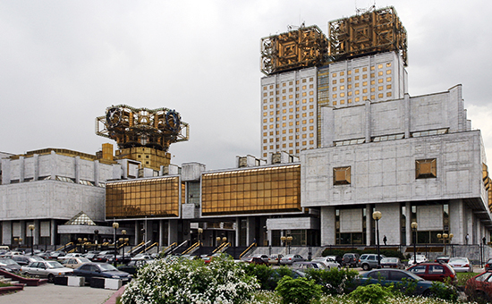
On the eve of the elections to the Russian Academy of Sciences 14.11.2019 г.
The Commission of the Russian Academy of Sciences (RAS) on countering the falsification of scientific research published a report on violations committed by 55 scientists nominated for election by academicians and corresponding members of the RAS. The commission revealed plagiarism, the forgery of empirical and statistical data in the works, the support of unscrupulous dissertations as a scientific adviser and opponent, the repeated publication of the same articles.
According to the commission, the election of new academicians requires zero tolerance for plagiarism, authors of pseudoscientific articles and dissertations cannot be considered scientists and should not be elected to the RAS.
Notes:
n November, the election of academics and corresponding members of the Academy of Sciences took place and for the first time ethical issues were publicly announced.

Slide 34
Politicians fight against corruption
For 3 years now, a law has been in force in Russia, according to which documents on the education of all candidates for deputies of various levels, civil servants applying for high positions are checked.
In March 2017 , the chairman of the Central Election Commission of the Russian Federation, Ella Pamfilova, reported that the control department of the commission identified 21 candidates for deputies who provided fake diplomas.
Notes:
Politicians also began to more principally approach any fake documents, primarily education documents

Slide 35
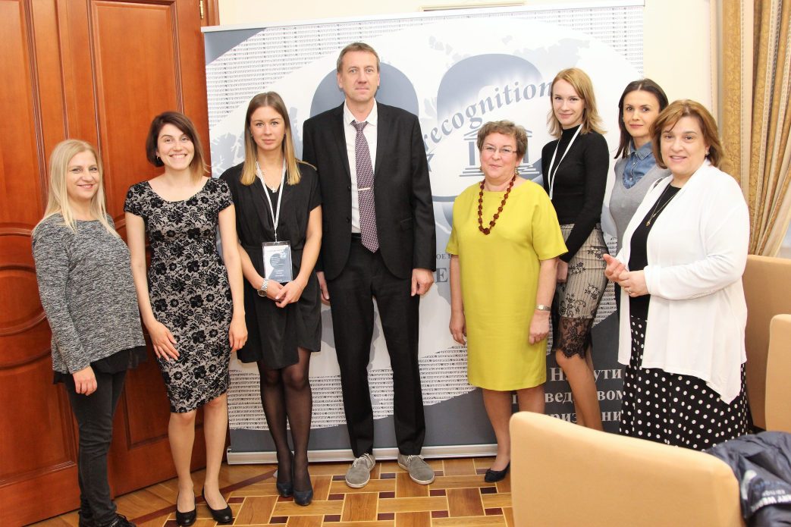
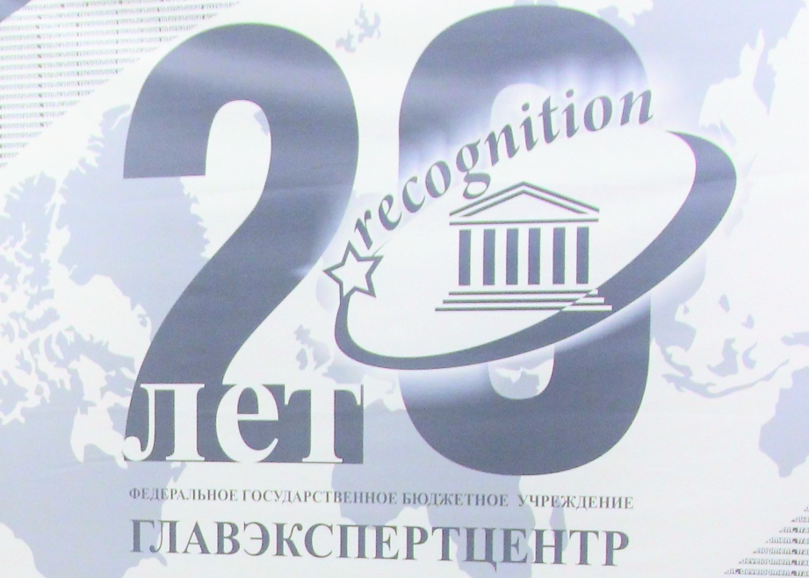
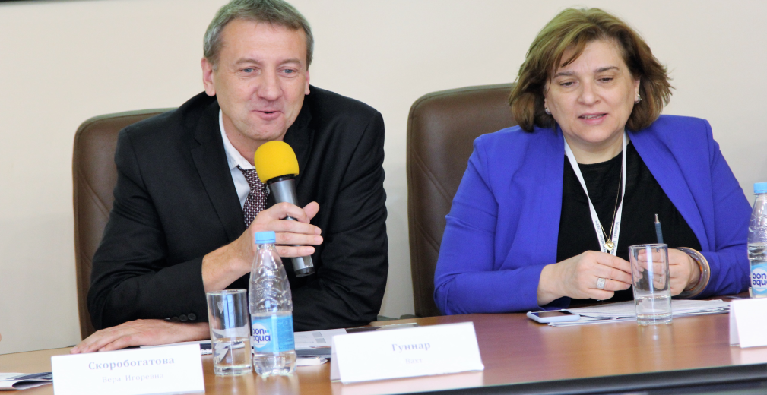
International seminar “The Transnational education: trends, prospects, recognition”
Moscow,2017

Slide 36
Honesty and cleanliness of the educational system is a credit of trust in education
The proposals:
When accrediting universities, assessing the quality of education, take into account the revealed facts of plagiarism, fraud with diploma and doctoral dissertations
Further develop and test digital tools and digital solutions to fight education fraud.
Creation of tools for the exchange of information databases of dissertations, closer cooperation of universities and competent authorities in this matter
Trust is an open door
for future !
Notes:
As well as international cooperation, the exchange of best practices, the creation and promotion of document registers as a guarantee of honesty and quality of education

Slide 37
www.nic.gov.ru
Vera Skorobogatova,
Head of National Information Centre
recognition@glavex.ru

