Slide 1
Developing a Council of Europe Instrument on the Smuggling of Migrants
Council of Europe 2nd International Conference on the Smuggling of Migrants
10 - 11 September 2024 Strasbourg
Calogero Ferrara
---

Slide 2
Introduction
- **Context:** Migration as a complex, multifaceted phenomenon shaping global society.
1
- **Global Influence:** Migration has been central in political and public debates in recent years.
2
- **Challenges:** Migrant smuggling threatens sovereignty, security, and human dignity.
3
- **Purpose:** Developing a legal instrument to address migrant smuggling effectively.
4

Slide 3
International relevance and acknowledgement
Secretary-General’s Proposal: Origin and background of the proposal from November 2023.
Global Endorsement: Member states agreed to assess the feasibility of a new legal instrument.
With this in mind, I proposed, and our member states just agreed last week, to take this forward by assessing, in the course of next year, the feasibility of a new legal instrument in this field
Ideally, in my view, a legally-binding, open convention, involving European and non-European states.
And I am clear about what this text should address.
First, the need for precise, detailed and coherent criminalisation rules that will ensure even more effective international co-operation. On extradition and mutual legal assistance to start with.
Second, the future text should apply irrespective of whether the smuggling occurs at the national or transnational level
And, third, it should include provisions for the protection of smuggled migrants’ human rights, including children and pregnant women.
The link between migrant smuggling, corruption and money laundering must also be better understood and addressed
Including the online aspects of these crimes, the handling of e-evidence and the conduct of such investigations, and creating necessary bridges to our Convention against Cybercrime
Finally, any new Council of Europe legal instrument should be open to non-Council of Europe member states, and to the European Union too.

Slide 4
Goals of the New Instrument
Assembly of Council of Europe, as articulated in Resolution 232 (2020) and Recommendation 2171 (2020) on “Concerted action against human trafficking and the smuggling of migrants,”
CoE, Parliamentary Assembly, Committee on Migration, Refugees and Displaced Persons, A shared European approach to address migrant smuggling, (2024).
New instrument as a complement to international standards in Un Protocols and other international sources balancing national security with the protection of migrants
Maximalist approach: establish a legally binding open convention
Focus on Enforcement: Need for precise definitions and criminalization rules
Foster international cooperation as a consequence of clearer rules on criminalization
Protect the human rights of smuggled migrants, with special attention to vulnerable groups and with ECHR & UNTOC as the backbone of the human rights agenda.
Ensure participation of non-European states and the European Union

Slide 5
Which instrument?
Conventions/Agreements
Recommendations
Resolutions
Guidelines
Action Plans
Protocols
Differences in scope, legal binding force, adoption process
The issue of political will and consensus

Slide 6
Legal Definitions and Scope
Smuggling Definition: Based on art. 3 UN Palermo Protocol on SoM and distinguishing from UN Protocol on THB
Stress on procurement of illegal entry for material gain/financial benefit and focus on organized crime involvement as key elements
Scope: including all forms of smuggling encompassing CoE and ECHR values
Challenges:
Ensuring clarity in definitions to prevent misuse and risks of Over-Criminalization
Ensuring humanitarian aid is not mistakenly criminalized
Ensuring consideration of migrants as victims
Risk of non-compliance or selective enforcement

Slide 7
Criminalization and Penalties (1) ** criminalization of smuggling **
Core Principle: Criminalize smuggling at both national and international levels as severe offence
Preparatory Activities: organizing, directing, aiding and abetting, supporting, financing and all related activities are sanctioned (art. 3 and art. 6 UN Protocol)
Legal systems and enforcement levels vary among member states and so need of laws comprehensive yet enforceable
Focus on Financial Benefit
Challenges
Consistency
Alignment with Domestic Law

Slide 8
Criminalization and Penalties (2) ** Aggravating Circumstances and sanctions **
Violence, exploitation, and inhumane treatment as aggravating factors (art. 6 UN Protocol)
Special penalties for crimes involving children and pregnant women
Involvement of organized criminal group (art. 2 UNTOC)
Sanctions: Imprisonment and fines for smugglers BUT also alternative sanctions (Non-custodial measures, community service, prohibitions)
Economic sanction: confiscation of assets
Challenges
Proportionate, dissuasive and fair penalties
Risk of inconsistencies in interpretation and application
Effective enforcement mechanisms: resource-intensive and time-consuming
Balance with mitigating factors in case of involvement of migrants
Resource constraints and legal frameworks for seizing assets.

Slide 9
Criminalization and Penalties (3) ** Exemption for humanitarian assistance **
Solidarity Clause: Protect genuine humanitarian acts from criminalization with mandatory rules
Legal Protection: Ensure NGOs and individuals helping are not prosecuted and complement with the law of the sea (SAR operations)
Challenges
Risk of abuse of the human humanitarian clause for hidden smuggling activities
Risk of legal gray areas
Consistent application of humanitarian exemption

Slide 10
Prevention Measures (1)
Awareness Campaigns:
Public campaigns to deter smuggling
Depict realistic risks, dangers, and alternatives.
Reaching the target audience
Credibility and trust of campaigns
Partnership with civil society
Effective resources

Slide 11
Prevention Measures (2)
Capacity Building for Law Enforcement:
Training Programs, adequate resources, and specialized units
Digital investigations, cybercrime, and handling e-evidence
Links with corruption and money laundering (FATF)
Resources constraints
Updated skills and knowledge
Coordination across multiple jurisdictions

Slide 12
Prevention Measures (3)
Border control cooperation :
Joint Task Forces: Establish cross-border operations
Shared Intelligence databases
Information exchanges
(art. 18-19 UNTOC – Cybecrime convention – Money Laundering Convention )
Different level of IT capability
Legal and bureaucratic hurdles for cooperation
Data protection and Privacy issues

Slide 13
Protection and Assistance to Victims
Protection of Victims’ Rights (ECHR – ICCPR):
Legal Assistance
Medical and Psychological Care
Safe accommodation
Non – Refoulement (Refugee Convention - ECHR):
Serious assessment of risks
Pressure of migration flows and political-influenced response
Adequate training of LEAs
Return and Reintegration (Global Compact for Safe, Orderly and Regular Migration)
Voluntary Return
Reintegration Support through employment, education, and community integration
Risk of social stigma

Slide 14
International Cooperation
- **Law Enforcement and Judicial collaboration:
Joint investigations and shared intelligence
Facilitation of extradition and MLA
The challenge of “trust”
- **Coordination with International Organizations: UN, Interpol, Europol, and NGOs
**Challenges:
Aligning goals and priorities between different organizations
Overlapping of responsabilities and gaps
- **Need for Secure Data Sharing:
Focus on smuggling routes, financial flows, and networks.
- **Technological Requirements:
Ensure access to databases for all states
Address data protection, privacy, and ensuring secure access.
Cyber Investigations to address online smuggling through secure networks.

Slide 15
Monitoring and compliance
- ** Reporting Mechanisms
Accuracy
Comprehensiveness
Collection of data
Effective use of reports
- ** Evaluation and Review (ICC System)
Adaptability
Needs of resources
Expertise
- ** Sanctions for non-compliance (Vienna Convention on Treaties)
Diplomatic pressure
Public reporting
Legal sanctions

Slide 16
Training and Technical Assistance
- ** Training programs up-to-date and tailored for
LEAs
judiciary
border Officers
- ** Technical assistance
Specialized equipment
Adequate infrastructures
Sharing of best practice
Monitoring and evaluatio

Slide 17
Victim-Centerd Approach
- ** HUMAN RIGHTS SAFEGUARDS
No arbitrary detention
Legal representation
Fair trial
Return procedures grant
- ** CONFIDENTIALITY PROTECTION
Ensuring migrants safety
Fostering cooperation

Slide 18
Choosing the Right Instrument (1)
new convention
- Binding legal obligations
- Comprehensive legal framework
- Enforcement mechanisms
Recommendations
- Flexibility
- Quicker implementation
- Promotion of best practices
Guidelines
- Practical guidance
- Capacity building
- Adaptability

Slide 19
Choosing the Right Instrument (2)
DECLARATIONS
- Political commitment
- Flexibility
- Foundation for future instruments
ACTION PLANS
- Operational focus
- Enhanced accountability
- Coordination
PROTOCOLS
- Building on existing frameworks
- Focused scope

Slide 20
** Next Steps**
Advocacy for Action:
Push for binding legal frameworks
BUT
BALANCING THE NEED FOR LEGAL CERTAINTY AND ENFORCEMENT
WITH THE NECESSITY OF URGENCY, CONSENSUS AND POLITICAL WILL
Monitoring and Evaluation:
Ensure the effectiveness of the chosen instrument
SUPPORT BY STAKEHOLDERS AND OTHER INTERNAITONAL ORGANIZATIONS
LEAD TO CONCRETE ACTIONS
COMMITMENT TO PROTECTING HUMAN RIGHTS AND PROMOTING JUSTICE
Ensure that the chosen instrument is implemented effectively

Slide 21
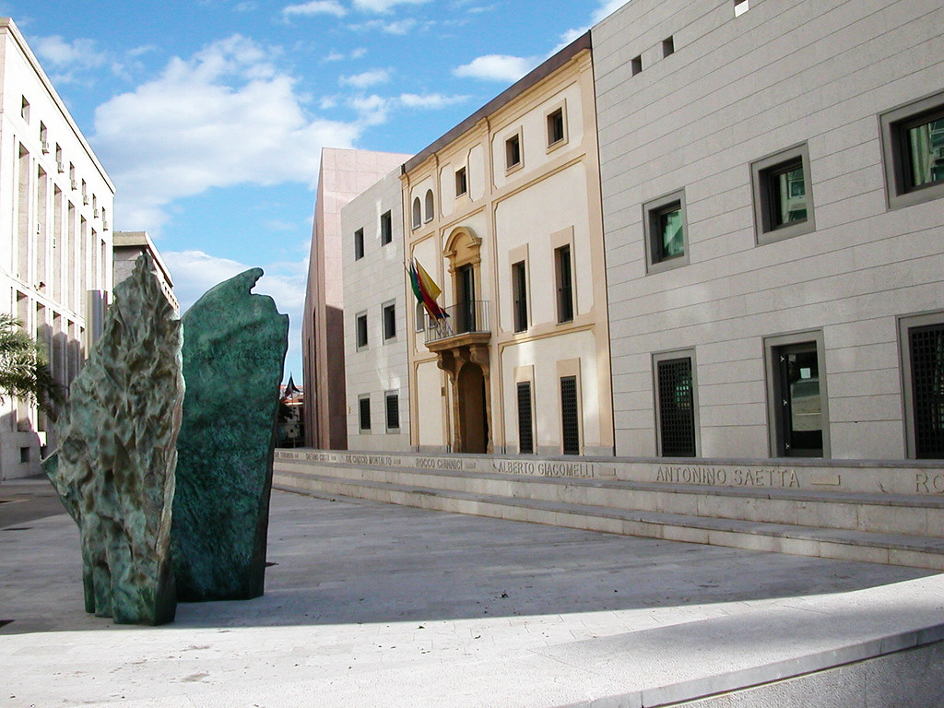
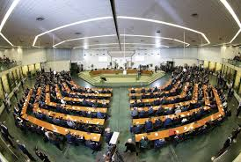
“THE WITNESS: May I say something, sir? JUDGE : Yes, do. THE WITNESS: Never in my dream I would hope one day seeing my rapists and other criminals sitting before a court, being arrested, questioned and charged for what they did. I hope that you as a Judge, together with all the people in the world will make sure that nobody, not even my worst enemy ever experiences what I went through during my MIGRATION TRIP. Thank you very much.”

Slide 22
Merci!
¡Gracias!
Bedankt!
Danke schön
Ευχαριστώ!
Vala!
Dekuji!
Obrigado!
Grazie!
Tak!
Thank you!
calogero.ferrara@giustizia.it
Notes:
22

