Slide 1
Perspectives from civil society; Country of Origin
Lilian Obiye, Africa Regional Manager

Slide 2
Context
Smuggling exposes migrants to human rights violations and abuses.
Migrants may not fully comprehend the risks.
Abuses in the country of origin are a push factor to force migrants to select this option.
Reality- The harsh search for a better life
restrictive migration or asylum policies and rising costs of smuggling
Smugglers take advantage of the lack of solutions and offer services, at a high cost and high risk to migrants.
Notes:
Smuggling of migrants exposes them to human rights violations and abuses, notably their right to life, freedom from inhuman and degrading treatment, the rights of the child, the right to be protected from trafficking and sexual exploitation. Smuggling exposes children, in particular unaccompanied minors, to sexual abuse, violence and human rights abuses.
Smuggled migrants are vulnerable to abuse and exploitation. Their safety and even their lives are often put at risk: they may suffocate in containers, perish in deserts or drown at sea while being smuggled by profit-seeking criminals who treat them as goods.
They can even enter into debt to pay the smuggler
Large number of people who do not have access to legal channels of migration.
People move to other countries for many reasons, but for undocumented migrants it is nearly always for a better life. This may be for themselves or for their families, and it may involve searching for work or escaping from poverty, natural disasters, violence, armed conflict or persecution.

Slide 3
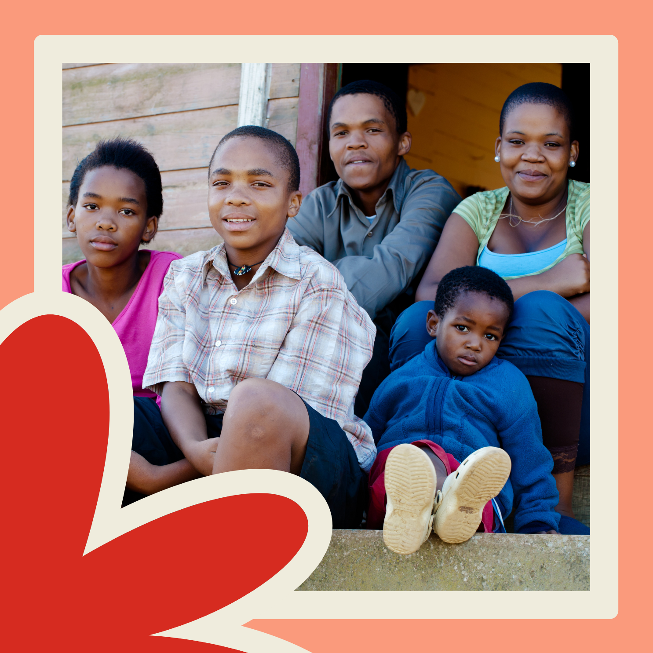
Opportunities with countries of
origin
Further develop and implement the concept of route-based approach
Ensuring individuals are well informed - Share real stories and experiences of the migratory journey, and life in countries of destination.
Access to counselling and legal assistance in countries on origin.
Engagement of solutions that are focused on supporting people to reach case resolution by providing them with holistic, individualised support and exploring all their options.
Notes:
Route based approach allowing a 360-degree response to mixed movements of refugees and migrants, in line with the Global Compact on Refugees and the Global Compact for Safe, Orderly and Regular Migration.
Where gaps are identified, establish safe houses, accommodation and spaces where assistance to meet basic needs, including hygiene, dignity and nutrition, and psychological first aid is available, along with safe

Slide 4
Considerations
Responses that recognize the mixed nature of migration in line with international law,, Global Compact on Refugees and the Global Compact for Safe, Orderly and Regular Migration.
Record and maintain an updated mapping of protection and essential services along the route.
Prevention -measures aimed at would-be migrants, alerting them to the real and potential dangers associated with smuggling.
Notes:
Where gaps are identified, establish safe houses, accommodation and spaces where assistance to meet basic needs, including hygiene, dignity and nutrition, and psychological first aid is available, along with safe

Slide 5
THANK YOU
QUESTIONS?

