Slide 1
Combatting Migrant Smuggling
2nd International Conference on Migrant Smuggling
Strasbourg, 10-11 September

Slide 2
Germany irregular entries by nationalities
LIMITED – for law enforcement only
Total

Slide 3

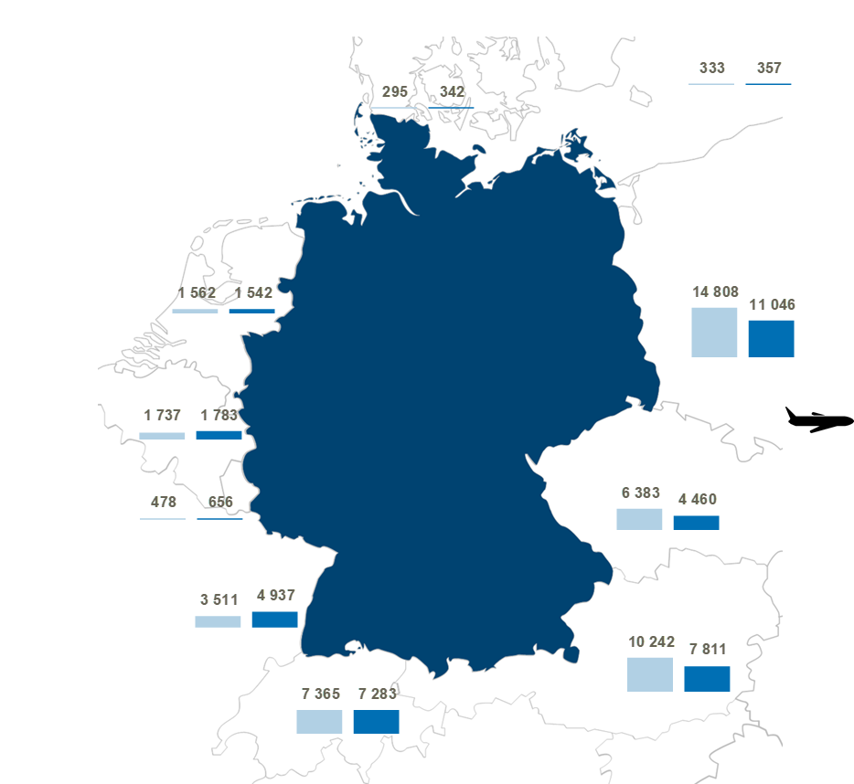
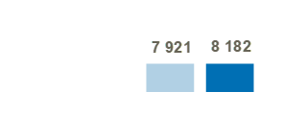
Germany irregular entries by borders

Slide 4
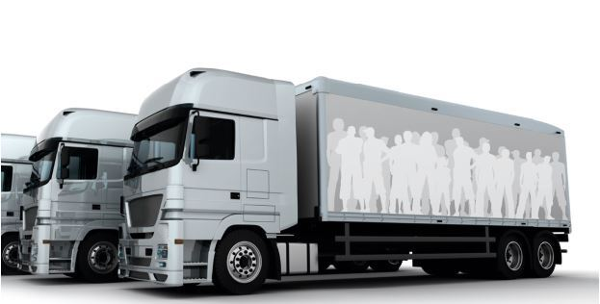
Migrant Smuggling
Germany represents the main destination country of (irregular) migration in Europe
In 2023 the Federal Police investigated 52 organized crime groups active in the field of migrant smuggling
Main Modi Operandi used:
  Smuggling in concealments
  Smuggling for the purpose of illegal employment
  Smuggling for the purpose of prostitution
509 suspects
Profit of more than 37 Mio Euro
use of informal transaction services (Hawala)
Violent behavior of smugglers against migrants

Slide 5
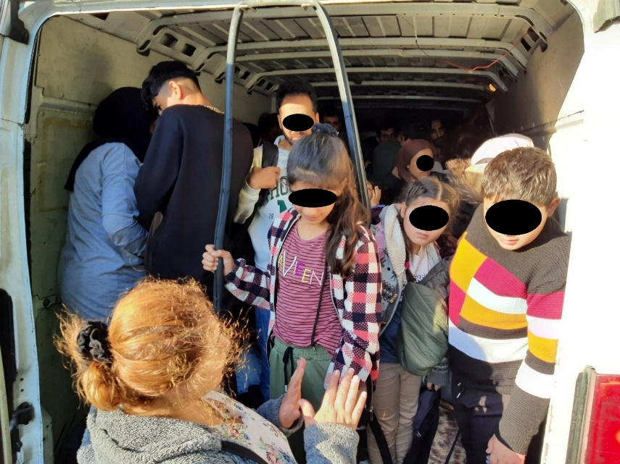
Case study
Smuggling of migrants in concealments
55 Migrants, including 30 minors in a Fiat Ducato
Apprehended at the German-Polish border on September 28, 2023

Slide 6
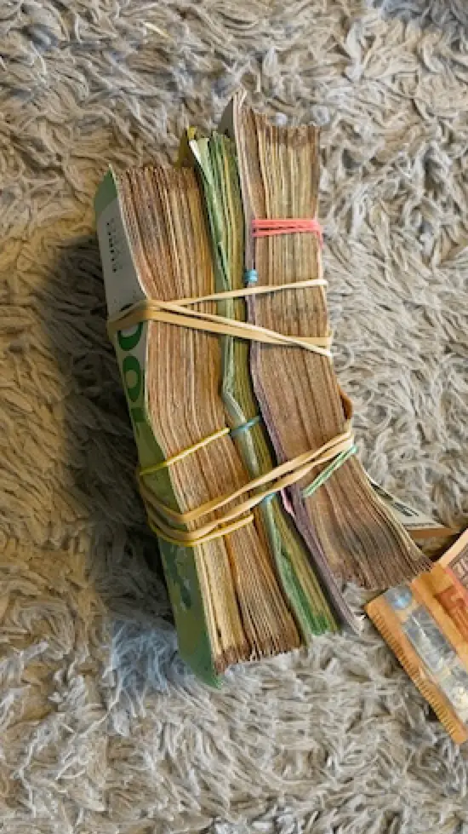
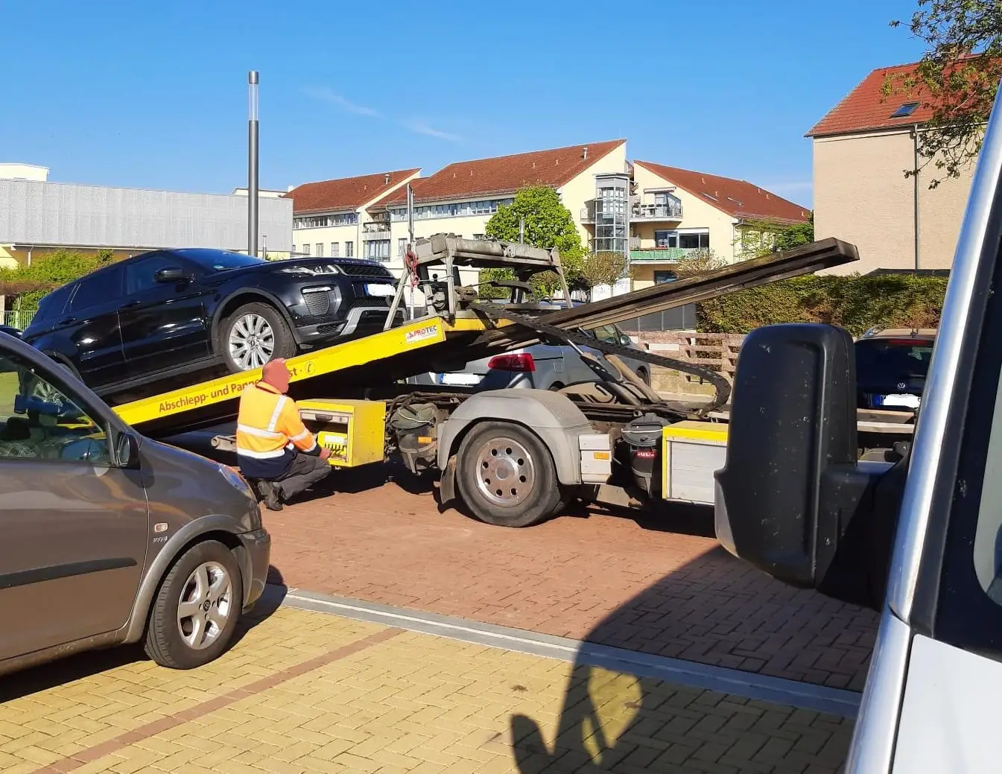
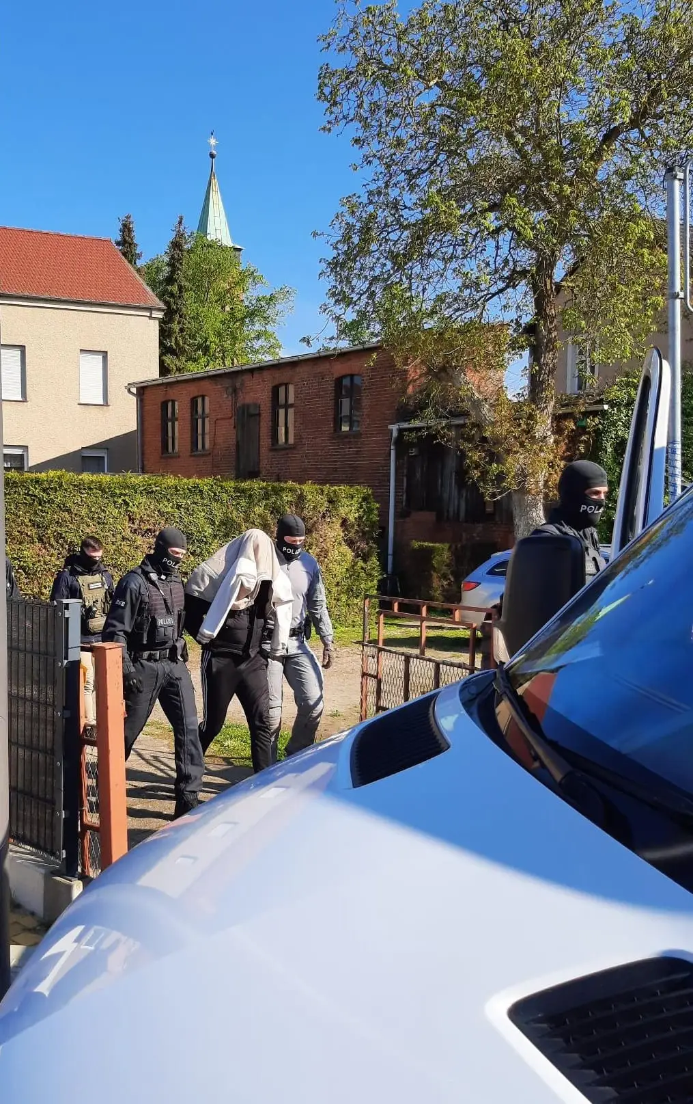
International cooperation
Common Action Days 22-24 April 2024
21 arrests, 24 searches and seizures of vehicles, jewelry, forged documents and 80.000 Euro in cash
The network smuggled migrants from Iraq via Belarus to Poland and further on to Germany and the United Kingdom
Migrants had to pay between 3.000 and 5.000 Euro for the smuggling services

Slide 7
Contact person
Slawomira Dewitz
  Federal Ministry of the Interior and Community
  Division B2
  Alt Moabit 140
  11014 Berlin
Kontakt
Slawomira Dewitz
Slawomira.dewitz@bmi.bund.de
www.bundesregierung.de
Tel. +49 30 18 681-10698
Mobile:+49 160 90859639

