Slide 1
The education industry between democratization and content control
Janice Richardson June 2020

Slide 2
Purpose of educational content
Literacy – preparing to use today’s tools in tomorrow’s context
Just-in-time learning – to cater to rapid knowledge turnover
Critical thinking – to sort info from mis-info, consume mindfully
Creativity – problem solving for evolving challenges, resilience
Values & Attitudes - the cornerstone for responsibility, respect of rights
Equality & Inclusion – access for all to customised, quality content

Slide 3
Challenges and obstacles
School equipment/infrastructure – state of the art (in European Union)
Pedagogical paradigms – to achieve realistic educational goals
Good practice models/platforms – exchange of practitioners’ experience
Professional development opportunities – understanding challenges
Microcosm of school/classroom – exploiting all content opportunities
Curriculum – meaningful learning goals and evaluation methodologies

Slide 4
Digital technology in EU schools - 2019
Infrastructure - 1 in 3 in primary school students and 1 in 2 secondary students attend ‘highly’ digitally equipped schools
Student experience with tech-based learning
- 1 computer per 18:1 students in primary schools, 1:7 or 8 in secondary
- 1 in 3 secondary students use computer less than once weekly
Professional development opportunities – 60% of students taught by teachers who have to use their own time to follow training activities
Parent experience with children’s digital technology use
- 1 in 2 secondary students don’t talk about online risks with parents
- 1 in 2 don’t think parents know enough about their computer use
Ref: https://ec.europa.eu/digital-single-market/en/news/2nd-survey-schools-ict-education

Slide 5
Remote learning during Covid-19 confinement
How did you learn?
Who did you learn with?
Ref: JimPlus2020; by courtesy of LMK and Dortmund University, Germany

Slide 6
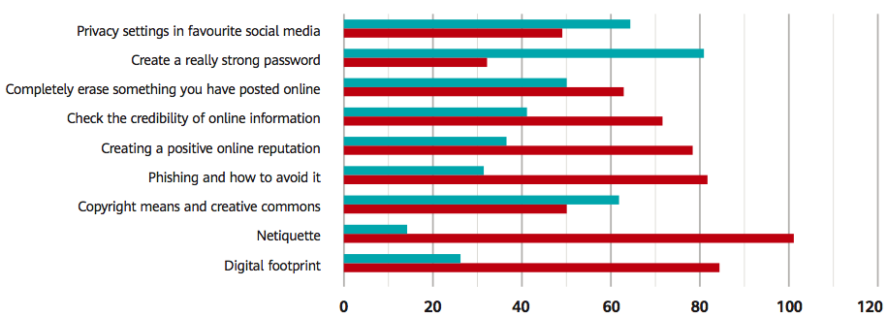
Children – prolific content creators!
SOURCE: Huawei pre-session SmartBus survey, Aug 2019; 113 children aged 12-14 years

Slide 7
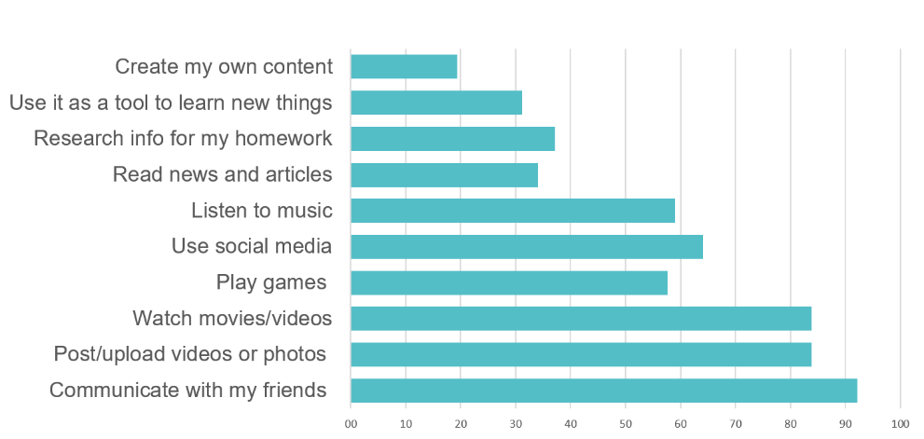
Innovation – evidence-based learning
SOURCE: Huawei pre-session survey, Aug 2019; 113 children aged 12-14 years

Slide 8
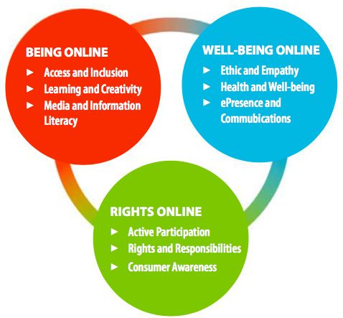
Inclusion, creativity, rights & wellbeing

Slide 9
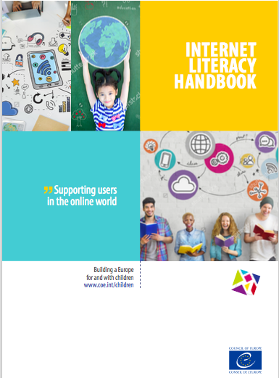
Content implementation
Clear objectives responding to real learning needs
Understanding of educational benefits
Awareness of ethical challenges & risks
IDEAS for classroom work – teachers are experts!
Credible link to community and real world

Slide 10
Looking to the future
Quality education
Student-centred – based on needs, interests
Meaningful – using today’s tools & context in real contexts
Engaging, intrinsically motivating, flexible
Opens access to new opportunities
Fosters self-evaluation and advocacy – follow up materials for learning within a context

Slide 11
Democratisation of content?
Let’s get the foundations right first!
Multi-stakeholder approach for credible, effective content
Better awareness of tools, platforms, challenges and solutions
Optimise fast, secure, reliable internet access for all
Match classroom learning to today’s world context
Encourage active participation, foster critical understanding
Open opportunities to learn in virtual environments, to exploit quality resources and content
Build competences based on values, skills, attitudes, knowledge

Slide 12
Janice.Richardson@insight2act.net

Slide 13
Living the remote learning experience
Philippine, Paris
- 15 year-old secondary school student - member of the European Council for Digital Good (ECDG)
add link to video

