Slide 1
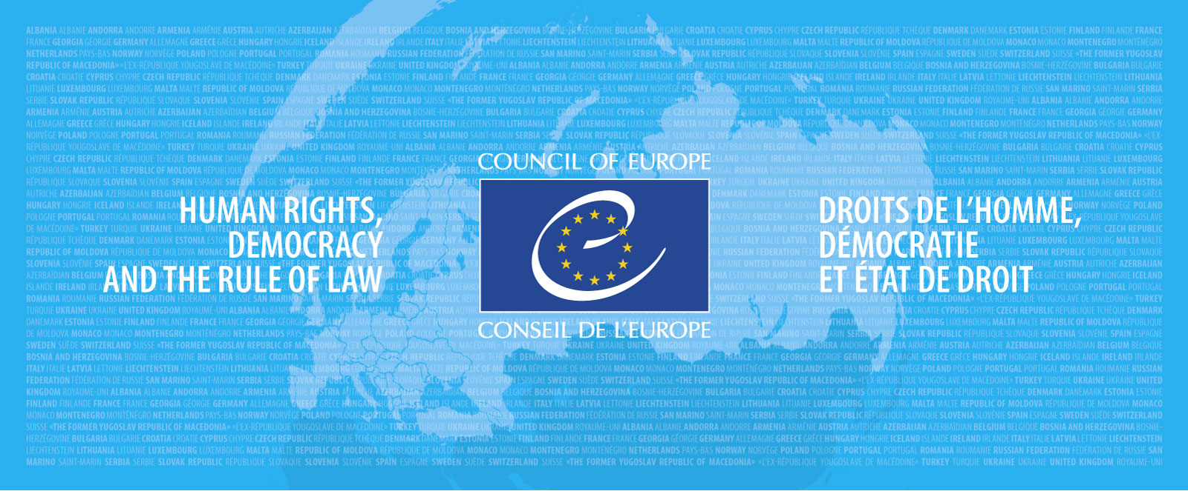
Work of the Council of Europe on gender equality and on combating sexism Cécile GREBOVAL, Gender Equality Division, Council of Europe Seminar “Combating sexist advertising: learning from practice” - 28.10.2021

Slide 2
Gender equality at the Council of Europe
Equality between women and men: an important area for the CoE for a long time
Legal status of women in Europe has greatly improved, but no de facto equality between women and men

Slide 3
Gender equality at the Council of Europe
How to understand gender inequalities?
We have not achieved gender equality. This is supported by research and statistics.
Gender is an area of knowledge. There is also a research field: gender studies.
Important to look at both the public and private sphere, including unpaid care work
Gender equality concerns both women and men. Not only a women’s issue!
Gender equality concerns all institutions and all areas

Slide 4
Gender equality standards of the Council of Europe
European Convention on Human Rights: Art. 1, 14 and Protocol 12 (no discrimination) + case-law of the Court
Istanbul Convention to combat violence against women and domestic violence
Anti-human trafficking Convention
European Social Charter
CM Recommendations adopted since1979: education, media, sexist language, sport, education, political participation, audio-visual policy, health, sexism

Slide 5
CoE policy framework on gender equality: Gender Equality Strategy 2018-2023
Six objectives :
1. Combat gender stereotypes and sexism;
2. Preventing and combating violence against women;
3. Guaranteeing women’s equal access to justice;
4. Achieve balanced participation in political and public decision-making;
5. Protect the rights of migrant, refugee and asylum-seeking women and girls
6. Achieve gender mainstreaming in all policies and measures.

Slide 6
The Council of Europe Recommendation on preventing and combating sexism (2019)
In response to #MeToo and other movements
First internationally agreed definition of sexism.
Proposes a common understanding of concepts & helps identifying sexist behaviours: e.g. mansplaining, silencing behaviour, « benevolent » sexism
Proposes concrete measures
Larger and different impact on women than men
Identification of particularly targeted groups of women
Intersectional approach

Slide 7
Definitions
Sexism
#
Discrimination
#
Violence

Slide 8
Sexism
“Any act, gesture, visual representation, spoken or written words, practice or behaviour based upon the idea that a person or a group of persons is inferior because of their sex, which occurs in the public or private sphere, whether online or offline, with the purpose or effect of:
i. violating the inherent dignity or rights of a person or a group of persons; or
ii. resulting in physical, sexual, psychological or socio-economic harm or suffering to a person or a group of persons; or
iii. creating an intimidating, hostile, degrading, humiliating or offensive environment; or
iv. constituting a barrier to the autonomy and full realisation of human rights by a person or a group of persons; or
v. maintaining and reinforcing gender stereotypes.”

Slide 9
Discrimination
European Convention on Human Rights
Article 14
The enjoyment of the rights and freedoms set forth in this Convention shall be secured without discrimination on any ground such as sex, race, colour, language, religion, political or other opinion, national or social origin, association with a national minority, property, birth or other status.

Slide 10
Violence against Women
Istanbul Convention of the Council of Europe:
Violation of human rights and a form of discrimination against women
Acts of gender-based violence > physical, sexual, psychological or economic harm or suffering to women
Includes threats of such acts, coercion or arbitrary deprivation of liberty
Both in public of in private life

Slide 11
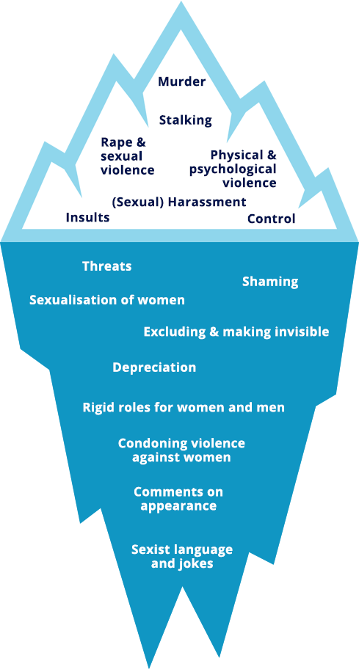
Links between sexism and violence
Today = heightened awareness of sexist behaviour
The negative impact of gender stereotypes
Widespread and prevalent in all sectors and all societies
Feeds the continuum of violence
Notes:
Le sexisme et les stéréotypes de genre comme base des inégalités de genre;
Il existe à tous les niveaux de la société et dans tous les secteurs, privés comme publics.
Le sexisme justifie ainsi les inégalités et crée un climat qui conduit à accepter la violence
(j’ai trouvé pertinent de garder l’iceberg parce que justement un effet du sexisme = la violence)
Iceberg de la violence: toutes les violences sont liées - on ne s’intéresse au bas que depuis peu (CI)
Les stéréotypes de genre ont un impact négatif sur tous les aspects de la vie;
Un exemple > l’influence que les stéréotypes de genre ont sur l’orientation des étudiant.e.s (more men in Stem field etc)
4 P: prévention, protection, poursuites, politiques intégrées (co-ordinated and comprehensive, in that they encompass all relevant measures to prevent and combat all forms of violence against women. )

Slide 12
Topics included in the CoE Recommendation:
Language and communications
Internet, social media and online sexist hate speech
Media, advertising and other communication products and services
Workplace
Public sector (public services, elected assemblies)
Justice sector
Education
Culture and sport
Private sphere

Slide 13
Gender equality in the media
Media actively shape opinions, attitudes and ideas
Women = only 24% of the persons heard, read about or seen in the news - even less as experts: 17%
More women in the media profession but under-represented in media decision-making and ownership
Social media: high prevalence of sexism and violence is frequent (anonymity online and lack of control)
Women journalists, women in decision-making, young women = particular targets of sexist hate speech in social media – risk of being silenced
Lack of reporting & sanction of sexist hate speech
Notes:
Attacks on men are mostly based on professional opinions or competence, while women are more likely to be subject to sexist/sexualised abuse
Online attacks may « silence » women and girls, preventing them from being active online
Sexist misuse of social media (eg. posting intimate images without the consent of those depicted) is a form of violence that should be addressed

Slide 14
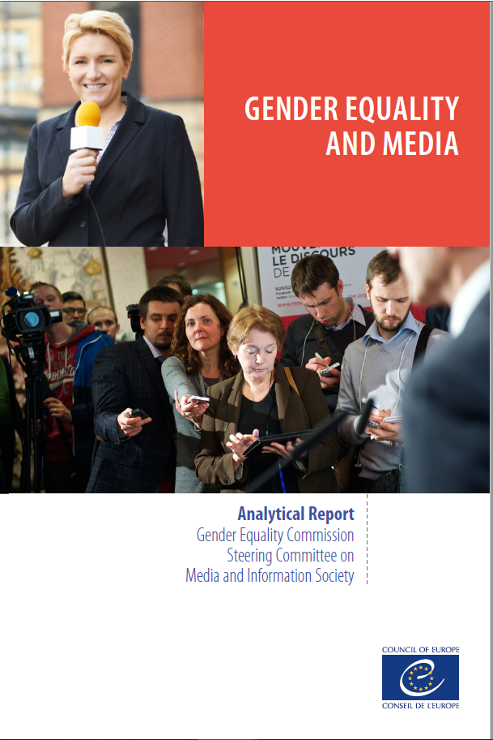
Gender equality in the media – CoE Action
Encourage member states to have a regulatory framework on content of media regarding human dignity, gender equality, violence against women + encourage media auto regulation (Istanbul Convention)
CM Recommendation and its follow up
Sexist hate speech : integrating women /gender in draft Recommendation on combating hate speech – no freedom of speech if used to silence parts of the population
Promotion of a non-sexist /non-stereotypical portrayal of women and men and working to improve women’s position in the communication and media sector

Slide 15
Sexism in the media and communication sector
What is it?
Sexualised depiction of women in media
Stereotypical images of men/ women
Victim blaming in media reporting on violence against women
Men explaining to women how to use household items in adds

Slide 16
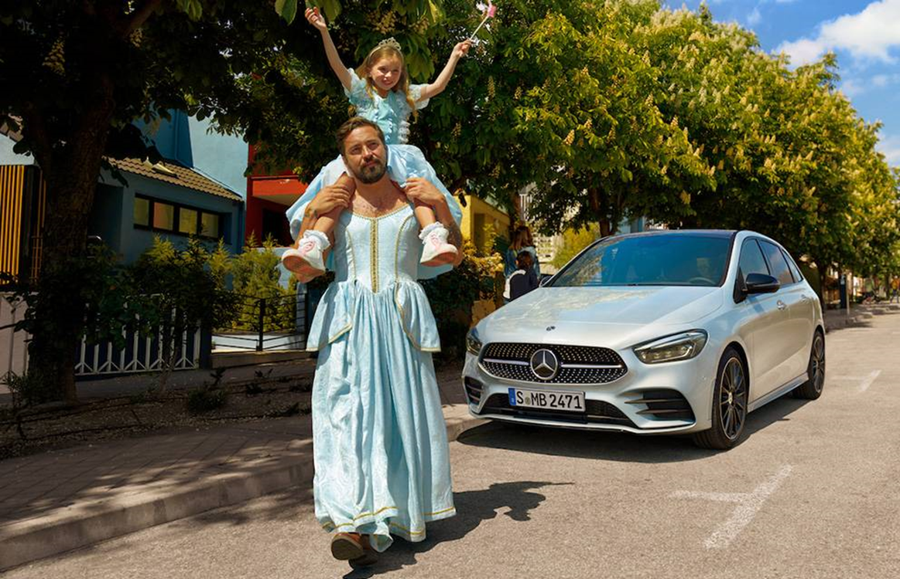
Measures proposed by the 2019 Recommendation to prevent sexism in the media and adversising
Implement legislation on gender equality in media
Train media and communication professionals
Promote advertisement that plays with / reverse gender stereotypes rather than reinforce them

Slide 17
Measures proposed by the 2019 Recommendation to prevent sexism in the media and adversising
Provide digital and media literacy training, especially for children and young people
Procedures for reporting and removing harmful materials - and appropriate sanctions
Legally define and criminalise sexist hate speech
Put in place specialised services to provide advice on how to deal with sexist hate speech
Research and collect sex- and age-disaggregated data on cybersexism and cyberviolence
Raise awareness and promote the use of gender sensitive language

Slide 18
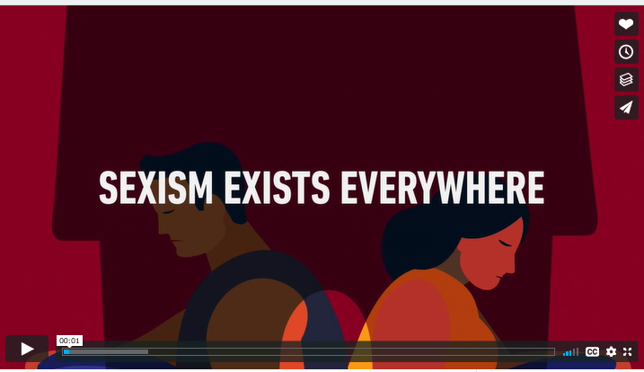
Visibility tools on combating sexism

Slide 19
Some conclusions
Progress remains slow
“sexism remains widespread and prevalent in all sectors and all societies”
“sexism and sexist behaviour are rooted in and reinforce gender stereotypes”
“sexism is linked to VaWG, acts of “everyday” sexism are part of a continuum of violence creating intimidation, fear..”
Gap between gender equality standards and implementation
Gender equality requires a holistic approach, addressing inter-connected issues/sectors
Growing threats to women’s human rights: (at the regional and global level) role of nationalism and religions, family policies, attacks on sexual rights, attacks on activists often by using gender stereotypes

Slide 20
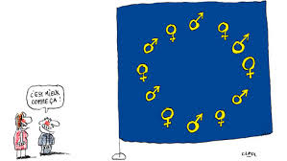
Cecile.greboval@coe.int
http://www.coe.int/equality www.coe.int/stop-sexism

