Slide 1
Seismic Studies based on data from the Luxembourg National Seismic Network
ECGS
Meeting of Directors, EUR-OPA Major Hazards Agreement
6-7 November 2018

Slide 2
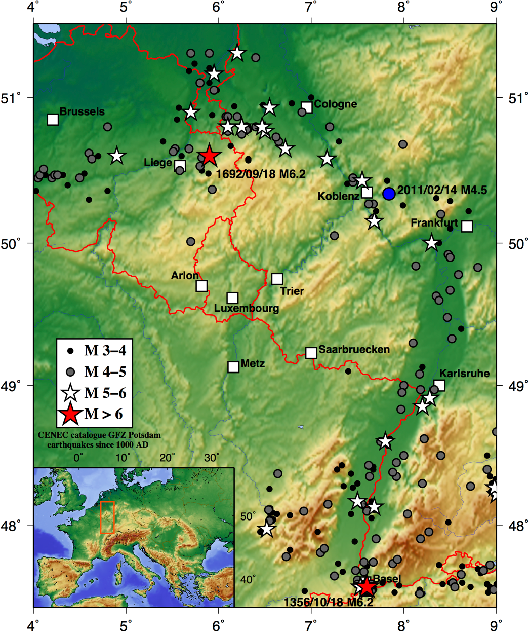
Context of the study
Luxembourg is a low-seismicity region
As a result, little efforts have been made in the past to establish a systematic seismic monitoring of its territory
However, seismic hazard is not null:
Little knowledge on small-scale seismicity or active faults
Largest historical event in Western Europe, the 1692 Verviers earthquake, took place about 100 km from its borders
What about man-made events (quarry blasts, mining events, etc...)?
Also for Luxembourg, an appropriate seismic monitoring system is important!

Slide 3
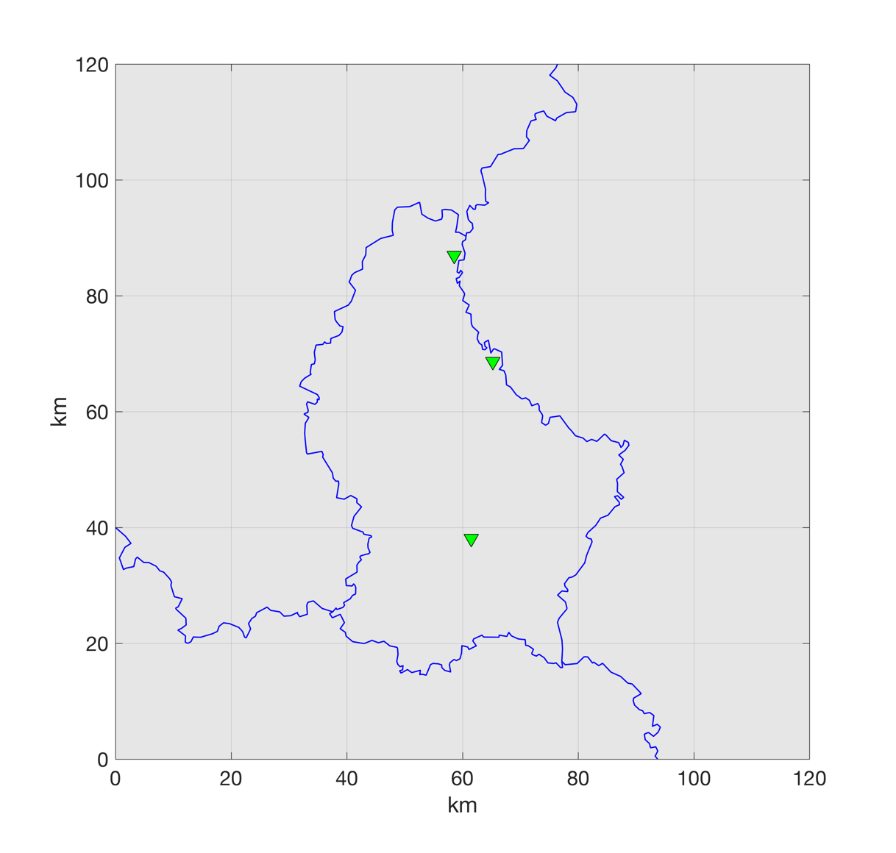
Monitoring situation in Luxembourg
Prior 2010: only 3 seismic stations, insufficient for analyzing seismic activity in the country
KLB
VIA
WLF

Slide 4
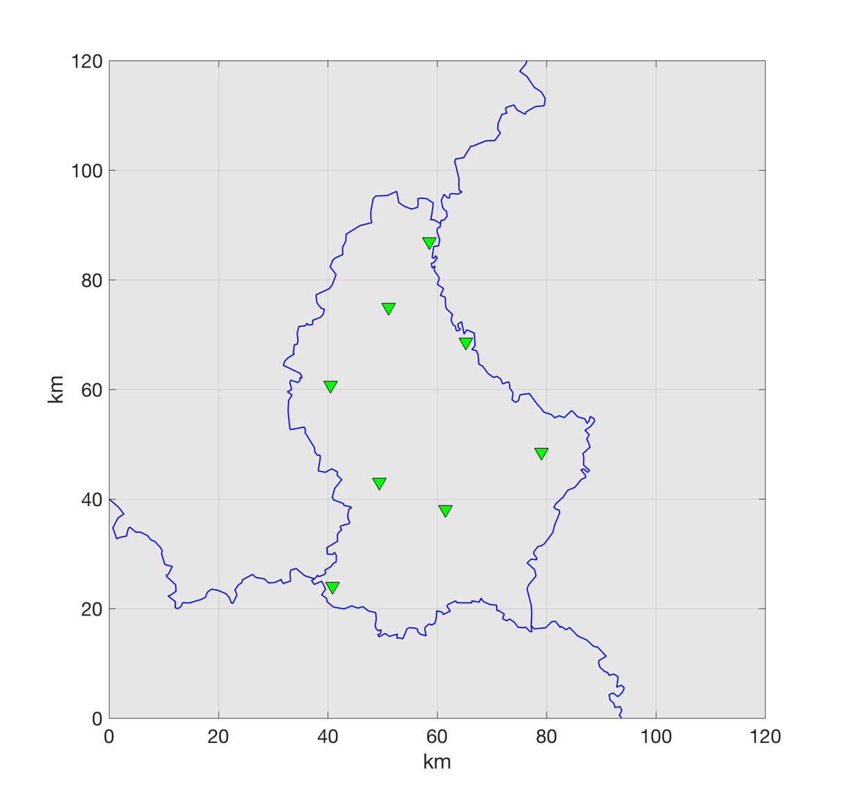
Monitoring situation in Luxembourg
Prior 2010: only 3 seismic stations, insufficient for analyzing seismic activity in the country
Starting 2010: progressive installation of temporary broadband stations (LBB) in collaboration with Karlsruhe Institute of Technology, Germany
KLB
LBB07
VIA
LBB04
LBB02
LBB01
WLF
LBB08

Slide 5
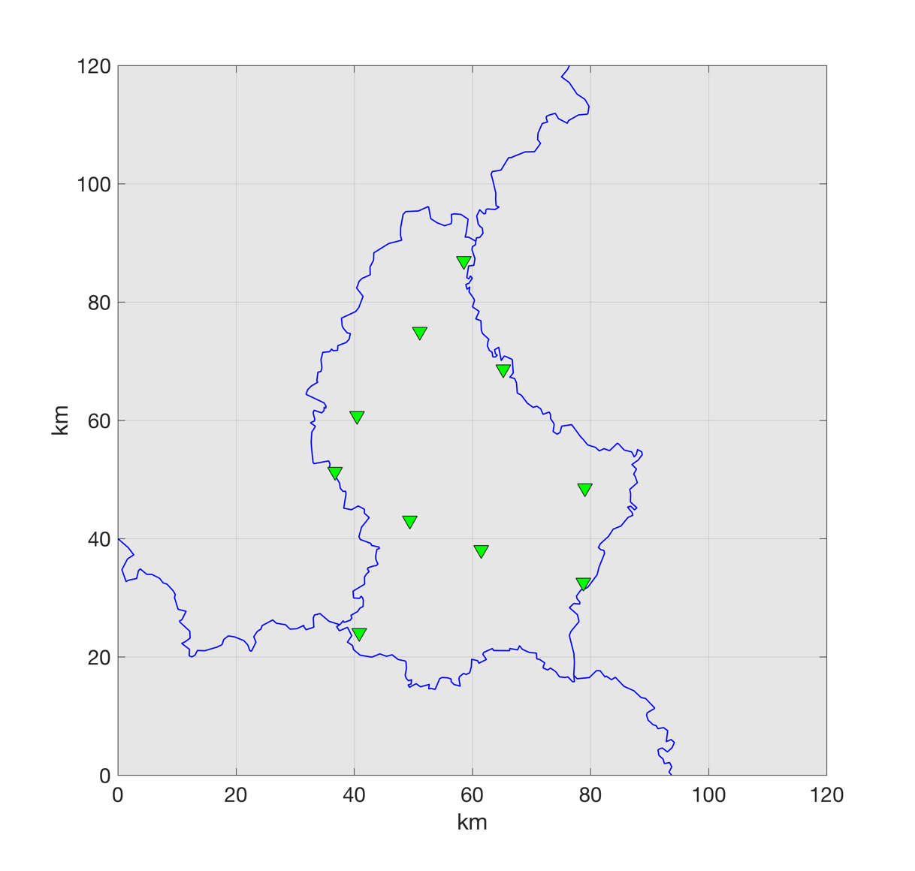
Monitoring situation in Luxembourg
Prior 2010: only 3 seismic stations, insufficient for analyzing seismic activity in the country
Starting 2010: progressive installation of temporary broadband stations (LBB) in collaboration with Karlsruhe Institute of Technology, Germany
From 2012: 4 ECGS stations in order to start migration to a permanent network of appropriate density
Real-time transmission of data
Search for further adequate station sites on-going
KLB
WILW
VIA
LBB04
PNBR
LBB02
KIND
LBB01
WLF
WMG
LBB08

Slide 6
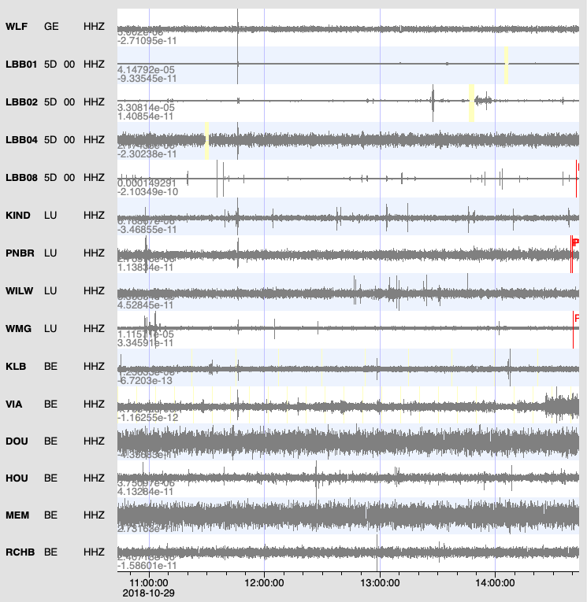
Some general comments
All data are acquired in real-time from all stations
We share seismic data with the Royal Observatory of Belgium and with the Erdbebendienst SüdWest (Rhineland-Palatinate and Baden-Württemberg, Germany)
We developed near-real-time processing tools based on waveform correlation rather than classical phase picking for event detection and location, based on our previous & on-going work in volcano seismology in eastern DR Congo

Slide 7
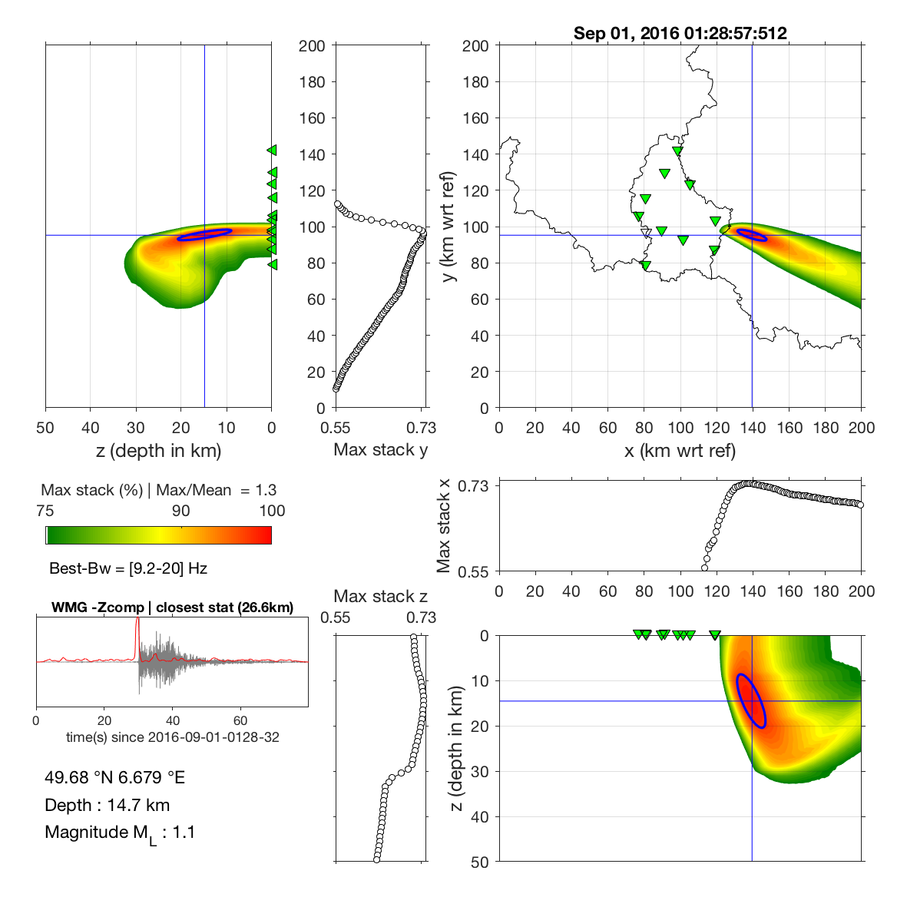
Results: Event example (natural event)
Location is carried out by grid-searching for point best explaining the observed data characteristics
Example: M_{L} 1.1 tectonic event across the border with Germany
If events are outside the network, the uncertainties are large, in particular in depth
Data sharing with our neighbours is very important
Notes:
CF (kurtosis - Pwave, envelope - Swave) pour chaque station calculée et sommée sur 16 freqs bands overlapped de 0.5 à 20 Hz. Si localisation pour P-wave passe les critères, alors solution choisie en priorité (que 27 events ici, ~14% qui correspondent aux tectoniques et aux tirs de carrières aux Luxembourg qui sont des events avec du contenu haute fréquence) Critères de sélection : - min 5 "bonnes" observations (max de la CF pour chaque station est <= 1 sec du temps d'arrivée associé à la localisation finale, sinon ça veut dire que la CF est mauvaise et ne contribue peu ou pas à la solution finale) -Max_stack >= 0.5 (Stack de toutes les cross-corrélations normalisées / nombre de paires)

Slide 8
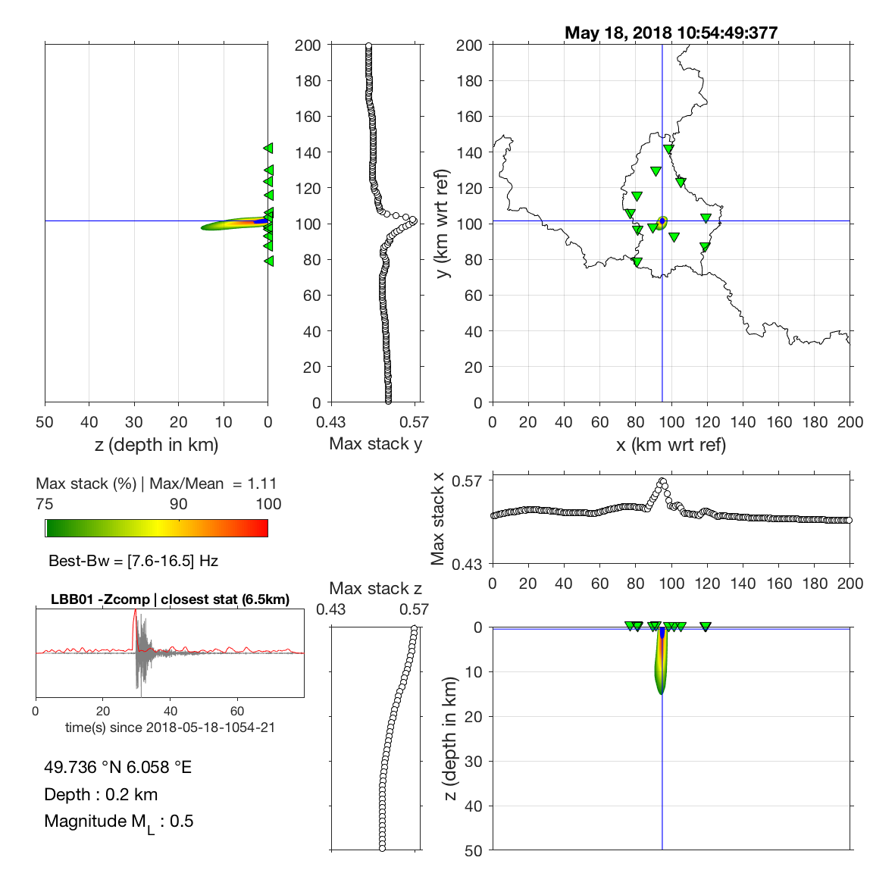
Results: Event example (quarry blast)
What kind of seismicity do we see?
Predominantly quarry blasts, as shown in this example!
Low-magnitude (M_{L} 0.5) events can be reliably detected and located with our national-scale network
Epicentral location well-constrained, depth less well, but with enough confidence very shallow
Notes:
CF (kurtosis - Pwave, envelope - Swave) pour chaque station calculée et sommée sur 16 freqs bands overlapped de 0.5 à 20 Hz. Si localisation pour P-wave passe les critères, alors solution choisie en priorité (que 27 events ici, ~14% qui correspondent aux tectoniques et aux tirs de carrières aux Luxembourg qui sont des events avec du contenu haute fréquence) Critères de sélection : - min 5 "bonnes" observations (max de la CF pour chaque station est <= 1 sec du temps d'arrivée associé à la localisation finale, sinon ça veut dire que la CF est mauvaise et ne contribue peu ou pas à la solution finale) -Max_stack >= 0.5 (Stack de toutes les cross-corrélations normalisées / nombre de paires)

Slide 9
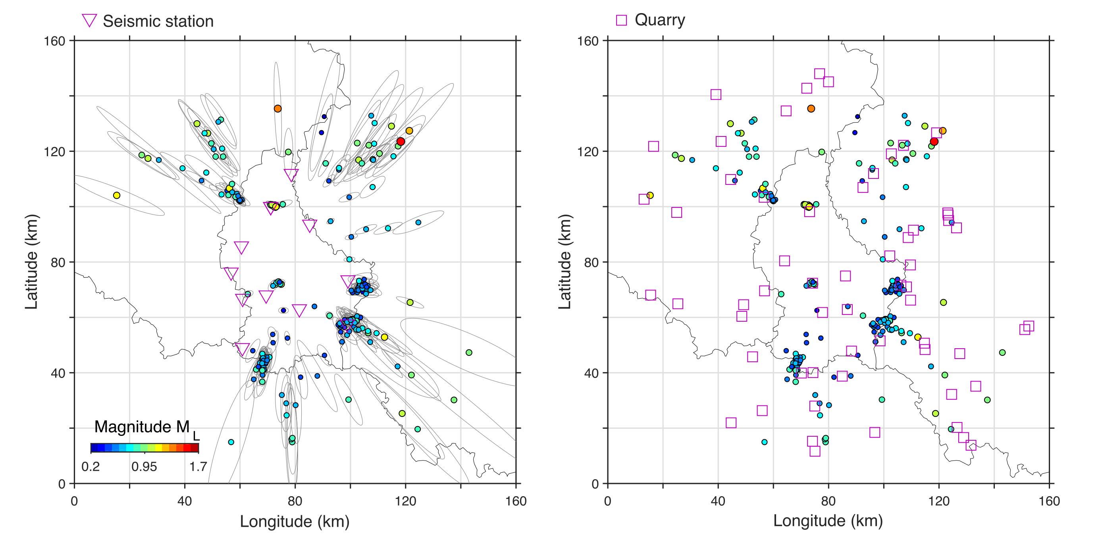
Results: All located events of 2 past years
Overview map of 194 local events detected and located during the last 2 years
Right-hand plot provides hints that most events are quarry blasts!

Slide 10
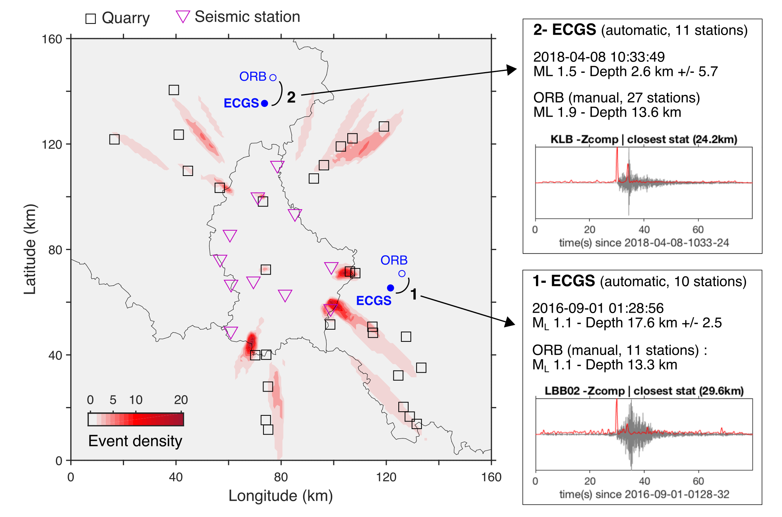
Results: All located events of 2 past years
Density map provides good summary information on repetitive events (e.g., from a quarry)
”Smearing” at the edges of the network, normal effect
Example of two tectonic events in comparison with location of Royal Observatory of Belgium (i.e., without entire Luxembourg network)

Slide 11
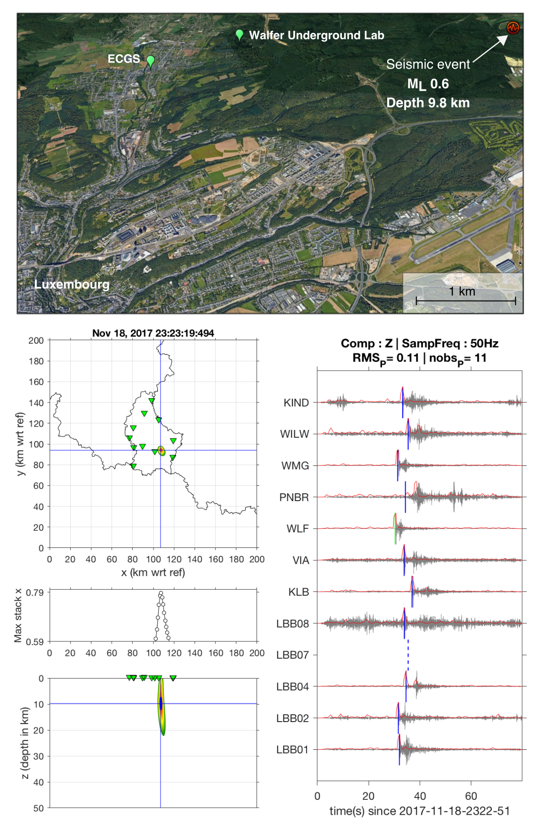
Results: Potential of the network
BUT: A small event with epicenter above a quarry does not automatically mean it is a quarry blast!
Nice example: a M_{L} 0.6 event well-located above a quarry, but late at night (23:23 UTC) and clearly too deep (10 km)
That means: there is also small-scale tectonic activity within Luxembourg, even though rather rare
Notes:
Les traces sont filtrées dans la "meilleure" bande fréquentielle [9-20] Hz et les kurtosis en rouge sont ceux stackés pour toutes les bandes de 0.5 à 20 Hz.

Slide 12
Planned work for 2019
Structural investigations (in particular so-called receiver functions)
Continuation of seismicity monitoring and establishment of a seismic catalogue of natural and anthropogenic events
Work on classification of events
Interfacing of our tools (currently Matlab® based) with the SeisComP3 real-time software

