Slide 2
Community Engagement in Higher Education: Toward a European Framework for the Community Engaged Universities
Institute for the Development of Education, Croatia
Ninoslav S. Schmidt, Executive Director / Co-Chair of the BFUG Advisory Group on Social Dimension
Thomas Farnell, Higher Education Policy Expert
www.iro.hr / www.tefce.eu
Council of Europe, 18 June 2019

Slide 3
OVERVIEW OF PRESENTATION
About the TEFCE (Toward a European Framework for Community Engagement in HE) project
About community engagement in higher education
Approaches to ‘measuring’ the societal engagement and impact of HE
The TEFCE approach: the Toolbox for Community Engagement in HE within the EHEA

Slide 4
1. ABOUT THE TEFCE PROJECT TEFCE - Toward a European Framework for Community Engagement in HE

Slide 7
BASIC PROJECT DATA
Project funded by Erasmus+, Key Action 3, Forward Looking Cooperation projects (FLCPs):
‘FLCPs are trans-national co-operation projects aiming to develop innovative policy approaches that have the potential of becoming mainstreamed and giving input for improving HE systems.’
Duration: 1 January 2018 – 31 December 2020

Slide 8
TEFCE PROJECT: OBJECTIVE
Develop innovative policy tools at the university and European level for supporting, monitoring and assessing the community engagement of universities.
Develop and pilot an innovative toolbox
including measures for guidance, assessment and peer-learning on the community engagement of universities

Slide 10
2. ABOUT COMMUNITY ENGAGEMENT IN HIGHER EDUCATION

Slide 11
BACKGROUND: THE THIRD MISSION OF HIGHER EDUCATION
Third mission = the societal impact and relevance of universities
… increasingly as a response to increased pressure on universities to ‘prove’ their value to governments and society.
The focus, however, has been on the economic significance and impact of universities, e.g.: innovation, entrepreneurship, business cooperation, labour market relevance
Starting point of TEFCE project: The need to rebalance the societal contributions of universities, by promoting community engagement of universities

Slide 12
DEFINING COMMUNITY ENGAGEMENT IN HIGHER EDUCATION (HE)
Process whereby universities engage with community stakeholders to undertake joint activities…
…that can be mutually beneficial…
…with an emphasis on communities with fewer resources

Slide 13
CLARIFYING THE TERM ‘COMMUNITY’
External groups or organisations that do not have the resources to engage easily with universities, e.g.
NGOs
social enterprises
cultural organisations
schools
local governments
citizens
The community does not necessarily need to be local - community engagement can also have regional, national and international dimensions.
There is no ‘one-size-fits-all’ aproach to community engagement - it is always context-specific.
businesses
policy makers
stakeholders involved in technology transfer and commercialisation of intellectual property

Slide 14
ILLUSTRATIVE EXAMPLES OF COMMUNITY ENGAGEMENT IN HE
Teaching | Research | Service/knowledge exchange | University-level
Community-based learning / service-learning (placements in community-based organisations) | Collaborative/ participative research Citizen science | ‘Science shops’ Capacity-building for community groups | Open access to university resources and facilities Community represented in university boards

Slide 15
3. ‘MEASURING’ THE COMMUNITY-ENGAGED UNIVERSITY

Slide 16
MEASUREMENT IN HIGHER EDUCATION
Typical measurement and assessment tools
Guidelines Standards Indicators Targets | Accrediting Auditing Benchmarking Evaluating Ranking

Slide 17
MEASUREMENT IN HIGHER EDUCATION
Typical measurement and assessment tools
Guidelines Standards Indicators Targets | Accrediting Auditing Benchmarking Evaluating Ranking

Slide 18
THE TEFCE APPROACH?
Not scoring and ranking!
Not self-assessment, either!

Slide 19
FOUNDATIONS OF THE TEFCE APPROACH (1)
There is no ‘one-size-fits-all’ approach to community engagement – it is always context-specific.
Community engagement is resistant to being measured. Most attempts to externally assess community engagement have had limited success and uptake.
The university is not a homogenous, ideal-type institution whose performance can be easily steered centrally by university management and be reduced to a score.

Slide 20
FOUNDATIONS OF THE TEFCE APPROACH (2)
New Public Management (NPM) tools focusing on comparisons of competitive performance and top-down steering have reached their limits.
There is increasing acceptance by the European Commission of multidimensional assessment approaches that avoid simplistic indicators
U-Multirank
University Regional Innovation Impact Assessment
RRI indicators

Slide 21
THE TEFCE APPROACH: 4 PRINCIPLES
1. Authenticity of engagement | 2. Empowerment of individuals
The Toolbox's interpretative framework differentiates authentic community engagement (that provides the community with a meaningful role and tangible benefits) from instrumental and 'pseudo-' engagement. | The Toolbox aims to recognise and award value for different kinds of individual efforts and results, thus encouraging universities to develop empowering environments for individuals at the university
3. Bottom-up rather top-down steering | 4. Learning journey rather than benchmarking
The Toolbox is based on mapping stories of practitioners (rather than on best practices selected by senior management) and providing both university staff and the community with a say in the process. | The Toolbox results in a qualitative discovery of good practices, a critical reflection on strengths and areas to improve, achieved through a collaborative learning process.

Slide 22
THE TEFCE ‘TOOLBOX’: 5 STAGES
Steps | Description
1. Quick scan | Initial discussion by university/community team on the type and extent of community engagement at the university.
2. Evidence collection | Collecting stories of community-engaged practitioners throughout the university
3. Mapping | Using the TEFCE Toolbox matrix to map the level of community-engagement of the university and to identify good practices.
4. Self-reflection | Open discussions among university management, staff, students and the community on strengths and areas of improvement
5. Institutional report | Promoting good practices and impact, and critical self-reflection for planning improvements to university-community engagement

Slide 23
TEFCE TOOLBOX DIMENSIONS
DIMENSION I. TEACHING AND LEARNING
The university has study programmes that include content about societal needs that are specific to the university's external communities and that include a community-based learning component for students.
DIMENSION II. RESEARCH
The university has research projects about societal needs of external communities and collaborative/participatory research projects which are implemented in cooperation with community groups
DIMENSION III. SERVICE/ KNOWLEDGE EXCHANGE
University staff use their knowledge to contribute to matters of interest to the community, to support community organisations, to build their capacity, and have a positive impact on the community
DIMENSION IV. STUDENTS
Students deliver their own community engagement activities through student organisations or initiatives, and the university supports them.
DIMENSION V. MANAGEMENT (communication and partnerships)
The university has partnerships with community groups, and makes its both its facilities/services and the results of its research, teaching and other activities open and accessible to the public
DIMENSION VI. MANAGEMENT (policies and support structures)
University policies recognise and acknowledge achievements in community engagement through staff development processes (e.g recruitment, tenure, promotion), awards The university commits itself to community engagement through its mission/strategy, through support structures and funding
DIMENSION VII. SUPPORTIVE PEERS
Academic staff supportive of their university undertaking community-engaged learning, and there are prominent academic influencers / mavens advancing community engagement.

Slide 24
TOOLBOX INTERPRETATIVE FRAMEWORK
 | Level 1 | Level 2 | Level 3 | Level 4 | Level 5 | References
 | Superficial | Ad hoc | Building block | Systematic | Hallmark
1. Ethos | Pseudo | Tentative | Stable | Authentic | Sustainable | Hoyt (2011)
2. Relationships | Transactional | Bilateral | Network | Systemic | Structural/ transformational | Bowen et al. (2010), Enos and Morton (2003), Clayton et al. (2010)
3. Mutuality | Exploitative | Donating | Assisting | Accommo-dating | Including | Benneworth (2013)
4. Directionality | Dissemination | Hearing voices | Listening to the voices seriously | Creating structures to hear voices | Co-creation | Hall et al. (2011)
5. Endowment | Betterment | Co-planning | Shared community | Co-determining | Empowerment | Himmelman (2001)

Slide 25
Example: Dimension I – Teaching and learning

Slide 26
CONCLUSIONS: WHAT IS A COMMUNITY-ENGAGED UNIVERSITY?

Slide 27
Being a community-engaged university …
1 | … does not imply that community engagement is necessarily the primary goal or mission of the university | … implies that community engagement is considered as one of the university’s key goals or missions
2 | … is not necessarily dependent on having a “top-down” university management strategy for community engagement | … implies having a range of “bottom-up” community engagement activities in place. Supportive leadership is important to consolidate these efforts.
3 | … does not imply conforming to “one-size-fits-all” guidelines that prescribe a specific community-engagement activities. | … implies carrying out community engagement activities that depend entirely on context.

Slide 28
Being a community-engaged university …
4 | … does not imply that community engagement can (or should) be carried out equally in different disciplines. | … implies that community engagement activities are carried out in a variety of ways in different disciplines. Academics ultimately retain the autonomy to determine how to organise their community engagement activities.
5 | … does not imply that university activities that are not community-engaged are of less value. | … implies that the community-engaged activities bring additional value to the university and its communities.
6 | … cannot be measured quantitatively, and hence is not institutionally comparable. | … can be determined individually and qualitatively based on the collection of evidence and based on a structured reflection

Slide 29
BENEFITS OF THE TOOLBOX
Demonstrating the value that the university brings to communities, as well as the value that community engagement brings to university.
Supporting intrinsic motivation of community-engaged staff, students and external partners by recognising and showcasing good practices.
Basis for planning improvements to the universities’ mutually beneficial community engagement activities.

Slide 30
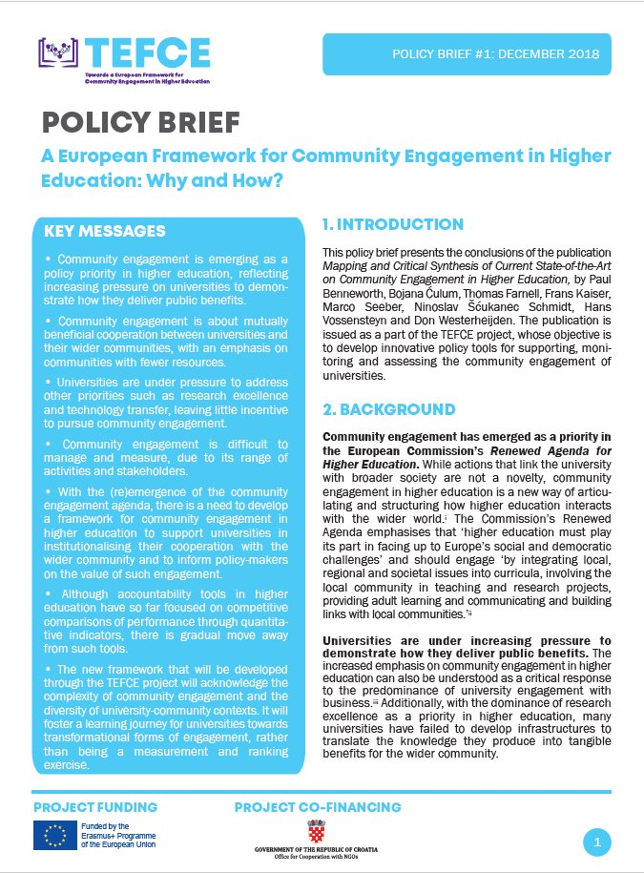
See our first publication and policy brief on: www.tefce.eu

Slide 31
Points for discussion
Potential of the inclusion of the enhancement of the community engagement as one of the future goals of the EHEA for the period 2020-2030?
Acceptance of the TEFCE toolbox and methodology by the universities in the EHEA?

Slide 32
Thank you for your attention!
Contacts:
Institute for the Development of Education, Zagreb, Croatia
Ninoslav S. Schmidt, nscukanec@iro.hr, Executive Director
Thomas Farnell, tfarnell@iro.hr, Higher Education Policy Expert
www.tefce.eu and www.iro.hr

