Slide 1
“Academic Freedom, Institutional Autonomy, and the Future of Democracy” - Global Forum
Marcello Scalisi
Director, UNIMED-Mediterranean Universities Union
Strasbourg 20-21 June 2019

Slide 2
UNIMED- Mediterranean Universities Union
UNIMED - Who we are
UNIMED is a network of universities and research centres, active in promoting Euro-Mediterranean academic cooperation. Our mission is to facilitate the Euro-Mediterranean dimension of University collaborations in order to enhance scientific, cultural, social and economic development of the region.
It counts 117 associated Universities from 23 countries of both shores of the Mediterranean.

Slide 3
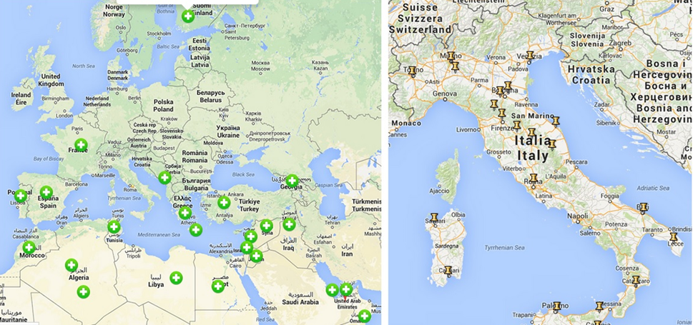
UNIMED – Our Network

Slide 5
HIGHER EDUCATION GOVERNANCE
EMPLOYABILITY
LEARNING INNOVATION
REFUGEES
CURRICULA DEVELOPMENT
INTERNATIONALISATION
RESEARCH
RECOGNITION OF QUALIFICATIONS
MOBILITY
INTERREGIONAL COOPERATION
SubNetworks
Notes:
MARCELLO

Slide 6
AUTONOMY

Slide 7
REGIONAL INTEGRATION

Slide 8
TRANSFORM
silo-mentality into networked communities

Slide 9
RESPONSABILITY

Slide 10
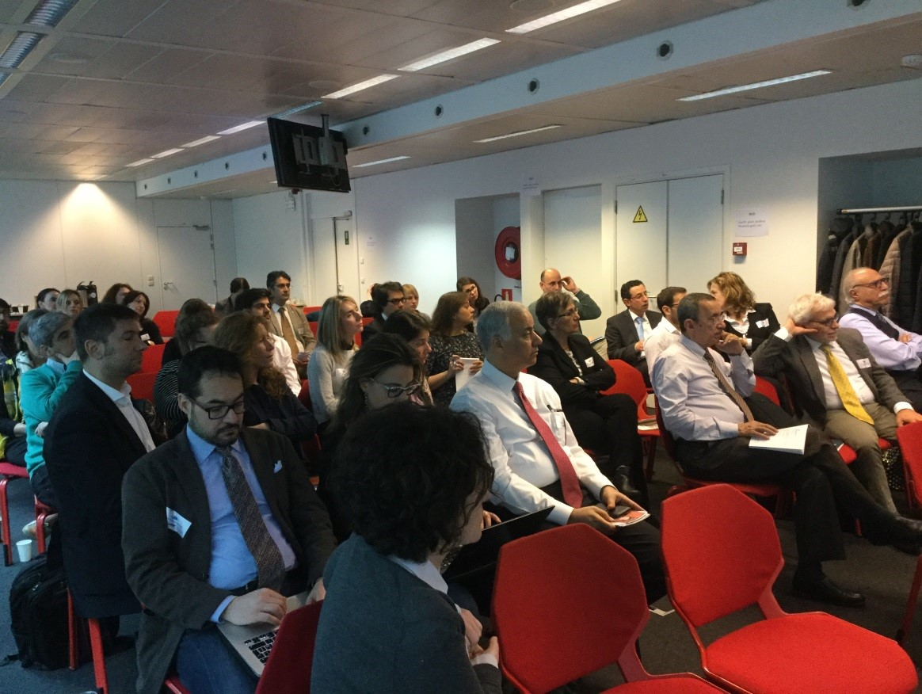
INSTITUTIONAL DIALOGUE

Slide 11
General overview about institutional autonomy and governance in higher education with focus on Morocco, Tunisia and Algeria
Tunisia, Algeria and Morocco have ‘inherited’ the French tradition: higher education is totally financed by the state in the name of social equality and democracy;
Under the influence of social demand, massification, economic crisis and under-graduate employment – by the 1980s these HE systems were in crisis, and the question of reform arose. In the early 2000s, these HE systems introduced some reforms taken from the Bologna process (LMD system, credit recognition);
Disparities in the qualification of the teaching staff;
High rate of graduates’ unemployment (especially in SSH);)
Tunisia and Algeria are more centralised HE systems with less autonomy in terms of HR management and financial aspects, but with some more academic autonomy

Slide 12
The case of Algeria: Overview 1/2
Higher education has, since independence, experienced the fastest growth of the education system.
This rapid growth can be explained both by guaranteeing employment in the state sector for higher education graduates and by other social factors (social promotion).
In Algeria, the financing of this sector is provided almost entirely by the State, but in a time of budget cuts, the sharp decline in public funding threatens the quality and continuation of existing programs.
Massification was a core part of the reform, in part motivated by the demographic reality of a large youth population, but also by explicit policy choices undertaken by the government

Slide 13
The case of Algeria: Overview 2/2
Algeria’s higher education sector has been marked by some major policy reform since its independence.
The most recent of these – the adoption of the three-cycle degree higher-education framework known as the 'LMD system' (License/Bachelor-Master-Doctorate) – has been in place since 2004/2005.
The LMD Reform helped universities to move to a greater internationalisation, more in line with the neighbour EU HE system; sought to enhanced university governance and autonomy; sought to provide quality education

Slide 14
About autonomy in HEIs in Algeria
High level of centralization: participation of the state at all levels, participation of government members in all the governing boards of the institutions, the almost absence of the private sector…
Academic autonomy: The Algerian institutions can in most cases decide on the introduction of new programs, the types of courses the number of hours per program, the format of the student evaluation, the academic partnerships with other institutions as well as admissions questions but these decisions must be validated by the State
HR autonomy: They all have, or almost, the autonomy to hire or dismiss administrative staff or professors, to train staff or to grant promotions, but, with the exception of training and the promotion of personnel, these decisions must be validated by the State in most cases
Financial autonomy: There is little autonomy to establish incentives: almost no institution has the autonomy to set salaries, both teachers and administration, and very few can establish performance-related bonuses or establish the contractual conditions of the staff (duration, benefits ...). These limitations are linked to the low financial autonomy of Algerian institutions. The financing of all the Algerian institutions comes from 99% of the funds of the government
Notes:
indirect, financial support in the form of accommodation, food, medical services and socio-educational services and facilities. Every student who lives more than 50 km away from the institution has access to accommodation in the halls of residence;
Every holder of the baccalauréat or an equivalent foreign certificate is entitled to matriculate free of charge at a university institution. The automatic access of bachelors to the university gives them many advantages such as obtaining a scholarship, access to subsidized services (catering, transportation, accommodation, etc.). In 2002, for example, 51.27% of students are housed in university cities and 89.41% receive a scholarship
These very high coverage rates are due to award criteria that are not very rigorous and have repercussions on the quality of the service (lack of maintenance of university cities, overstaffing, scholarships that are far from meeting basic needs). students, etc.)
Especially since faced with the difficulty of obtaining a job after the end of studies, these privileges have the unfortunate consequence of pushing students to extend the length of their education and increase the operating budgets of university and university institutions
The criteria for the choice of course are the student’s wishes, the nature of the baccalauréat or other qualifying certificate, the student’s marks or grades in the relevant subjects and the numberof places available in every specific course.

Slide 15
The case of Tunisia: Overview
Tunisia has allocated increasing levels of resources to education, particularly higher education, mainly through public funding over the past few decades.
However, in the last few years, the budgetary constraints have increased, and are likely to remain so in the near future.
The public sector remains dominant in the provision of higher education.
Notes:
In 2005-2008, public expenditure on education amounted to around 7.4 percent of GDP, with 2 percent allocated to higher education.
These budgetary constraints exist within a context of rapidly increasing student enrollment, and the need to improve the quality of education to insure better employability of graduates. In light of this situation, public policy is obliged to define orientations and programs, improving quality and efficiency while reducing costs and resource wastage, to enhance access and equity.

Slide 16
The case of Tunisia: About institutional and academic autonomy
The decree of 2008 allowed universities to switch their legal status from the general case of « public institutions » to the specific « public institutions of scientific and technological nature » (EPST) if they complied with financial, budgetary and managerial requirements. This specific legal framework allows universities more administrative and financial flexibility and autonomy (Only UVT has obtained the new statute yet)
Tunisia’s National Constituent Assembly adopted a constitutional provision guaranteeing protection of academic freedoms.
Revision of the modes of appointment of the university leaders (Decree-law 2011-31 26/04/2011): election of the presidents of university; election of HEI directors (and not only deans); reaffirmation of the role of the university council
Lack of academic autonomy in curricula development, in the introduction of new programs, and the allocation of hours: they have more freedom in student evaluation and institutional partnerships.
Notes:
In 2005-2008, public expenditure on education amounted to around 7.4 percent of GDP, with 2 percent allocated to higher education.
These budgetary constraints exist within a context of rapidly increasing student enrollment, and the need to improve the quality of education to insure better employability of graduates. In light of this situation, public policy is obliged to define orientations and programs, improving quality and efficiency while reducing costs and resource wastage, to enhance access and equity.

Slide 17
The case of Morocco: Overview 1/2
In 1999 the government laid a policy for the reform of the Moroccan education system.
Statute No 01-00 of May 2000, aimed to establish the educational, administrative and financial autonomy of higher education centres.
Universities in Morocco enjoy a certain degree of educational, scholarly and literary autonomy. They are ruled by Presidents elected by the king under the minister of higher education recommendations

Slide 18
The case of Morocco: Overview 2/2
A new 2015-2030 strategic vision aims to achieve the following objectives by 2030:
Equity and equal opportunities
Quality for all
individual fulfilment and social progress
by strengthening the LMD system and vocational training programmes, including equivalences of the diplomas upon completion of non-university programmes, and the consideration of the skills and qualifications required by the labour market.

Slide 19
Conclusions 1/2
There is a strong international trend to increase the autonomy of public institutions by making them independent and self-governing. It is up to the ministries but also to universities to experiment forms of autonomy that can contribute to a progressive increase of quality standards
Shared governance can work when there is a spirit of information sharing, collaboration, and teamwork between the president, senior faculty leaders, and mid-management. In other words, it works when the silos come down and the institution becomes a unified learning community.
Universities should be responsible in their societies because they are directly involved in generating new knowledge

Slide 20
Conclusions 2/2
Participation and Accountability are one of the great challenges of the HE system in the Southern Mediterranean Countries because this implies a growing shift from hierarchical forms of organization to more heterogeneous ones in which network relations are based on conditions of trust, reciprocity, reputation, openness to learning and an inclusive and empowering disposition. It necessarily involves a more decentralized, open and consultative form of governing.
Revision of the Neighbourhood Policy should lead to a rethinking of the principle of the More for More: actors of civil society should be involved in the reforms. Universities, and its leaders, in this sense should take the responsibility of this mission
Examples of SAGESSE (Tunisia) and ESAGOV (Algeria) Capacity Building projects

Slide 21
Thank you for your attention!
Marcello Scalisi
Director, UNIMED
m.scalisi@uni-med.net
www.uni-med.net

