Slide 1

ACTIONS AGAINST COVID-19

Slide 2
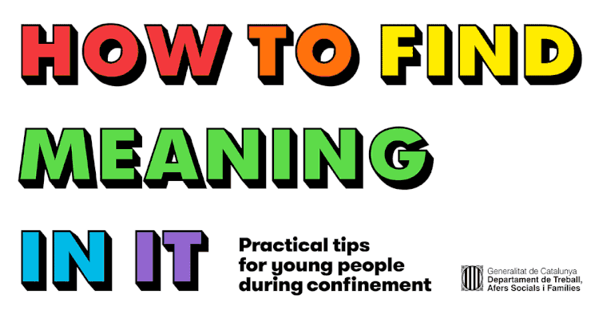
1. Mental health guides
Practical tips for youth and youth workers during confinement
As a response to the lockdown caused by the COVID-19 pandemic, the Catalan Youth Agency (ACJ) has published two interesting guides targeting young people and youth work professionals.
The aim of “How to find meaning in it” is to help young people and those working with young people - such as youth workers, youth information workers and educators - deal with the lockdown in a meaningful way

Slide 3



1. Mental health guides
Practical tips for youth and youth workers during confinement
They include dozens of practical tips to learn how to manage the lockdown by keeping emotional balance, a positive attitude, and a cooperative spirit.
Originally produced in Catalan, we have made the guide available in English, French and Spanish

Slide 4
1. Mental health guides
Practical tips for youth and youth workers during confinement
EN- How to find meaning in it for youth
EN- How to find meaning in it for youth workers
FR- Quel sens donner a tout cela? for youth
FR- Quel sens donner a tout cela? for youth workers
ES- Démosle sentido for youth
ES- Démosle sentido for youth workers

Slide 5
Youth Card actions
1. Information COVID-19
2. Promotion of online discounts, proposals and raffles
3. Information of postponed events
4. Spread of online universal and free proposals
5. Support to SME
6. Collaboration to search spaces to host vulnerable groups affected by COVID-19

Slide 6
www.gencatt.cat/joventut
THANKS!!!

