Slide 1
(Social) media and digital app. to support disaster risk communication”
Caroline Rizza
I3 UMR 9217 – CNRS
Telecom Paris
Institut Polytechnique de Paris
caroline.rizza@telecom-paris.fr

Slide 2
My curriculum and approach as a researcher
PhD & associate Prof. in Information & Communication Sc. since 2005
Change management, Information Systems and ICT (Telecom Paris)
European Commission, JRC (Ispra, Italy) in 2010-2014
Ethics of social media
Evidence-based policy
I3-Telecom Paris since 2014
Digital and crisis/emergency management
A communicational approach of crisis management
Transformations of the democratic public space
Mediations and interactions between public institutions and citizens,
The socio-technical devices (as social media) that underlie them
The civil protection in France
DGSCGC, SDIS, ANSC and their partners

Slide 3
Which perspectives related to the digital question (in France)
A macro, meso & micro approach of the operational chain of crisis management
Macro : related to the ministerial management of a crisis or emercengy
The after 13th nov. 2015 : the rise of social media & the implementation of inter-organisational information systems
Meso : the level of the organization, the French Firefighters departments (SDIS), & their integration
In the operational chain of crisis management : interactions with their hierarchy
in their local environment : interactions with citizens, with their institutional and private partners
The digital strategies they are implementing, their tools (social media, app., carto…), Their choices & positions, The changes they are experiencing
Micro : the individual practices of citizens in the context of an emergency or a crisis
The social media uses and their implications on the crisis management processes
Digital app and video feedback for dispatchers to improve the out-of-hospital cardiac arrest handling

Slide 4
Making the case through 4 examples
1. Flash flooding in Genoa 2011
2. Huricane IRMA in Cuba 2017
3. Flash flooding in the South of France in 2019
4. Vancouver Riots

Slide 5
1. The 2011 Genoa flood
Rizza – Pereira Joint Research Centre, European Commission
Context
The 4th Nov. 2011 floods touch violently Genoa (Italy)
Social media is used in several ways to cover and respond to this emergency situation
Social media at stake
A volunteer group of students creates a Facebook page to communicate with citizens and organize rescue and support activities
Rapidly, the FB page becomes the node of communication between citizens, local authorities and rescue teams.

Slide 6
Lessons learnt
Illustration of how SM allows citizens to answer competently to the floods, supporting community disaster resilience building
SM as a virtual space of care for citizens to exercise their citizenship, care and solidarity
Through the virtual space of care both citizens and local authority became empowered actors to address the crisis
A trustful relationship has developed a sine qua non condition for:
respected cooperation, shared understanding of preparedness and what is needed for building community resilience
The re-configuration of the space of care through a co-responsability
Re-arrangements of the relationships between private and public forms of care:
Co-construction of the response

Slide 7
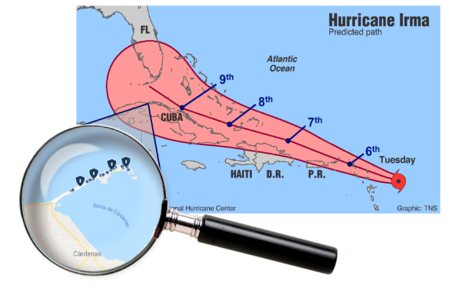
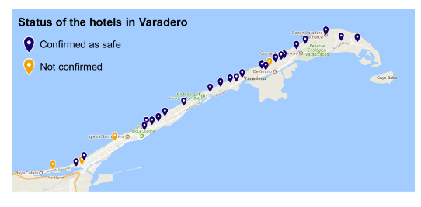
2. The 2017 Hurricane Irma in Cuba
Context
While Hurricane Irma was expected to reach the US costs, its trajectory changed
Tourists in Cuba were delocated to the area of Varadero: during 3 days no news from them
The social media at stakes
Families and relatives used SM to share information & specifically locating people and states of the hotel after the Hurricane
Authorities did not take into consideration this information when dealing with the crisis
Notes:
Irma supposed to move quickly to the US coasts
Predicted path has changed => created panic
Wednesday 6th – Irma announced as potentially dangerous for Cuba
Thursday 7th – Tourists informed that they would be moved to Varadero area in prev. Of the hurricane
Friday 8th – Tourists placed in the several hotel complexes in the Peninsula of Varadero – confined in their rooms

Slide 8
A counter example of the previous case
The social media have constituted a virtual space of mutual aid and support between citizens
A relationship of trust was created between citizens to
Cooperate to identify the status of hotels and establish lists of tourists by hotel
Express their support and help each other using instant messengers
There was no reconfiguration of the space for mutual aid between institutions
Public institutions did not trust the information that came out through social media
Crisis management remains traditional with instructions for behavior (Top-down communication)

Slide 9
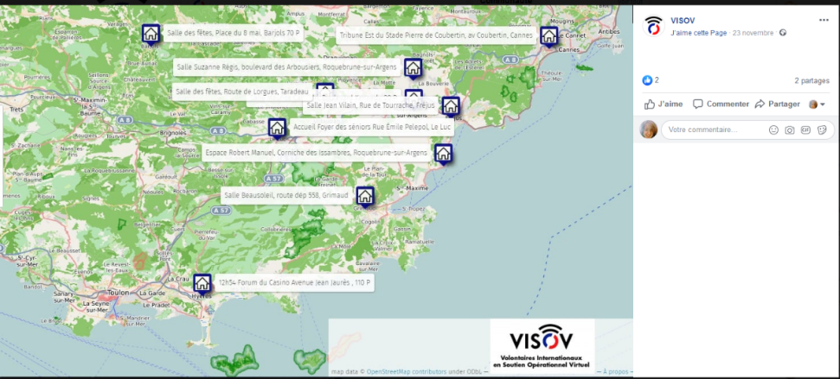
Flash flooding in Nov. 2019 in the South of France: An example of affiliated volunteers
The VISOV*’s FB page – The 23rd of Nov. 2019 at 17:38
VISOV – French Virtual Operation Support Team (French VOST)
Association
Official agreements with French institutions such as SDIS, Préfectures, Homeland Ministry

Slide 10
VISOV’s FB page – Comments
Three types of contributions from citizens
Updating of the opened crisis shelters to welcoming citizens
Proposals to welcoming fellow citizens
Direct questions to friends possibly in difficulties
How may social media constitute an added value for crisis managers?
What have they changed ?

Slide 11
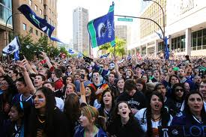
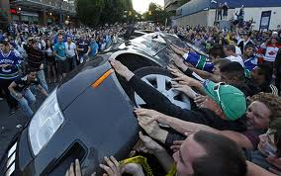
4. The 2011 Vancouver Riots
Rizza – Pereira Joint Research Centre, European Commission
15 June 2011,Vancouver (Canada): Ice hockey Stanley Cup final between Vancouver & Boston
Vancouver is losing: riots start & last all night long

Slide 12
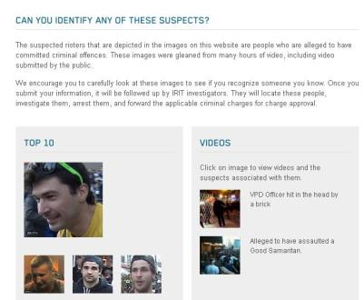
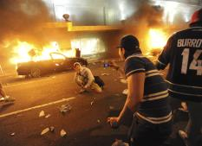
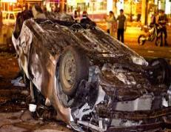
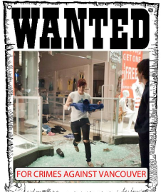
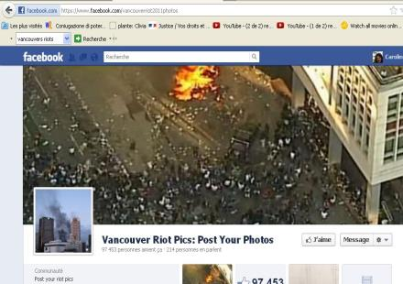
Social media are used to ‘cover’ the event
Citizens witness during the event
Rioters take pictures of themselves
Local authorities use social media content to identify rioters
Vancouver citizens support local authorities to identify them
Vancouver citizens enforce justice by themselves
Unpreparedness of local authorities to deal with social media and its content

Slide 13
The challenges raised by social media and other digital applications in crisis management

Slide 14
Framing social media in crisis management
Social media
Platforms 2.0
Creation of content
Share it
Use / consume it
Interact with others or the environment
In 2019 acebook, Twitter and WhatsApp counted 5.7 billion of users (Statistica, 2019)
Nature of social media has changed especially during crisis when they have been becoming more collaborative

Slide 15
State of the art
Micro-blogging activities
Social media offer opportunities
Ubiquitous information
Answering
Instantaneous communication
Forwarding information
Place where harvesting information
Possibilities of crossing sources
Different sources & formats can be crossed
Communication
Instantaneous collection
Relevant geo-localization
Collecting & sharing info.
crowd-sourcing activities

Slide 16
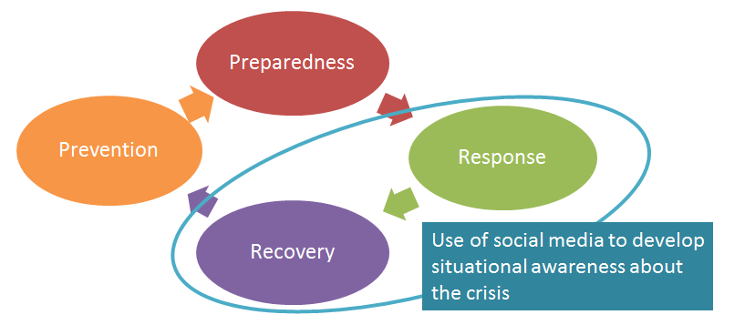
Use of social media in the crisis management cycle
Reuter et al., 2019 & Rizza, 2022
The question of interactions with other stakeholders arises:
- The institutional partners: The Common Operational Picture
- The citizens:
Communicating with them
Taking into account their expertise
The integration of their initiatives
Contributing to a fine vision of the situation "situational awareness"
Working on decisional information, i.e. information that makes it possible to initiate an intervention "actionable information "

Slide 17
Technical and social challenges (4)
Technical challenges
Data quality, trust
Format content
interoperability
Big data questions
Collected data visualization
Recommendation systems based on social media data
Legal challenges
Absence of legal basis to involve citizens in the response
Personal data protection issues / privacy concerns
Ethical issues
Co-accountability of stakeholders / actors
Empowerment
Equity / justice /fairness
Design challenges
Which methodologies implemented in order to think about and design tools integrating these parameters?
From the institutional side:
Barriers more organizational than technical
Lack of time and resources
Need for procedures, doctrines and training
Notes:
SM in crisis situation:
Micro-blogging and crowdsourcing activities
Social media opportunities :
Communication
Resilience and recovery
Challenges
Data quality, trust, format content, interoperability, sense-making, security, and coordination
Ethical, legal and social implications (ELSI)
Absence of legal basis to involve citizens in the response
Privacy concerns
Ethical issues: co-responsibility, accountability, fairness & justice
Methodologies for designing EMIS
Technical aspects
The question of big data
Towards automated volunteers-oriented recommendation systems based on social media data
Visualization to harvest collective intelligence during crisis management

Slide 18
How do social media impact practices ?
Institutional practices and citizens’ involvement
Information creation & circulation on social media during a major event
MACIV project – 2018 - 2021 Funded by the French Research Agency
Notes:
Studying the re-organization of information flows between citizens/volunteers on-site or on-line, rescue teams and crisis managers at the time of a crisis to support:
The integration of volunteers and citizens in the crisis management and response processes;
The ‘adaptation’ of the practices of crisis managers and rescue teams;
The resilience of the affected community
Designing a specific module “on-line social networks and citizens” in the mediation platform dedicated to integrate data from heterogeneous data sources, including SM, & to translate it into “understandable” information for stakeholders (RIO-Suite)

Slide 19
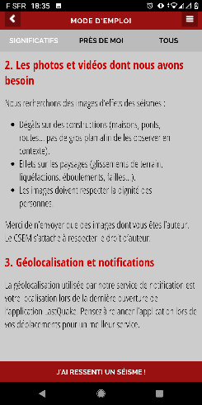
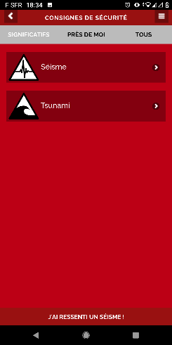
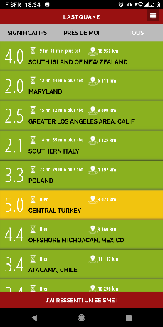
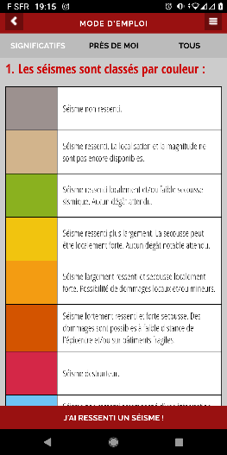
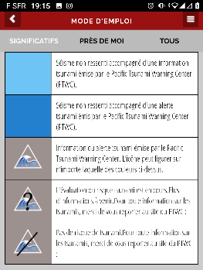
The digital app. on mobile to involve citizens

Slide 20
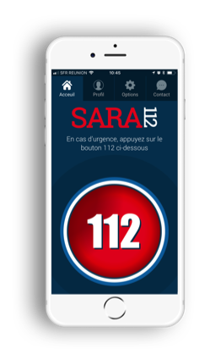
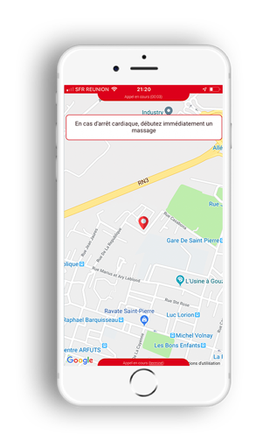
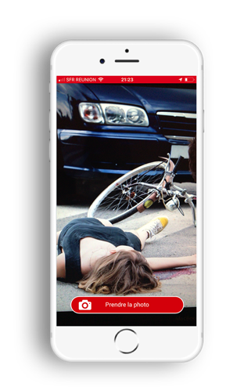
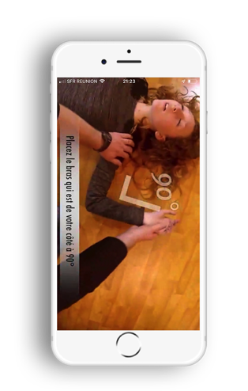
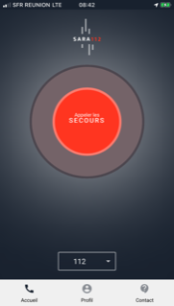
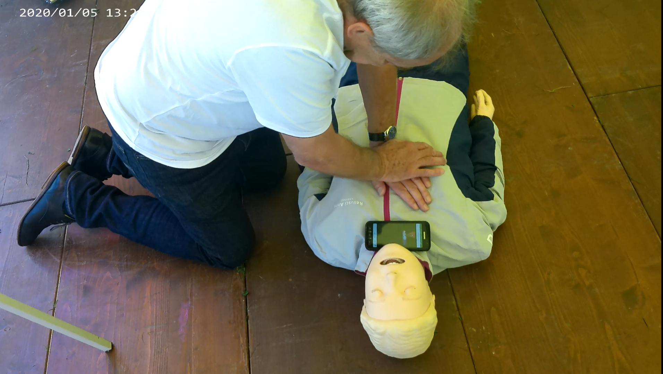
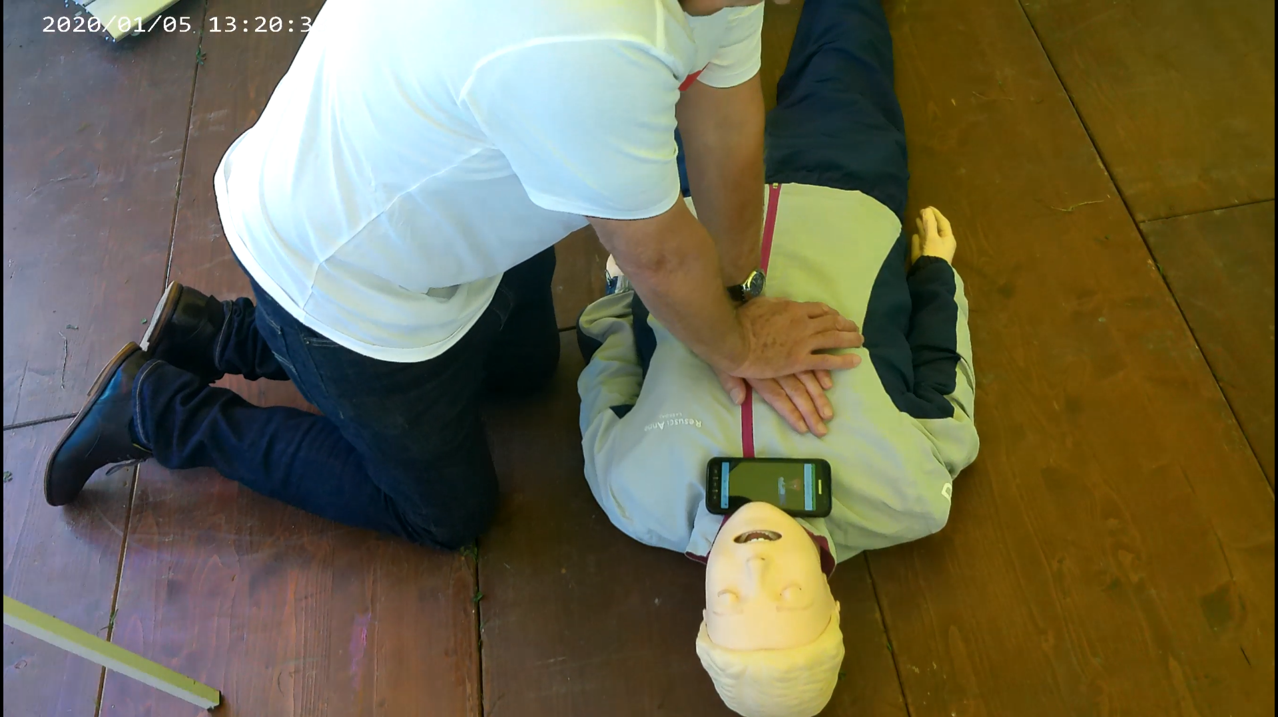
Cardiopulmonary ressucitation through video & digital app.
SARA application
Allows any witness calling an emergency number to be connected to the regulation center
Provides first aid demonstration sent by the disptacher
Video effect on cardiac massage
Better hand position
Keeping a good rhythm
Reassures the bystander
Effect of simulation on the relationship between stakeholders
Confirmation that the witness is perceived as essential and as a resource instead of a burden
As a relay for massage
As a liaison with 144
Opportunity to explain processes to avoid confusion and frustration

Slide 21
To conclude

Slide 22
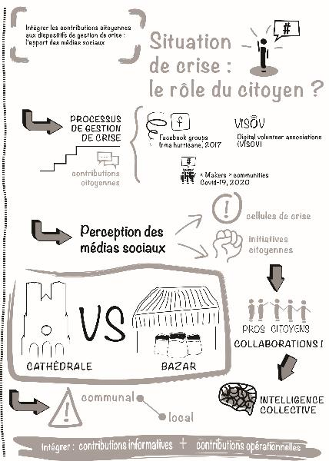
Institutional/citizen collaboration: two opposing worlds
"The Cathedral and the Bazaar" illustrates this opposition (Batard, 2021):
A vertical and organized organization: the cathedral’s one
A horizontal and distributed organization via social media and digital applications: the bazaar
ANR MACIV project: Robin Batar, PhD thesis, 2021

Slide 23
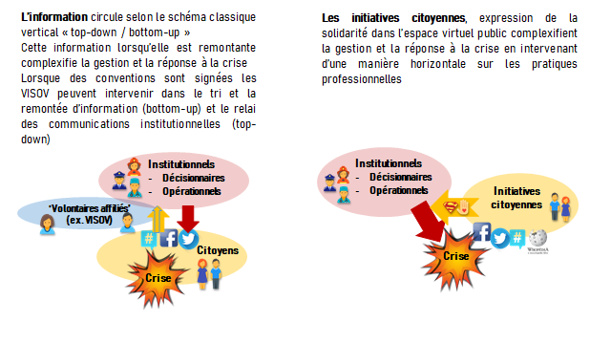
Using social media to build trust / digital trust
Understanding how information is created and circulates on social media during a major event
What are the schemes of this creation and circulation on the main social media?
Who are the main actors?
How social media may contribute to build the communities’ resilience

Slide 24
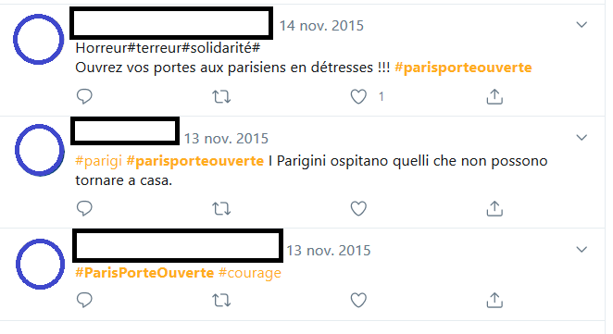
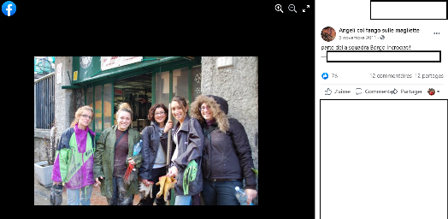
Grassroots initiatives and social media
Citizens’ initiatives:
Spontaneous or affiliated
On site and online
Social media constitute a public space of expression of self-help and solidarity
Social media present two relevant dimensions:
Informational
Organizational
Citizens’ initiatives impact ‘horizontally’ the professional practices and complicate the crisis management processes
Notes:
The scientific literature in the field has demonstrated that grassroots initiatives appear at the same time as the crisis in order to respond to it: during an earthquake or flood, members of the public who are present on-site are often the first to help the victims, and after the crisis, local people are often the ones who organize the cleaning and rebuilding of the affected area. During the Nice terror attacks of July 2016, for example, taxi-drivers responded immediately by helping to evacuate the people present on the Promenade des Anglais. A few months earlier, during the Bataclan attacks in 2015, Parisians opened their doors to those who could not go home and used the hashtag #parisportesouvertes (parisopendoors). Genoa experienced two rapid and violent floods in 1976 and 2011; on both occasions, young people volunteered to clean up the streets and help shop owners and inhabitants in the days that followed the event.
There has been an increase in these initiatives, following the arrival of social media in our daily lives, which has helped them emerge and get organized online as a complement to actions that usually arise spontaneously on the field.
We generally distinguish between “volunteers” in the field and online. As illustrated above, volunteers who are witnesses or victims of an event are often the first to intervene spontaneously, while social media focuses on organizing online help. This distinction can help us understand how social media have become a means of expressing and organizing solidarity.
It is interesting to note that certain groups of online volunteers are connected through agreements with public institutions and their actions are coordinated during an event. In France, VISOV (international volunteers for virtual operation support) is the French version of the European VOST (Virtual Operations Support Team)
There is therefore an informational dimension and an organizational dimension to the contribution of social media to crisis management.
Informational in that the content that is published constitutes a source of relevant information to assess what is happening on site: for example, fire officers can use online social media, photos and videos during a fire outbreak, to readjust the means they need to deploy.
And organizational in that aim is to work together to respond to the crisis.
For example, creating a Wikipedia page about an ongoing event (and clearing up uncertainties), communicating pending an institutional response (Hurricane Irma, Cuba, in 2017), helping to evacuate a place (Gard, July 2019), taking in victims (Paris, 2015; Var, November 2019), or helping to rebuild or to clean a city (Genoa, November 2011).

Slide 25
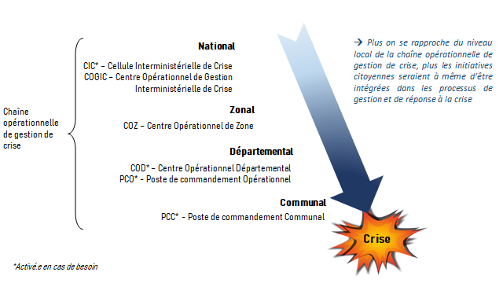
Rethinking the citizen's contribution and the local level of the crisis management operational chain
Rizza (2020) « Gestion de crise : mieux intégrer la réponse des citoyens », The Conversation, juillet 2020
https://theconversation.com/gestion-de-crise-mieux-integrer-la-reponse-des-citoyens-141741
Rizza (2022) « La réorganisation d’un SDIS face à la première vague de COVID-19. Innover en temps de crise : réactions et adaptations face à la crise Covid-19, 9782356718334. ⟨hal-03713618⟩

Slide 26
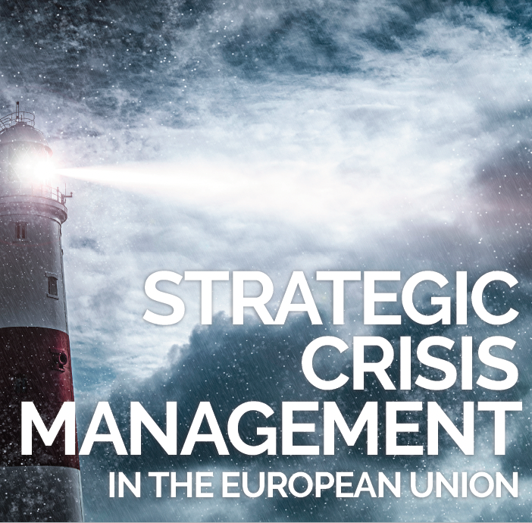
Two main policy-reports
SAPEA working group (2022) Strategic Crisis Management in the European Union
Findings from the Evidence Review Report
Ministère de la transition Ecologique (2021)
Mission sur la transparence, l’information et la participation de tous à la gestion des risques majeurs, technologiques ou naturels
Trust
Trust is key for the formation of public policy and its successful implementation
Trusting citizens in adjusting their behaviour and complying with crisis management policies
Inspiring trust by starting a virtuous cycle of reciprocity: showing citizens they trust them
Fake news and misinformation, different from rumours, can endanger trust building initiatives
Participation
Public institutions need to adapt their digital culture and practices, when communicating and engaging with citizens through social media
Collective intelligence: A combination of various solution approach often delivers solutions that work better for more people
Educating citizens
Developing national educational "kit
Creating mobile units to go and meet the inhabitants and allow them a physical and sensory experience of risks.
Seting up a warning system for populations, known and recognized by all
Training stakeholders
Raising the awareness of elected officials, developing their sense of crisis anticipation, implementing in-depth training adapted to each territory and helping them build a proactive policy.
Raising awareness and training the industrial/private stakeholders in solutions incorporating preventive measures
Innovating
Making better use of the complementarity of historical media and social media to ensure that messages are disseminated through all channels and received by the entire population and seizing the opportunity offered by social media to interact and engage with citizens

Slide 27
- Thanks for your attention -
Main research projects
« Numérique et Living-Lab pour un citoyen secouriste », Fondation MAIF (2021-2023) – coordinatrice scientifique
Projet MESCOV « Les medias sociaux lors de la crise covid-19 : circulation de l’information et initiatives citoyennes », Comité Analyse Recherche et Expertise, Ministère de l’Enseignement Supérieur, de la Recherche et de l’Innovation (2020-2021) – coordinatrice scientifique
Projet Etude et Prospective du IHEMI « Accompagner le déploiement du SI NEXSIS » Institut des Hautes Etudes du Ministère de l’Intérieur (2019-2021) – coordinatrice scientifique
Projet ANR MACIV – Management of citizens and volunteers: social media in crisis situation (2018-2021) – coordinatrice scientifique
Étude exploratoire “réseaux sociaux et spatialité de l’information: l’utilisation des médias sociaux en gestion d’urgence” Zone de défense et de sécurité de Paris (fév-juil. 2018) – coordinatrice scientifique
Co-encadrement d’une thèse « Les médias sociaux, passerelles vers l’intégration d’initiatives citoyennes aux processus de gestion de crise » Telecom ParisTech / Mines Albi (2017-2021)
École thématique CNRS pluridisciplinaire “Social Networks & crisis management” – (15-19 mai 2017 à Télécom ParisTech) – coordinatrice scientifique
Équipe de recherche Euridice – (2016-2018)
Caroline RIZZA
Enseignante-chercheure
I3-Telecom Paris (UMR 9127)
Institut Polytechnique de Paris
https://www.telecom-paris.fr/caroline-rizza
caroline.rizza@telecom-paris.fr

