Slide 1

Resolution No. 8 (2012) reporting
Hands-on training on Reportnet 3
© Frank Vassen
Training 20th March 2025

Slide 2
Agenda for the morning session
EU login
User settings
Notification system
Dataflow: schemas
Additional reporters
Dataflow help
Reference datasets
Dataset schemas: mandatory and non-mandatory tables and fields (validation rules)
Checklists, spatial data and Habitat/Species schemas (work off-line & on-line)
Validations
Data correction
Release to data collection

Slide 3
Introduction to the reporting process

Slide 4
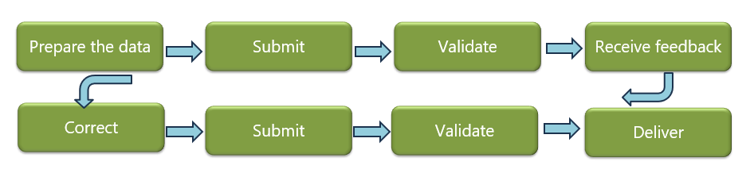
Reporting process
Preparation of data (on the EET or other documents)
Submission
Validation
Correction and re-submission based on the feedback of the validation
These steps should be repeated until the data has achieved the required quality, and the delivery can be finalised
Delivery

Slide 5
Reportnet 3

Slide 6
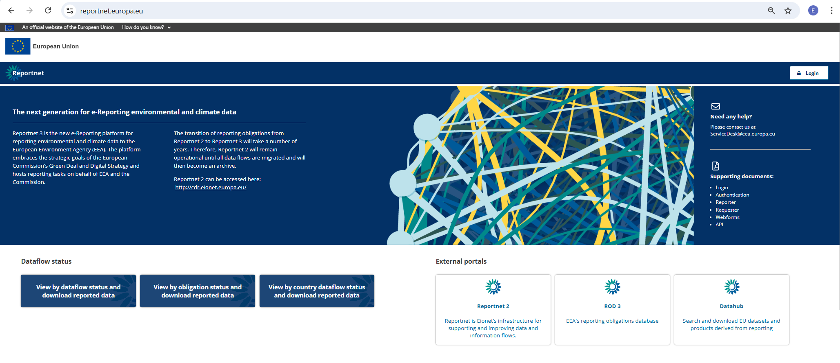
Reportnet 3

Slide 7
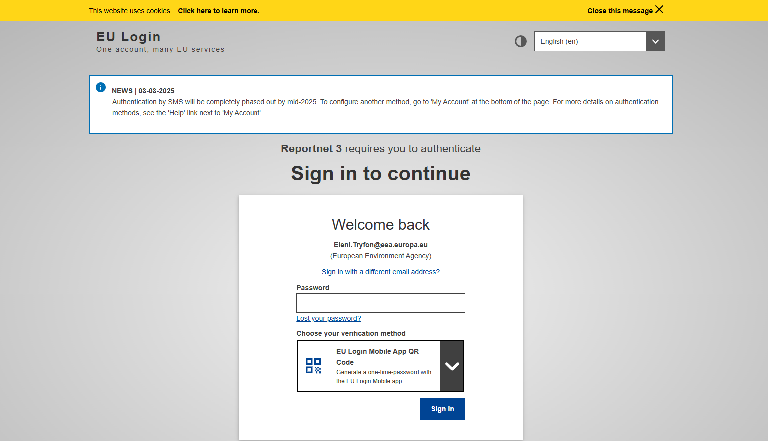
Guidance on getting EU Login and registering to the platform can be found in the Supporting documents on the main page
https://reportnet.europa.eu/
Lead reporters can internally designate additional national reporters on the platform
Lead –additional Reporters are advised to log in to Reportnet 3 before they are assigned to a dataflow
By default Eionet national data coordinators have reading rights to all national dataflows
Notes:
EU login App to be install in your smartphone

Slide 8
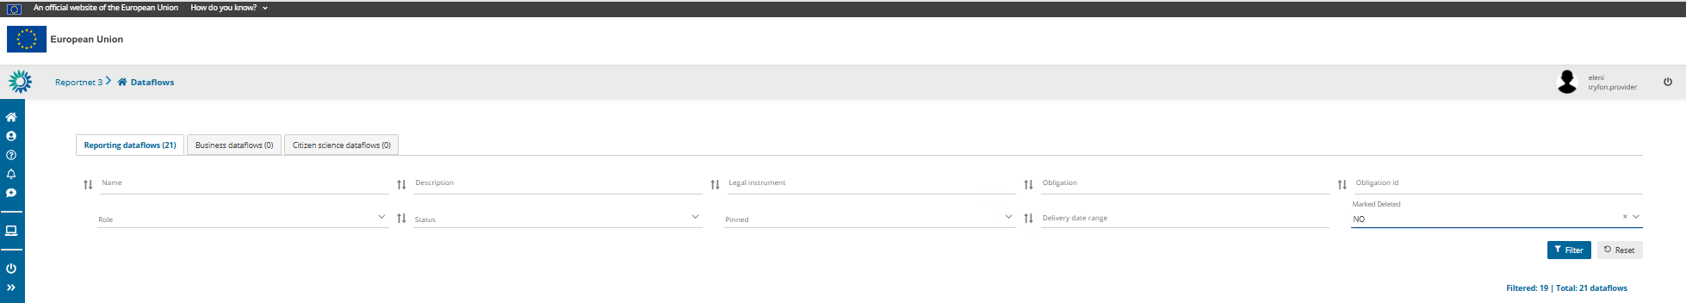

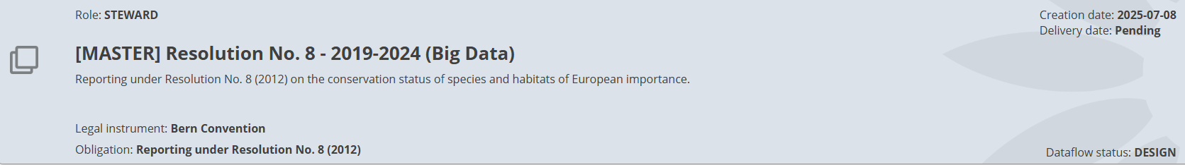

Slide 9
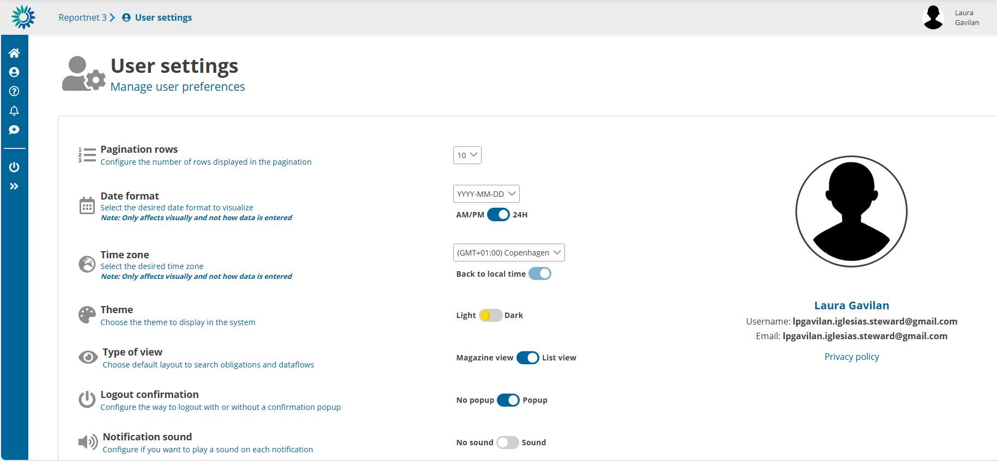
User settings

Slide 10
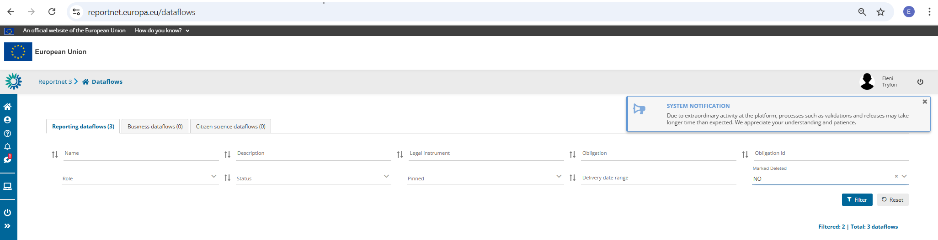


Notification system

Slide 11
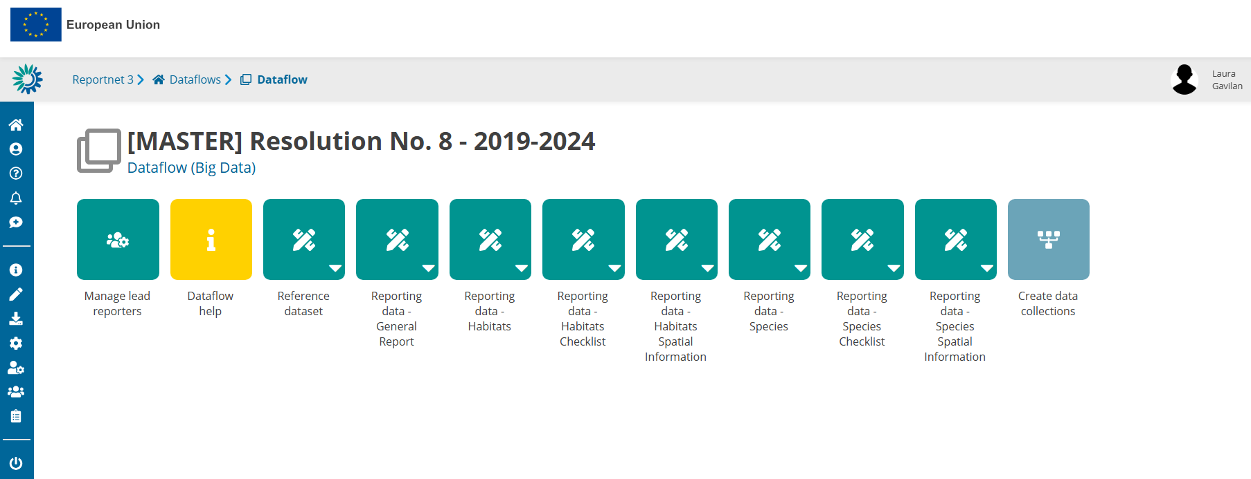
Resolution No.8 (2012) dataflow schemas
A lead reporter can add additional reporters. They must have logged into Reportnet 3. Additional reporters cannot add other reporters or release the data.

Slide 12
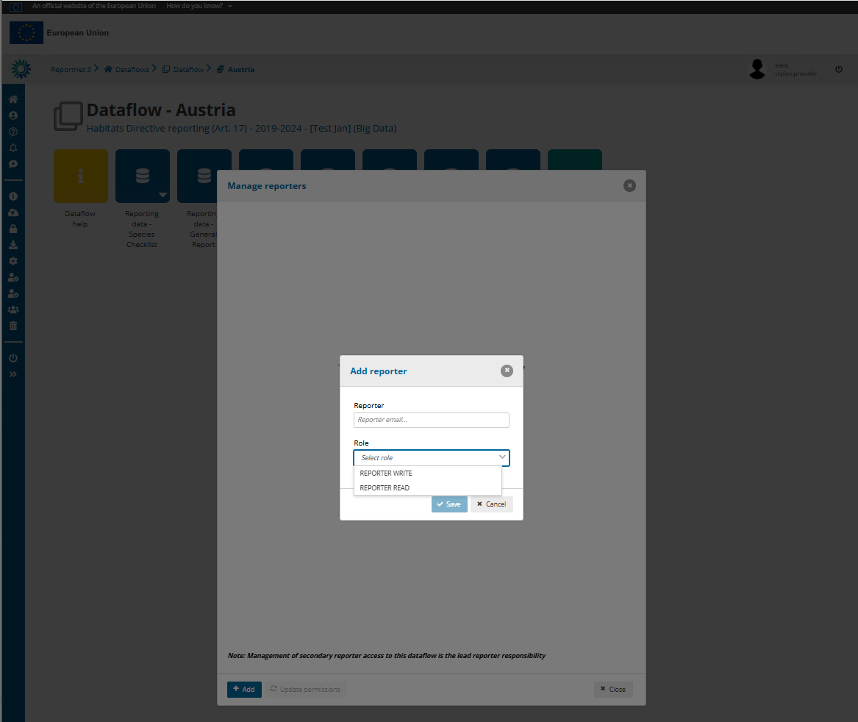

Slide 13
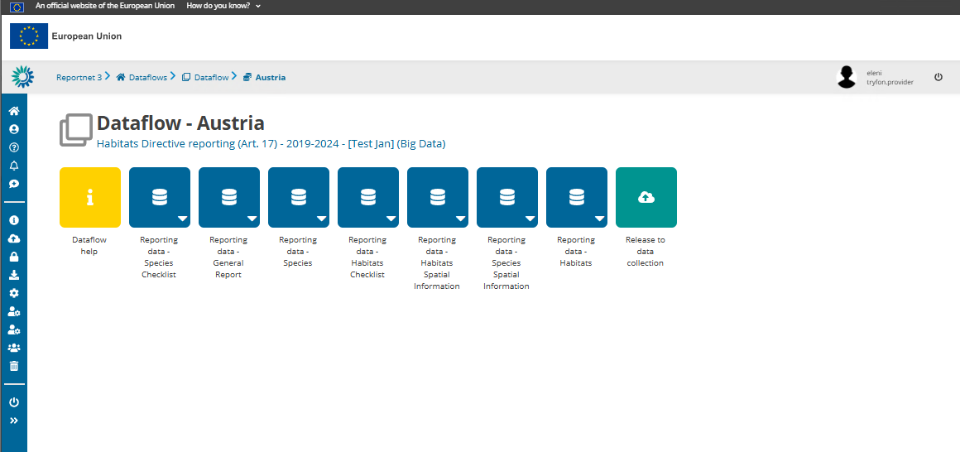

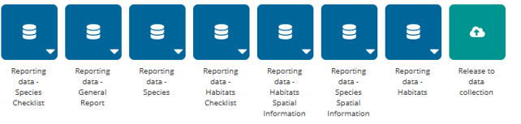

Dataflow help

Slide 14
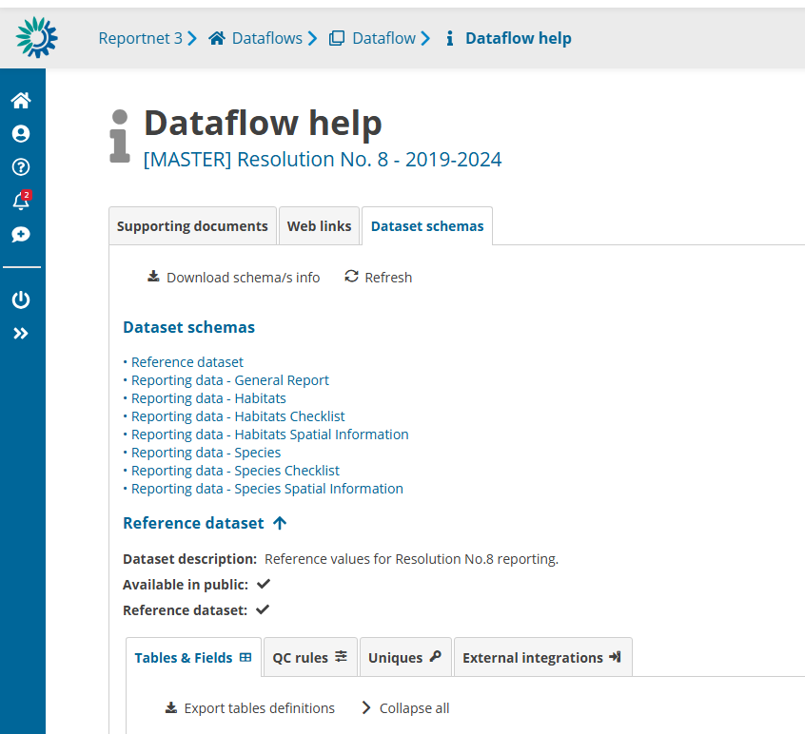
Info on mandatory / non-mandatory tables and required fields and validation rules

Slide 15
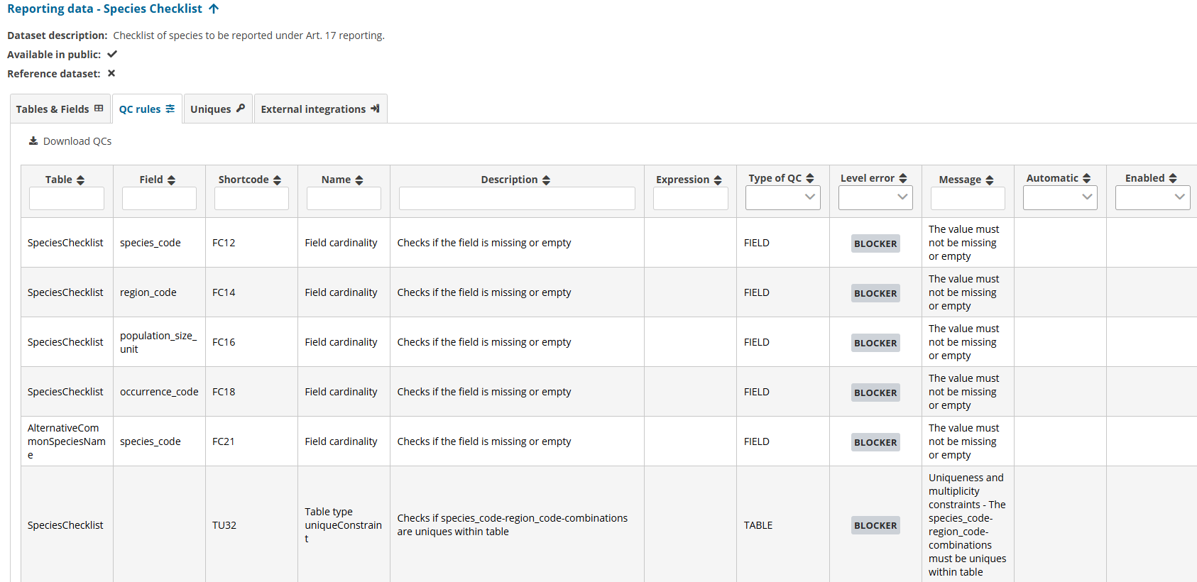

Slide 16
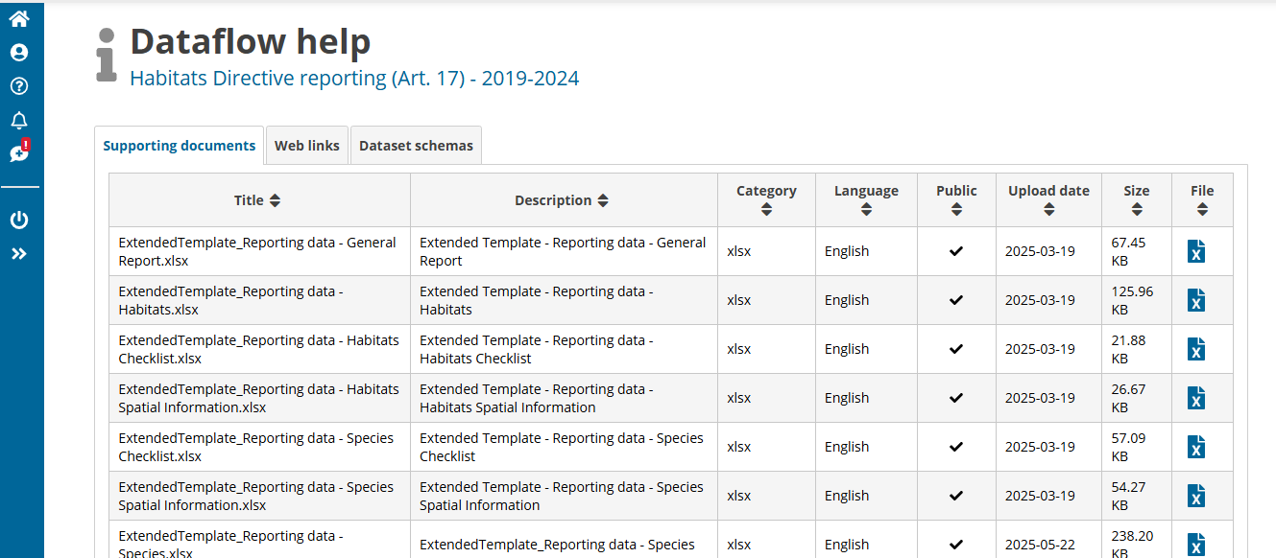
In Web links, we will include the link to the Reporting Reference Portal

Slide 17
Reference datasets

Slide 18
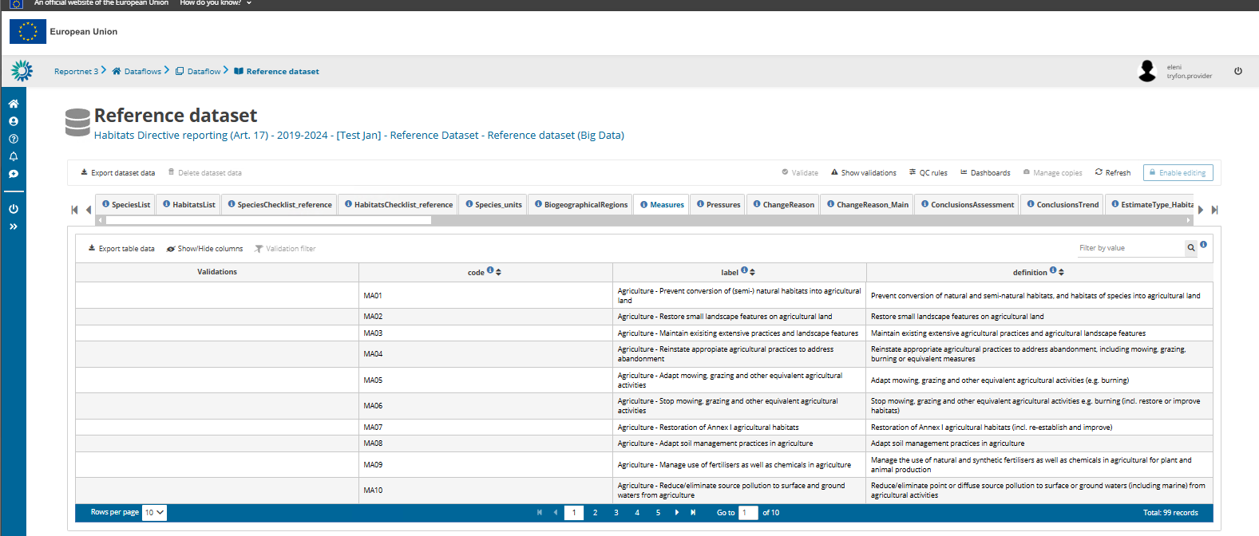

Slide 19
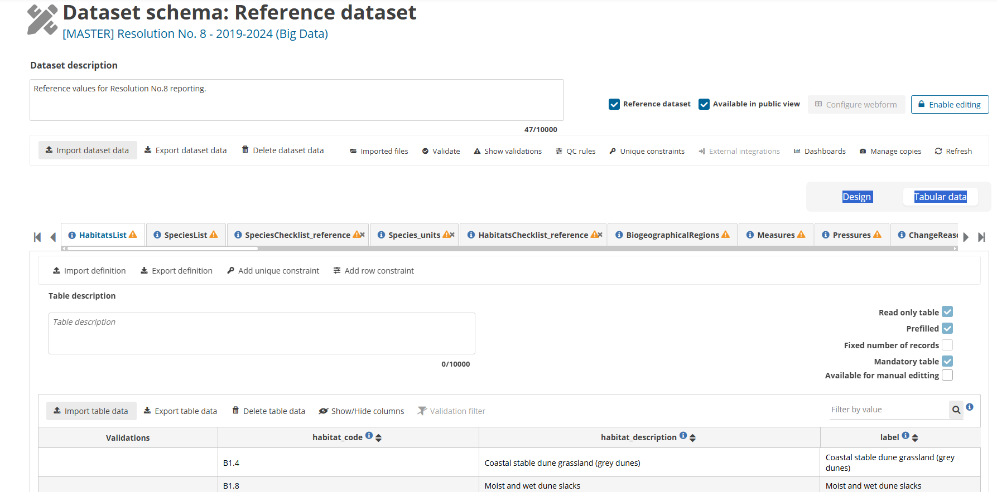

Slide 20
Reporting schemas- data import
Reporting data

Slide 21
All the schema structures and validation rules must be fully considered when preparing data
Disregarding this can result in mistakes that must be rectified before the data is delivered
The same applies to the code lists considered
While working offline the use of the Extended Import Template is recommended
Extended Import templates are also available in the Reference Portal

Slide 22
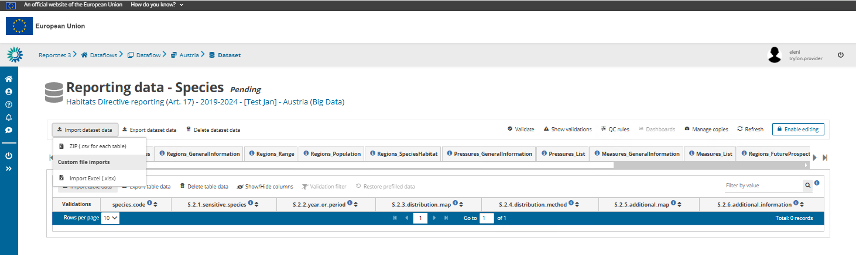
Work offline and import data
Import dataset data

Slide 23
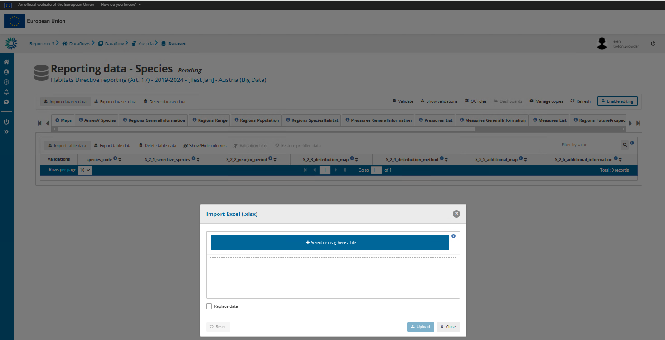

Slide 24
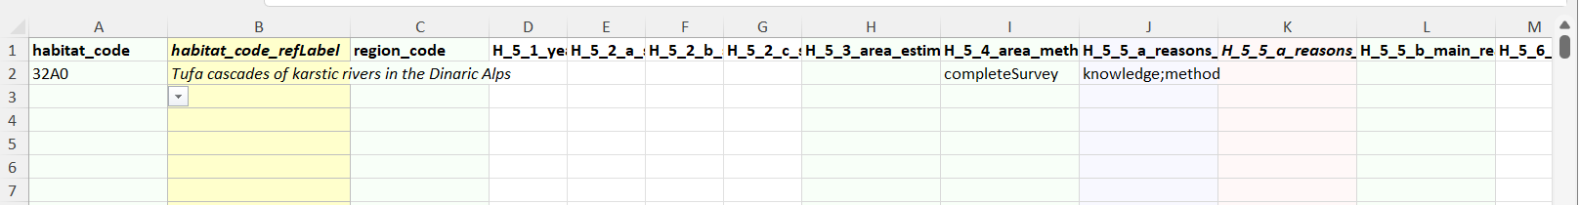
Extended Import Templates
Drop-downs with reference codes, available when pressing the fields with reported values
(_refLabel): labels of the reference codes appear. Available only for species, habitat codes, pressures, measures
: reference codes directly applicable
Light red colour code (_mv): reference codes that can be copy-paste in the light purple multi-select reporting fields, separated by semi colon and no space
An additional spreadsheet includes all relevant reference codes and labels (refLOVs)
Import the extended import templates – the redundant columns and spreadsheets are automatically excluded from the import

Slide 25
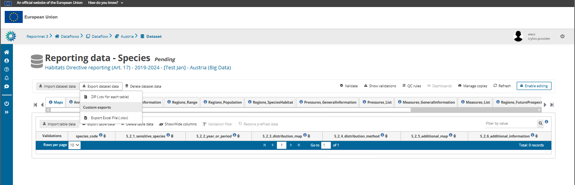
Work offline and import data
Export empty template in Excel format

Slide 26
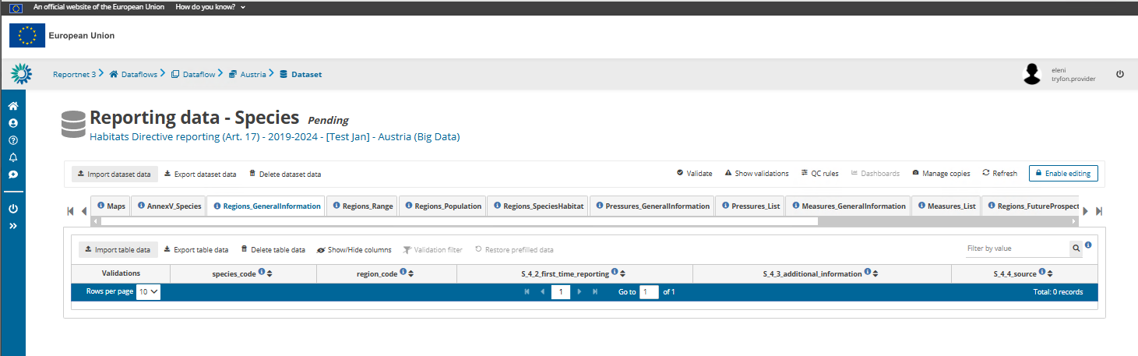
Work online
The function “Enable editing” must be activated to edit and manually enter data in Reportnet 3

Slide 27
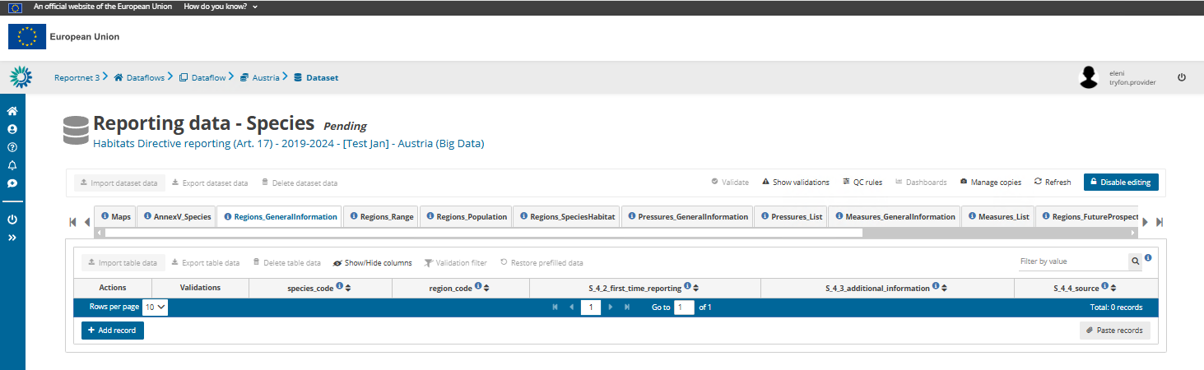
Work online
To import data you need to Disable editing

Slide 28
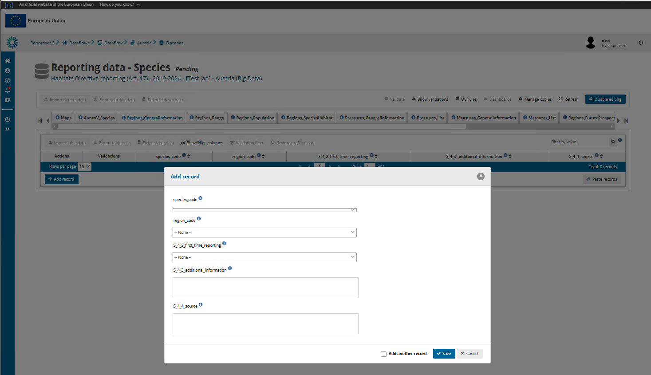

Slide 29
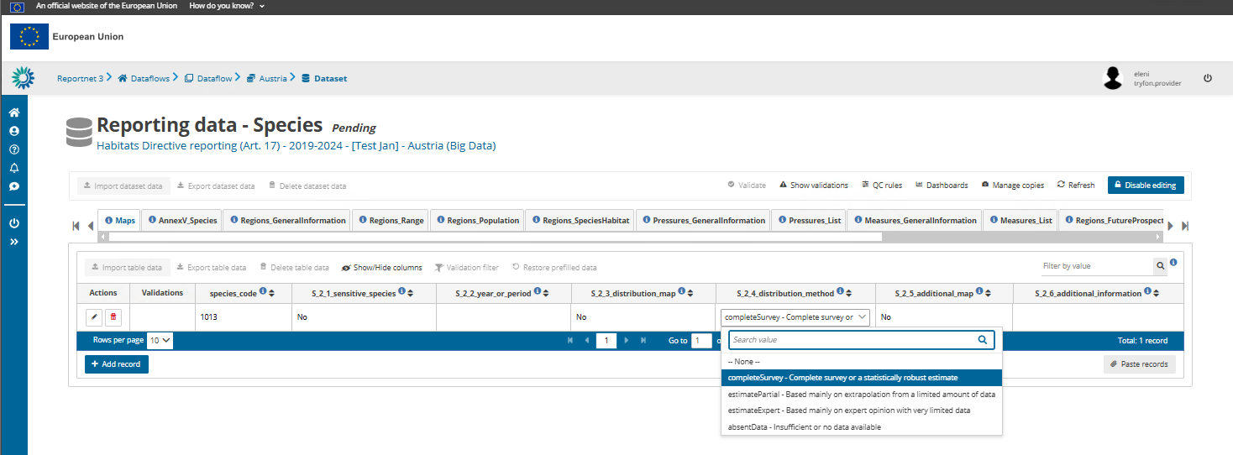
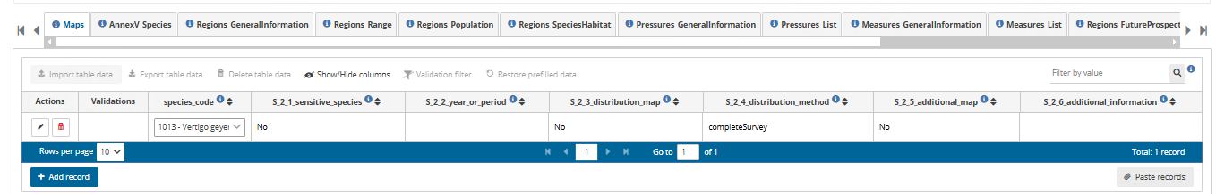
Work online

Slide 30
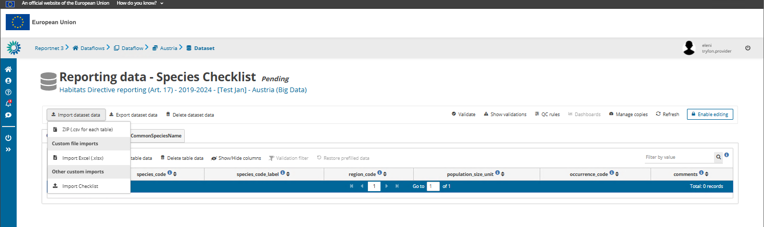
Checklist - import
As a first step check, amend (if necessary) and validate the national species and habitats checklists

Slide 31
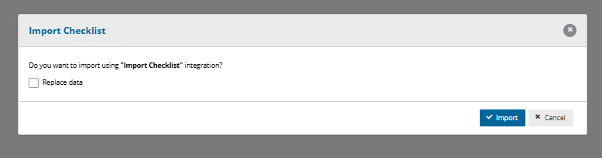
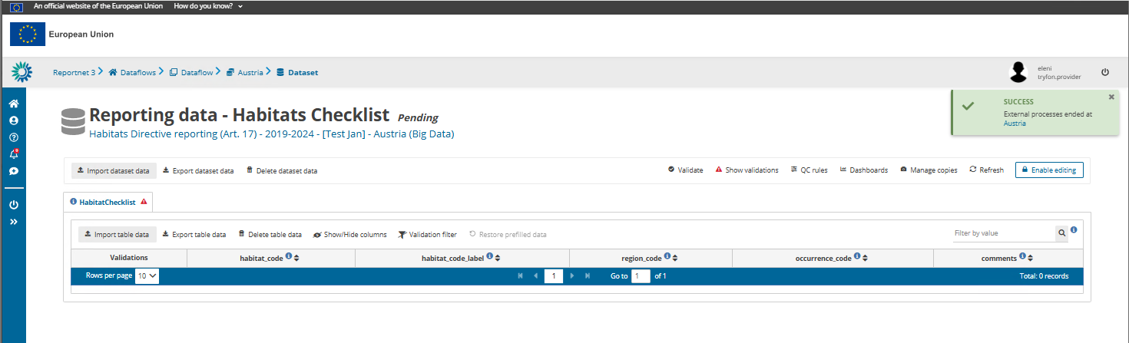
Habitats Checklist - import
Refresh to see the data

Slide 32
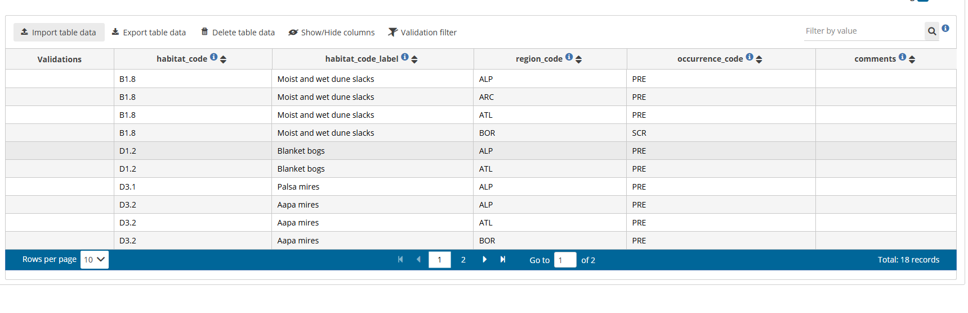
Code labels for habitats and species in checklists are editable and are not validated. They are only for the ease of work of reporters

Slide 33
Checklist – changes, correction of data
Flag species / habitats – region combinations for deletion by selecting in the occurence_code ‘DEL’
Add new species / habitats – region combination
Modify information in occurence_code
Information on reason behind any change in the field ‘comments’ is mandatory otherwise a delivery is blocked
Select the appropriate species population_size_unit
For invertebrate and non-vascular plant species present in one single country, indicate the population unit from the corresponding reference table For the vascular plant species where more than one population unit is proposed (i.e. i or m2), one of those units must be selected for reporting
For species that you will not report (e.g. OCC), fill NA
If the population size unit is not filled in, validations will produce blockers.
Mandatory species and habitats to be reported are those specified in the Explanatory Notes
All mandatory features should be reported apart from those flagged for deletion (DEL) in the country checklist
Reporting non-mandatory features is left to MS. Any non-mandatory feature reported should comply with the validation rules and blockers

Slide 34
Any questions so far?

Slide 35
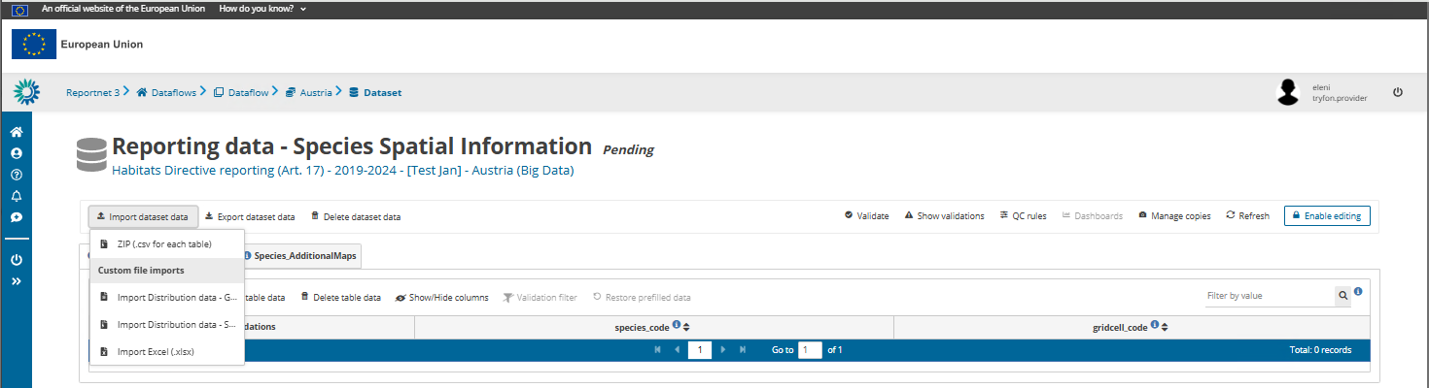
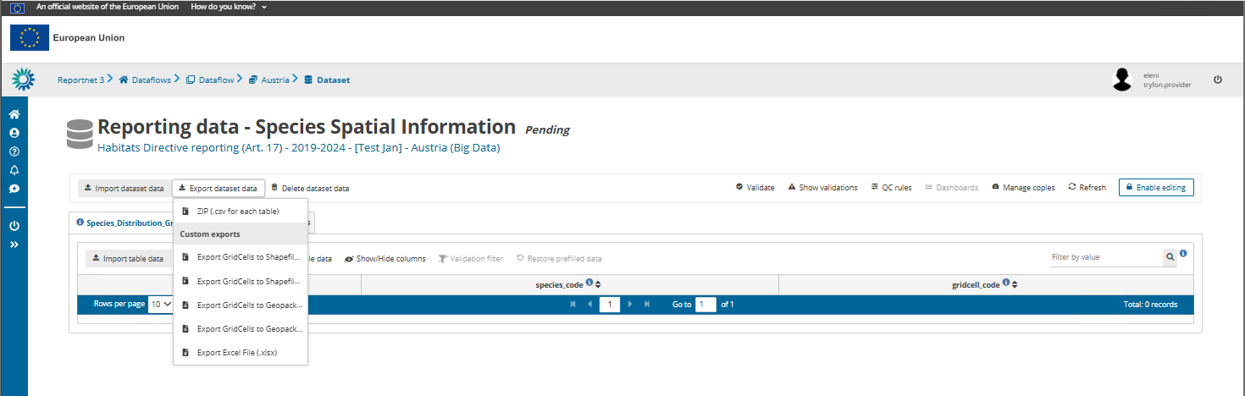
Spatial information schemas
The spatial data may be imported as table with the grid cell codes and feature codes, or in shapefile, or geopackage formats

Slide 36
Validations and data correction

Slide 37
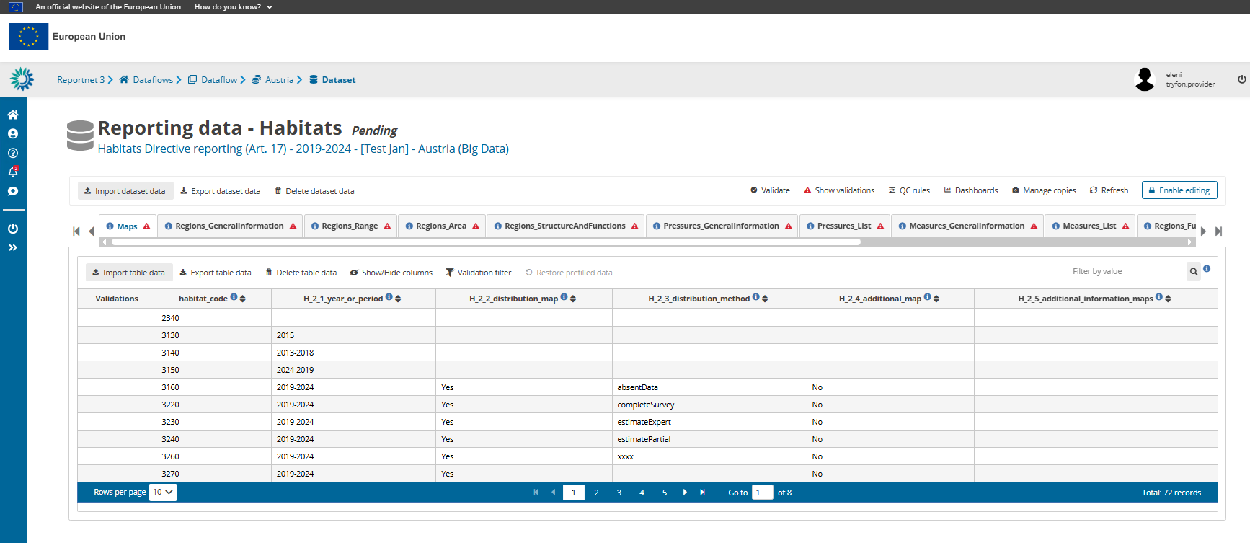

Slide 38
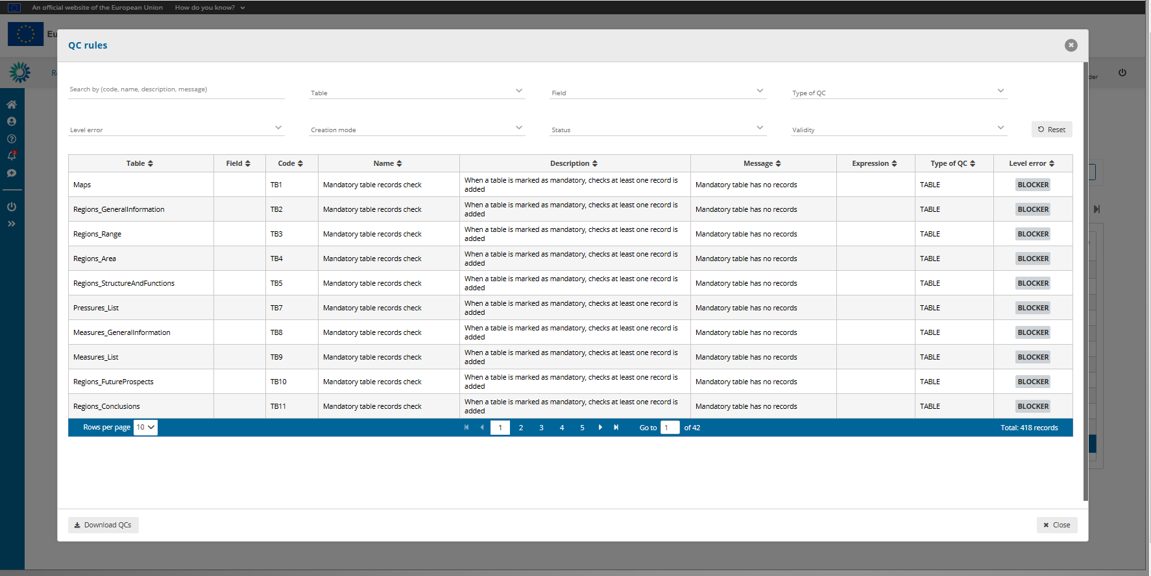

Slide 39
To validate, the ‘Enable editing’ must be disabled

Slide 40
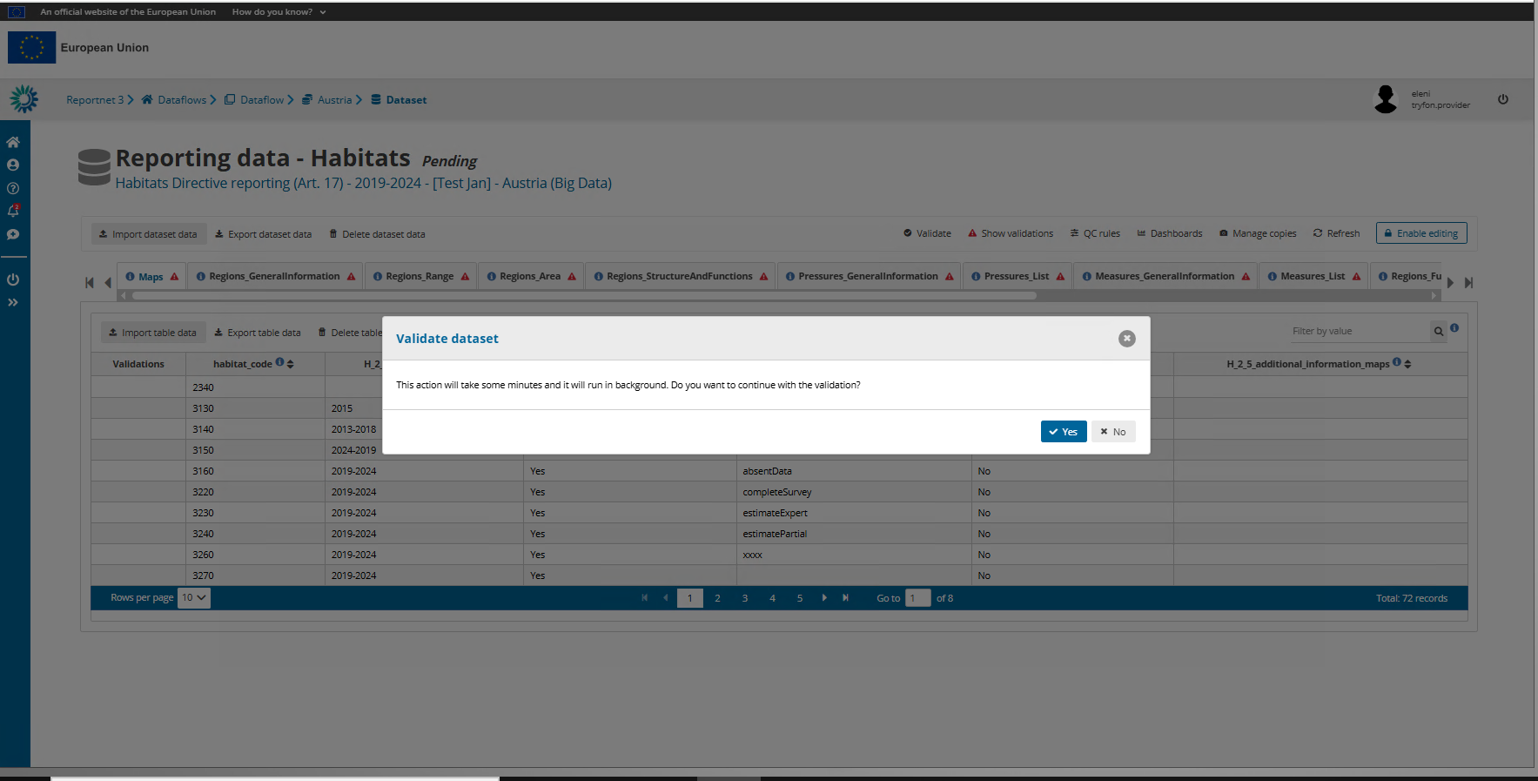

Slide 41
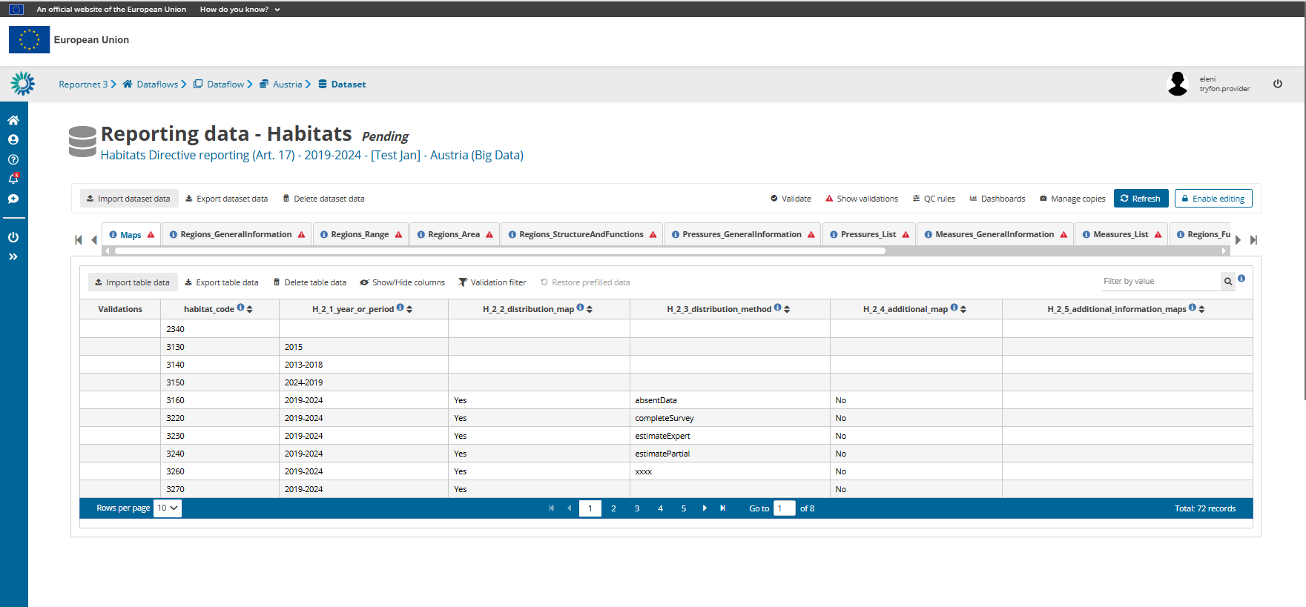


Slide 42
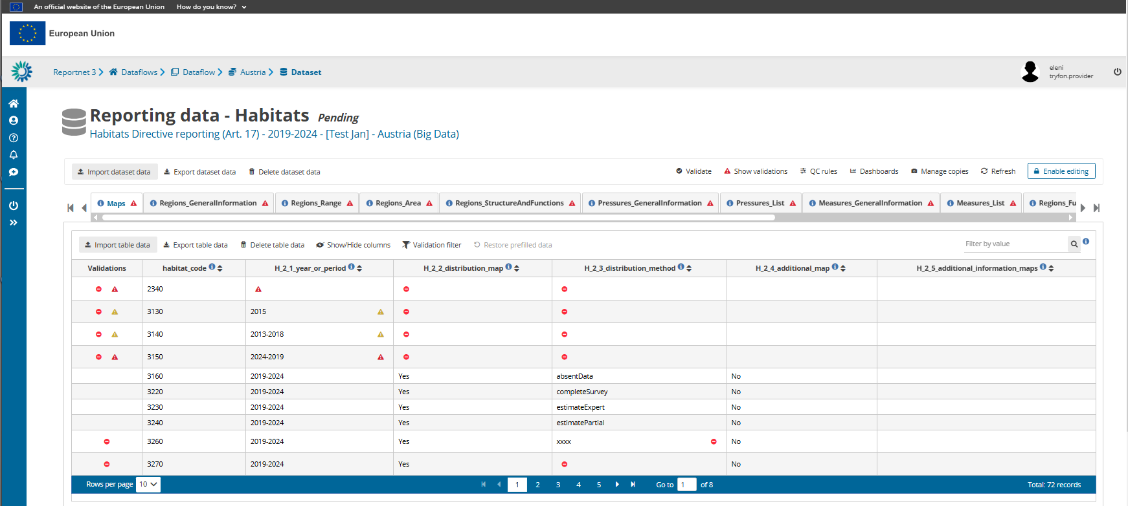

Slide 43
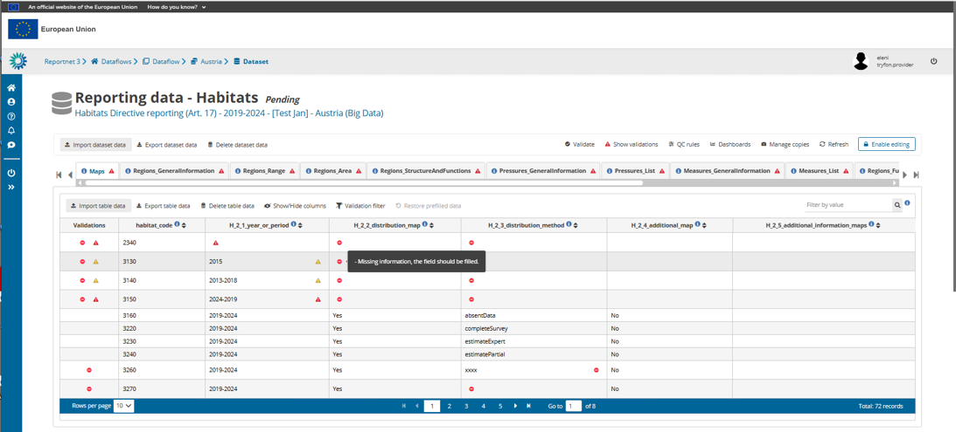

Slide 44
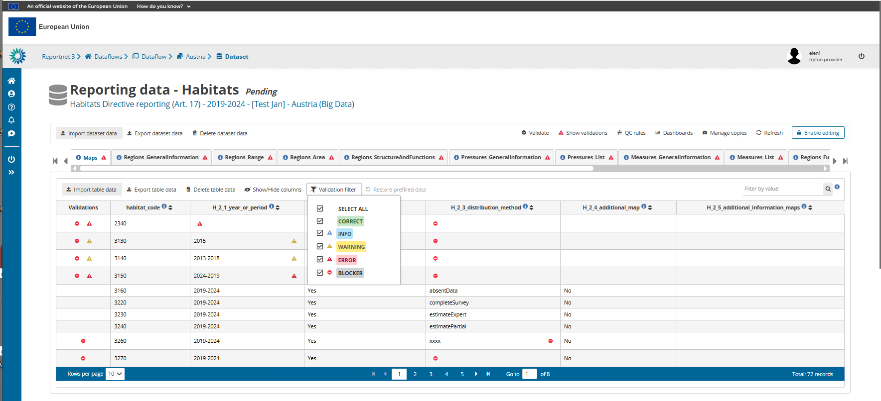

Slide 45
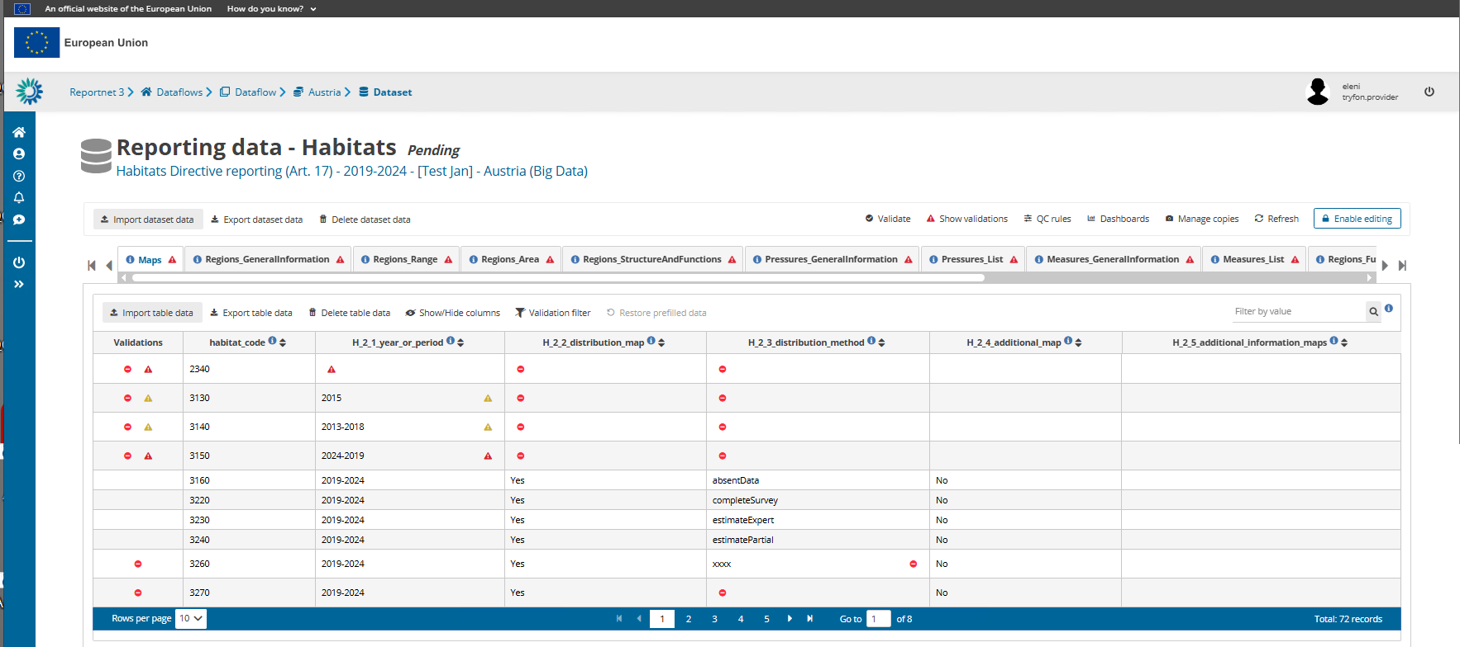

Slide 46
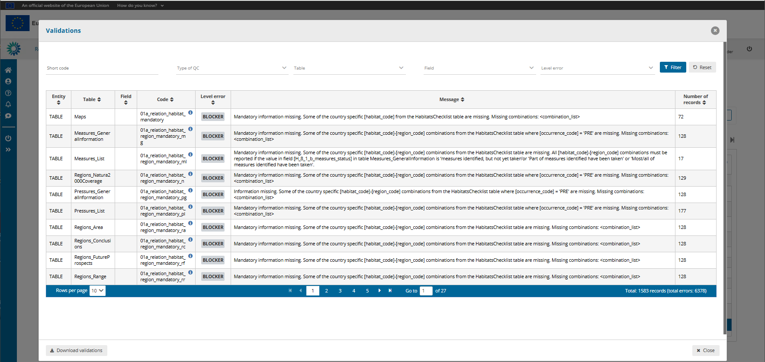
Table functionality: Click on a record and it will take you back to the reporting table and apply a filter to show only those records with QC result

Slide 47
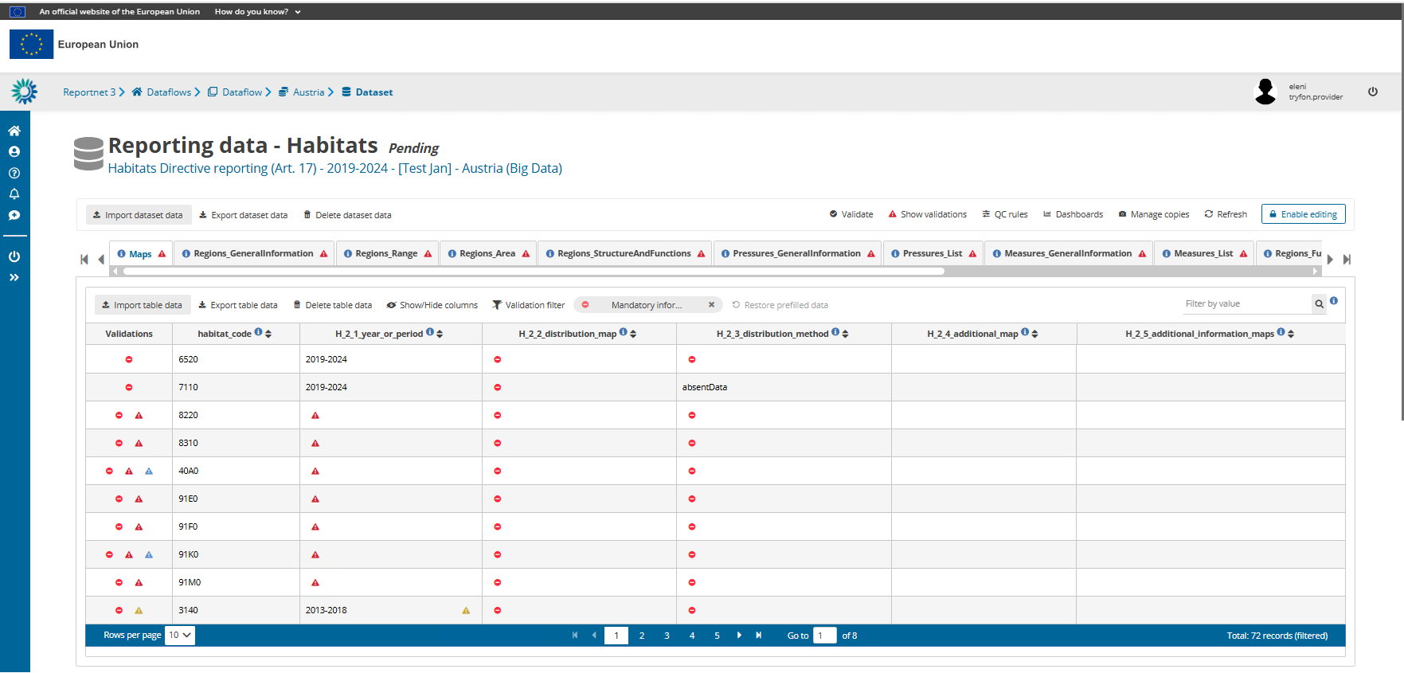

Slide 49
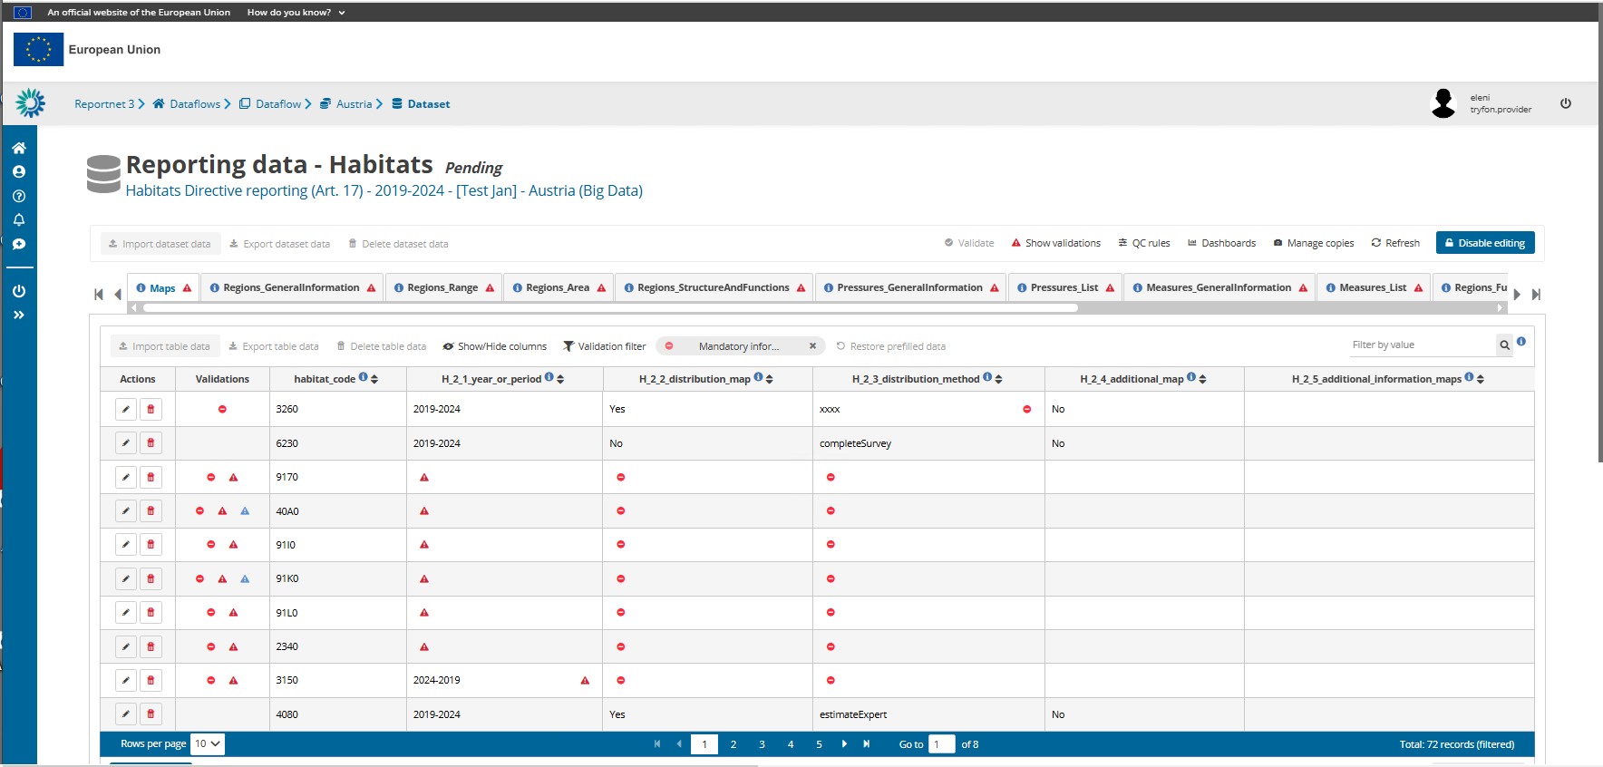

Slide 50
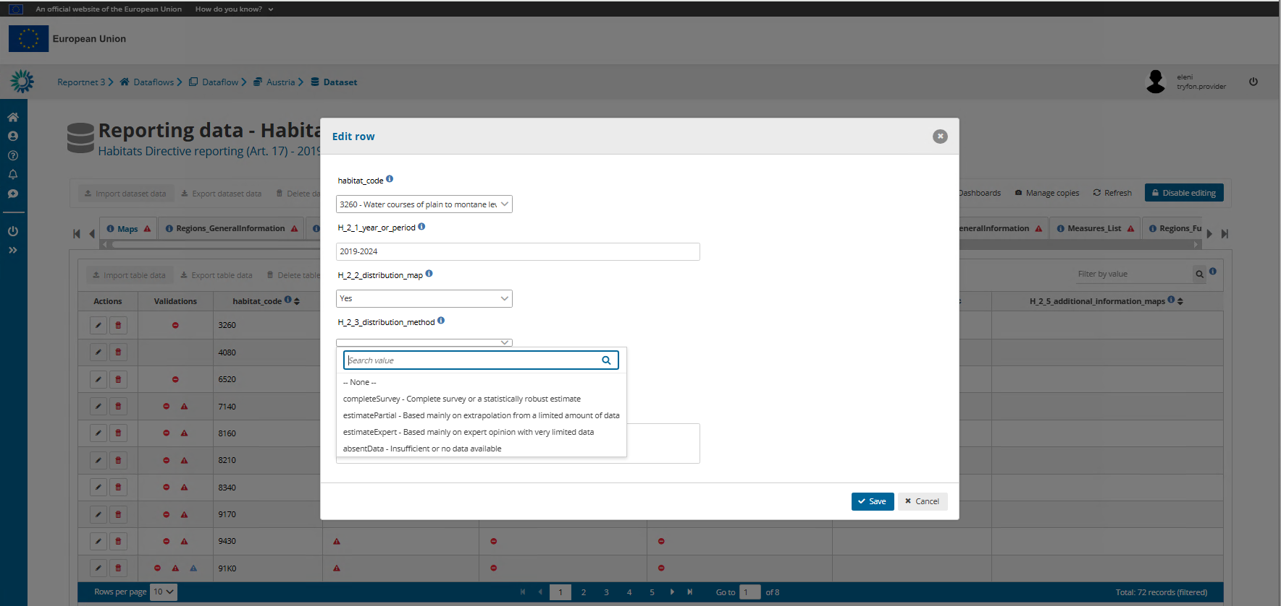

Slide 51
Validation is done at schema level but there are interlinked tables between different schemas, this means validations may involve more than one tables and schemas – coordination of reporters necessary
Unresolved Blockers do not allow delivery
NOTE: Required fields in the schema vs Mandatory fields in the Reporting Format
  Required fields at schema level => BLOCKER or ERROR
  Non-required fields may have ERRORS from QC rules
  Mandatory fields in the reporting format => BLOCKER or ERROR through QC rules
  Optional fields in the reporting format => INFO
  Empty mandatory tables -> BLOCKER (please, use “no data” options)
  Incorrect use of all Reference data values -> BLOCKER

Slide 52
Any questions so far?

Slide 53
Releasing your data submission

Slide 54
Delivery step revalidates data in all schemas and if no Blockers encountered then a copy of the data is delivered to EEA

Slide 55
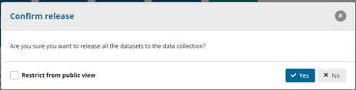
Open deliveries are strongly encouraged
Spatial data are by default restricted from public view

Slide 56



Slide 57
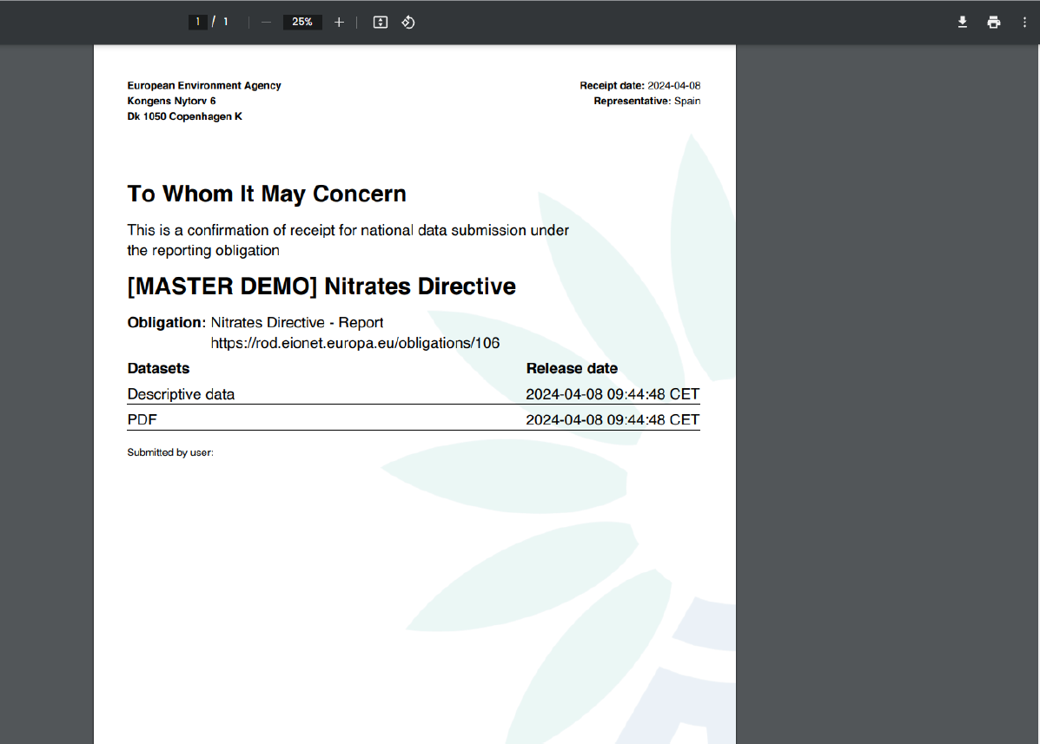
Example of confirmation receipt. It will be similar for Resolution No.8

Slide 58
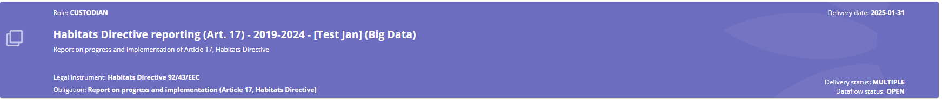
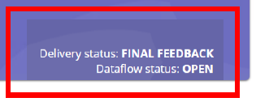

Slide 59
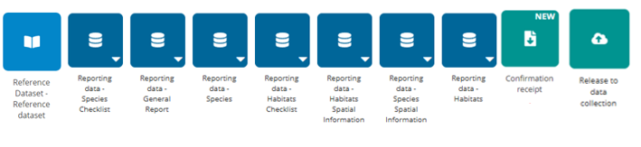


Technical acceptance follows

Slide 60
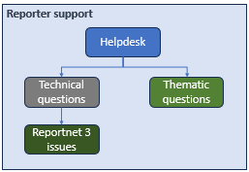
When questions are related to IT issues:
resolution8.helpdesk@eiont.europa.eu
Questions related to content:
Helpdesk.reporting-bernconvention@coe.int
Start to function in 2026 !

Slide 61
Any questions?

Slide 62

Thank you for your attention
Special thanks to the EEA:
Marek, Mette, Eleni, Jonathan, María, Ramón, Jaime and José.
This training would not have been possible without their precious help.
© Dominika Hrašková, REDISCOVER Nature/EEA

