Slide 1
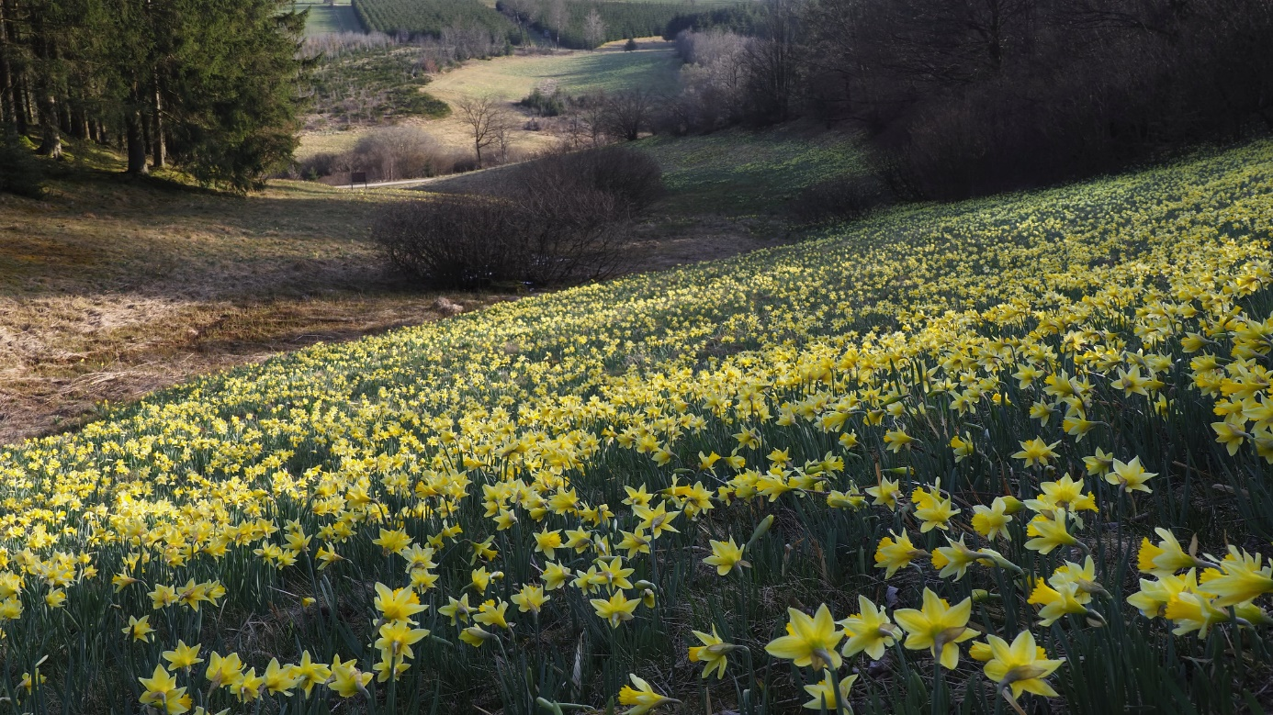
Resolution No. 8 (2012) reporting
Hands-on training on Reportnet 3
© Frank Vassen
Training 20th March 2025

Slide 2
Agenda for the afternoon session
2 pm Practical session based on ETT prepared at home
Import EET for habitats and species (only tabular data)
Pre-fill your checklist
Validate data
Check validations (BLOCKERS, ERRORS)
Correct data
3.30 pm Q&A session
4.30 pm End of the meeting

Slide 3
Google authenticator
Log in to Reportnet
https://test.reportnet.europa.eu/
Accept the user in Google Authenticator
One-time code from Authenticator (Reportnet)
Change your password
Enter
WELCOME!

Slide 4
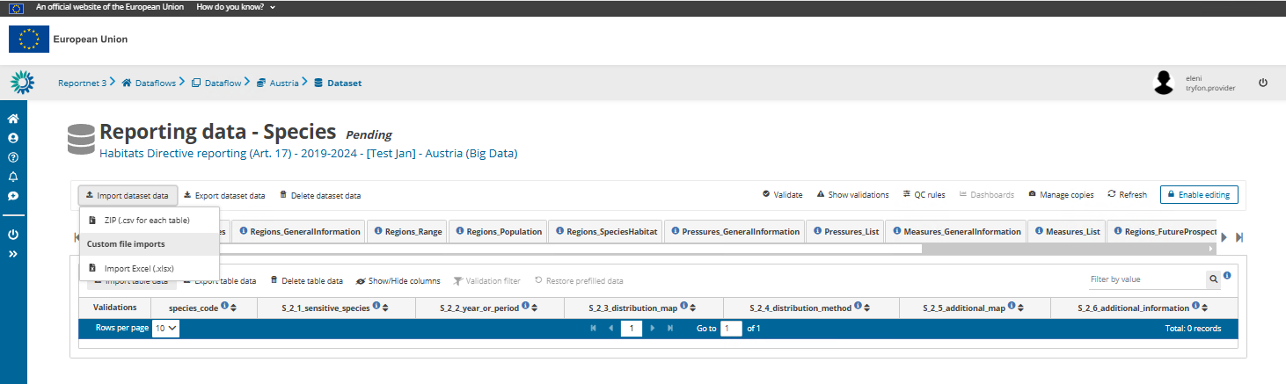
Work offline and import data
Import dataset data

Slide 5
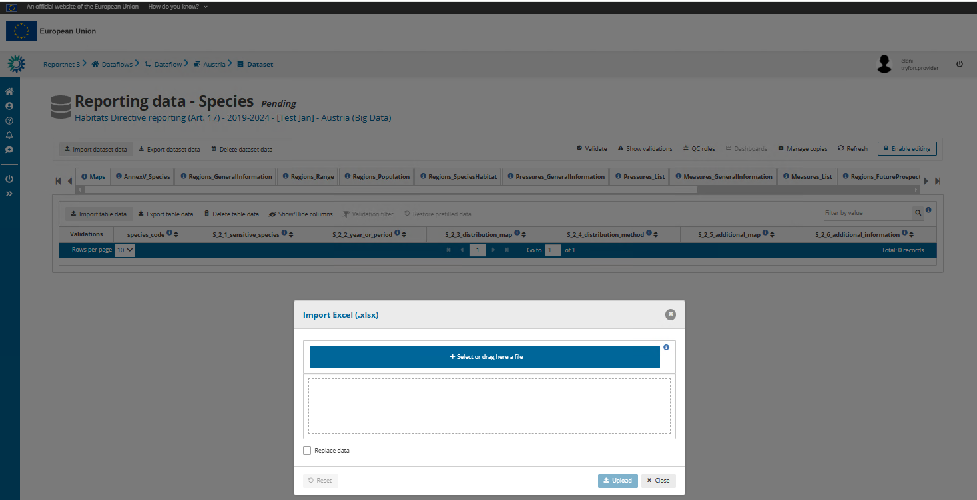

Slide 6
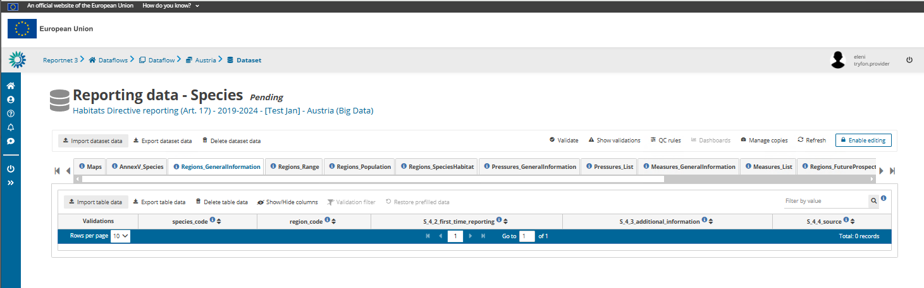
Work online
The function “Enable editing” must be activated to edit and manually enter data in Reportnet 3

Slide 7
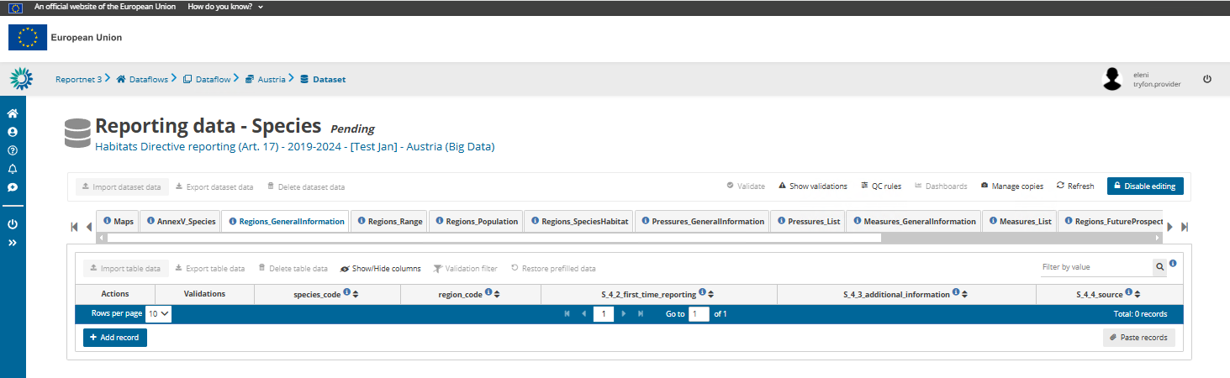
Work online
To import data you need to Disable editing

Slide 8
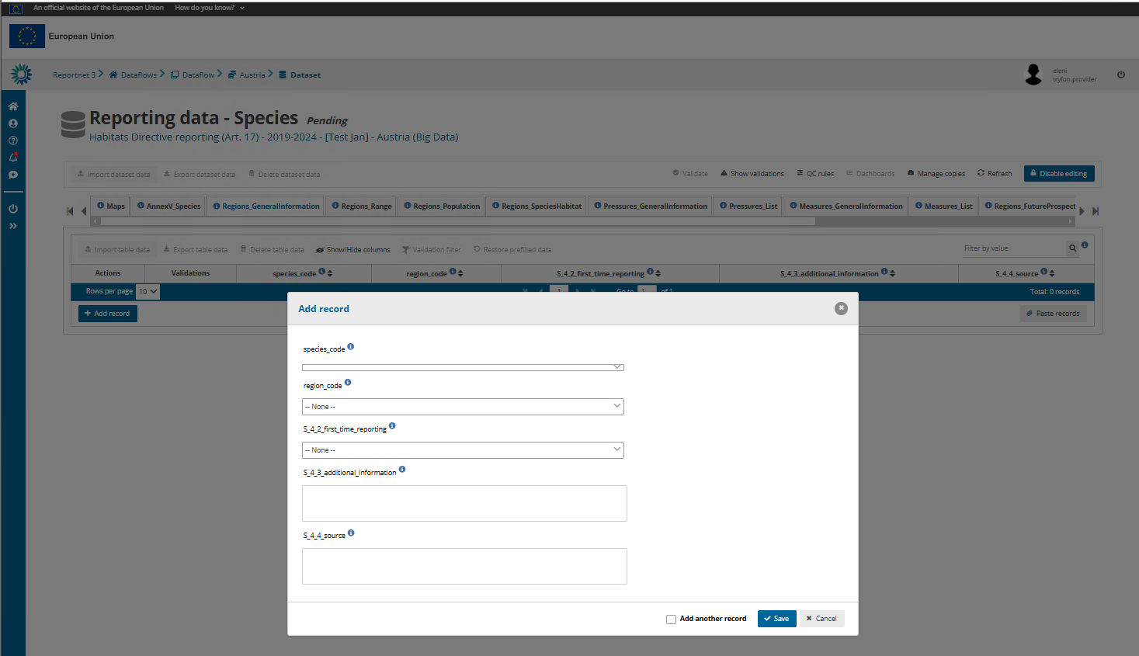
Notes:
Add data record by record using this approach. You save later.

Slide 9
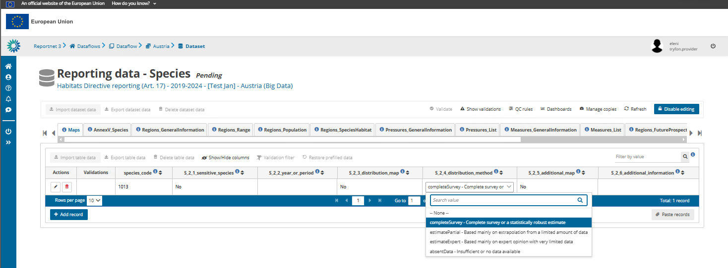
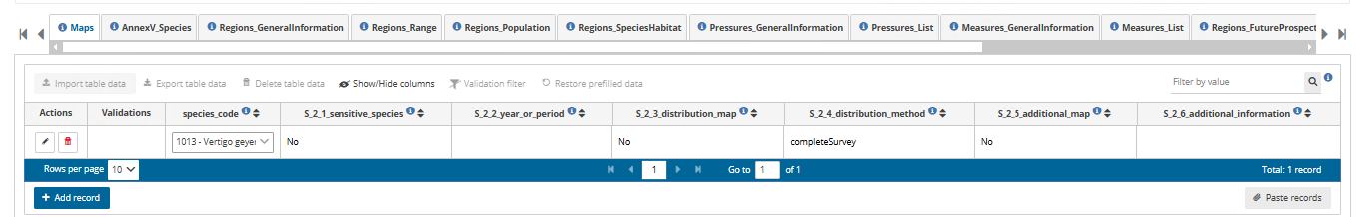
Work online

Slide 10
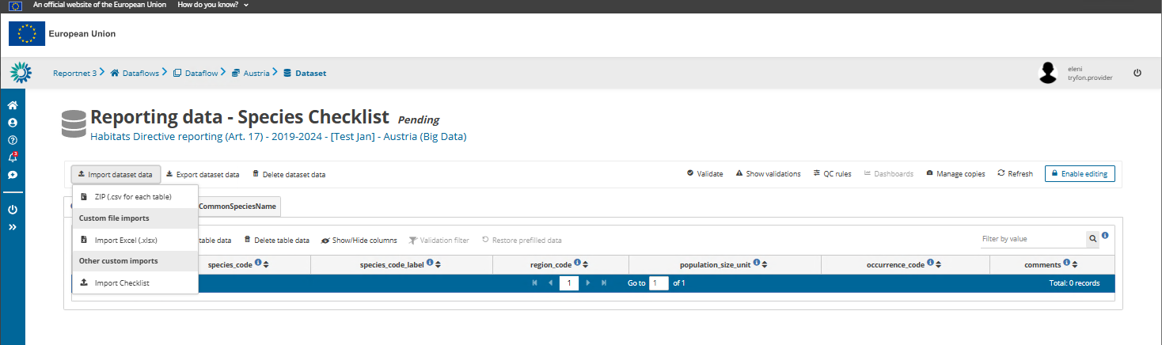
Checklist - import
As a first step check, amend (if necessary) and validate the national species and habitats checklists

Slide 11
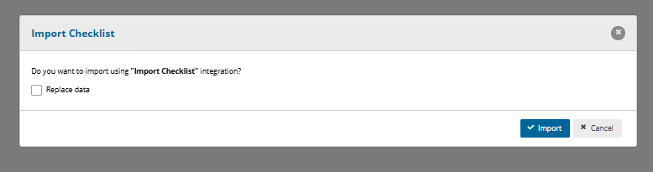
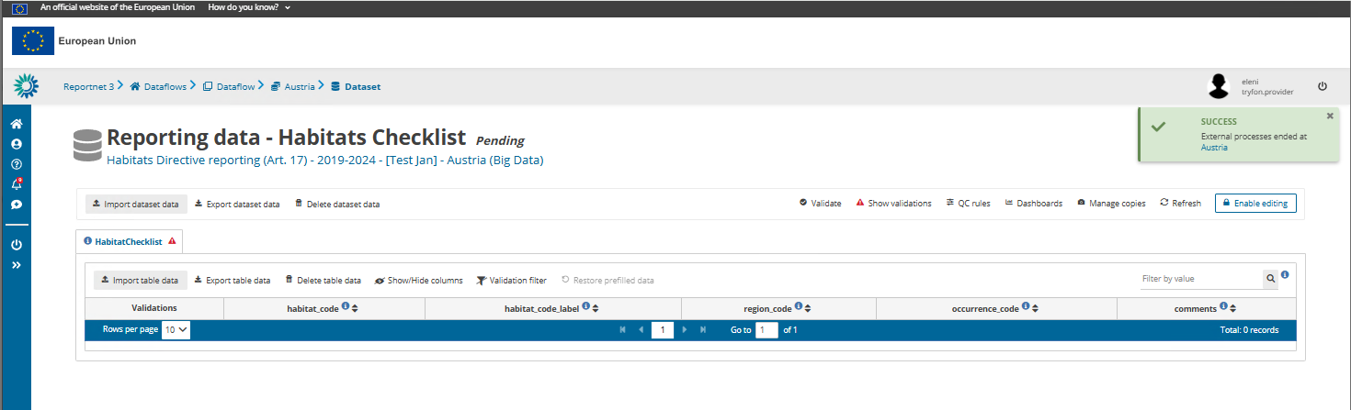
Habitats Checklist - import
Refresh to see the data

Slide 12
Validations and data correction

Slide 13
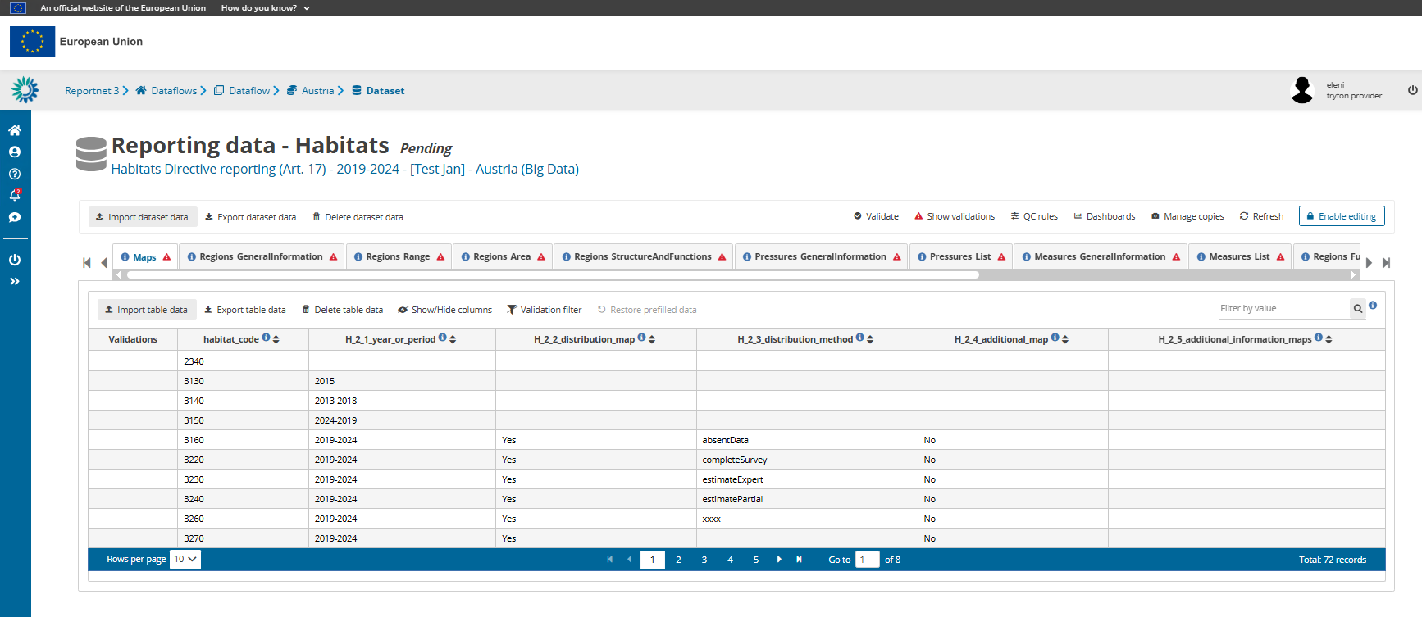
To validate, the ‘Enable editing’ must be disabled

Slide 14
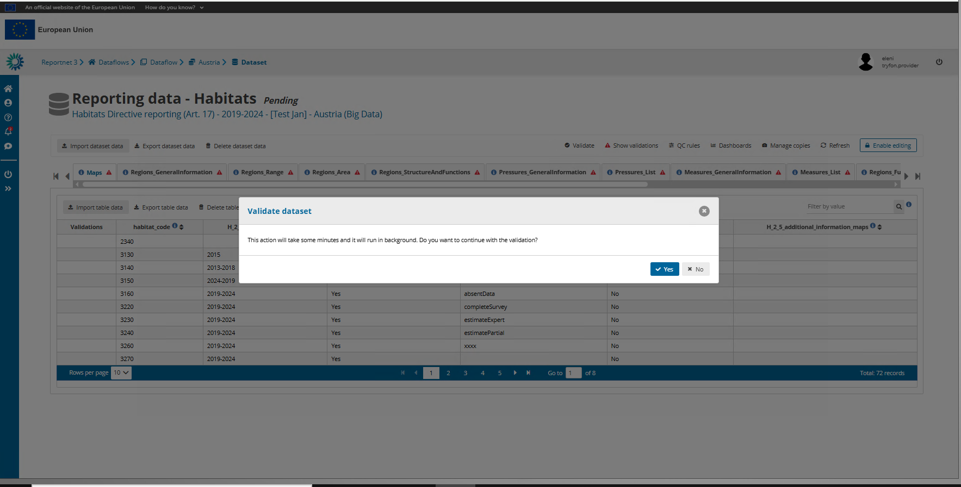

Slide 15
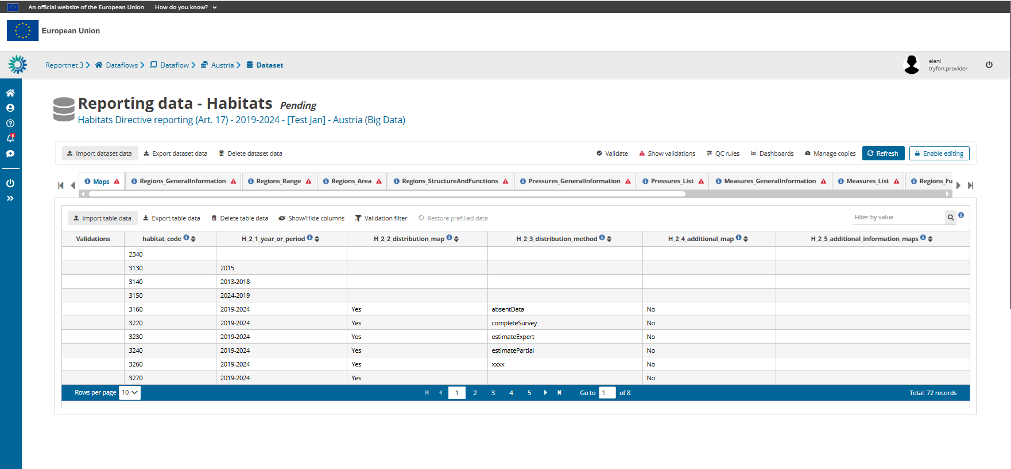


Slide 17
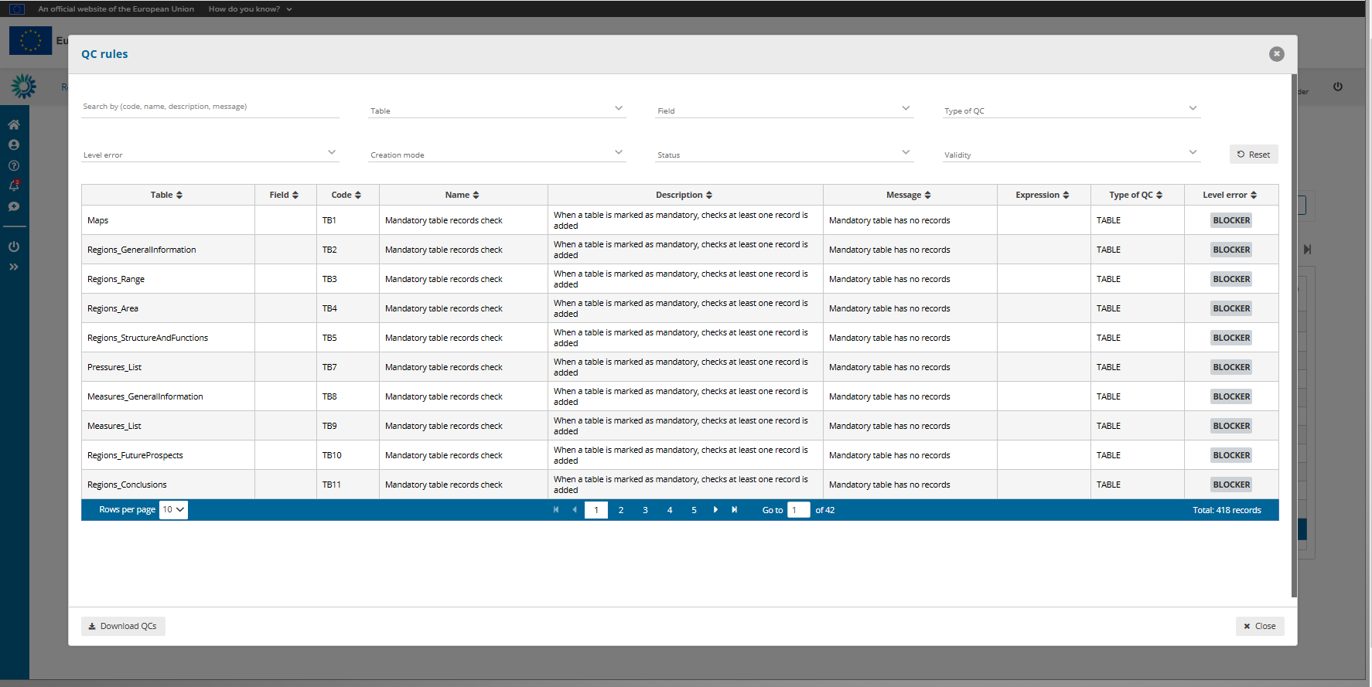

Slide 18
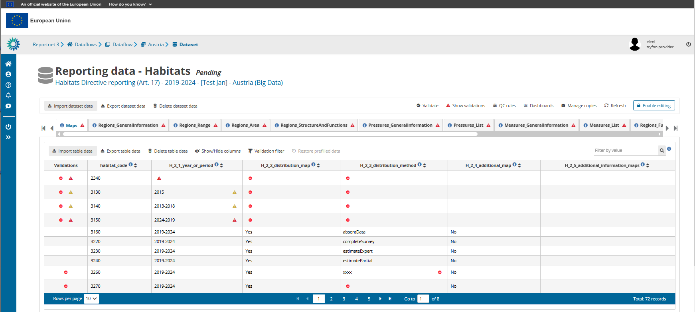

Slide 19
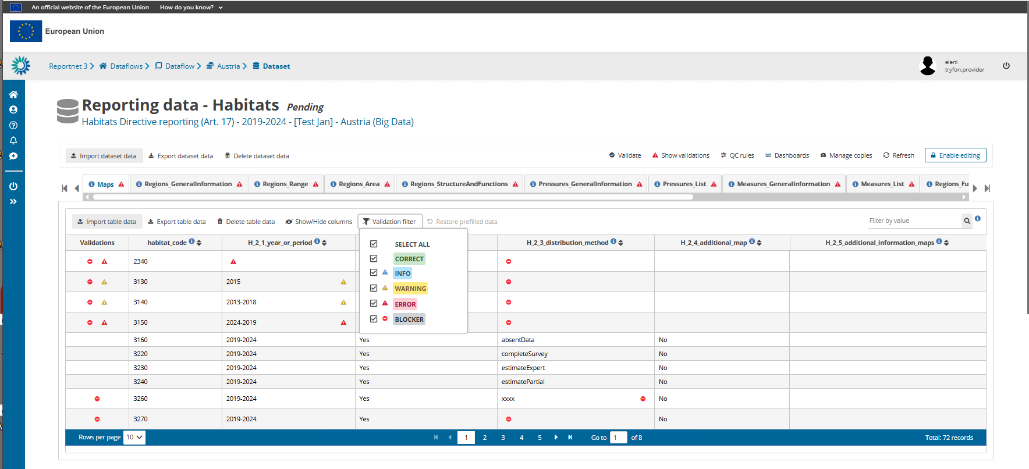

Slide 20
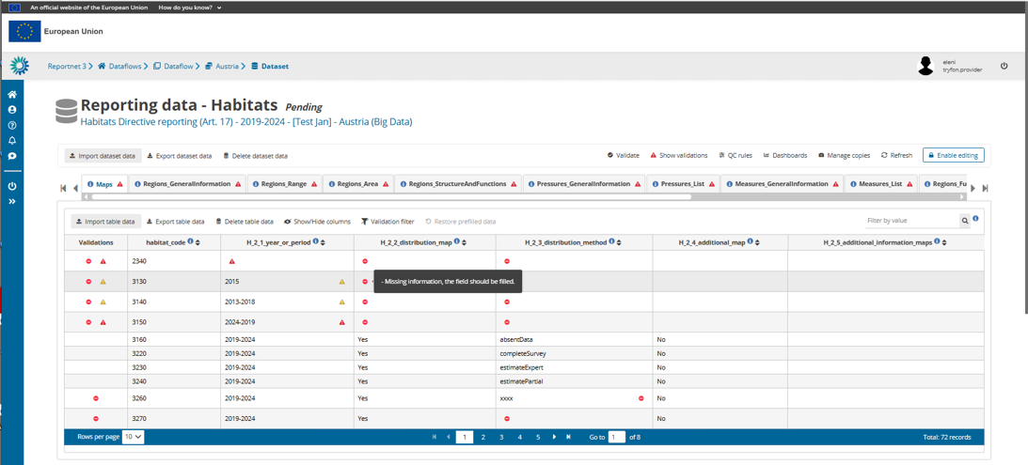

Slide 21
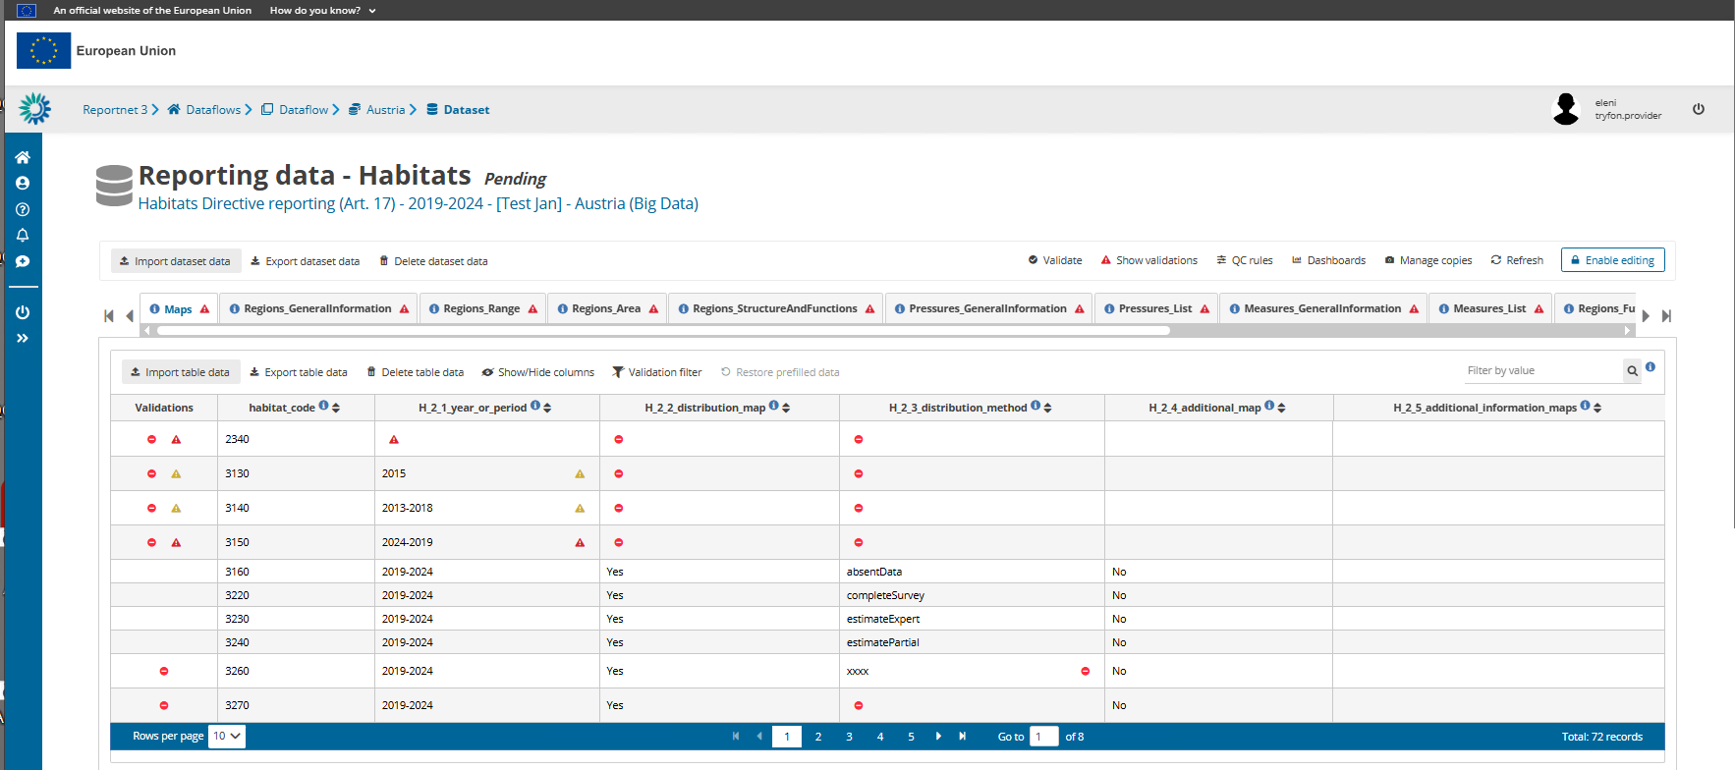

Slide 22
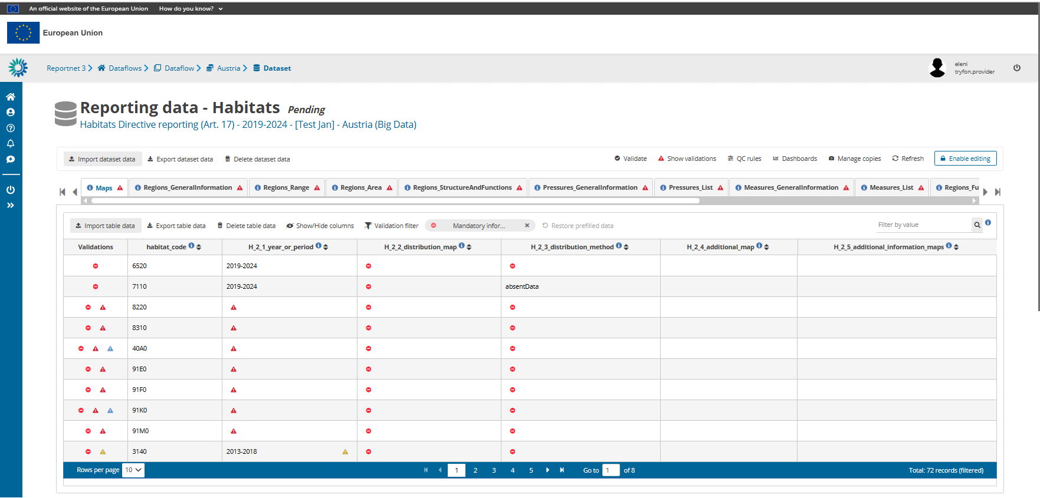

Slide 24
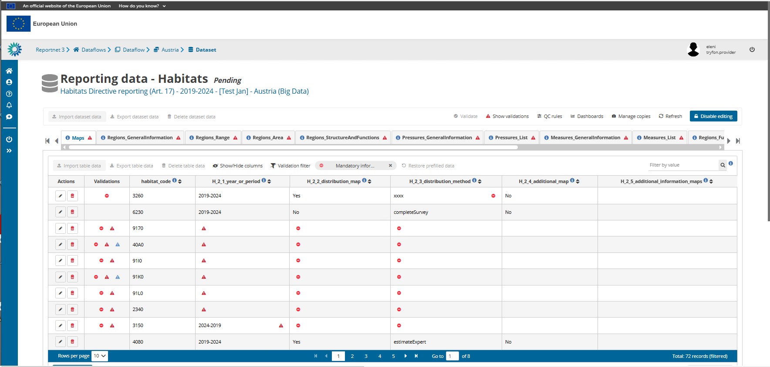

Slide 25
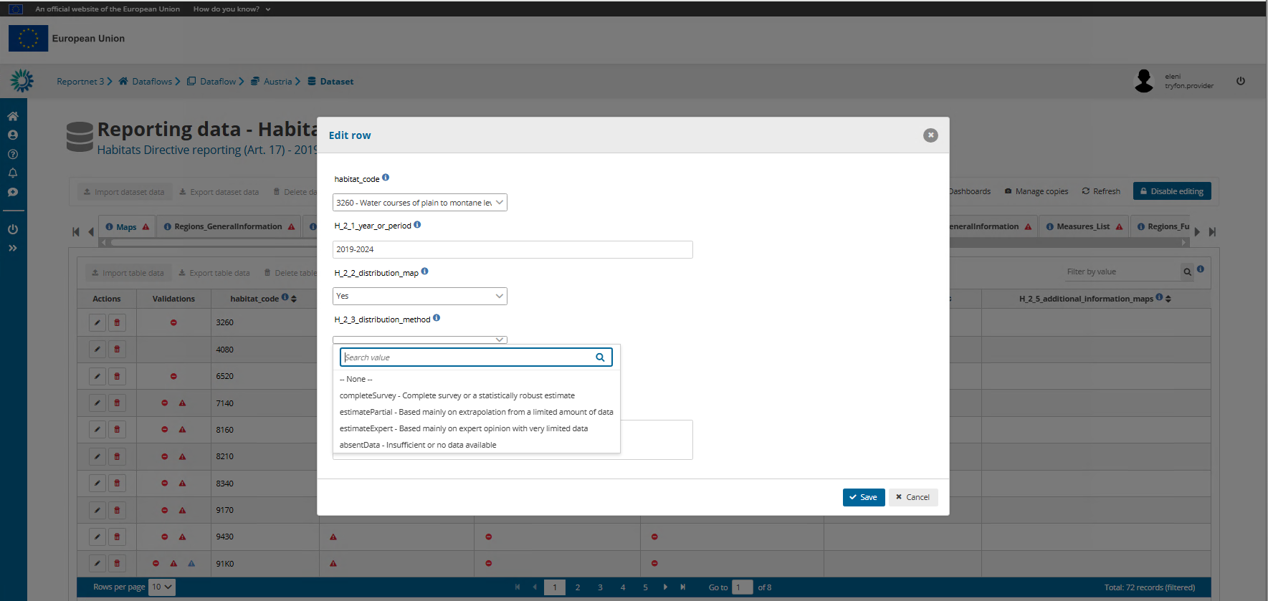

Slide 26

Thank you for your attention
Special thanks to the EEA:
Marek, Mette, Eleni, Jonathan, María, Ramón, Jaime and José.
This training would not have been possible without their precious help.
© Dominika Hrašková, REDISCOVER Nature/EEA

