Slide 2
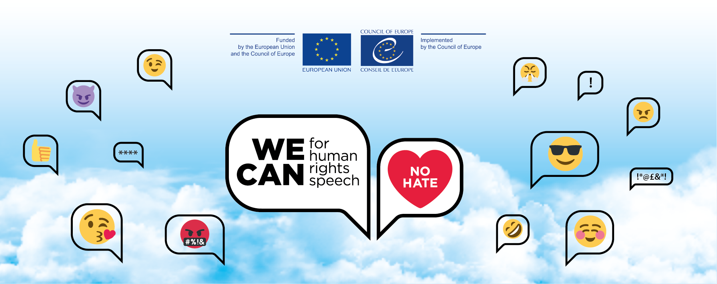
Timing & Formats and their effect on the performance of counter & alternative narrative campaigns Alessandra Coppola, Debora Barletta & Sina Laubenstein

Slide 3
Timing & Formats – Structure
Background: Why is this relevant?
Research on Formats: Methodology, Limitations & Results
Research on Timing: Methodology & Results
Conclusions & Questions

Slide 4
Background: Why is this relevant?
Challenges for activists:
counter speech & alternative narrative have to be produced & launched fast
working with / against the algorithm of social media platforms
spiking interest in users to gain attention & support
info on formats (how?) & timing (when?): to support activists & NGOs, putting them in the best possible position when launching their campaigns

Slide 5
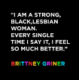
Research on formats: Methodology
Produced various graphic formats for selected days, to be published on various platforms in two countries

Slide 6
Research on formats: Methodology
Monitored the reach & engagement of the published content in an extensive coding grid
Expert interviews with representatives of the social media companies

Slide 7
Research on formats: Limitations
Tested only for different graphic formats, but did not include video or audio files
Participating NGOs have differing target audience & national contexts
Difficult to measure long-term impact of counter speech campaigns

Slide 8
Research on formats: Results
Knowing the target audience (and its preferences) is more important than getting the format right
Visual content is key, as it is benefitted by the algorithm, but only if there is not too much text.
especially on Facebook and Instagram
especially when it includes authentic messengers

Slide 9
Research on formats: Lessons learned
Resources are always scarce, especially in an activist context. However, it might be worth it to take the time to check
where is my target audience active?
who do I currently reach via social media?
what are current trends?
Also: Try to work with the algorithm, activate your network, and be creative!

Slide 10
Research on formats: Results
Knowing the target audience (and its preferences) is more important than getting the format right
Visual content is key, as it is benefitted by the algorithm, but only if there is not too much text.
especially on Facebook and Instagram
especially when it includes authentic messengers
Yes, formats are important,
but they are not the sole factor determining whether your campaign is a success.

Slide 11
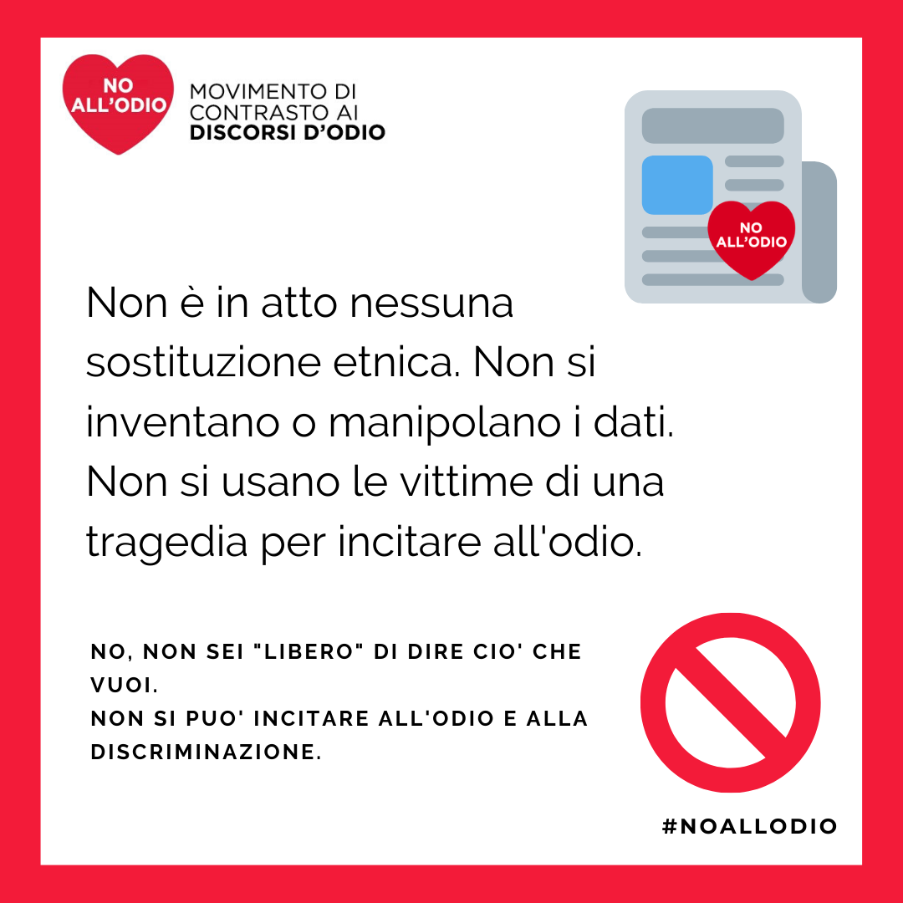
Research on timing: Methodology
Creating a standard model for counter-narrative production that would allow the collection of reliable data asking experts feedback
Producing counter-narrative contents to be launched at different times after the hate incident (within 12-24-48 hours)

Slide 12
Research on timing: Methodology
Keeping the activist practice consistent while also trying to have timing as the only real variable in the sharing process.
Monitoring and collecting the insights provided by the social media used, especially Facebook

Slide 13
Research on timing: Limitations
Shift in hate manifestations due to COVID19 impact
Limited amount of cases analysed
Difficult to apply the imagined model due to the contingency of the different situations in the different time slots identified
It’s not easy to find the right conditions to apply the research in a complex and fluid scenario, neither is possible to artificially produce the right cases to analyse

Slide 14
Research on formats: Results
A counter narrative posted between 12 and 24 hours produces positive reactions
Responding before 12 hours can be ineffective, if the counter narrative is hidden by hateful emotions and reactions and it can even feed trolls if not well-designed
Responding after 24 to 48 hours can result in a reduced impact, because the incident is already digested and the users already formed their opinion about it.

Slide 15
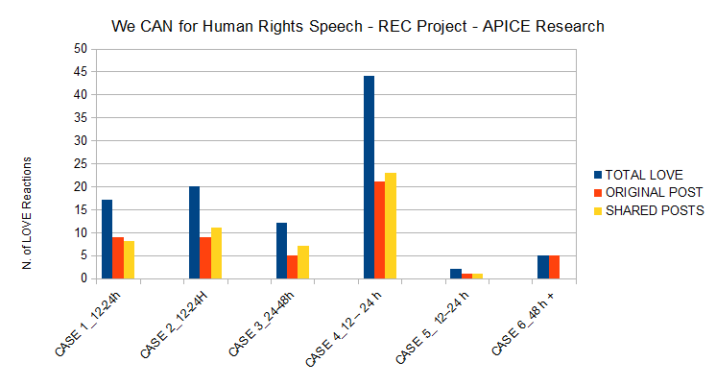
Counter Narrative Actions posted between 12 and 24 hours on our Facebook Page produces positive reactions, the majority of them are expressed on shared posts. This can be interpreted as an indicator of success of the counter narrative beyond the usual audience of the page and a higher penetration outside our influence bubble.

Slide 16
Lesson learnt
Consistency is vital but repetition can weaken your actions
Study and understand your field of action
Choose your battles. Just because a topic is popular you DON’T HAVE TO do something about it to stay relevant.

Slide 17
Hate Storm: A case study
Hate storms have proved to be connected with trend topics in public discourse and even activist spaces can be suddenly invaded by extremists and violent instances if intercepted by organised individuals.
Our own content and narratives can become vessels for hate and go beyond our control. In our case a post on inclusive language became the space for transphobic and trans exclusionary hate speech.
More than 88k reach (our average is 1k)
Almost 3k comments 2k of which on external pages
817 comments on the original post and mostly including hate speech and violent attacks.

Slide 18
Hate Storm: Lesson learnt
Keep track of the sharing of your post and research the possible affiliations of accounts and pages connected with the hate storm.
Keep an ongoing communication with the activist groups/the people in charge of moderating the content on your account. Make sure they always feel safe and in control of the situation.
Find allies and friends who can support you in responding to comments as well as experts that can give you the necessary insight to produce valid counter narrative contents.
Be ready to reconsider your content, be critical of your own work and ask yourself if the hate was involuntarily helped by some inaccuracies and/or manipulations. Was it the right content to deliver your message?

Slide 19
Hate Storm: Lesson learnt
Sometimes defending unconditionally our work can do more damage than having a critical and unbiased (as it is possible to have one) reflection on what you did.
Showing honesty and the ability to be open to discussion can go a long way in creating opportunities for meaningful dialogue and even a significant change in attitudes.

Slide 20
Thank you for the kind attention

