Slide 1
Problem behaviour in children and youth: What works, and how to make it work – the case of Norway
Knut Taraldsen, Psychology specialist and Senior Advisor
Dagfinn Mørkrid Thøgersen, PhD, Clinical Director of Youth Program Development
Regional Discussion on Children’s Rights and Alternative Care
Strasbourg/online, 1 June 2021

Slide 2
Policy
Research
Practice
Positive Child Development

Slide 3
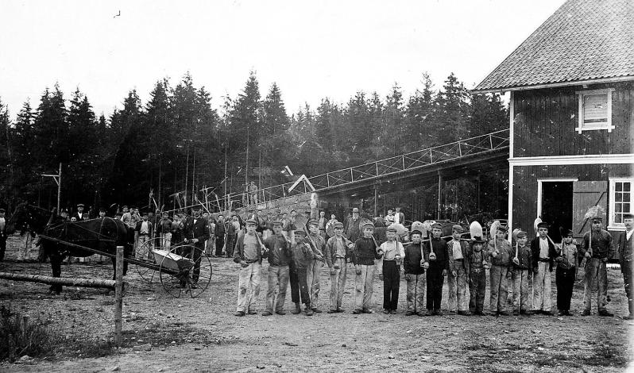
Context: A brief historical sweep through Norwegian child welfare

Slide 4
Context: A brief historical sweep through Norwegian child welfare
1953: «The Child Welfare Act»
Based on child psychology/psychiatry: Prevent and intervene while avoiding out-of-home placement.
Primary goal: Ensure adequate child functioning in their home environment through strengthening the family.
Support to be directed primarily at the family, and in such a way that problems driving conflicts could be eliminated or reduced.
Home-based interventions to be exhausted before placement out-of-home.
Leading principle: The child’s best interest.
https://bufdir.no/Barnevern/Om_barnevernet/barnevernets_historie_i_norge/

Slide 5
Despite this: Alarming long-term outcomes

Slide 6
Despite this: Alarming long-term outcomes
for adults who had been under the custody of the Child Welfare Services
Especially those in institutional care
Regarding:
Education
Income
Dependency of social welfare
Mental health
Physical health
Substance dependency
Crime
Suicide rates
Life span

Slide 7
The 1990s
An increased awareness in the government, society and media on children and youth with serious behaviour problems:
lack of available and effective out-patient treatments
child welfare mainly offered institutional placements with limited treatment focus
many institutions were privately owned and produced large revenues for their owners
Governmentally initiated Expert conference 1997:
What works?
What to do?
Notes:
Liten interesse for å finne frem til og utvikle metoder i fagfeltet i psykisk helsevern
Barnevernet hadde kun institusjonsplassering – få av disse intstitusjonene hadde psykologer ansatt og drev behandling

Slide 8
1. What works?

Slide 9
Youth with serious behaviour problems
Crimes and misdemeanors
Trauma
Poverty
Sexual abuse
Family conflicts
Substance abuse
Violence
Anxiety and depression
Victim of violence
Hyperactivity disorder
Learning difficulties
Dropping out of school
Friends with bad influence

Slide 10
50 years of research: Multiple risk faktors for developing adolescent problem behaviour

Slide 11
50 years of research: Multiple risk faktors for developing adolescent problem behaviour
Individual
Internalizing problems, impulsivity, social and cognitive skills deficiency, high emotional unrest, antisocial assumptions and attitudes...

Slide 12
50 years of research: Multiple risk faktors for adolescent antisocial behaviour
Individual
Internalizing problems, impulsivity, social and cognitive skills deficiency, high emotional unrest, antisocial assumptions and attitudes...
Family
Poverty, inappropriate parental practices, high level of conflict, lack of monitoring, mental health problems, substance dependency…
Peer relations
Social isolation, immaturity, marginalized friends…
School
Low academic performance, learning difficulties, relational problems with teachers and fellow students...
Neighbourhood
High mobility, crime, drug use...

Slide 13
50 years of research: Multiple risk faktors for adolescent antisocial behaviour
Individual
Internalizing problems, impulsivity, social and cognitive skills deficiency, high emotional unrest, antisocial assumptions and attitudes...
Family
Poverty, inappropriate parental practices, high level of conflict, lack of monitoring, mental health problems, substance dependency…
Peer relations
Social isolation, immaturity, marginalized friends…
School
Low academic performance, learning difficulties, relational problems with teachers and fellow students...
Neighbourhood
High mobility, crime, drug use...
Systemic problems > Individual expressions – how to intervene?

Slide 14
50 years of research: Multiple risk faktors for adolescent antisocial behaviour
Individual
Internalizing problems, impulsivity, social and cognitive skills deficiency, high emotional unrest, antisocial assumptions and attitudes...
Family
Poverty, inappropriate parental practices, high level of conflict, lack of monitoring, mental health problems, substance dependency…
Peer relations
Social isolation, immaturity, marginalized friends…
School
Low academic performance, learning difficulties, relational problems with teachers and fellow students...
Neighbourhood
High mobility, crime, drug use...
Systemic problems > Individual expressions – how to intervene?

Slide 15
Systemic problems > Individual expressions – how to intervene?
Incarceration and institutional treatment may be harmful
Risk of a negative developmental trajectory increases due to
Break in the relational tie between caregiver and the child
Decreased opportunities for being with prososial peers
Increases contact with other at-risk youths – can increase marginalization and provide «deviance training»
Limited focus on adressing risk factors in the youth’s family/parents and social ecology
High risk of returning to negative interaction patterns when returning home

Slide 16
Systemic problems > Individual expressions – how to intervene?
Incarceration and institutional treatment may be harmful
Risk of a negative developmental trajectory increases due to
Break in the relational tie between caregiver and the child
Decreased opportunities for being with prososial peers
Increases contact with other at-risk youths – can increase marginalization and provide «deviance training»
Limited focus on adressing risk factors in the youth’s family/parents and social ecology
High risk of returning to negative interaction patterns when returning home
But: Out-of-home placement may sometimes be unavoidable
– important to be aware of and mitigate these potentially harmful effects

Slide 17
Systemic problems > Individual expressions – how to intervene?
What works:
Comprehensive, assessment based interventions in the youth’s social ecology
- parents/family – school – friends - neighbourhood
Focus on:
Inclusion vs. marginalization
Systemic/family vs. individual interventions
Treatment vs. penalty
At home vs. at institution
Strengths vs. deficiencies (in the youth, family, and social ecology)

Slide 18
Examples of evidence-based treatment models
Parent Management Training – Oregon (PMTO)
Functional Family Therapy (FFT)
Multisystemic Therapy (MST)
Treatment Foster Care – Oregon (TFCO)

Slide 19
Clearing houses, governmental and NGO agencies that evaluate and list treatment models

Slide 20
2. How to make it work?

Slide 21
Two main barriers to efficient policy (e.g. on addressing child and youth problem behaviour)

Slide 22
Two main barriers to efficient policy (e.g. on addressing child and youth problem behaviour)
The research to practice gap: research supported interventions are not widely used in practice, or are not implemented with appropriate quality

Slide 23
Two main barriers to efficient policy (e.g. on addressing child and youth problem behaviour)
The research to practice gap: research supported interventions are not widely used in practice, or are not implemented with appropriate quality
The inertia trap: Lack of decommissioning unefficient or harmful interventions

Slide 24
Good, lasting outcomes for children, youths and families
?
High quality intervention

Slide 25
Good, lasting outcomes for children, youths and families
Implementation
High quality intervention

Slide 26
Good, lasting outcomes for children, youths and families
Active implementation
framework
Performance monitoring and feedback
Systems intervention
Coaching
Competency
Organization
Facilitative administration
Training
Recruitment
Decision support data systems
Leadership (incl. Policy)
High quality intervention
© National Implementation Research Network

Slide 28
3. The case of Norway

Slide 29
Policy decisions in Norway
Governmentally initiated Expert conference 1997: what works, what to do?
Conclusion: The Ministry of Children and Families and the Ministry of Health would initiate and invest in a national implementation of evidence-based treatments
Established NCCBD to lead this implementation along with research and development
Specifically MST (Multisystemic Therapy) for adolescents and PMTO (Parent Management Training – Oregon) for children
Close collaboration with practice organizations on sustained implementation
Notes:
Liten interesse for å finne frem til og utvikle metoder i fagfeltet i psykisk helsevern
Barnevernet hadde kun institusjonsplassering – få av disse intstitusjonene hadde psykologer ansatt og drev behandling

Slide 31
Success factors during the last 20 years
Close collaboration between:
Policy makers
ensuring sustained support and stable funding
Research and implementation teams
An implementation team with nation-wide responsibility for evaluating, implementing, developing and sustaining the treatment models (NCCBD)
Practice organizations
Leadership support
Accepting the long-term need for implementation
E.g. systems for monitoring/improving practitioner performance, and required organizational support

Slide 32
Take-home message 1
Research firmly supports an approach to child behavior problems to be
systemic (vs. individual)
treatment (vs. penalty)
in the child’s natural ecology (vs. out of home)
Effective treatments need to be combined with high quality implementation
In order for children, youths and families (and society) to attain good and lasting outcomes

Slide 33
Take-home message 2: The good news
There are effective methods for systemically intervening on child and adolescent problem behaviour, that 1) preserve the family, 2) serve the child’s best interest, and 3) are economically cost-effective compared to incarceration and out-of-home placement
They can provide high quality care and beneficial outcomes through a committed and long-term implementation collaboration between policy makers, research/implementers and practice organizations.

Slide 34
Thank you for your attention!
www.nubu.no
d.m.thogersen@nubu.no
knut.taraldsen@nubu.no

