Slide 1
Casa Pia de Lisboa, I.P.
01 June 2021

Slide 2
A secular institution
1780
2021
that provides education, training, rehabilitation and residential care in Portugal

Slide 3
One of the most challenging moments in its history, was when its confronted with the problem of sexual abuse perpetrated on children and young people entrusted to its care
1780
2021

Slide 4
Human Suffering
A unknown and hidden reality
From the attentive eyes of caregivers
National dimension
Extraordinarily difficult times
Perplexity, sadness, fear, blame
1780
2021

Slide 5
Impactful reflection on everyone;
children, young people and caregivers, often being nicknamed of abused or abusers, receiving pitiful glances or seen in disrepute;
1780
2021

Slide 6
The resilience of the workers and their tenacity allowed Casa Pia:
not to be affected by the media exposure associated with the judicial process,
to remain focused on carrying out therapeutic care of children and young people Casa Pia was in charge of.
1780
2021

Slide 7
In 2003, Casa Pia, had more than 600 children and young people in residential care and 4000 in Education and Training, supported by a total of 1300 workers.
1780
2021

Slide 8
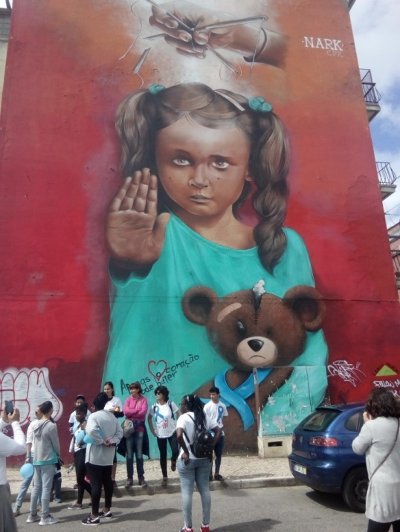
Casa Pia:
- clang to the values of humanity that stand at the core of its foundation;
- undertook a demanding process of change,
- bringing onboard a group of experts in various areas of knowledge, the Technical-Scientific Council of Casa Pia.
1780
2021
Notes:
In this context of crisis,

Slide 9
The Council had in mind the need to meet some requirements:
respect for the identity, memory and path of the institution,
carrying out a rigorous diagnosis of the situation and a vision of the future,
defining priorities for action through broad dialogue and auscultation of stakeholders and partners.
1780
2021

Slide 10
Studies, programs, action plans
Links to the academics
The Inquiry report
Links to the experts
1780
2021

Slide 11
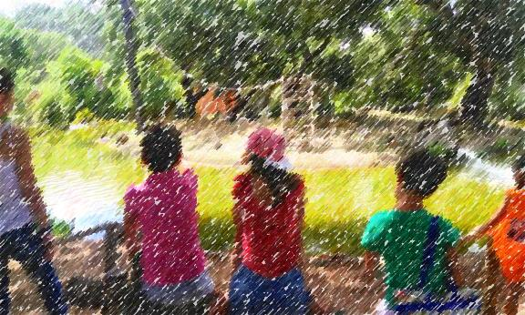
1780
2021
Casa Pia assumed a set of objectives, taking
six consistent steps in its implementation:

Slide 12
Step 1 - Refocus the institution on its essential mission
Integrate children and young people
at risk and with sensory disabilities
The intervention of Casa Pia covers:
Residential care
Educational and training services
Specialized responses in the area of disability
1780
2021

Slide 13
Step 2 - Revert mass educational/formative and care responses and restore the institution’s human scale
Clarify the typology of situations Casa Pia responds in the protection system:
- 8 Houses for Residential Care,
- 2 Houses with Pre-autonomy Program,
- 9 Indepent Living Apartments (one specific for young Mothers with their children),
- 1 Center for Family Support and Parental Counseling, to monitor the transition processes of our children and young people to a natural environment of life (may it be autonomy of life or family reintegration);
1780
2021

Slide 14
Reduce the dimension of residential care homes, in co-education;
Relocate the residential care homes into local socio-community environments;
Increase the number of intervention support workers (psychologists and social workers).
1780
2021

Slide 15
Intervention on care system as a transitory response; placing de return to the family in the center;
Develop life projects with the active participation of children and young people;
Implementation of programs to promote personal and social skills.
1780
2021

Slide 16
CSI - Programa Transversal
Acolhimento Residencial e Respostas Educativas e Formativas
Integrated Social Skills Program (CSI)
Integrated Social Skills Program
Created to respond to the process of sexual abuse experienced in the institution
For all children and young people of Casa Pia
Promotes skills in the fields of :
Sexual Education, Vocational Development and Other Citizenship Themes, with sessions that are appropriate to the needs of each group;
Notes:
16

Slide 17
It made available other Social Responses /Specialized Services to support the needs of populations with specific needs:
a Center for Occupational Activities;
a Center for Care,
Accompaniment and Rehabilitation of People with Disabilities;
Specialized Resources Center;
Center for Qualifications and a Research Unit;
1780
2021

Slide 18
To participate in the social network and regular articulation with external partners in the areas of health, justice, social security, education, among other entities with competences in matters of childhood and youth;
To adequate the educational and training offer, in order to let it match the interests and needs of students and those of the job market.
1780
2021
Notes:
The strategies adopted also made it possible:

Slide 19
Step 3 - Adopt the teaching models and strengthen alternating training
The educational service offers of Casa Pia includes services at nursery, preschool education and basic education levels;
The training offer includes training education courses, professional courses and technology specialization courses.
1780
2021

Slide 20
Over the past few years, it has been possible to:
Restructure management and pedagogical action
Progressively give way to project work methodologies
To the use of digital tools/spaces of experimentation and training
1780
2021
Converge to a participated process of learning that is co-built between students, teachers and technicians;

Slide 21
Focus on innovative teaching - The f@b. Casa Pia
Born from the need to create a multidisciplinary space where new skills could be enhanced through learning based on creativity, invention and implementation of projects, as well as from the need to respond to new teaching methodologies adopted at Casa Pia;
1780
2021

Slide 22
It has also been possible to promote the exercise of full citizenship and the demonstration of acquired competences, which transposes technicality and focuses on a critical, conscious and participatory attitude in the different areas of the children and young people’s life.
The challenge is to align the purposes defined for the training and professional profile of young people and that of the 21st century student;
1780
2021

Slide 23
The strong commitment to the promotion of workplace learning as a complement to the curriculum, with students carrying out a practical training in work context, with a variable duration according to the level and type of training;
1780
2021

Slide 24
The support of the Employability Team of Casa Pia, which works with a vast network of entities and companies and has specialized professionals who match the students’ profile and training needs with the profile and organizational approach of the company;
The Business Mentoring project, which approaches training to the needs of the labor market and foster a commitment between these aspect, promoting the employability of our courses and, at the same time, increasing the recruitment base of the mentoring companies;
Committing to a broad and appealing dissemination of the educational and formative offer, using technological means and social networks.
1780
2021

Slide 25
Step 4 - Professionalize management, recruit quality human resources and commit to the permanent qualification of professionals
Definition of the human and technical profile of the professionals; updating of the models of recruitment and selection;
Strengthen the technical and educational teams, both quantitatively and regarding qualification;
1780
2021
Notes:
The caregivers who have been recruited have higher education training, framed by and compatible with the profile of their function

Slide 26
The technical and educational teams of residential care are also externally supervised while carrying out professional duties,
Annually, a training plan for workers is designed and implemented internally, and they are encouraged to participate, as well as to continuously update their knowledge, particularly in the context of issues related to the different forms of violence that can affect children and young people, namely sexual abuse.
1780
2021

Slide 27
Step 5 – Focus on the promotion of the well-being of residential care workers, in order to care for caregivers
Assessment of the psychosocial risks of residential care workers was implemented;
Action plan is being developed that aims to respond progressively and consistently to the identified needs.
2021

Slide 28
Step 6 - Promote leaderships with the affirmation of values and an efficient and effective management of resources and create self-regulatory attitudes
Strict supervisory and quality assessment mechanisms are implemented through continuous assessment and evaluation and regular audits of the institution;
A process management model is established in the various areas of execution and support of the institution;
Leaderships were strengthened at various pre-existing levels and intermediate leaderships were newly created.
1780
2021

Slide 29
Two Decades passed over the crisis…
External Supervision
Training Plan for Workers (different forms of violence, namely sexual abuse)
Reformist Aproach
Respect of the foundation values
Caregivers (recruit quality human resources, psychosocial risks, Assessment and plan action)
1780
Therapeutic Intervention
2018
Assessment e continuous improvement
(Innovate teaching, audits of institution, process management model )
29
Notes:
a Reference Institution in residential care, education and training of children and young people.

Slide 30
Casa Pia de Lisboa, I.P.
01 June 2021

