Slide 1
Building a Europe
for and with children
Construire une Europe
pour et avec les enfants
Regional Discussion on
Children’s Rights and Alternative Care
1 June 2021

Slide 2
Building a Europe
for and with children
Construire une Europe
pour et avec les enfants
Regional Discussion on
Children’s Rights and Alternative Care
Monitoring oF alternative child care system in Ukraine
The lessons learned
Naira Avetisyan
Chief, Child Protection programme
UNICEF Ukraine

Slide 3
Building a Europe
for and with children
Construire une Europe
pour et avec les enfants
Regional Discussion on
Children’s Rights and Alternative Care
Key Child Protection Concerns in UkraiNE
Children in residential care
Over 100,000 children in public care and numbers are increasing (despite lower birth rate).
Institutionalisation is used as state strategy to mitigate family poverty, family migration, address the needs of children with disabilities and other vulnerable children.
Limited numbers of family-based alternative care, especially for emergency cases (foster care).
High rate of infants (children 0-3 years old) in residential care.
Possible increase of the rates due to COVID-19 socio-economic consequences.
Violence and neglect against children
Domestic violence, institutional violence, online violence with long term impact on child survivors and witnesses (but issue remains hidden).
Professionals in contact with children often deny the existence of the problem, and are not equipped and accountable for reporting cases of violence against children.

Slide 4
Building a Europe
for and with children
Construire une Europe
pour et avec les enfants
Regional Discussion on
Children’s Rights and Alternative Care
Key Challenges for Child Protection & Welfare
Social welfare and protection systems
do not sufficiently support families and are not appropriately designed to prevent risks.
Social protection and justice systems
not child-friendly, fragmented and re-active instead of being proactive (weak prevention, early identification and early intervention / lack of specialised response, over-use of institutionalisation, punitive measures).
Families are in distress
Increased level of stress due to the conflict, poverty, COVID-19;
limited parenting skills to address child distress;
Family break-up, domestic violence, dysfunctional families, IDPs;
Migration (children left behind with extended family or in boarding schools, etc).
Children are facing new risks…

Slide 5
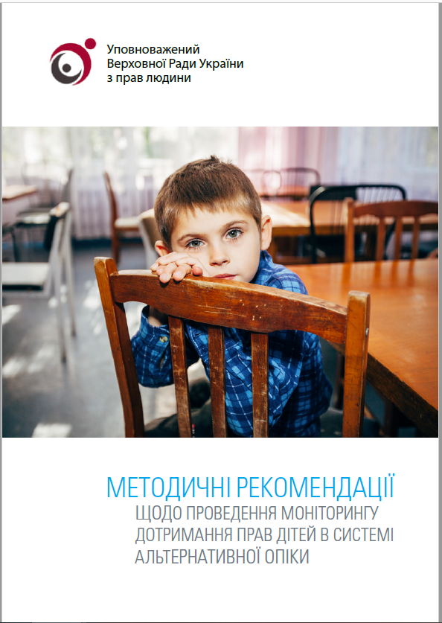
Building a Europe
for and with children
Construire une Europe
pour et avec les enfants
Regional Discussion on
Children’s Rights and Alternative Care
Monitoring of Alternative Child Care System PROCESSES/Methodology
Memorandum of Understanding signed between the office of Human Rights Defender (Ombudsman), Ministry of Social policy (MOSP), UNICEF and Ukrainian Child rights NGO network (UCRN).
Adaptation of international tools for monitoring in alternative child care system (Tracking Progress Initiative: Measuring Progress in the Implementation of Alternative Care Guidelines by Better Care Network).
Capacity building of staff of the office of ombudsman, MOSP and UCRN on the monitoring tools.

Slide 6
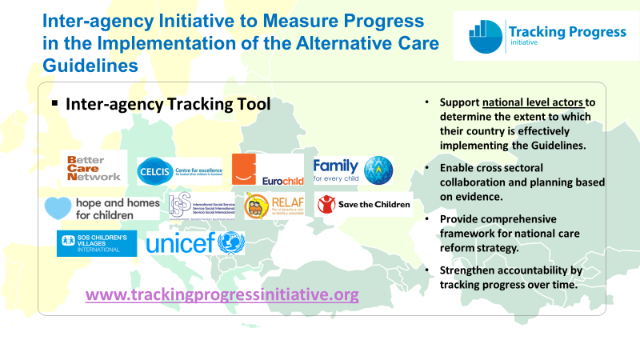
Building a Europe
for and with children
Construire une Europe
pour et avec les enfants
Regional Discussion on
Children’s Rights and Alternative Care

Slide 7
Building a Europe
for and with children
Construire une Europe
pour et avec les enfants
Regional Discussion on
Children’s Rights and Alternative Care
Monitoring of Alternative Child Care System PROCESSES/Methodology
Selection of five pilot regions (1st phase) + FIVE regions (2nd phase).
Analysis of the existing administrative data and desk review.
multi-disciplinary / multi-sectoral Field visits to the regions and monitoring of targeted institutions.
analysis of the statistics, monitoring reports and development of recommendations for each region.
Discussion of findings and recommendations with regional and local authorities (decision makers) and other stakeholders.
Identification of priority follow up actions by the authorities.

Slide 8
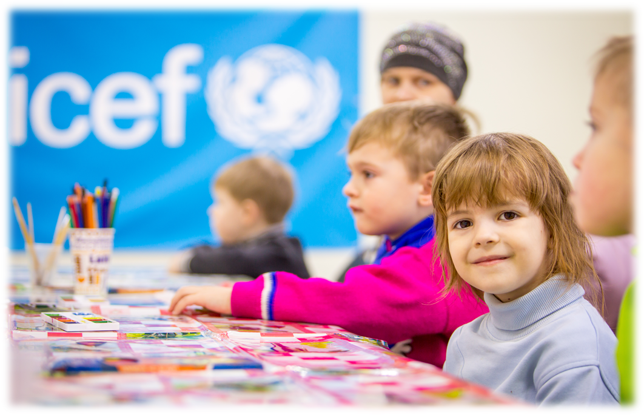
Building a Europe
for and with children
Construire une Europe
pour et avec les enfants
Monitoring oF alternative child care system in Ukraine

Slide 9
Building a Europe
for and with children
Construire une Europe
pour et avec les enfants
Regional Discussion on
Children’s Rights and Alternative Care
Key Highlights
The role of the national Human Rights Institution (NHRI).
The role of CSO.
The importance of muLTi-sectoral and comprehensive monitoring of all types of alternative child-care, the processes, data collection / monitoring / reporting.
The importance of accountability.
The importance of access to and availability of the complaint mechanisms for all children (including those in institutions).
The right to remedy and Access to justice.

Slide 10
Building a Europe
for and with children
Construire une Europe
pour et avec les enfants
Regional Discussion on
Children’s Rights and Alternative Care
Lessons learned
Consider the monitoring and complaint mechanism as a critical source of information on children’s daily experiences and how the system functions to protect and realize their rights.
Use the monitoring reports and the complaint mechanism as a tool for advocacy and communication purposes.
Analyse the data and monitoring reports and use them for evidence-based advocacy and policy making / budgeting
Strengthen the role of the national independent monitoring system (access for CSO to closed institutions).
Assess possible protection concerns and take the measures needed to guarantee the child’s safety.

Slide 11
Building a Europe
for and with children
Construire une Europe
pour et avec les enfants
Regional Discussion on
Children’s Rights and Alternative Care
The impact of COVID-19 on alternative child care
In March 2020, COVID-19 and subsequent quarantine measures resulted in closure of schools, including boarding schools, sending back 42,000 children to their families without assessing the family situation and without warning social workers.
UNICEF together with MOSP and UCRN initiated an “Assessment and Response to Challenges to Child Protection during the COVID-19 Pandemic” in 5 regions of Ukraine, assessing around 3350 families where children from alternative care institutions returned.

Slide 12
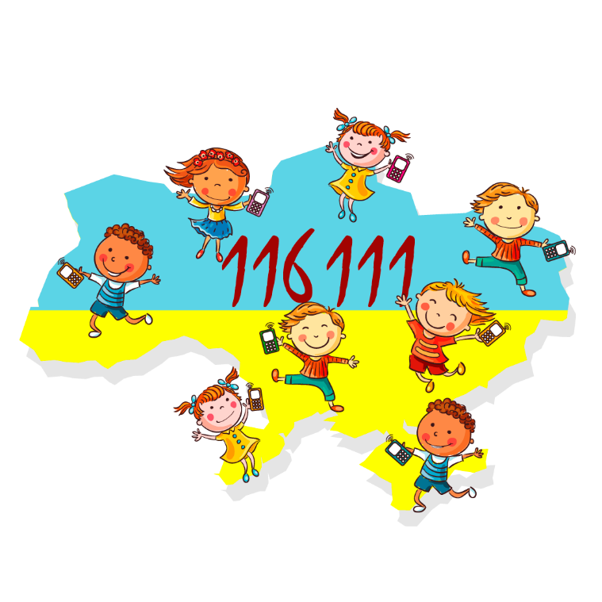
Building a Europe
for and with children
Construire une Europe
pour et avec les enfants
Regional Discussion on
Children’s Rights and Alternative Care
Other forms of monitoring / complaints mechanisms
child helpline
which provides online consultations to children, caregivers and youth affected by violence and neglect.
In 10 months of 2020, around 16,000 children, youth and caregivers received consultations.
A good system of monitoring /complaints On child rights, but it is rarely accessible for children in closed institutions.

Slide 13
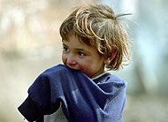
Building a Europe
for and with children
Construire une Europe
pour et avec les enfants
Regional Discussion on
Children’s Rights and Alternative Care
The importance of the continuum of services
PREVENTION
EARLY
IDENTIFICATION
CLOSURE &
REINTEGRATION
FAMILY
CASE REVIEW
ASSESSMENT
& REGISTRATION
PROVISIONS
REFERRAL &
SERVICE PURCHASING

Slide 14
Building a Europe
for and with children
Construire une Europe
pour et avec les enfants
Thank you!!!

