Slide 1


Building a Europe
for and with children
Construire une Europe
pour et avec les enfants
Regional Discussion on
Children’s Rights and Alternative Care
1 June 2021

Slide 2

Building a Europe
for and with children
Construire une Europe
pour et avec les enfants
Regional Discussion on
Children’s Rights and Alternative Care
Supporting Children with Difficult Behaviors:
Examples of Family- and Community-based Programmes in Iceland
Margrét Sigmarsdóttir, Ph.D - Psychologist
Assistant Professor University of Iceland, school of education

Slide 3
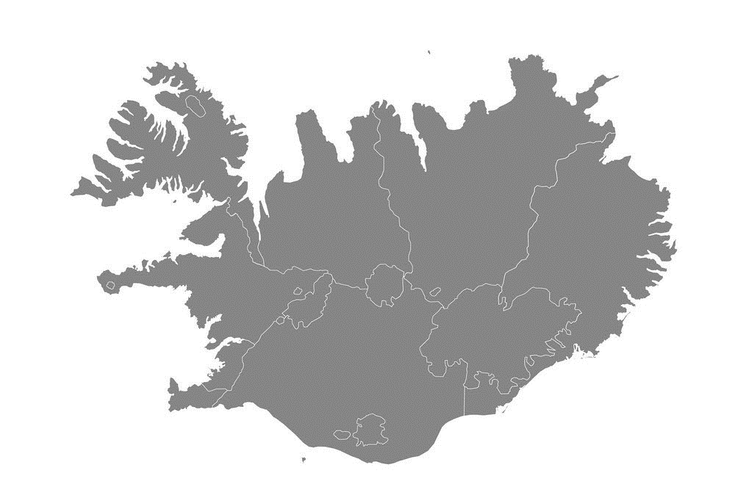


Building a Europe
for and with children
Construire une Europe
pour et avec les enfants
Iceland - Population about 340.000
The systematic work with the selected EBP started in 2000

Slide 4

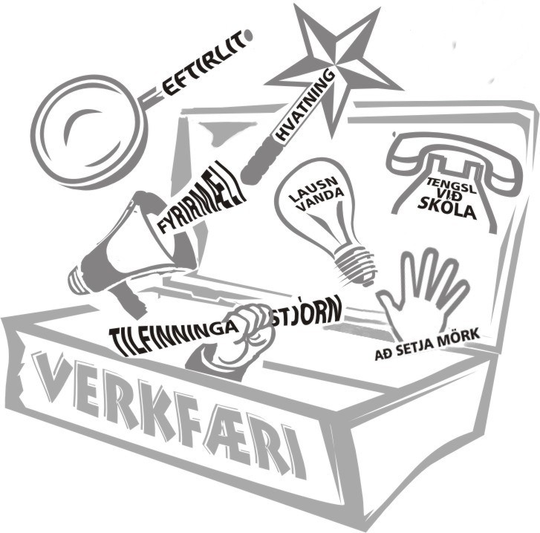
Building a Europe
for and with children
Construire une Europe
pour et avec les enfants
EVIDENCE-BASED PROGRAMME:
PARENT MANAGEMENT TRAINING - OREGON / PMTO
(Patterson, Forgatch, & DeGarmo, 2010; Rains, Sigmarsdóttir, & Forgatch, 2021)

Slide 5
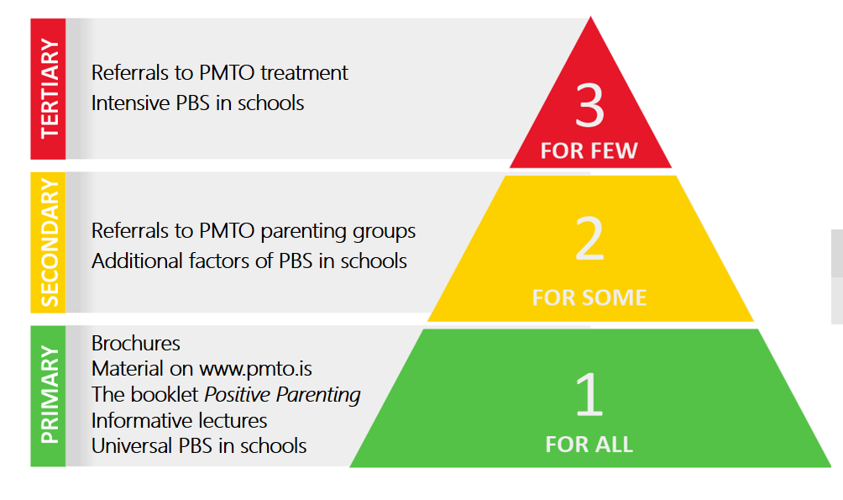
THE COMMUNITY
Building a Europe
for and with children
Construire une Europe
pour et avec les enfants
(Sigmarsdottir & Björnsdóttir, 2012)

Slide 6
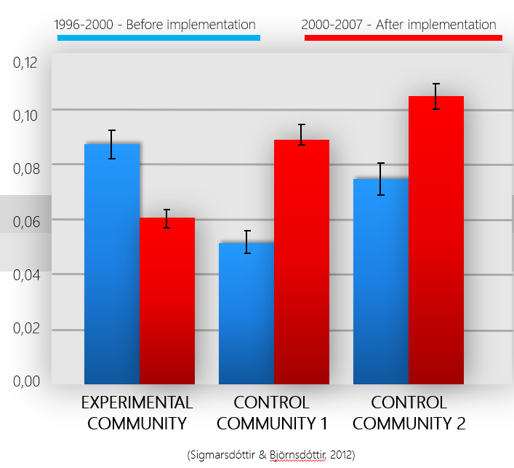
Building a Europe
for and with children
Construire une Europe
pour et avec les enfants
THE COMMUNITY
https://onlinelibrary.wiley.com/doi/pdf/10.1111/j.1467-9450.2012.00974.x

Slide 7
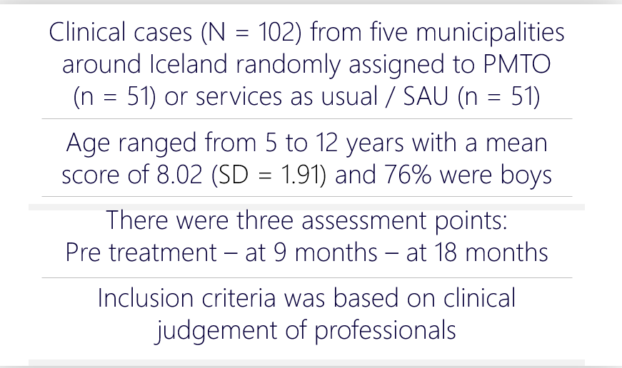
Building a Europe
for and with children
Construire une Europe
pour et avec les enfants
A RANDOMIZED CONTROLLED TRIAL (RCT)
(Sigmarsdóttir et al.,2013, 2015)

Slide 8
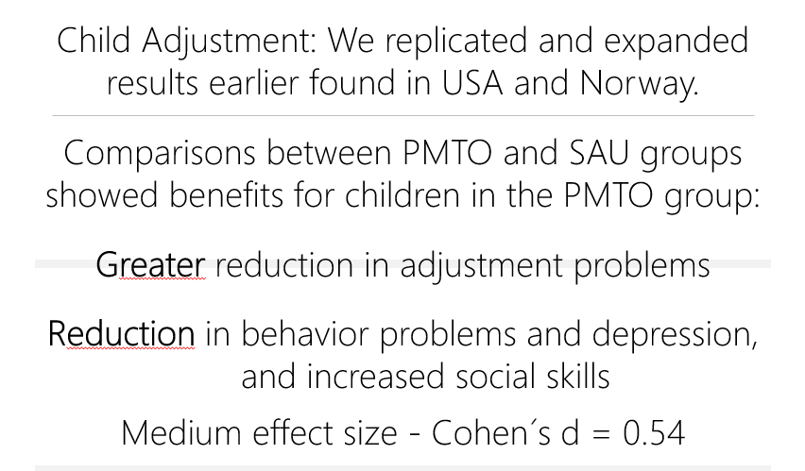
Building a Europe
for and with children
Construire une Europe
pour et avec les enfants
CHILD OUTCOME
https://onlinelibrary.wiley.com/doi/pdf/10.1111/famp.12109

Slide 9
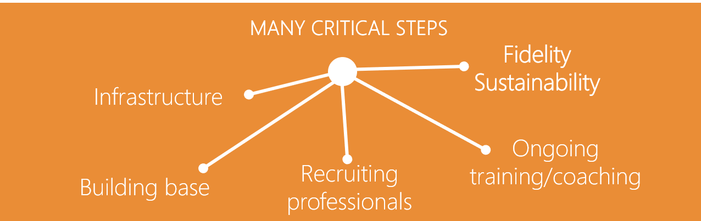
Building a Europe
for and with children
Construire une Europe
pour et avec les enfants
IMPLEMNETATION
Fixsen et al., 2005, 2020; Forgatch et al., 2013; Sigmarsdóttir et al., 2019

Slide 10
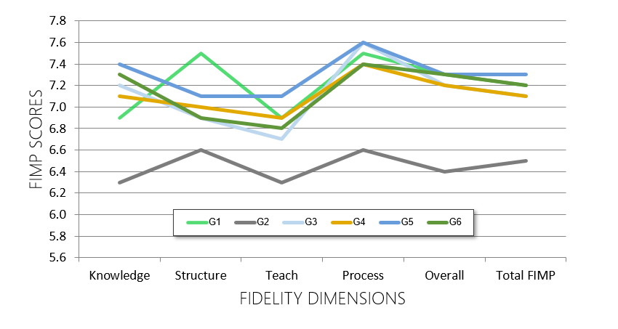
Building a Europe
for and with children
Construire une Europe
pour et avec les enfants
FIDELITY FOR PMTO OVER TIME - ICELAND
https://www.tandfonline.com/doi/pdf/10.1080/15374416.2018.1466305?casa_token=2UfKOUAyj14AAAAA:ZGNhD7Gsf-RFQbm0RqpeTJ0imZQPHE7nwqxq9KHU6gKXo8VffpcE2e5rru3RhOc1Tmlx0AQV2vmrjg

Slide 11
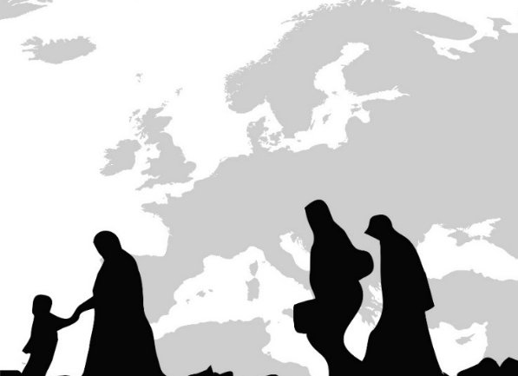




SPARE
STRENGTHENING PARENTING AMONG REFUGEES IN EUROPE
AN ADAPTATION OF THE PMTO PROGRAMME

Slide 12
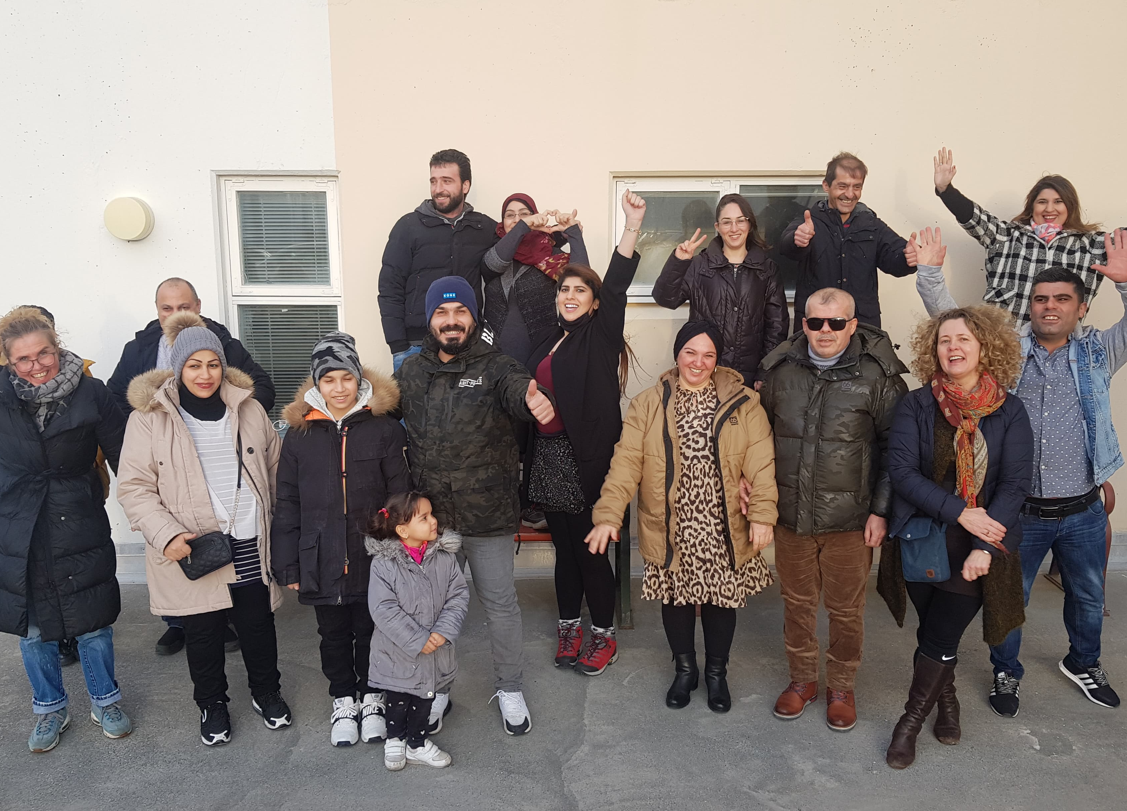
SUPPORT AND RESULTS
MAIN SUPPORT: Nordplus – 2019 Erasmus – 2020
Results from groups within each nation
From all Groups in all nations

Slide 13
Building a Europe
for and with children
Construire une Europe
pour et avec les enfants
IDEAS ABOUT FEASIBILITY OF SPARE IN ICELAND
GROUP 1
N=12 Parents
Age range 2-18
70% Certified
73% Attendance
85% Involvement
94% Satisfaction
GROUP 2
N=13 Parents
Age range 2-18
80% Certified
90% Attendance
80% Involvement
96% Satisfaction
GROUP 3
N=15 Parents
Age range 2-18
80% Certified
90% Attendance
90% Involvement
90% Satisfaction
There are pre / post measures for groups 2 and 3 that show positive effects.
Jakobsdóttir, Sigmarsdóttir, & Njarðvík, In Press

Slide 14

Building a Europe
for and with children
Construire une Europe
pour et avec les enfants
DEVELOPMENT STATUS
WE ADAPTED AND
TESTED
GOVERNMENTAL INVOLVEMENT- TODAY THE PROGRAM IS IN TWO PARTS
WE STARTED
IN ONE COMMUNITY
THE INITIATER IN ICELAND IS NOW LOCATED AT THE NATIONAL UNIVERSITY IN THE COUNTRY
A STRONG EVIDENCE BASED PROGRAMME
THANK YOU
margr@hi.is

