Slide 1
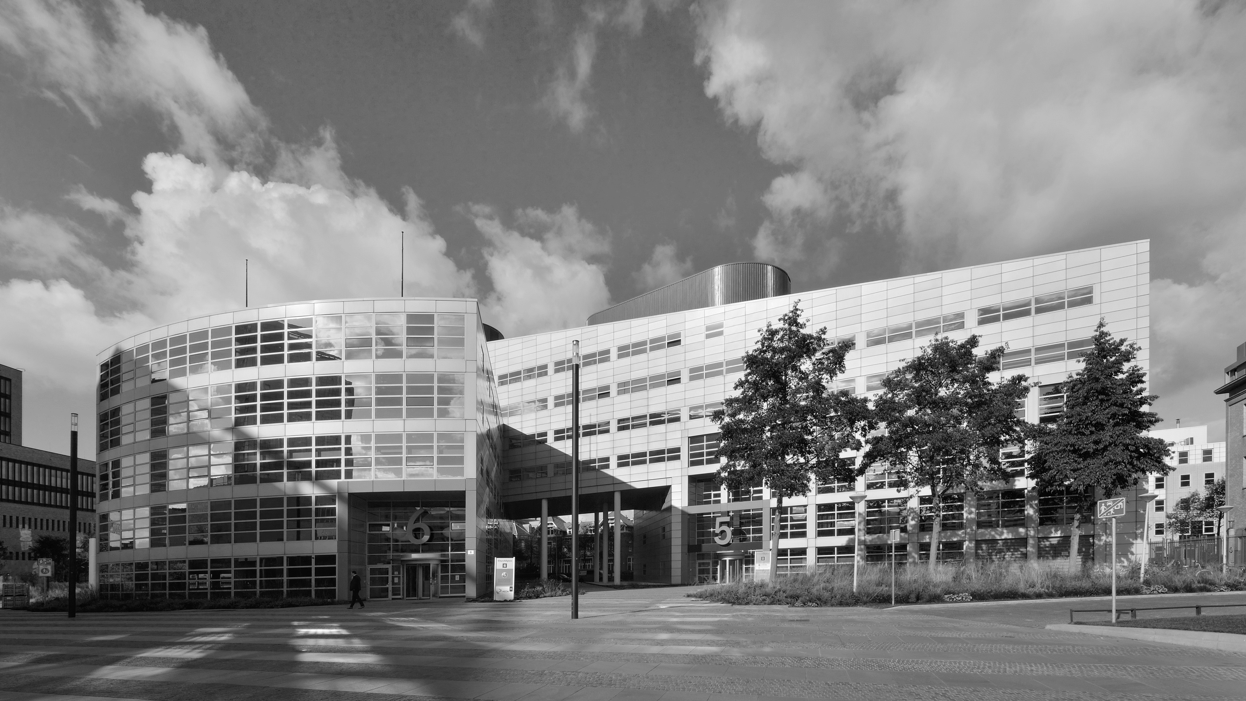


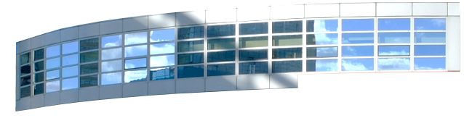
Responsibility of the Sending and Receiving State for Safeguarding the Rights of the Child
Building a Europe
for and with children
Construire une Europe
pour et avec les enfants
Council of Europe Committee for the Rights of the Child
Regional Discussion on Children’s Rights and Alternative Care
1 June 2021
Dr Gérardine Goh Escolar
First Secretary
HCCH

Slide 2







Building a Europe
for and with children
Construire une Europe
pour et avec les enfants
Regional Discussion on
Children’s Rights and Alternative Care
PLEASE USE FONT Calibri 28

Slide 3
Building a Europe
for and with children
Construire une Europe
pour et avec les enfants
Regional Discussion on
Children’s Rights and Alternative Care
If Article 33 is not complied with, authorities can refuse to recognise measures of protection on alternative care taken by another State.
How does the 1996 Child Protection
Convention work in alternative care?
Art 3(e):
applies to
children
whose
parents are
unable to
provide care
Obligatory
consultation among
the involved
Contracting States
Central Authority of
Sending State must
transmit a report on the
child, together with the
reasons for the placement
Central Authority of
the receiving State
must consent, taking
into account the best
interests of the child
Art 33: Specific obligations arise when an
authority is contemplating a child's placement
1996 Child Protection Convention: Arts 3 and 33

Slide 4




Building a Europe
for and with children
Construire une Europe
pour et avec les enfants
Regional Discussion on
Children’s Rights and Alternative Care
Unaccompanied and separated children
Refugee children
Children subject to cross-border trafficking
and other forms of exploitation
Children (temporarily)
travelling alone
The 1996 Child Protection Convention applies to

Slide 5

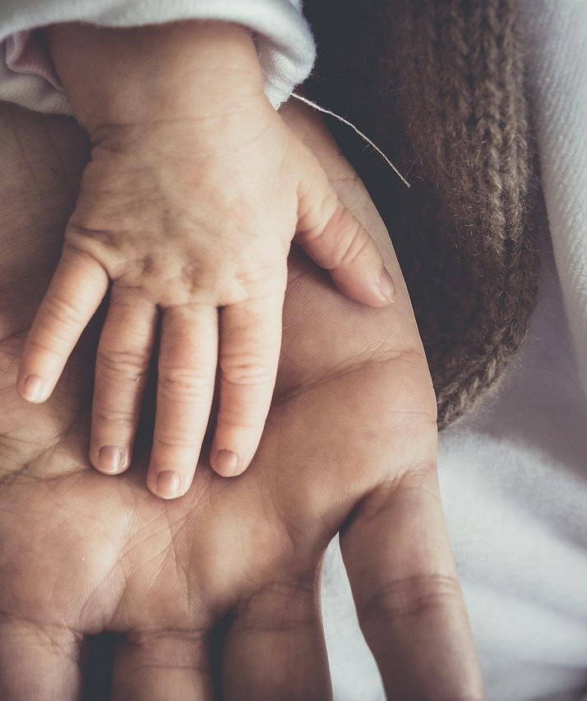

Building a Europe
for and with children
Construire une Europe
pour et avec les enfants
Regional Discussion on
Children’s Rights and Alternative Care
Adoption
Contested parental-child links
Public measures regarding
education or health
The Convention does not apply to

Slide 6



Building a Europe
for and with children
Construire une Europe
pour et avec les enfants
Regional Discussion on
Children’s Rights and Alternative Care
Practical Examples of the Use of the 1996 Child Protection Convention
#1: Child whose parents living in the country are no longer able to take care, and there is a relative abroad willing to
take care
#3: Unaccompanied and
separated children
#4: Kafala - Question of
another State's
compliance with Art 33 of the 1996C
#2: Delegation of
parental responsibility
#5: Child (temporarily)
travelling alone

Slide 7
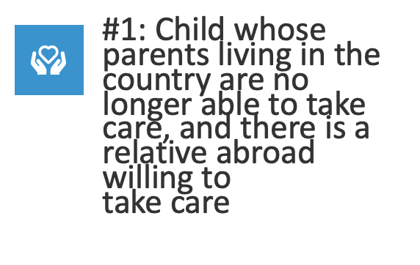
Building a Europe
for and with children
Construire une Europe
pour et avec les enfants
Regional Discussion on
Children’s Rights and Alternative Care
Practical Examples of the Use of the 1996 Child Protection Convention
#1: Child whose parents living in the country are no longer able to take care, and there is a relative abroad willing to
take care
#3: Unaccompanied and
separated children
#4: Kafala - Question of
another State's
compliance with Art 33 of the 1996C
#2: Delegation of
parental responsibility
#5: Child (temporarily)
travelling alone

Slide 8





Building a Europe
for and with children
Construire une Europe
pour et avec les enfants
Regional Discussion on
Children’s Rights and Alternative Care
Practical Example #1: Child whose parents living in the country are no longer able to take care, and there is a relative abroad willing to take care
Cooperation
between
Central
Authorities
Jurisdiction
Request
Meeting &
Verification
Decision
Consideration of long-term
placement of
child for care
abroad
Communica-tion
Detailed report with reasons of
placement, and reasons
placement is in the child's best interests
Meeting with
proposed
caretaker
Report of
assessment
Confirmation of
consent to
placement
Cooperation
regarding the
child's move
Contact
arrangements
Decision
concerning
placement
Decisions
concerning
contact
Recognition by operation of law

Slide 9

Building a Europe
for and with children
Construire une Europe
pour et avec les enfants
Regional Discussion on
Children’s Rights and Alternative Care
Practical Examples of the Use of the 1996 Child Protection Convention
#1: Child whose parents living in the country are no longer able to take care, and there is a relative abroad willing to
take care
#3: Unaccompanied and
separated children
#4: Kafala - Question of
another State's
compliance with Art 33 of the 1996C
#2: Delegation of
parental responsibility
#5: Child (temporarily)
travelling alone

Slide 10
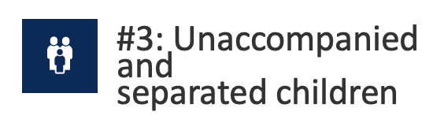
Building a Europe
for and with children
Construire une Europe
pour et avec les enfants
Regional Discussion on
Children’s Rights and Alternative Care
Practical Examples of the Use of the 1996 Child Protection Convention
#1: Child whose parents living in the country are no longer able to take care, and there is a relative abroad willing to
take care
#3: Unaccompanied and
separated children
#4: Kafala - Question of
another State's
compliance with Art 33 of the 1996C
#2: Delegation of
parental responsibility
#5: Child (temporarily)
travelling alone

Slide 11

Building a Europe
for and with children
Construire une Europe
pour et avec les enfants
Regional Discussion on
Children’s Rights and Alternative Care
Practical Examples of the Use of the 1996 Child Protection Convention
#1: Child whose parents living in the country are no longer able to take care, and there is a relative abroad willing to
take care
#3: Unaccompanied and
separated children
#4: Kafala - Question of
another State's
compliance with Art 33 of the 1996C
#2: Delegation of
parental responsibility
#5: Child (temporarily)
travelling alone

Slide 12
Building a Europe
for and with children
Construire une Europe
pour et avec les enfants
Regional Discussion on
Children’s Rights and Alternative Care
Switzerland: 5A_341/2020 17.11.2020 (bger.ch). « Le Tribunal fédéral confirme le refus de la Cour de justice de Genève de reconnaître une kafala alors que l’art. 33 n’a pas du tout été respecté. Les parents avaient obtenu une kafala au Maroc sans mentionner du tout leur lien avec la Suisse. La femme vit au Maroc avec les enfants depuis le début, dans l’attente de pouvoir entrer en Suisse et, un jour, les adopter. »
Practical Examples of the Use of the 1996 Child Protection Convention
#1: Child whose parents living in the country are no longer able to take care, and there is a relative abroad willing to
take care
#3: Unaccompanied and
separated children
#4: Kafala - Question of
another State's
compliance with Art 33 of the 1996C
#2: Delegation of
parental responsibility
#5: Child (temporarily)
travelling alone

Slide 13

Building a Europe
for and with children
Construire une Europe
pour et avec les enfants
Regional Discussion on
Children’s Rights and Alternative Care
Practical Examples of the Use of the 1996 Child Protection Convention
#1: Child whose parents living in the country are no longer able to take care, and there is a relative abroad willing to
take care
#3: Unaccompanied and
separated children
#4: Kafala - Question of
another State's
compliance with Art 33 of the 1996C
#2: Delegation of
parental responsibility
#5: Child (temporarily)
travelling alone

Slide 14




Building a Europe
for and with children
Construire une Europe
pour et avec les enfants
Regional Discussion on
Children’s Rights and Alternative Care
Challenges when considering alternative care
Time frame of requests
when sent from an
overseas CA (Australia)
Kafala already
advanced in requested
states before consent
was given by the CA
(France, Netherlands)
Differences of
Legislation (Finland)
Determining which
documents follow the
demand of placements/
Kafala (Belgium)
Lack of equivalent
mechanisms, e.g.
supervisory
mechanisms (UK)
Financial costs of
alternative placements
(Germany)
Application of Brussels
II Regulation for EU
countries (Czech
Republic, Austria,
Sweden)
Lack of consultation
with requested state/
pre-contact (Morocco,
Norway)
Frequently requesting
States are not aware of
the requirements under Article 33 (Norway,
Switzerland)

Slide 15
Building a Europe
for and with children
Construire une Europe
pour et avec les enfants
Regional Discussion on
Children’s Rights and Alternative Care
Safeguarding the rights of the child in alternative care placements: K, T and U (Placement of Children with Kinship Carers Abroad) [2019] EWFC 5
"45. There may be a perception that a placement abroad will raise more complex issues than a potential placement within the UK or that a placement within a country that is not signatory to BIIa or The Hague Convention 1996 will prove more problematic than a placement to such a country. Different issues are certainly likely to arise, but complexity is likely to exist whichever country is involved. The 2018 CFAB Report highlighted difficulties in securing collaboration with the receiving jurisdiction where the proposed placement was in Scotland and in Northern Ireland. What was said to make the difference was not whether the country was part of the UK, a signatory to Brussels IIa or The Hague Convention, but the attitudes and processes in the other country and the "ability to establish an effective, direct point of contact".

Slide 16
Building a Europe
for and with children
Construire une Europe
pour et avec les enfants
Regional Discussion on
Children’s Rights and Alternative Care
Safeguarding the rights of the child in alternative care placements: Case C-129/18 , CJEU
The Preliminary Ruling mentioned the 1996 Hague Convention as part of the international legal context of the case (at paras [6]-[10]).
It also mentioned that, in connection to the risk assessment that national authorities must make, authorities cannot assume that there will be the risk of abuse, exploitation or trafficiking of the child simply because the Algerian kafala system is based on an assessment of the suitability of the adult and of the interests of the child which is less extensive than the procedure carried out in the host Member State for the purposes of an adoption or the placement of a child.
Similarly, such risks also cannot be taken for granted just because the procedure provided for in the 1996 Hague Convention has not been applied because that convention was not ratified by the third country concerned. On the contrary, authorities must weigh these observations against the other relevant elements of fact. (at para 70).

Slide 17
Building a Europe
for and with children
Construire une Europe
pour et avec les enfants
Regional Discussion on
Children’s Rights and Alternative Care
Safeguarding the rights of the child in alternative care placements: Communication 12/17, UN Committee on the Rights of the Child
The case is based on the 1996C as a legal recognition of the importance of kafala as a measure of protection of the child and for the recognition of a family tie.
In consideration of the merits, the Committee looked into the question of whether the best interest of the child had been considered by the State who had refused to issue a humanitarian visa to a child under the kafala regime.
The Committee considered the specific facts pertaining to the individual child in this case.

Slide 18


Building a Europe
for and with children
Construire une Europe
pour et avec les enfants
Regional Discussion on
Children’s Rights and Alternative Care
Safeguarding the rights of the child in alternative
care placements
Acts before the child is placed in alternative care abroad
Guarantees that there is an
agreement between receiving and sending States before the child is
sent abroad
Allows for exchange of information and careful examination of the
particular situation of the child
Creates international obligations for contracting parties whenever placing
a child in any form of alternative care abroad
It can also help to decide that it is best for the child not to be placed in alternative care abroad

Slide 19
Building a Europe
for and with children
Construire une Europe
pour et avec les enfants
Regional Discussion on
Children’s Rights and Alternative Care
Relevance of the mechanism of cooperation of Central Authorities
Exchange of
information and mutual assistance during care
proceedings involving
more than one
jurisdiction
Liaise with other
governmental and
non-governmental
stakeholders
Facilitate agreed
solutions for the
protection of the person or property of the child

Slide 20






Building a Europe
for and with children
Construire une Europe
pour et avec les enfants
Regional Discussion on
Children’s Rights and Alternative Care
The HCCH 1996 Child Protection Convention…
Enables direct communications between the relevant authorities
1
2
Establishes clear obligations for sending and receiving States
3
Avoids conflicting decisions regarding alternative care and parental responsibility
4
Protects the right of the child to
be heard
5
Uses concepts independent of the legal system in each jurisdiction involved
6
Encompasses different legal traditions regarding child care

Slide 21
Thank you
Building a Europe
for and with children
Construire une Europe
pour et avec les enfants
Council of Europe Committee for the Rights of the Child
Regional Discussion on Children’s Rights and Alternative Care
1 June 2021
Dr Gérardine Goh Escolar
First Secretary
HCCH

