Slide 1
Building a Europe
for and with children
Construire une Europe
pour et avec les enfants
Regional Discussion on
Children’s Rights and Alternative Care
1 June 2021

Slide 2
Building a Europe
for and with children
Construire une Europe
pour et avec les enfants
Regional Discussion on
Children’s Rights and Alternative Care
“Concluding Remarks”
George Nikolaidis
Psychiatrist, MD, MA, MSc, PhD
Director, Department of Mental Health and Social Welfare,
Institute of Child Health, Greece
Former Chair and member of the Lanzarote Committee

Slide 3
Building a Europe
for and with children
Construire une Europe
pour et avec les enfants
Regional Discussion on
Children’s Rights and Alternative Care
We do not need to begin from scratch!
CoE’s previous documents on the rights of children deprived from parental care (examples)

Slide 4
Building a Europe
for and with children
Construire une Europe
pour et avec les enfants
Regional Discussion on
Children’s Rights and Alternative Care
CoE Recommendation Rec(2005)5 of the Committee of Ministers to member states on the rights of children living in residential institutions and the report on its implementation;
CoE Recommendation CM/Rec(2010)2 of the Committee of Ministers to member states on deinstitutionalisation and community living of children with disabilities
Resolution 1762 (2010) of Parliamentary Assembly: “Children without parental care: urgent need for action”

Slide 5
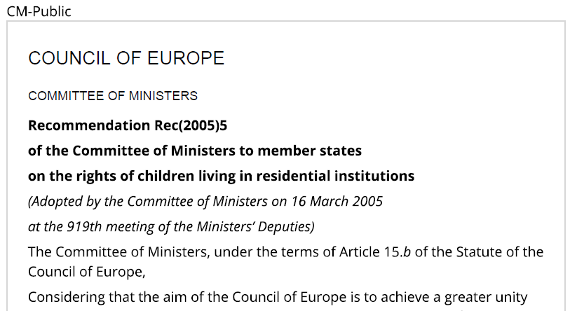
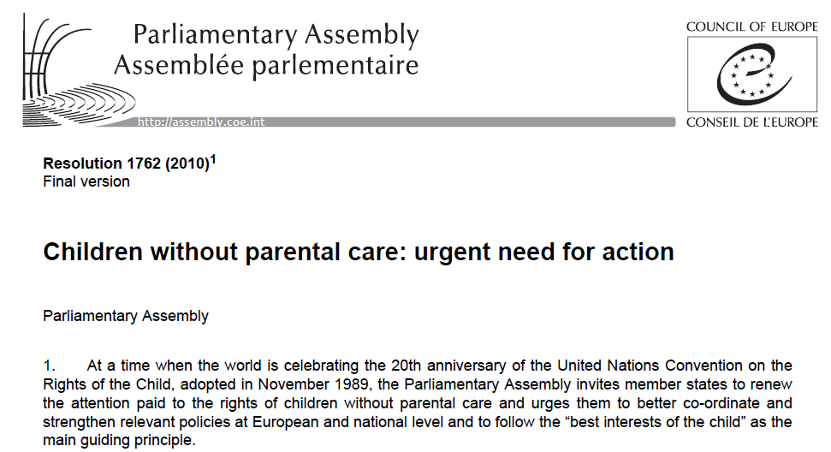
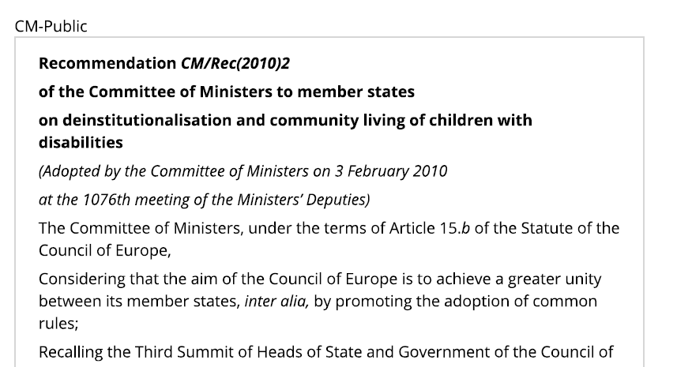
Building a Europe
for and with children
Construire une Europe
pour et avec les enfants
Regional Discussion on
Children’s Rights and Alternative Care

Slide 6
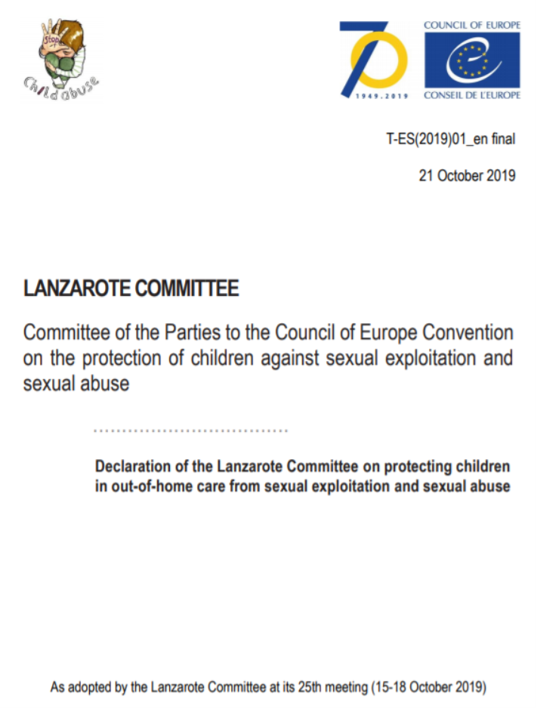
Building a Europe
for and with children
Construire une Europe
pour et avec les enfants
Regional Discussion on
Children’s Rights and Alternative Care
“ensure that in all types of out of home care settings there are:
(i) comprehensive screening procedures for all persons taking care of children;
(ii) specific measures to prevent abuse of children’s increased vulnerability and dependence;
(iii) adequate mechanisms for supporting children to disclose any sexual violence;
(iv) protocols to ensure that, in the event of disclosure, effective follow-up is given in terms of assistance to the alleged victims and investigation of the alleged offences by the appropriate authorities;
(v) clear procedures to allow for the possibility of removing the alleged perpetrator from the out of home care setting from the onset of the investigation;
(vi) effective monitoring of the practices and standards, to prevent/combat child sexual abuse;
apply the following prioritisation, where appropriate:
(i) family strengthening and support;
(ii) foster care;
(iii) supervised independent accommodation for older children or other forms of noninstitutional care;
(iv) placement in small-scale institutional units; and
(v) reform traditional institutional formats towards deinstitutionalisation and into the aforementioned types of out-of-home placement, in order to minimise the danger of sexual abuse victimisation;”

Slide 7
Building a Europe
for and with children
Construire une Europe
pour et avec les enfants
Regional Discussion on
Children’s Rights and Alternative Care
Also: European Court rulings in specific cases
Example: X and Others against Bulgaria of February 2021, in which the EC’s decision focuses on investigative and international cooperation measures while examining sexual abuse in an orphanage

Slide 8
Building a Europe
for and with children
Construire une Europe
pour et avec les enfants
Regional Discussion on
Children’s Rights and Alternative Care
Further recourses
Other international organizations’ previous documents on the rights of children deprived from parental care (examples)

Slide 9
Building a Europe
for and with children
Construire une Europe
pour et avec les enfants
Regional Discussion on
Children’s Rights and Alternative Care
The UN (64/142) Guidelines for the Alternative Care of Children (2009);
The Report of the Office of the High Commissioner for Human Rights (OHCHR): “Forgotten Europeans, Forgotten Rights – The Human Rights of Persons Placed in Institutions” (2011);
The European Commission’s Recommendation: “Investing in children: breaking the cycle of disadvantage” (2013/112/EU)
European Commission “Report of the Ad Hoc Expert Group on the Transition from Institutional to Community based Care” (2009)

Slide 10
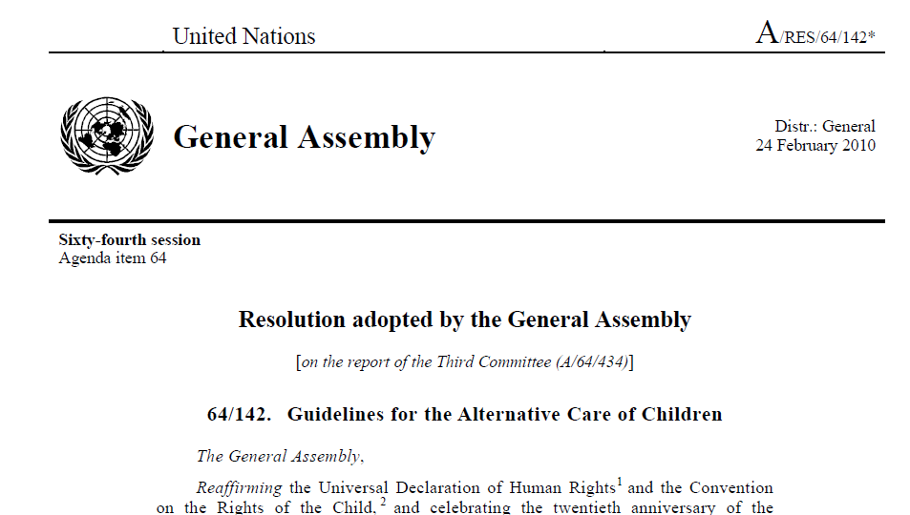
Building a Europe
for and with children
Construire une Europe
pour et avec les enfants
Regional Discussion on
Children’s Rights and Alternative Care

Slide 11
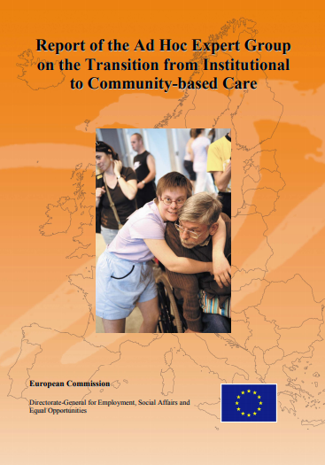
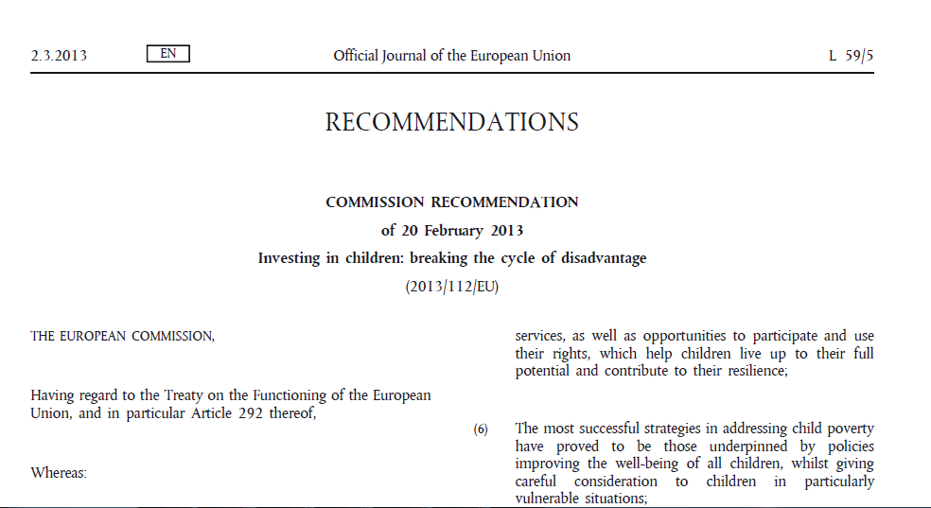
Building a Europe
for and with children
Construire une Europe
pour et avec les enfants
Regional Discussion on
Children’s Rights and Alternative Care

Slide 12
Building a Europe
for and with children
Construire une Europe
pour et avec les enfants
Regional Discussion on
Children’s Rights and Alternative Care
A recent decision made by the UN (2019) on the Anniversary of 30 years from the adoption of the CRC (UN, A74/395/27.11.2019)
An entire section on the protection of the Rights of children without parental care (paragraphs 21-35)
Special, specific and detailed references to the obligations of states to make all possible efforts for obstructing removal of children from families, promoting alternative, family-based care instead of institutional-residential care for children and for setting up quality standards and external review/monitoring systems required even in alternative care

Slide 13
Children’s Rights and Alternative Care - Discussion Input
Building a Europe
for and with children
Construire une Europe
pour et avec les enfants
Regional Discussion on
Children’s Rights and Alternative Care

Slide 14
Building a Europe
for and with children
Construire une Europe
pour et avec les enfants
Regional Discussion on
Children’s Rights and Alternative Care
Child abuse or neglect or victimization occurs in high rates in all care placements. In most occasions, “traditional” residential care institutions exhibit higher rates of violations of children’s rights compared to alternative placements in which however rates of children’s victimization are still high compared to family ones. Placing children under care within correctional/restorative facilities or forms of care, traditional or alternative, seems to be linked with increased rates of children’s rights violations and children’s victimization.
Improving the model of care to children in need is a complex procedure with emphasis on developing all necessary care and support to children and families with children in need. Transformation of the current model of care entails investment on community care services to support families and prevent children’s removal from families. That entails:
• safeguarding in all care settings;
• end to abuse writhing diff settings and learning from past abuses;
• supporting children with challenging behaviors through family and community based programs;
• children sent to formal alternative care settings across border.
Promoting deinstitutionalization should still be a priority concerning all types of child residential care regarding legal status, providers, geographical location.

Slide 15
Building a Europe
for and with children
Construire une Europe
pour et avec les enfants
Regional Discussion on
Children’s Rights and Alternative Care
Necessity to realize the same level of rights for all children including immigrant/asylum seeking children without discrimination (and without developing incommensurable systems of care for mainstream child protection on one hand and for unaccompanied minors on the other)
Necessity to intensify efforts for primary (identification of vulnerable families with children in need) and secondary (emergency intervention to enhance family reunification with safety for children) prevention of institutionalization of children
Necessity to eliminate placement into care and parental separation exclusively due to reasons such as disability, poverty and social exclusion, racial or ethnic discrimination some or other cause of difficulty in parenting.
Necessity for promoting family care by enhancing parental capacities, providing positive parenting counselling for parents and caregivers at risk of neglecting or abusing children.
Necessity for comprehensive strengthening child and social protection services, improving conditions for healthy family life, social security and housing, helping women in crisis and single, unemployed families and addressing lack of services for children with disabilities

Slide 16
Building a Europe
for and with children
Construire une Europe
pour et avec les enfants
Regional Discussion on
Children’s Rights and Alternative Care
Necessity to invest in child protection systems, address lack of professional staff, training gaps, fragmentation and under-resourcing and in overall improve their effectiveness and efficiency.
Necessity for interdisciplinary collaboration to avoid fragmentation of services and provisos that might inflict harmful effects on already vulnerable children.
Necessity for introducing evidence-based protocols for child protection services, providing systems for reporting and investigating of suspected cases of children at risk.
Necessity to safeguard rigorous standards of quality for child care including residential and alternative child care.
Necessity for effective data collection and monitoring mechanisms to supervise all types of child care, residential and alternative one.
Necessity for minimizing the average time of children’s staying into residential and alternative care by introducing appropriate social technologies and closely monitor their application.
Necessity to directly eliminate institutionalization of children under 3 years old since there is compelling evidence about the irreversible damage that such placement causes to children.

Slide 17
Building a Europe
for and with children
Construire une Europe
pour et avec les enfants
Regional Discussion on
Children’s Rights and Alternative Care
Necessity to emphasize on standardizing the criteria for removal and placement of children in order for those to confirm with the best interest of the child principles.
Necessity to inform Court decisions regarding the primacy of the best interest of the child in all cases in which there is the possibility of a child to be deprived from parental care.
The European Court has already ruled on relevant cases; however, this has to be mainstreamed throughout countries as a way of examining such issues.
Such principles should guide both public and private law spheres including not just parental deprivation in virtue of removal and placement into care but also in cases of parental separation or dispute over custody issues.
Apart from biological parents, best interest of the child perspective entails decision making to attempt to preserve as much of relationships with significant others to the child as possible.
Intersectorial and interdisciplinary collaboration seems to be important for making available to courts of law and social policy decision makers evidence from research for making evidence-based decisions regarding children’s care.
CJ/ENF-ISE is currently conducting feasibility studies/survey (open until June 4th for comments) to draft recommendations and practical implementation guidance.

Slide 18
Building a Europe
for and with children
Construire une Europe
pour et avec les enfants
Regional Discussion on
Children’s Rights and Alternative Care
Within the context of the current covid-19 pandemic and measures to respond to it things seem to have been deteriorated: rights of children in institutions are often bypassed, children in detention, immigrant/asylum seeking children seem to face discriminative additional restrictions and supervising agencies function was often disrupted.
Additionally, the pandemic per se but mostly socioeconomic, mental health and social well-being implications from emergency measures seem to increase the number of children that will be placed under care.
However, apart from challenges, there are also good practices throughout Europe that could guide interventions to secure the rights of children deprived of parental care prior and during the pandemic era.
Comprehensiveness of provided services with emphasis on training activities, establishing relationships with children in care and their social incorporation in local communities can be of paramount importance to addressing current challenges

Slide 19
Building a Europe
for and with children
Construire une Europe
pour et avec les enfants
Regional Discussion on
Children’s Rights and Alternative Care
Further to the above:
Necessity to recognize historical institutional/care abuse and provide adequate support to survivors with experience insofar by investigating committees and bodies in several countries highlighting the need for support to adult survivors of child institutional abuse; also to be offered to survivors of abuse in alternative care (bypassing also misinterpretations of personal data legislation as obstructing to that end).
Necessity to provide appropriate support (public health model being a good candidate to provide technical guidance) to children and adolescents with challenging behaviours avoiding their medicalization or criminalization since both incarceration, over-medication and hospitalization, placement in institutional care have been proved to deteriorate the situation rather than improve it; instead social incorporation, support to families and family placement as well as appropriate therapy should be provided.
Necessity to formalize and regulate all types of alternative care for children especially the ones operating outside the borders of their countries so that services providers are subjected equally to the rule of law and children enjoy also the level of protection of their rights as all children should but also all develop a step-by-step clear and unified framework (“96 convention”, Dublin Regulation…) based on the best interest of the child for all cross-border situations involving separation of children from their parents (e.g. unaccompanied/separated children, international adoption, foster placement aboard, private delegation of parental responsibility).
In overall: no child should be left behind!!!

Slide 20
Thank you very much!!! George Nikolaidis Institute of Child Health, Department of Mental Health and Social Welfare 7 Fokidos Str., 11526 Athens, Greece Email: gnikolaidis@ich-mhsw.gr ich-mhsw@otenet.gr ULR: www.ich-mhsw.gr

