Slide 1
Recommendation CM/Rec(2022)10 on multilevel policies and governance for intercultural integration
Building bridges, breaking walls
Ivana D’Alessandro
Secretary of ADI-INT
Head of the Intercultural Cities Unit
CoE Network of Focal Points on Migration
9-10 June 2022

Slide 2
The intercultural approach – ICC and CoE
 | Economic rights | Civil and social rights | Cultural rights | Community building and cohesion
Guest worker | ✔
Assimilation | ✔ | ✔
Multiculturalism | ✔ | ✔ | ✔
Interculturalism | ✔ | ✔ | ✔ | ✔

Slide 3
The intercultural approach – ICC and CoE (2)
Equality
Diversity
Meaningful interaction
Fundamental rights, anti-discrimination and equal treatment
Recognition of diversity and reciprocity
Mixing
Belonging and ownership (vicinity)
Intercultural approach
Acknowledgment
Active citizenship
Participation
Power sharing
Integration is not only about rights:
Promoting real equality
Building on the diversity advantage to create a “WE” culture based on shared values
Fostering interaction within and between
Ensuring active citizenship and participation
Integration requires policies for inclusion

Slide 4
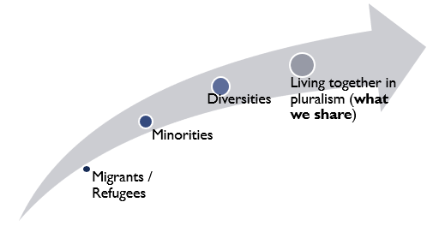
The context: Intergovernmental work
Subordinate to CDADI
1st Mandate: 2020-2021:
Promote equality and build more inclusive societies through intercultural integration and the positive management of diversity
Develop a Multilevel Policy Framework for Intercultural Integration
Promoting multilevel cooperation
Composition: 10 States and 10 Local Authorities
Committee of Ministers
State level
CDADI
Anti-discrimination, Diversity and Inclusion
Roma
Expert Committee
Combating Hate Speech
10 CDADI + 10 CDMSI
Intercultural Integration
10 States + 10 Cities

Slide 5
The context: Intergovernmental work (2)
5 meetings (Sept 2020 - Sept 2021):
Review the implementation of the recommendation on intercultural integration (CM/Rec(2015)1)
Model strategy for intercultural integration at national level
Draft recommendation on multi-level governance and policies for intercultural integration

Slide 6
Review report on the implementation of CM/Rec(2015)1
National and institutional frameworks
Multilevel cooperation
Mainstreaming at national level
Mainstreaming of equality
Top-Down: National bodies with an intercultural mandate
Constitutional provisions and legislation
Funding streams
Institutions
National Strategies/Action Plans
Top-down and bottom-up: Associations of public authorities at regional and local levels
Bottom-up: ICC National networks
Focus ensured in specific national policies
Response from 33 Member States;
Commitment to intercultural integration;
Appreciation of the importance of multi-level governance;
Actions taken to align integration policies with CM/REC(2015)1

Slide 7
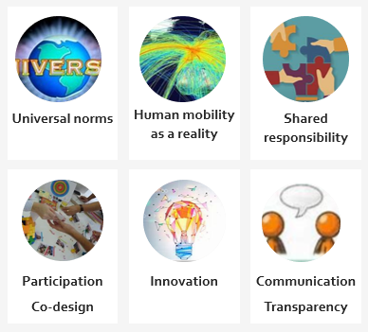
The model framework for an intercultural integration strategy
A source of knowledge, inspiration and ideas based on objective data;
A guide for practitioners involved in the design and implementation of intercultural policies;
A document based on:
CM/REC(2015)1 monitoring results
CoE standards and reports from monitoring bodies;
Member States' experience and innovation;
Conclusions of the multilevel policy workshops of the Intercultural Cities programme

Slide 8
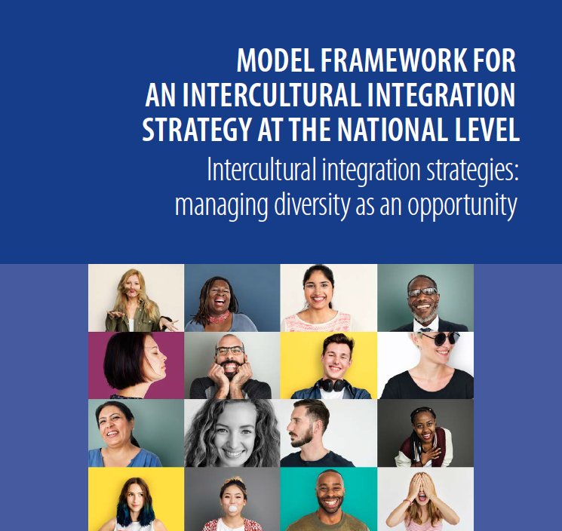
The model framework (2)
Definition of rationale and goals
Principles of intercultural integration
Policy Matrix
10 points structure

Slide 9
CM/Rec(2022)10 on multilevel policies and governance for intercultural integration
AIM
Respond to challenges identified by member states;
Enabling states to benefit from the positive results of the intercultural integration model at the local level;
Promoting multi-level governance and cooperation;
Enrich CoE standards.
Public consultation before finalisation

Slide 10
CM/Rec(2022)10: THE APPENDIX
Commitment - political leadership
Strategic vision and narrative
Common conceptual frameworks
Mainstreaming (cross-cutting / transversality) and specific policies
Participation
Resources
Permanent monitoring and evaluation of policies
Continuous training for elected officials and public staff

Slide 11
THE EXPECTED OUTCOMES
Inclusive Governance
Inclusive facilities and infrastructures
Inclusive Culture
Inclusive Communication
Inclusive Public Services
Policy
Understanding
Change
Support and engagement
Collective action

Slide 12
HOMOGENIZATION
Is one of the main risks of not recognising and acknowledging diversity. This may be due to the 'direct' imposition of a dominant group, or the result of more subtle processes marked by differences in economic, political and cultural power. In general, in the most culturally homogeneous societies, the advance towards interculturality finds greater complexities due to the difficulties of accepting and recognizing the diversity and plurality of identities on the part of the majority and / or dominant group.
RISKS OF NOT ‘MANAGING’ DIVERSITY
DISCRIMINATION
The main threat to equal rights and opportunities is discrimination. Therefore, interculturality requires a commitment and clear action against any discriminatory practice. It must be addressed both from the perspective of prevention, questioning stereotypes, prejudices, rumours and the social norms that support them, as well as from the legal and institutional sphere to address structural changes and guarantee protection and support for victims. The existence of high levels of socioeconomic inequalities added to discrimination is an important barrier to achieving real equality of opportunity.
FRAGMENTATION
The fragmentation of society into different groups that hardly interact with each other is another of the risks and consequences of not generating links and shared sense of belonging. Society can fragment as a result of the indifferent coexistence of groups closed in on themselves; by the segregation of certain groups motivated by processes of discrimination and exclusion. Fragmentation may also be due to an increase in social polarization and the tendency to create multiple subgroups separated by identity nuances that end up leading to insurmountable walls, generating attitudes of mistrust and hostility.

Slide 13
ADI-INT 2022-2025
Capacity building programme
Legal/Benchmarking tool for inclusion
Implement new Rec
Notes:
Since the adoption of CM/Rec(2022)10 intercultural integration has become the standard model for state-level policies. The next four years will be a turning point in co-operation work aimed at increasing states’ capacity to implement the standards and recommendations made in the field of migrant integration, but also to develop a holistic approach and tools for inclusion.
Renewed membership (regions)
4 years mandate

