Slide 1
Bioethics: A path forward to face future challenges
Vardit Ravitsky, PhD
President, The Hastings Center
@VarditRavitsky

Slide 2
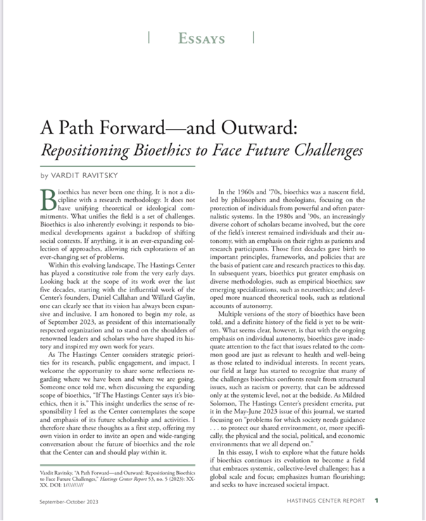

Slide 3
where we have been where we are going
Bioethics 3.0 ?

Slide 4
where we have been where we are going
1960s and ‘70s: a nascent field, led by philosophers and theologians, focusing on the protection of individuals from powerful and often paternalistic systems
1980s and ’90s: increasingly diverse cohort of scholars involved, but the core of the field’s interest remained individuals and their autonomy

Slide 5
where we have been where we are going
In subsequent years –
greater emphasis on diverse methodologies (empirical bioethics)
emerging specializations (neuro-ethics)
more nuanced theoretical tools (relational autonomy)

Slide 6
where we have been where we are going
However, with the ongoing emphasis on individual autonomy
we gave inadequate attention to the fact that issues related to the common good
are just as relevant to health and well-being as those related to individual interests

Slide 7
Repositioning bioethics – why now?
Lessons of the pandemic
Existential and global challenges
climate change, inequity, polarization, misinformation, trust, AI
Recognition of
The relevance of bioethics
The gaps in our scholarship & impact
AI as an example of the need to be responsive

Slide 8
Repositioning bioethics – the ‘scope’ debate
The risk of diluting expertise & effectiveness
Stick to patient care, healthcare delivery, emerging biotech, biomedical research
The need to expand for timely needed work
Reinvigorating insights that were eclipsed early in our history
Callahan’s common good
Potter’s ecological and global bioethics
Jonas’ responsibility for the whole of nature & future generations

Slide 9
A possible future
Explore what the future holds if bioethics continues its evolution to become a field that
embraces systemic, collective-level challenges
has a global scale and focus
emphasizes human flourishing
seeks to have increased societal impact
I offer this vision to invite an open and wide-ranging conversation about the future of bioethics

Slide 10
A path forward – and outward
From individual to collective-level issues
From local to global
From human health to human flourishing
From scholarship to impact
From a field to a hub

Slide 11
A path forward – and outward
From individual to collective-level issues
From local to global
From human health to human flourishing
From scholarship to impact
From a field to a hub

Slide 12
From individual to collective-level issues
Need to acknowledge -
familial, cultural, organizational, and societal contexts that must be considered
ethical dimensions of social determinants of health and of health disparities
resource-allocation challenges are present in every aspect of health care
our conceptual tools for addressing issues of justice, fairness, and equity are underdeveloped and need to become much more sophisticated

Slide 13
From individual to collective-level issues
Shift -
from negative rights and the protection of the individual against systemic forces
to a consideration of positive rights, to asking what humans owe each other

Slide 14
From individual to collective-level issues
From -
research ethics principles focused on protection from exploitation
to those addressing the right to be included in research
to solidarity and a possible responsibility to participate in research

Slide 15
From individual to collective-level issues
The Covid-19 pandemic was a dramatic wake-up call for bioethics
We needed public health ethics principles to cope with tensions between indi­vidual freedoms and the common good
lockdowns, curfews, school closures, or vaccine mandates
Theories of justice and resource-al­location frameworks were needed to feed into policies sur­rounding
triage protocols, national vaccination priorities, and the debate regarding vaccine nationalism versus global vaccine equity

Slide 16
A path forward – and outward
From individual to collective-level issues
From local to global
From human health to human flourishing
From scholarship to impact
From a field to a hub

Slide 17
From local to global
New, epidemiological, meaning to the notion of the global village
Other challenges that are coming our way, giving additional mean­ings to the notion of an interconnected world
digital economy and the integration of artificial intelligence (AI) into every aspect of human lives

Slide 18
From local to global
Normative concepts of global justice, equity, solidarity, and what all human beings owe each other
move be­yond the focus on the values of individuals
and of the dif­ferent communities and cultures in which individuals are situated
to those that undergird a truly global bioethics
Thinking globally also means learning to take diver­sity seriously

Slide 19
A path forward – and outward
From individual to collective-level issues
From local to global
From human health to human flourishing
From scholarship to impact
From a field to a hub

Slide 20
From human health to human flourishing
move beyond a focus on human health
set the more ambitious goal of exploring the conditions for hu­man flourishing
Attention to factors such as race, indigeneity, gender, sexuality, and disability are crucial for understanding and overcoming the systems of oppression that stand in the way of the flourishing of all
more ambitious bioethics should be about removing barriers to flourishing and build­ing societies that promote it

Slide 21
From human health to human flourishing
…poverty, racism, war, global warming, misinfor­mation, gun violence, domestic violence, homelessness, threats to de­mocracy…..
Are these ‘bioethical issues’?

Slide 22
A path forward – and outward
From individual to collective-level issues
From local to global
From human health to human flourishing
From scholarship to impact
From a field to a hub

Slide 23
From scholarship to impact
Bioethics -
Produced superb scholarship and a lit­erary canon
Built a rich and nuanced knowledge base, both conceptual and empirical
used this expertise to contribute to decision-making
engage regularly with the media and mak­e genuine efforts to make bioethics more accessible to the general public
But - at the end of the day, mainstream bioethics resides in the academic world

Slide 24
From scholarship to impact
Acknowledge impact as a core mission, one of equal value to scholarship
Impact can mean various things:
policy development
implementation of recommendations
public engagement and education
mainstream and social media

Slide 25
From scholarship to impact
Such contributions should not be seen as pe­ripheral to our mission
They should be key considerations in how we
train bioethicists
formulate our research questions and write our grant proposals, e
valu­ate our achievements
Going forward, we should acknowledge the importance of impact and design our field to meet its challenges.

Slide 26
A path forward – and outward
From individual to collective-level issues
From local to global
From human health to human flourishing
From scholarship to impact
From a field to a hub

Slide 27
From a field to a hub
We mapped the regions of our terri­tory:
delineated specialties such as clinical ethics, research ethics, and public health ethics
identified subfields of in­terest, such as reproductive ethics, animal ethics, and now AI ethics

Slide 28
From a field to a hub
I propose the metaphor of bioethics as a hub – building bridges beyond our own territory, beyond interdisciplinar­ity, to become a convening force that operates as a hub
expanding its mission and scope in the ways I described means that we need even more players
does not mean that all these players should be seen as, or define themselves as, bioethicists
means that we are recognized enough to use our convening power and become a hub of thinking and activity

Slide 29
A path forward – and outward
From individual to collective-level issues
From local to global
From human health to human flourishing
From scholarship to impact
From a field to a hub
Let’s discuss!

