Slide 1

The Council of Europe’s Reference Framework of Competences for Democratic Culture
Călin Rus
Intercultural Institute, Timisoara, Romania

Slide 2
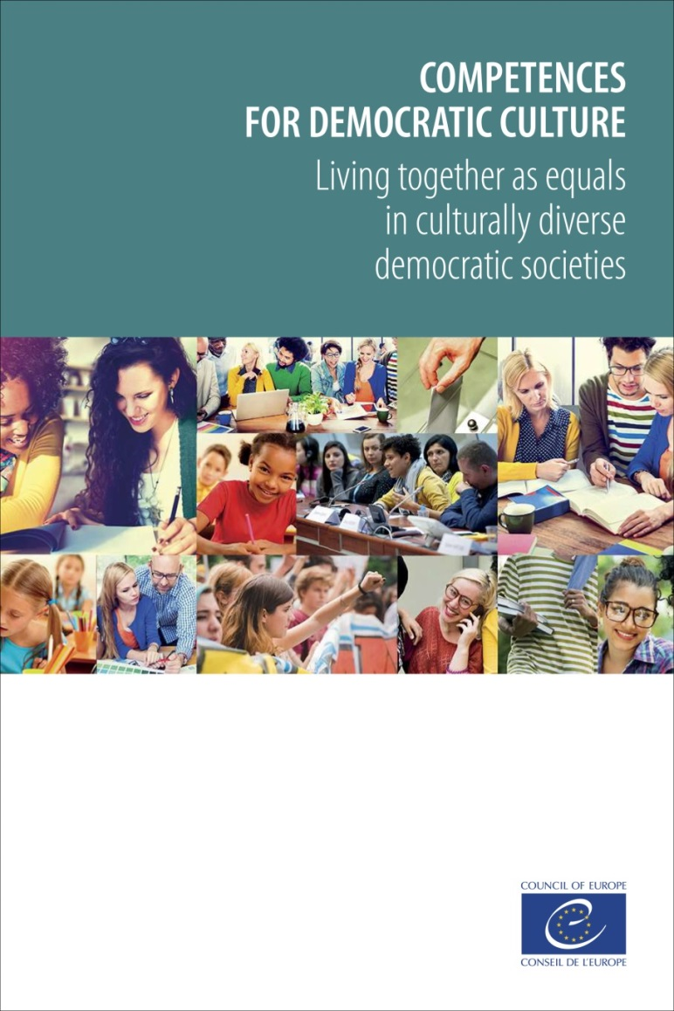
The Reference Framework of CDC
Compatible with the mission of the Council of Europe and builds on the previous work in education
Developed by the Council of Europe and aimed at all levels of education
Endorsed by the Ministers of Education in CoE members states in Brussels (April 2016) and Nicosia (March 2017)
Seen as a contribution of education to the current challenges faced by the European societies
www.coe.int/competences

Slide 3
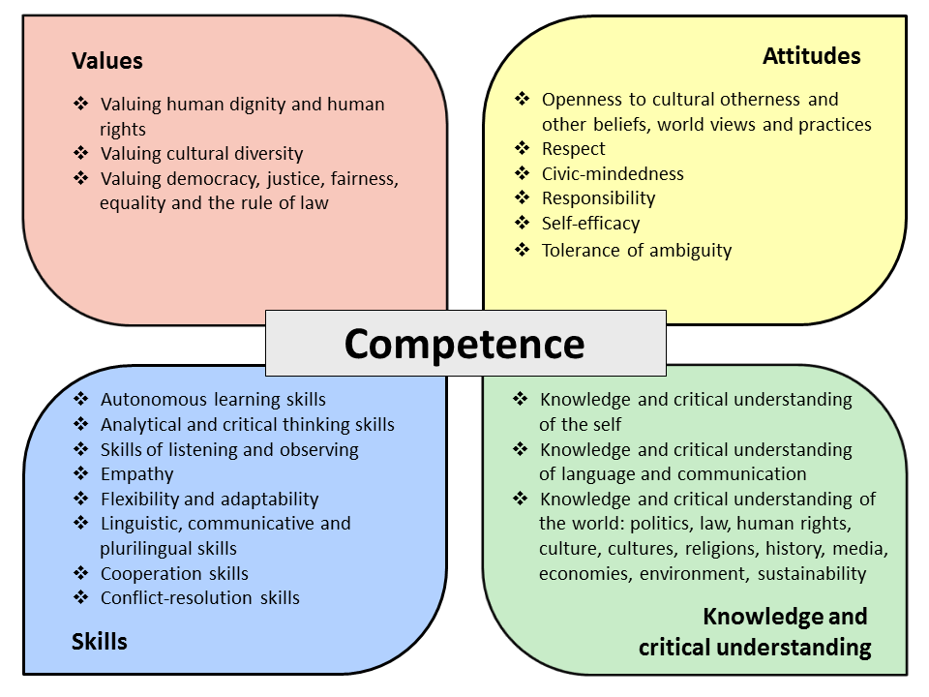

Slide 4
CDC and ETINED
Awareness: the harm generated by corruption, fraud, and unethical behaviour in education
Reacting to corruption, fraud, and unethical behaviour in education
Promoting ethics, transparency and integrity in education

Slide 5
CDC and ETINED
Awareness: the harm generated by corruption, fraud and unethical behaviour in education
Valuing fairness and equality
Valuing the human rights and the rule of law
Civic-mindedness
Responsibility
Empathy
Valuing human dignity and respect
Valuing cultural diversity
Skills of listening and observing
Analytical and critical thinking skills
Critical understanding, including critical understanding of communication, culture, cultures, religion, and of the media

Slide 6
CDC and ETINED
Reacting to corruption, fraud and unethical behaviour in education
Valuing human dignity and human rights: distinction between people and behaviour
Valuing justice, equality, fairness and the rule of law: respecting rules but maintaining presumption of innocence.
Cooperation and conflict resolution skills
Respect
Responsibility
Empathy
Tolerance of ambiguity
Self-efficacy

Slide 7
CDC and ETINED
Promoting ethics, transparency and integrity in education
  Addressing ethics, transparency and integrity develops CDC
  Promoting CDC enhances ethics, transparency and integrity
  Whole-school / whole-institution approach based on CDC: democratic and ethical governance and management of the education system and educational institutions;
  Codes of ethics, ethics committees, university charters
  Debate, consultation, not just imposing rules
  Fair treatment, prompt reaction, transparent procedures and response, role models
  Recognising progress
  Effects beyond education, in society

