Slide 1
The annual employee appraisal
as planning tool

Slide 2
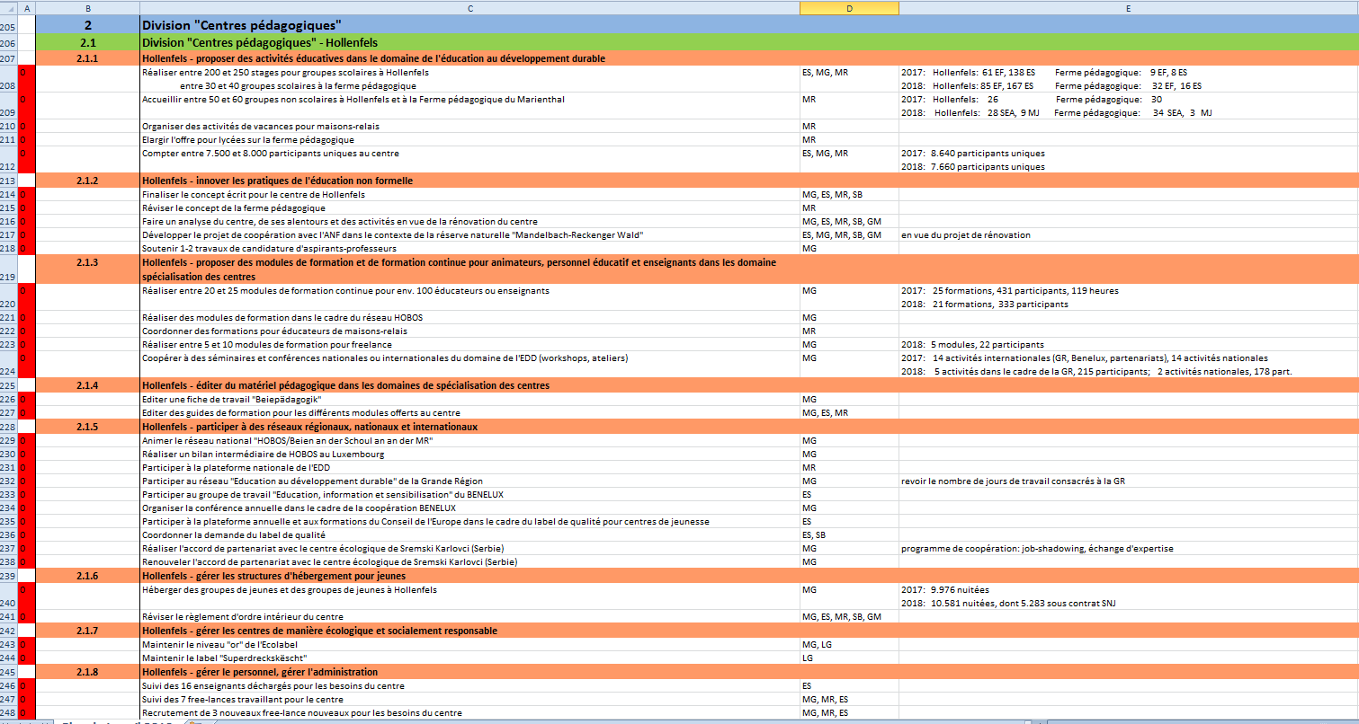

Slide 3
Quality cycle
Planning: develop work plan, setting targets
Doing: implementing the services and activities
Checking: reviewing the work & evaluating
Acting: adapting processes and programmes
Notes:
These appraisal talks are a planning tool in that sense that they cover different steps in the quality cycle. -- explain

Slide 4
Annual employee appraisal
In the beginning of each year
Individual conversation
Based on a template from the public administration (form)
Integration of the goals in the overall annual program for the service
Notes:
Preferably during the first 2 months
Done by the head of division or the coordinataor of a section
Duration depends on the need for discussion can be just 30min or more
The manager fills out the form after the talk and sends it for approuval to the employee
Signature of the form by employee, head of division, and director of the service
Each receive a copy, this one will also be used for the employee appraisal for next year

Slide 5
Annual employee appraisal
Overall objective:
Retrospective of the last year
Lay down personal and professional goals for the coming year
Notes:
- Evaluation
Planning
Top down & bottom up: some goals are imposed by politics, by certain necessities or priorities of the service. Most of them are the outcome of the employee appraisal.

Slide 6
Annual employee appraisal
Content:
Goals from the past years
Defining goals for the coming year
Professional development
Satisfaction
Wishes for in-service mobility
Comments
Notes:
The different topics will be treated in this order
Go into depths on my next slides

Slide 7
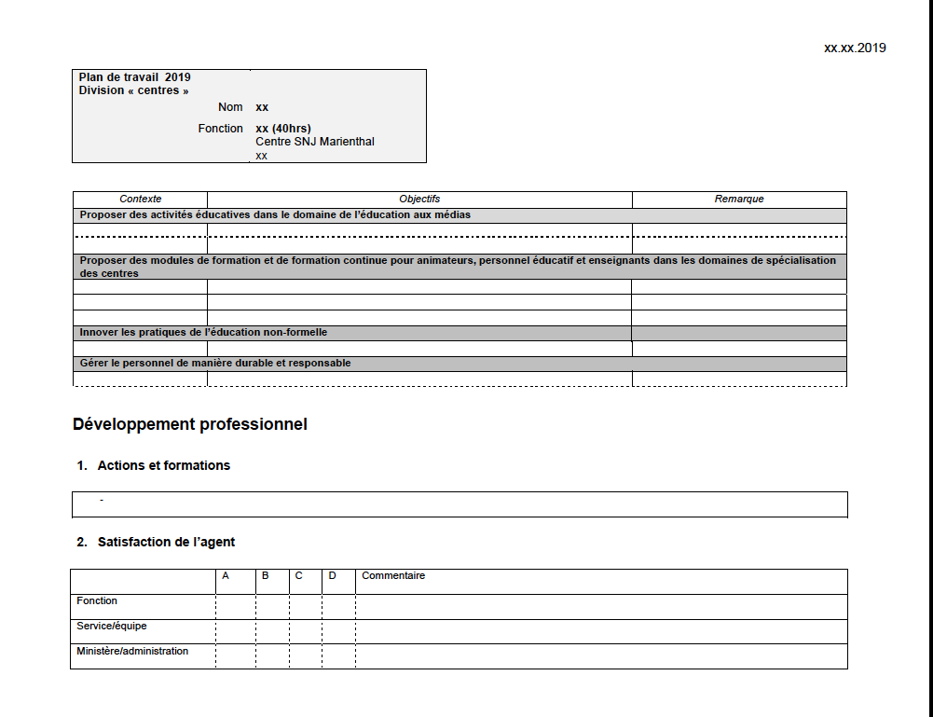

Slide 8
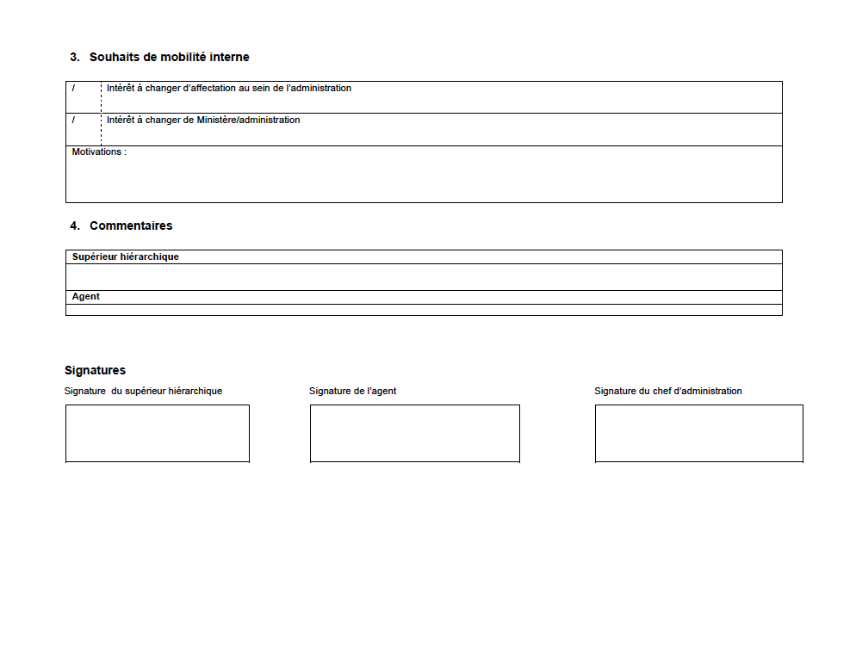

Slide 9
Annual employee appraisal – goals from last year
…as a tool for the manager:
Why could certain goals not be reached? - Problems with the task itself? - The situation has changed? - Needs for training - Personal problems of the staff member?
What is realistic?
What works good?
Feedback for the staff member (recognition)
…as a tool for the staff member:
Inform the manager about issues, changes, needs for action (bottom-up)
Feedback for the manager : receive a sincere assessment of his or her work

Slide 10
Annual employee appraisal – goals for next year
…as a tool for the manager:
Communicate new developments in the service (changing priorities, budget…)
Defining new realistic goals together with the staff member
…as a tool for the staff member:
Communicate ideas for future projects/activities (bottom-up)
Knowing your concrete tasks for the coming year (what is expected from me?)
Guidance in the definition of priorities
Tool that can be used throughout the year to « stay on track » and to track progress.
Notes:
- Readapt to new situation, subjects, priorities

Slide 11
Annual employee appraisal – development
…as a tool for the manager:
Identify needs for training based on the evaluation of the past year, new developments, changes in the mission.
Give necessary support to employees.
…as a tool for the staff member:
Communicate needs for trainings, study visits

Slide 12
Annual employee appraisal – satisfaction
…as a tool for the manager:
Build a relationship of trust
Identify the different reasons for eventual dissatisfaction
Detect lacks in communication
Direct feedback for the manager
Insight into the ambiance in the different teams
Finding solutions together (motivation)
…as a tool for the staff member:
Opportunity to speak openly about frustration, difficulties in dealing with certain situations or needs in regard of his or her personal and professional evolution

Slide 13
Annual employee appraisal – in-service mobility
…as a tool for the manager:
Know beforehand when an employee thinks about changing the job
Giving staff members the opportunity to evolve in a different context.
Keep good people in your service.
…as a tool for the staff member:
Inform the manager about the need for a new challenge
Get the opportunity to stay in the same administration/organisation
Notes:
- Plan departure, adapt missions etc

Slide 14
Annual employee appraisal – comments
…as a tool for the manager:
Keep track of comments that have been made during the discussion (track evolution)
…as a tool for the staff member:
Documentation of importants remarks
Notes:
- For employee: Gives the employee the reassurance that the information will not be lost, and that issues will be readressed

Slide 15
Advantages
The appraisal talk needs a beforehand reflection from both sides
Collaborate search for ideas, solutions and defining goals in a collaborate process (bottom-up)
Get a sincere assessment of your own work (employee and manager)
Have anchor points that help tracking progress on professional and personal level
Feed the general annual plan of the service/organisation

