Slide 1


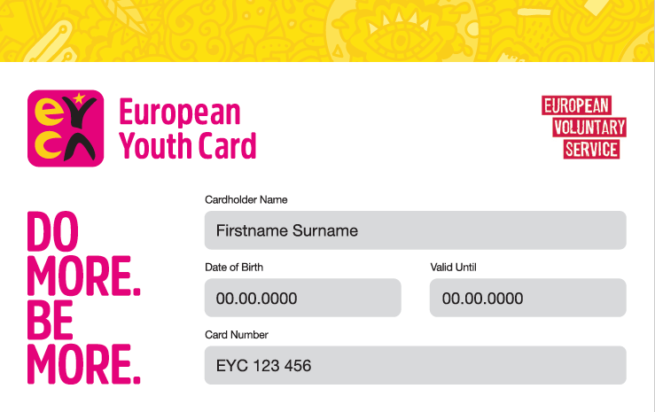
PARTIAL AGREEMENT
ON YOUTH MOBILITY THROUGH THE YOUTH CARD

Slide 2
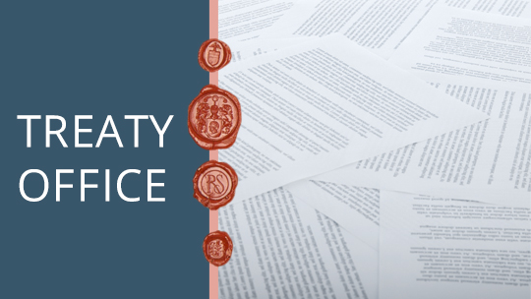
What is a Partial Agreement
in the Council of Europe?
A particular form of co-operation, not a treaty
A special programme with its own budget and working methods determined solely by the members of the PA
Created and joined by member States which advocate a certian activity; free to join and free to leave
16 Partial Agreements in the Council of Europe

Slide 3

YOUTH MOBILITY
Partial Agreement on Youth Mobility
through the Youth Card
Open Partial Agreement
To date 25 member States
Part of the Youth Department
Follows the priorities + objectives
of the youth sector and of the
Council of Europe as a whole

Slide 4
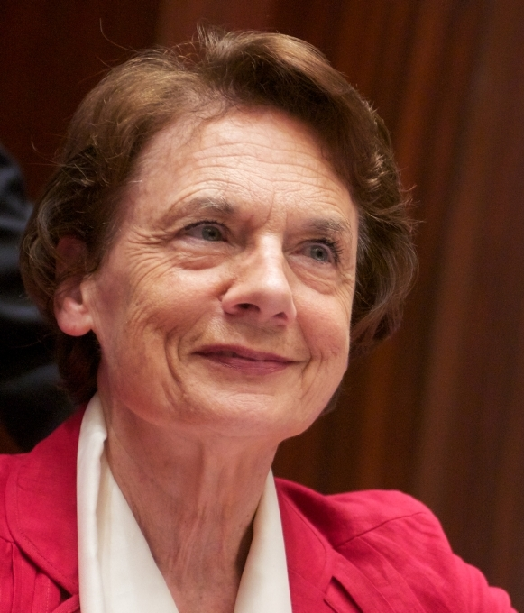
YOUTH MOBILITY
Partial Agreement
on Youth Mobility through the Youth Card
Created in 1991
unanimously supported by
the 1st Conference of Ministers
responsible for youth held in Lisbon in 1990
Established by a Committee of Ministers' Resolution
Purpose: “The Partial Agreement shall be aimed at developing the Youth Card scheme, particularly at European level in the best interests of young people […] with a view to facilitating their mobility as well as their access to the various goods and services necessary for their personal and cultural development.”

Slide 5
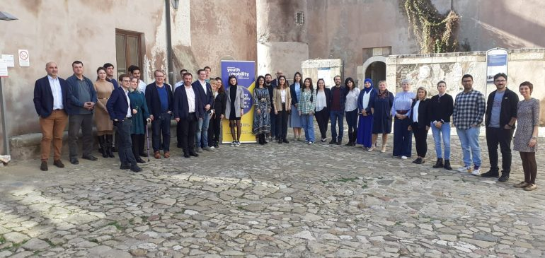

YOUTH MOBILITY
Objectives
Development of the European Youth Card Scheme
Development of intergovernmental co-operation in the field of youth mobility and young people’s access to rights (culture, sport..)
An annual prograrmme of activities, implemented in co-operation with EYCA
Since 2013, 37 activities (seminars, conferences, knowledge exchanges, study visits, trainings and workshops)
Part of the official programme of the Chairmanships of the Committee of Ministers (Austria, Croatia, Greece, Hungary)

Slide 6
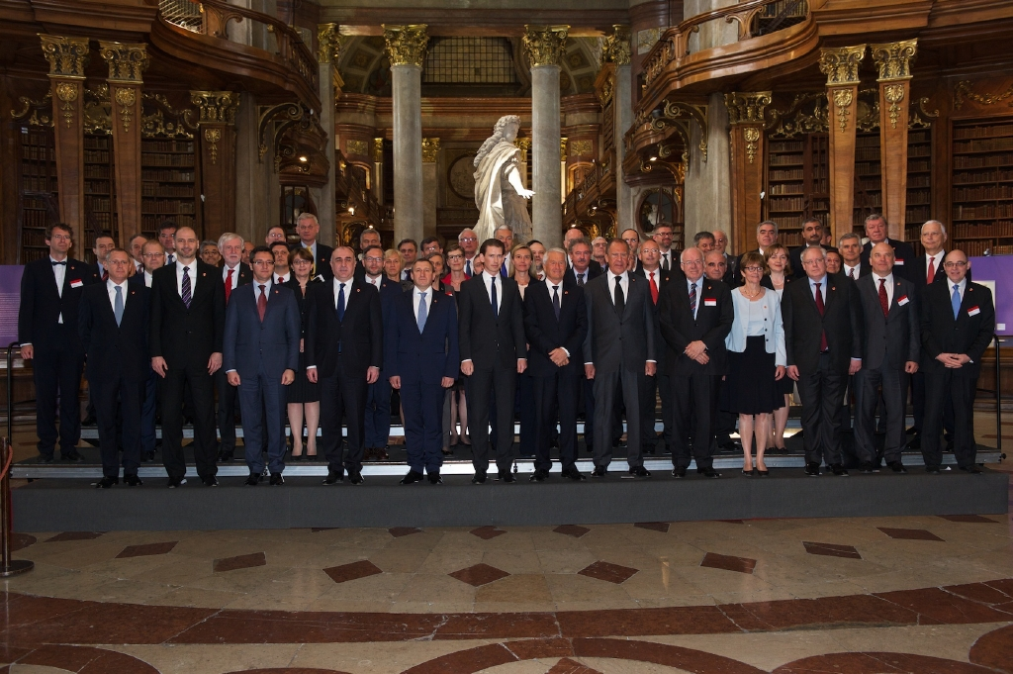
YOUTH MOBILITY
Partial Agreement –
an international intergovernmental platform to develop better youth policies with & for Governments
Caters to the interests and needs of policy-makers
Generates and mobilises knowledge for their use
Shares best practices to
inspire actions
Offers realistic policy tips

Slide 7
YOUTH MOBILITY
Partial Agreement – an international intergovernmental platform
to develop better youth policies with & for Governments
Participants of surveys of 2020 and 2025
“Meeting various actors and connecting in person - one of the most significant advantages: this creates a growing network and a community of practice of youth sector actors. This way, activities are not seen as one-off events, but as a starting point for developing stronger connections”.
“The more times you meet, the more you interact. […] You establish better connections. You build relevance. […] Others around you listen to and understand your opinion more. You have a wider scope of experience and understanding of how things work.” Participant, Thematic seminar

Slide 8
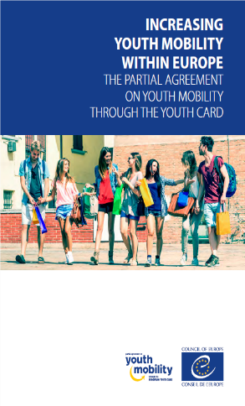
How is this done?
Participants of surveys of 2020 and 2025
Best practices: « most useful to learn how different
countries, for ex., use social media, cooperate
with businesses to offer discounts and opportunities,
work with partners in government and civil society.
This allows to reflect on one’s own experiences in a
national context and how one might tackle similar
challenges or issues”.
“It's very, very important for us to have this mobility,
because [our country] has had a very difficult history
in the past 15 years. So now we can go abroad, we
can travel. This is one of the most important things
that youngsters should take part in.” Participant, Promotional Seminar

Slide 9
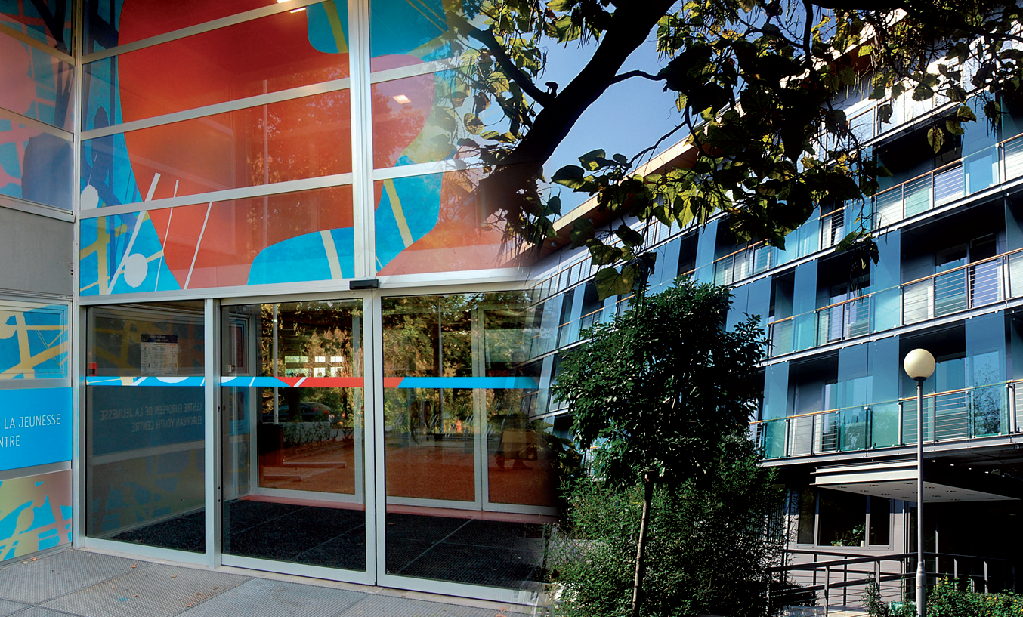
How is this done?
Participants of surveys of 2020 and 2025
“Learning skills valuable in everyday work, such as digital skills during COVID or running communications campaigns”.
Awareness-raising about relevant thematic topics, about which participants had little prior knowledge, for ex. cultural routes, prevention of brain-drain or of radicalisation, mental health or ecology, urban spaces for youth participation
For example, a site visit to a youth centre made a particularly big impact on a participant:
“Immediately when I came back, I talked to the president and the counsellors of the municipality about the possibility of reviving municipal state buildings […]. Not to make it like a fancy hub with fancy coffee, but like the places the host showed us, youth centres that can be common for everybody.” Participant, Thematic seminar

Slide 10
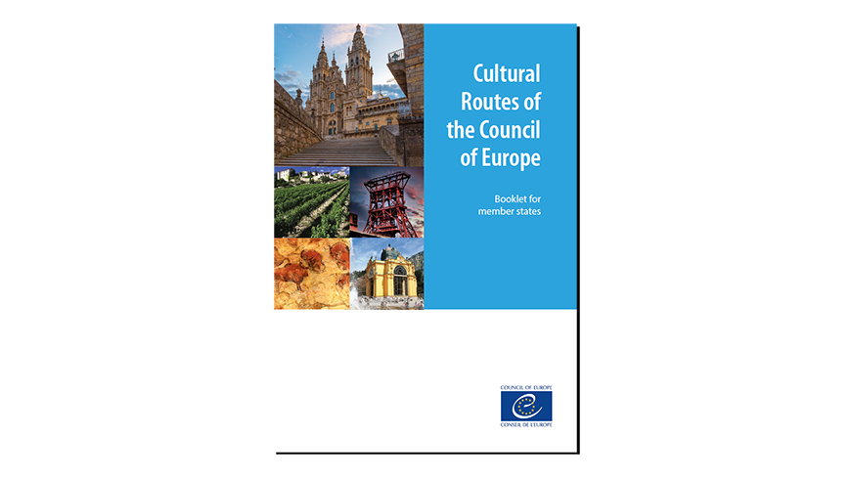
How is this done?
Participants of surveys of 2020 and 2025
connections with counterparts from other Ministries in the same country
“I didn’t know about cultural routes because in my country it's another ministry, the Ministry of Culture […]. After this seminar, I came into contact with the Ministry of Culture, and we planned to cooperate. The most important thing from these seminars is that we […] can come into contact with other organisations in our own country.”
(Interviewer) “Do you think that if you had not
attended the seminar, you would not have
made this connection?”
“No, definitely not. I would have never come in contact
with the other ministry.” Participant, Thematic seminar

Slide 11


Partial Agreement is a tool to promote European values
Interviewees: “the Youth Card helps to address democratic backsliding by putting governments in touch with young people and increasing their trust in institutions.”
“In promoting mobility to other countries, young people can learn about other cultures and break down differences. This strengthens European identity, […] it connects them to Europe.” The latter is particularly important for interviewees outside of the EU.
“One of the issues we are dealing with in more recent years is democratic back-sliding, and how certain tools can be used to strengthen democratic processes.
The Youth Card is not the cure for everything,
but it is a contributory tool. It reaches out to
young people, and [governments] can get
information out to them.”
Participant, Promotional Seminar

Slide 12
Added value of being a member of the PA on Youth Mobility
provides a European dimension to national youth mobility policies;
excellent communication tool to reach young people, especially unorganised ones;
keeps members updated on youth policy issues “Public authorities can follow and be part of relevant European initiatives beneficial to young people (”access to events, expertise, research on youth mobility”);
networking, promotion and facilitation of mobility for all young people within Europe (particularly outside the EU but not only);
policymakers obtain real and direct feedback from young card-holders across Europe on various issues - this helps to be proactive in youth policy development;
an inexpensive programme, good value for money.

Slide 13
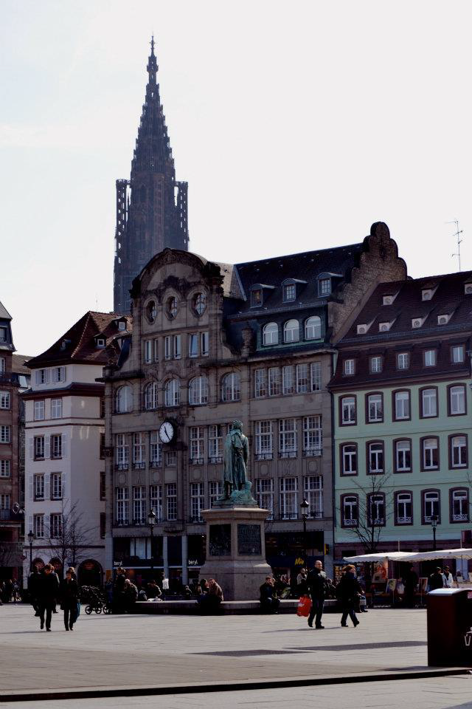
YOUTH MOBILITY
CONTACTS
Address:
Youth Department, Youth Policy Divison
Council of Europe
F-67075 Strasbourg Cedex
Tel.: +33(0)3 88 41 29 98
Email: youthmobility@coe.int
Website: https://www.coe.int/en/web/youth/youth-mobility

