Slide 1
Ambassadors for Gender Equality
Training workshop on gender equality and intersectionality mainstreaming for Council of Europe Gender Equality Rapporteurs
Strasbourg 3-4 November 2025
1
Trainer: Dr. Patricia Munoz Cabrera
pmunozcabrera@cs.com

Slide 2
46 ÉTATS MEMBRES
700 MILLIONS D’EUROPÉENS
Welcome and introduction
Programme and objectives
Interactive presentation of participants

Slide 3
46 ÉTATS MEMBRES
700 MILLIONS D’EUROPÉENS
Programme Day 1 – 3 November 2025
09:30-10:30. Welcome, introduction and presentation of the programme
10:30-11:00. Session 1 - Building common ground on gender equality and intersectionality
11:00-11:30. Coffee break
11:30-11:45. Session 1 continued
11:45-13:00. Session 2 – Ambassadors for gender equality
13:00-14:30. Lunch break
14:30-15:30. Session 3 – How to scan documents from a gender and intersectional perspective
15:30-15:45. Coffee break
15:45-16:15. Session 3 continued
16:15-16:45. Energiser- Gender equality quiz
16:45-17:00. Key take aways from Day 1.

Slide 4
46 ÉTATS MEMBRES
700 MILLIONS D’EUROPÉENS
Programme Day 2 – 4 November 2025
09:30-10:45. Welcome, recap from previous day
10:45-11:15. Coffee break
11:15-12:30. Session 4 – Shifting mindsets: strategies to deal with resistance to gender equality and intersectionality
12:30-13:00. Conclusions and evaluation of the workshop

Slide 5
46 ÉTATS MEMBRES
700 MILLIONS D’EUROPÉENS
Objectives of the training workshop
→ To build and enhance the analytical and operational capacity of Council of Europe Gender Equality Rapporteurs to mainstream a gender equality and intersectional approach in their overall work, including when working with committees and other bodies.

Slide 6



46 ÉTATS MEMBRES
700 MILLIONS D’EUROPÉENS
Expected outcomes: By the end of the training, as GER you will have:
Acquired a set of tools and entry points on how to mainstream gender equality and intersectional issues in your daily work, including working with your Committees and bodies.
Enhanced your understanding of the key role you play as Gender Equality Rapporteur, and developed compelling arguments to more effectively tackle resistances to gender equality and intersectional inclusion.
Designed your own roadmap for putting your respective committees/bodies in action.
Notes:
Guidance Note for trainer:
After you present expected outcomes you can briefly refer to the methodology:
-An empowering mix: analytical presentations, applied concepts, practical exercises and exchanges on good practices.
Applying the principle of transformative thinking on gender equality and intersectionality. What does it mean? GERs = change agents.
Enhancing your skills for building your own Roadmap to encourage your committees and bodies to take action on gender equality and intersectional inclusion,……. in line with human rights commitments and obligations of members states.
Emphasise the key role GERs can play in raising awareness within their respective committees on the social gains of incorporating gender equality and intersectional approach in their overall work…

Slide 7
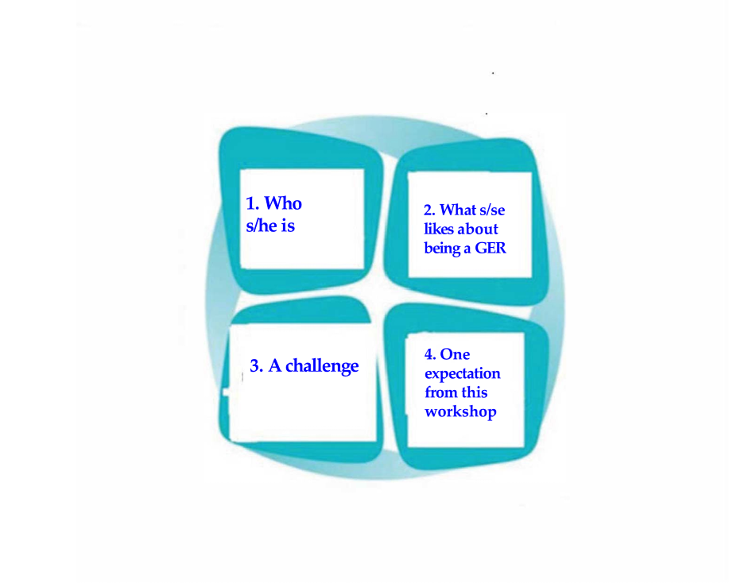
46 ÉTATS MEMBRES
700 MILLIONS D’EUROPÉENS
Getting to know each other : interactive presentation of participants
Guidelines:
Participants turn to the neighbour on their right side and introduce each other based on the following (10 min):
  Name – Country – Committee or Body.
  Something each one likes about being a CoE Gender Equality Rapporteur.
  Something you may find challenging for a GER.
  One expectation from this training workshop.
Neighbours introduce each other in plenary (10 mins.)

Slide 8

46 ÉTATS MEMBRES
700 MILLIONS D’EUROPÉENS
10:00 – 10:30. Group energiser: “The Elevator Pitch” (Task sheet #1)
Key question for collective reflection:
  “Why mainstreaming gender equality and an intersectional approach in our work?
Please follow the guidelines in Tasksheet #1
Notes:
Notes:
Stress the fact that Building compelling arguments on why integrating gender equality and intersectional issues in all Council of Europe activities and domains is critical

Slide 9
46 ÉTATS MEMBRES
700 MILLIONS D’EUROPÉENS
Session 1 – Building common ground on gender equality and intersectionality: concepts, tools, standards and policies
10:30 – 11:00. Part A) Key concepts and their applications by Dr. Patricia Muñoz Cabrera, trainer
11:00 – 11:30. Coffee break
11:30 – 11:45. Part B) Council of Europe gender equality standards and policies by Yanna Parnin, Head of the Policy Unit, Gender Equality Division

Slide 10
46 ÉTATS MEMBRES
700 MILLIONS D’EUROPÉENS
PART A) Key concepts and their applications
Dr. Patricia Muñoz Cabrera, trainer

Slide 11
46 ÉTATS MEMBRES
700 MILLIONS D’EUROPÉENS
Key concepts: what they mean and why they matter
Gender Equality
Intersectionality
Gender mainstreaming
The links between gender equality & gender-based violence / violence against women

Slide 12
46 ÉTATS MEMBRES
700 MILLIONS D’EUROPÉENS
Gender equality at the CoE
“ A prerequisite for a functioning democracy, in which all women and men, all girls and boys, in all their diversity, enjoy their human rights in law and in practice.”
“Gender equality and the full, equal and effective participation of women in public and private decision-making processes are essential to the rule of law, democracy and sustainable development.” (SDGs)
    An area where legal commitments have been made: legal and policy framework for gender equality and gender mainstreaming
“We underline the pioneering role of the Council of Europe, including through the Istanbul Convention, in the fight against violence against women and domestic violence”. (Reykjavik Declaration).
CoE Gender Equality Strategy 2024-2029
Notes:
Gender Equality Strategy 2024-2029
The Strategy, adopted on 6 March 2024, builds upon the vast legal and policy acquis of the Council of Europe as regards gender equality, as well as the achievements of the second Council of Europe Gender Equality Strategy 2018-2023.
Preventing and combating gender stereotypes and sexism
Preventing and combating violence against women and girls and domestic violence
Ensuring equal access to justice for women and girls
Achieving balanced participation of women and men in political, public, social and economic life
Ensuring women’s empowerment and gender equality in relation to global and geopolitical challenges
Achieving gender mainstreaming and including an intersectional approach in all policies and measures

Slide 13

46 ÉTATS MEMBRES
700 MILLIONS D’EUROPÉENS
Gender equality
LET US HAVE A LOOK AT THE DATA

Slide 14


46 ÉTATS MEMBRES
700 MILLIONS D’EUROPÉENS
Q1. What is the average percentage of women in national parliaments in Council of Europe member states? (2024)
You will find example of an intersectional analysis (Ukraine) here
33%
19%
51%
Notes:
Notes for trainer
In 2024, women held one-third (33.4%) of the seats in national parliaments across the EU, marking a 5.6 percentage points (pp) increase compared with 2014.
Sweden (45.6%), Finland (45.5%) and Denmark (44.7%) had the highest shares of female representatives, while Cyprus (14.3%), Hungary (14.6%) and Romania (19.5%) had the lowest.
Compared with 2014, 3 EU countries increased the share of female representatives by 10 pp or more: Malta (+14.9 pp), Latvia (+13.0 pp) and France (+10.3 pp).

Slide 15

Q2. What was the average percentage of women professional judges in CoE countries in 2022?
14%
50%
57%
81%
Source: Efficiency and quality of Justice in Europe CoE Report 2024
Notes:
While this shows a majority of judges are women, the representation in top judicial positions remains lower.
Overall average: 57% of professional judges in Europe were women in 2022.
Growing trend: The proportion of women judges has been increasing over time.
Underrepresentation in top positions: Despite the high overall percentage, women are still underrepresented in the highest-level judicial positions.
Regional variation: The percentage varies significantly by country, with some having higher rates (e.g., Latvia with 81% and Romania with 79%).

Slide 16
Q3. What is the average percentage of women researchers in the business economic sector in the EU? (2021, EU-27)
34%?
48%?
22%?
Women represent just 22% of researchers in the business economic sector in the EU. Given that this sector employs the largest share of researchers in the EU—57% of the total—this disparity underscores a substantial gender gap in a critical area for EU’s competitiveness.
Source: She-figures-2024
Notes:
Explain that when the human rights argument does not work, the economic or business argument may do.

Slide 17
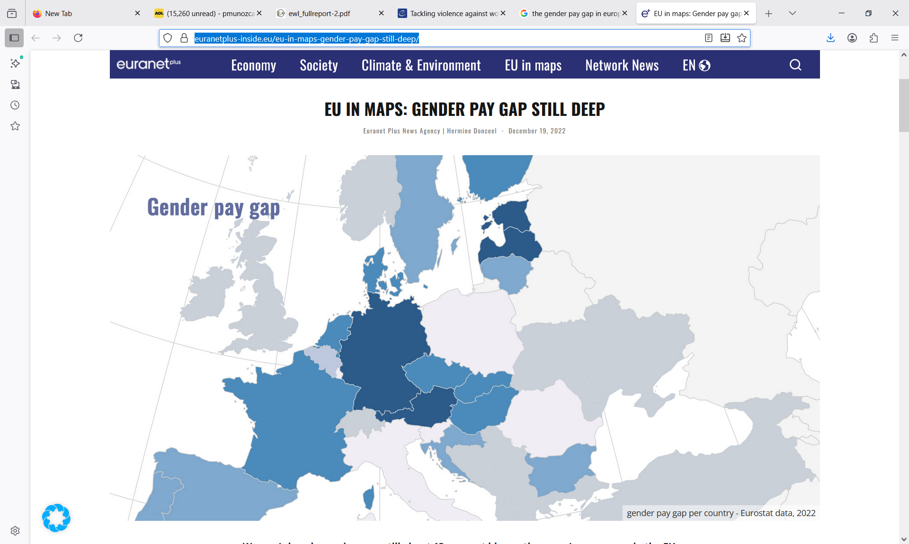
Q4. What is the gender pay gap in Europe? (2021, EU-27)
13 %
12.%
10 %
Source:
https://euranetplus-inside.eu/eu-in-maps-gender-pay-gap-still-deep/
Notes:
In 2021, the gap between men's and women's gross earnings in the EU stood at 12.7%, meaning that women earned, on average, 13% less per hour than men that year.
The average gross hourly wage of female employees in the EU was 12 percent less than that of male employees in 2023.
Women’s hourly earnings are still about 13 per cent blower than men’s on average in the EU.
If ‘equal pay for equal work or work of equal value’ is set in stone as an EU right since 1958, gender equality in the bloc’s labour market still has not been reached today. In many cases, women are still paid less than men for doing the same job. Despite a slight reduction in the pay gap in the past decade – about 3.5 per cent – in 2020, women’s gross hourly earnings were still on average 13 per cent below those of men in the EU, according to Eurostat data.
The gender pay gap is much lower for young employees, but it widens with age, mostly as a result of the career interruptions women may experience during their working life, in particular connected with childcare. Finally, the pay gap is the most important at managerial levels, with a 45 per cent difference.
Greater pay transparency and new enforcement mechanisms have been sought to combat gender-based pay discrimination and help close the gender pay gap. On 16 December, the European institutions found a way to improve pay transparency rules.

Slide 18


The root causes of gender inequalities: social, cultural and gender norms reproducing women’s subordination, VAWG and intersecting inequalities
IMPACTS:
-inequality & intersect. in access to/control of resources, assets, voice, opportunities.
-Unequal treatment (discrimination in law)
-Assigned gender roles that devalue women’s contributions to society and limit their capabilities .
2.Fixed gender roles which grant social privilege/power to certain social groups.
1. The constructed idea that our world is defined and built according to a
male-driven view which still permeates institutions , Laws and social interactions ...

Slide 19
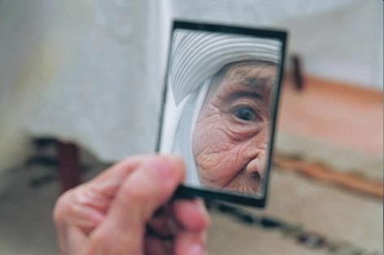
Impact of gender stereotypes through the life course
Gender stereotypes also affect older women and men in significant ways:
Lack of recognition of
their rights (ex.
“Carvalho vs. Portugal”)
Elderly women more associated to the home- space: “Grandma’s recipes”
lower ability to accumulate social security entitlements for their pension age.
Notes:
https://unece.org/DAM/pau/_docs/age/2009/Policy_briefs/Policy-brief-Gender.pdf

Slide 20
INTERSECTIONALITY

Slide 21
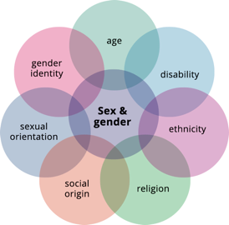
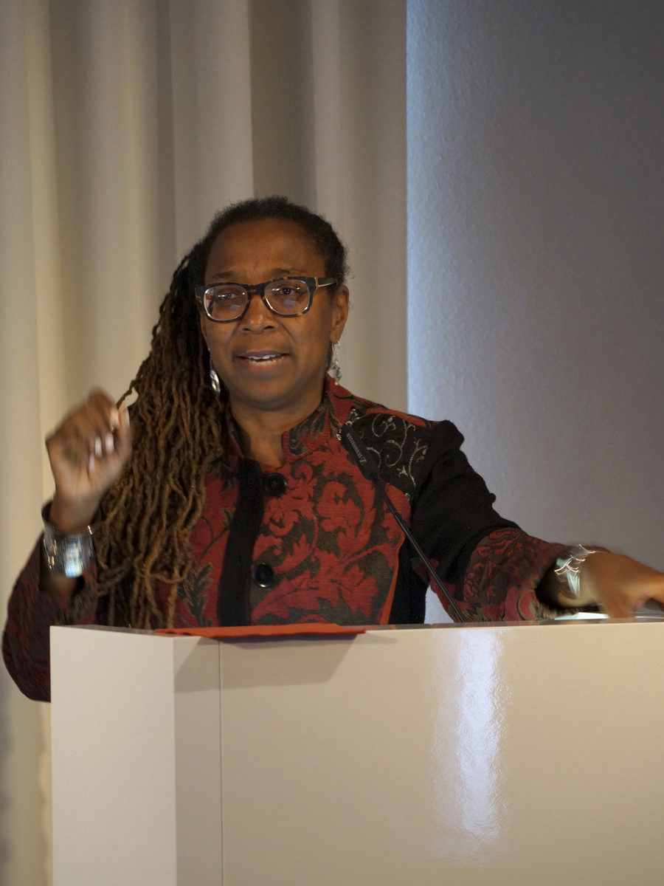
Intersectionality:
Certain groups of women (men and non-binary persons), due to the combination of their sex/gender with other factors, such as their race, colour, language, religion, political or other opinions, national or social origin, association with a national minority, property, birth, sexual orientation, gender identity, age, status, refugee or migrant status or other status*, are often subjected simultaneously to one or several other types of discrimination.
* Want to know more? : see Grounds of discrimination included in article 4§3 of the Istanbul Convention - https://www.coe.int/en/web/istanbul-convention
Key to remember: focus is not only on identity but also on power systems/structures that create/perpetuate multiple forms of inequality or disadvantage which have an impact on our daily lives….
Kimberle Crenshaw, one of the creators of the intersectionality theory
Notes:
The theory of intersectionality was first developed by Kimberlé Crenshaw, leading American scholar of civil rights and professor of law, who published a paper in 1989 entitled Demarginalizing the Intersection of Race and Sex and Mapping the Margins: Intersectionality,. Identity Politics, and Violence Against. Women of Color. Kimberle Crenshaw* She was inspired in particular by the legal case DeGraffenreid v. General Motors (US District Court for the Eastern District of Missouri, May 4, 1976) that involved racial, sex and class discrimination against five black women workers who were refused jobs in a factory. The court ruled that there was no instance of discrimination, as the factory hired both black people and women. However, the court failed to see that the factory did hire black men and white women but discriminated specifically against black women. The term intersectionality was coined by Crenshaw to capture this unique combination of discrimination.

Slide 22
Intersectionality: what it means and why it matters
The integration of an intersectional approach in intergovernmental activities is crucial to ensure that the combined forms of discrimination and oppression experienced by some groups, in particular certain groups of women and girls, are addressed.
An intersectional approach can also better inform strategies for the prevention of gender-based violence by looking at the myriad of factors that lead to certain groups becoming more vulnerable and which limit their access to services and support.

Slide 23
Practical example of intersectional discrimination in employment
In France, an experiment showed that women with a French-sounding name had a 22.6 % of being called for an interview when applying for a job, compared with women with a Senegalese sounding name (8.4 % chance) and men with a Senegalese sounding name (13.9 %)
UNHRC 2017, “Impact of multiple and intersecting forms of discrimination and violence.” https://digitallibrary.un.org/record/1298043?ln=en&v=pdf

Slide 24
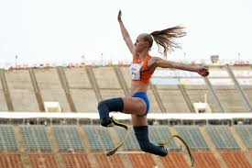
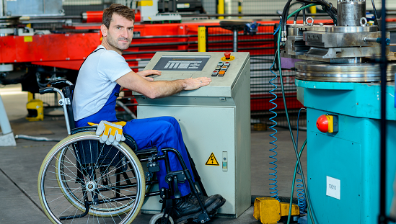
Added value of the intersectional approach : other grounds of dimensions of inequality/discrimination become visible - agency – empowered subjects
DATA: In 2024, 24% of the EU population
over the age of 16 had some form of disability (1 in 4 adults).
Photo credits: Fleur de Jong (https://www.lemonde.fr/en/sports/article/2024/08/31/paralympic-athlete-fleur-jong-a-dutch-long-jump-superstar_6724077_9.html
Added value of intersectional analysis:
Ensuring the visibility of marginalised social groups and persons;
Ensuring they enjoy equal access to justice, resources, opportunities, equal opportunities & equal treatment…
Notes:
Guidance notes:
Estimated % for 2020 was set at 20%..... Compared to current24 %, this means an increase in the number of people with disability (34,9%).

Slide 25
Applying a gender and intersectional approach to patents, pharmaceutics, science and technology
Facts & Figures:
Globally, only 22% of critical trials include women.
Only 1 % of global funding goes to female-specific health conditions.
This means that 4 out of 5 trials are done without women.
How to redress these inequalities:
Include women in the design of medicines and as test subjects.
Promote gender balance in composition of scientific teams., including scientists from marginalised social groups.
Advocate for increased funding for women scientists developing cutting edge solutions to global health issues (learning lesson from COVID).
Impacts:
Women have 4 times more adverse reactions to the medicines sold in markets.
They have to wait sometimes more than 4 years to be diagnosed because test & diagnosis on them is not prioritized.
Source World economic Forum, Global gender gap report 2024
Notes:
Overall the world has closed 68,5% of its gender gap… at the current rate of progress we won’y reach full gender parity until 2158!
Source: https://www.weforum.org/publications/global-gender-gap-report-2024/in-full/key-findings-e7709cd964/#key-findings-e7709cd964
Gender gaps skewing the technology transition: According to LinkedIn data, women’s representation in both science, technology, engineering and mathematics (STEM) and non-STEM workforces has increased since 2016, yet women remain underrepresented in STEM roles, comprising only 28.2% of the STEM workforce compared to 47.3% in non-STEM sectors. Women make up over half of the workforce base in non-STEM roles, compared to only a third in STEM. In turn, they make up a fourth of non-STEM leaders, and only over one-tenth in STEM. This gives women a double disadvantage with regards to technological and workforce transitions, as they continue to occupy the lower-growth, lower-paying jobs that are likely to be negatively affected in the short term.

Slide 26
Intersectionality as a tool for reinforcing the HHRR dimension of equality through data collection (for evidence-based argumentation and engagement with resistances)
Globally: 150 million children under the age of five (around two in 10) remain unregistered (UNICEF, 2024).
An intersectional approach provides a framework for asking fundamental questions about who (which groups of people) are being blocked from registering births and potentially produced as stateless, by whom (who is wielding this power, how, and in what institutional and social locations), and in what ways diverse individuals experience and resist different forms and combinations of oppressions.
An intersectional approach can reveal patterns and mechanisms of exclusion of multiple marginalised social groups
Notes:
Source : https://www.tandfonline.com/doi/epdf/10.1080/14754835.2025.2477493?needAccess=truepopulation groups.

Slide 27
Issue: Blocked access to birth registration
A gender and intersectional analysis exposes the multiple roots of social exclusion and unequal power, for example
Gender/religious/ethnic discrimination at the civil registrar (India, a Dalit, non-Hindu, baby girl).
Gender/disability/ethnic discrimination in contexts of mobility (i.e. Roma and Travellers across Europe)
Gender/racial discrimination/migration status in access to reproductive healthcare (i.e. non-European migrants in Europe)…

Slide 28
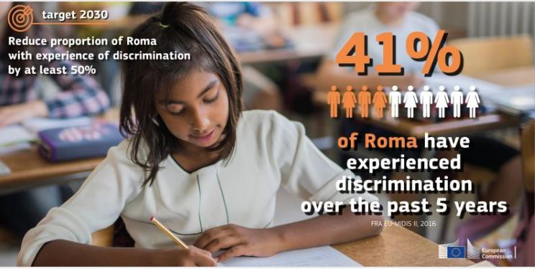
The impact of intersectional discrimination on children’s lives and rights - the case of Roma children
During COVID (2020 Data):
Mid-Term socio-economic impacts ( ex. lack of access to remote learning, no internet connection, electricity).
Long-term Impact: deepening of inequalities in education, rising unemployment.
Scapegoating during the Coronavirus crisis across Europe.
Before COVID
Post-COVID (2023 Data):
85% of Roma children in the EU are at risk of poverty compared to 20% of children in the general.
Intersectional questions to make your analysis more inclusive: what about Roma girls and boys? Where is the data? What does it tell us? What about Roma children to non-Roma children?
Notes:
Source: https://commission.europa.eu/system/files/2020-10/factsheet_-_a_new_eu_roma_strategic_framework_en.pdf

Slide 29
Gender mainstreaming

Slide 30
Gender mainstreaming: what it is and why it matters to the CoE
Gender mainstreaming refers to the (re)organisation, improvement, development and evaluation of policy processes so that a gender equality perspective is incorporated in all policies at all levels and at all stages, by the actors normally involved in policy making. Where boys and girls are concerned, a child-rights approach will be incorporated together with a gender equality perspective. The Gender Equality Strategy 2024-2029 provides a framework for the Council of Europe’s work on gender equality and women’s rights and sets out strategic policy and operational objectives and key actions for the period spanning from 2024 to 2029.
Notes:
Guidance notes:
FN 43 on p.50 shows the recomm made by the CoE

Slide 31

The link between gender equality and violence against women
Violence against women is not an individual phenomena, it has a structural nature, and it is one of the crucial social mechanisms by which women are forced into a subordinate position compared with men.
Given its impact in the private and public domain, the issue of violence against women is relevant to public policies ….. It should therefore be considered an integral part of gender mainstreaming (from design to implementation and impact assessment).
This is valid for example concerning access to justice, equal access to health, education, equal treatment in labour markets, equal access to and control over productive resources . This is why shifting mindsets has become an imperative ….
See CoE video on the Istanbul Convention here: Video on VAW and the CoE Istanbul Convention

Slide 32
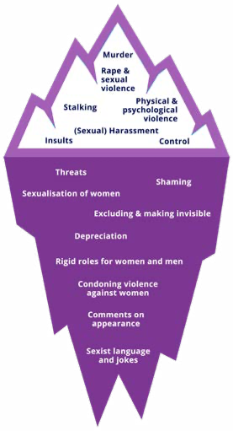
The continuum of violence against women
GREVIO has drawn attention to the need to acknowledge digital VAW as a continuum of violence against women offline, which forms part of GBV against women.
VAW in digital spaces is part of the continuum of multiple, recurring and interrelated forms of violence across online and offline spaces. Many forms of violence occurring offline are replicated and intensified in digital spaces.
Data here
Notes:
As stressed by the Advisory Committee on Equal Opportunities for Women and Men, CV is part of a continuum of violence against women; it does not exist in a vacuum, rather, t both stems from and sustains multiple forms of offline violence. Indeed, online violence and offline violence are often interconnected
and/or intertwined. 25 In this regard,

Slide 33
Gender mainstreaming at the Council of Europe
  Gender mainstreaming at the CoE
  Some good examples:
  Pompidou Group: the gender dimension of drug abuse and addictions
  Monitoring: national minorities and minority languages
  Eurimages: considering GE criteria regarding the funding of films
  + many more good examples in the areas of sport, media, justice, anti-terrorism etc

Slide 34

Gender mainstreaming in practice (2)
Gender mainstreaming at the Council of Europe
Example: Work on drug abuse and addictions (Pompidou Group)
Women and men have different health needs and use drugs differently
A study by the Pompidou Group identified women as a “high risk category for non-medical use of prescription drugs”.
The link between women victims of violence and the abuse of prescription drugs was also identified

Slide 35
Gender mainstreaming in practice (2)
Gender mainstreaming at the Council of Europe
Example: Work on drug abuse and addictions (Pompidou Group)
Work done in the framework of cooperation activities with Mediterranean countries
Work on violence, women and rape drugs
Handbook for practitioners and decision makers on Implementing a gender approach in drug policies
This work has shown the need to address the existing gaps in data and to understand gender differences as a critical requirement for developing effective policy responses

Slide 36
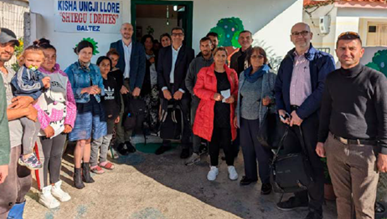
Gender mainstreaming in practice (2)
Example: Monitoring Framework Convention for the Protection of National Minorities and the European Charter for Regional or Minority Languages
Systematic integration of gender equality aspects into the monitoring work – how?
  Gender equality issues included in monitoring questionnaires and reports
  Creation of specific gender equality webpage
  Translation of CoE on combating sexism into minority languages
  Analyses of opinions on national minorities from a GE perspective

Slide 37
46 ÉTATS MEMBRES
700 MILLIONS D’EUROPÉENS
11:30 – 11:45. Session 1 – Building common ground on gender equality and intersectionality: standards and policies
Part B) CoE gender equality standards and policies
Yanna Parnin, Head of the Policy Unit, CoE Gender Equality Division

Slide 38
46 ÉTATS MEMBRES
700 MILLIONS D’EUROPÉENS
11:45 – 13:00: Session 2 – Ambassadors for Gender Equality
Part A)
What is the role of a Gender Equality Rapporteur? Cécile Gréboval, CoE Senior Gender Equality Advisor.
The use of gender transformative approaches, Krista Orama, CoE Policy Adviser on Gender Equality.
Part B)
How to integrate gender equality and intersectionality perspectives in my/our daily work/committee/body

Slide 39
46 ÉTATS MEMBRES
700 MILLIONS D’EUROPÉENS
11:45 – 13:00: Session 2 – Ambassadors for Gender Equality – Part B) How to integrate gender equality and intersectionality perspectives in my/our daily work/committee/body
Guidelines
In this Session 1 GER (5 mins.) will present based on the following entry points:
What have you been able to do to promote gender equality?
What have you achieved? (positive results)
Where are the obstacles/challenges?
Where do I see opportunities for enhanced integration of gender equality and intersectionality issues in my work as GER?
The presentation will be followed by a collective discussion on GERs individual experiences (30 mins.)

Slide 40
46 ÉTATS MEMBRES
700 MILLIONS D’EUROPÉENS
14:30 – 15:30. Session 3 – How to scan documents from a gender and intersectional perspective?
Practical exercise using a gender equality and intersectional screening - Task sheet #2
First, let us start with an energiser: Redrawing the balance
https://youtu.be/p9cU6J2Df9o

Slide 41

46 ÉTATS MEMBRES
700 MILLIONS D’EUROPÉENS
14:30 – 15:30. Session 3 – How to scan documents from a gender and intersectional perspective?
Practical exercise using a gender equality and intersectional screening - Task sheet #2
Guidelines
Please look at the next slide and organise according to your group.
Go through Task sheet # 2 and follow the guidelines
Groups choose a rapporteur
Facilitators will be there in case you have further questions, doubts.

Slide 42

46 ÉTATS MEMBRES
700 MILLIONS D’EUROPÉENS
15: 45 – 16:15. Session 3 (continued): How to scan documents from a G&I perspective?
Rapporteurs present
the results of group work
(5-6 mins. each rapporteur).
Plenary reporting

Slide 43


46 ÉTATS MEMBRES
700 MILLIONS D’EUROPÉENS
16: 15 – 16:45. Gender equality quiz – SHARING IN PLENARY
… and here is the reason reason why
I agree
Rapporteurs present
the results of group work
(5-6 mins. each rapporteur).
I disagree

Slide 44


46 ÉTATS MEMBRES
700 MILLIONS D’EUROPÉENS
16: 15 – 16:45. Gender equality quiz – I agree /I disagree
Guidelines
In this session, we will begin with a short YouTube video (4 mins): https://www.weforum.org/videos/product-design-women/
Working in pairs, participants walk around the room, looking at a series of A3 sheets with very biased statements. They will draw a happy face if they agree and a sad face if they do not.
They choose one statement and explain your choices in plenary. (20 mins.)
We will finish with a short PPT with a few case laws (2) that exemplify how gender/intersectional bias operates within the judiciary. (5 mins.
Participants are encouraged to share other examples they have seen, heard of or read about. (5 mins.)

Slide 45
46 ÉTATS MEMBRES
700 MILLIONS D’EUROPÉENS
16: 15 – 16:45. Case law of the European Court on Human Rights as examples of transformative change
Case Law #1
2017: Carvalho de Souza vs. Portugal
Discrimination on the grounds of sex (& age)
Case Law #2
2009: Roma female citizen M.D. vs. Spain
Discrimination on the grounds of cultural origin & sex)
Case Law #3
I.G., M.K. and R.H. v. Slovakia
Violation of the prohibition of inhuman degrading treatment (Art. 3)

Slide 46
46 ÉTATS MEMBRES
700 MILLIONS D’EUROPÉENS
16: 15 – 16:45. Case law of the European Court on Human Rights as examples of transformative change
What they achieved:
Brought justice for women and men experiencing intersectional discrimination.
They exposed subtle forms of judiciary bias shaping the law and normative frameworks.

Slide 47

16:45 – 17:00. Key take aways
Key learnings
Doubts
Wrap up and overview of programme for day two

Slide 48
46 ÉTATS MEMBRES
700 MILLIONS D’EUROPÉENS
Programme Day 2 – 4 November 2025
09:30-10:45. Welcome, recap from previous day
10:45-11:15. Coffee break
11:15-12:30. Session 4 – Shifting mindsets: strategies to deal with resistance to gender equality and intersectionality
12:30-13:00. Conclusions and evaluation of the workshop

Slide 49
46 ÉTATS MEMBRES
700 MILLIONS D’EUROPÉENS
09:35 – 10:45. Session 4 – Shifting mindsets: strategies to deal with resistance to gender equality and intersectionality
Guidelines:
Small group conversation on resistances and strategies.
Participants go back to their respective thematic groups
Each group chooses a member to report back in plenary
Groups discuss the two sets of questions (see next slide), (35 mins. in total).
Reporting and discussion in plenary (15 mins.)

Slide 50
46 ÉTATS MEMBRES
700 MILLIONS D’EUROPÉENS
09:35 – 10:45. Session 4 – Shifting mindsets: strategies to deal with resistance to gender equality and intersectionality
First set of questions: focus on resistances
• What kind of resistances have you observed (in your field of work, society more broadly (media, public, debate, etc.?)
• Where do you think these resistances come from?
• What has worked for you in the past to bring people on board?
•What do you find most difficult to respond to?

Slide 51
46 ÉTATS MEMBRES
700 MILLIONS D’EUROPÉENS
09:35 – 10:45. Session 4 – Shifting mindsets: strategies to deal with resistance to gender equality and intersectionality
Second set of questions: focus on strategies
•What facts, data and commitments on gender equality do we have to counteract the arguments?
•What are the risks if gender equality issues and intersectionality are not taken into consideration?
• What are the positive impacts of gender equality on freedom, wellbeing, fairness and justice for all?
• What positive alliances or examples have you seen?
–How can we communicate these impacts to different audiences/stakeholders?

Slide 52
46 ÉTATS MEMBRES
700 MILLIONS D’EUROPÉENS
09:35 – 10:45. Session 4 – Shifting mindsets: strategies to deal with resistance to gender equality and intersectionality
Groups share what they discussed, and collective reflection on issues discussed.
Plenary reporting and discussion

Slide 53
46 ÉTATS MEMBRES
700 MILLIONS D’EUROPÉENS
11:15 – 12:30. Session 5 – Designing my “Gender equality & intersectional mainstreaming roadmap” to put my Committee in action
Individual work, followed by collective brainstorming based on roadmap guidelines provided in Task sheet # 3
Once they have responded to the suggested questions (40 mins.), participants share their individual roadmaps in plenary (20 mins.).
Finally, they post them on the Roadmap Wall and take a walk to look at what other colleagues wrote (5 mins).

Slide 54
46 ÉTATS MEMBRES
700 MILLIONS D’EUROPÉENS
11:15 – 12:30. Session 5 – Designing my “Gender equality & intersectional mainstreaming roadmap” to put my Committee in action – Guiding questions – See Task sheet #3
What: entry points to initiate gender equality and/or intersectional mainstreaming activities in my committee/body?
Which activities would I need to implement after this training, and Why?
What positive alliances or examples could I use?
Who could be relevant stakeholders, allies and targets?
2–3 phrases that could be used more effectively to convey the importance of gender mainstreaming in my committee?

Slide 55
46 ÉTATS MEMBRES
700 MILLIONS D’EUROPÉENS
11:15 – 12:30. Session 5 – Designing my “Gender equality & intersectional mainstreaming roadmap” to put my Committee in action
Presenting my Roadmap for gender equality and intersectionality
Collective sharing in
plenary

Slide 56
46 ÉTATS MEMBRES
700 MILLIONS D’EUROPÉENS
12:30-13:00. Conclusions and written evaluation of the workshop

