Slide 1
Council of Europe gender equality standards
Yanna Parnin
Head of the Policy Unit, Gender Equality Division
Secretary to the Gender Equality Commission

Slide 2
Gender Equality Strategy 2024-2029
Continuity of the 2018-2023 Strategy, consolidating progress and achievements
Stronger intersectional approach
Involvement of men and boys from a horizontal perspective, under each strategic objective. They should be active partners in combating violence against women and girls, and in promoting the human rights of women and girls. Men and boys also benefit from gender equality policies.
Greater emphasis on AI and technology-facilitated violence against women and girls
Implementation is in close cooperation with youth representatives
Notes:
The Council of Europe Gender Equality Strategy guides the activities of the Council of Europe in the area of gender equality.
Who is involved in the Gender Equality Strategy?
All Council of Europe institutions, decision-making, advisory and monitoring bodies, as well as human resources policies, will support and actively contribute to the achievement of the goal and strategic objectives of the Gender Equality Strategy 2024-2029.
Other contributors and partners include:
• European Institute for Gender Equality
• European Union
• Organisation for Security and Co-operation in Europe
• UN Women
• Office of the High Commissioner for Human Rights (OHCHR)
• Organization of American States
• Organisation for Economic Co-operation and Development (OECD)
• EDVAW Platform
• Member states parliaments and national governments
• Local and regional authorities and their associations
• Gender equality bodies
• National human rights institutions
• Ombudsperson institutions and equality bodies
• Professional networks and relevant specialist organisations, in particular in the fields of justice, journalism, education, health and social services
• Social partners
• Youth-led organisations and youth workers
• Academic, educational and research institutions
• the media
• the private sector

Slide 3

Gender Equality Strategy 2024-2029
Six strategic objectives
Preventing and combating gender stereotypes and sexism
Preventing and combating violence against women and girls and domestic violence
Ensuring equal access to justice for women and girls
Achieving balanced participation of women and men in political, public, social and economic life
Ensuring women’s empowerment and gender equality in relation to global and geopolitical challenges
Achieving gender mainstreaming and including an intersectional approach in all policies and measures

Slide 4

Gender Equality Strategy 2024-2029
Preventing and combating gender stereotypes and sexism
Promoting and implementing the Recommendations on sexism and on hate speech
Continue addressing gender inequality in education and in the media
Addressing gender bias in AI systems
Collecting sex-disaggregated data
Notes:
Member states and the Council of Europe will:
•promote and implement the Council of Europe Recommendation CM/Rec (2019)1 on preventing and combating sexism;
•promote and implement the Council of Europe Recommendation CM/Rec(2024)1 of the Committee of Ministers to member States on equality of Roma and Traveller women and girls
•prevent and combat gender stereotypes;
•address algorithmic gender-based and intersectional discrimination (2 draft recommendations are under preparation
Examples of CoE actions
-Supported member states in implementing campaigns and other resources such as: Stop sexism campaign and Preventing and combating sexism – see next slide
-Identified, compiled and disseminated good practices to eradicate gender stereotypes in education, training, labour markets, and family life including the gendered division of tasks between women and men.
-Prepared a draft Recommendation on artificial intelligence, gender equality and non-discrimination and promote and support its implementation.

Slide 5



Online communication tools on combating sexism
Sexism video
Brochure
Action page

Slide 6

Gender Equality Strategy 2024-2029
2. Preventing and combating violence against women and girls and domestic violence
Implementing recommendations from the monitoring of the Istanbul Convention
Addressing technology-facilitated violence against women and girls
Developing strategies and action plans and exchanging good practices, including in relation to perpetrator programmes
Notes:
Member states will:
•take stock of and implement the recommendations from the monitoring of the implementation of the Istanbul Convention conducted by GREVIO and the CoP;
•take measures to address emerging forms of violence against women and girls, including its digital dimension
•develop strategies and plans to prevent and combat violence against women and girls and domestic violence and exchange good practices, including those in relation to perpetrator programmes.
Examples of CoE actions
-Supported member states in implementing relevant international instruments including CEDAW, SDGs Nos. 5 and 16, Landmark resolution on Women, Peace and Security and the recommendations of the monitoring bodies of the Istanbul Convention.
-Encouraged signatories of the Istanbul Convention to accelerate ratification and utilise recommendations from GREVIO.
-Developed tools to counter misinformation about these conventions and increase funding for campaigns against misinformation (e.g. undergoing project: deflecting anti-gender rhetoric, Budapest INGO conference in July 2024)
-Supported member states in taking measures to address all forms of violence, including steps to address sexual violence in public spaces, strengthen legislation on sexual violence based on lack of consent, and take measures to address conflict-related sexual violence to address the issue of access by victims to shelter, legal services and psychological counselling, financial assistance, housing, education, training, and assistance in finding employment.
-Developed new standard to address technology-facilitated violence against women and girls and support its implementation (GEC/PC-eVIO - Committee of Experts on combating technology-facilitated violence against women and girls, first meeting on 1-2 October, preparing draft recommendation on TFVAWG)
-Developed information tools on the role of men and boys in preventing violence against women and girls (the guideline).
-Designed pilot projects, programmes / perpetrator programmes and developed specialised psychological care for perpetrators and evaluated the impact and effectiveness of these interventions in preventing recidivism.
-Supported the development of disaggregated data collection by sex and age as well as research on violence against all women and girls and domestic violence.

Slide 7

Gender Equality Strategy 2024-2029
3. Ensuring equal access to justice for women and girls
Increasing capacities to remove barriers and obstacles to women’s access to justice
Collecting sex-disaggregated data and conducting research
Notes:
Member states will:
-use Council of Europe guidance and the case law of the European Court of Human Rights to ensure women’s equal access to justice;
-increase their capacity to remove barriers and obstacles to women and girls’ access to justice;
-improve sex-disaggregated data collection and research.
Examples of CoE action
-Supported member states in implementing relevant instruments such as General Recommendation No. 33 of the CEDAW Committee on Women’s access to justice and the CoE report on The impact of Covid-19 on women's access to justice and recommendations from relevant studies.
-Continued to address harmful impact of gender stereotypes on judicial decision making by monitoring court decisions and raise awareness among legal professionals including stereotypes in the judicial system and protection against gender-based violence and discrimination.
-Developed and disseminated training tools and materials including the Human Rights Education for Legal Professional (HELP) courses to promote gender equality, prevent violence against women, and improve access to justice.
-Monitored and followed up on court decisions to raise awareness and ensured a better understanding among legal professionals of issues related to women’s access to justice, including stereotypes in the judicial system and protection against gender-based violence and discrimination.
-Encouraged standardised data collection by sex and age and research in the area of access to justice for women and girls, considering intersectional characteristics such as ethnicity, sexual orientation, and disability.

Slide 8

Gender Equality Strategy 2024-2029
4. Achieving balanced participation of women and men in political, public, social and economic life
Ensuring equal participation of women and men in political and public decision-making
Supporting women’s equal access to the labour market and the equal distribution of unpaid care and domestic work
Ensuring effective access to sexual and reproductive health and rights, and to healthcare services
Notes:
Member states will:
•ensure equal participation of women and girls, men, and boys in political and public decision-making;
•ensure women’s equal access to the labour market and tackle their higher levels of precariousness and related risks of poverty;
•ensure that all women and girls, men and boys have effective access to sexual and reproductive health and rights and to affordable, equitable and quality healthcare services, including in the area of mental health.
Examples of CoE action
-Supported the full implementation of relevant standards such as the Recommendation Rec(2003)3 of the Committee of Ministers on balanced participation of women and men in political and public decision making (neither sex should be represented in a political or public decision-making body at a level below 40%) and Recommendation CM/ Rec(2023)4 of the Committee of Ministers to member states on Roma youth participation and of effective gender mainstreaming strategies and policies.
-Encouraged and supported action to facilitate women’s participation in elections, tackling sexism and violence against women in politics, and promoting gender equality in electoral systems and decision-making bodies.
-Encouraged employers to take measures to promote women’s economic independence and remove obstacles to their labour market participation, particularly in emerging sectors such as the green and digital economy.
-Recognised the value of care and promoted the equal distribution of unpaid care and domestic work; promoted paid maternity and paternity leave and quality childcare and encouraged men's involvement in caregiving and flexible working arrangements.
-Prepared a study on women’s effective rights to decide on matters related to their sexual and reproductive health and rights, free of coercion, discrimination, and violence including women who face multiple and intersecting forms of discrimination. https://www.bing.com/search?q=Council+of+Europe+study+on+women%E2%80%99s+effective+rights+to+decide+on+matters+related+to+their+sexual+and+reproductive+health+and+rights&cvid=11853dca45564f7a9aa129dad7eeeec0&gs_lcrp=EgZjaHJvbWUyBggAEEUYOdIBCDM4MDdqMGoxqAIAsAIA&FORM=ANAB01&PC=U531 (coe.int)
-Worked to achieve balanced participation of women and men in all Council of Europe bodies, institutions and decision-making processes.

Slide 9
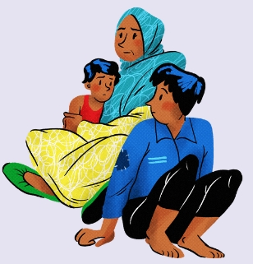
Gender Equality Strategy 2024-2029
5. Ensuring women’s empowerment and gender equality in relation to global and geopolitical challenges
Implementing the Recommendation on migrant, refugee and asylum-seeking women and girls
Adopting a gender-responsive approach in the prevention and mitigation of all forms of crisis
Countering anti-gender narratives in co-operation with relevant stakeholders
Notes:
Member states will:
-take action based on the lessons learned from the COVID-19 pandemic in the field of gender equality;
-adopt a gender perspective in the prevention and mitigation of crises;
-implement Council of Europe Recommendation CM/Rec(2022) on protecting the rights of migrant, refugee and asylum-seeking women and girls;
- join forces to counter anti-gender narrative
Examples of CoE actions
-Disseminated and supported the implementation of relevant standards on the rights of migrant women through co-operation projects.
-Carried out activities addressing the adverse effects of climate change on gender equality.
-Supported the systematic integration of a gender equality perspective in policies and measures regarding public health, conflict resolution, climate change, and economic downturn.
-Supported member states in recognising gender equality and women’s rights as core elements of multilateral relations and crisis management, addressing gender-based violence in conflict situations, and supporting women and girls as agents for conflict prevention and building sustainable peace as per the Recommendation CM/Rec(2010)10 of the Committee of Ministers to member states on the role of women and men in conflict prevention and resolution and in peace building.
- Undergoing project: deflecting anti-gender rhetoric (research of anti-gender movement, their narrative and mapping of promising practices to counter it)

Slide 10
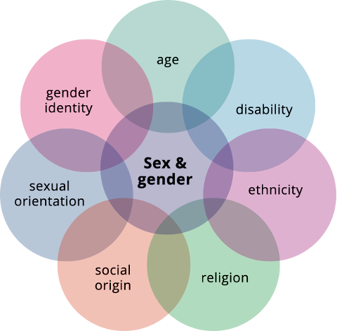
Gender Equality Strategy 2024-2029
6. Achieving gender mainstreaming and including an intersectional approach in all policies and measures
Gender mainstreaming throughout all policy, programming and budgetary processes, ensuring awareness and inclusion of intersecting forms of discrimination
Notes:
Member states and the Council of Europe will:
•strive to achieve gender mainstreaming in all policies and sectors;
•strive to achieve gender mainstreaming through co-operation activities ;
•integrate a gender equality and intersectional approach in all their activities and policy areas.
Examples of CoE actions
-Provided targeted training and produce materials and tools on gender mainstreaming and gender equality in various intergovernmental, monitoring and co-operation sectors.
-Encouraged CoE sectors to address the need for sex disaggregated data in standard-setting, monitoring and cooperation activities.
-Monitored progress on the implementation of a gender mainstreaming approach within the organisation, identifying, supporting and replicating promising initiatives.
-Facilitated networking and exchange of information with members, partners, and organisations on gender mainstreaming, gender budgeting, and human rights-based solutions for inequalities.
-Involved all relevant actors including gender equality experts and civil society, in the promotion and implementation of a gender mainstreaming and intersectional approach.
-Continued to mainstream gender equality in Council of Europe staff and other internal policies, including budgets, tools and indicators to measure and assess progress.

Slide 11
xx
Gender equality standards of the Council of Europe
European Convention on Human Rights (1950): Art. 14 and Protocol 12 (non-discrimination)
Case-law of the European Court of Human Rights
European Social Charter (1961)
Convention against trafficking in human beings (2005)
Istanbul Convention to combat violence against women and domestic violence (2011)
Committee of Ministers Recommendations and Guidelines: preventing and combating sexism, place of men and boys in gender equality policies, balanced participation of women and men in political and public decision making, protecting the human rights of migrant, refugee and asylum-seeking women and girls, equality of Roma and Traveler women and girls, role of women and men in conflict prevention and resolution and in peace building, etc.
Notes:
European Convention on Human Rights:
First Council of Europe’s convention and the cornerstone of all its activities. It was adopted in 1950 and entered into force in 1953. Its ratification is a prerequisite for joining the Organisation.
Article 14 – prohibition of discrimination, but it’s not “free-standing”, to rely on this article, you must show that discrimination has affected the enjoyment of one or more of the other rights of the Convention.
Protocol 12 (no discrimination): case law under this protocol is still under-developed: only 20 Member State ratified it and 18 signatures not followed by ratifications
European Social Charter: Council of Europe treaty that guarantees fundamental social and economic rights for all as a counterpart to the European Convention on Human Rights, which refers to civil and political rights. It guarantees a broad range of everyday human rights related to employment, housing, health, education, social protection and welfare.
Council of Europe Convention on Action against Trafficking in Human Beings (2008 - entry into force): The Convention is the first international legal instrument to take a human rights-based approach to the fight against human trafficking. The Convention applies to all forms of trafficking and to all victims of trafficking. Monitoring mechanism by GRETA (Experts on Action against Trafficking in Human Beings).
Council of Europe Convention on preventing and combating violence against women and domestic violence (usually referred to as Istanbul Convention) – see: later
CM Recommendations: The Committee of Ministers is composed of the Ministers for Foreign Affairs of the 46 member States of the Council of Europe or their Permanent Representatives in Strasbourg. The Committee of Ministers is the Council of Europe’s decision-making body. It is both a governmental body where national approaches to European problems are discussed on an equal footing and a forum to find collective responses to these challenges. The Committee of Ministers adopt recommendations and guidelines which provide guidance to member states on how to apply the principles set out in the Council of Europe's conventions and other legal texts.
Some of the most important recommendations/guidelines concerning gender equality and adopted by the CM:
Recommendation on preventing and combating sexism (2019) – detailed later
Guidelines on the place of men and boys in gender equality policies (2023)
Recommendation on balanced participation of women and men in political and public decision making (2003)
Recommendation on protecting the rights of migrant, refugee and asylum-seeking women and girls (2022) – detailed later
Recommendation on the role of women and men in conflict prevention and resolution and in peace building (2010)

Slide 12
Gender equality standards of the Council of Europe
Landmark case law of the Court on gender equality
  Opuz v. Turkey (2009): For the first time the Court declared that domestic violence constitutes discrimination based on sex under Art. 14
  Konstantin Markin v. Russia (2012): Court underscored that achieving gender equality is a key objective for the Member States and only "very weighty reasons" can justify differential treatment under Art. 14, and traditions, assumptions or societal attitudes are insufficient grounds for sex-based discrimination
  Kurt v. Austria (2021): States have obligation to take proactive and effective measures when they are aware or should be aware of a real and immediate risk to the life or safety of a domestic violence victim, this includes implementing preventive measures to protect potential victims
Notes:
“very weighty reasons” = A difference of treatment based on sex may, in certain circumstances, be justified where it constitutes a form of positive action aimed at correcting factual gender inequalities

Slide 13

Gender equality standards of the Council of Europe
Convention on preventing and combating violence against women and domestic violence, Istanbul Convention (2011):
  4 pillars: prevention, protection, prosecution, integrated policies
  Approaches adopted: gender-sensitivity, victim-centered, cross-border
  Monitoring mechanism: two pillar system: GREVIO + Committee of Parties
Notes:
The Council of Europe Convention on preventing and combating violence against women and domestic violence, also known as “the Istanbul Convention” is the most far-reaching international legal instrument to set out binding obligations to prevent and combat violence against women and girls. It requires parties to develop laws, policies and support services to end violence against women and domestic violence. The Convention was adopted by the Council of Europe Committee of Ministers in 2011 and entered into force in August 2014. Since then, 38 countries have become party to the Convention. In October 2023, the treaty entered into force in respect of the European Union, making it also party to the Convention.
Content of the Convention: 4Ps
Prevention: Preventives measures aiming at changing attitudes and gender roles that make VAW acceptable
Protection: The general obligation to protect victims from further violence and to set up support services for them and their children
Prosecution: The existence of procedures and legislation ensuring the prosecution of perpetrators, including the continuation of criminal investigations and proceedings even if the victim withdraws the complaint
Integrated policies: Adoption of policies enabling that all the above measures become part of a coordinated and holistic response to VAW and domestic violence
Approaches adopted by the Convention:
Gender- Sensitive: Parties shall implement gender-sensitive measures and acknowledge differences between men and women to promote gender equality
Victim-centered: It focuses on the human rights and the needs of the victims of acts of violence covered by the scope of the Convention
Cross-border: given the transnational nature of some forms of violence: the Convention makes it obligatory for States parties to extend their jurisdiction to cover crime committed abroad by their nationals and it facilitates access to justice for nationals who are victims of VAW abroad
Istanbul Convention monitoring mechanism: a two-pillar system
GREVIO: an independent expert body created to monitor the implementation of the Convention. It is now composed of 15 members. GREVIO draws up and publishes reports evaluating legislative and other measures taken by the parties to give effect to the provisions of the convention. In cases where action is required to prevent a serious, massive or persistent pattern of any acts of violence covered by the convention, GREVIO may initiate a special inquiry procedure. GREVIO may also adopt general recommendations on themes and concepts of the convention.
Committee of Parties (CoP): is composed of the representatives of the Parties to the Convention, it constitutes the political body of the Convention. They are tasked to elect the members of the GREVIO and to adopt and supervise the implementation of their own recommendations.

Slide 14
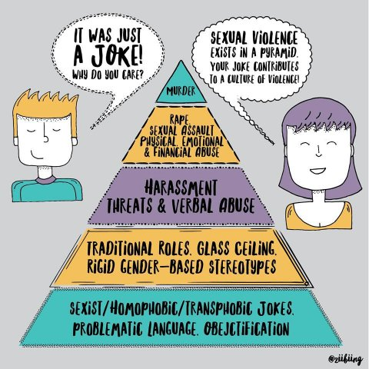
Gender equality standards of the Council of Europe
Recommendation on preventing and combating sexism (2019)
  First ever internationally agreed definition of sexism
  Includes concrete measures to prevent and end sexism, including the criminalization of sexist hate speech
  Stresses that sexism has a larger and different impact on women than men and identifies particularly vulnerable groups of women
  Identifies vulnerable statuses (ethnicity, minority, indigenous status, age religion, refugee or migrant status, disability, marital status, gender identity, sexual orientation)
Notes:
2 years of work
Drafting committee of the Gender Equality Commission
Adopted by the Committee of Ministers of the CoE in March 2019
It requests that member states monitor progress in implementing its guidelines and to inform the Council of Europe’s Gender Equality Commission of measures taken and progress achieved.
Topics included:
Language and communications
Internet, social media and online sexist hate speech
Media, advertising and other communication products and services
Workplace
Public sector (public services, elected assemblies)
Justice sector
Education
Culture and sport
Private sphere

Slide 15
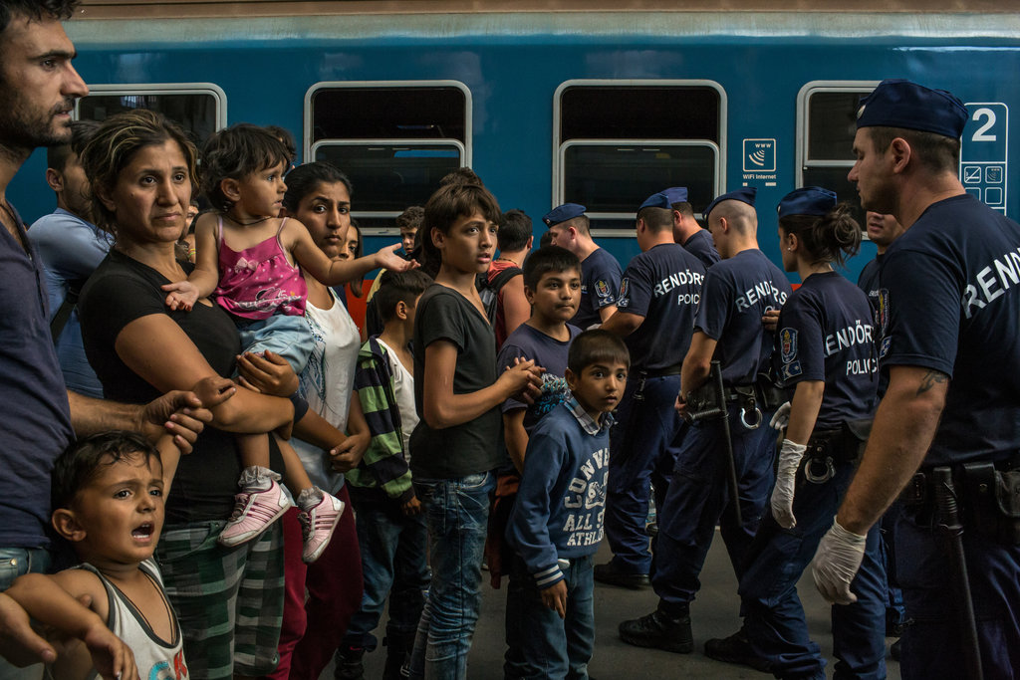
Gender equality standards of the Council of Europe
Recommendation on protecting the rights of migrant, refugee and asylum-seeking women and girls (2022)
  Integration of a gender equality perspective in all relevant public policies: migration, asylum and integration policies
  Intersectional perspective: addressing the needs of specific groups, e.g. girls, women with disabilities, undocumented migrant women, etc.
  Horizontal issues: non-discrimination/stereotypes, information, empowerment, awareness of rights, access to justice including legal aid, AI, data protection, data collection, civil society and research
Notes:
Content of the recommendation:
Protection and support:
Addressing the situations of victims of gender-based violence and trafficking, in particular trafficking for the purpose of sexual exploitation
Training of relevant authorities and staff in GE issues and violence
Access to support services and to shelters
Issues related to State of emergency and crisis management
Arrival:
Transit and reception facilities (age- and gender-sensitive infrastructures access to services, availability of support and complaint mechanisms…)
Training of staff & presence of women among staff
Gender-sensitive asylum policies and procedures
Cross-border measures
Residence and integration
Access to health, including sexual and reproductive health & rights
Social services, social security and housing
Integration, empowerment, social and political participation
Education, training & employment
Residence permits & family reunion
Detention
Age- and gender sensitive approach to all aspects of deprivation of liberty (infrastructure, assistance, presence of women among staff etc)
Administrative detention in the context of migration as last resort
Returns
In safety and dignity – e.g. assessment of country of origin information
Non-refoulement from a gender sensitive perspective

Slide 16
Draft Recommendation on equality and artificial intelligence
Based on:
  the Study on the impact of artificial intelligence systems, their potential for promoting equality, including gender equality, and the risks they may cause in relation to non-discrimination
  the Framework Convention on artificial intelligence and human rights, democracy, and the rule of law (CETS No. 225)
Objective: supporting member States, as well as public and private actors, in promoting equality, including gender equality, and preventing and combating discrimination, throughout the lifecycle of AI systems.
Notes:
Draft Recommendation will be based on the “Study on the impact of artificial intelligence systems, their potential for promoting equality, including gender equality, and the risks they may cause in relation to non-discrimination” adopted by the GEC and the CDADI in 2023 and the Framework Convention on artificial intelligence and human rights, democracy, and the rule of law (CETS No. 225)
The objective of the draft Recommendation is to support member States, as well as public and private actors, in promoting equality, including gender equality, and preventing and combating discrimination, throughout the lifecycle of AI systems. In doing so, The draft Recommendation builds on existing legal instruments on equality and non-discrimination, adapting them to the opportunities and risks of AI.
It is anchored in both binding and non-binding standards. It maintains coherence with the Framework Convention on AI and the EU AI Act (regulatory framework for the EU).
Important clarification: the draft Recommendation is not an implementing instrument of the Framework Convention. It adopts its terminology and scope for coherence, but remains an independent policy tool.
The draft integrates legislative action, private sector responsibility, transparency, accountability, public engagement, and oversight, addressing AI’s complex risks in a holistic manner across society and multiple sectors.
Unlike broader AI-related instruments, it aims to serve a pragmatic purpose: offering concrete guidance on how to integrate equality and non-discrimination principles into AI systems, ensuring that AI promotes and protects gender equality instead of exacerbating discrimination and leading to violations of women’s rights.

Slide 17
Draft Recommendation on accountability for technology-facilitated violence against women and girls
Building on GREVIO General Recommendation No. 1 on the digital dimension of violence against women
Aims to address the pressing issue of technology-facilitated violence against women and girls, recognising the role of technologies in both facilitating and preventing such abuse.
Targeted approach to strengthening accountability
Key objectives: reinforcing legal frameworks, particularly under criminal law, holding perpetrators accountable and providing remedies to victims
Notes:
GR No. 1:
Explains how the existing provisions of the Istanbul Convention apply to digital manifestations of violence
Proposes specific actions to take in relation to the four pillars (4Ps) of the IC: prevention, protection, prosecution and co-ordinated policies
Draft Rec:
It aims to address the pressing issue of technology-facilitated violence against women and girls, recognising the role of technologies in both facilitating and preventing such abuse.
It also aims to take a targeted approach to strengthening accountability for technology-facilitated violence against women and girls, ensuring that victims receive adequate and effective responses from member States.
A key objective is to reinforce legal frameworks, particularly under criminal law, to hold perpetrators accountable and provide remedies to victims.

Slide 18
Thank you!

