Slide 1
FREE FROM CORRUPTION WEEK

Slide 2
ON THE BASIS OF THE GRANT OF COE - PROJECT FREE FROM CORRUPTION WEEK, MINISTRY OF EDUCATION, CULTURE AND RESEARCH HELD SEVERAL EVENTS IN MOLDOVAN HIGHER EDUCATION INSTITUTIONS. MINISTRY, IN PARTNERSHIP WITH STUDENT ORGANIZATIONS, ORGANIZED PUBLIC LECTURES IN OUR UNIVERSITIES.

Slide 3
IN THE FRAMEWORK OF THE GRANT, TWO MAJOR DIRECTIONS WE HAVE UNDERTAKEN IN ORDER TO REACH OUR GOALS, ACCORDING TO THE PROPOSED ACTIVITIES. OCTOBER, THUS, HAS PROVED TO BE A MONTH FULL OF EVENTS ON THE PANORAMA OF HIGHER EDUCATION IN THE REPUBLIC OF MOLDOVA. ALL INSTITUTIONS WERE VERY RECEPTIVE TO THE CALL MADE BY MEANS OF THE MINISTRY OF EDUCATION, CULTURE AND RESEARCH.

Slide 5
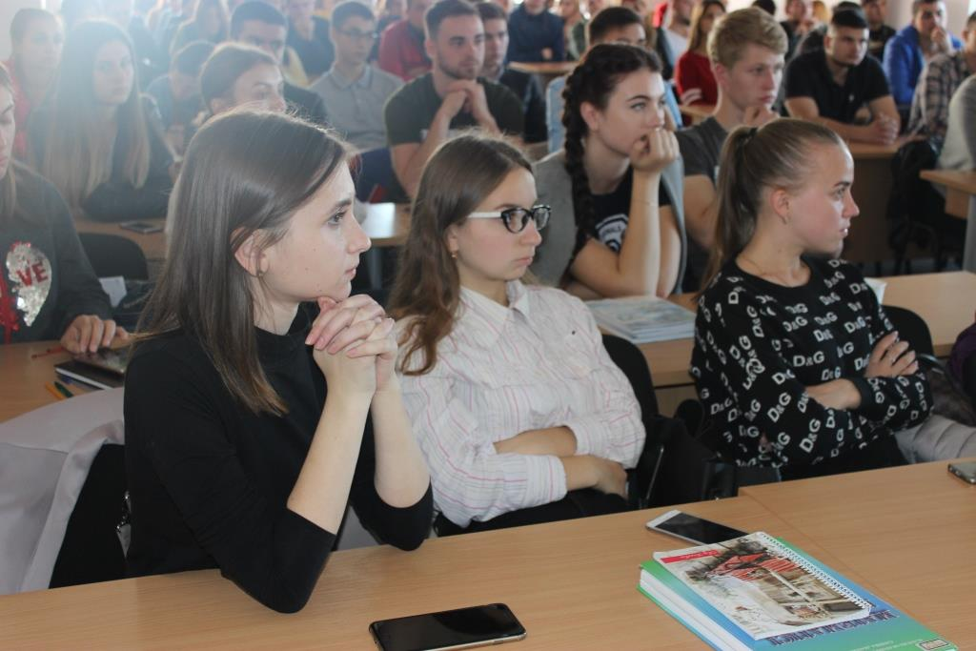

Slide 6
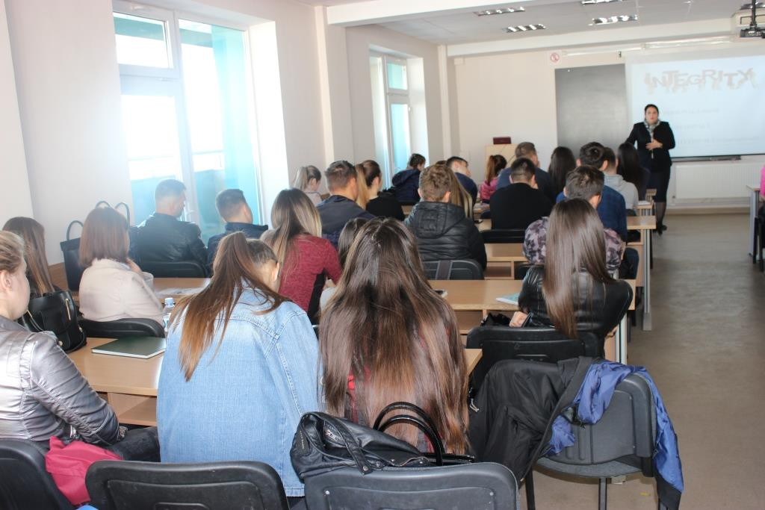

Slide 8
SO, IN ORDER TO COMPLETE THE GOALS WE SET, TWO ACTIONS WERE DESIGNED:

Slide 9
IST, THE MINISTER SIGNED AN ORDER APPROVING RECOMMENDATIONS FOR HOLDING PUBLIC LECTURES AS PART OF THE ANTI-CORRUPTION WEEK “FREE FROM CORRUPTION”. ACCORDING TO IT, PUBLIC LECTURES WERE HELD IN 27 UNIVERSITIES (BOTH PUBLIC AND PRIVATE) DURING THE WEEK OF 15-19 OCTOBER 2018 FOR IST YEAR STUDENTS. FROM THE PRELIMINARY DATA, MORE THAN 5000 STUDENTS FROM DIFFERENT FACULTIES WERE INVOLVED IN PUBLIC LECTURES ON DIFFERENT TOPICS RELATED TO THE FIELD.

Slide 10
WE MUST MENTION THAT FOR THIS PURPOSE INTERNATIONAL EXPERTS WERE INVOLVED AS WELL AS EXPERTS FROM THE NATIONAL ANTICORRUPTION CENTER AND OTHER NGOS INVOLVED IN THE FIGHT AGAINST CORRUPTION IN THE REPUBLIC OF MOLDOVA.
SOME OF THE TOPICS FOR DISCUSSION DURING THE PUBLIC LECTURES WERE:
COMBATTING PLAGIARISM IN HIGHER EDUCATION INSTITUTIONS IN THE REPUBLIC OF MOLDOVA
CAUSES AND EFFECTS OF CORRUPTION IN HIGHER EDUCATION INSTITUTIONS
INSTITUTIONAL INTEGRITY AND FIGHTING CORRUPTION
INTRODUCTION TO THE LEGAL FRAMEWORK REGULATING CORRUPTION
WAYS OF SEIZING CORRUPTIVE ACTS IN HIGHER EDUCATION
ROLE OF YOUTH IN PREVENTING CORRUPTIVE ACTS IN EDUCATION.

Slide 13
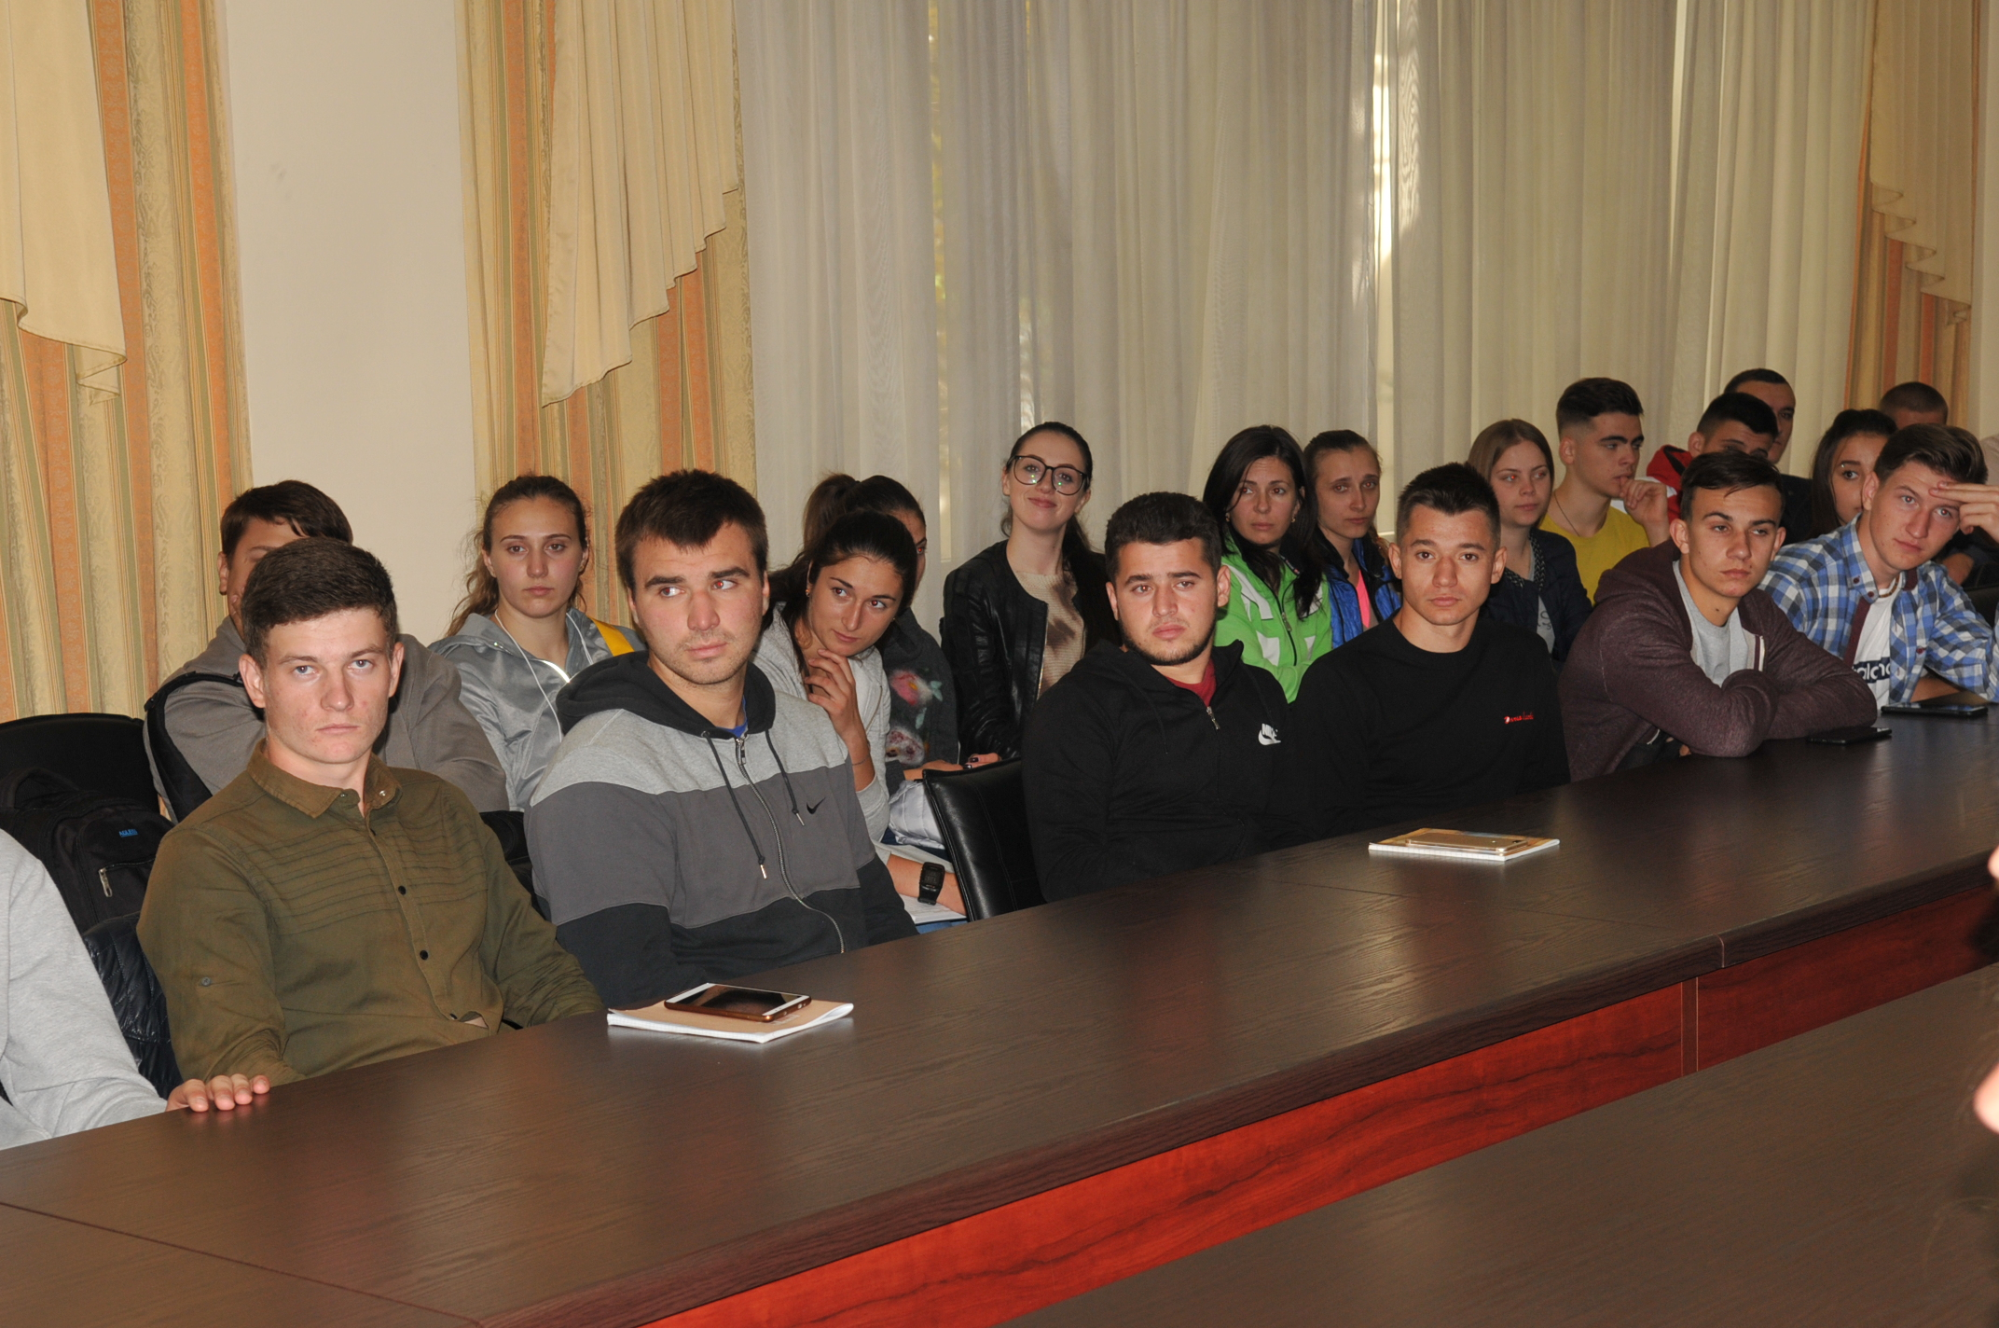

Slide 14
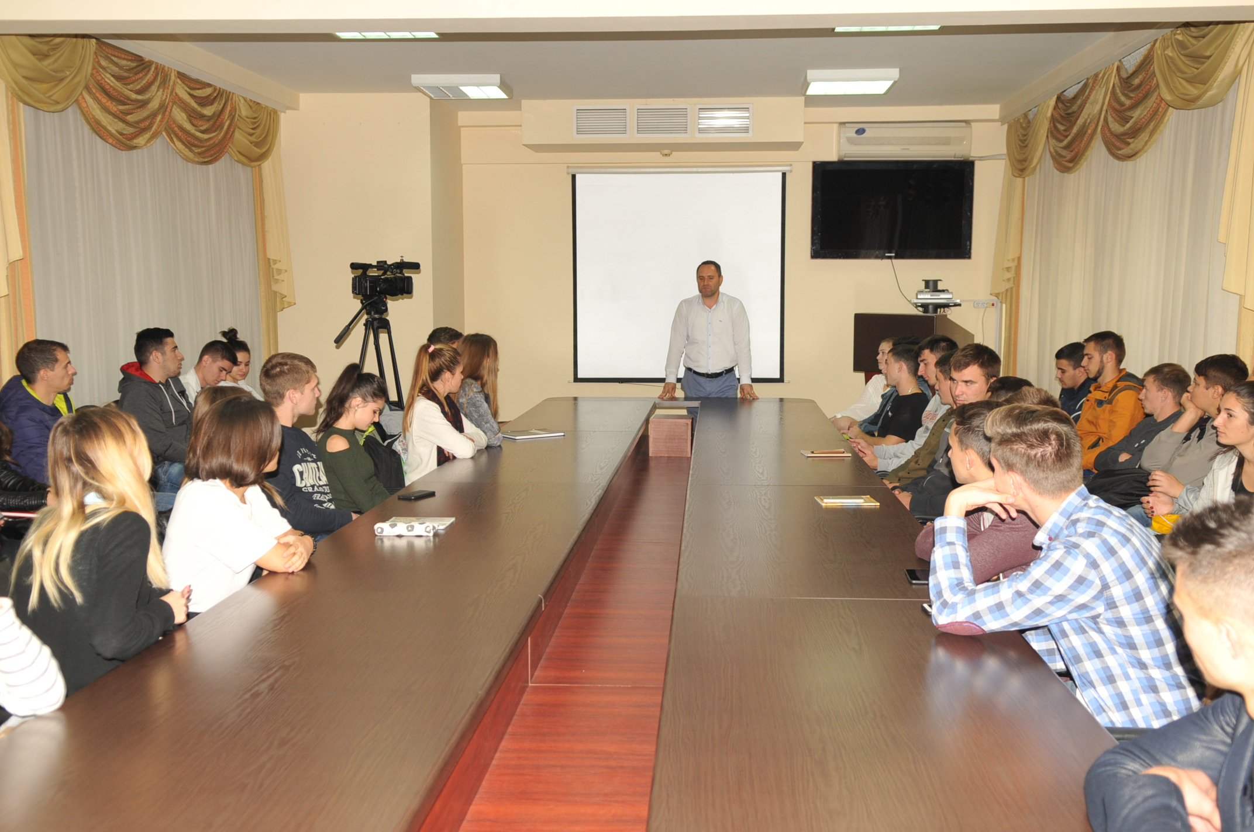

Slide 15
IIND, WAS ORGANIZED A WIDE PARTICIPATORY EVENT AT ONE STATE-OF-THE-ART ICT CANTERS IN CHISINAU ON 17TH OCTOBER 2018 WITH A TOTAL OF 165 PEOPLE PARTICIPATED AT THE EVENT FROM TECHNICAL UNIVERSITY OF MOLDOVA, STATE UNIVERSITY OF MEDICINE AND PHARMACY AND MOLDOVA STATE UNIVERSITY.

Slide 20
SOME INSTITUTIONS WENT BEYONG THIS, AND TRAINED OTHER STUDENTS BESIDES THE IST YEAR ONES. FOR EXAMPLE, STATE UNIVERSITY OF MEDICINE AND PHARMACY ORGANIZED PUBLIC LECTURES FOR DOCTORAL STUDENTS AND TEACHERS, AND SET UP A SPECIAL TELEPHONE LINE FOR CASES WHICH ARE TRIGGERED BY CORRUPTIVE ACTS IN THE INSTITUTION. MOLDOVA STATE UNIVERSITY ORGANIZED A ROUNDTABLE WITH HEADS OF ALL DEPARTMENTS AND THE DIRECTOR OF EUROPA INSTITUT AT THE UNIVERSITY OF ZURICH.

Slide 21
THE EVENT CONSISTED OF TWO PARTS:
THE FIRST PART WAS FACILITATED BY THE PRESIDENTS OF THE STUDENTS’ UNIONS OF THE THREE UNIVERSITIES, WHICH PRESENTED THE RESULTS AND REFLECTED ON THE PERCEPTION OF PLAGIARISM AND ON ACADEMIC FRAUD, AS A WHOLE, AND AT THE SYSTEM LEVEL, PER SE. ACCORDING TO ONE COMMENT, STUDENTS SEE A DRAMATIC DECREASE IN QUALITY OF HIGHER EDUCATION, AND AS A RESULT, THEY DO NOT WANT TO WASTE THEIR TIME TO OBTAIN OUTDATED AND USELESS KNOWLEDGE AND JUST IMITATE LEARNING PROCESSES, FEEDING FRAUDULENT PRACTICE. THE PANNEL DISCUSSIONS PROVED TO BE VERY ENGAGING AND USEFUL, AS STUDENTS PROVED A LOT OF INTEREST AND INVOLVEMENT ON THE TOPIC.

Slide 22
THE SECOND PART OF THE EVENT CONSISTED OF PRESENTATIONS MADE BY INVITED EXPERTS FROM UNIVERSITIES, NATIONAL ANTICORRUPTION CENTER, WHICH TALKED ABOUT THE MEASURES THAT SHOULD BE TAKEN IN ORDER TO PREVENT PLAGIARISM AND EXAM FRAUD, AS WELL AS POSSIBLE OUTCOMES OF MAKING USE OF THESE TWO. THE TOPICS RAISED BY STUDENTS AT THE EVENT ARE BUILT ON A LOGICAL LINE AND BEGAN WITH A PRESENTATION OF ETHICAL PRINCIPLES IN EDUCATION AND RESEARCH.

Slide 27
RESULTS AND ACTIVITIES
THE RESULTS OF THE ACTION PROVED TO BE MORE PROMISING THAN CONSIDERED AT THE BEGINNING. ALL UNIVERSITIES ENGAGED FURTHER ON IN EVENTS AND WERE VERY ACTIVE, INCLUDING NOT ONLY IST YEAR STUDENTS IN THE ACTIVITIES PLANNED, BUT ALSO STUDENTS FROM OTHER YEARS AND OTHER CYCLES.

Slide 28
OCTOBER WAS A MONTH FULL OF BEAUTIFULL EVENTS IN THE UNIVERSITIES OF THE REPUBLIC OF MOLDOVA. WE HAVE SEEN ENGAGEMENT FROM ALL POSSIBLE PARTNERS-STUDENTS, TEACHERS, ADMINISTRATIVE STAFF, NGOS, INTERNATIONAL AND NATIONAL EXPERTS. ALL OF THEM ARE LOOKING FORWARD TO FOLLOW-UP EVENTS OF SUCH KIND, AND HAVE SET DIFFERENT GOALS AT INSTITUTIONAL LEVEL FOR THIS PURPOSE.

Slide 29
THANK YOU FOR YOUR ATTENTION
WELCOME TO MOLDOVA

