Slide 1
International experience in working with perpetrators
Strategic session: “Adaptation of the Ukraine’s perpetrator’s programme”
Sandra Jovanovic Belotic
Training and Capacity Building Manager, WWP EN

Slide 2

What do you do when there is a fire?

Slide 3
Why do we need to work with perpetrators?
Many perpetrators repeat violence in their new relationships (Shortt, et al., 2012)
After separation, violence can become more severe rather than stopping (Ornstein & Rickne, 2013; Statistics Canada, 1993: 26)
Children exposed to intimate partner violence learn violent behaviour and repeat it in adult relationships (Murrell, Christoff & Henning, 2007)
Many survivors want the perpetrators to change and violence to stop (FRA, 2014)
Perpetrators also experience negative consequences; some want to improve the relationships with their partners and children and stop using violence (Rollero, 2020)
BUT ALSO BECAUSE
We need to shift the narrative from “Failure to protect”, to the “Accountability of Perpetrators”

Slide 4
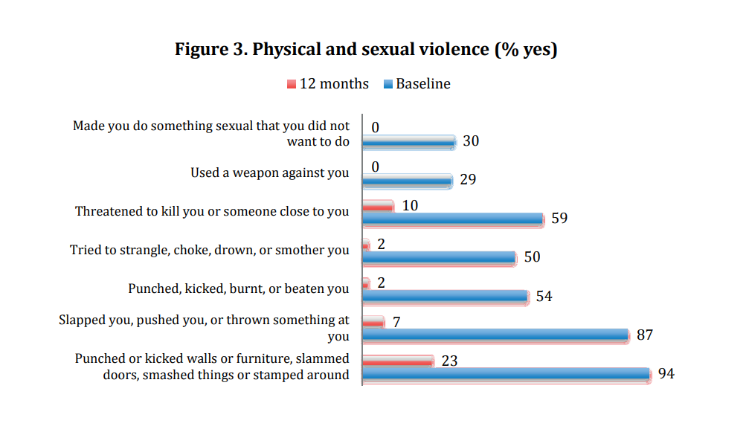
Do perpetrator programmes work?
Kelly, L. & Westmarland, N. (2015). Domestic Violence Perpetrator Programmes: Steps Towards Change. Project Mirabal Final Report. London Metropolitan University and Durham University
Notes:
Mention impact

Slide 5
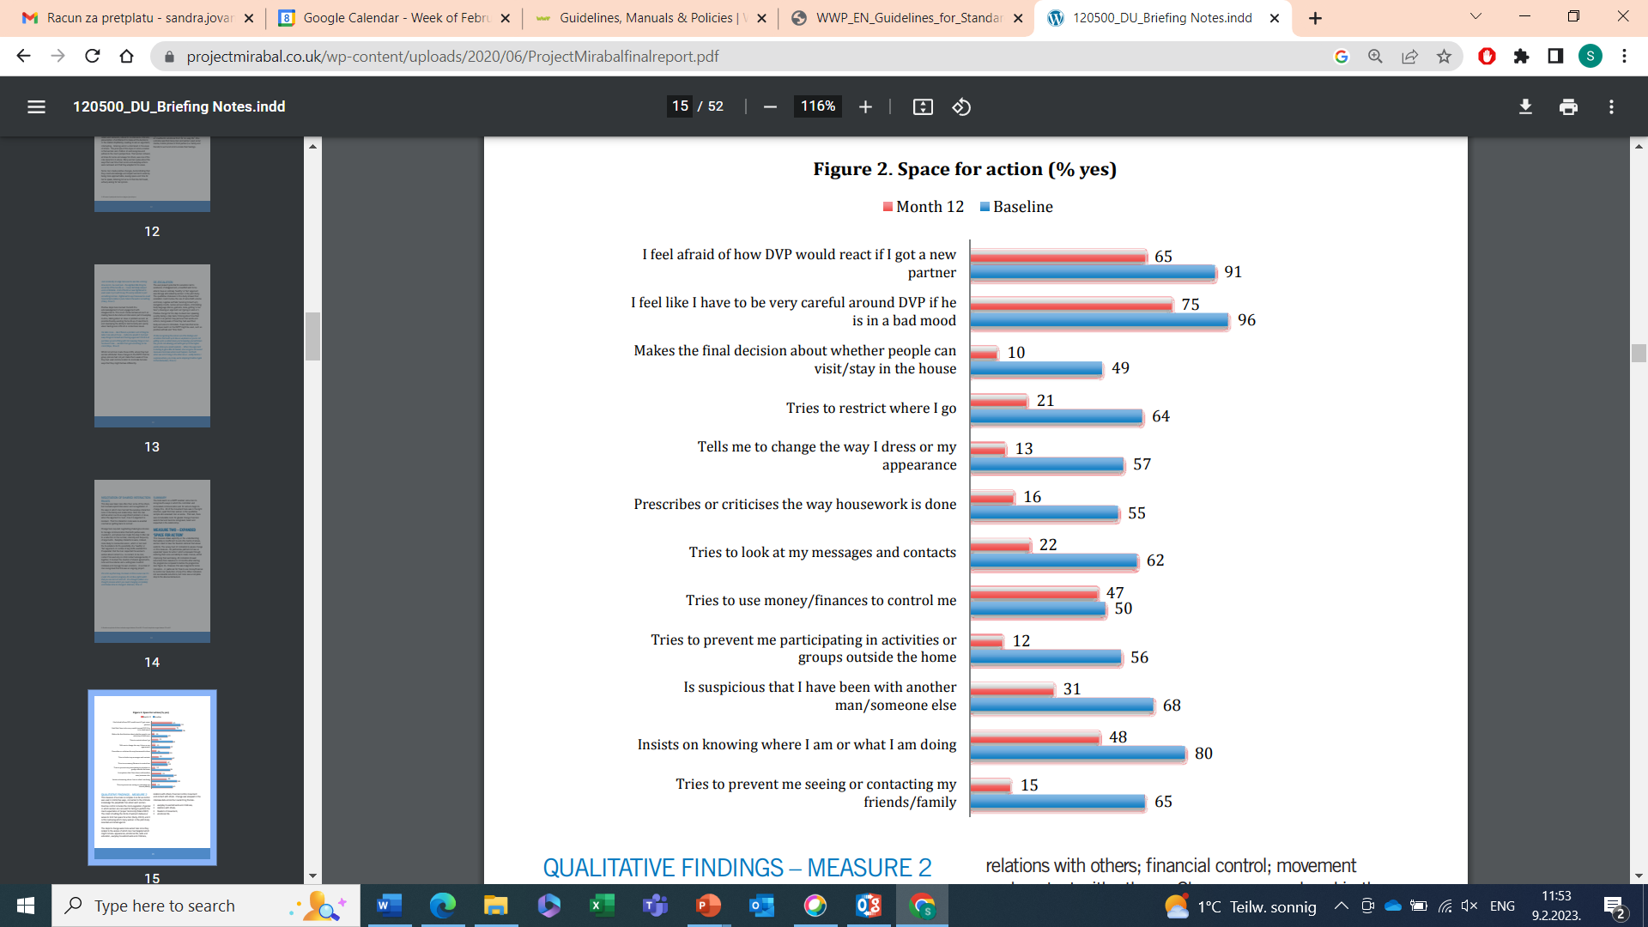
Do perpetrator programmes work?
Kelly, L. & Westmarland, N. (2015). Domestic Violence Perpetrator Programmes: Steps Towards Change. Project Mirabal Final Report. London Metropolitan University and Durham University

Slide 6

Perpetrator programmes can give good results, but can also create additional risks

Slide 7

Victims safety

Slide 8
What do perpetrator programmes need to do to make these situations safe for victims?
(Ex) Partner contact and support
Focusing on children
Information sharing and decision making
Risk assessment and management
Source: WWP EN. (2023). European Standards for Perpetrator Programmes – Standards for Survivor-Safety-Oriented Intimate Partner Violence Perpetrator Programmes. Working document.

Slide 9

Finding the right way

Slide 10
Key focus when working with perpetrators
Violence as gender-based phenomenon
Ecological model
Strategies to work with resistance and foster internal motivation

Slide 11

The system works

Slide 12
Perpetrator programmes
Framework for perpetrator programmes
Service providers
Programmes & programme curricula
Survivor safety & wellbeing
Notes:
Different from addiction program, or similar interventions

Slide 13
Ending domestic abuse by stopping men’s violence

