Slide 1
Protecting the rights of migrant, refugee and Asylum-seeking Women and Girls Meeting of the Network of Focal Points on Migration, 09.06.2022 Cécile Gréboval, Programme Adviser, Gender Equality Division

Slide 2
Facts and Figures
Notes:
The UN Report on International Migration 2020 only says that in Europe “the number of female migrants sightly exceeded that of male migrants”, but there are no more precise numbers.
This year, in 2022, this is probably going to change drastically considering that 90% of refugees fleeing from Ukraine are women and children.

Slide 3
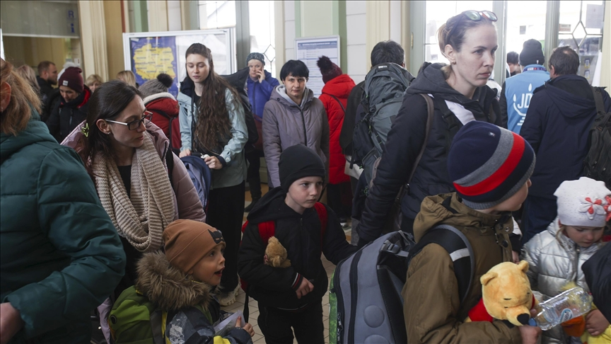
In 2022, about 90% of refugees fleeing Ukraine are women and children

Slide 4
The situation of migrant, refugee and asylum-seeking women and girls
A diverse group: nationality, age, legal status, professional and personal situation and characteristics and reasons for migrating
Gender inequalities impact on their experience of migration
Women and girls are often confronted with trafficking, and different forms of gender-based and sexual violence
They are also confronted to multiple forms of discrimination, racism and sexism
Notes:
Persisting unequal access for women to resources, property, education, protection, justice, the labour market and decision-making in both countries of origin and destination have an impact on their migration experiences

Slide 5
The situation of migrant, refugee and asylum-seeking women and girls
Particularly high risks for unaccompanied girls, pregnant women, those with small children or women experiencing intersectional discrimination
Often, policies and legislation in the areas of migration, asylum and integration do not fully take into account women’s situations and needs
In practice, gender-sensitive services and infrastructures are needed: shelters, transit and reception facilities, asylum procedure, counselling services or prevention programmes

Slide 6
Facts and Figures
Notes:
UN Office of Drugs and Crime, Global Report on Trafficking in Persons 2020

Slide 7
Notes:
Eurostat

Slide 8
Recommendation CM/Rec(2022)17on protecting the rights of migrant, refugee and asylum-seeking women and girls
Codifying in a single document “best” measures from existing CoE standards, monitoring activities, UN standards and policy documents, etc.
Focus on the protection of rights and the fight against all forms of discrimination and violence against women
Looking at the range of relevant public policies: migration, asylum and integration policies
Including ALL migrant, refugee and asylum-seeking women and girls
Intersectional perspective/addressing the needs of different groups: girls, women with disabilities, undocumented migrant women, victims of violence, etc.

Slide 9
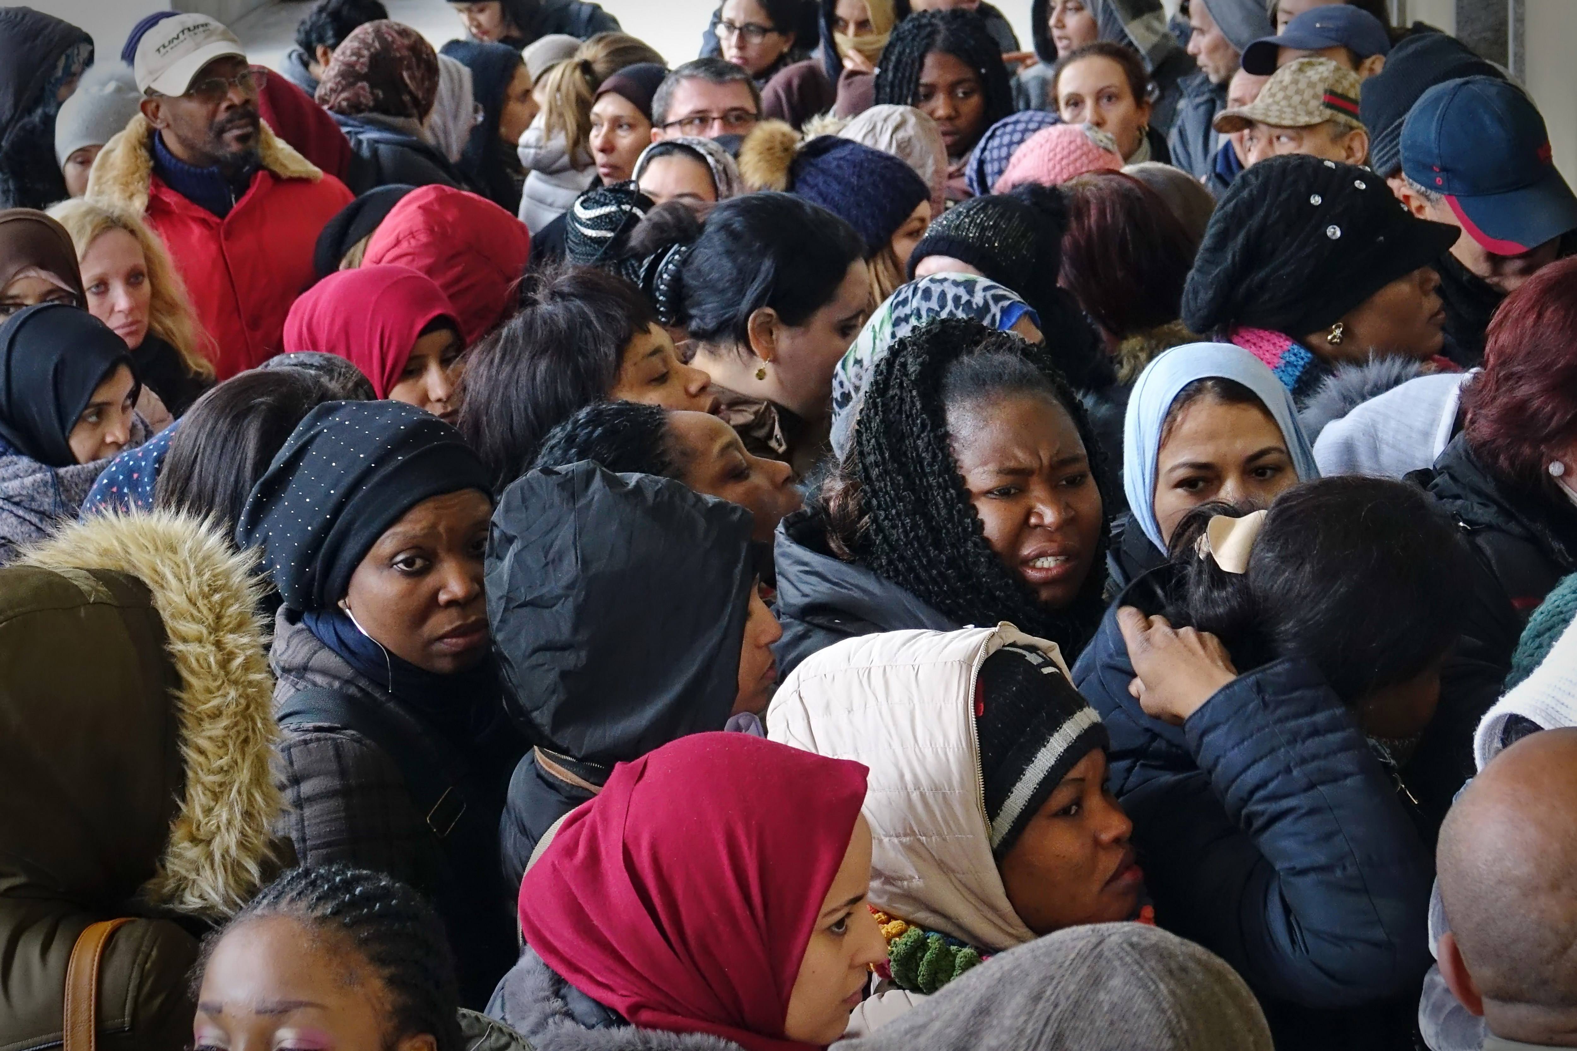
Structure of the Recommendation
Horizontal issues
Protection and support
Arrival
Residence and integration
Returns
Notes:
Horizontal issues: non-discrimination, girls, empowerment, access to information, access to justice, data collection
Protection and support : issues of violence against women, trafficking, support services, training of staff, compensation schemes
Arrival: transit and reception facilities, asylum
Residence and integration: Health, social services, participation, education, employment, residence permits, family reunion, detention
Returns

Slide 10
Horizontal issues
Non-discrimination and the needs of girls
Empowerment and access to all relevant information
Facilitate access to justice including access to legal aid
Artificial intelligence: non-discrimination and transparent governance mechanisms when such systems are used
Data protection: confidentiality, security and protection of personal data
Cooperation and support to civil society that defend & support migrant women
Collect age and sex-disaggregated data
Notes:
Non-discrimination
Ensure that there is no discrimination on any grounds, that everyone has access to their fundamental rights, including undocumented migrants, and that an intersectional approach is used
Girls
Take account of the age and specific vulnerable situation and needs of girls by adopting a child rights-based approach and applying the principle of the best interest of the child
Ensure that reception systems are appropriate to the sex and age of unaccompanied and separated girls and include suitable and safe alternative care arrangements
Ensure that unaccompanied and separated children are promptly assigned an independent and adequately trained guardian
Information, empowerment, awareness raising and promotion of human rights
Provide information in a language that the person addressed understands
Ensure access to digital services
Access to justice
Ensure access to national and international civil, administrative and criminal remedies
Ensure access to free legal aid
Ensure that the same conditions as for nationals are applied

Slide 11
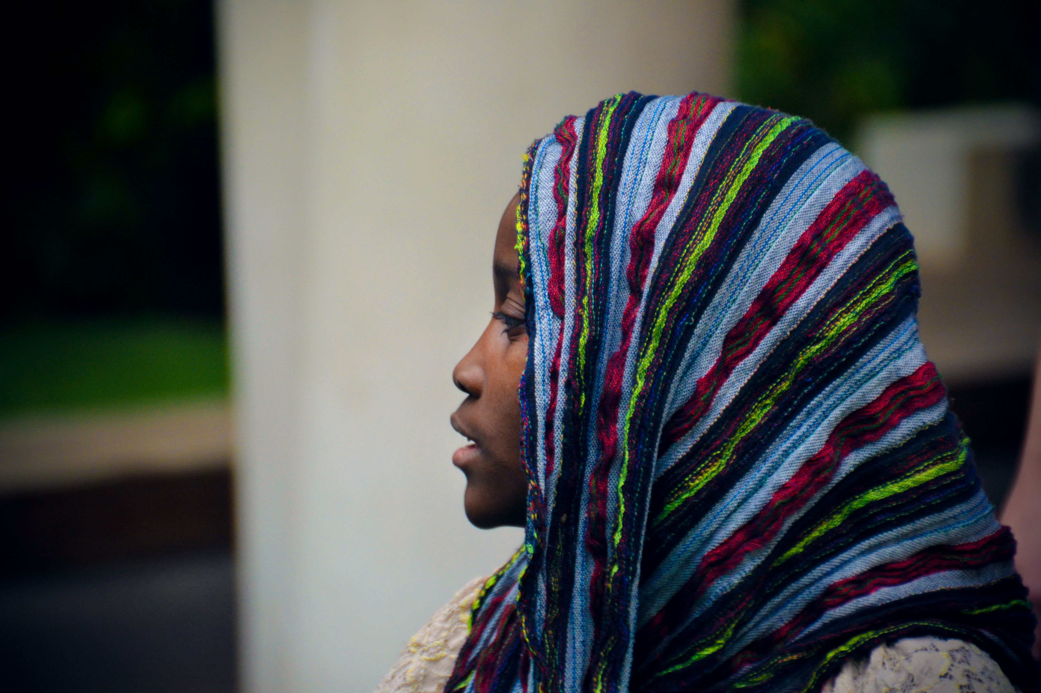
Protection & support (1)
Adopt a multi-agency, victim-centred approach that prevents secondary victimisation and is aimed at the protection and empowerment of migrant, refugee and asylum-seeking women and girls
Protection against all forms of violence against women including trafficking
Specific measures against trafficking for the purpose of sexual exploitation
Notes:
Protection from hate speech and sexism
Combat sexual exploitation
Provide psychological support and health care

Slide 12
Protection & support (2)
Measures against hate speech and sexism
Ensure that culture, custom, religion, tradition or so-called “honour” are not considered as justification for any exploitation or acts of VAW
Non-discriminatory access to shelters
Access to specialised support services + type of services needed
Access to compensation schemes & other programmes for the (re)integration of victims
Training of authorities and staff in gender equality issues and violence
Notes:
Training of relevant authorities and staff in gender equality issues and violence to allow in particular prompt identification of victims and awareness of the difficulties faced by migrant women in disclosing incidents of violence or being aware of their rights

Slide 13
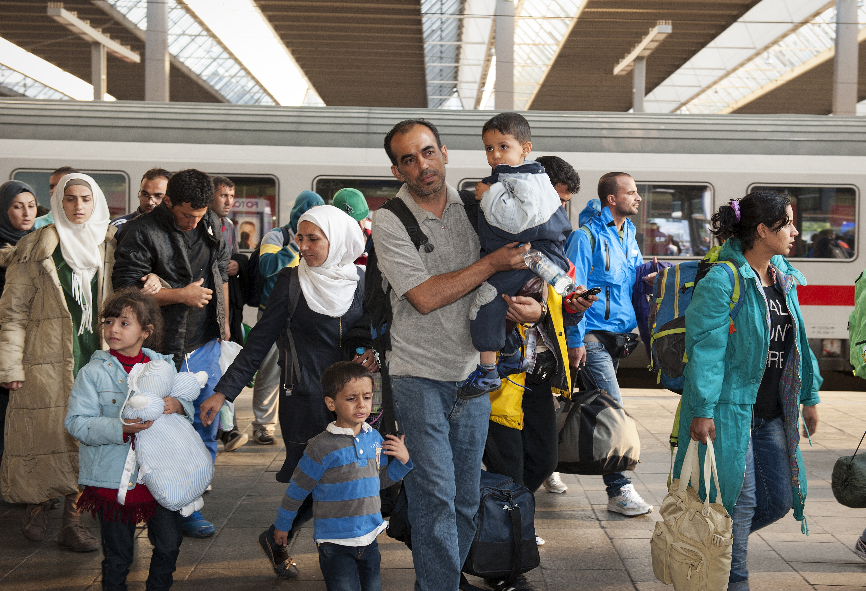
Arrival (1)
Transit and reception facilities:
concrete recommendations
(safety, hygiene facilities, separate sleeping areas…)
Access to complaint/reporting mechanisms concerning violence or other violation of rights
Regular independent monitoring of facilities
Addressing the special needs of women with disability, older, pregnant women, victims of violence
Training of staff & presence of women among staff
Notes:
Pre-arrival information
Take specific needs and characteristics into account
Provide information about legal entry and stay
Ensure that transit, reception and accommodation facilities and services are subject to regular independent monitoring

Slide 14
Arrival (2)
Asylum:
Adopt and implement age- and gender-sensitive asylum standards, practices and procedures
Ensure the possibility for women to lodge an independent asylum claim from their spouse or parents
Ensure a gender-sensitive interpretation of the 1951 Refugees Convention regarding the grounds for asylum and the recognition of gender-based violence, including trafficking in women and girls, as a possible form of persecution
Comprehensive gender-sensitive guidelines at all stages of the asylum process
Availability of women asylum officers and interpreters
separate interviews for women and men from the same family
Notes:
Provide separate interviews for women and men from the same family, including for underage married girls

Slide 15
Residence and integration (1)
Different provisions for different groups of migrants
Access to health services, including mental health and sexual and reproductive health & rights
Social services: no discrimination in access to housing and social assistance
Social and political participation: support those women who are entitled to vote and to stand for election
Access to compulsory education, higher education, vocational training, lifelong learning, language training and retraining
Facilitate the recognition of existing vocational and academic qualifications and work experience
Notes:
Health services
Should be age- and gender-sensitive
distinction between primary health care (for all, including undocumented migrant women) and other health services
Including mental health
Access should not be dependent on prior authorisation of the immigration authority
Taking into account language and cultural barriers, or disabilities, member states should ensure that women give prior, free and informed consent
Social services
Ensure that migrant status is not used to discriminate in respect of access to housing and social assistance schemes
Integration and participation
Ensure that any child born in the territory of a member state is entitled to be registered immediately after birth and is granted a pathway to a nationality
Ensure that those migrant and refugee women who are entitled to vote and to stand for election are aware of their rights and can participate without any form of discrimination
Education
Ensure access to compulsory education equal to that of nationals
Reach those who have been prevented from accessing education in their country of origin
Provide access to available higher education, vocational training, lifelong learning, retraining and rehabilitation facilities
Facilitate the recognition of existing vocational and academic qualifications and work experience
Provide quality language training

Slide 16
Residence and integration (2)
Promote access to employment and eliminate all forms of labour exploitation and discrimination including domestic workers
Access to work-life balance measures and other support measures (loans, volunteering, self-employment etc.)
Women granted a residence permit on the basis of a family relationship to be entitled to social rights and benefits in an autonomous capacity
Victims of violence whose residence permits depend on the spouse to be granted autonomous residence permits
Notes:
Employment
Prevent discrimination and promote access to employment for lawfully present migrant women
Comply with the obligations regarding the right to work and self-employment for refugee women and girls set out by the 1951 Convention
Eliminate all forms of labour exploitation and discrimination
protect domestic workers from discrimination, exploitation and abuse
Residence permit
Women who are granted a residence permit on the basis of a family relationship are entitled to social, economic and labour-related rights and benefits in an autonomous capacity
Victims of violence should be granted an autonomous and renewable residence permit
The evidentiary criteria and threshold for the granting of residence permits should be realistic and sensitive to the individual situation
Responsible statutory agencies should be adequately trained
Assist victims of forced marriage
Provide security of residence to migrants who have been present in a country for a long time, particularly for victims of VAW and women whose children are nationals of the host country
Provide pathways to naturalisation
Family reunion
Accept the transfer of asylum claims to enable the family reunion of families who got separated during the journey

Slide 17
Detention
Age- and gender sensitive approach to all aspects of deprivation of liberty (infrastructure, assistance, presence of women among staff etc.)
Places of deprivation of liberty, including administrative detention facilities to be subject to regular independent monitoring.
Administrative detention in the context of migration as last resort
Unaccompanied or separated girls should not, as a general rule, be detained.
Effective alternatives to administrative detention for some groups of women
Notes:
victims of torture or violence against women, including trafficking in human beings, pregnant and nursing women, elderly women and women with disabilities.

Slide 18
Returns
Voluntary returns are the preferred option & in safety and dignity
Non-refoulement from a gender sensitive perspective = no removal to a country where women’s life would be at risk or where they might be subject to torture or inhuman and degrading treatment or punishment including those acts which disproportionately affect women and girls or are directed at them because they are women or girls
Respect the right to family life and take into account the vulnerable situation of the person.
Notes:
vulnerability = ex pregnancy
For girls, the best interest of the child should be a primary consideration
Minimise the risk of refoulement for victims of VAW and human trafficking
Possibility of suspension of expulsion measures for migrant women where the decision was based on their status of being dependent on a spouse, to and enable them to apply for an independent residence permit

Slide 19
Conclusions
A comprehensive practical text
Support institutions and professionals working with migrant women
Raising awareness about existing rights
Need for:
Dissemination
Implementation
Cooperation with NGOs representing migrant women

Slide 20
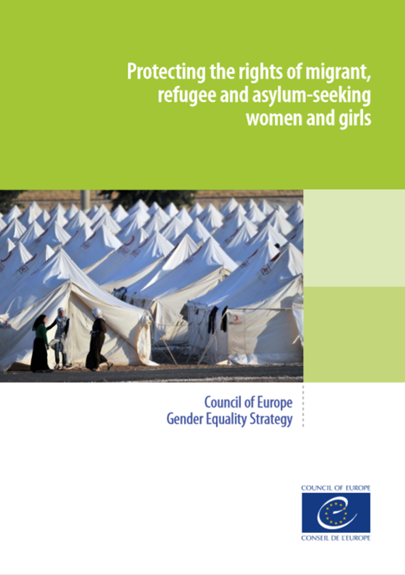
Cecile.greboval@coe.int
www.coe.int/equality

