Slide 1

European judicial systems
Efficiency and quality of justice
2020 edition (2018 data)
Update: 06/04/2020

Slide 2
The European Commission for the Efficiency of Justice
(CEPEJ)
Unique body composed by qualified experts from the 47 member States of the CoE
Develops tools and proposes concrete measures to improve efficiency and quality of the public service of justice by:
Promoting the effective implementation of instruments for the organisation of justice
Ensuring public policies concerning courts take into account the needs of the justice system users
Offering States effective solution to prevent violations of Art. 6 of the European Convetion on Human Rights

Slide 3
2020 CEPEJ
Evaluation Report
Tables, graphs and analyses
Country Profile
CEPEJ -STAT
47
Member
states and entities
evaluated
+3 observers
20
Months to collect, check and analyse data, to draft the reports and to build the internet database

Slide 4
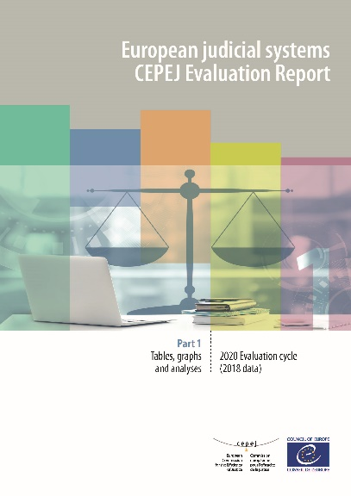
Tables, graphs and analyses (Part 1)
Budgets
Efficiency and Quality
Court organisation
Justice Professionals
Impact of e-Justice in the context of the Covid-19 crisis
ICT
Users
Overview of the judicial systems and Identification of trends
Best Practices

Slide 5
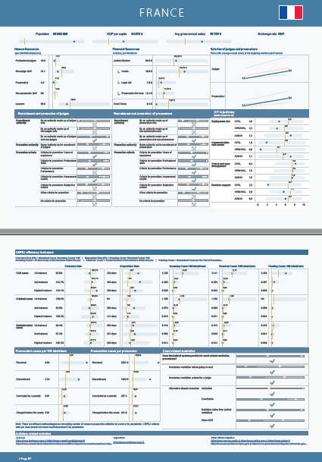
Country profiles (Part 2)
Information on resources, salaries, recruitment and promotion of judges and prosecutors
Efficiency: Clearance Rate (CR) and Disposition Time (DT)
Development of ICTs
Use of the median to situate a country in an European perspective

Slide 6
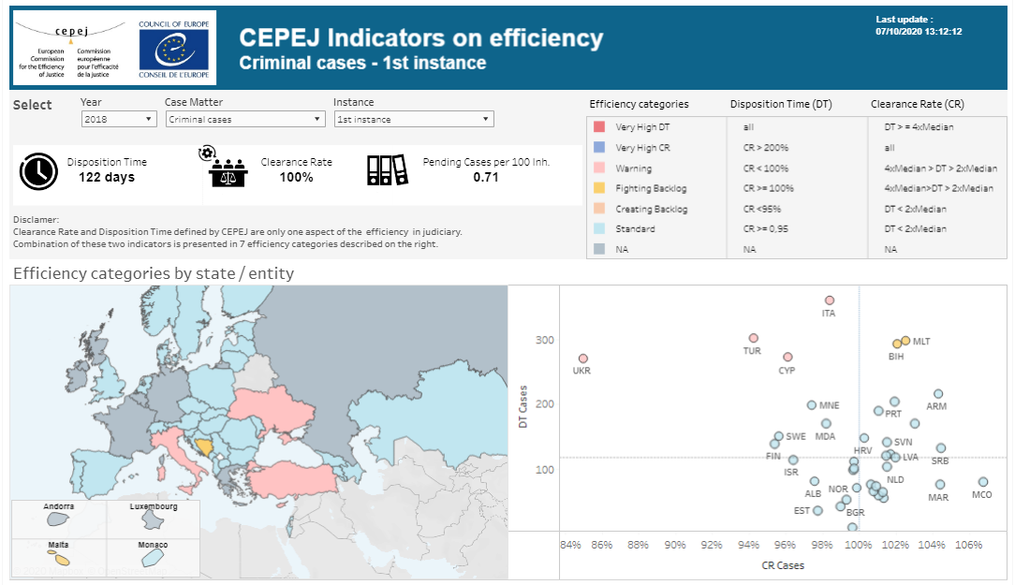
CEPEJ-STAT
Qualitative and Quantitative data collected since 2010
Countries’ comments
New: Efficiency Dashboard
New: Extended country profile

Slide 7
JUDICIAL SYSTEM BUDGET
JUDICIAL SYSTEM BUDGET
1 Bn €
72 € per inhabitant
LEGAL AID BUDGET
(11% of JSB)
PROSECUTION SERVICES BUDGET
(24% of JSB)
COURT BUDGET
(65% of JSB)
Spent on average by the European States

Slide 8
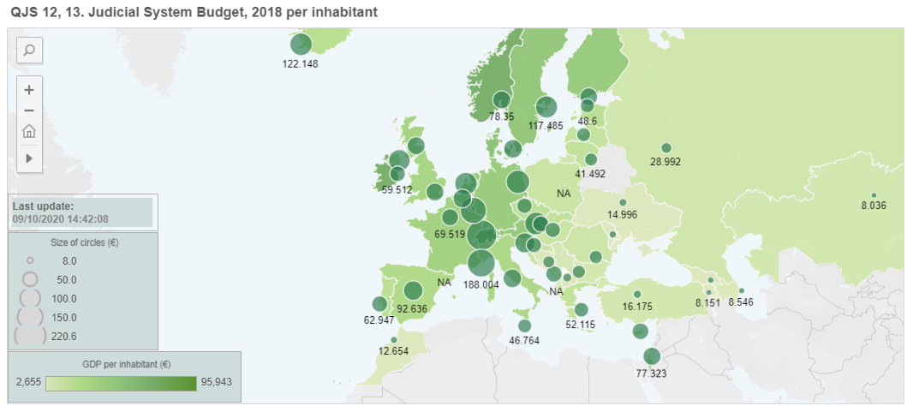
JUDICIAL SYSTEM BUDGET
Judicial System Budget in € per inhabitant and GDP per inhabitant
72 € Per inhabitant
0.33% of GDP
8 € than in 2016

Slide 9
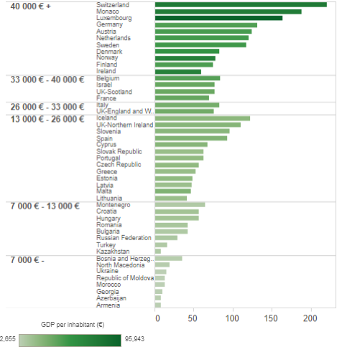
Which countries invest the most in their judicial systems?
Countries with higher GDP per capita
invest more
€ per inhabitant

Slide 10
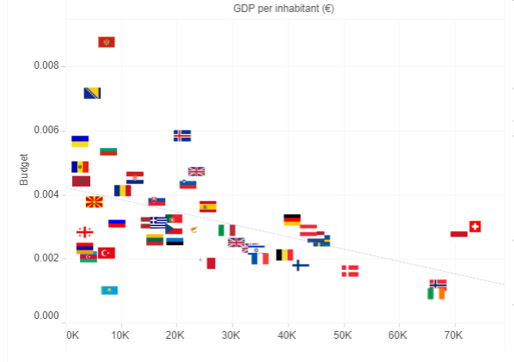
Which countries invest the most in their judicial systems?
JSB % of GDP
Countries with lower GDP per capita
invest more as
% of GDP
0.88% in Montenegro
0.72% in Bosnia and Herzegovina
GDP per capita

Slide 11
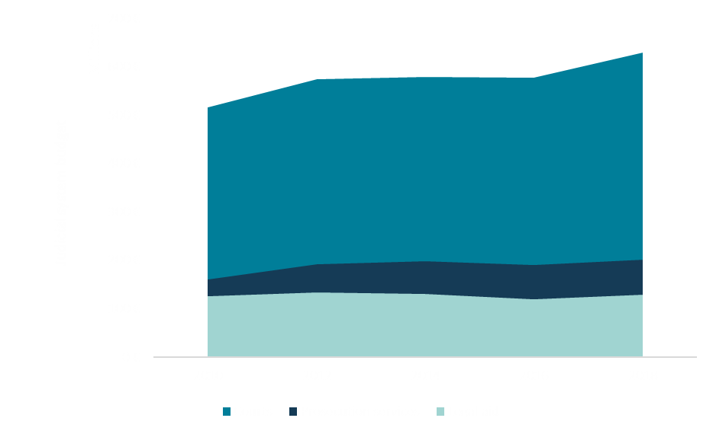
Evolution of average approved judicial system budget
+8%
Between 2010 and 2018
Figure 2.2

Slide 12
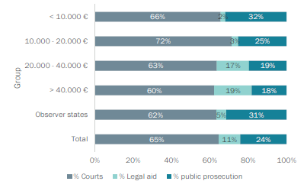
Components of the judicial system budget
Less wealthy countries invest proportionally more on prosecution services (32% on average)
Countries with higher GDP per capita spend relatively more in legal aid (19% on average)
Figure 2.6

Slide 13
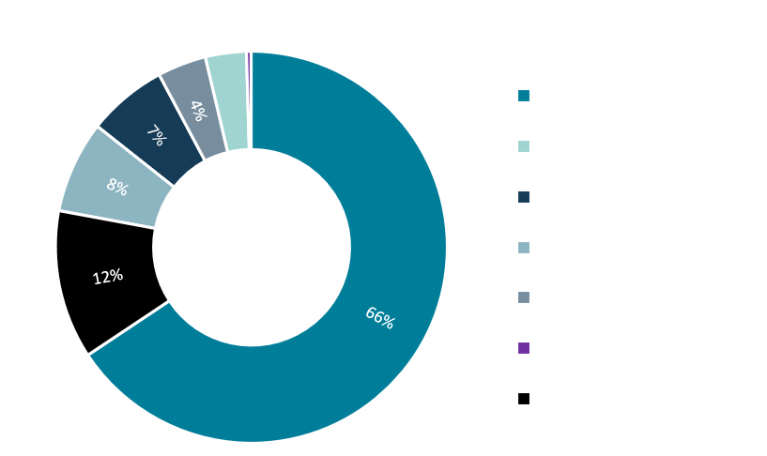
Budget allocated to Courts
Budget allocated to courts seems to be related to:
Wealth of a country
Number of courts (66% spent on salaries)
Figure 2.13

Slide 14
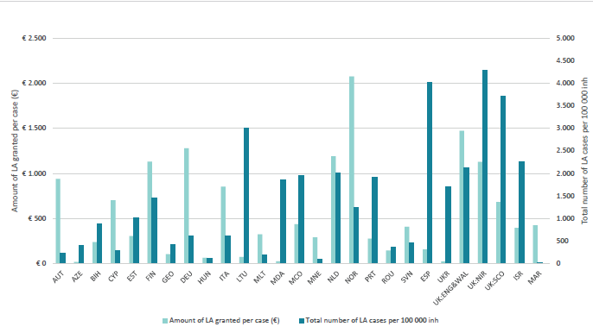
Legal Aid
All countries have implemented a legal aid system in criminal and other than criminal matters in compliance with the requirements of the European Convention on Human Rights and the case-law of the European Court
Some countries tend to have a low cost per legal aid case and a high number of cases granted legal aid, while others choose to provide a higher amount for a smaller number of cases
Figure 2.30

Slide 15
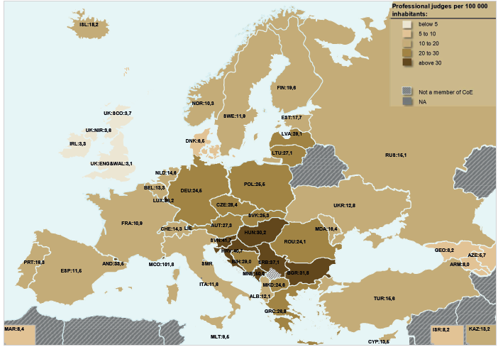
JUSTICE PROFESSIONALS: Judges
21
judges per 100 000 inhabitants on average
Map 3.2

Slide 16
JUSTICE PROFESSIONALS: prosecutors
Statutorily
Independent in
31 States
cases per 100 inhabitants
3
Prosecutors per 100 000 inhabitants
12

Slide 17
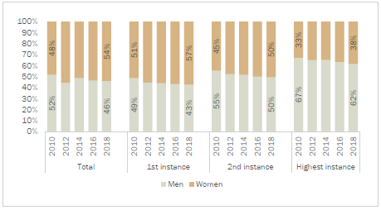


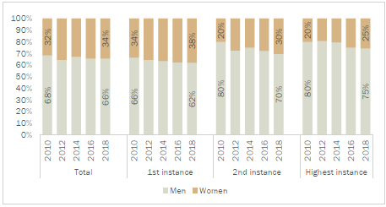
GENDER EQUALITY:
Judges / Court presidents
Distribution of judges by gender and by instance
Figure 3.31
Distribution of court presidents by gender and by instance
Figure 3.33

Slide 18
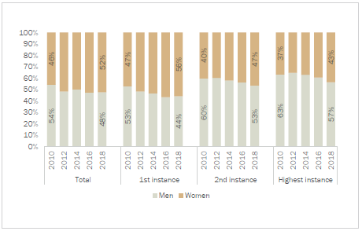
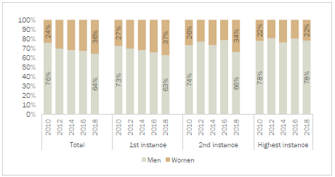
GENDER EQUALITY:
Prosecutors / Heads of prosecution offices
Distribution of public prosecutors by gender and by instance
Figure 3.32
Distribution of heads of prosecution offices by gender and by instance
Figure 3.34

Slide 19
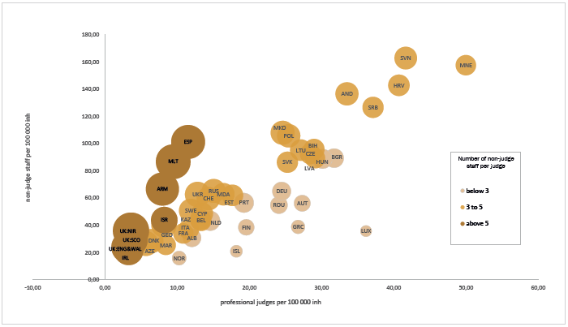
JUSTICE PROFESSIONALS:
Non-judge staff
Number of non-judge staff per 100 000 inhabitants compared to the number of professional
judges per 100 000 inhabitants; number of non-judge staff per professional judge
4
Ratio between non – judge staff and professional judges
1 in Luxembourg
10
in Northern Ireland
Figure 3.13

Slide 20
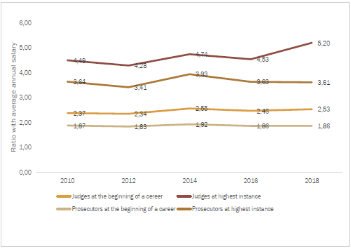
JUSTICE PROFESSIONALS:
Salaries of judges and prosecutors
Judges
At the beginning of career
At the highest instance
0.9 (Germany)
1.6 (Germany)
Variation in the average ratios of gross salaries of judges and public prosecutors in relation to annual gross salaries 2010 - 2018
4.8 (Ukraine)
31.5 (Ukraine)
Prosecutors
At the beginning of career
At the highest instance
0.8 (Ireland)
1.6 (Germany)
4.0 (Romania)
6.4 (Italy)
Figure 3.38

Slide 21
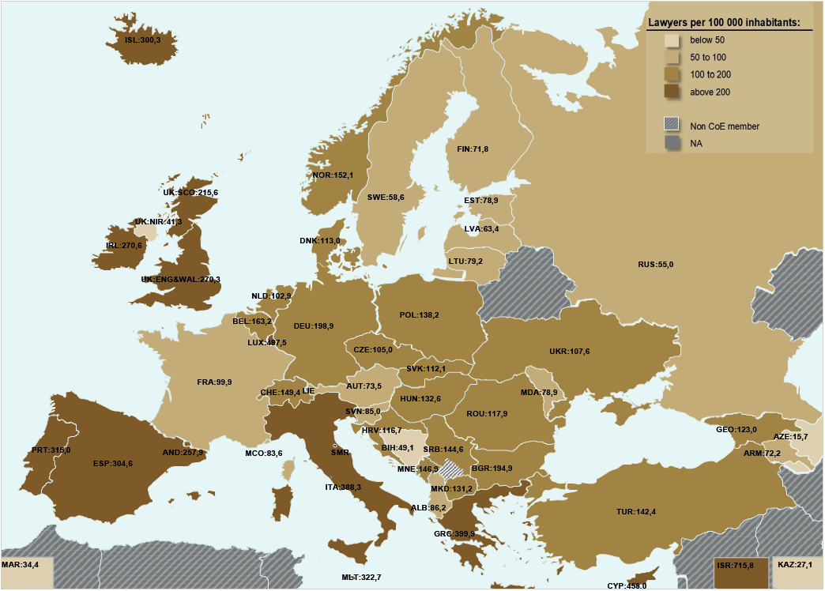
JUSTICE PROFESSIONALS:
Lawyers
164
Per 100 000 inhabitants
+ 27%
Between 2010 and 2018
Map 3.39

Slide 22
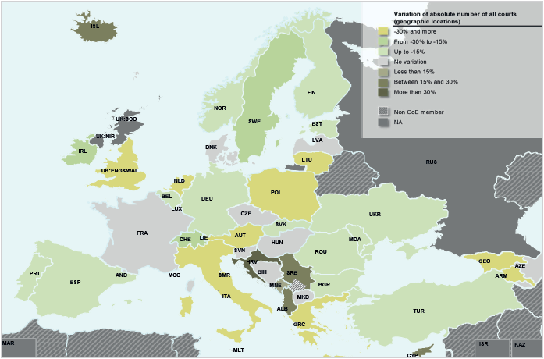
COURTS
2010 -> 2018
-19%
On average for the 1st instance courts of general jurisdition
-10%
General reduction of courts in Europe
On average for the absolute number of all courts (geographic locations)
Map 4.1.6: Variation of absolute number of all courts (geographic locations), 2010 - 2018

Slide 23
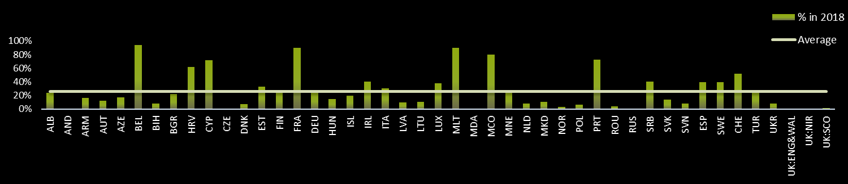
SPECIALISED COURTS
Partipation of first instance specialised courts within the total number of first instance courts (legal entities)
On average
21%
26.7%
In 2010
In 2018

Slide 24
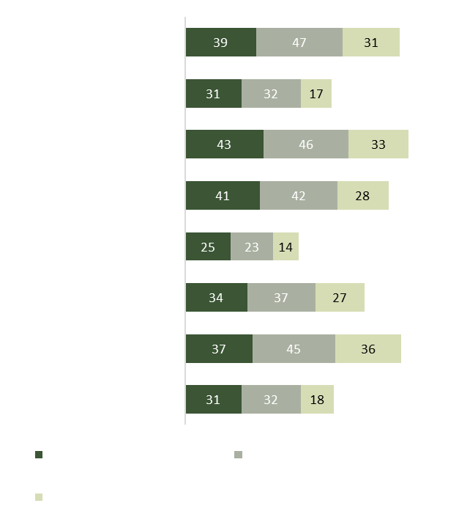
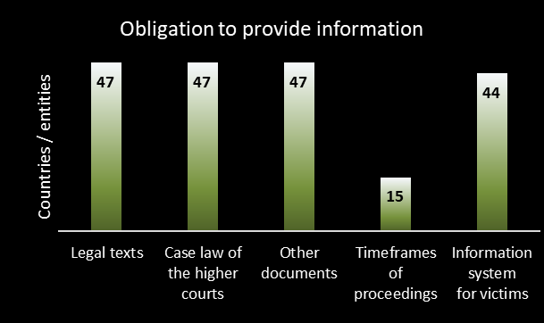
COURT USERS
Most of the States provide information to users (in particular to vulnerable categories)
43 States have compliaint procedures
€ 6 353 is the average amount of compensation in 2018
Figure 4.2.1
Figure 4.2.2

Slide 25

COURT USERS
Satisfaction surveys
Legitimacy
Efficient service

Slide 26

Infomation and Communication technology (ICT)
General ICT index varies among States/entities
Average Total ICT Deployment Rate and per category in 2018
1.52
In Cyprus
9.79
In Latvia

Slide 27
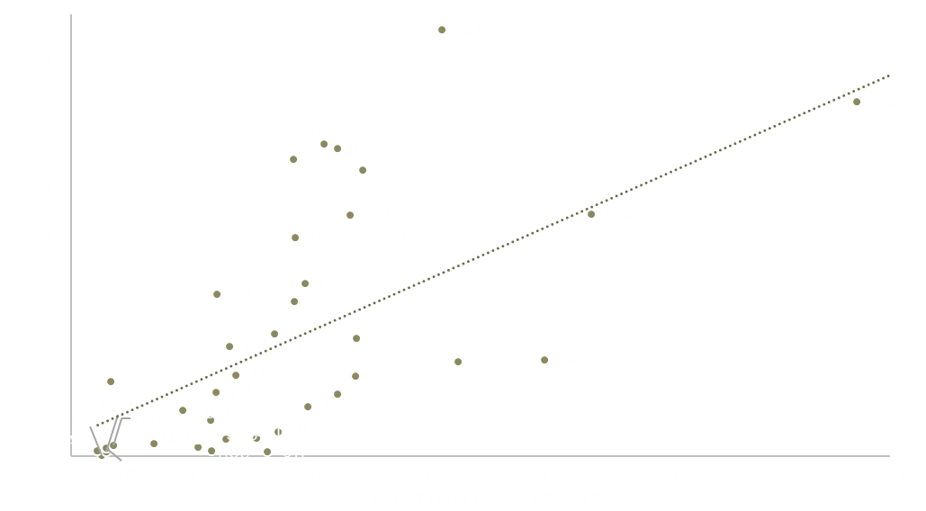
Infomation and Communication technology (ICT)
Implemented budget of courts per capita vs implemented budget dedicated to ICT per capita in 2018
Figure 4.3.2

Slide 28
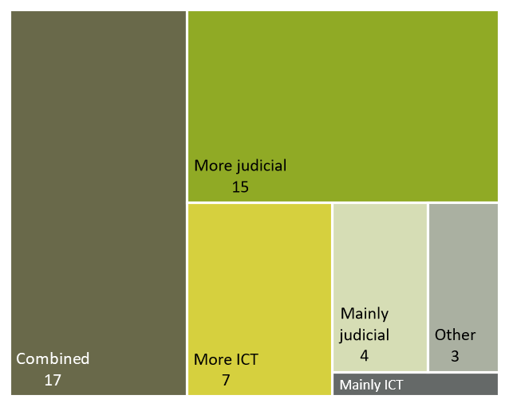

Infomation and Communication technology (ICT)
Leadership in governing of ICT in 2018
Figure 4.3.5

Slide 29
Justice in the context of Covid-19 crisis
Indispensable tools during the crisis
Changes in legislation
Technical improvements
Too early to asses their actual impact
CEPEJ Declaration on lessons learnt (10 June 2020)

Slide 30
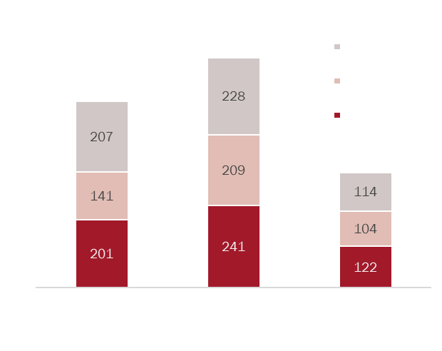
EFFICIENCY
Disposition Time by area of law in 2018 (median in days)
Average Clearance Rate stable and close to 100%
Figure 5.2

Slide 31
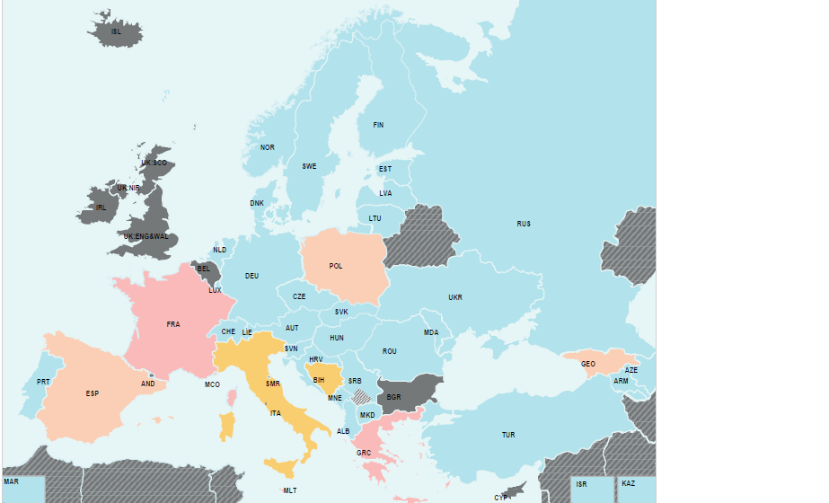
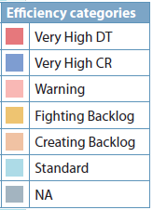
EFFICIENCY
First instance Civil and commercial litigious cases
201 days
in first instance courts
141 days
In second instance courts
207 days
Map 5.8
In third instance courts

Slide 32
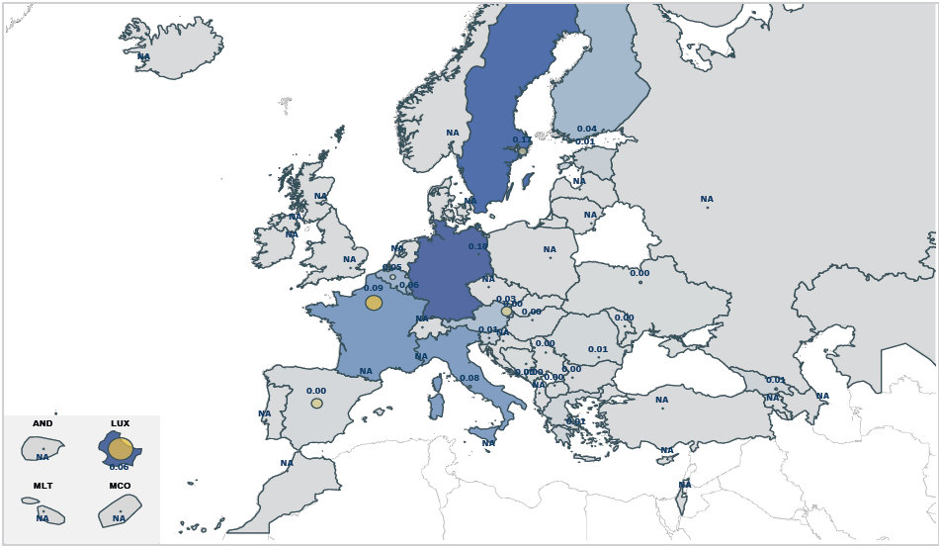
EFFICIENCY:
Asylum Seekers and Aliens’ cases
291 443 cases
- 8 % than in 2016
In Germany
149 593
+ 84% aliens’ cases

Slide 33
USEFUL LINKS
Presentation Notes link
Special report link
Part 1: Tables, graphs and analysis
Part 2: Country Profiles
Part 3: CEPEJ-STAT database

Slide 34
Thank you

Slide 35



http://www.coe.int/cepej/
CEPEJ Council of Europe
@CEPEJ_CoE

