Slide 1
ETINED Plenary
Strasbourg
Reviewing the Code of Professionalism and Conduct in Scotland: a case study of good practice on the review of codes for teachers
Tom Hamilton Maria Golubeva
February 2018

Slide 2
Ethics Transparency and Integrity in Education Platform
Working Group on Ethics in Education
Council of Europe’s preferred term: Codes of Ethics.

Slide 3
Previous Texts and Sources
Ethics, Transparency and Integrity in Education:
Volume 2 – Ethical principles (Council of Europe, 2016) (Smith and Hamilton)
Volume 3 – Ethical behaviour of all actors in education (Council of Europe, 2016) (Smith and Hamilton)
Codes of Conduct for Teachers in Europe: A background study for the Council of Europe Platform on Ethics, Transparency and Integrity in Education (Council of Europe, 2017) (Golubeva and Kalnins)
Earlier UNESCO and IIEP publications

Slide 4
Golubeva and Kalnins (2017)
Codes of conduct are instruments that formulate positive ethical principles for the profession and provide specific guidance on the conduct and practices expected from teachers.

Slide 5
Purposes of Codes
Codes tend to have the following purposes:
be expressions of the profession’s values and principles
strengthen the ethics of the teaching profession and improve the quality of teaching
improve the education experience for students and their parents
guide, support and professionally socialise teachers - particularly inducting new teachers
act as regulatory tools which prescribe standards of conduct
be a means of communicating the profession’s standards to other stakeholders
be a flexible means of tackling new challenges and reflecting changes in the education environment (eg the growing importance of online communication)
(Golubeva and Kalnins, 2017)

Slide 6
Successful Implementation
Successful implementation of codes of conduct depends on methods of development and dissemination. The following approaches add impact:
Stakeholder involvement in development;
Integration of dissemination into training and professional review of teachers;
Practical workshops and seminars for teachers on how to implement codes.
(Golubeva and Kalnins, 2017)

Slide 7
The General Teaching Council of Scotland (GTCS)
1965 non-departmental public body
2012 independent Professional, Statutory Regulatory Body
Register teachers
Standards for teachers
Teaching qualifications
Initial Teacher Education
Professional Update
Conduct and competence
Code of Professionalism and Conduct (COPAC)

Slide 8
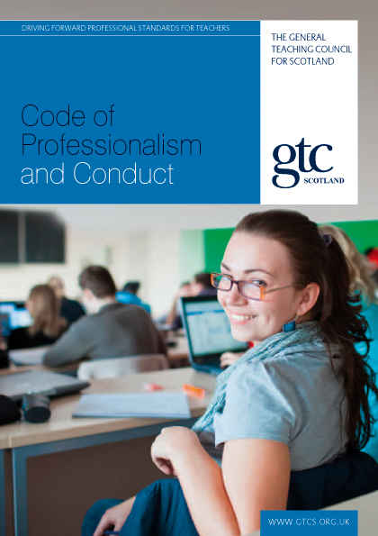
Code of Professionalism and Conduct

Slide 9
Code of Professionalism & Conduct
Original Code introduced in May 2008 and revised version came into force on 2 April 2012
Provides guidance of the conduct expected of a registered teacher in five parts:
Professionalism and maintaining trust in the Profession
Professional responsibilities towards pupils
Professional competence [fully registered teachers]
Professionalism towards colleagues, parents & carers
Equality and Diversity

Slide 10
Case Study Objectives
To assess the goals and methods of the review process
To identify key stakeholders’ views on the goals, values and effectiveness of the COPAC and the aspects that need to be improved/redefined
To identify aspects of the review that can be considered good practice and can be transferrable to other education contexts/countries

Slide 11
Methodology
Builds on pervious ETINED work
Interview with GTCS personnel
Questionnaire survey of relevant actors within Scottish education system

Slide 12
GTCS Rationale for the Review of COPAC
What needs to be changed and why (GTCS and Stakeholders):
Spirit and the tone of the document out of date and too much top-down
No longer reflects values and priorities of current policies (not sufficient emphasis on social justice)
Embed COPAC across the range of professional standards
End division between COPAC and Standards to ensure they complement each other
Reflect on the practices and presence of teachers on social media

Slide 13
Rationale for the Review of COPAC: Stakeholders
Address issue of respect by teachers for students (regardless of race, ethnicity, gender, sexuality, disability, etc)
Address the use of the use of aggressive, derogatory, sarcastic or demeaning language towards pupils
Prevent the abuse of COPAC as a disciplinary tool by line managers and employers
Reclaim COPAC as a document owned by the teaching profession
Integrate COPAC more closely with Professional Update
COPAC is a document of high relevance for the principles and practices of the teaching profession in Scotland
Use is widespread - teaching profession, various bodies and authorities
Perceived imperfect use of the code

Slide 14
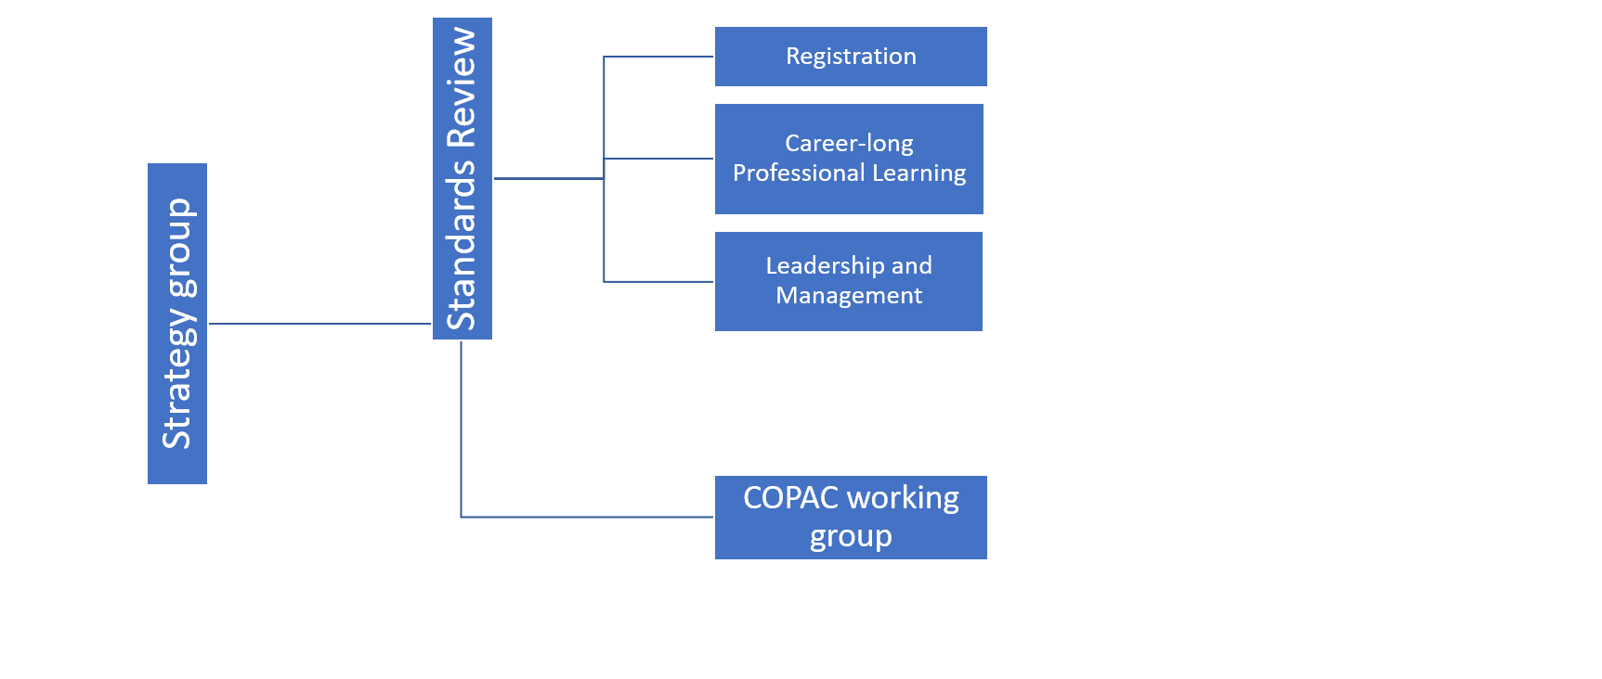
Stakeholder Involvement and Structure of the Consultation Process

Slide 15
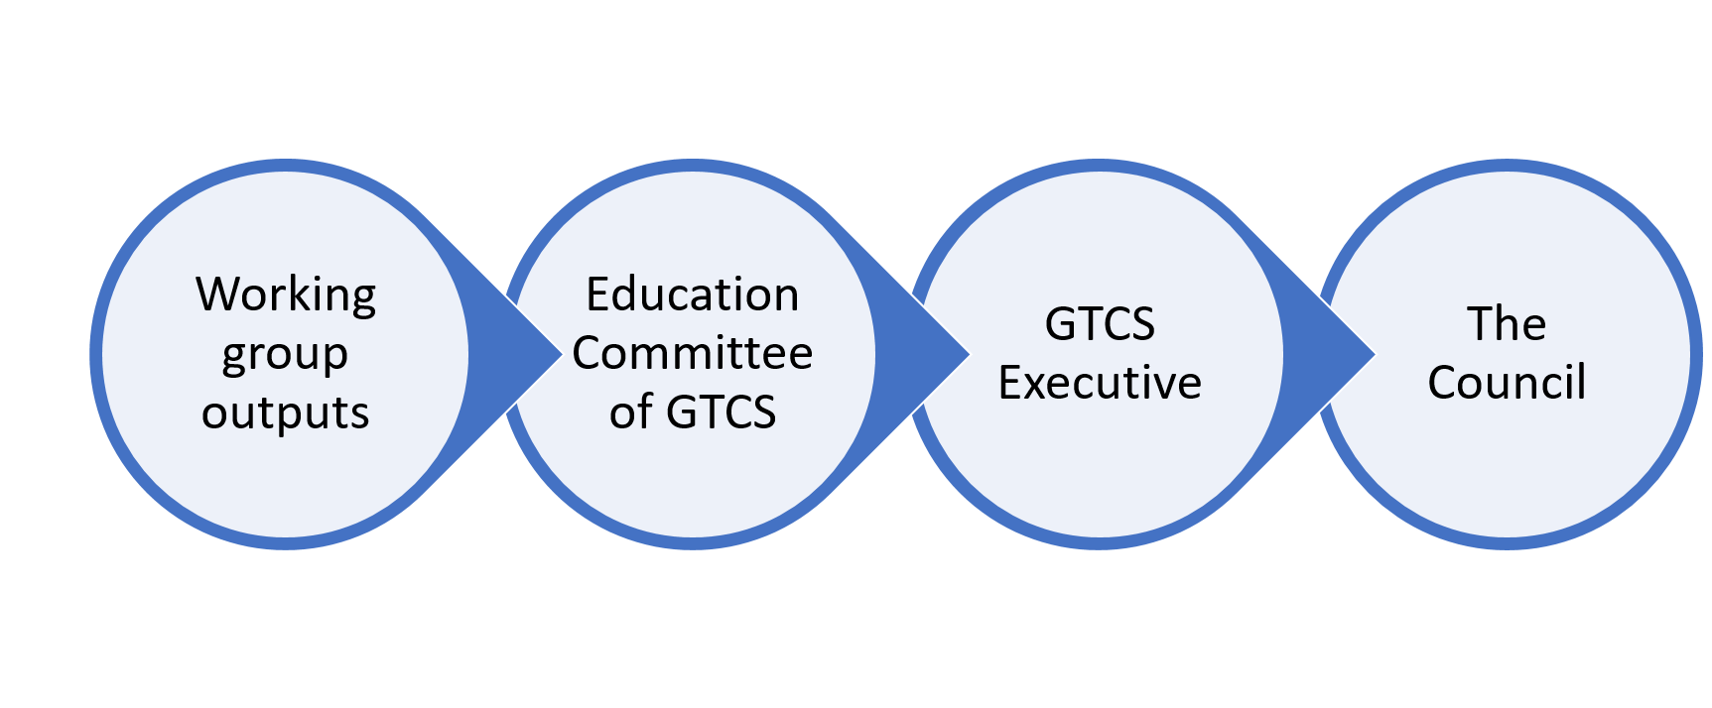
GTCS Processes

Slide 16
Working Groups
Chaired by a Council member
GTCS staff member as servicing officer
Further members:
  Scottish Government
  local government
  teacher unions
  teachers
  universities
  parents
Co-opt members with specialist knowledge as necessary
COPAC working group Chair is an elected registered teacher

Slide 17
Review Process
Inclusive as possible
Potentially stormy meetings
Lengthy review process - a two-year period
Acceptance that process would itself evolve and hence flexibility built in
Outcomes should be acceptable to all stakeholders including, very importantly, the teaching profession

Slide 18
Public consultation
Online mechanisms:
  questionnaires
  video conferencing
  social media
Face-to-face meetings
  teaching profession
  other stakeholders
  variety of regional venues
Communications channels through stakeholder organisations such as parent associations.
Focus groups
  school pupils
  young people (Scottish Youth Parliament)

Slide 19
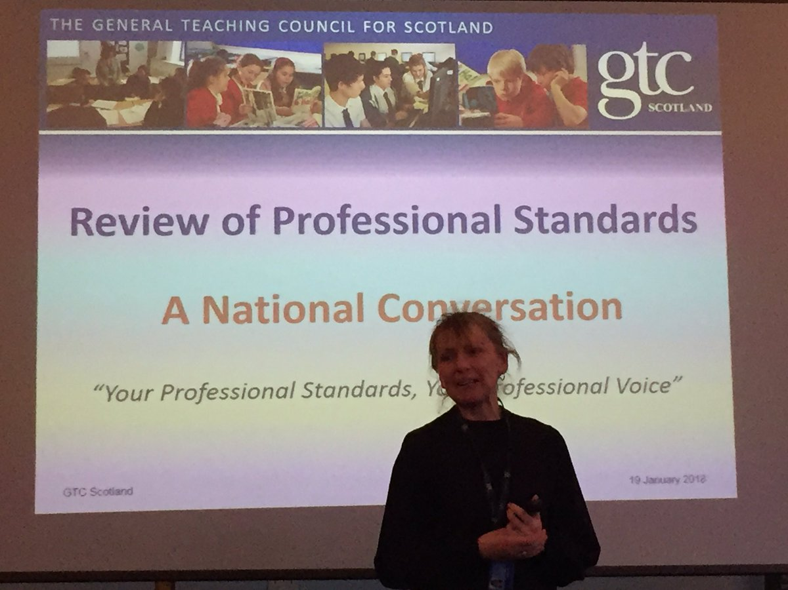
Review of the Standards and COPAC

Slide 20
Recommendations 1
Once established, there should be regular reviews of codes of ethics in order to reflect developments in teaching, teacher professionalism and society.
New areas of challenge and responsibilities emerging with social change should be reflected in reviewed codes: e.g. teachers’ practices of e-communication and responsible use of social media, teacher’s role in community cohesion and many other issues.
It is advantageous to have a strong professional body such as the GTCS managing consultation process and then providing guidance on the application of the code. In countries where codes of conduct are established by teachers’ organisations, it would be appropriate that these organisations also claim process ownership in the review.
In countries where codes are introduced by ministries of education or related public authorities, those institutions would be the most appropriate conveners of the review process, but the teaching profession’s ownership of the code should be ensured in any case.

Slide 21
Recommendations 2
A strong and procedurally robust stakeholder involvement in the development of and subsequent revision of codes is an absolute necessity. This is clearly evident in the review of COPAC where teachers are central to the review of the existing code and the development of its next iteration.
It is also necessary and clearly advantageous to have the strong involvement of other stakeholders, including, among others, schools, parents, local authorities and teacher education providers in such reviews. This helps to ensure that the revised code reflects the needs of the education system and society, and helps to support its acceptance and use.
Even with a well-established code such as COPAC, there should be an emphasis on the strong integration of dissemination activities within teachers’ education, training and professional review.
Advice on the use of a Code of Ethics should be provided and there should be practical workshops and seminars for teachers and employers with the involvement of the professional body or bodies responsible for the code. Supporting materials for teachers on what constitutes good practice are also needed.

Slide 22
Recommendations 3
Codes should be part of the infrastructure of professionalism, such as Standards, and clearly linked with other documents and policies. The tone of the codes should be positive and aspirational, encouraging individual teacher responsibility for behaviour and professional ethics.
However, codes should also be clearly linked with adequate disciplinary procedures and processes if there are violations of the code.
It is important to ensure that the profession’s ownership does not end with the process of adopting or reviewing a code of ethics/ conduct.
The use of the code by employers and local authorities should be monitored, in order to avoid situations when the code is used as an instrument to impose excessive external controls on teacher’s professional activity.
Ultimately, it is important that a code builds teachers’ professional identity and empowers them as professionals.

Slide 23
Post Script and Caveat
Scottish Government: Educational Governance Review
Education Workforce Council Scotland Proposals
The best laid schemes o' mice an' men
Gang aft a-gley.
To a Mouse
Robert Burns (1759-1796)

Slide 24
Conclusions and Thanks
Questions
Points
Discussion

