Slide 1
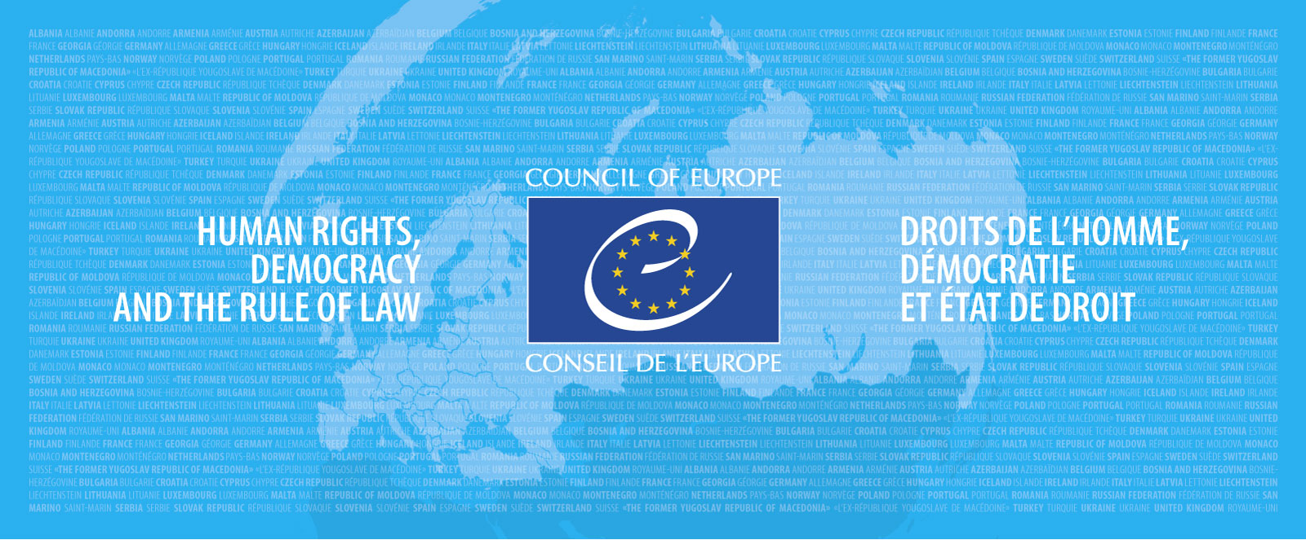
The European Ethical Charter on the use of AI in judicial systems and their environment

Slide 2

Background
Judicial decisions increasingly made available in the form of open data
New developments in CoE member states
New AI applications for the judiciary brought to the attention of policy makers

Slide 3
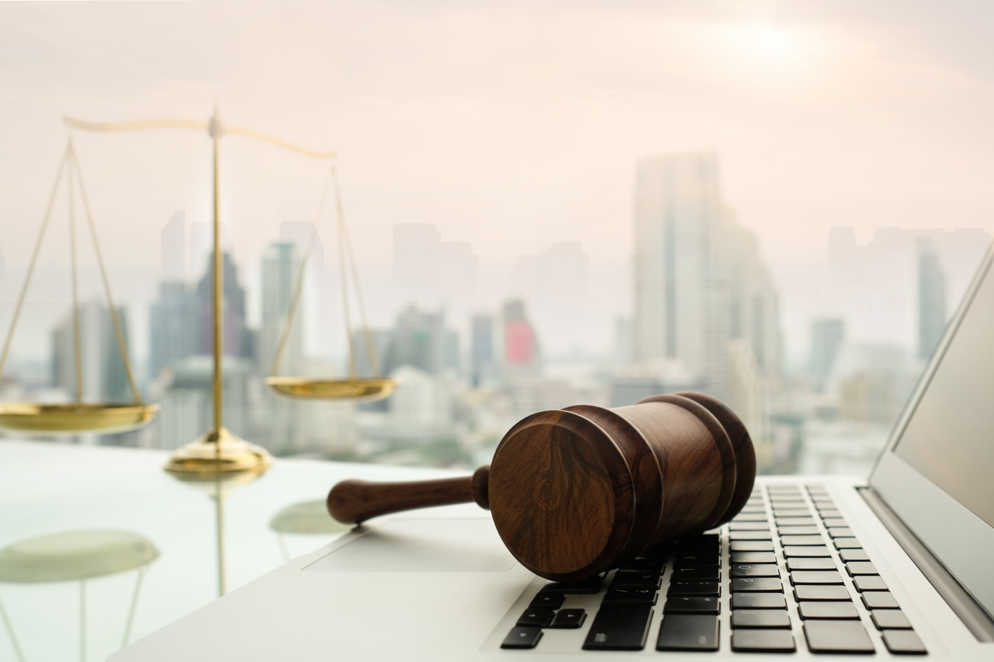
1) Provide a scientific, unbiased view of the possibilities and limits of some AI applications
P
Objectives of CEPEJ work
2) Highlight concerns and help identifying « positive » solutions
3) Advise on governance and ethical
aspects
Notes:
in line with human rights and meeting the interests of justice

Slide 4

Case law in open data: fuel for AI applications
As part of a global movemement calling for transparency and accountability of public action, growing tendency (including in Europe) to make available data coming from public institutions (including courts’ decisions) in the form of freely downloadable databases

Slide 5
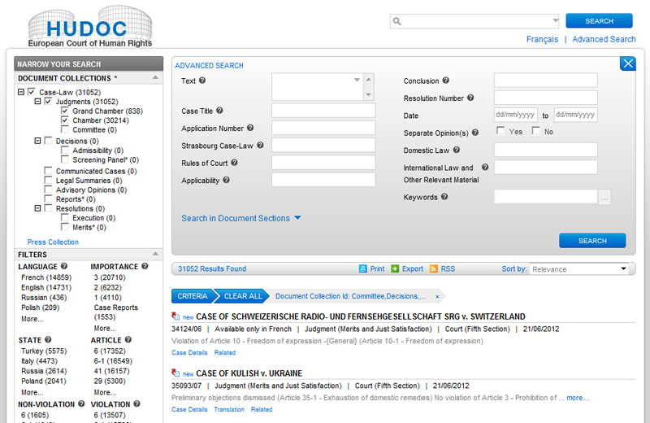
Case law in open data – points of attention
Open data: Access to data not to information
2/ Open data policies are not a new way to ensure directly an access to judicial decisions: this is access to information
Access to decision is already ensured by search engines in almost all Council of Europe member States (89%)

Slide 6
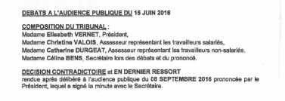
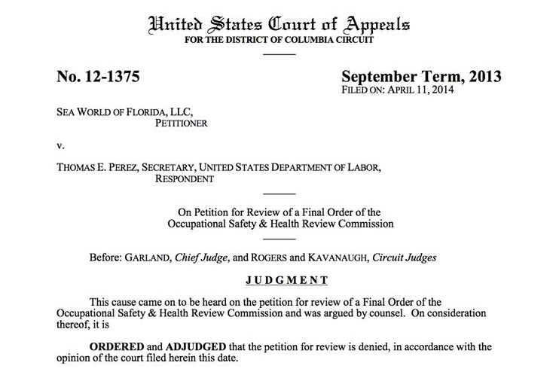
Case law in open data – points of attention
Open data: Access to data not to information
3/ Open data policies per se do not improve the publicity of court decisions nor the transparency of justice
Name of the judge, court clerks, parties must be written in court decisions
Open data does not guarantee as such this transparency goal: on the contrary, it can lead to possible misuses (profiling, forum shopping,…)

Slide 7

Case law in open data: fuel for AI applications
Case study: France
2016 law on the « digital Republic » → all court decisions at all instances to be disseminated in the form of open data, for free and with respect for the privacy of the persons concerned
This public availability is preceded by an analysis of the risk of reidentification of the persons concerned – not yet in place
  → Data protection concerns: names, addresses, sensitive data included in judicial decisions
    → At best pseudonymisation and not anonymisation
  Careful about the possible use which can be done of these data (names of parties, witnesses, judges) by third parties

Slide 8

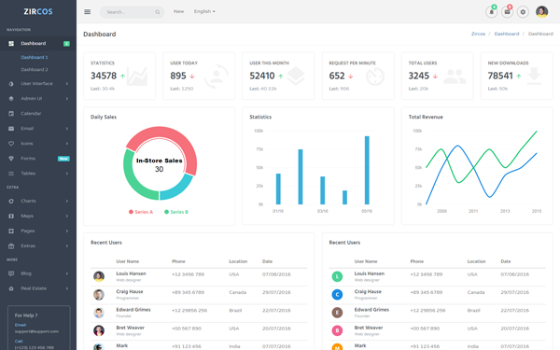


IA applications
Artificial intelligence (AI) : possible use with case law
1
2
3
4
Search engines
Administration of justice
Chatbot
Predictive justice

Slide 9
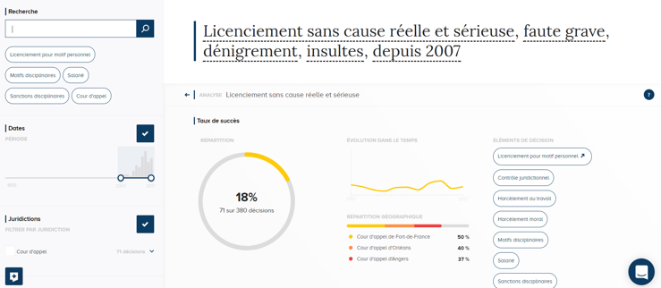
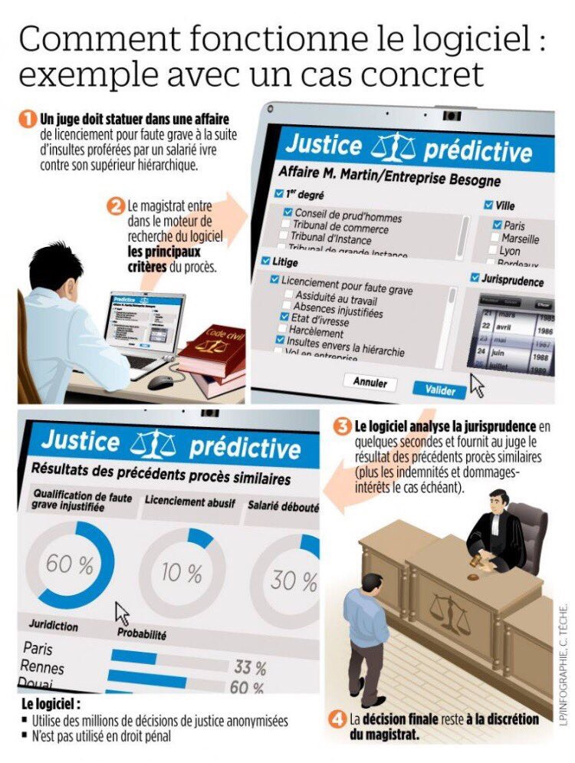
Application
« Predictive » justice?
Software anticipating a judicial decisions based on the analysis of a large quantity of case law

Slide 10

Definitions
A « predictive » justice?
Predictive : Word coming from hard sciences, which describes methods allowing to anticipate a situation
Prae (before) / Dictare (say) : Say before something happens
Prae (before) / Visere (see) : See before something happens, based on visibile findings (empirical and measurables)
In a narrow sense, building anticipation tools relates more to forecasting than predicting

Slide 11
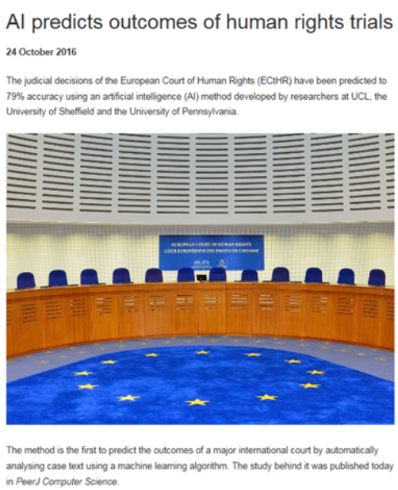
Study
Study of the University College of London based on 584 decisions of the ECtHR:
79% of decisions anticipated

Slide 12
Study
A machine that operates a probabilistic treatment of lexical groups
The joint processing of automatic natural language processing and automatic learning enabled the machine to identify lexical groups and classify them according to their frequency in violation or non-violation decisions
A machine that gets better prediction results on the "facts" part
The success rate of replication of the result is 79% on the "facts" part and drops to 62% on the application part of the Convention

Slide 13
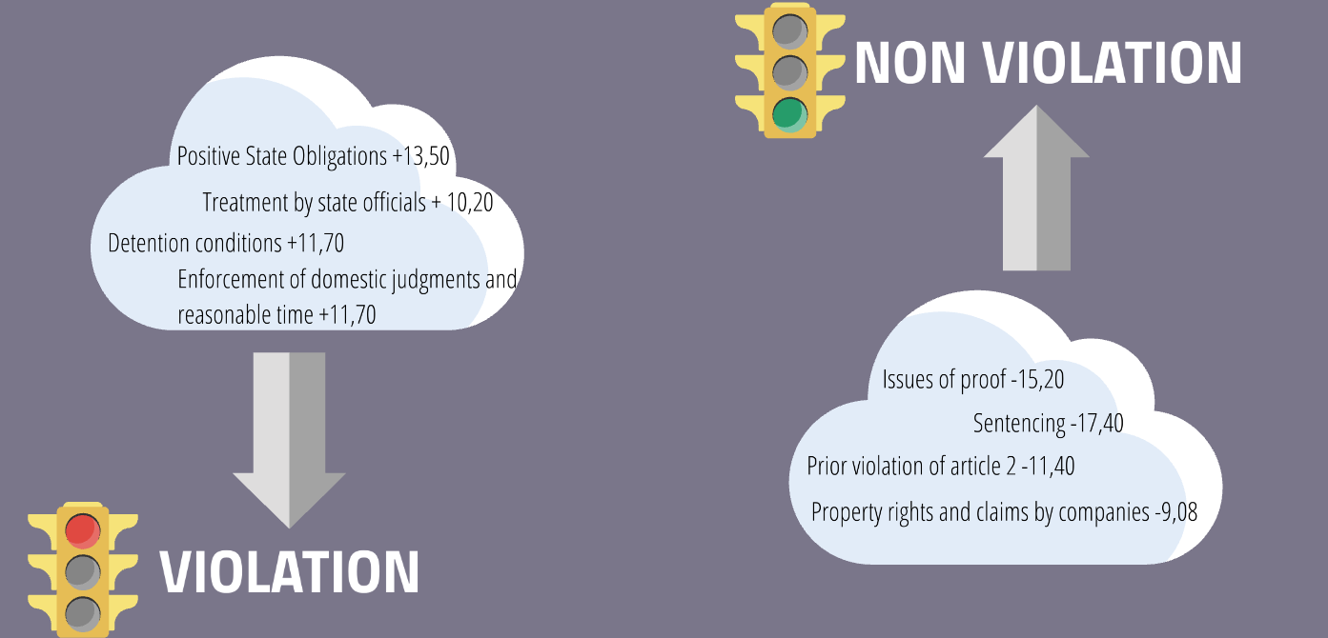
Study
In practical terms: Weighting of group of words

Slide 14
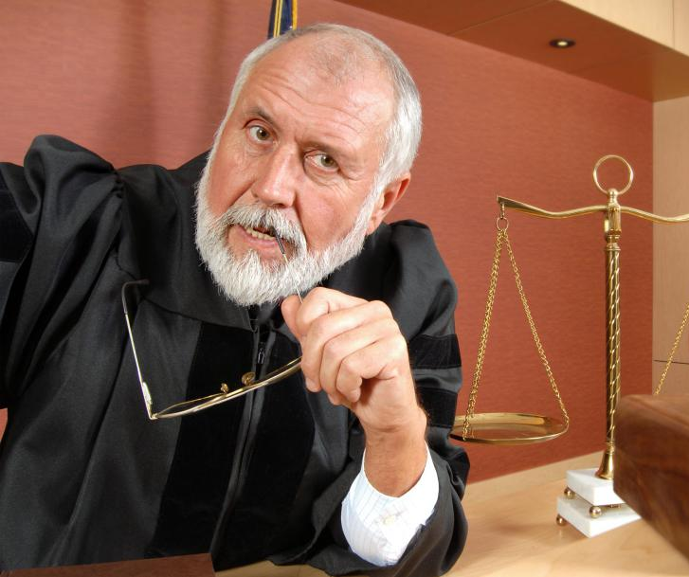
Findings
A machine that does not reproduce legal reasoning
It is a statistical or probabilistic approach, without understanding of legal reasoning
A machine that does not explain the meaning of the law or the behaviour of judges
Impossibility of mechanically identifying all the causative factors of a decision and risks of confusing correlation and causality

Slide 15
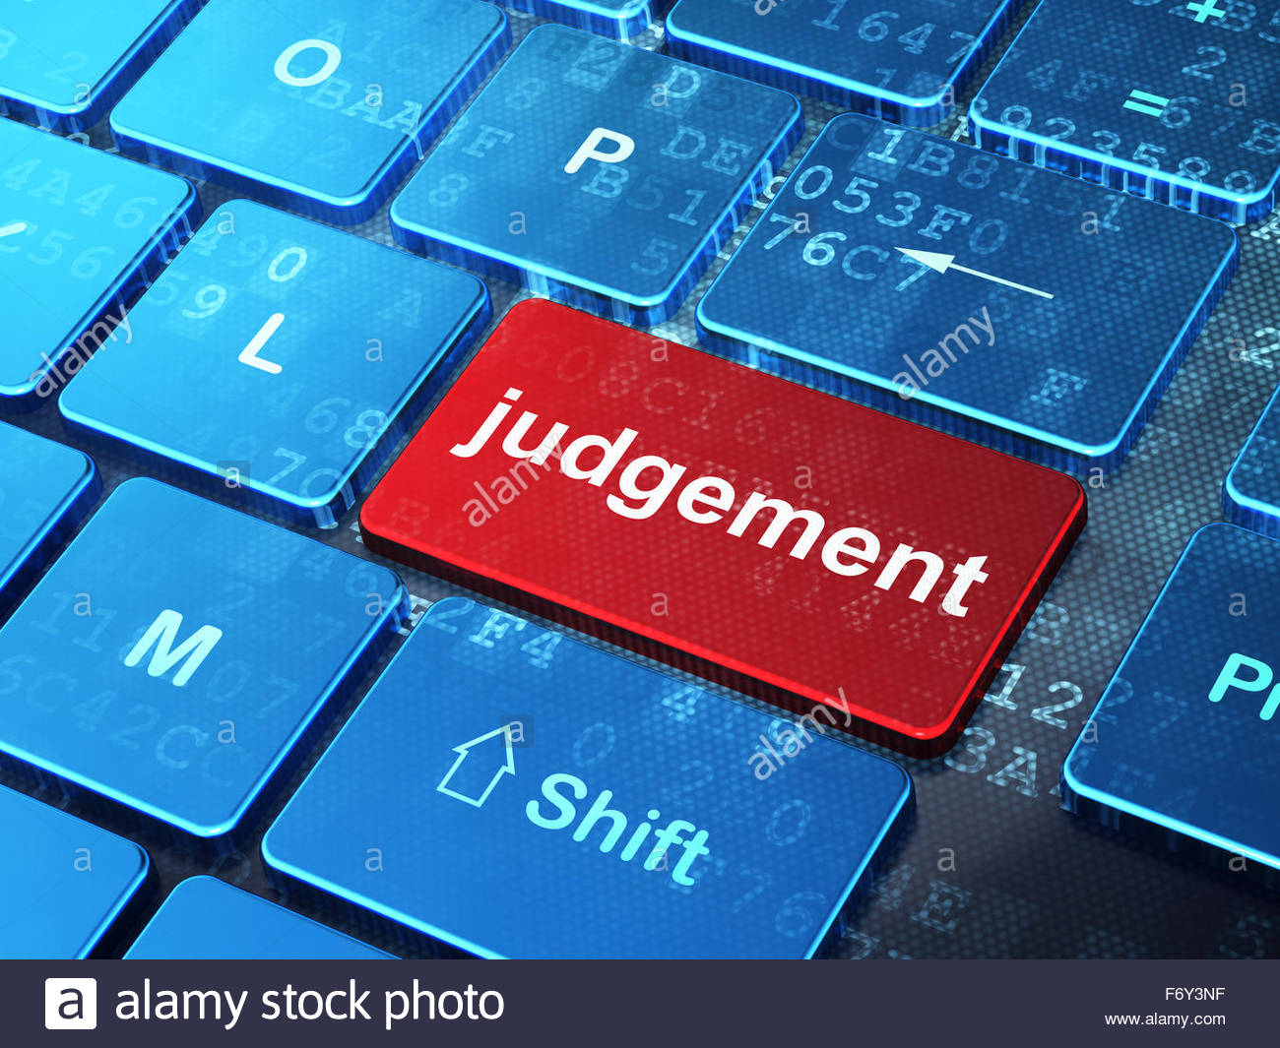
Findings
A court decision: an imperfect raw material for computers
What is a justice decision ?
- Selection of relevant facts by the judge in a raw account
- Application of standards that are rational but do not fit together in a perfectly coherent manner ("open texture of law")
- Formalization of reasoning in the form of a syllogism, which is more of an a posteriori narrative that does not strictly isolate all the causative factors of a decision (sometimes summary motivation)

Slide 16
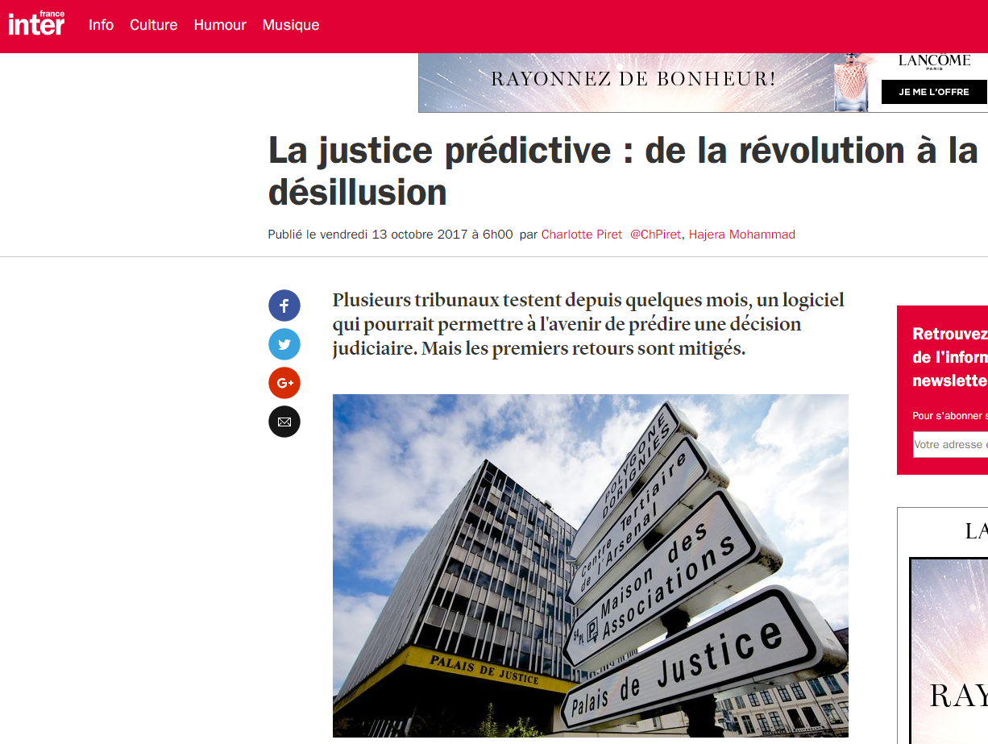
Tests
Tests of several months in 2 appeal courts in France (Douai and Rennes)
Judges concluded for the absence of « added value » for their activity

Slide 17
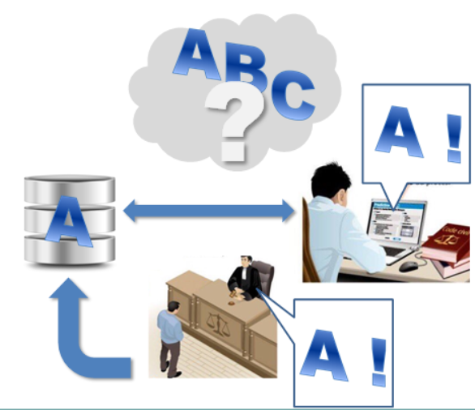
Points of attention: civil, administrative, commercial matters
Will the statistical average of decisions become a norm? Which place for the law provision that a judge is supposed to apply ?
Transformation of construction of case law: « horizontal» « flat », « cristallysed » around the amounts determined by scales ?
« Performative » effect
and indirect effects over
judges’impartiality

Slide 18
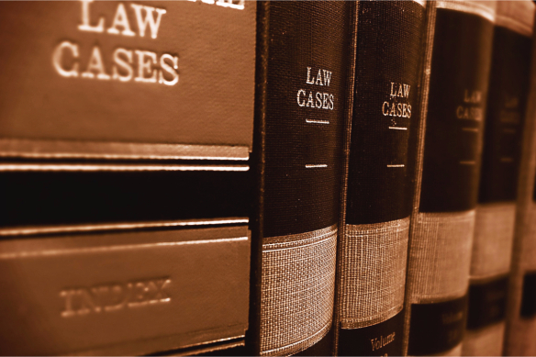
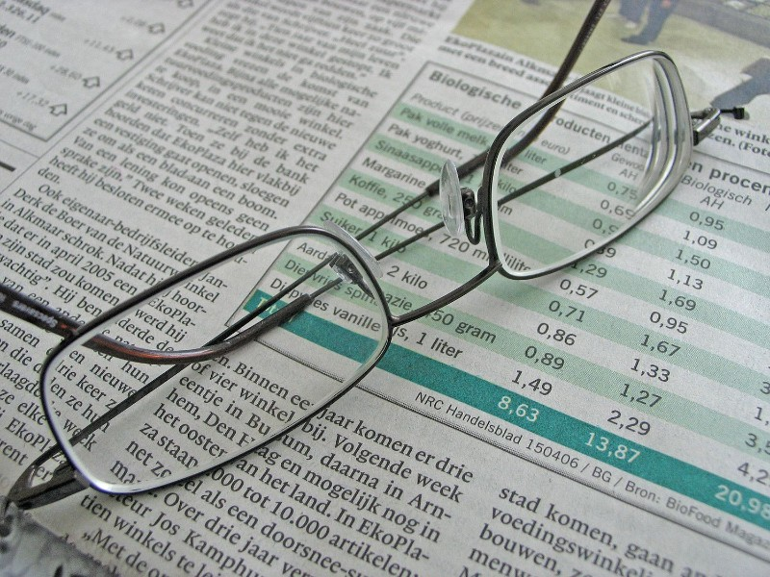
AI possible applications
Civil / commercial / administrative matters
Valorisation of case law
Research engines making links among doctrine, case law, laws and regulations
Compensation scales, support to on-line dispute resolution
Provided that data are of good quality, that certified and loyal algorithms are used and that access to a judge is always possible, for an adversarial debate

Slide 19
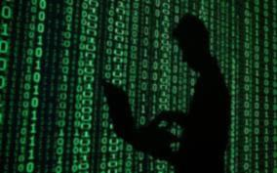
Use of AI/machine learning tools:
By the police
By the judge
Pros and cons?
AI outperforming the police and the judge?

Slide 20

Use of AI by the police: better investigation of crime
Recognition of patterns in huge volumes of data (ex:financial transactions: Connect, UK)
Vocal / picture recognition (ex: INTERPOL ICSE database)
Facial recognition (London police, UK)
Depending on applications:
Pros: effectiveness
Cons: invasion of privacy
Possible abuses?

Slide 21
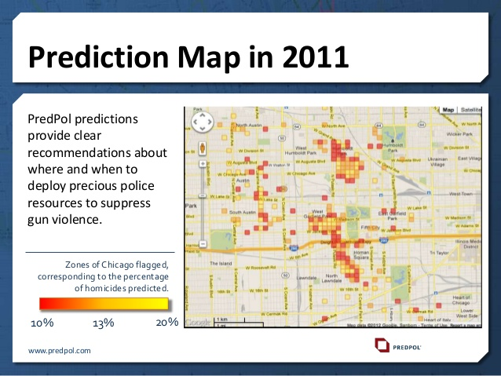
Use of AI by the police: prevent crime
Predictive policing or « Hotspots » mapping
Only some types of crime
Pros: good effectiveness rates (10 times more likely to predict crime location than normal patrolling); dissuasive effect in the surroundings
Cons: self-fulfillling prophecies and oversurveillance
« Tyranny » of the algorithm?

Slide 22
Use of AI within judicial proceedings
Risk- assessment tools : predicting reoffending
Three main fields of applications:
Custody
2. Sentencing
3. Execution of a criminal sanction
Predicting probabilities of reoffending by the interested person to support judicial decision - making
Not binding
High risk
2. Medium risk
3. Low risk

Slide 23
How does
this work in practice?
Fig.2: Machine learning alone produces models by automatically searching for correlation results.
Machine learning principles of functioning

Slide 24
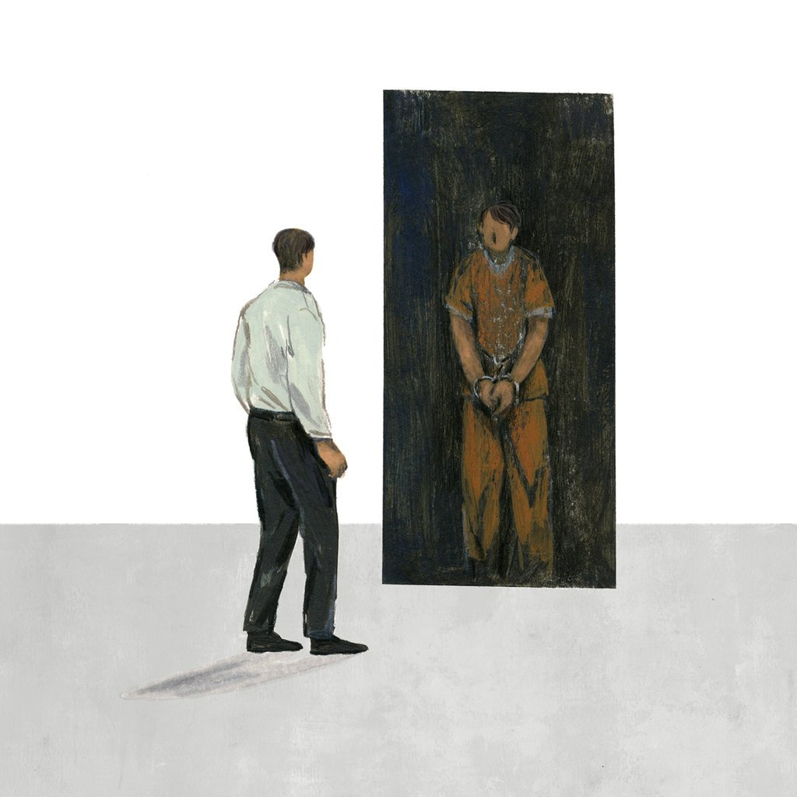
Risk- assessment tools : predicting reffending
Risk factors
Sexe
Age
Family history
Level of studies
Employment
Income and financial situation
Criminal history
Crime attitude
Residence

Slide 25
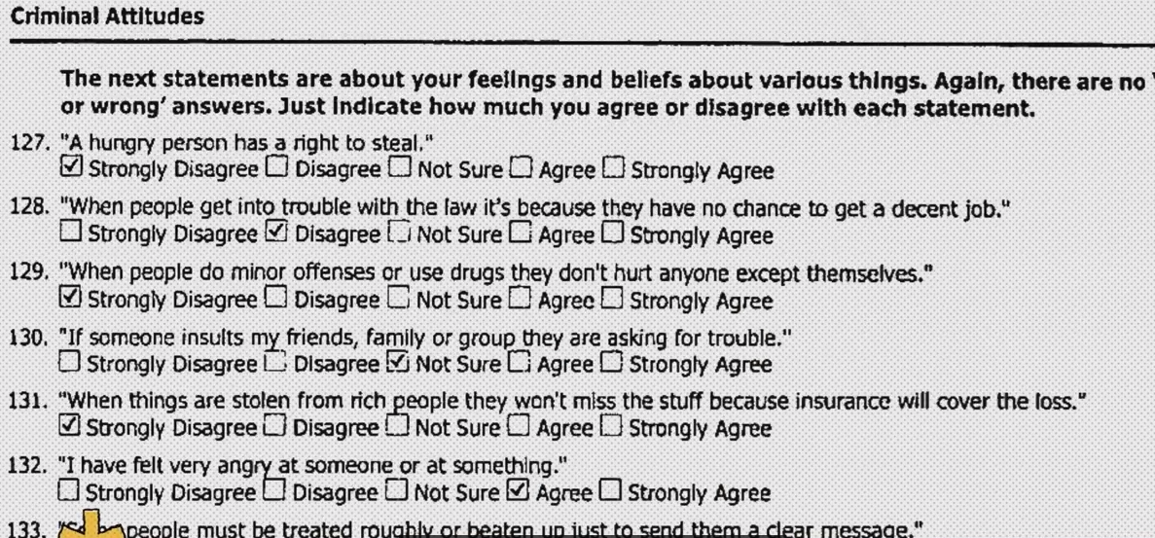
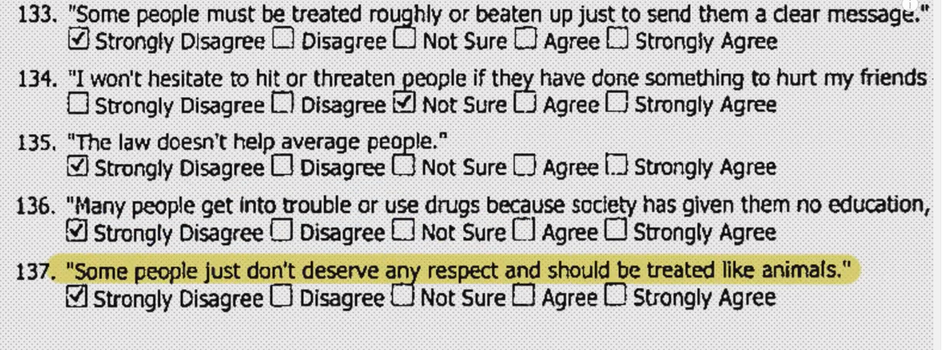
Example
COMPASS
137 questions
Extract
of questionnaire
More matches with recidivists’ previously answered questionnaires → Higher probabilities of reoffending

Slide 26
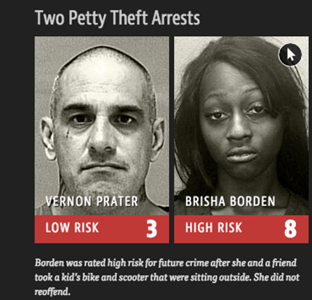
Risk- assessment tools : predicting re-offending
in real life……
Recidivism rate of afroamericans is estimated double than other populations in the two years following criminal conviction
ProPublica, 2016:
Biased data bring
biased results

Slide 27
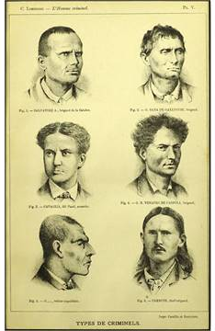
Points of attention: judicial phase
Risk of a resurgence of a determinist doctrine in criminal matters (vs. a social doctrine)
What individualization of sentence?
Risks of discriminations and mistakes

Slide 28

AI: more precise than humans?
HART in the U.K: Durham Police: asssing reoffending (custody)
High predictions rates (88% for individuals considered as high risks) but possible misclassification of false negatives and false positives pointed out

Slide 29
AI: more precise than humans?
Objective: not let false negatives go into society… help avoiding mistakes… BUT:
Out of 888 examples of custody studied, police officers agree with AI predictions on high risks offenders only in 10% of the cases

Slide 30
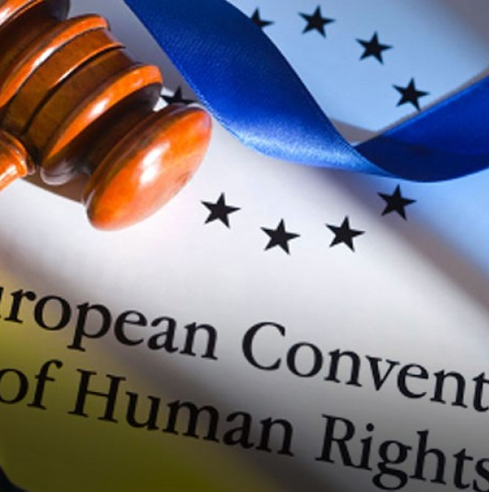
Points of attention: criminal field
Accountability and responsibility
Transparency of the algorithm and equality of arms in a criminal trial
Which place, which effects of algorithms on judicial decision-making?

Slide 31
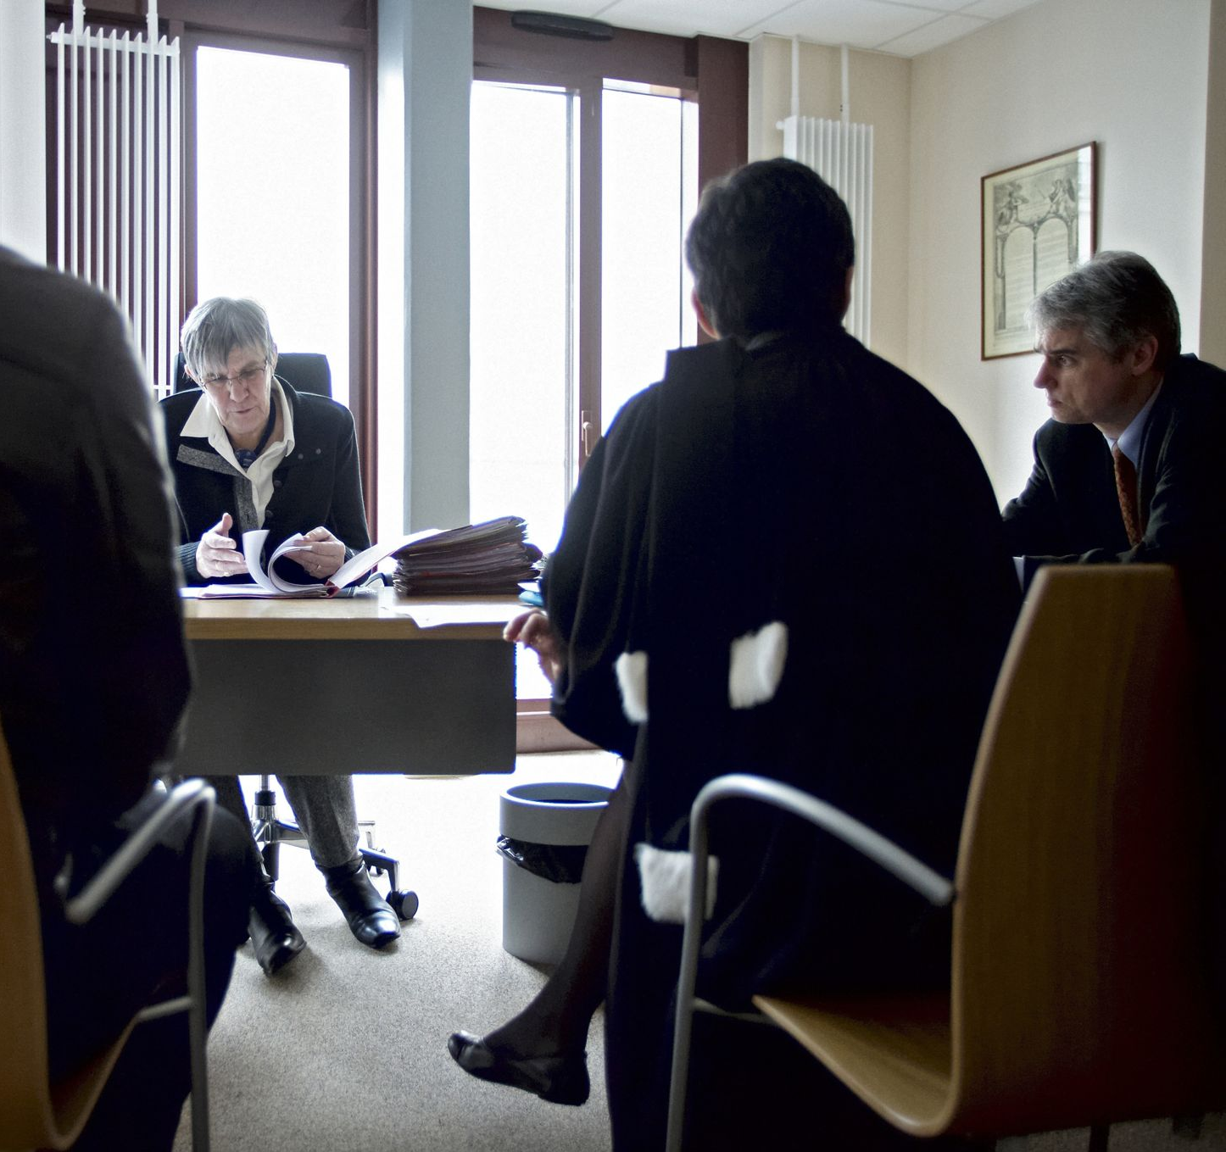
Possible positive applications….
Study whether big data can facilitate the collection of objective information on an individual's life path, processed by a professional (judge, probation officer)

Slide 32
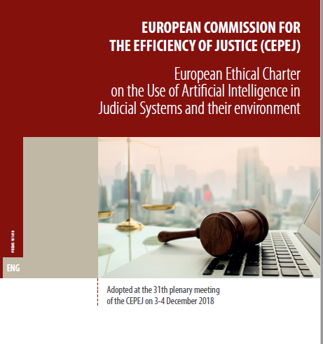
Which avenues for governance
of AI?
Not hasty and controlled application by public decision-makers, legal professionals and scientists
Accountability, transparency and control of private actors.... Accompanied by "cyberethics"

Slide 33
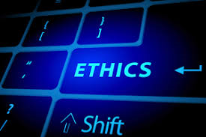
European Ethical Charter of the use of AI in judicial systems and their environment
Substantive and methodological principles on AI integration into national judicial policies
For policy-makers drawing up relevant national legislation and policies
For courts and legal professionals
designing and testing AI tools
For private companies

Slide 34
Ensure that the design and implementation of artificial intelligence tools and services are compatible with fundamental rights.
Ensure that the design and implementation of artificial intelligence tools and services are compatible with fundamental rights.
European Ethical Charter on the use of AI in judicial systems and their environment
A landmark in the definition of ethical principles concerning the use of Artificial Intelligence in the Judicial Systems
The five principles (the big five)
Appendix I: an in-depth study on AI use in judicial systems
Appendix II: advice on AI applications to be encouraged and those to be used with some reservations
Appendix III: a Glossary
Appendix IV: a Checklist of
self-evaluation

Slide 35

Ensure that the design and implementation of artificial intelligence tools and services are compatible with fundamental rights.
Ensure that the design and implementation of artificial intelligence tools and services are compatible with fundamental rights.
European Ethical Charter
on the use of AI in judicial systems and their environment
PRINCIPLE 1:
PRINCIPLE OF Respect for fundamental rights
Ensure that the design and implementation of artificial intelligence tools and services are compatible with fundamental rights.

Slide 36
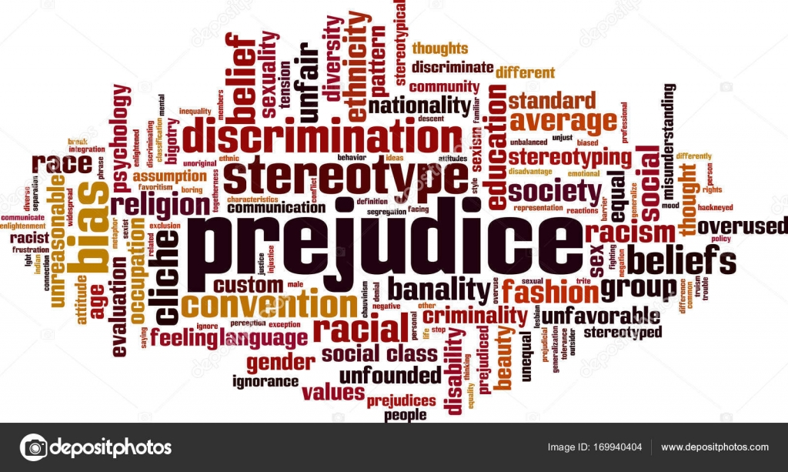
Ensure that the design and implementation of artificial intelligence tools and services are compatible with fundamental rights.
Ensure that the design and implementation of artificial intelligence tools and services are compatible with fundamental rights.
European Ethical Charter
on the use of AI in judicial systems and their environment
PRINCIPLE 2:
PRINCIPLE OF NON-DISCRIMINATION
Specifically prevent the development or intensification of any discrimination between individuals or groups of individuals.

Slide 37

Ensure that the design and implementation of artificial intelligence tools and services are compatible with fundamental rights.
Ensure that the design and implementation of artificial intelligence tools and services are compatible with fundamental rights.
European Ethical Charter on the use of AI
in judicial systems and their environment
PRINCIPLE 3:
PRINCIPLE OF QUALITY AND SECURITY
With regard to the processing of judicial decisions and data, use certified sources and intangible data with models conceived in a multi-disciplinary manner, in a secure technological environment

Slide 38

Ensure that the design and implementation of artificial intelligence tools and services are compatible with fundamental rights.
Ensure that the design and implementation of artificial intelligence tools and services are compatible with fundamental rights.
European Ethical Charter on the use of AI
in judicial systems and their environment
PRINCIPLE 4:
PRINCIPLE OF TRANSPARENCY, IMPARTIALITY AND INTELLECTUAL INTEGRITY
Make data processing methods accessible and understandable, authorise external audits

Slide 39
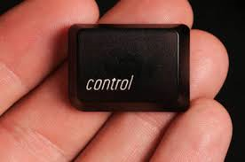
Ensure that the design and implementation of artificial intelligence tools and services are compatible with fundamental rights.
Ensure that the design and implementation of artificial intelligence tools and services are compatible with fundamental rights.
European Ethical Charter on the use of AI
in judicial systems and their environment
PRINCIPLE 5:
PRINCIPLE “UNDER USER CONTROL”
Preclude a prescriptive approach and ensure that users are informed actors and in control of the choices made

Slide 40
European Ethical Charter on the use of AI in judicial systems
Appendix I: In-depth study on the use of AI in judicial systems
1. State of the use of artificial intelligence algorithms in the judicial systems of Council of Europe member States
2. Overview of open data policies relating to judicial decisions in the judicial systems of Council of Europe member States
3. Operating characteristics of artificial intelligence (machine learning) applied to judicial decisions
4. Can artificial intelligence model legal reasoning in advance?
5. Can AIs explain judges' behaviour in retrospect?
6. How is AI to be applied in civil, commercial and administrative justice?
7. Issues specific to criminal justice: prevention of offences, risk of recidivism and assessment of the level of danger
8. Specific questions relating to the protection of personal data
9. The potential and limitations of predictive justice tools
10. The need for an in-depth public debate on these tools prior to the implementation of public policies for their development. The urgent need for cyberethics to provide a framework for the development of artificial intelligence algorithms while respecting fundamental rights

Slide 41
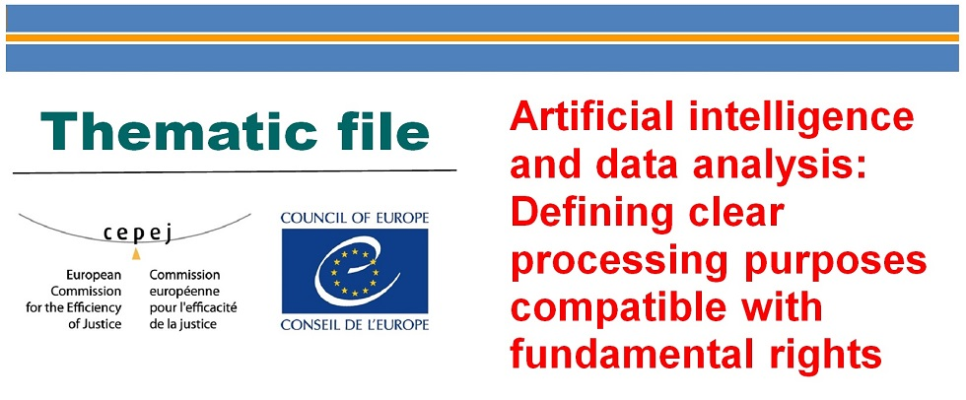

European Ethical Charter on the use of AI in judicial systems and their environment
Appendix II: Which uses of AI in the European judicial systems?
Uses to be encouraged
Possible uses, requiring considerable methodological precautions
Uses to be considered following additional scientific studies
Uses to be considered with the most extreme reservations

Slide 42

European Ethical Charter on the use of AI in judicial systems and their environment
Appendix III: Glossary
ARTIFICIAL INTELLIGENCE: A set of scientific methods, theories and techniques whose aim is to reproduce, by a machine, the cognitive abilities of human beings. Current developments seek to have machines perform complex tasks previously carried out by humans

Slide 43

European Ethical Charter on the use of AI in judicial systems and their environment
Appendix IV: Checklist for self-evaluation
Extent to which the Charter’s principles are integrated in AI tools

Slide 44
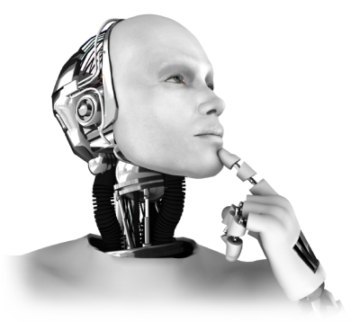

Thank you !
Questions / Discussion

